Slide 1
BLOCK ROCKET
LAUNCH PAD
ASSEMBLY GUIDE · Techtelligence- Elecfreaks
54 STEPS

Slide 2
DESIGN BRIEF
OBJECTIVE
Based on the form and composition of existing rocket launchers, open discussion and rationalise the design of a block rocket launch pad.
DESIGN PRINCIPLES
01. Structural Stability
Rigid base frame with vertical tower supports and cross-bracing to withstand launch forces.
02. Modular Block Design
Block-based Techtelligence- Elecfreaks construction enables systematic assembly and easy reconfiguration.
03. Component Integration
Precision pins, axles, and beams ensure accurate alignment across all sub-assemblies.
04. Scalable Architecture
Standardised connector grid allows the pad to be scaled up or adapted for different payloads.
Techtelligence- Elecfreaks · BLOCK ROCKET LAUNCH PAD

Slide 3
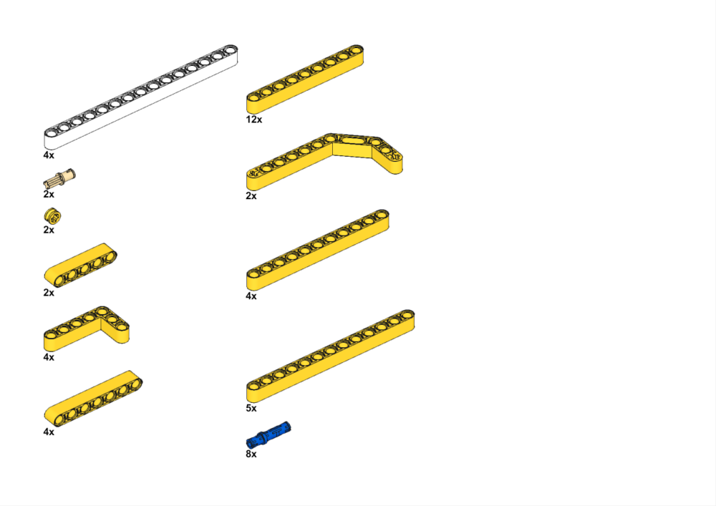
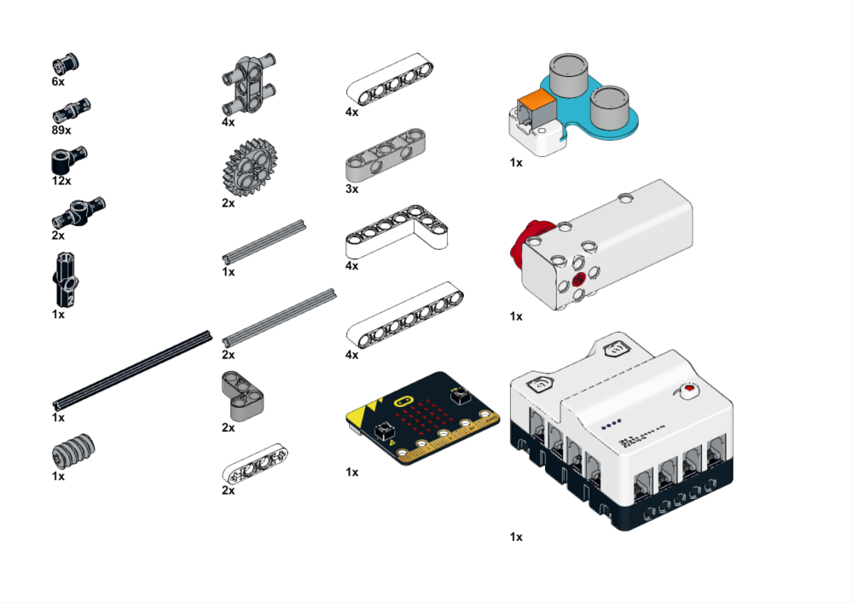
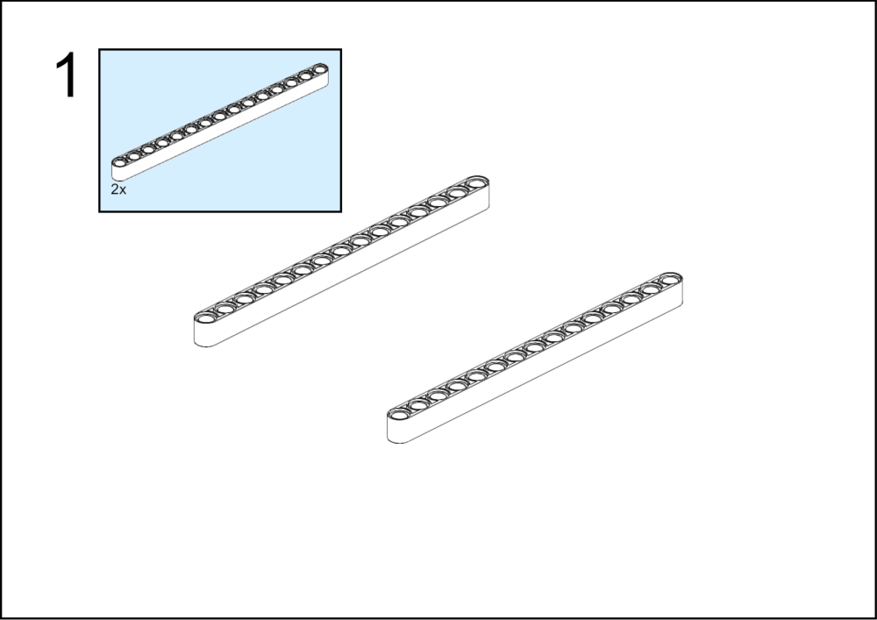
ASSEMBLY STEPS
PARTS – 1
PROGRESS: 6% COMPLETE
PARTS
PARTS
STEP 1
BLOCK ROCKET LAUNCH PAD · Techtelligence- Elecfreaks
1 / 18

Slide 4
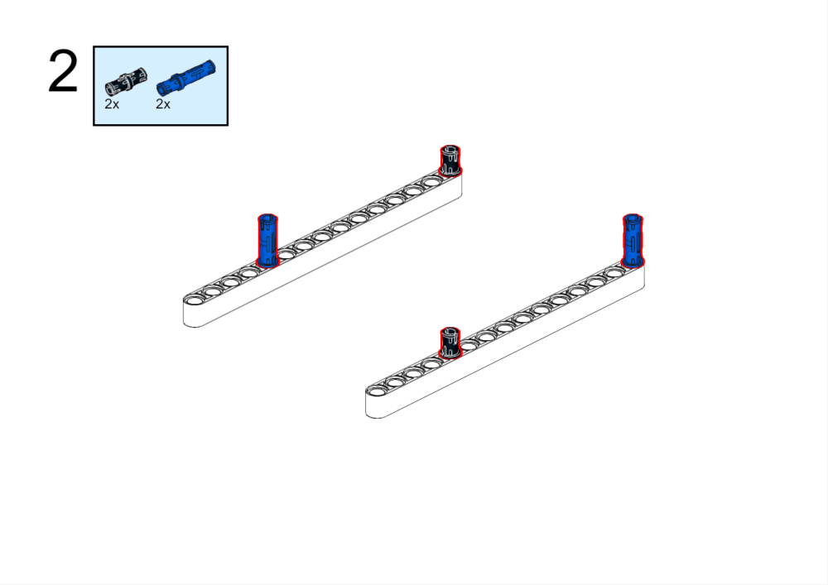
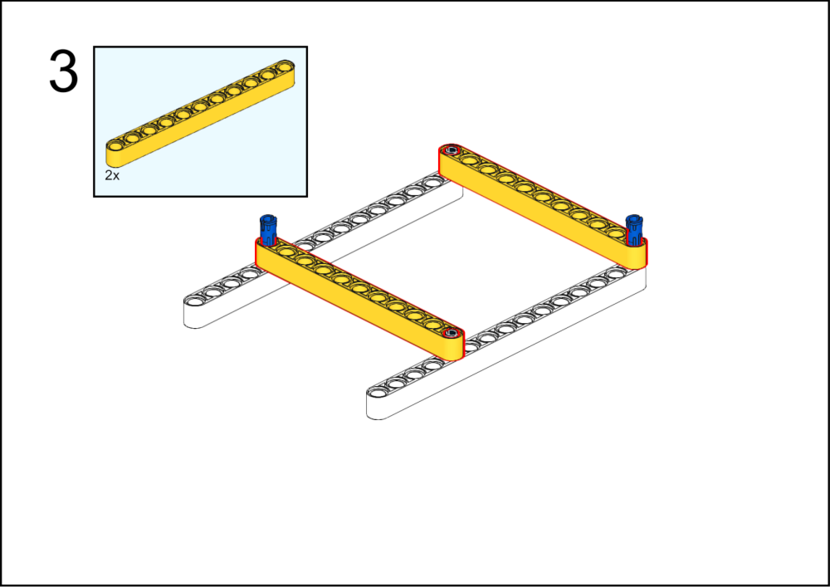
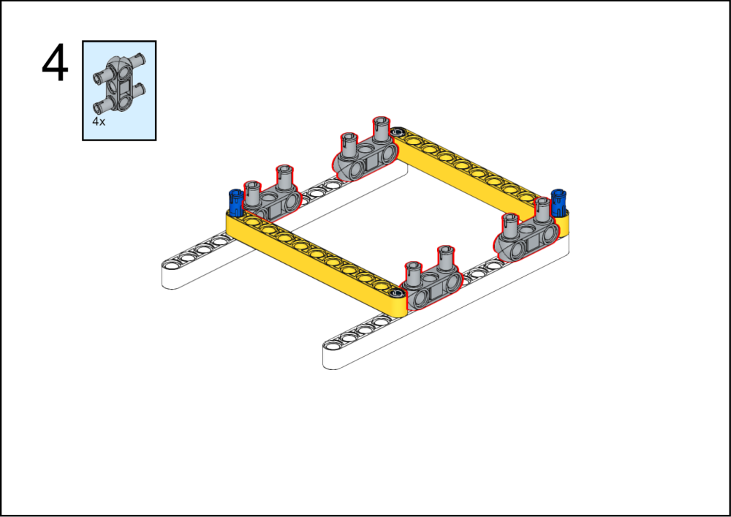
ASSEMBLY STEPS
2 – 4
PROGRESS: 11% COMPLETE
STEP 2
STEP 3
STEP 4
BLOCK ROCKET LAUNCH PAD · Techtelligence- Elecfreaks
2 / 18

Slide 5
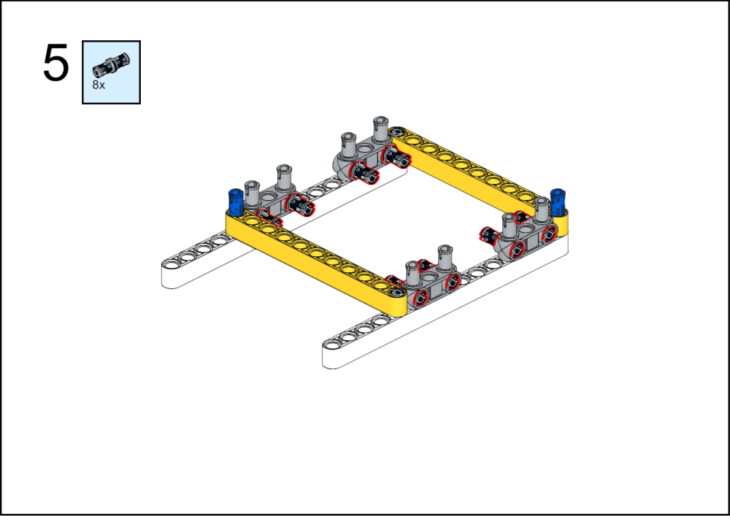
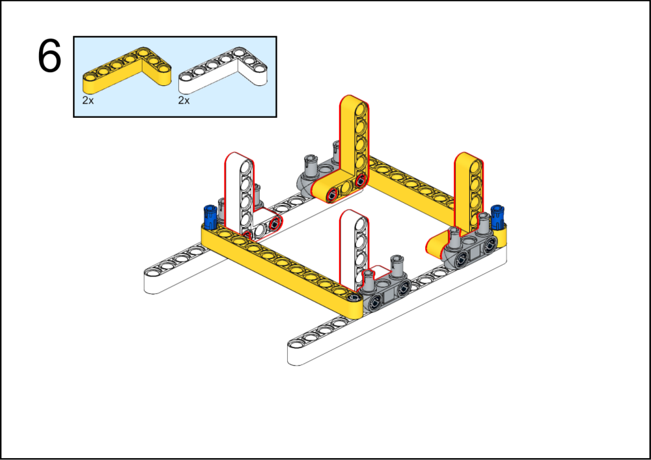
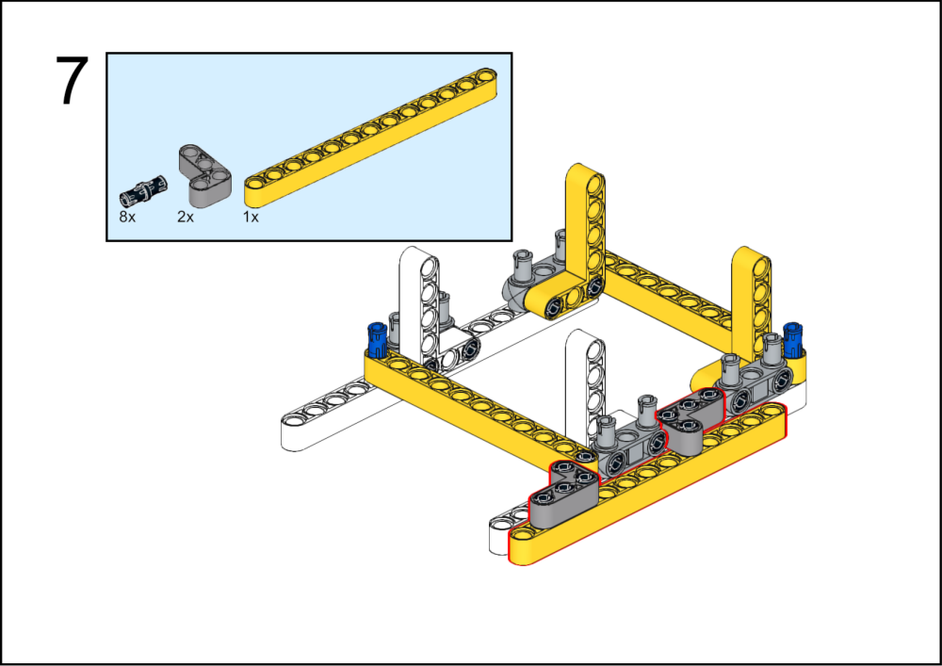
ASSEMBLY STEPS
5 – 7
PROGRESS: 17% COMPLETE
STEP 5
STEP 6
STEP 7
BLOCK ROCKET LAUNCH PAD · Techtelligence- Elecfreaks
3 / 18

Slide 6
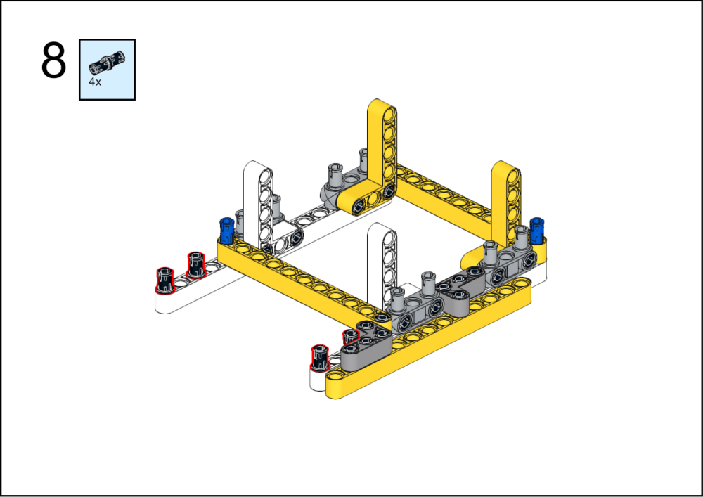
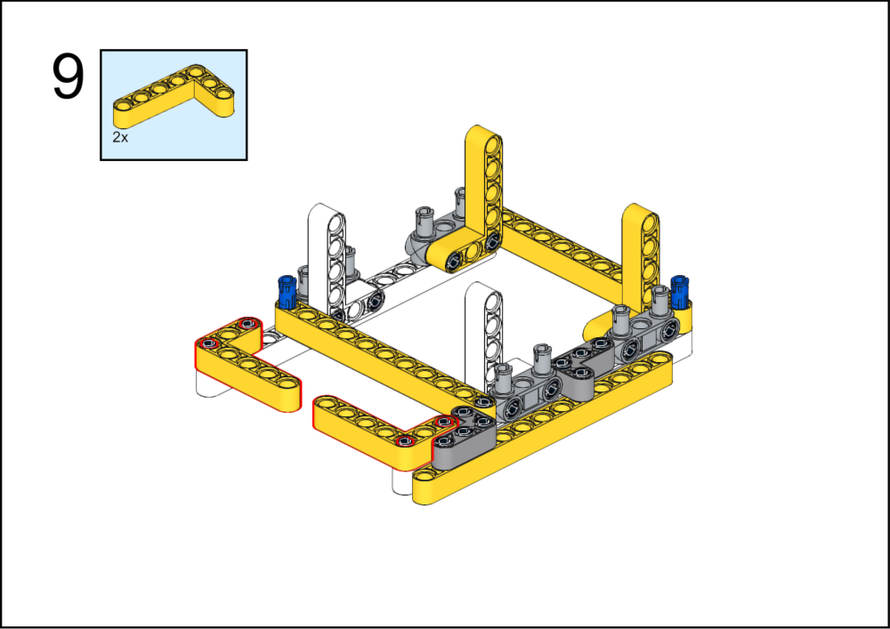
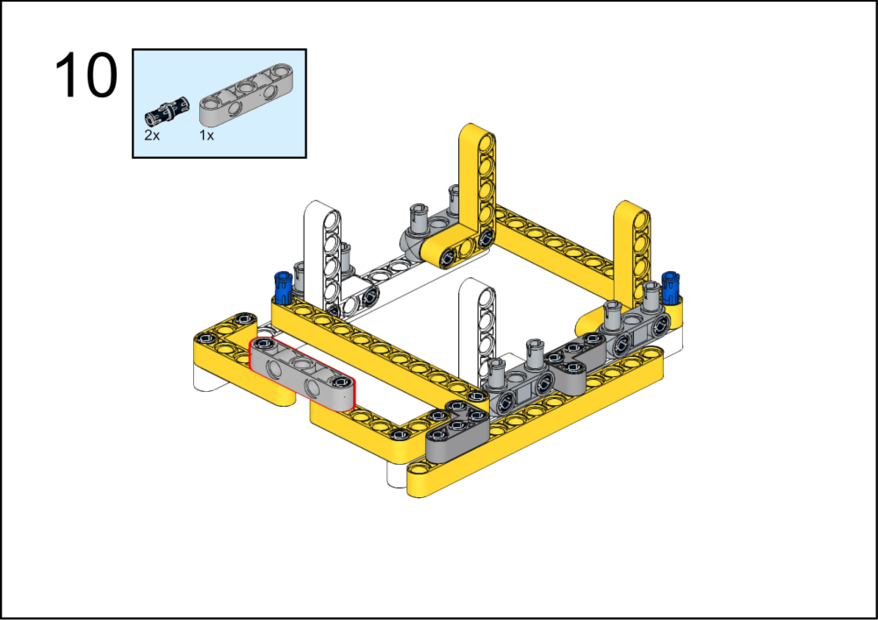
ASSEMBLY STEPS
8 – 10
PROGRESS: 22% COMPLETE
STEP 8
STEP 9
STEP 10
BLOCK ROCKET LAUNCH PAD · Techtelligence- Elecfreaks
4 / 18

Slide 7
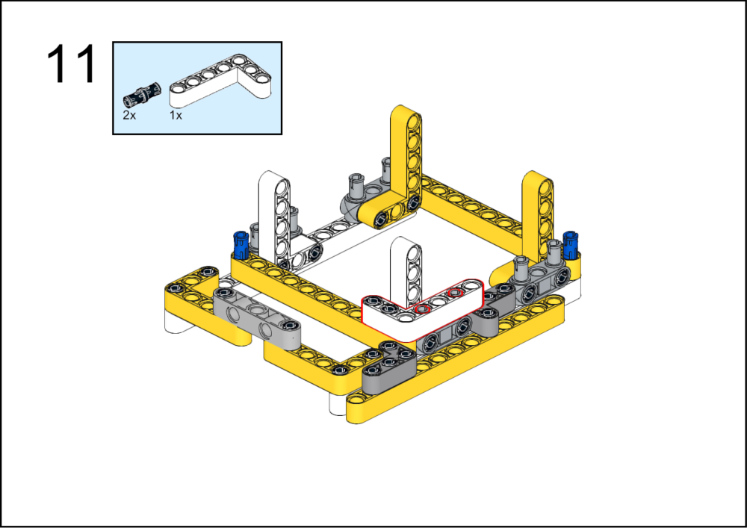
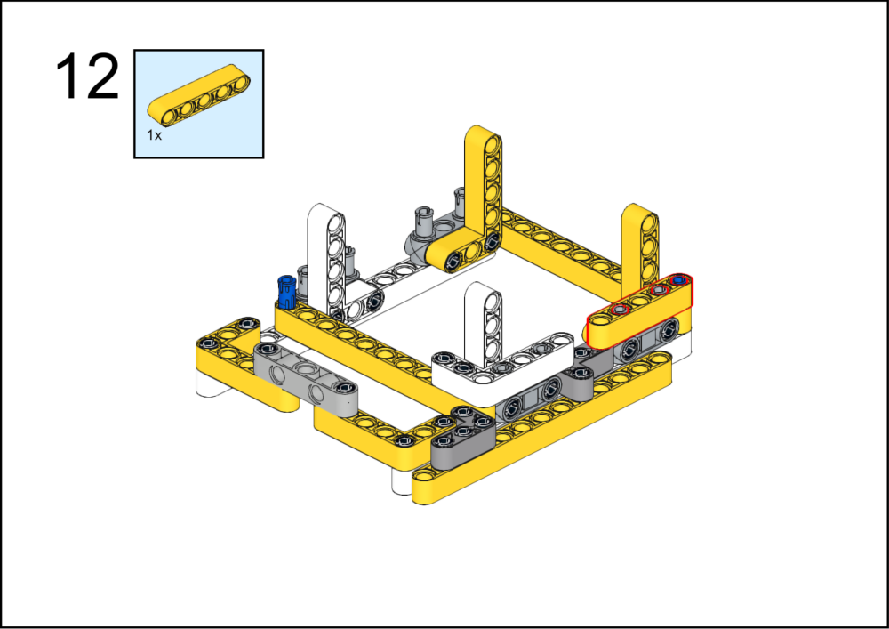

ASSEMBLY STEPS
11 – 13
PROGRESS: 28% COMPLETE
STEP 11
STEP 12
STEP 13
BLOCK ROCKET LAUNCH PAD · Techtelligence- Elecfreaks
5 / 18

Slide 8
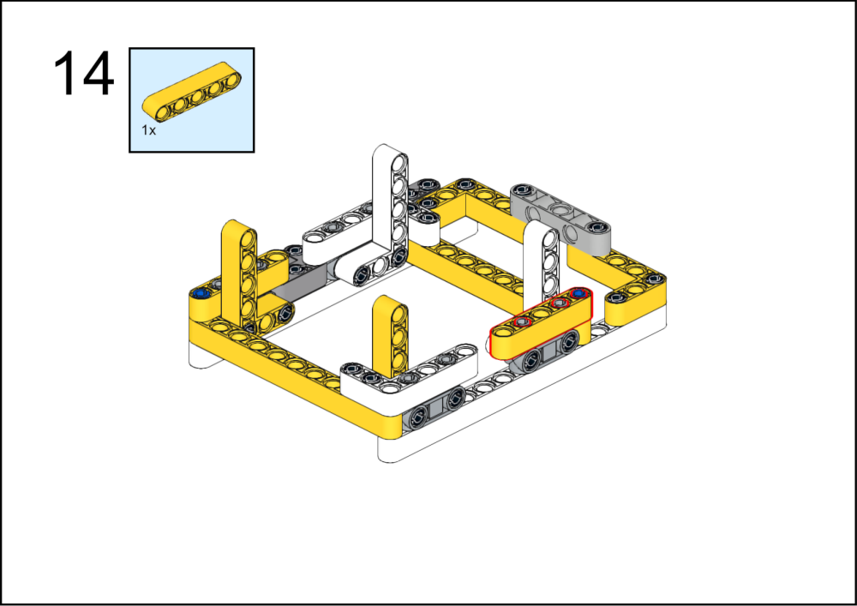
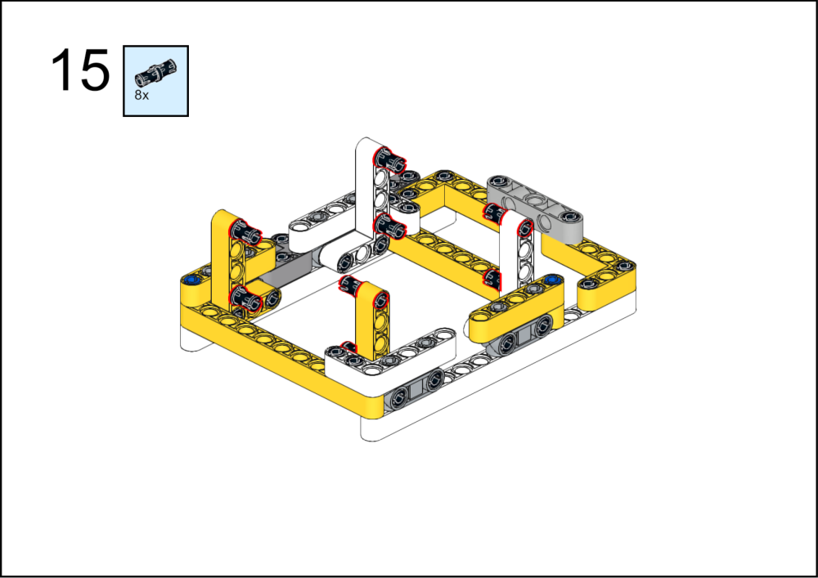
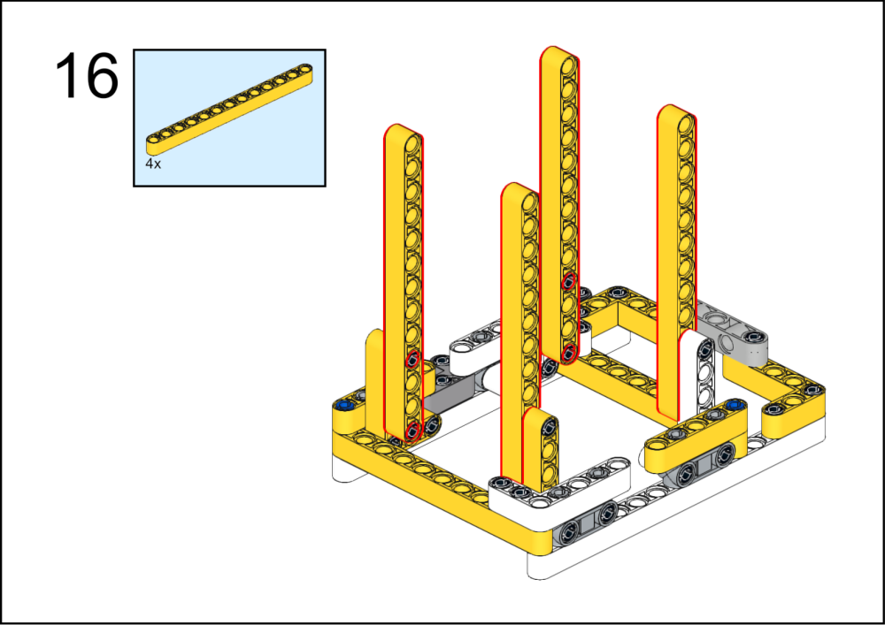
ASSEMBLY STEPS
14 – 16
PROGRESS: 33% COMPLETE
STEP 14
STEP 15
STEP 16
BLOCK ROCKET LAUNCH PAD · Techtelligence- Elecfreaks
6 / 18

Slide 9
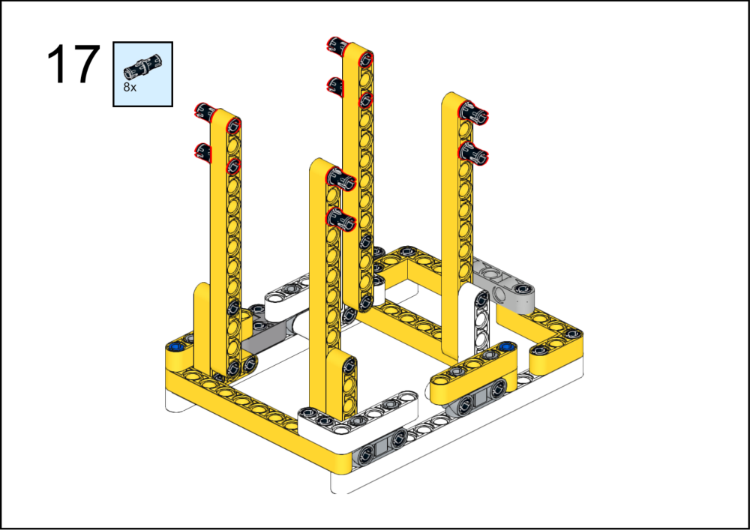
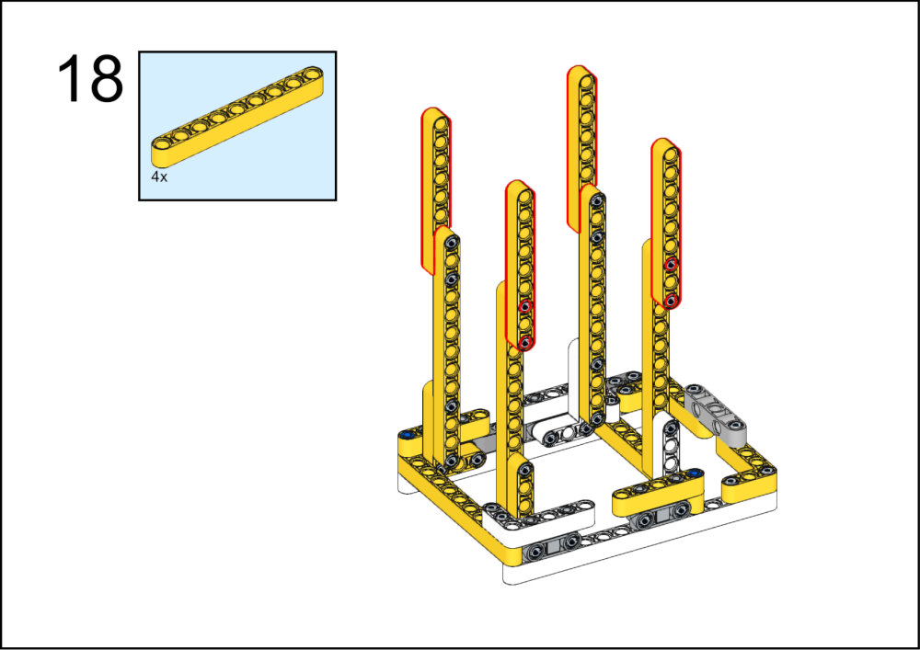
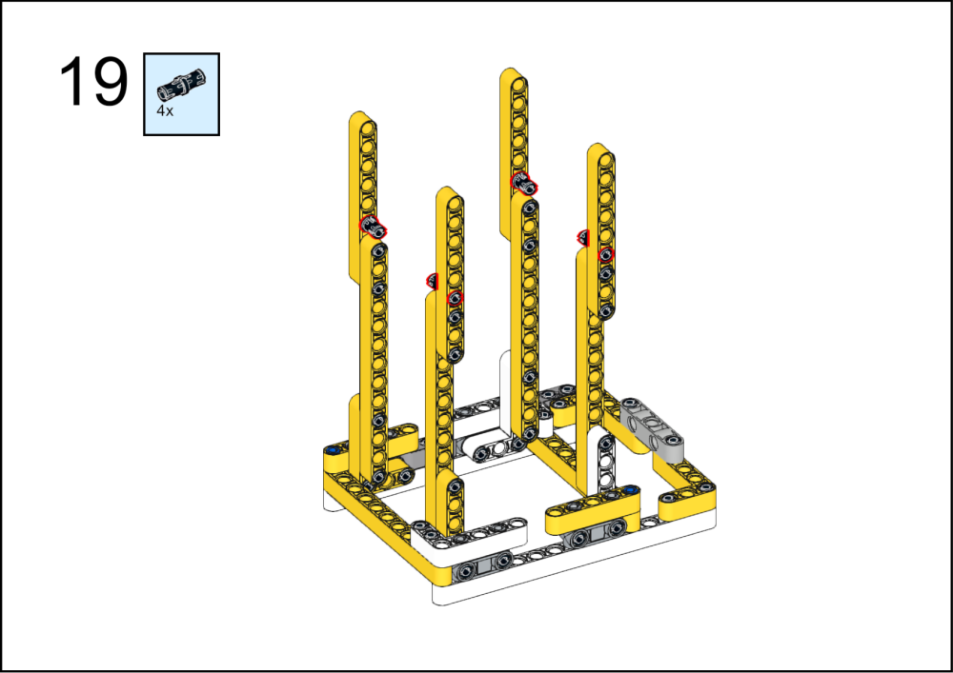
ASSEMBLY STEPS
17 – 19
PROGRESS: 39% COMPLETE
STEP 17
STEP 18
STEP 19
BLOCK ROCKET LAUNCH PAD · Techtelligence- Elecfreaks
7 / 18

Slide 10
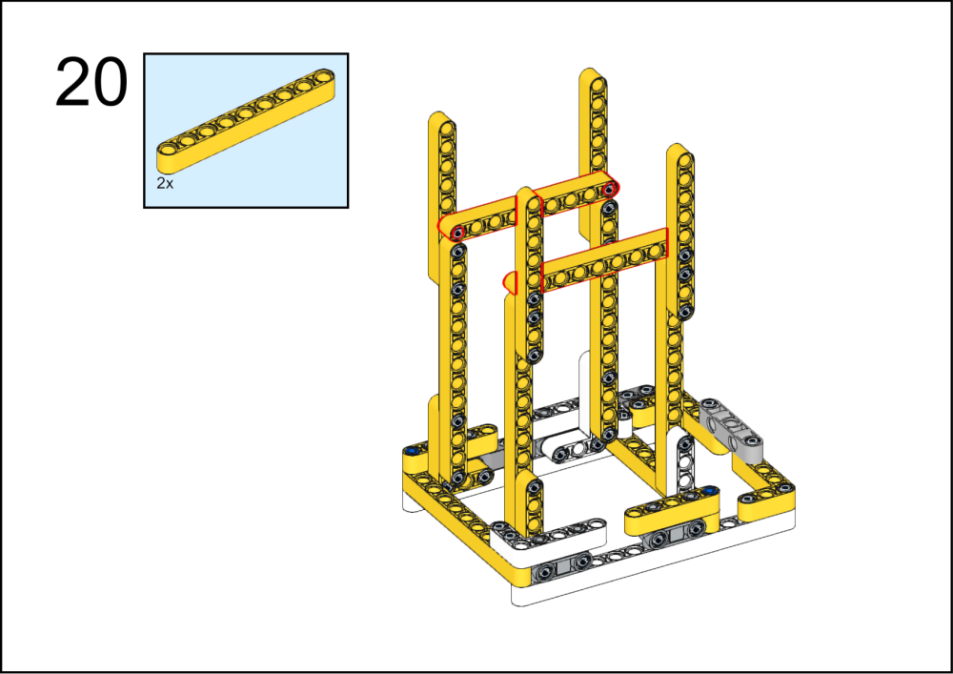
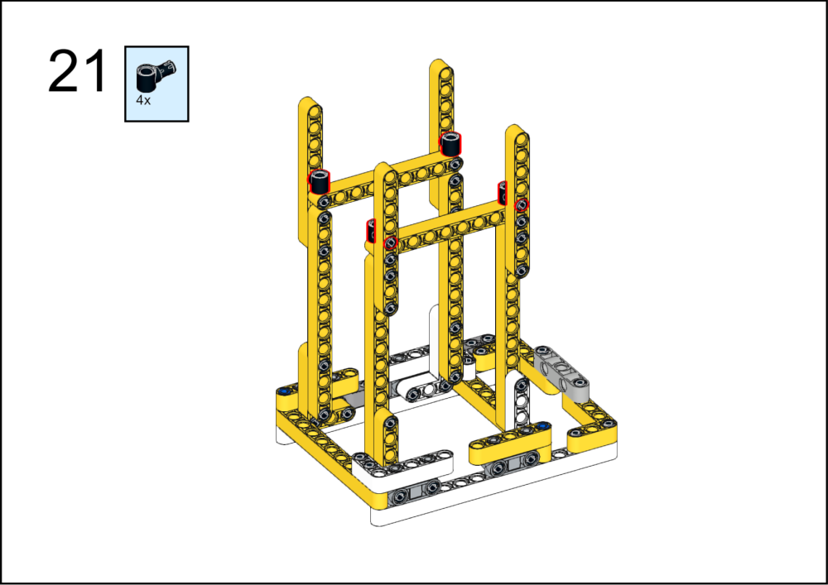
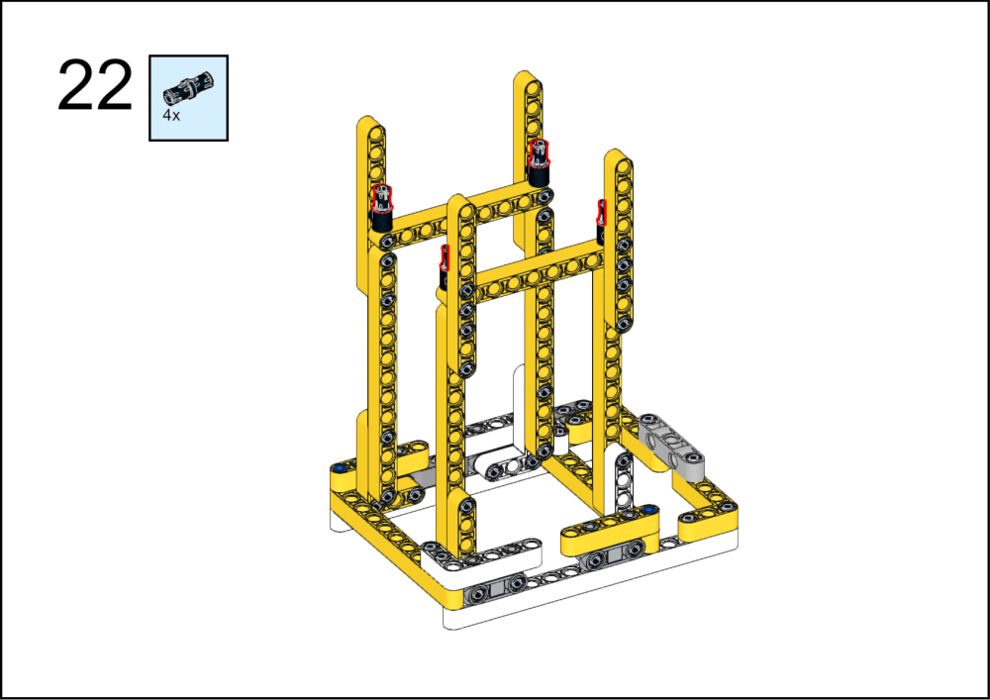
ASSEMBLY STEPS
20 – 22
PROGRESS: 44% COMPLETE
STEP 20
STEP 21
STEP 22
BLOCK ROCKET LAUNCH PAD · Techtelligence- Elecfreaks
8 / 18

Slide 11
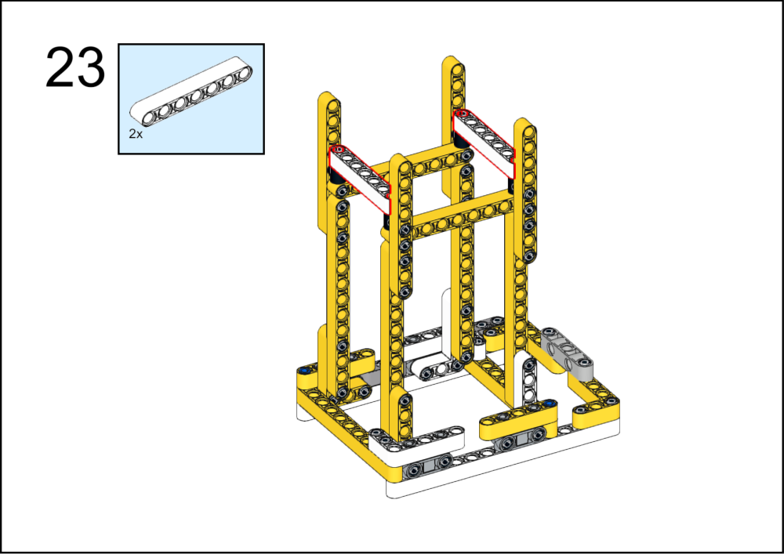
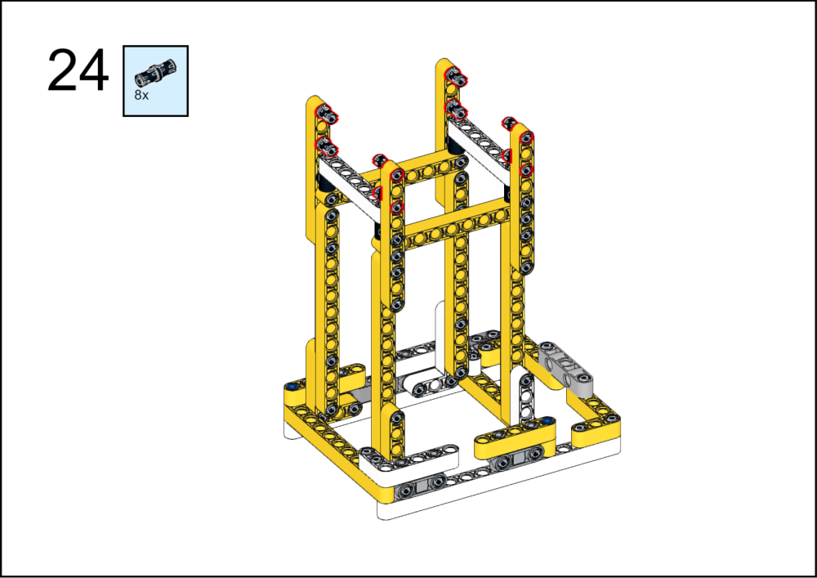
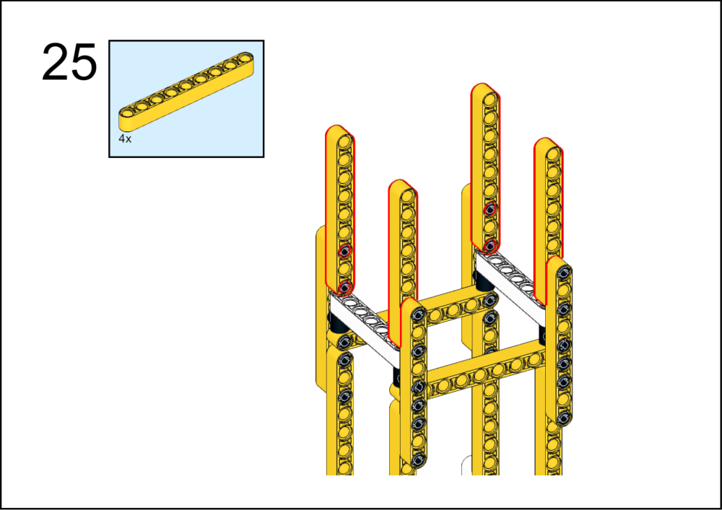
ASSEMBLY STEPS
23 – 25
PROGRESS: 50% COMPLETE
STEP 23
STEP 24
STEP 25
BLOCK ROCKET LAUNCH PAD · Techtelligence- Elecfreaks
9 / 18

Slide 12
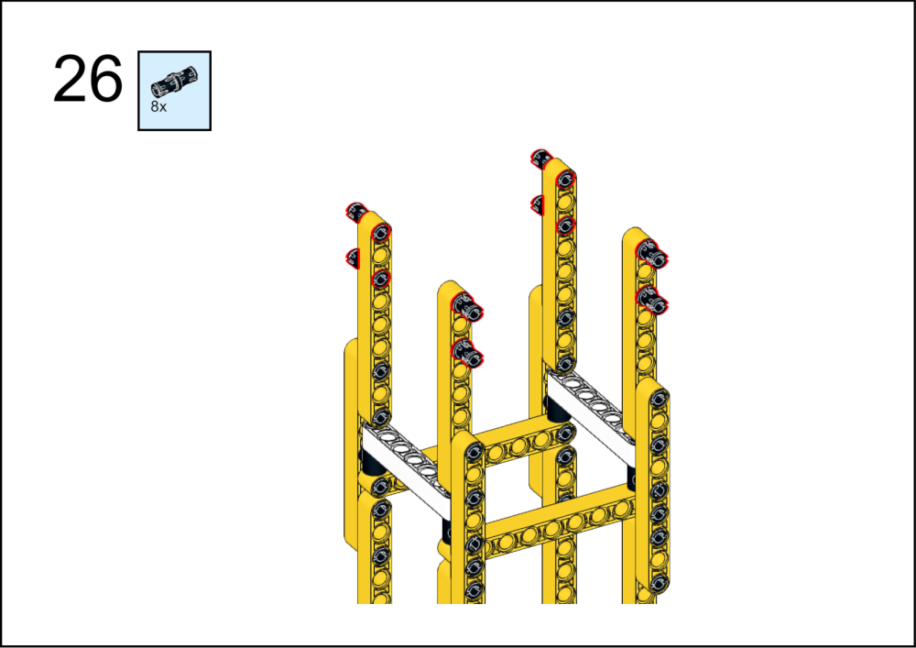
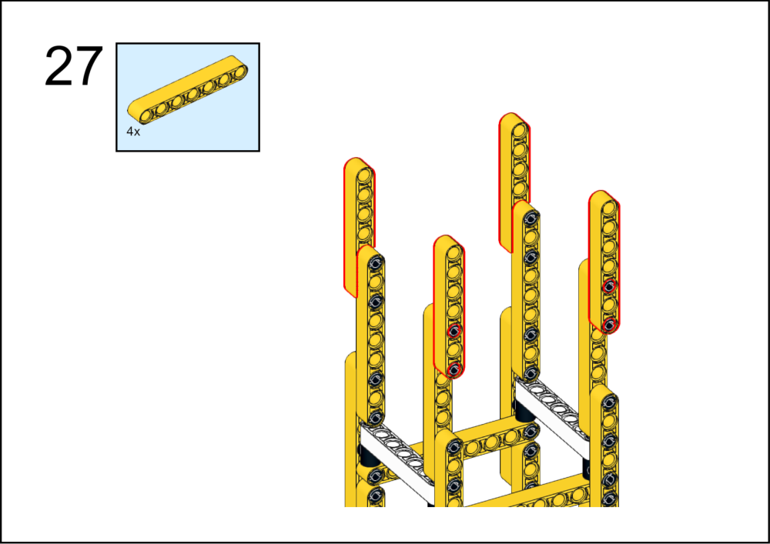
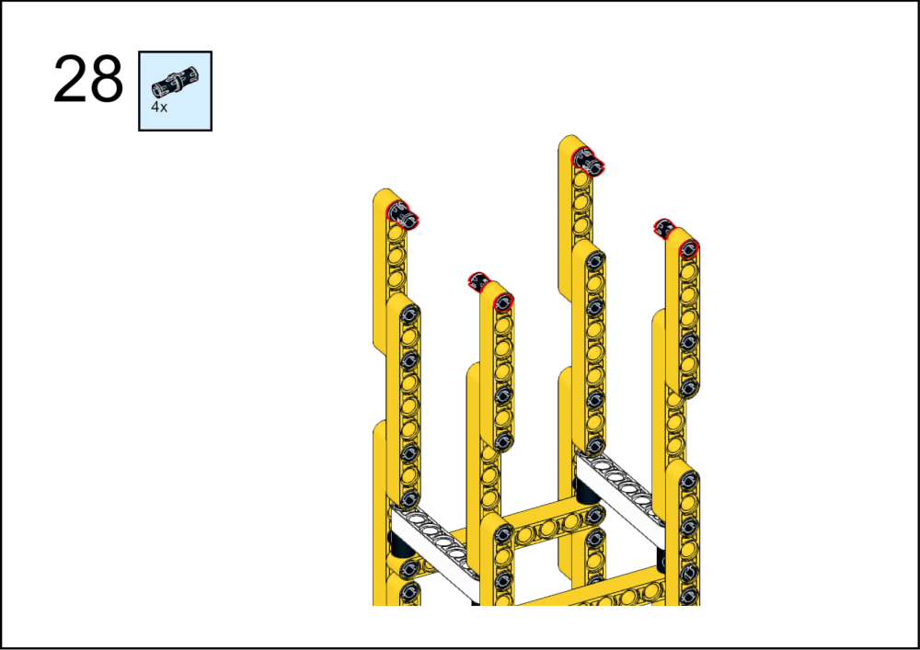
ASSEMBLY STEPS
26 – 28
PROGRESS: 56% COMPLETE
STEP 26
STEP 27
STEP 28
BLOCK ROCKET LAUNCH PAD · Techtelligence- Elecfreaks
10 / 18

Slide 13
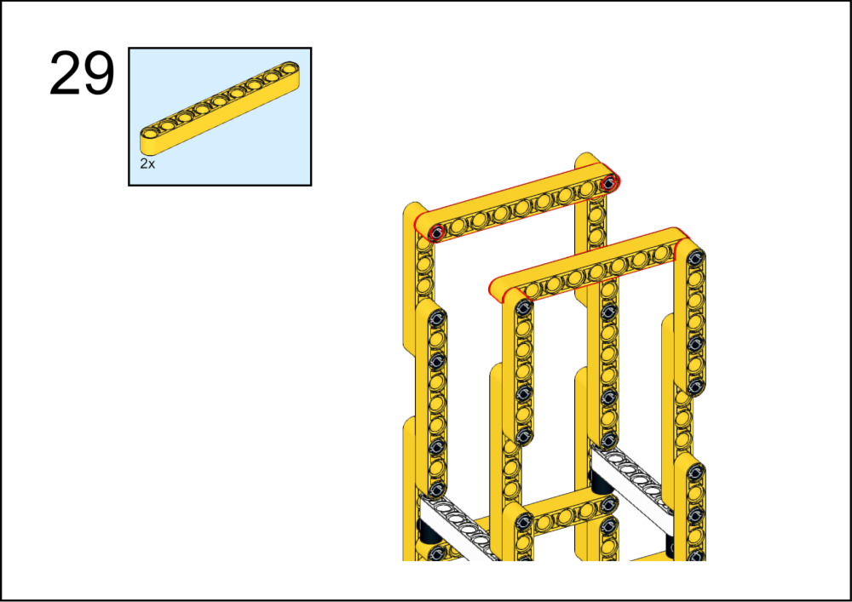
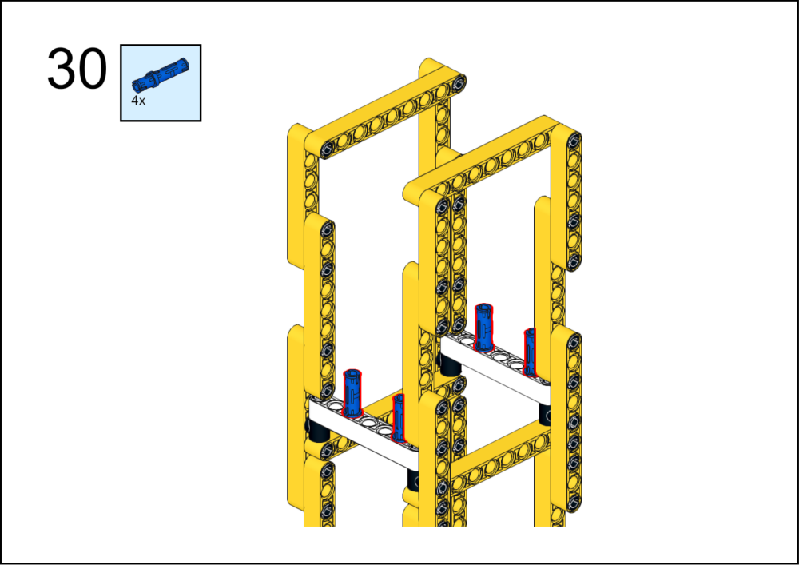
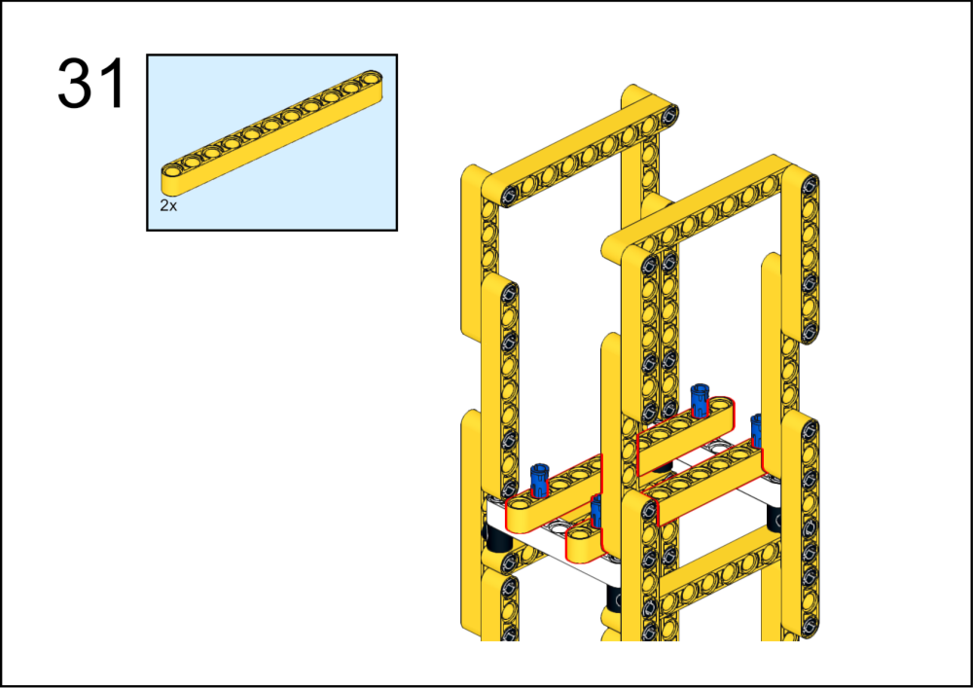
ASSEMBLY STEPS
29 – 31
PROGRESS: 61% COMPLETE
STEP 29
STEP 30
STEP 31
BLOCK ROCKET LAUNCH PAD · Techtelligence- Elecfreaks
11 / 18

Slide 14
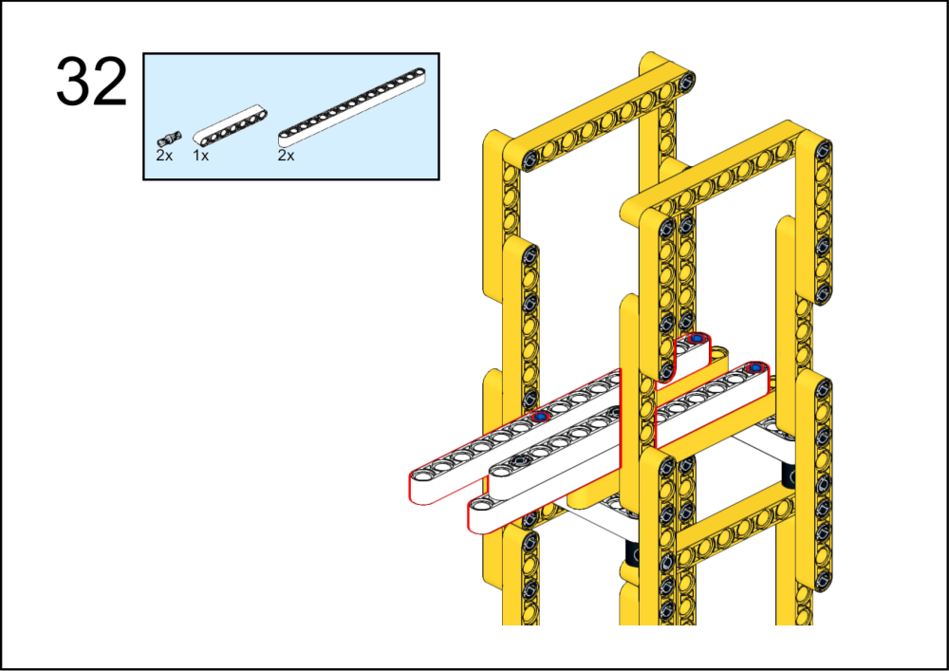
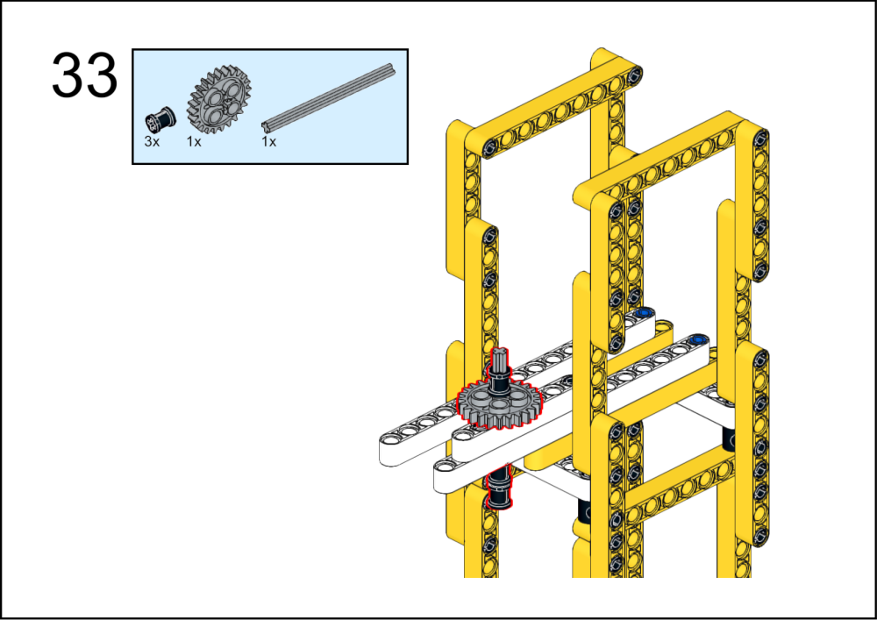
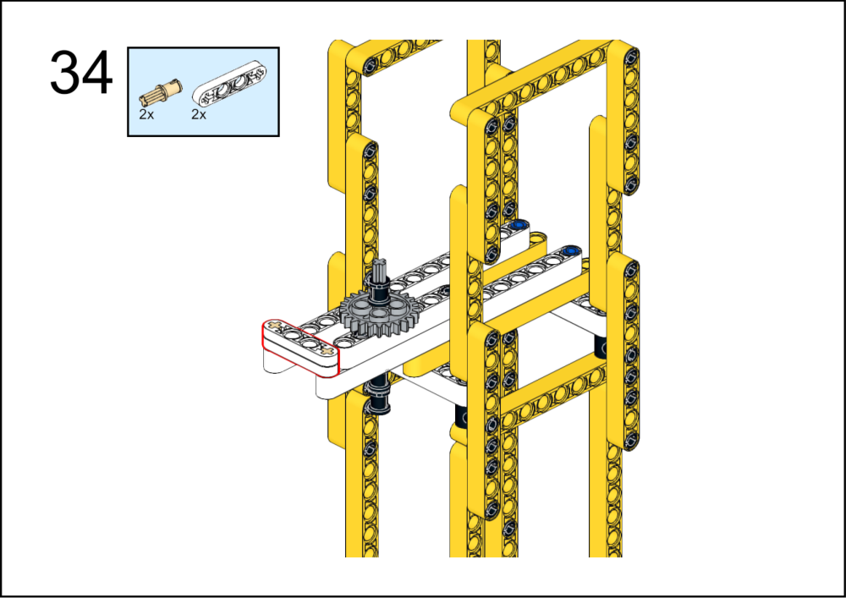
ASSEMBLY STEPS
32 – 34
PROGRESS: 67% COMPLETE
STEP 32
STEP 33
STEP 34
BLOCK ROCKET LAUNCH PAD · Techtelligence- Elecfreaks
12 / 18

Slide 15
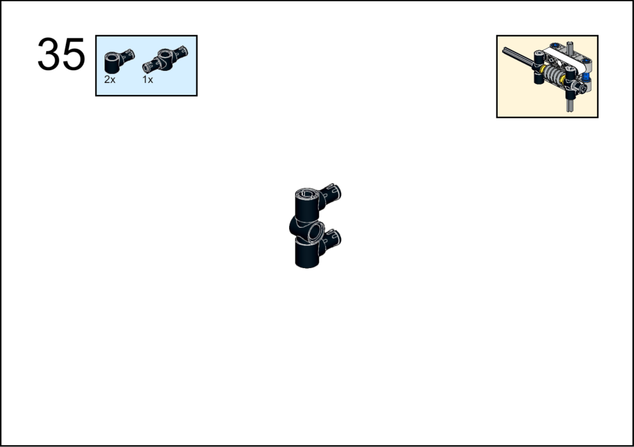
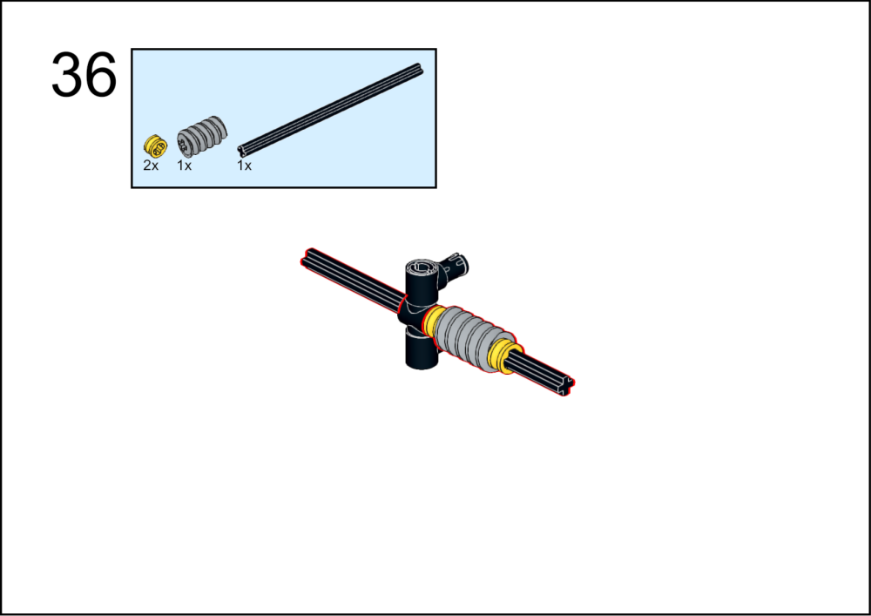
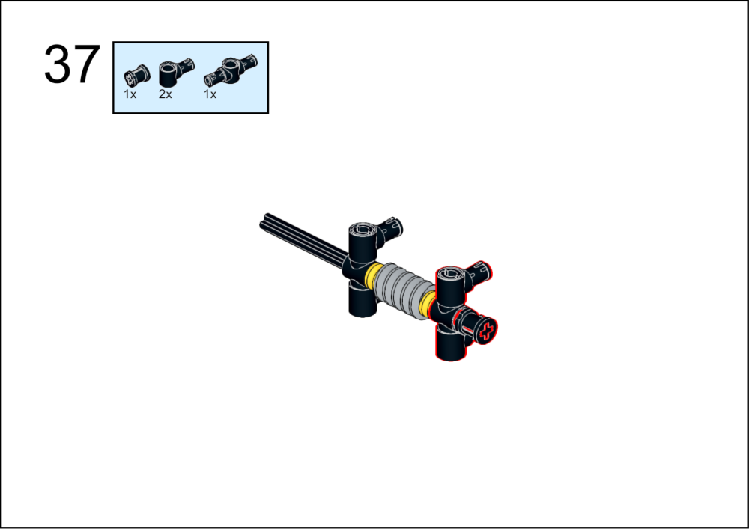
ASSEMBLY STEPS
35 – 37
PROGRESS: 72% COMPLETE
STEP 35
STEP 36
STEP 37
BLOCK ROCKET LAUNCH PAD · Techtelligence- Elecfreaks
13 / 18

Slide 16
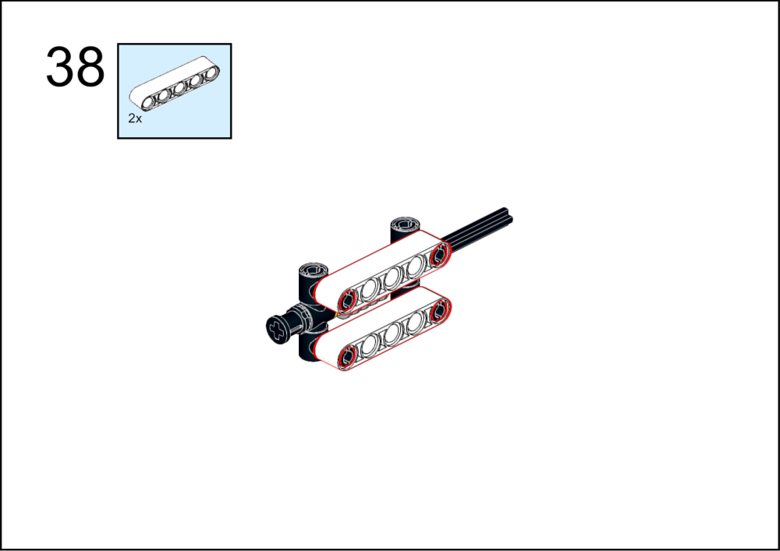
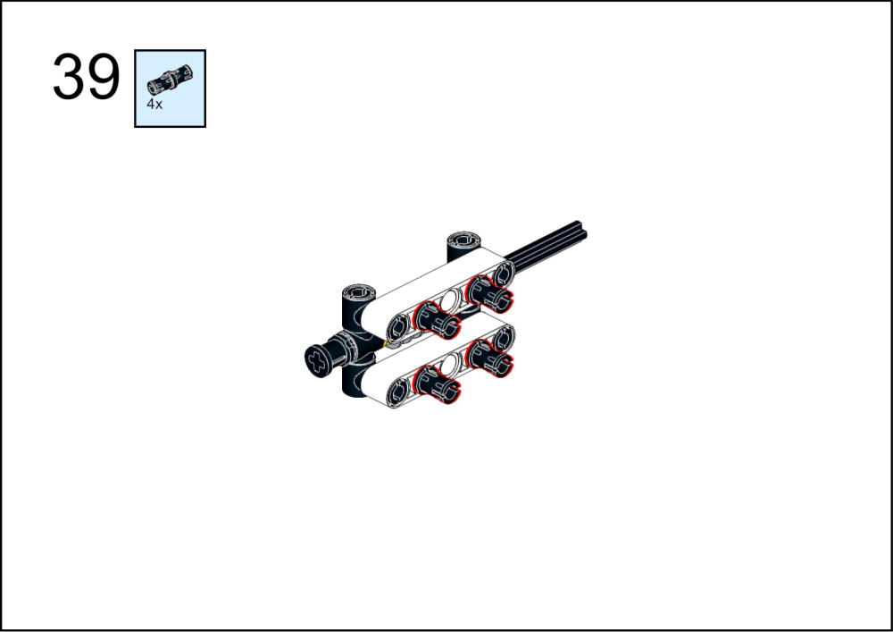
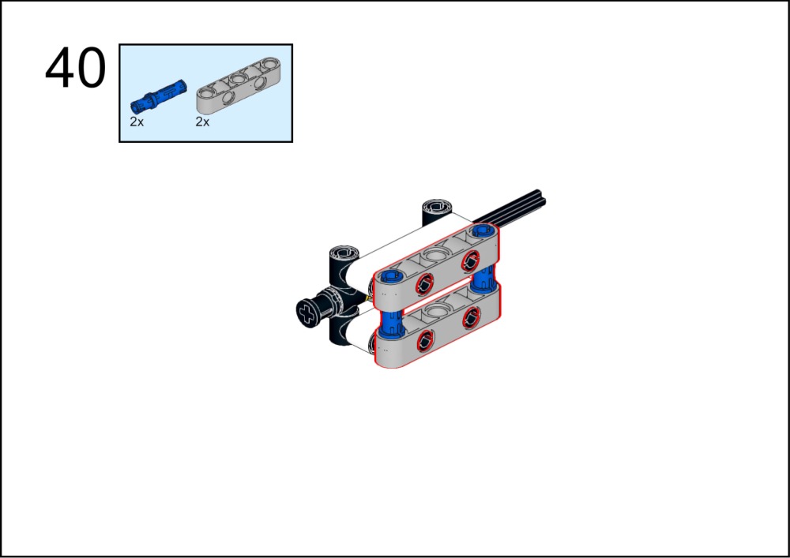
ASSEMBLY STEPS
38 – 40
PROGRESS: 78% COMPLETE
STEP 38
STEP 39
STEP 40
BLOCK ROCKET LAUNCH PAD · Techtelligence- Elecfreaks
14 / 18

Slide 17
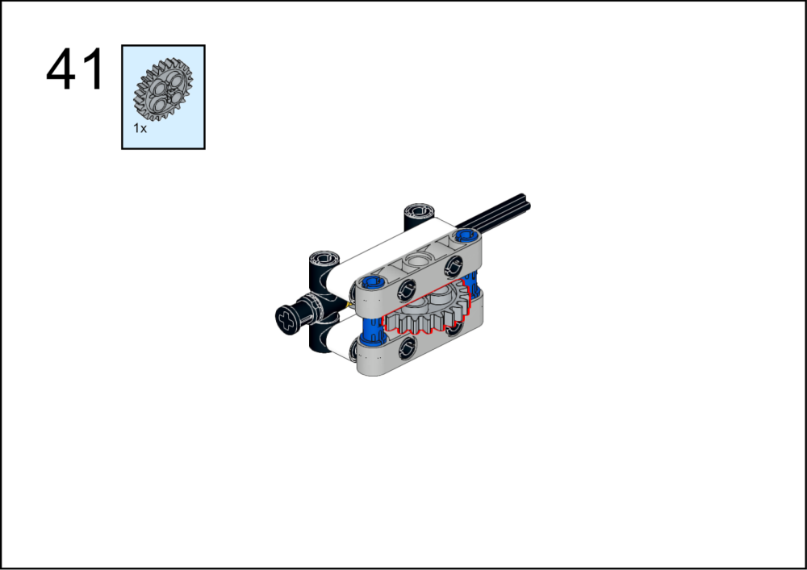
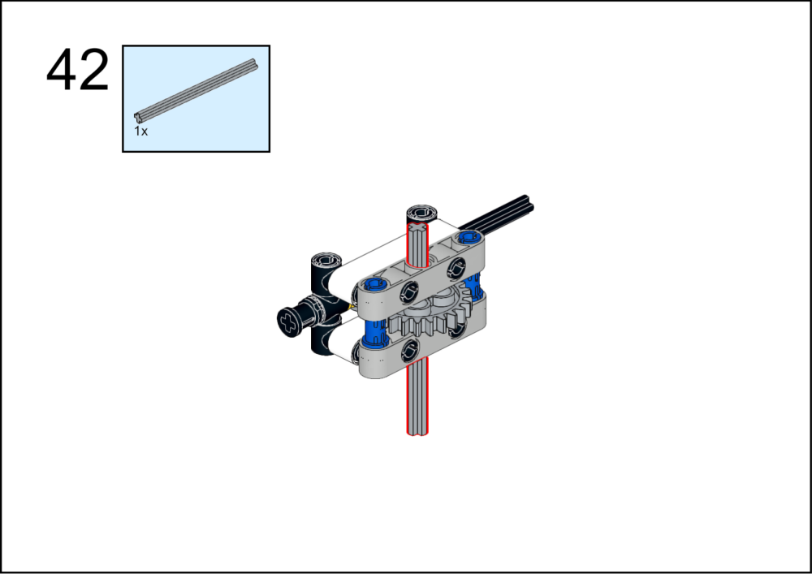
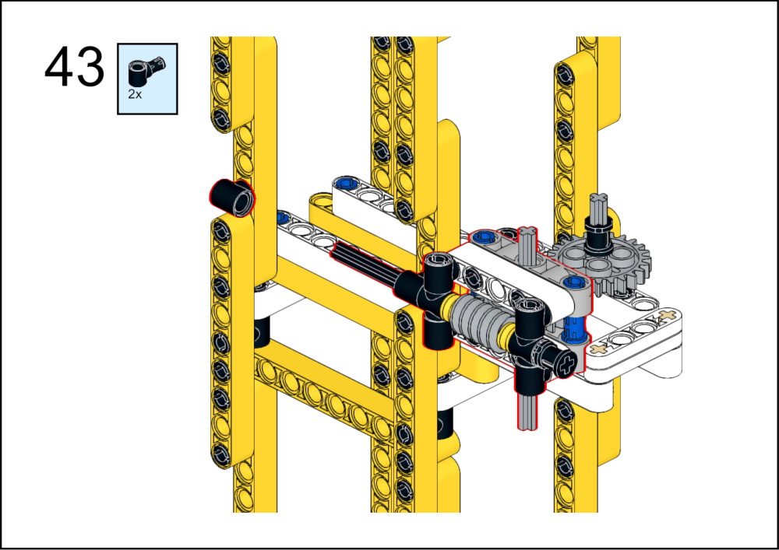
ASSEMBLY STEPS
41 – 43
PROGRESS: 83% COMPLETE
STEP 41
STEP 42
STEP 43
BLOCK ROCKET LAUNCH PAD · Techtelligence- Elecfreaks
15 / 18

Slide 18
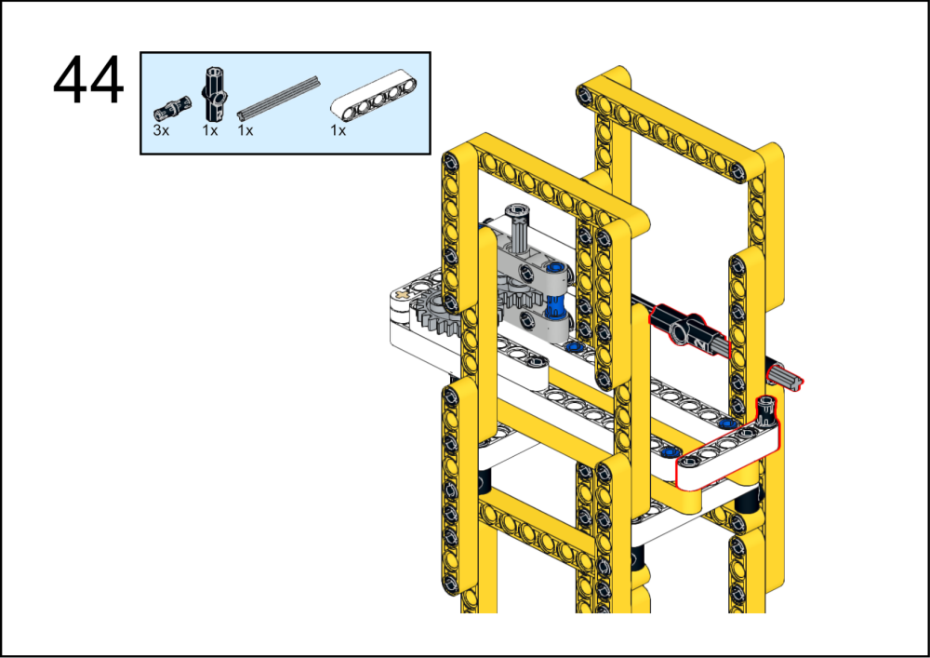
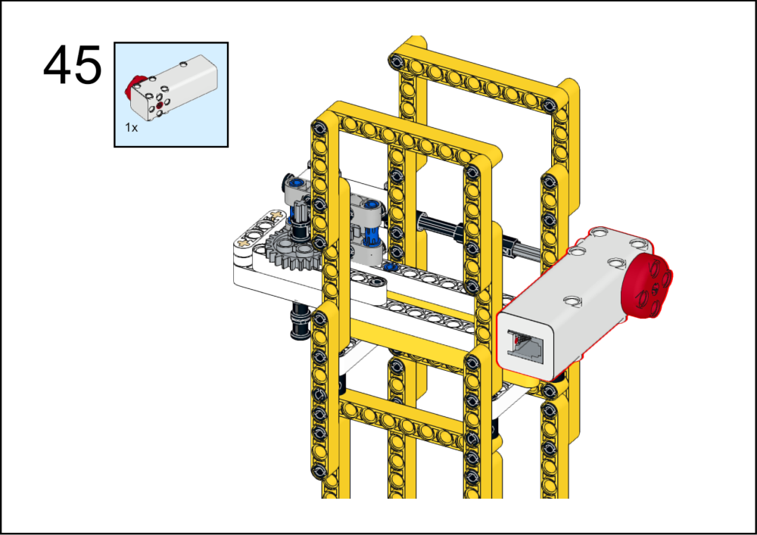
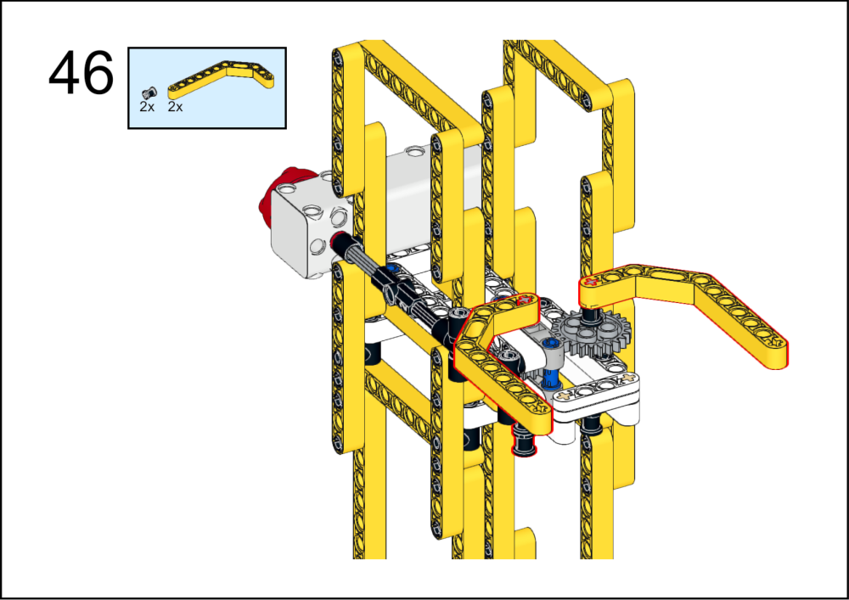
ASSEMBLY STEPS
44 – 46
PROGRESS: 89% COMPLETE
STEP 44
STEP 45
STEP 46
BLOCK ROCKET LAUNCH PAD · Techtelligence- Elecfreaks
16 / 18

Slide 19
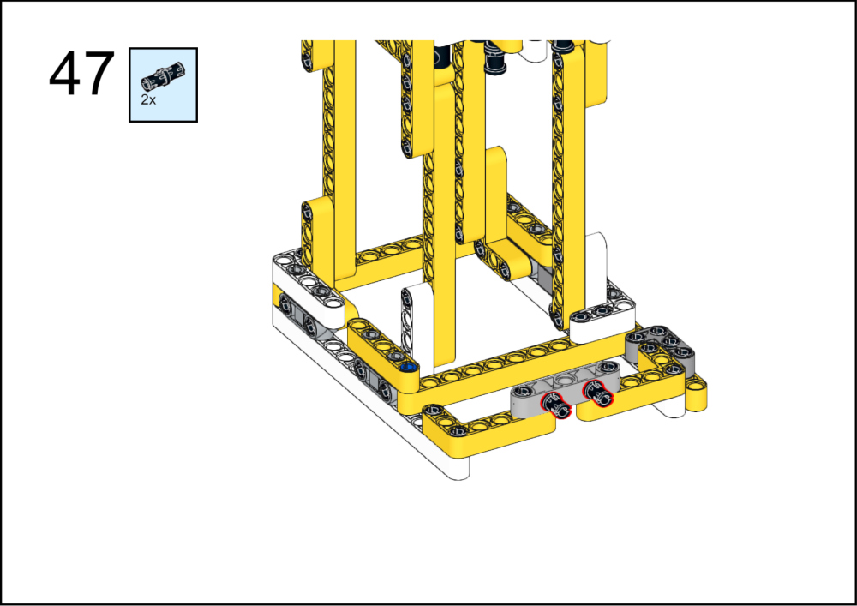
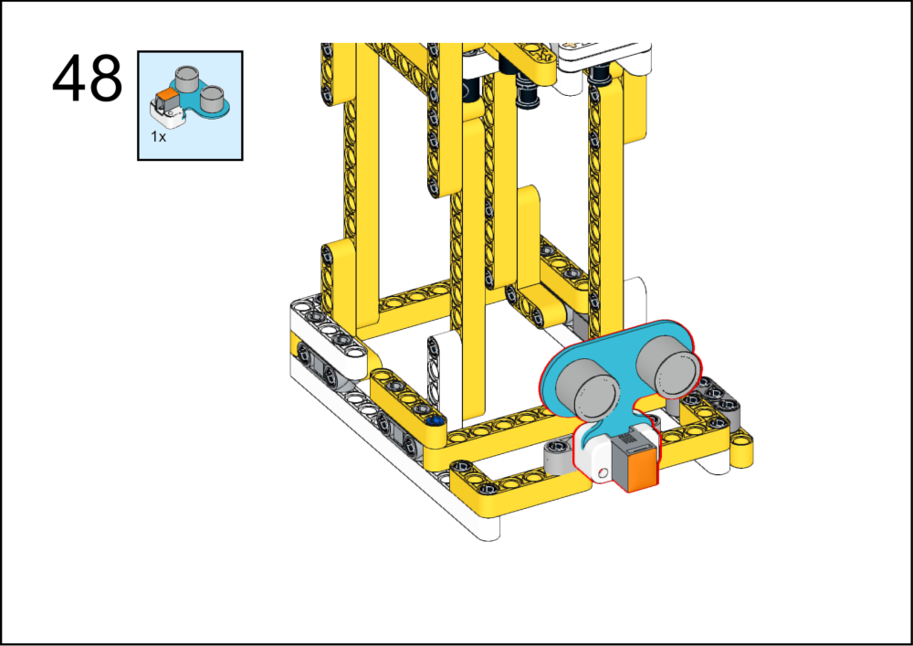
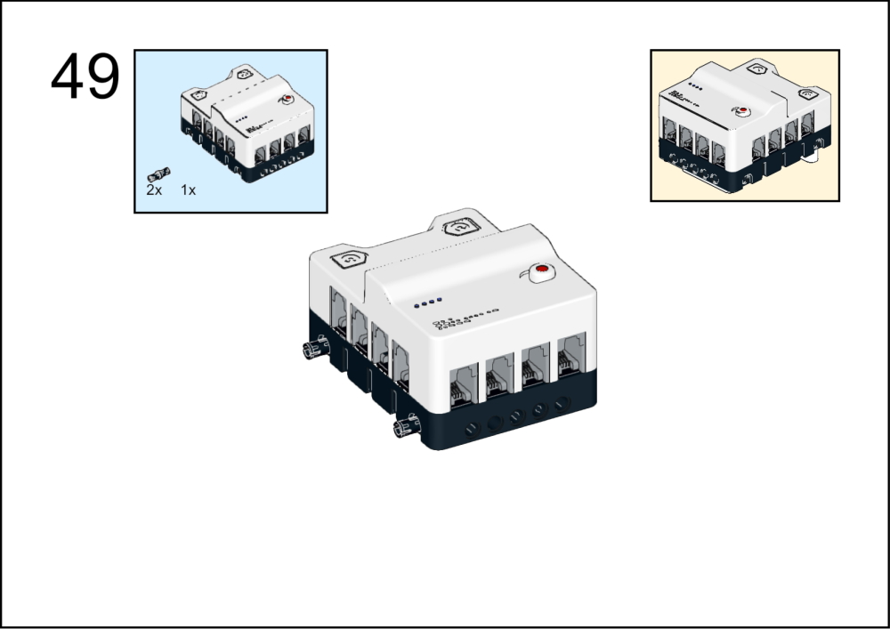
ASSEMBLY STEPS
47 – 49
PROGRESS: 94% COMPLETE
STEP 47
STEP 48
STEP 49
BLOCK ROCKET LAUNCH PAD · Techtelligence- Elecfreaks
17 / 18

Slide 20



ASSEMBLY STEPS
50 – 52
PROGRESS: 100% COMPLETE
STEP 50
STEP 51
STEP 52
BLOCK ROCKET LAUNCH PAD · Techtelligence- Elecfreaks
18 / 18

Slide 21
ASSEMBLY
COMPLETE
54 STEPS · BLOCK ROCKET LAUNCH PAD · Techtelligence- Elecfreaks
54
18
100%
TOTAL STEPS
SLIDE SECTIONS
COMPLETE

