Slide 1
CASE 3
LUNAR
LANDING ROVER
ASSEMBLY GUIDE · SPACE SCIENCE KIT · Techtelligence- Elecfreaks
66 STEPS
TOTAL

Slide 2
DESIGN BRIEF
OBJECTIVE
Construct a fully functional Lunar Landing Rover using modular block-based components. Students explore lunar surface operations through systematic assembly of a motorised rover with articulated suspension and navigation systems.
DESIGN PRINCIPLES
01. Structural Integrity
Robust modular frame construction ensures stability throughout the entire assembly and operation.
02. Step-by-Step Build
Sequential instruction design guides students from individual components to a complete working model.
03. STEM Integration
Hands-on mechanics reinforce space science, engineering, and robotics concepts at every stage.
04. Scalable Design
Standardised connectors and components allow for reconfiguration and adaptation of the final model.
Techtelligence- Elecfreaks · LUNAR LANDING ROVER

Slide 3
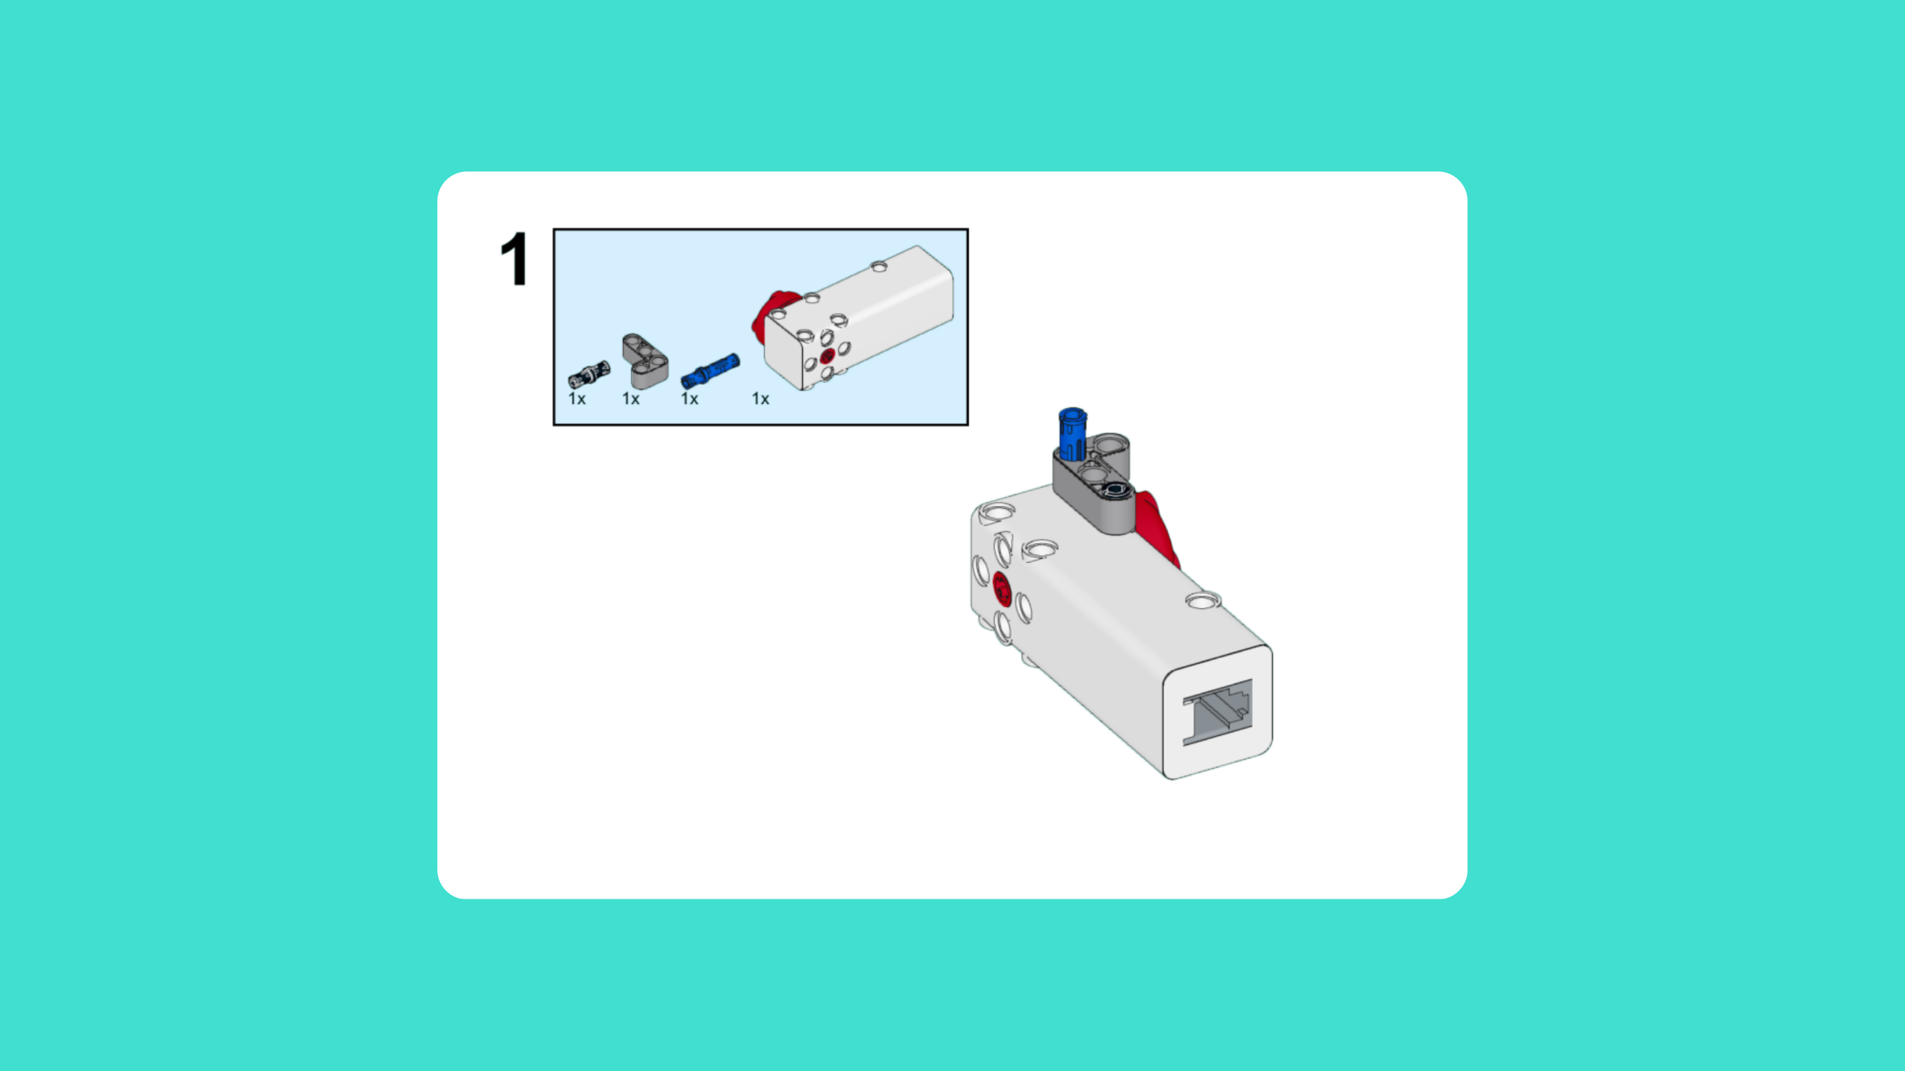
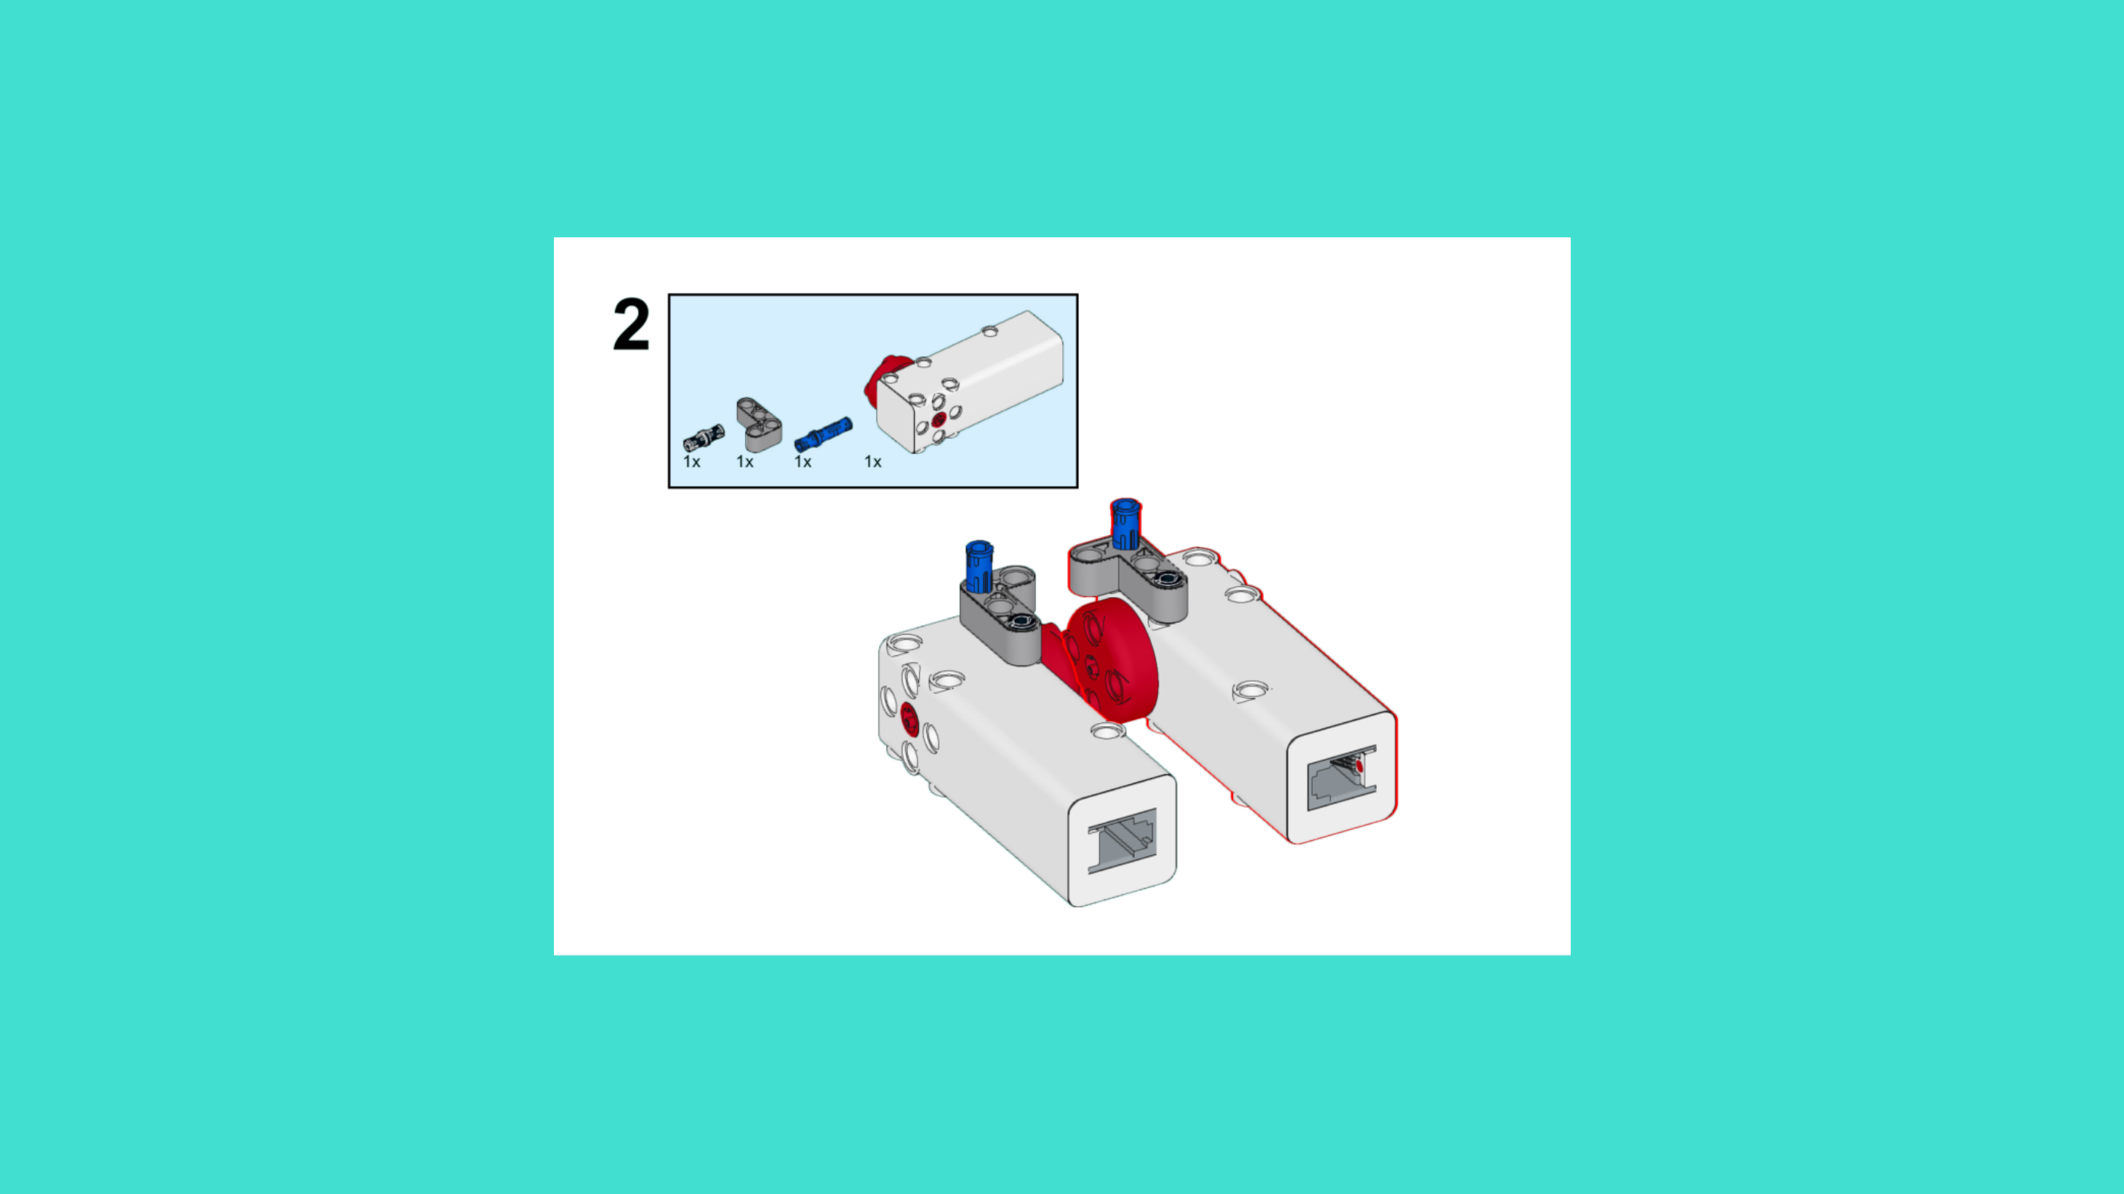
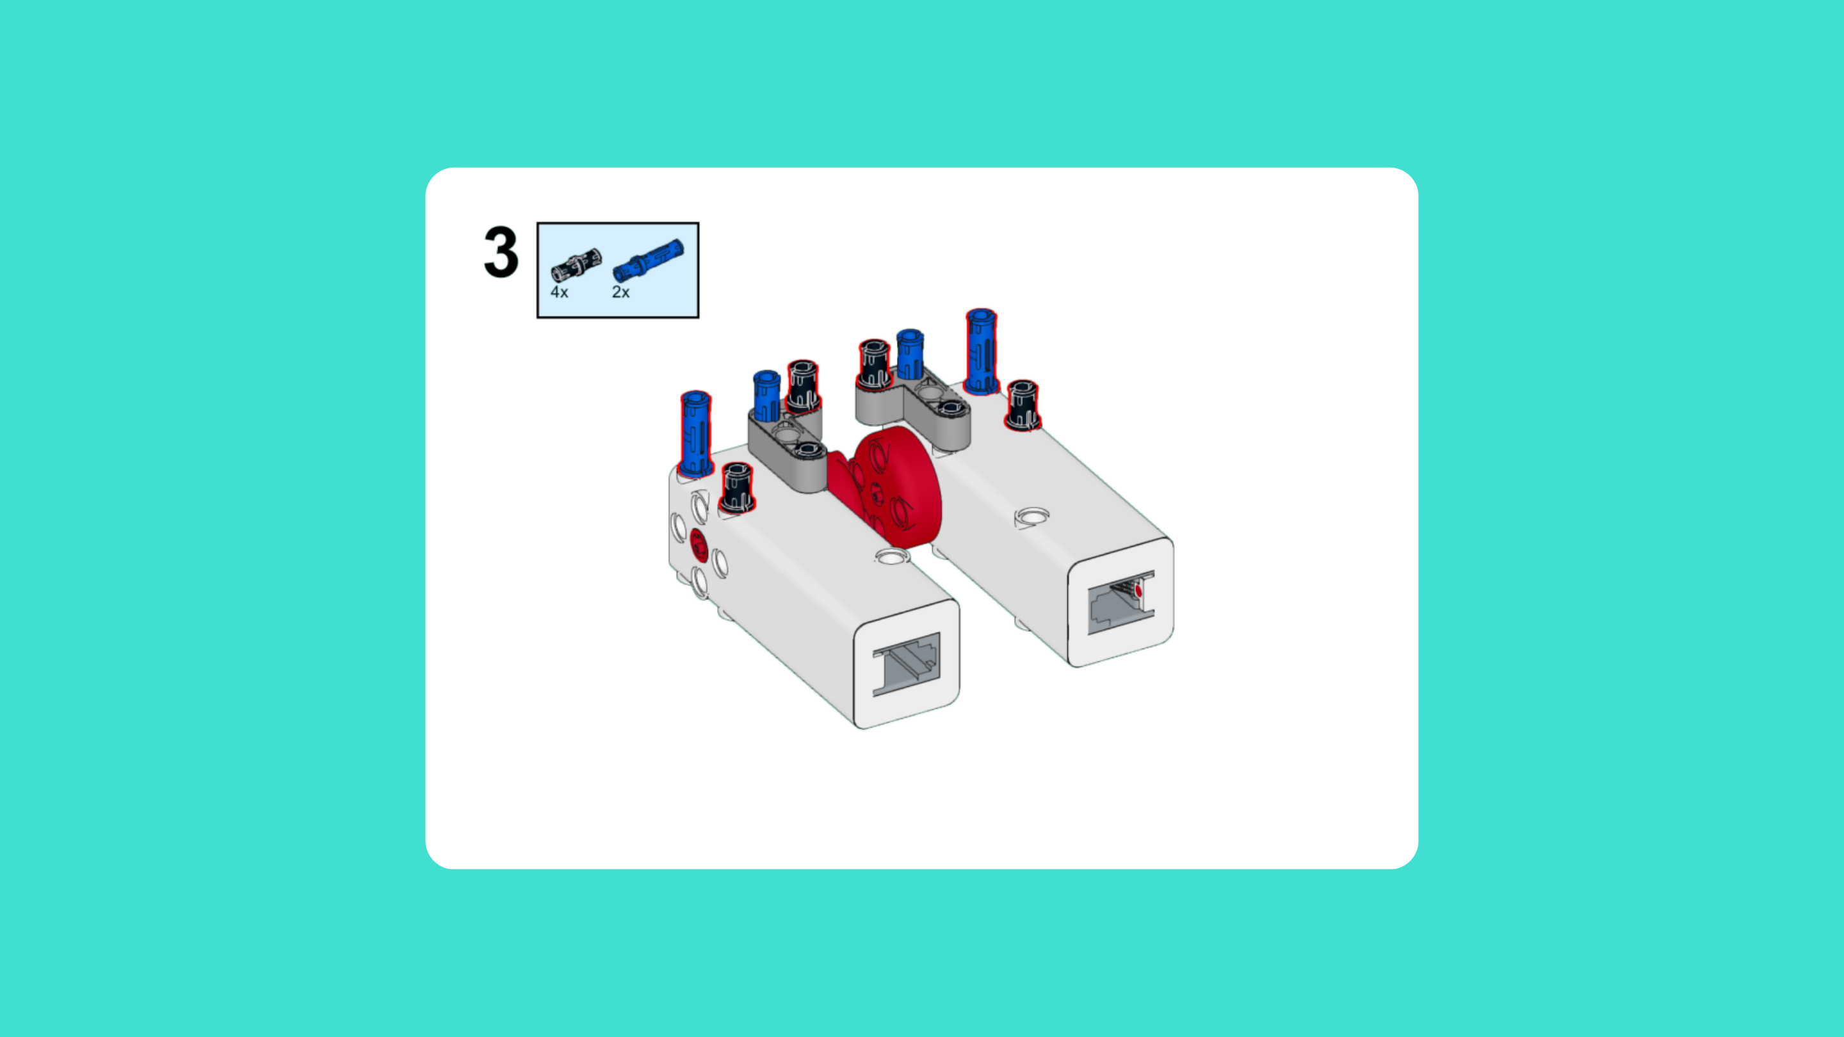
ASSEMBLY STEPS
STEP 1 – 3
PROGRESS: 5% COMPLETE (3 of 66 steps)
STEP 1
STEP 2
STEP 3
LUNAR LANDING ROVER · Techtelligence- Elecfreaks
1 / 22

Slide 4
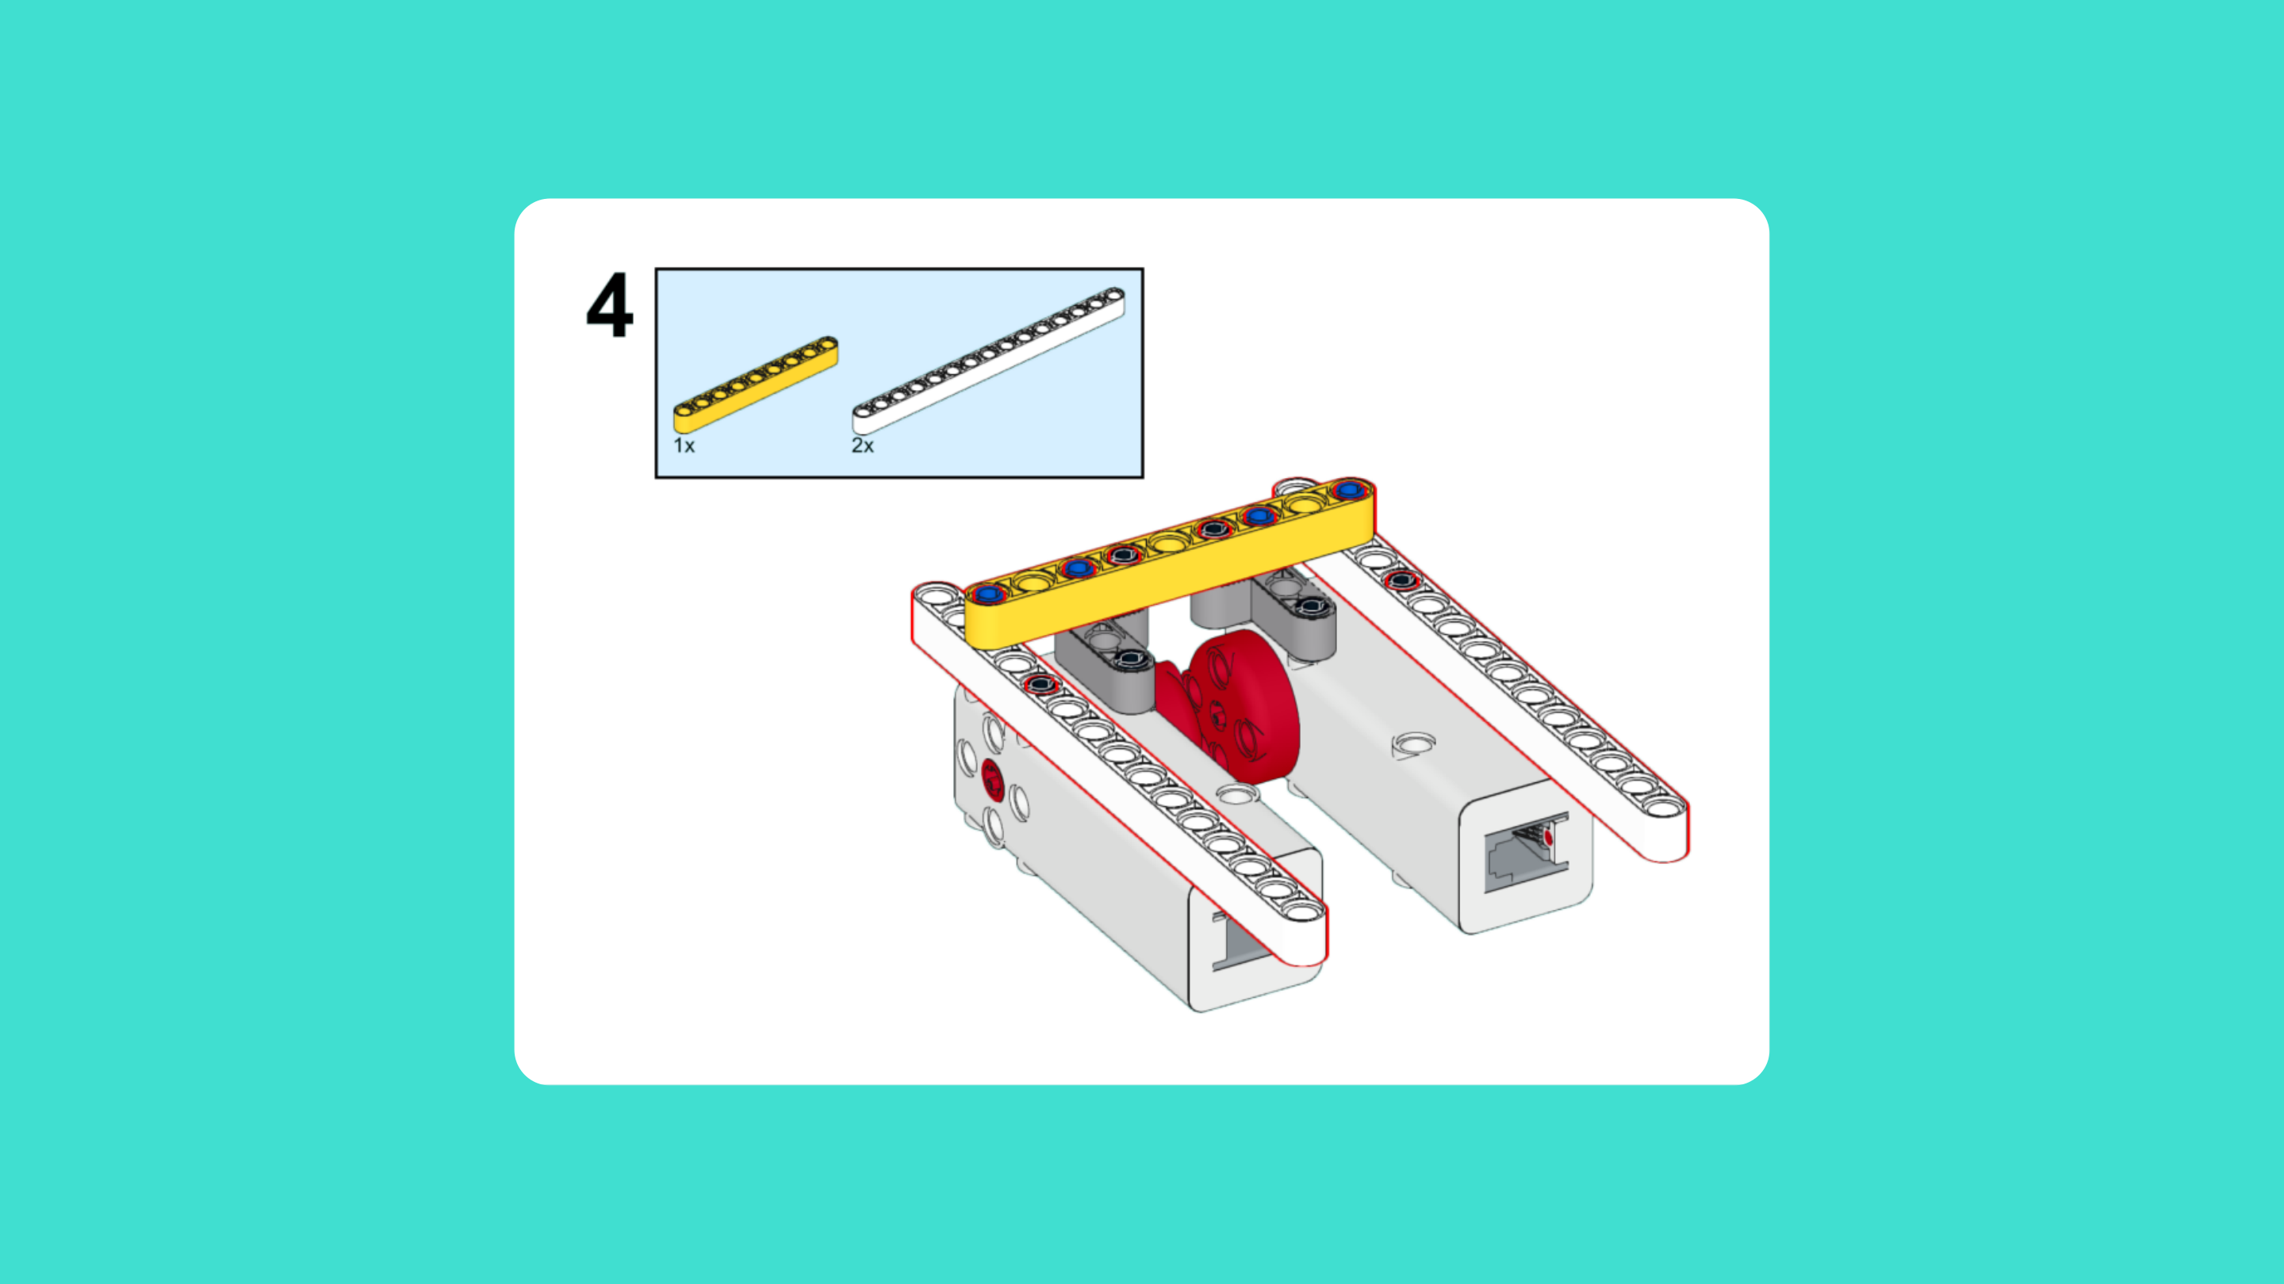
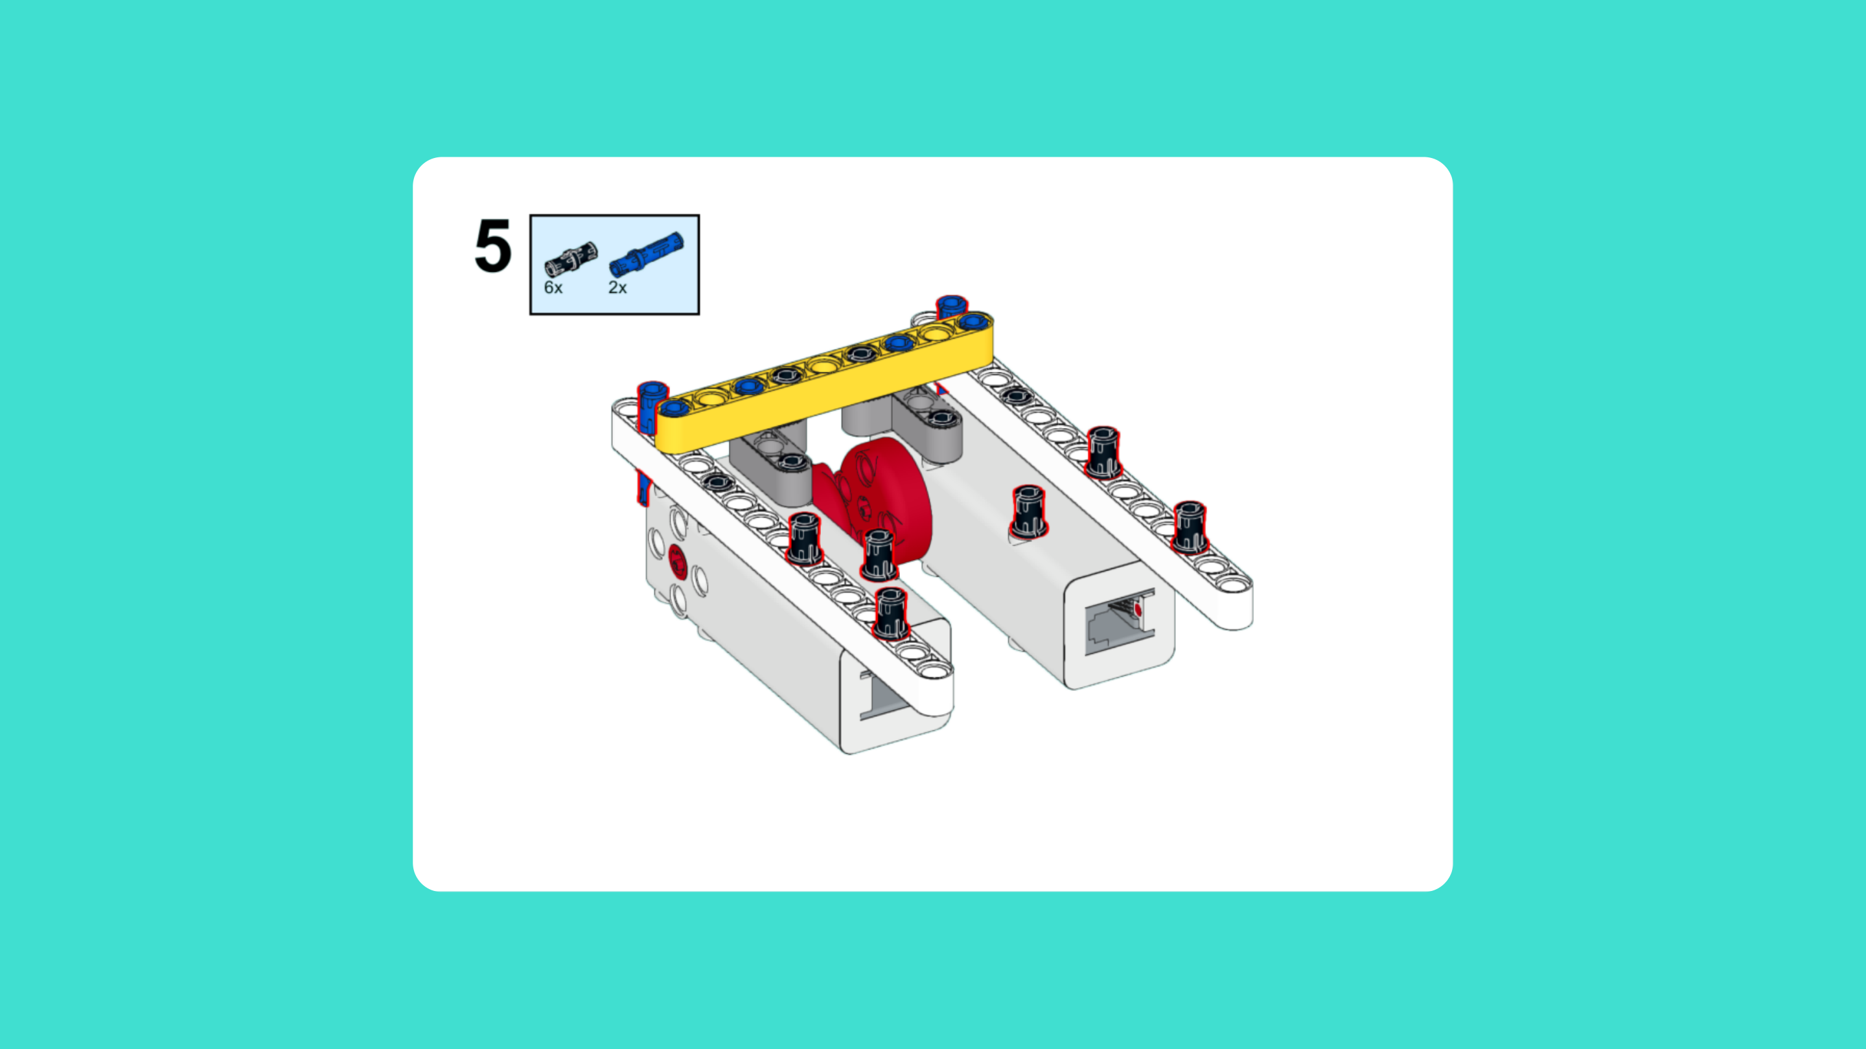
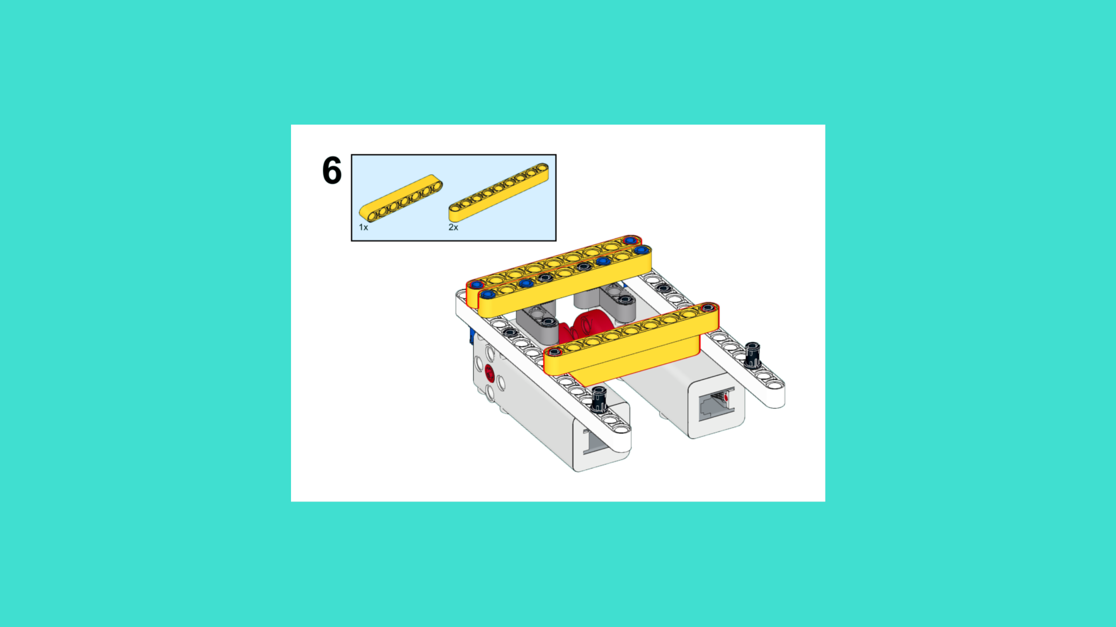
ASSEMBLY STEPS
STEP 4 – 6
PROGRESS: 9% COMPLETE (6 of 66 steps)
STEP 4
STEP 5
STEP 6
LUNAR LANDING ROVER · Techtelligence- Elecfreaks
2 / 22

Slide 5
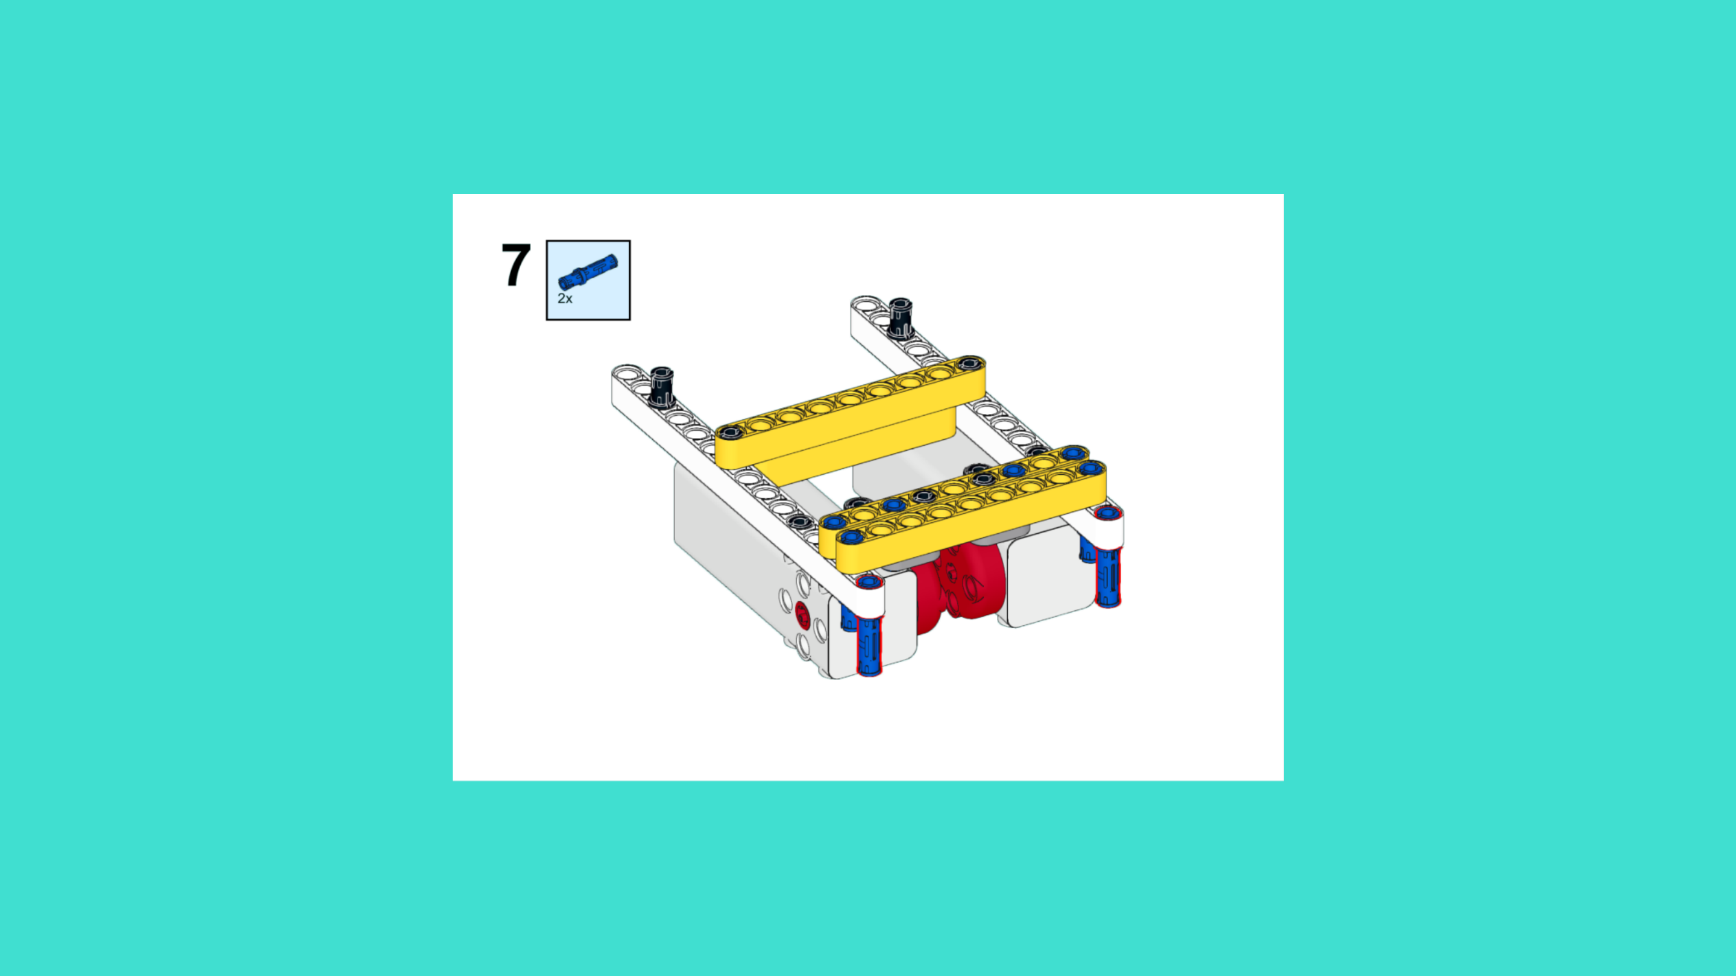
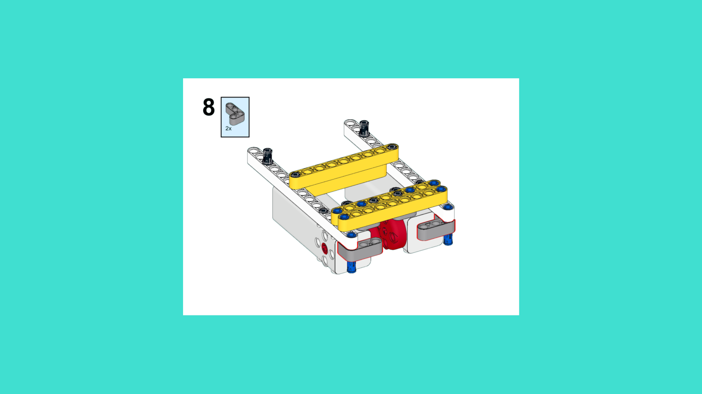
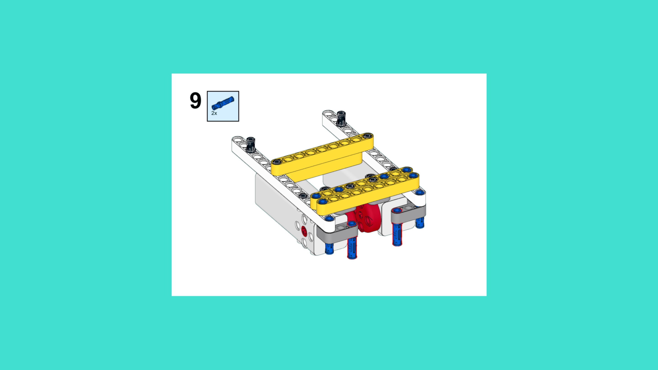
ASSEMBLY STEPS
STEP 7 – 9
PROGRESS: 14% COMPLETE (9 of 66 steps)
STEP 7
STEP 8
STEP 9
LUNAR LANDING ROVER · Techtelligence- Elecfreaks
3 / 22

Slide 6

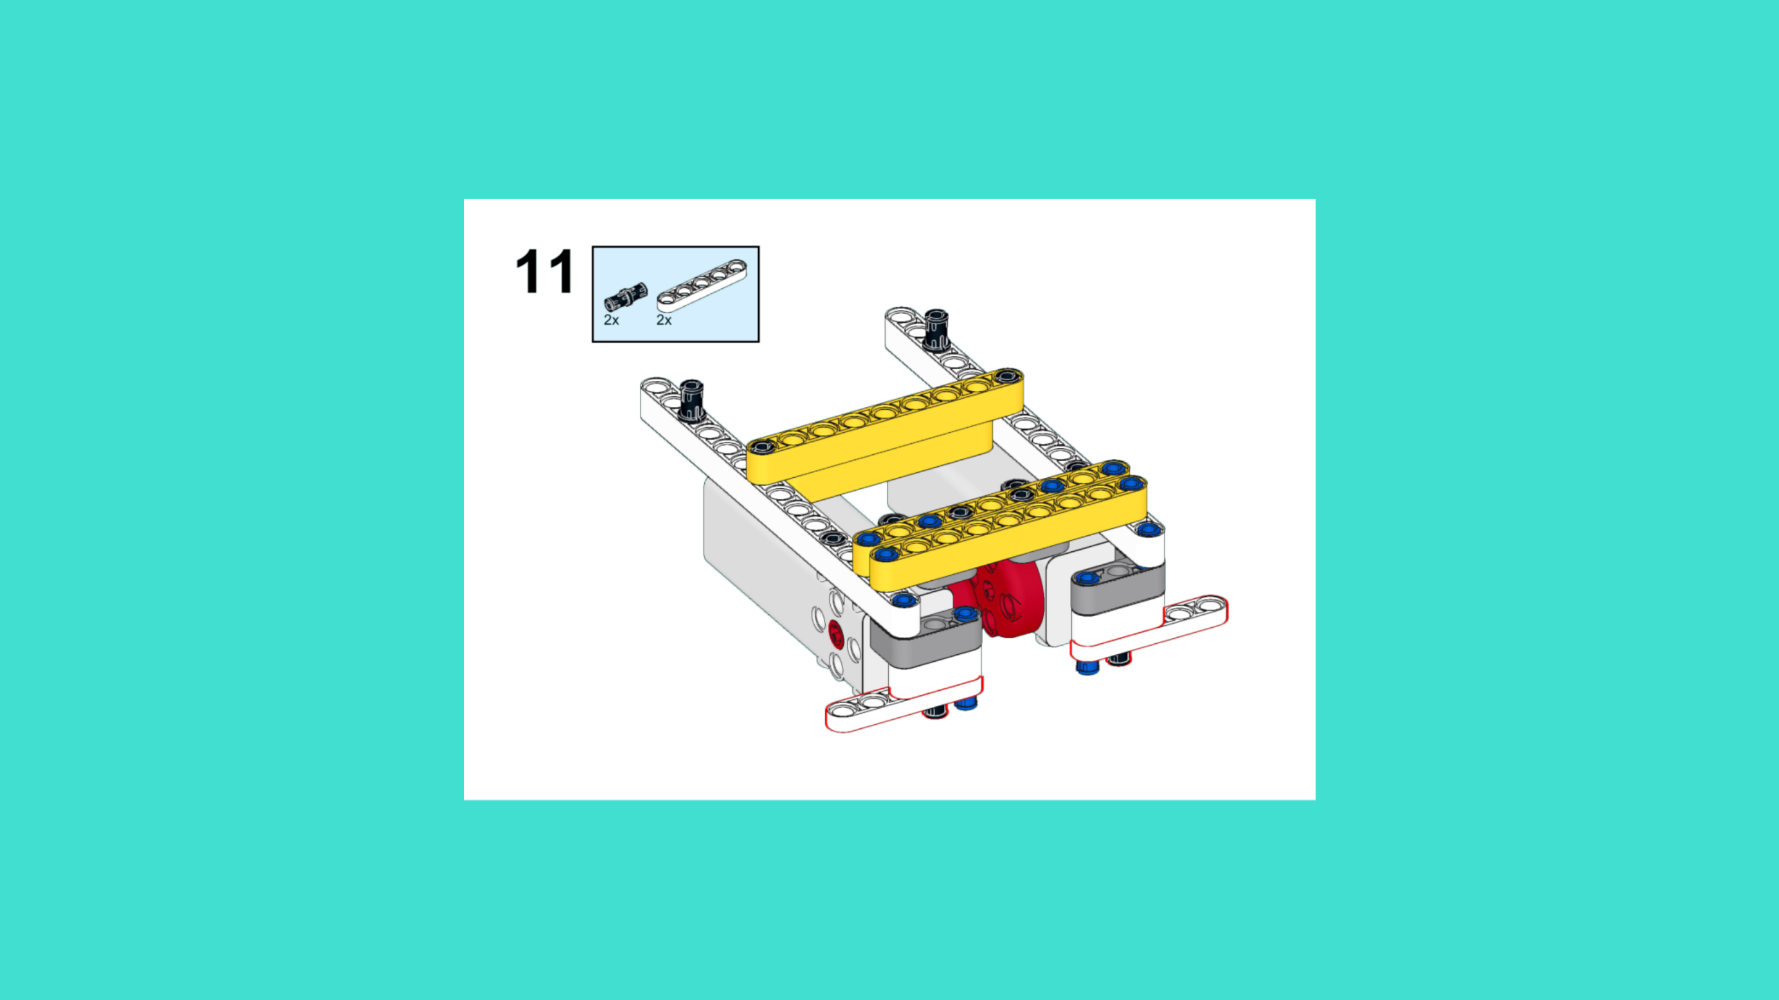
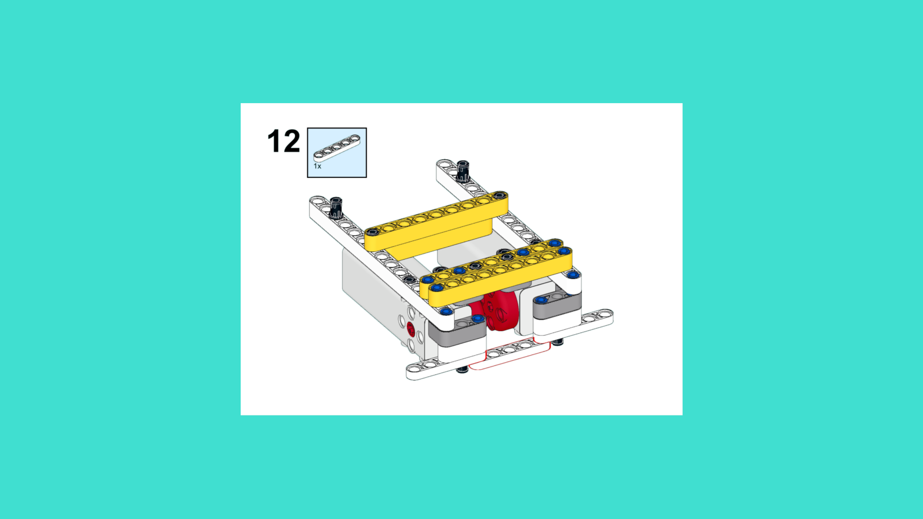
ASSEMBLY STEPS
STEP 10 – 12
PROGRESS: 18% COMPLETE (12 of 66 steps)
STEP 10
STEP 11
STEP 12
LUNAR LANDING ROVER · Techtelligence- Elecfreaks
4 / 22

Slide 7
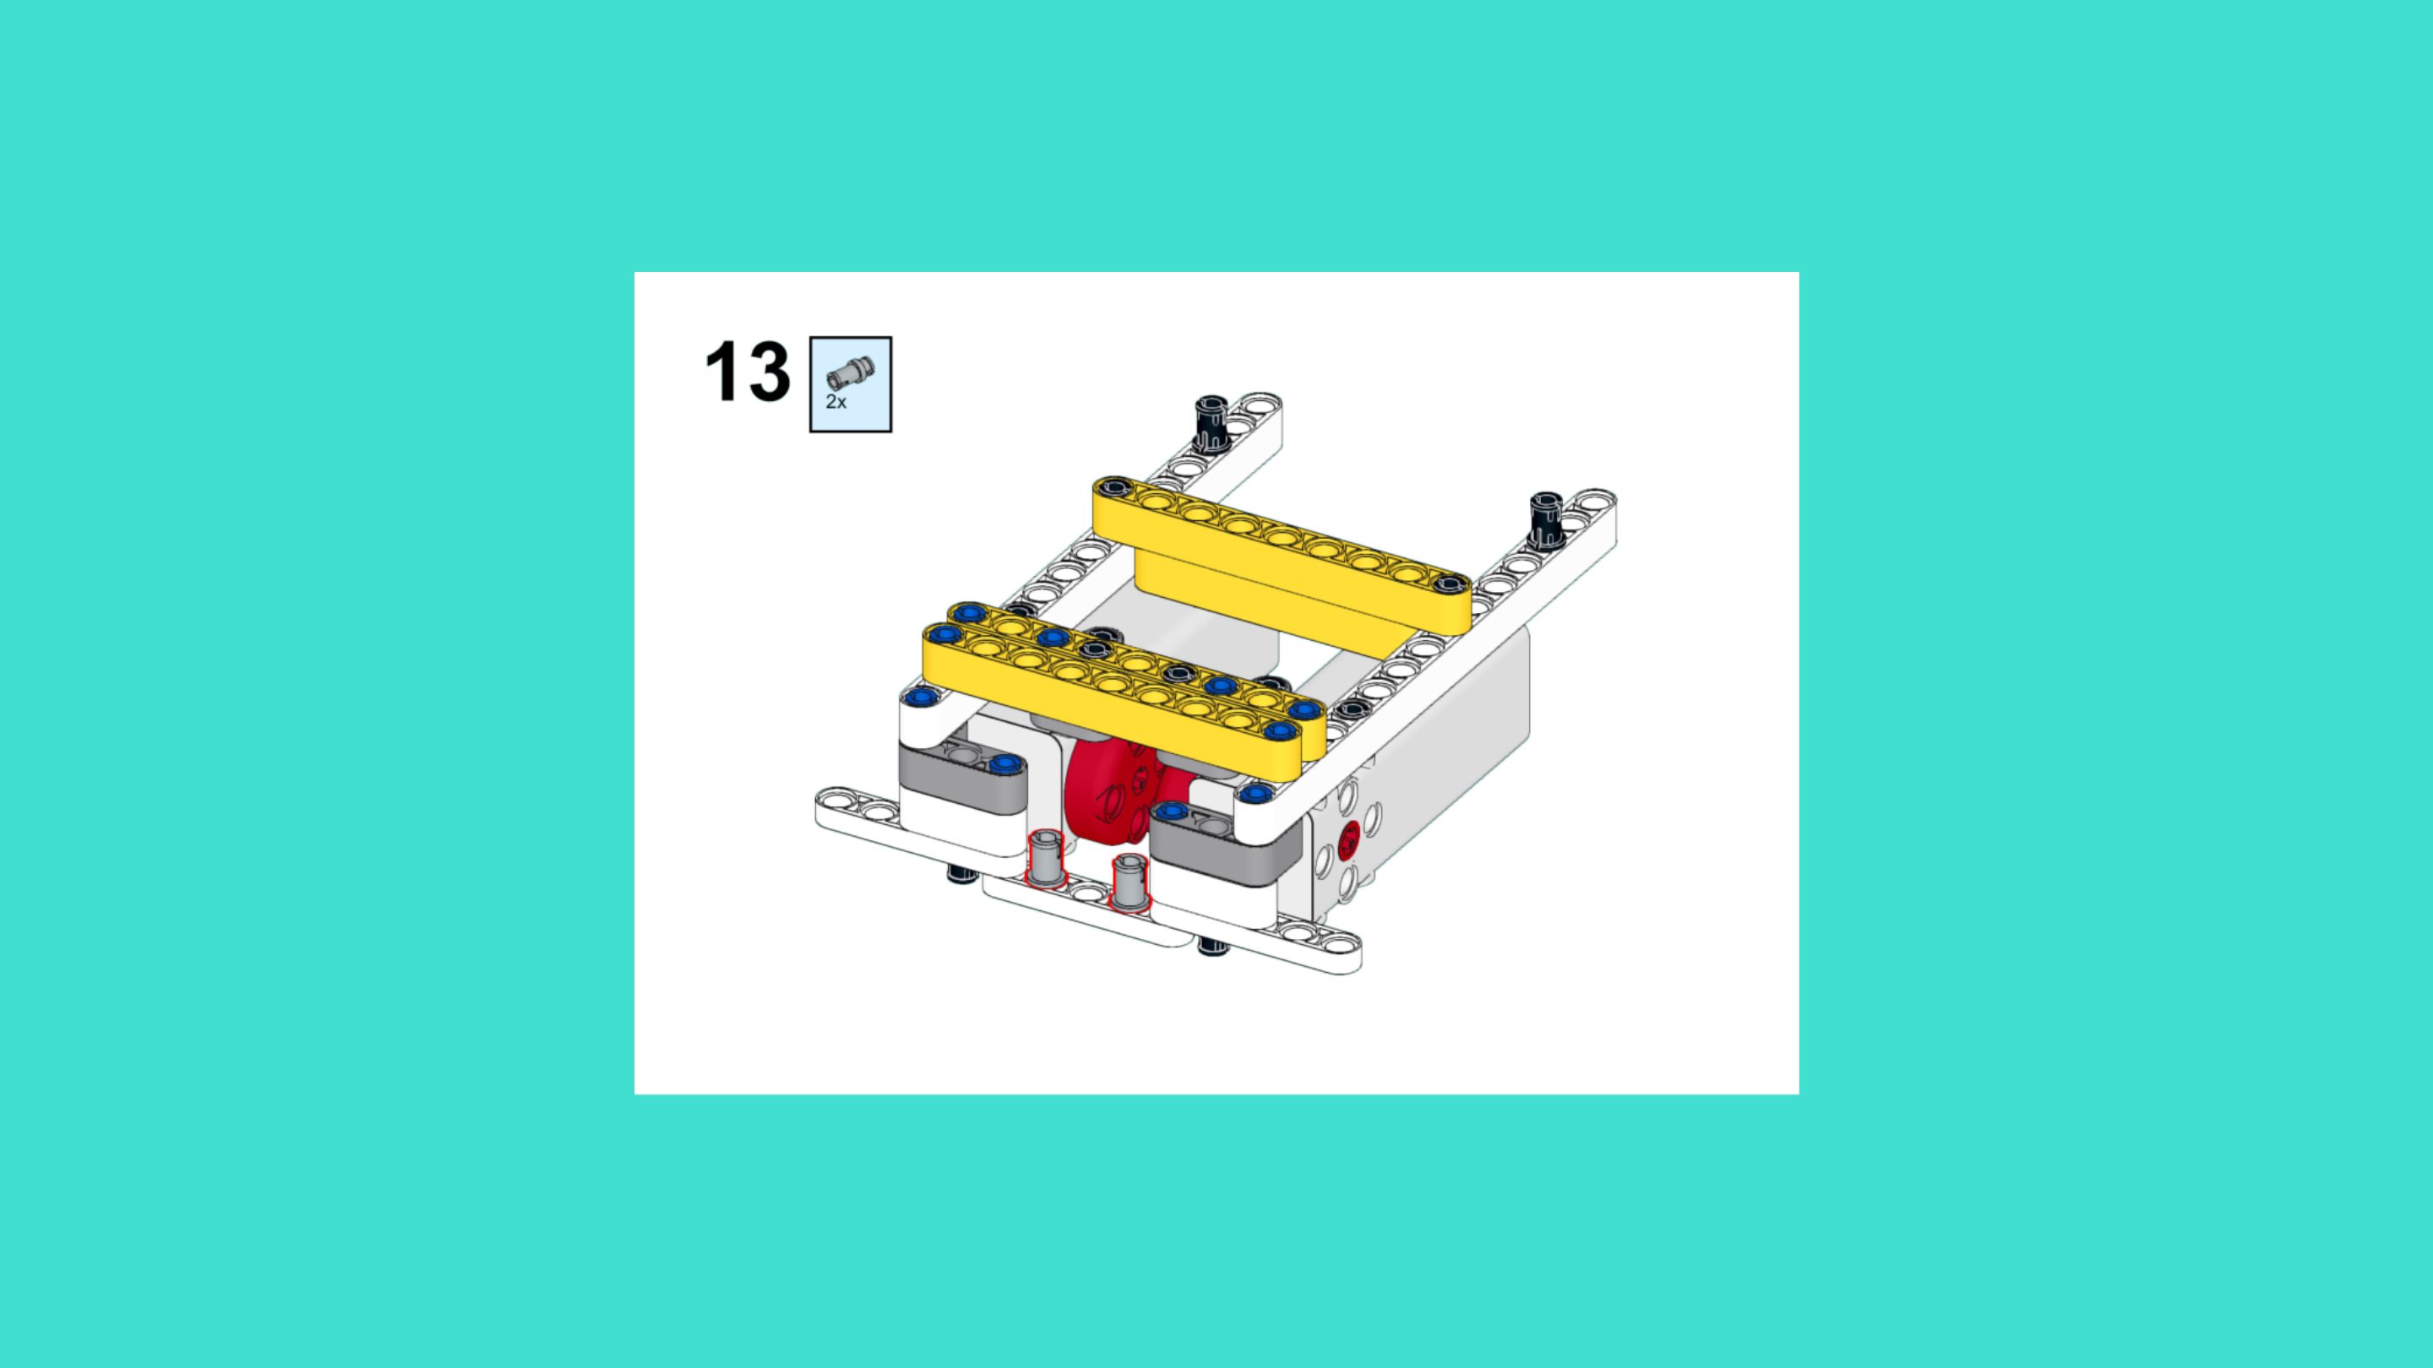
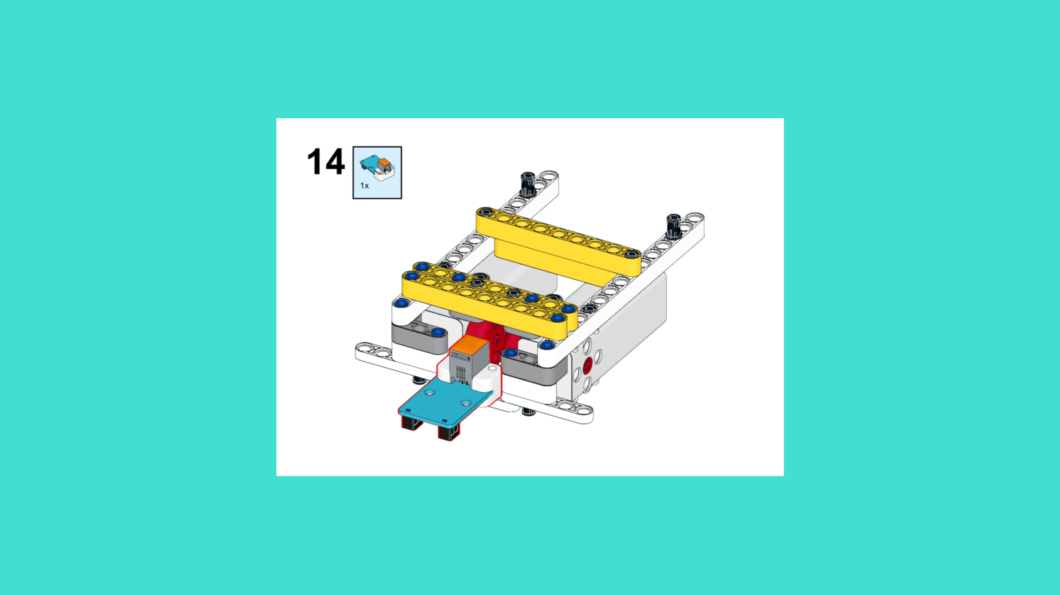
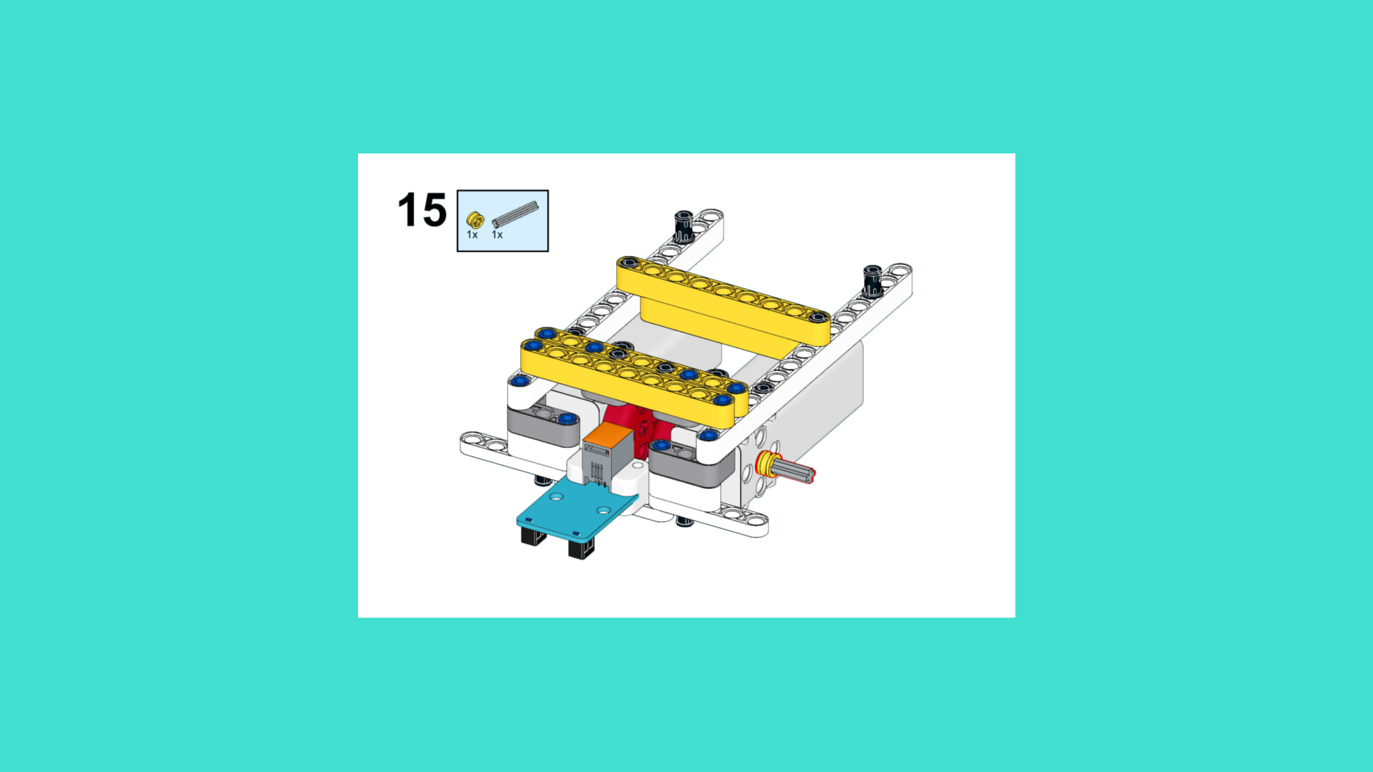
ASSEMBLY STEPS
STEP 13 – 15
PROGRESS: 23% COMPLETE (15 of 66 steps)
STEP 13
STEP 14
STEP 15
LUNAR LANDING ROVER · Techtelligence- Elecfreaks
5 / 22

Slide 8
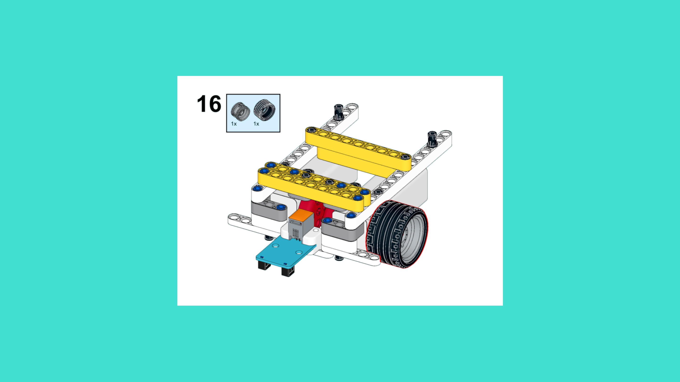
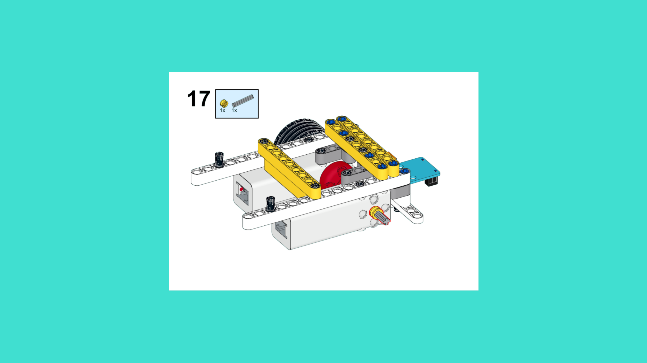
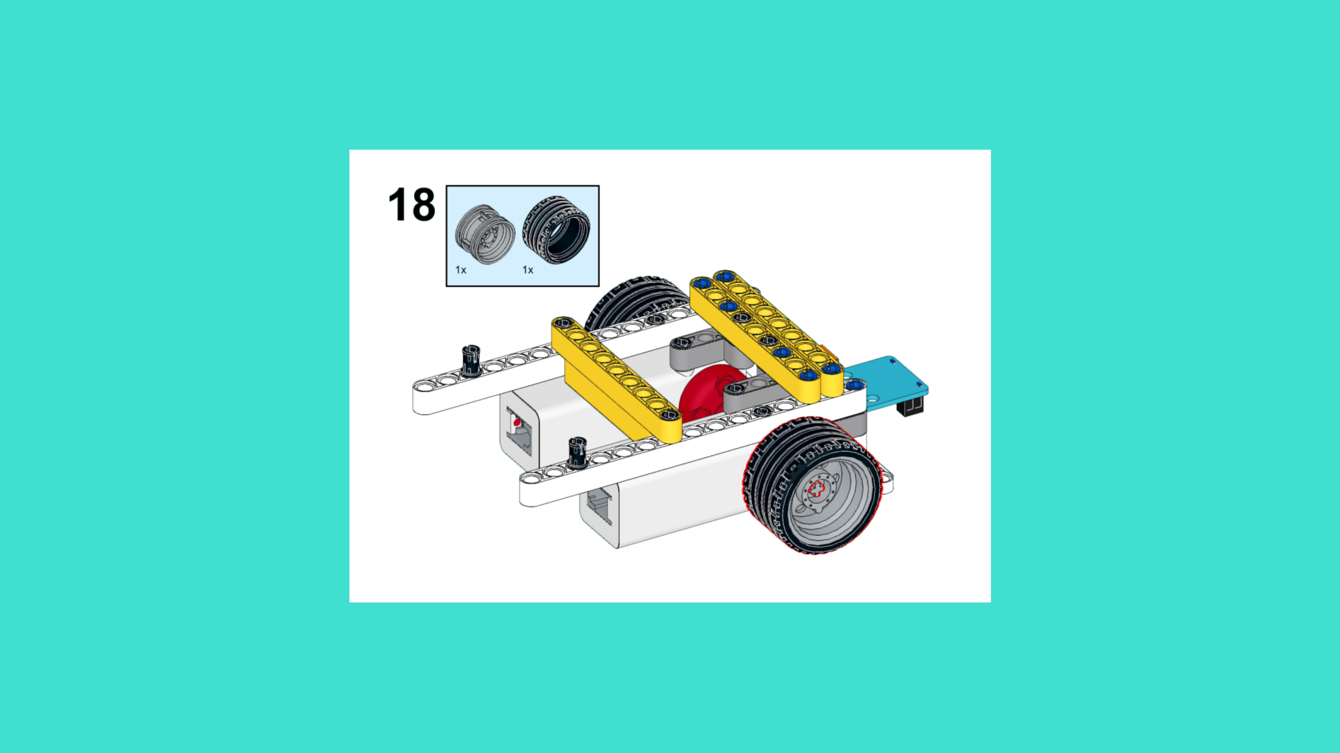
ASSEMBLY STEPS
STEP 16 – 18
PROGRESS: 27% COMPLETE (18 of 66 steps)
STEP 16
STEP 17
STEP 18
LUNAR LANDING ROVER · Techtelligence- Elecfreaks
6 / 22

Slide 9
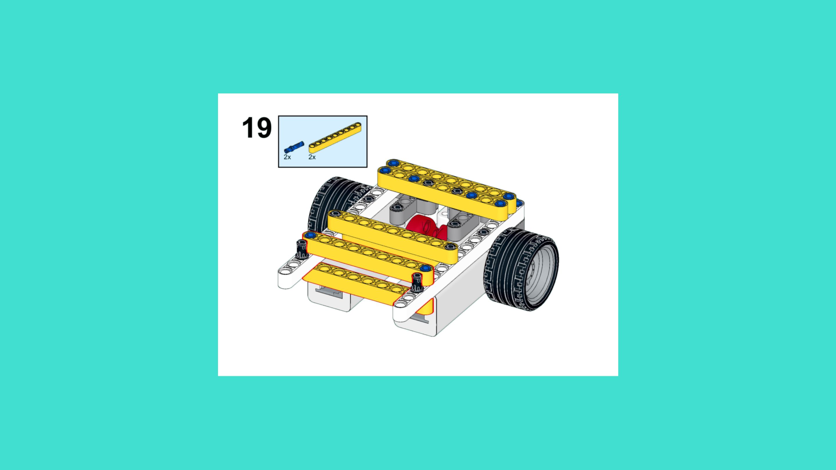
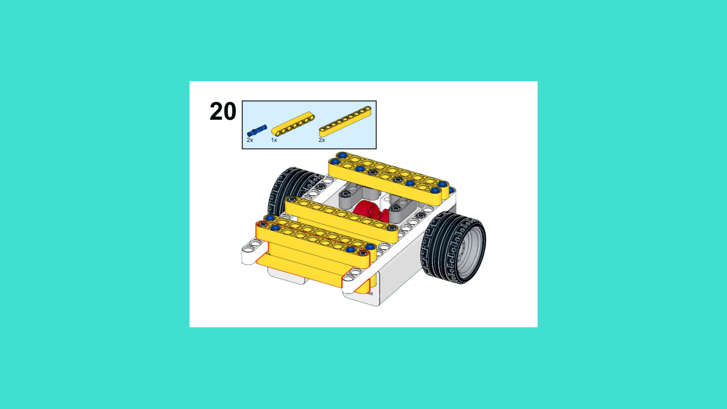
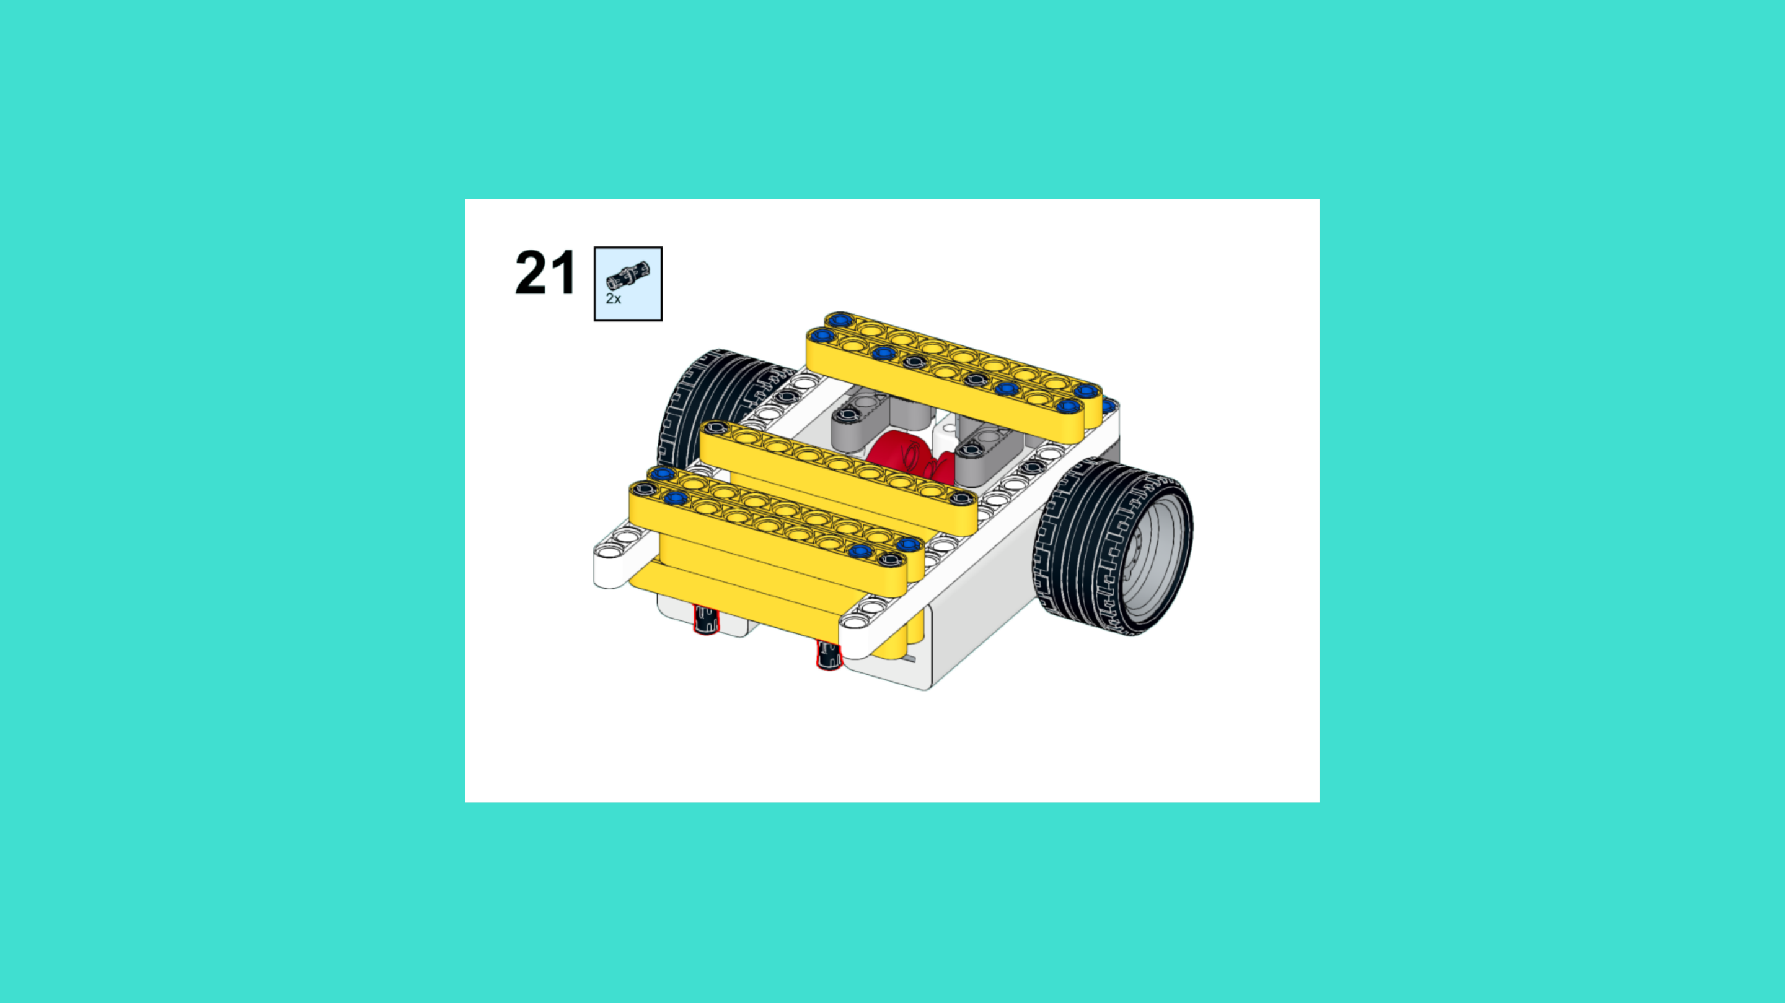
ASSEMBLY STEPS
STEP 19 – 21
PROGRESS: 32% COMPLETE (21 of 66 steps)
STEP 19
STEP 20
STEP 21
LUNAR LANDING ROVER · Techtelligence- Elecfreaks
7 / 22

Slide 10
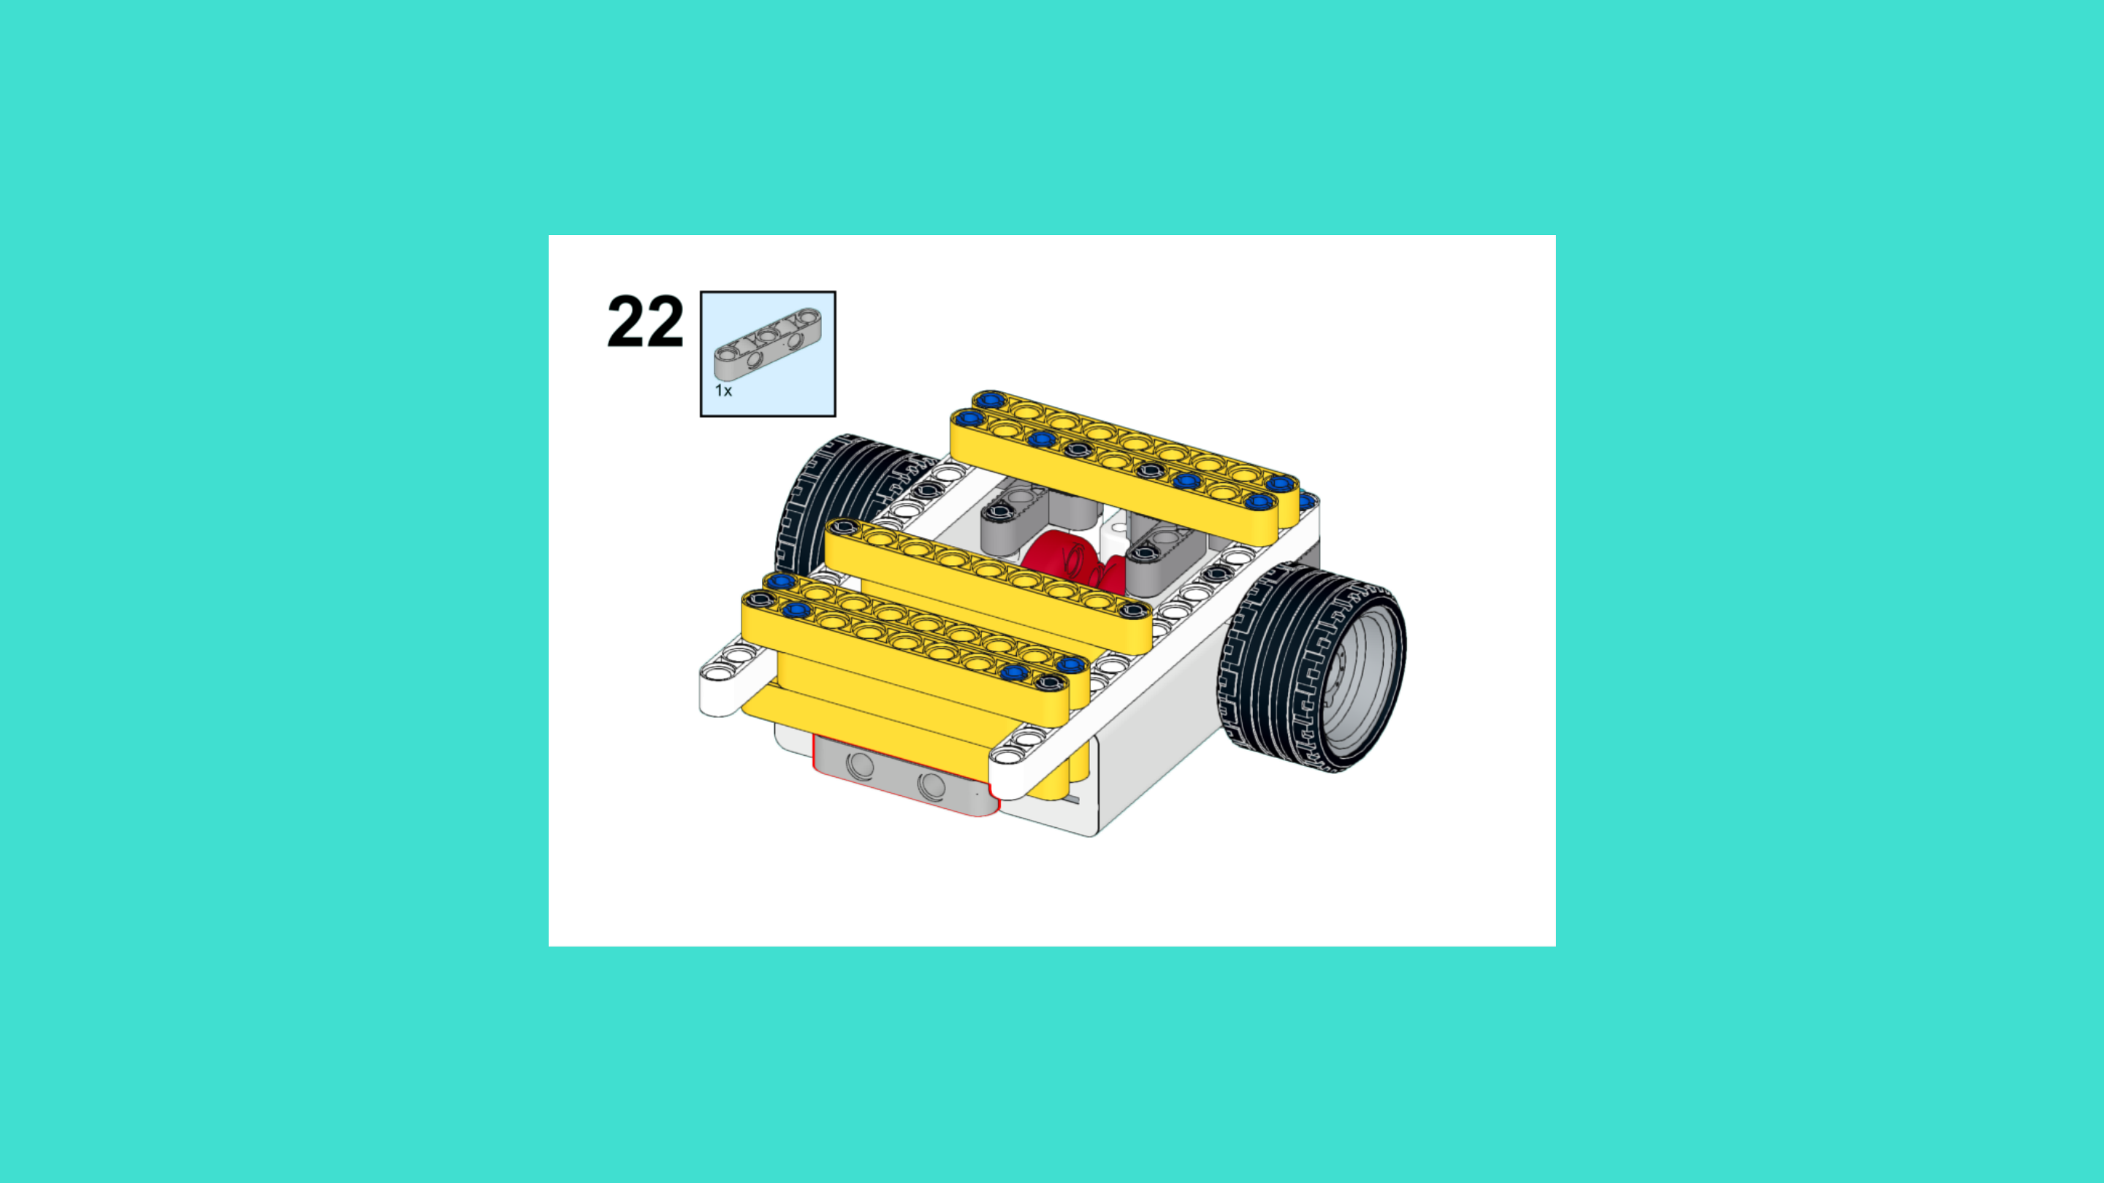
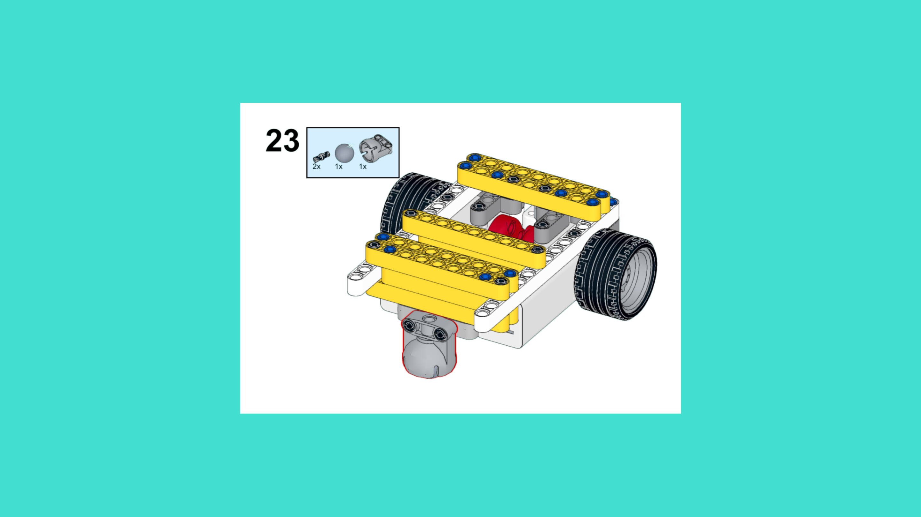
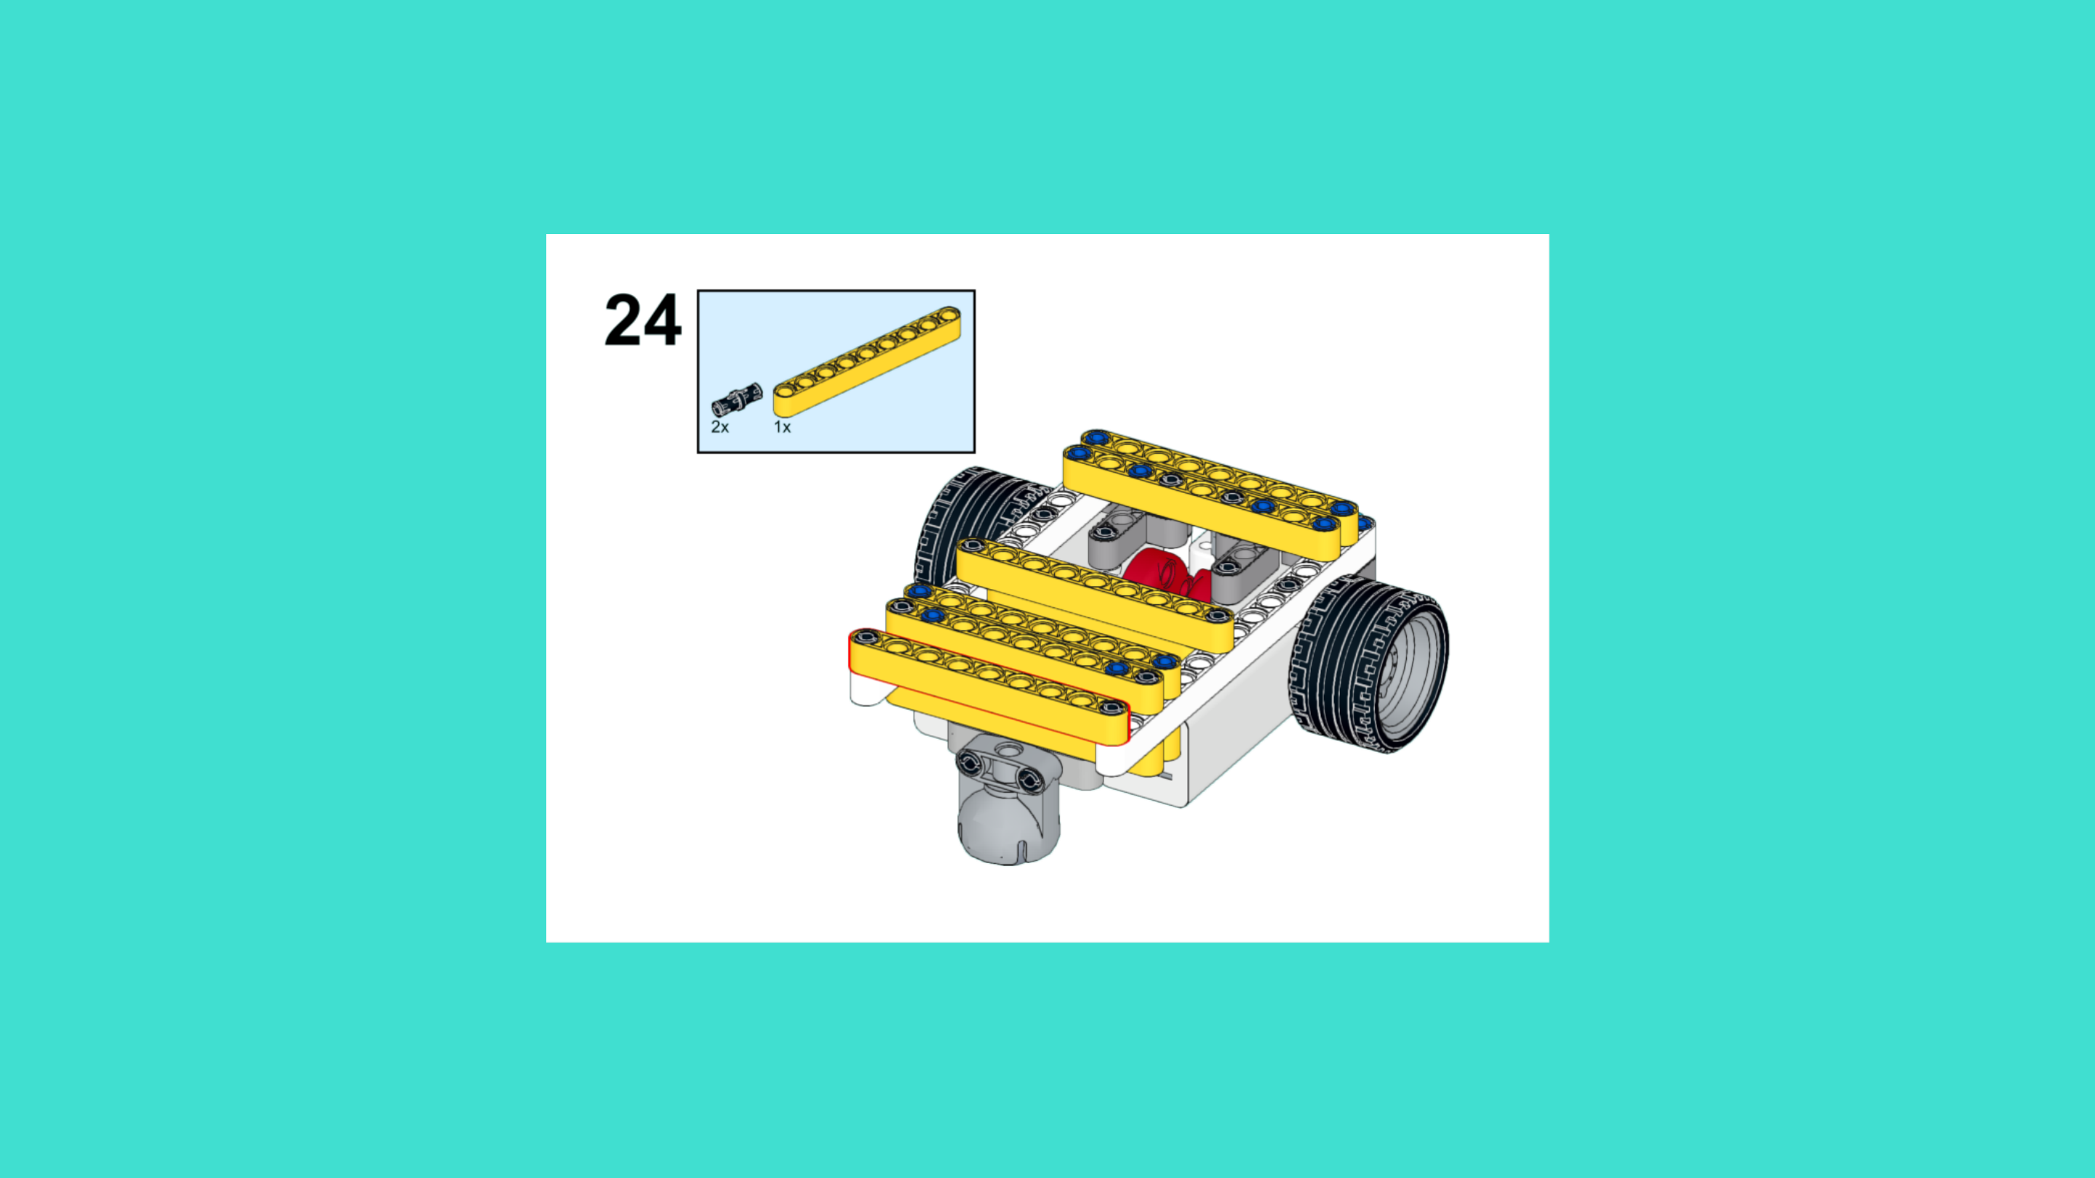
ASSEMBLY STEPS
STEP 22 – 24
PROGRESS: 36% COMPLETE (24 of 66 steps)
STEP 22
STEP 23
STEP 24
LUNAR LANDING ROVER · Techtelligence- Elecfreaks
8 / 22

Slide 11
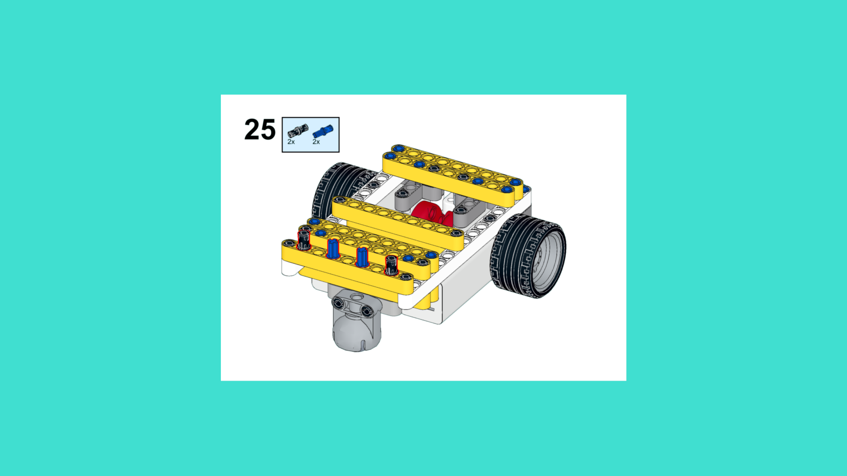
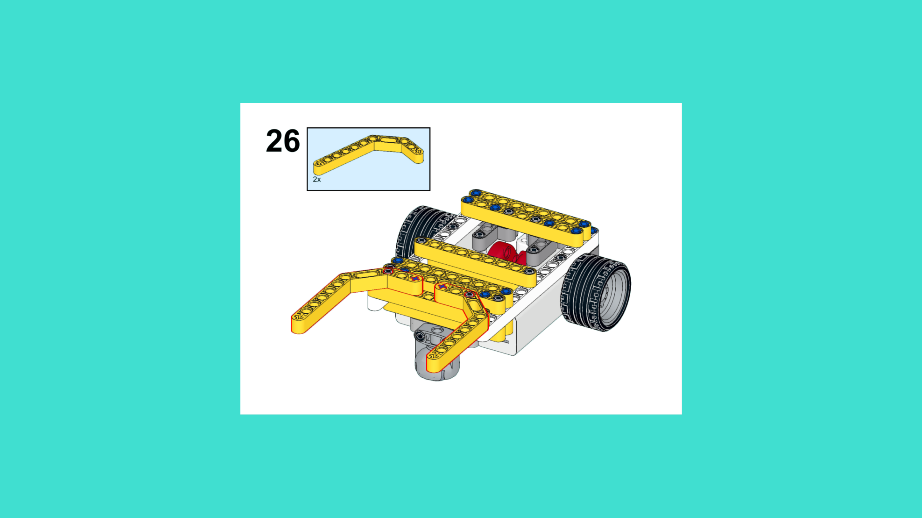
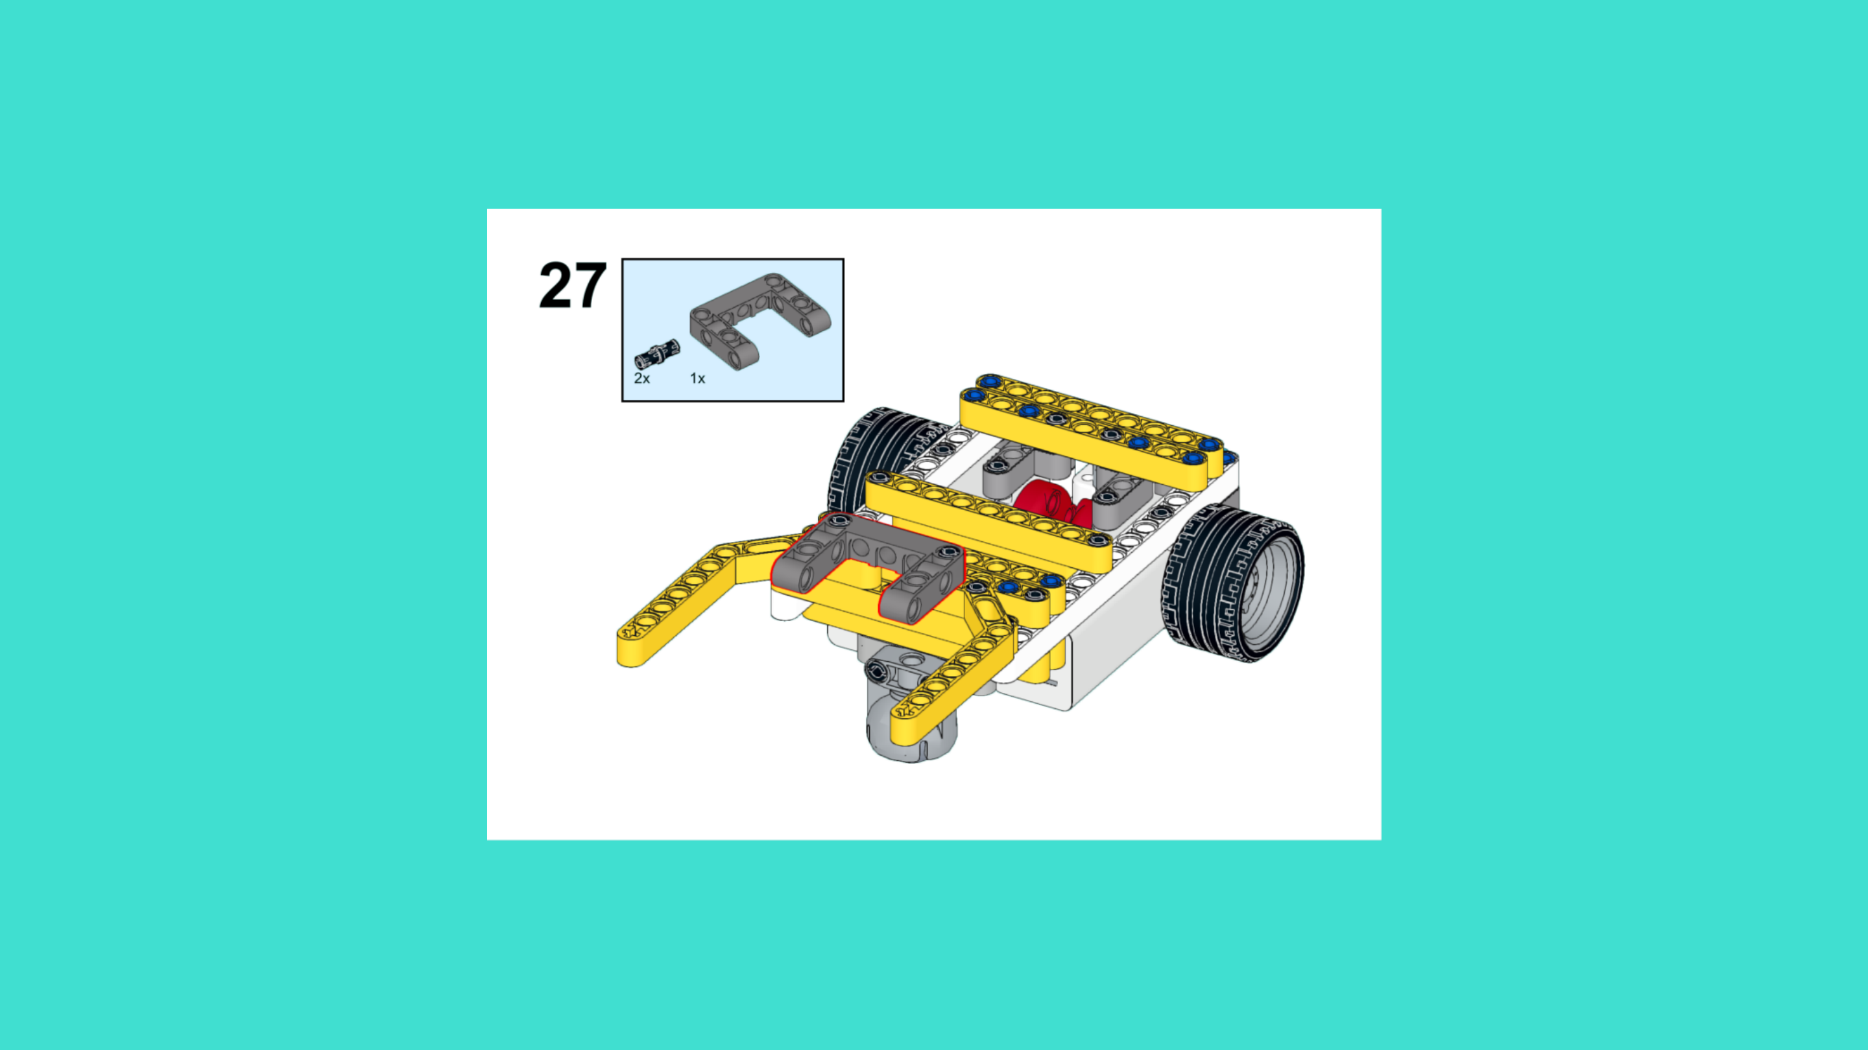
ASSEMBLY STEPS
STEP 25 – 27
PROGRESS: 41% COMPLETE (27 of 66 steps)
STEP 25
STEP 26
STEP 27
LUNAR LANDING ROVER · Techtelligence- Elecfreaks
9 / 22

Slide 12
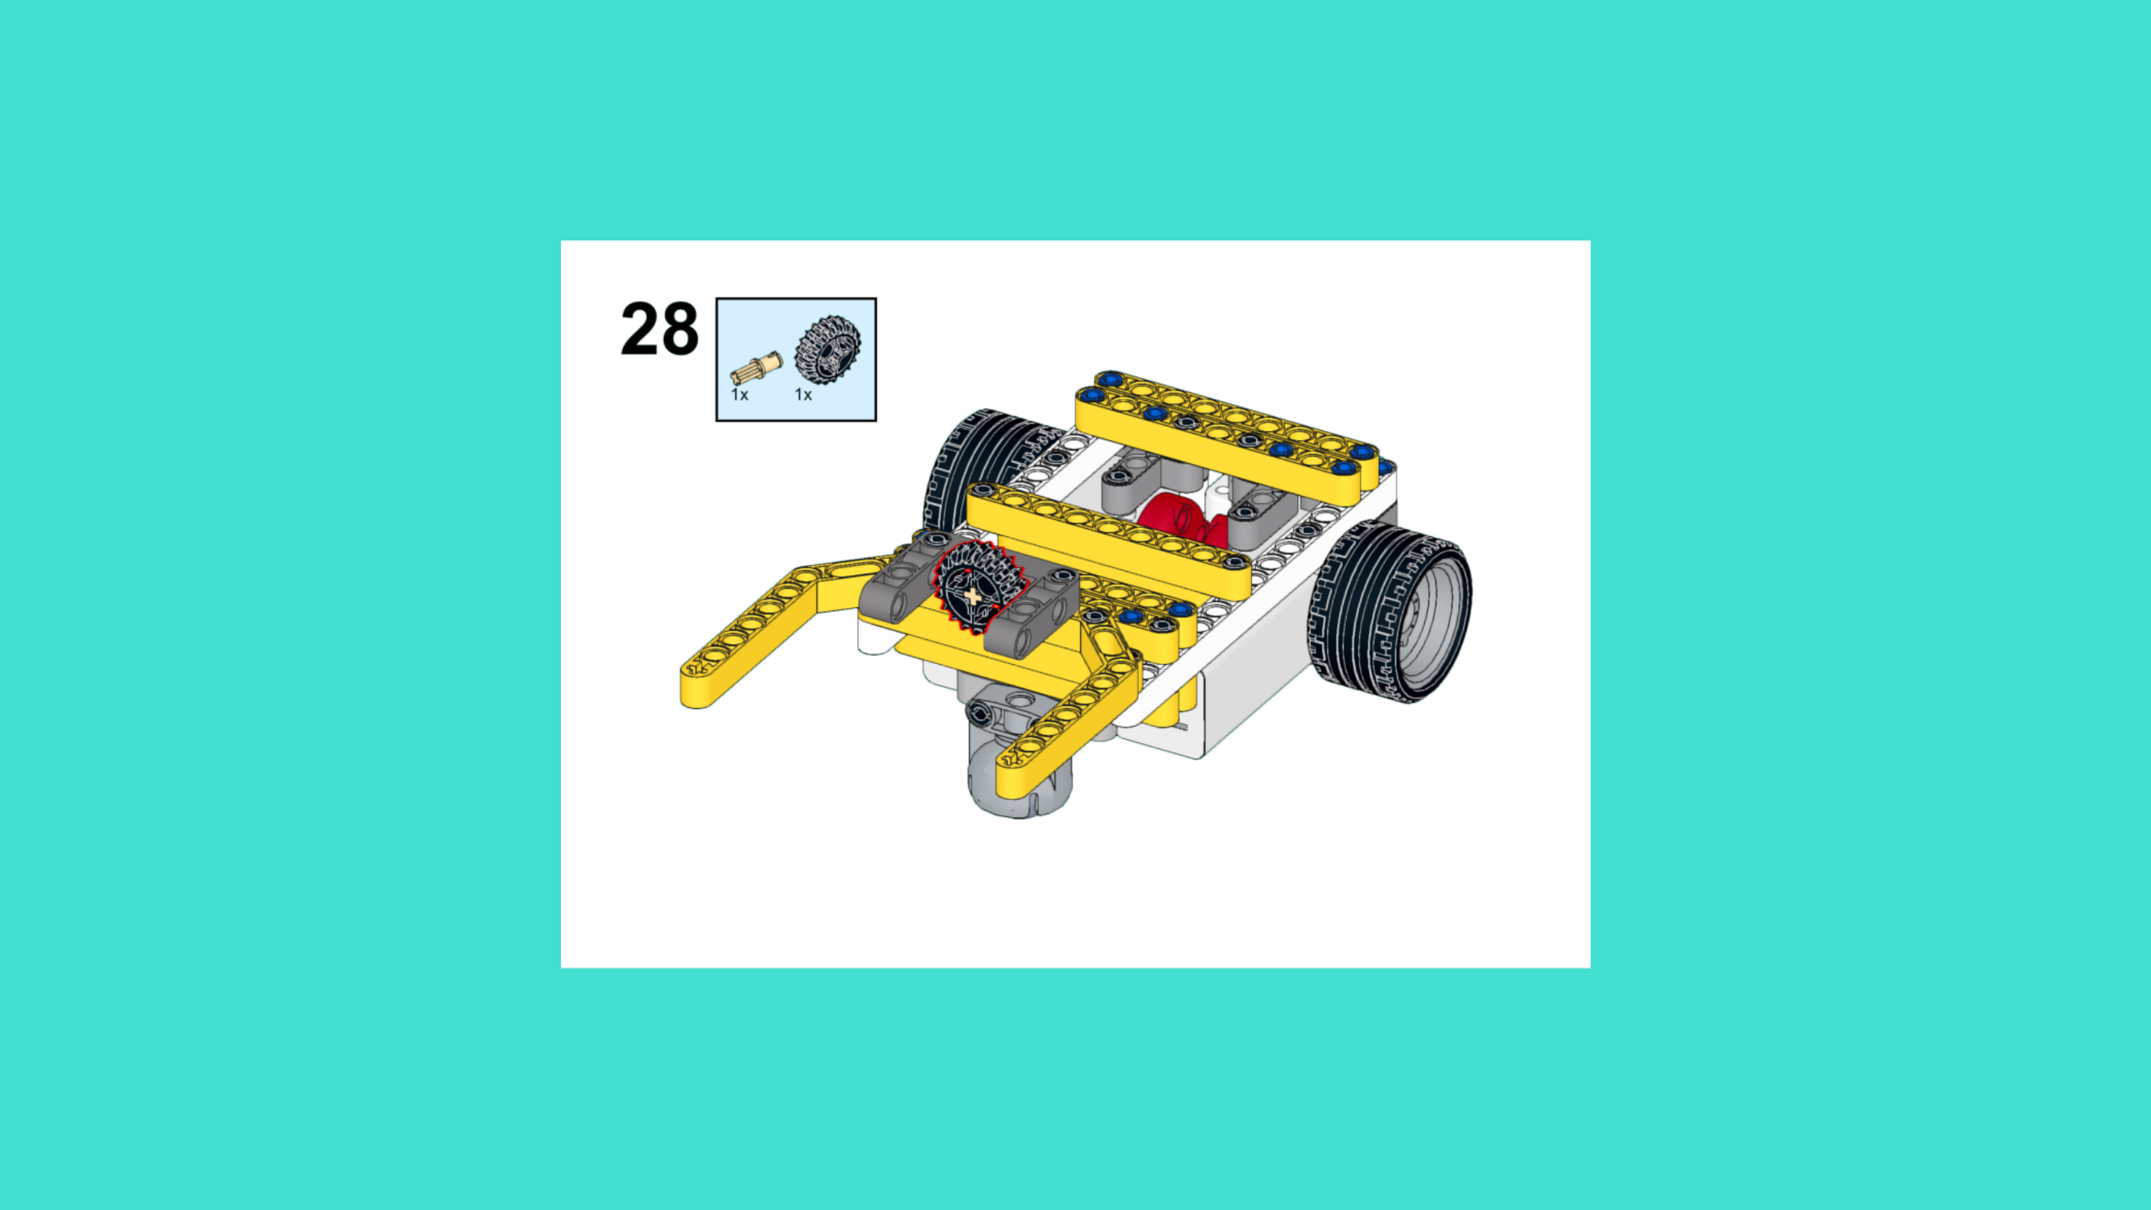
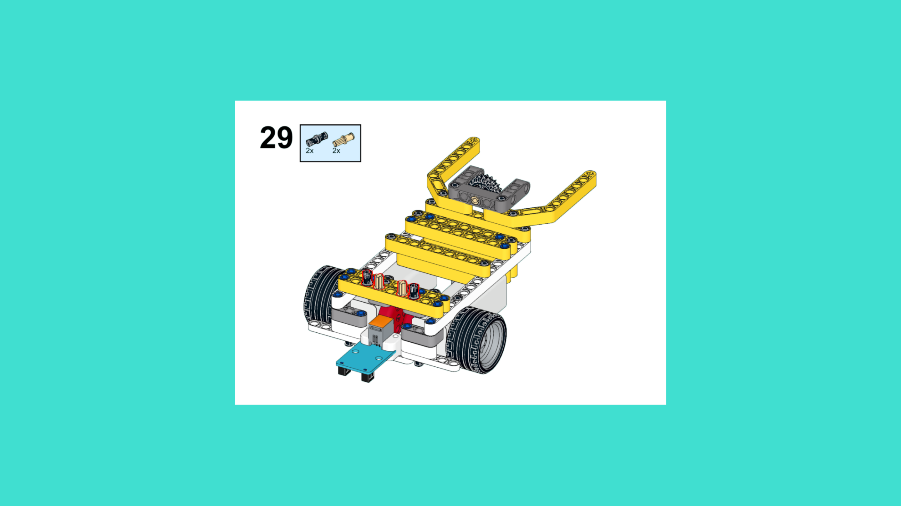
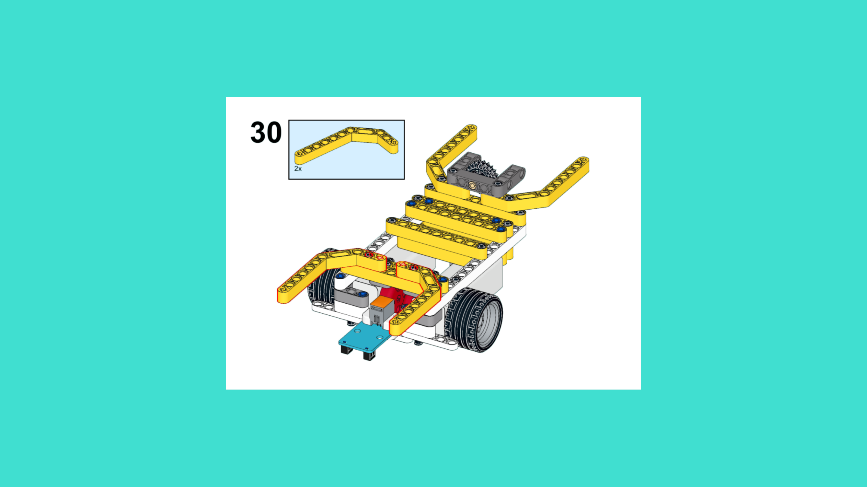
ASSEMBLY STEPS
STEP 28 – 30
PROGRESS: 45% COMPLETE (30 of 66 steps)
STEP 28
STEP 29
STEP 30
LUNAR LANDING ROVER · Techtelligence- Elecfreaks
10 / 22

Slide 13
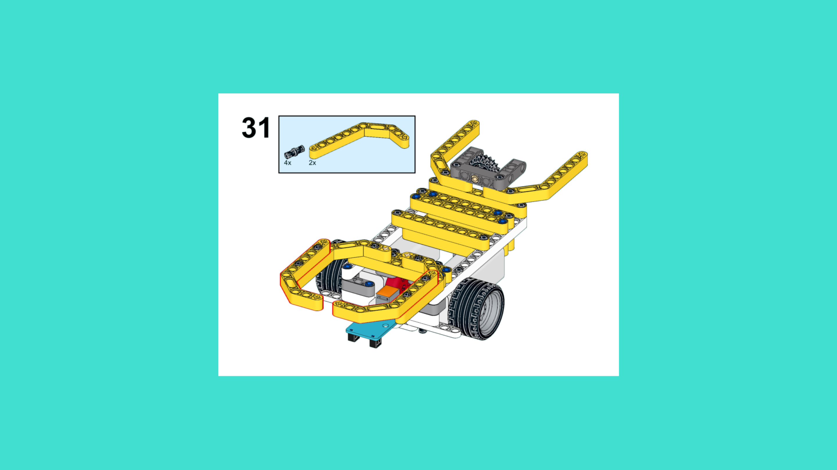
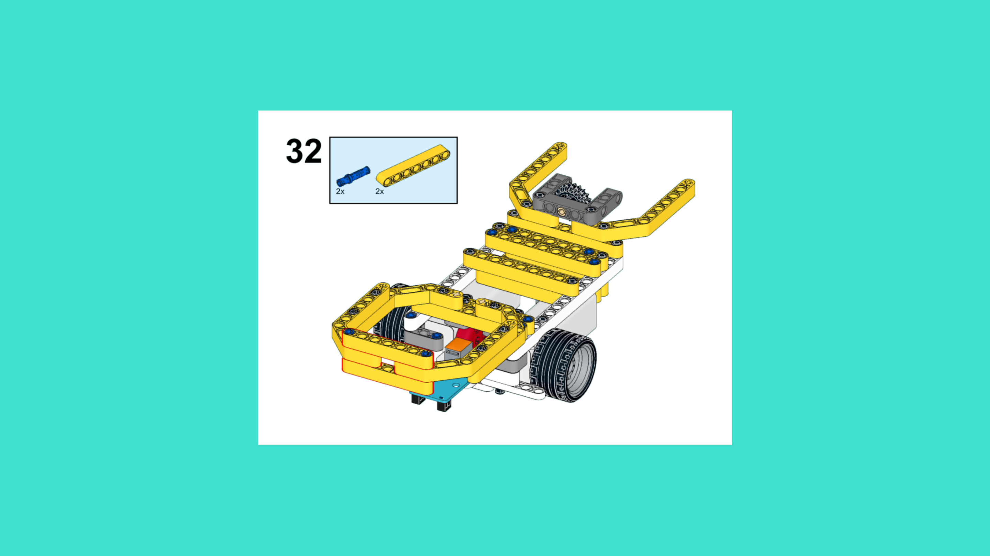
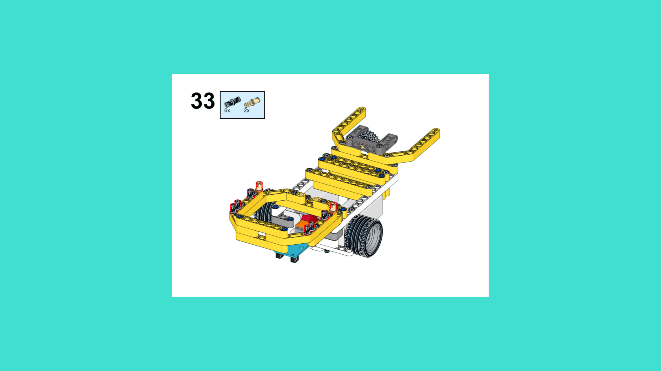
ASSEMBLY STEPS
STEP 31 – 33
PROGRESS: 50% COMPLETE (33 of 66 steps)
STEP 31
STEP 32
STEP 33
LUNAR LANDING ROVER · Techtelligence- Elecfreaks
11 / 22

Slide 14
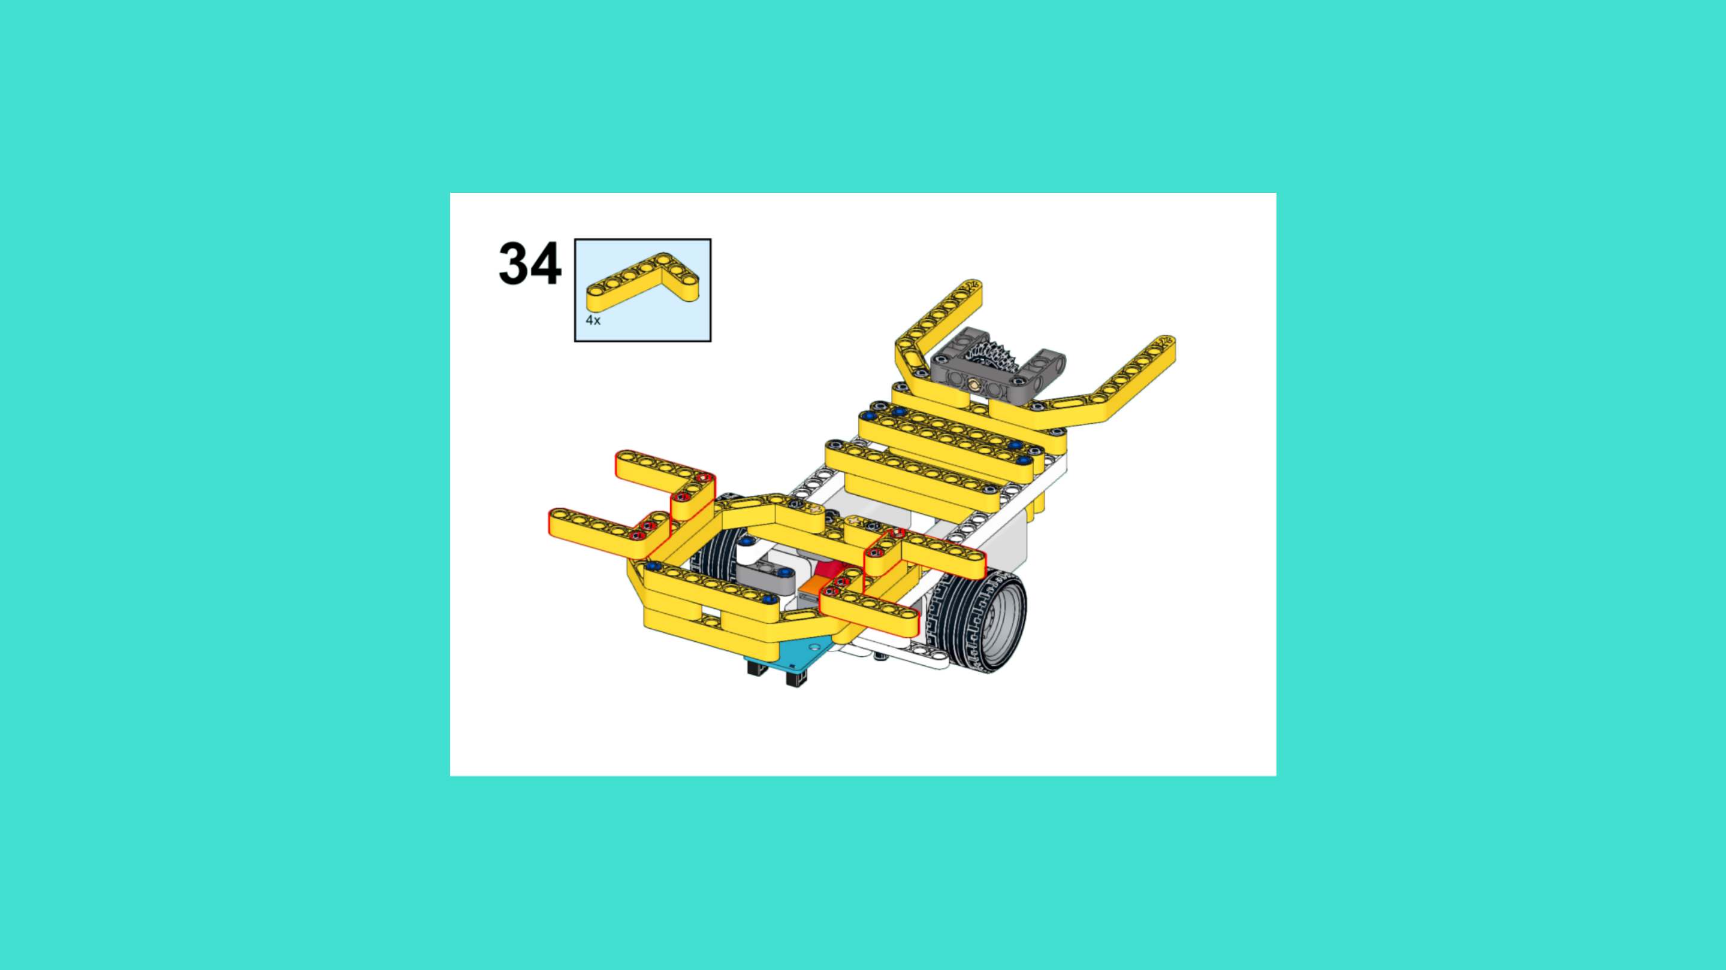
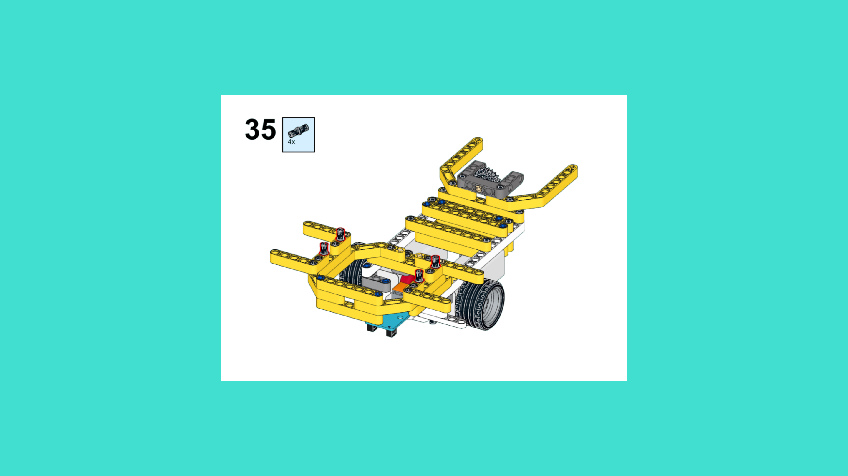

ASSEMBLY STEPS
STEP 34 – 36
PROGRESS: 55% COMPLETE (36 of 66 steps)
STEP 34
STEP 35
STEP 36
LUNAR LANDING ROVER · Techtelligence- Elecfreaks
12 / 22

Slide 15
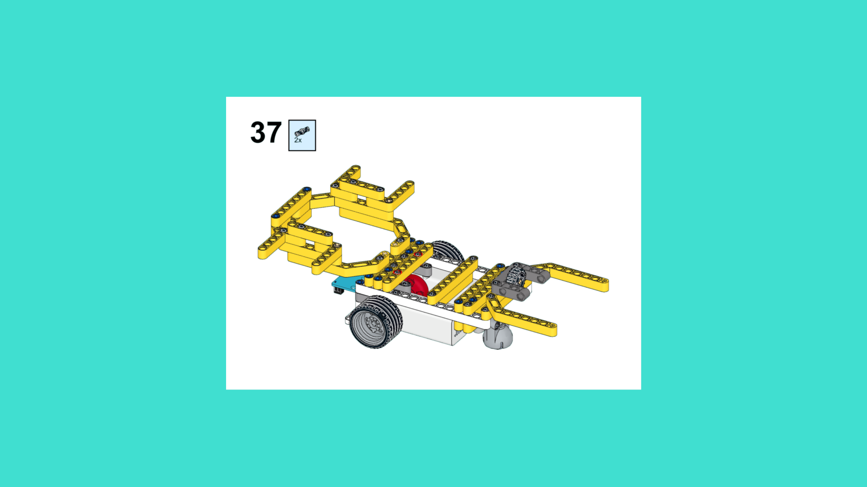
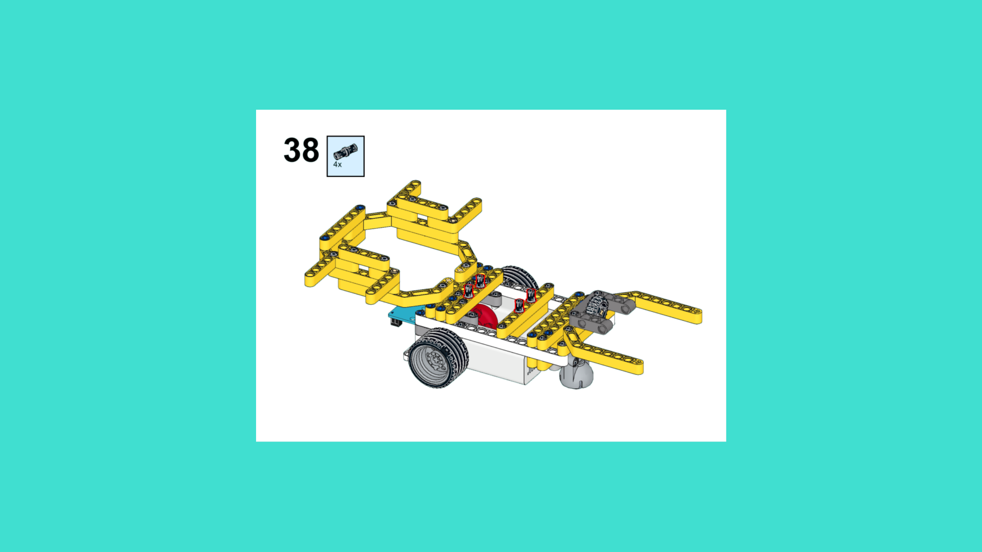
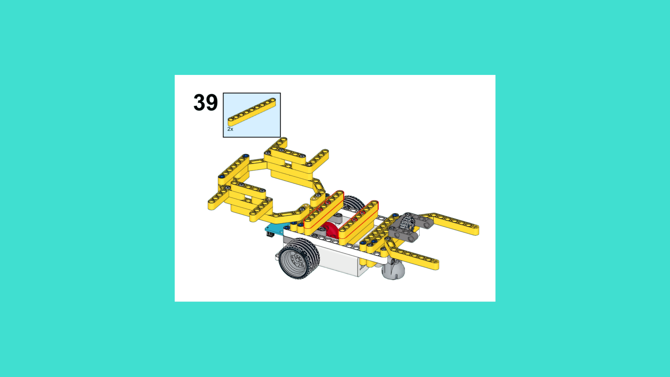
ASSEMBLY STEPS
STEP 37 – 39
PROGRESS: 59% COMPLETE (39 of 66 steps)
STEP 37
STEP 38
STEP 39
LUNAR LANDING ROVER · Techtelligence- Elecfreaks
13 / 22

Slide 16
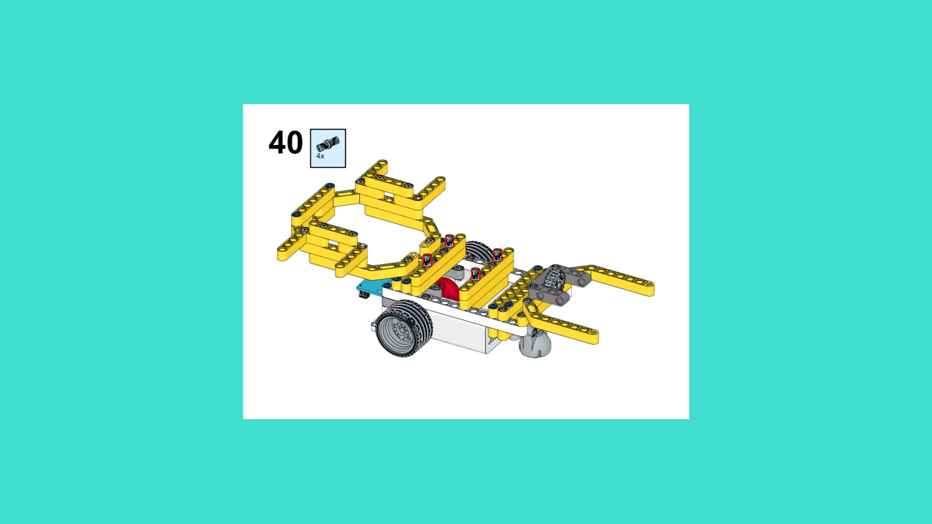
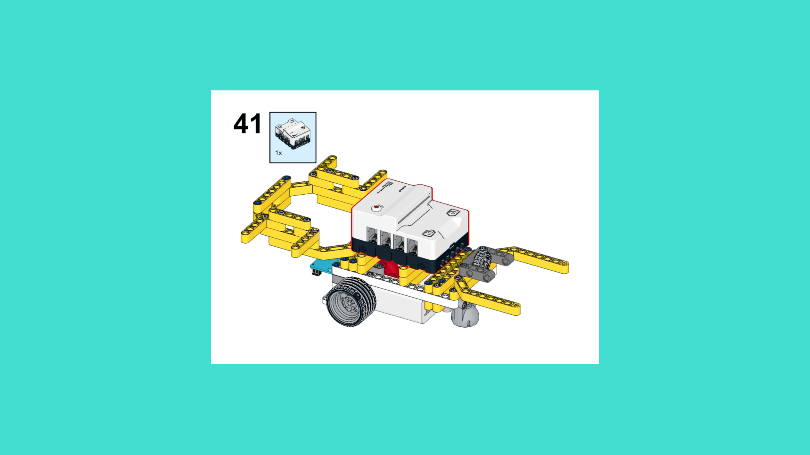
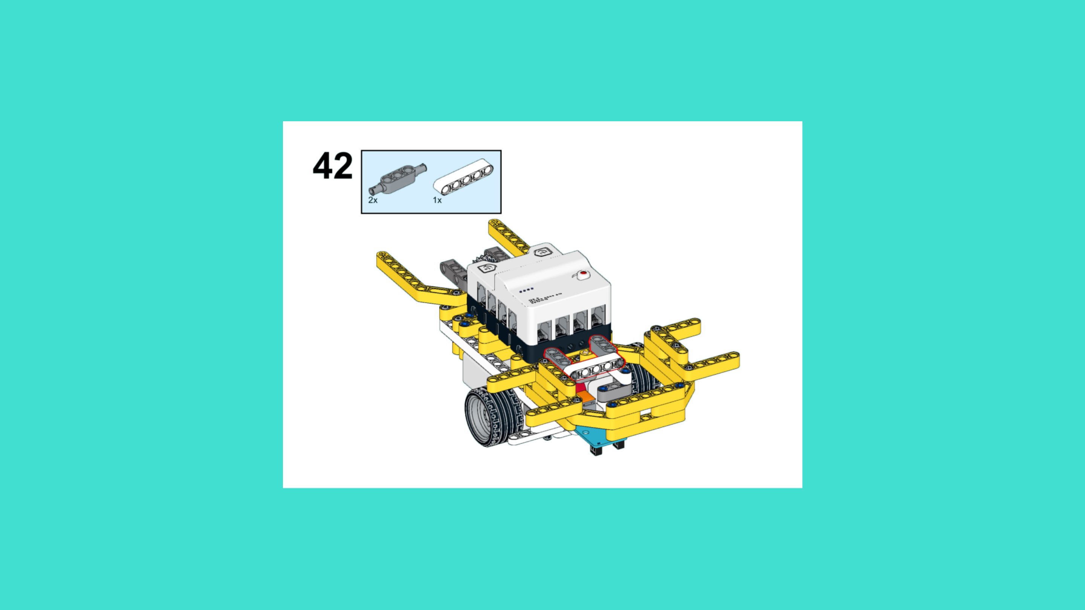
ASSEMBLY STEPS
STEP 40 – 42
PROGRESS: 64% COMPLETE (42 of 66 steps)
STEP 40
STEP 41
STEP 42
LUNAR LANDING ROVER · Techtelligence- Elecfreaks
14 / 22

Slide 17
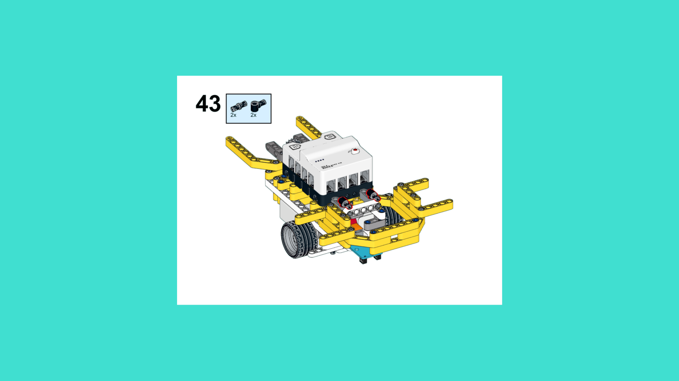
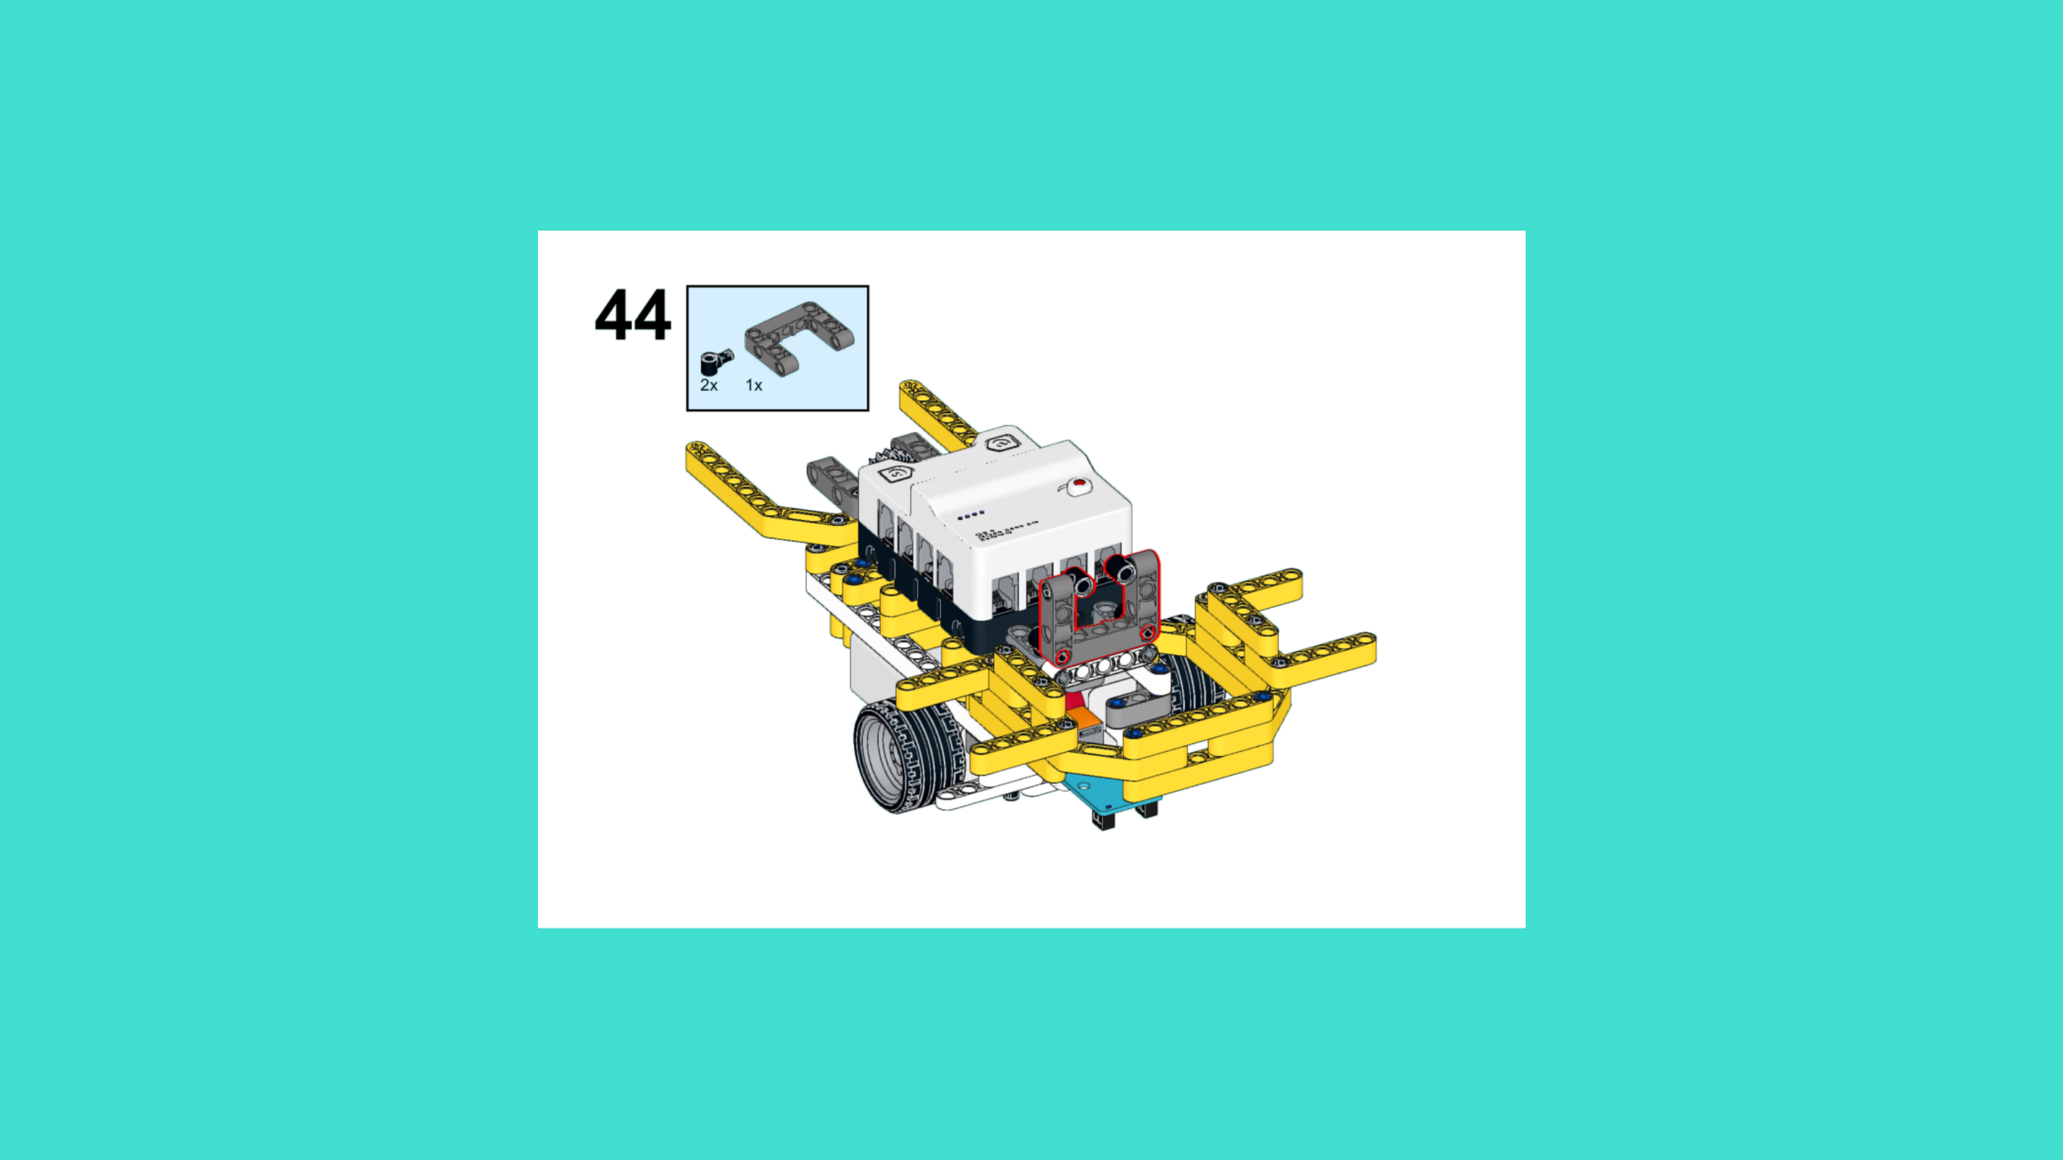
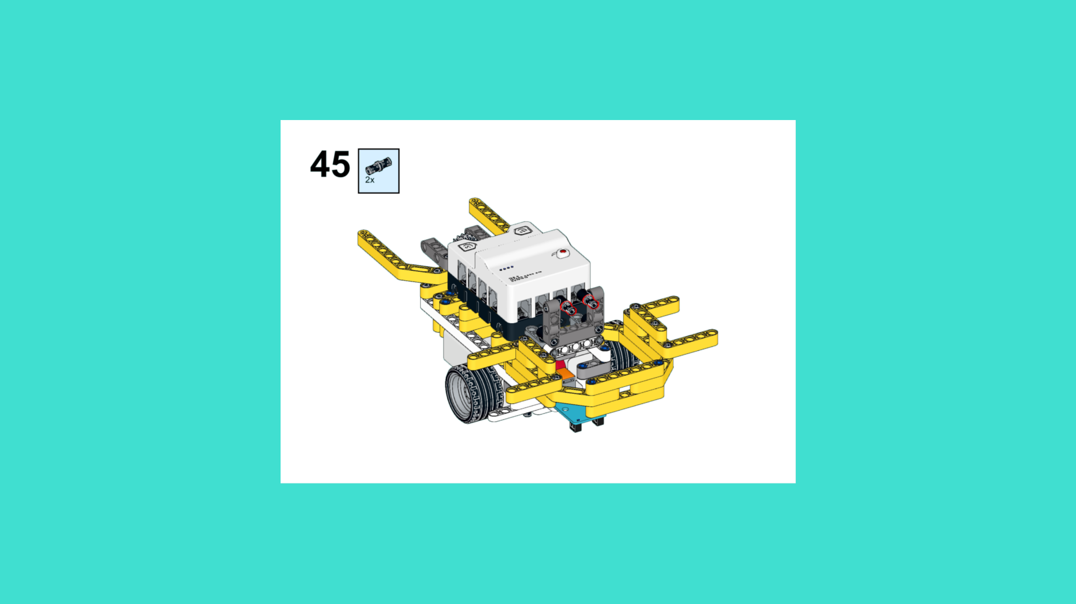
ASSEMBLY STEPS
STEP 43 – 45
PROGRESS: 68% COMPLETE (45 of 66 steps)
STEP 43
STEP 44
STEP 45
LUNAR LANDING ROVER · Techtelligence- Elecfreaks
15 / 22

Slide 18
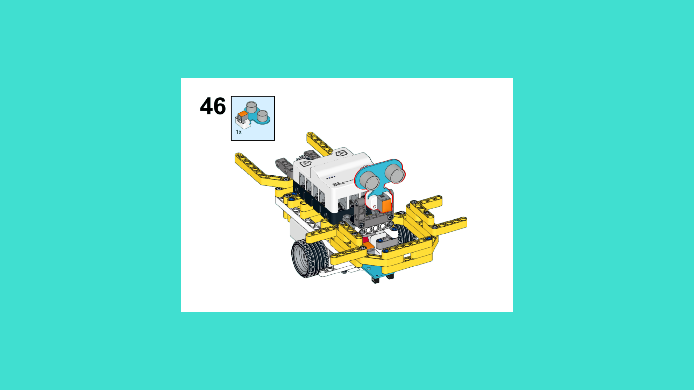
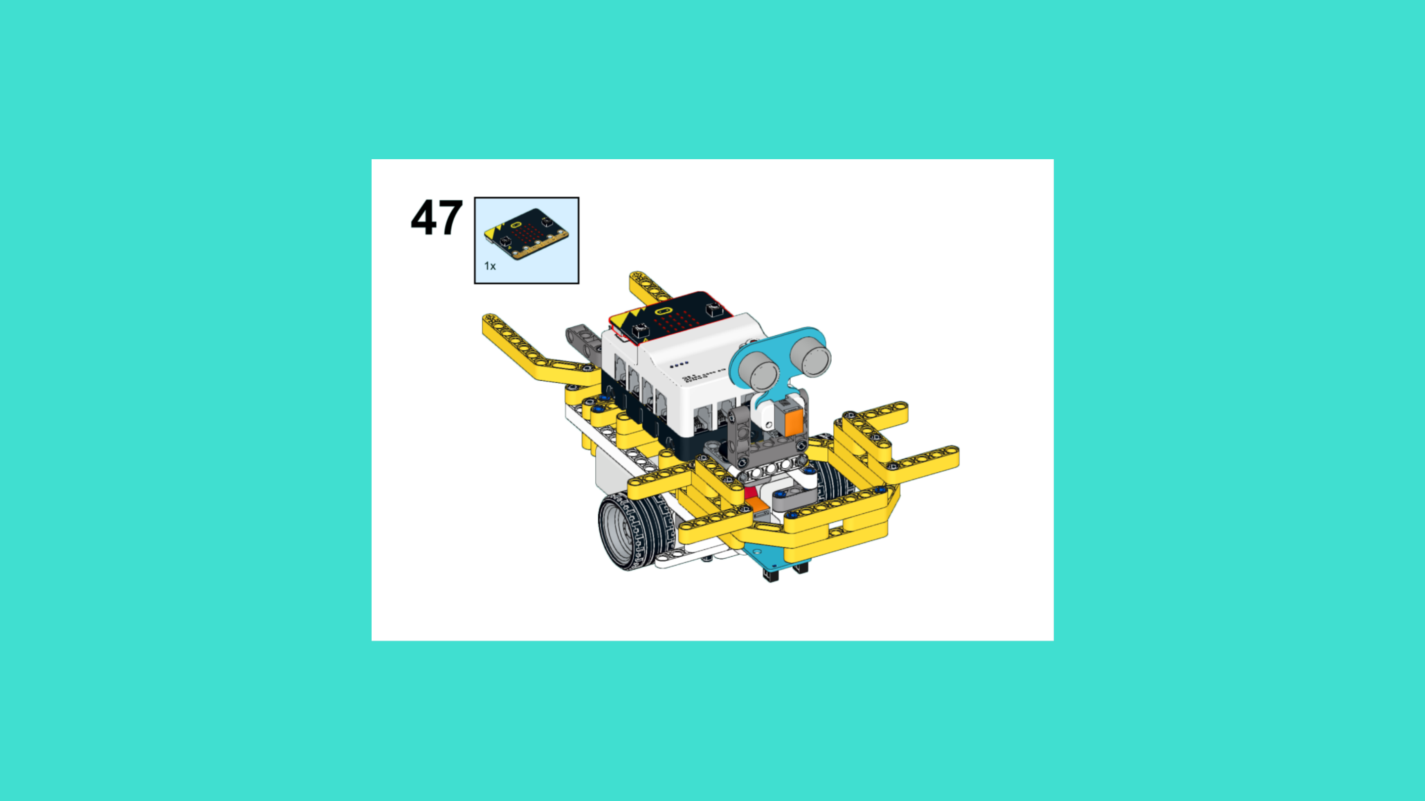
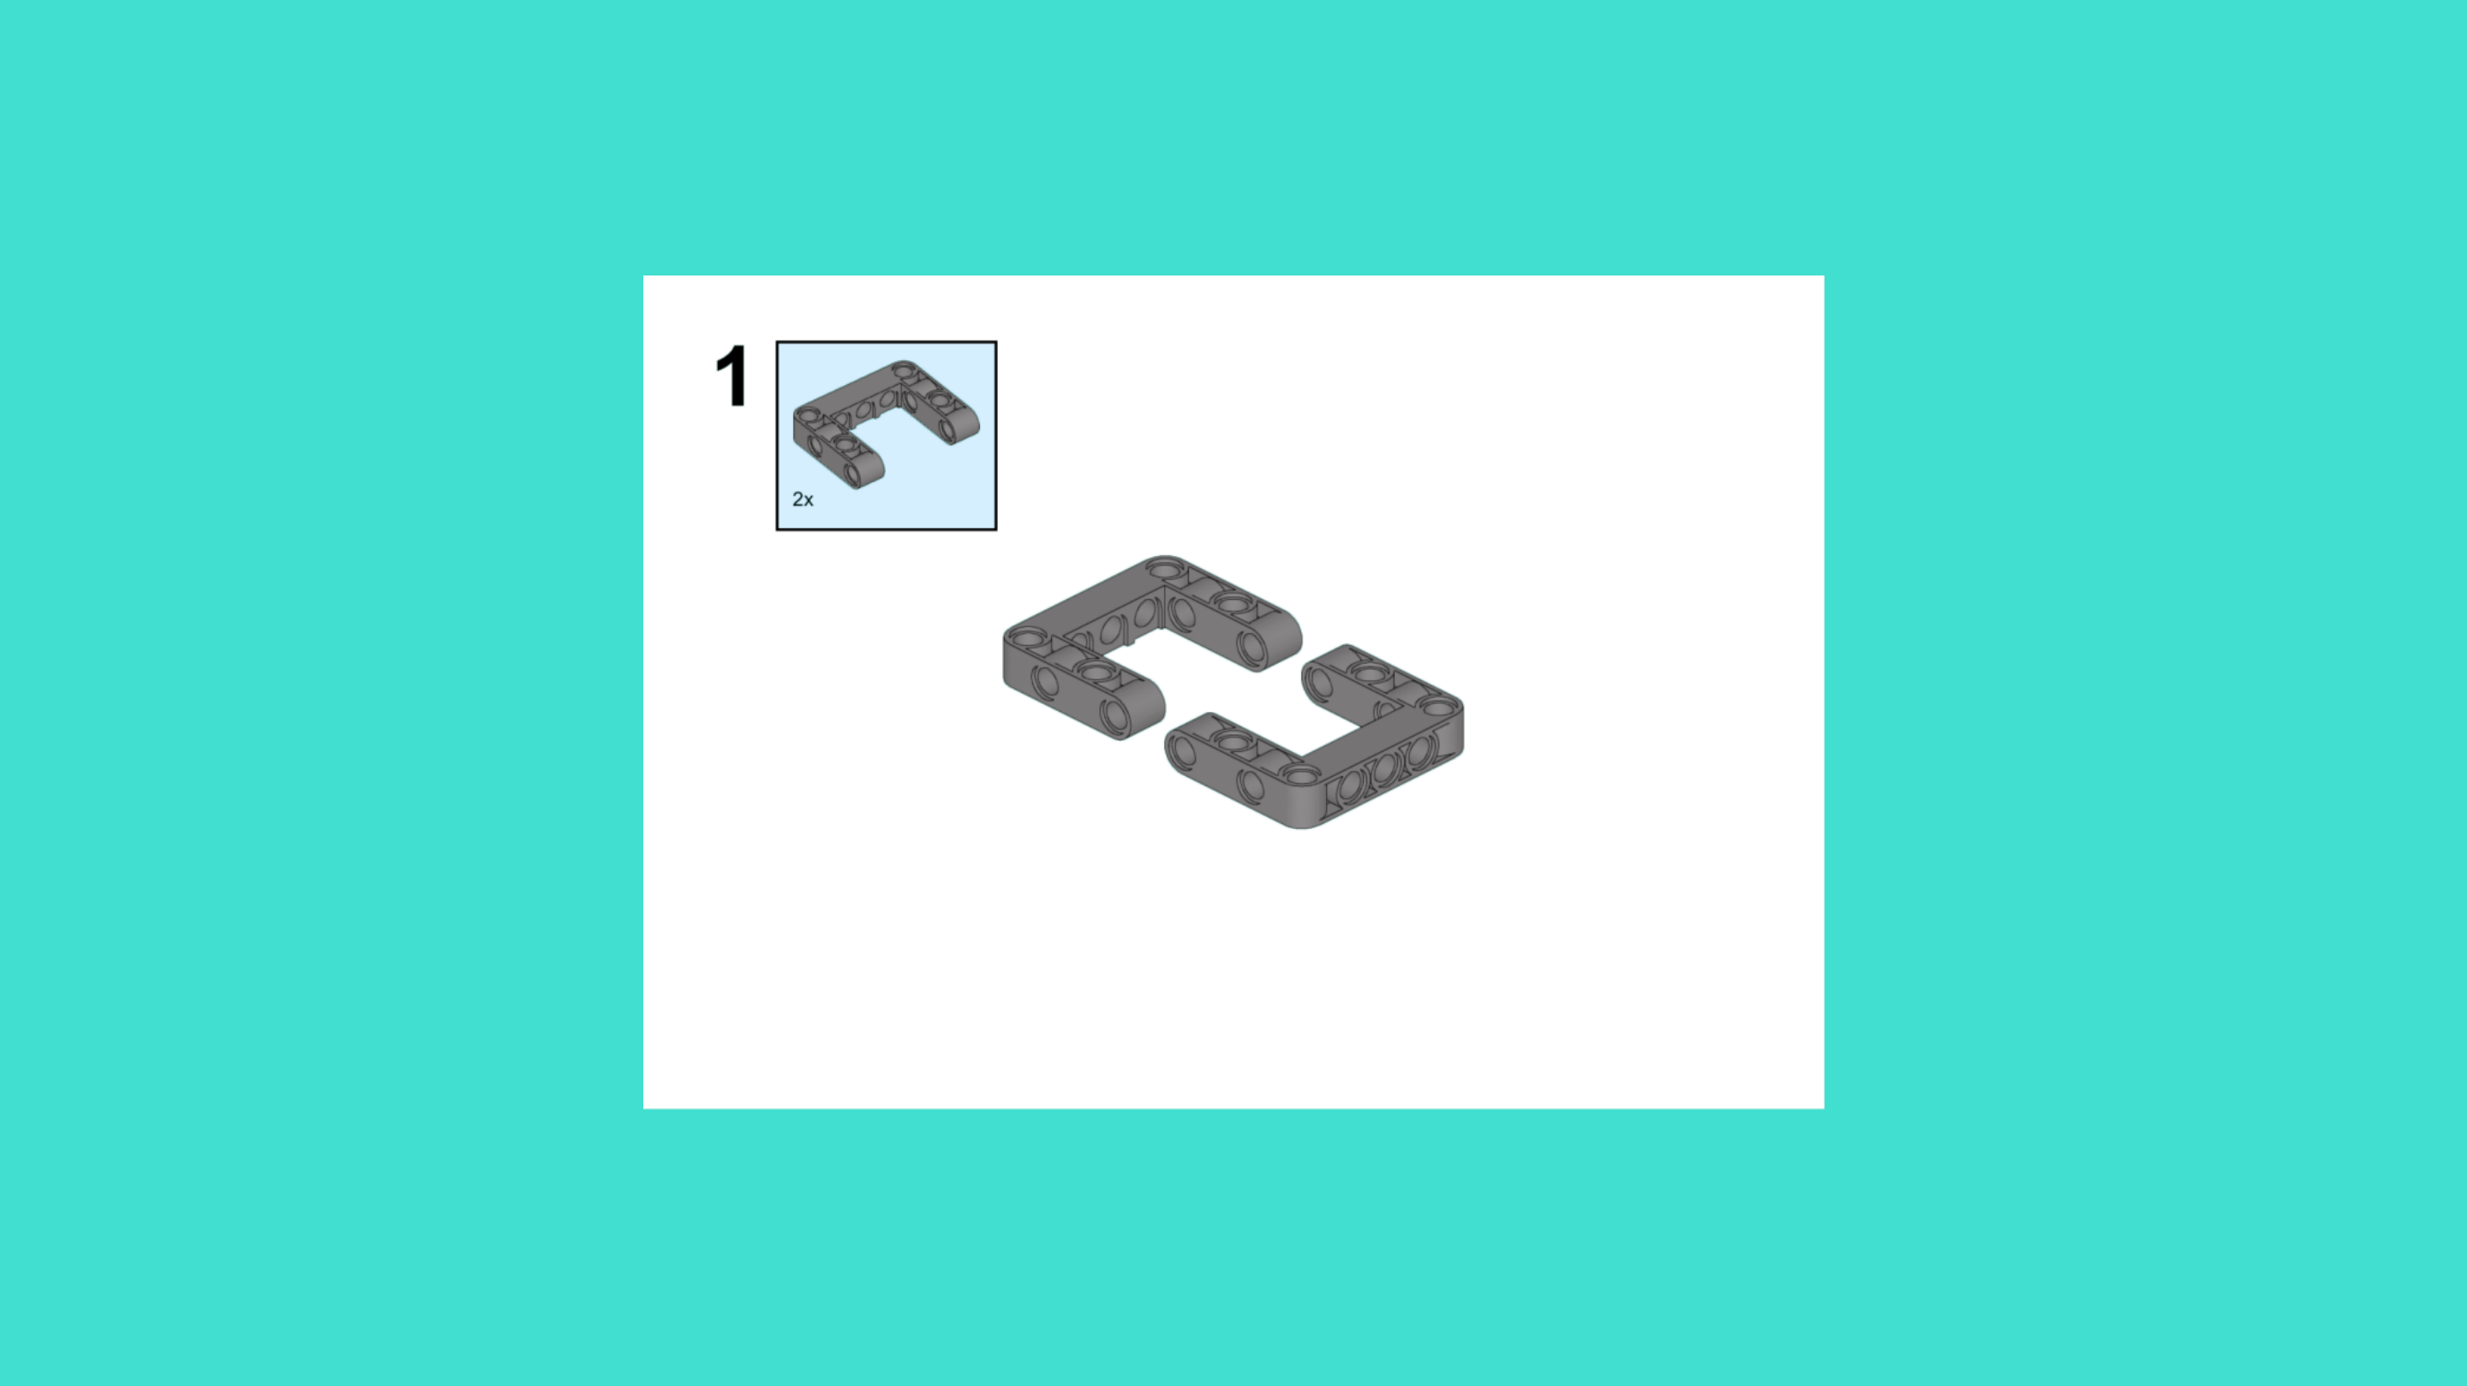
ASSEMBLY STEPS
STEP 46 – 48
PROGRESS: 73% COMPLETE (48 of 66 steps)
STEP 46
STEP 47
STEP 48
LUNAR LANDING ROVER · Techtelligence- Elecfreaks
16 / 22

Slide 19
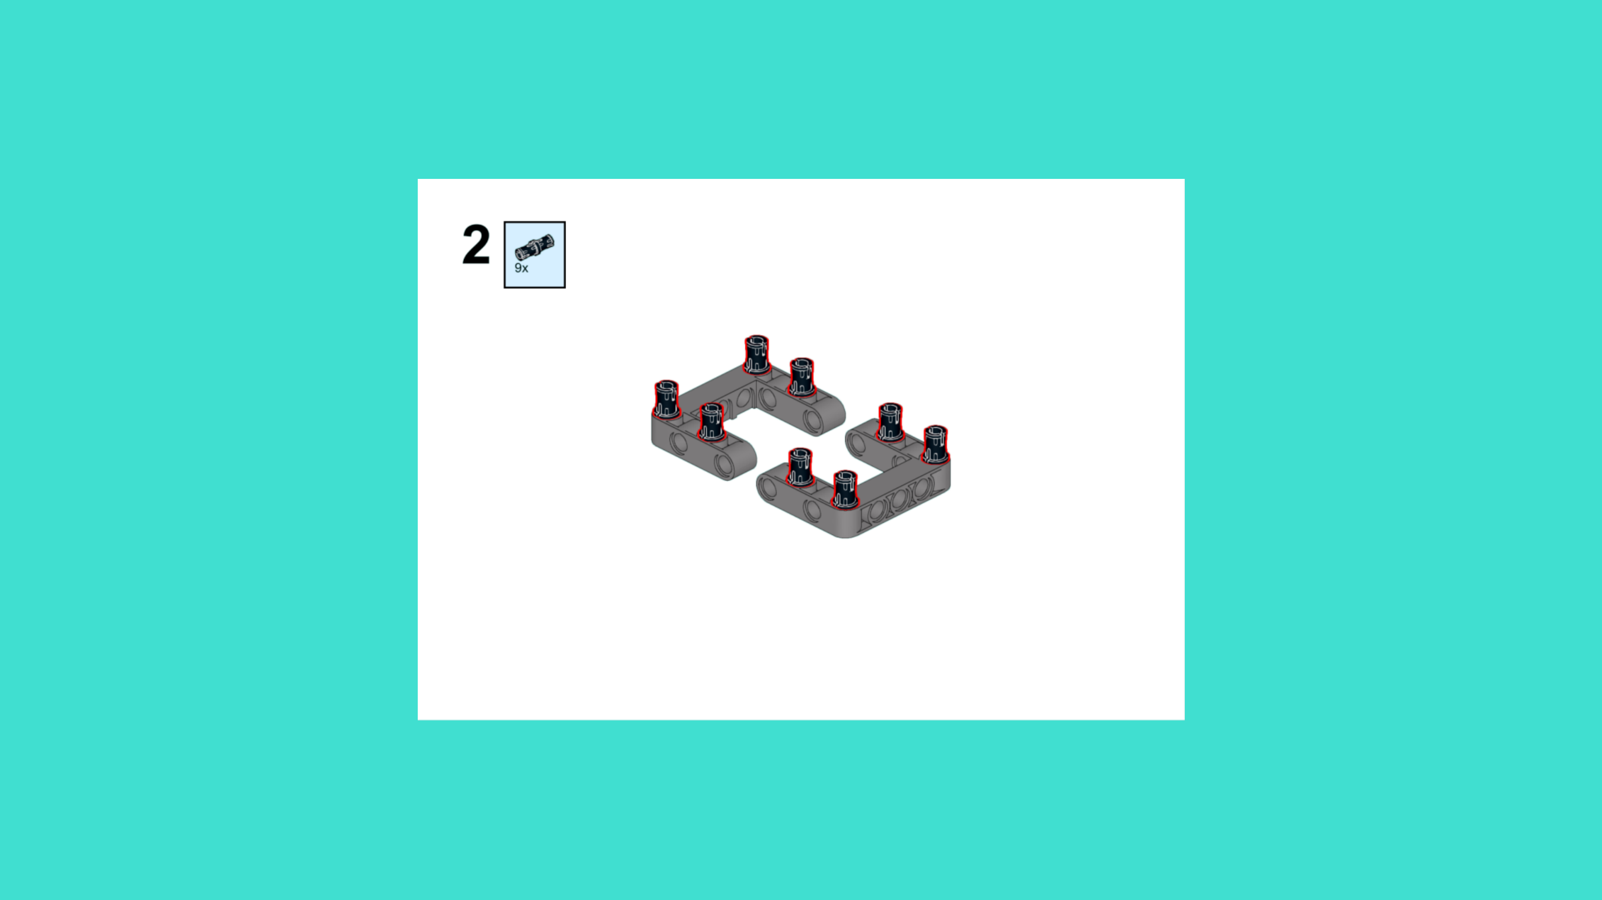
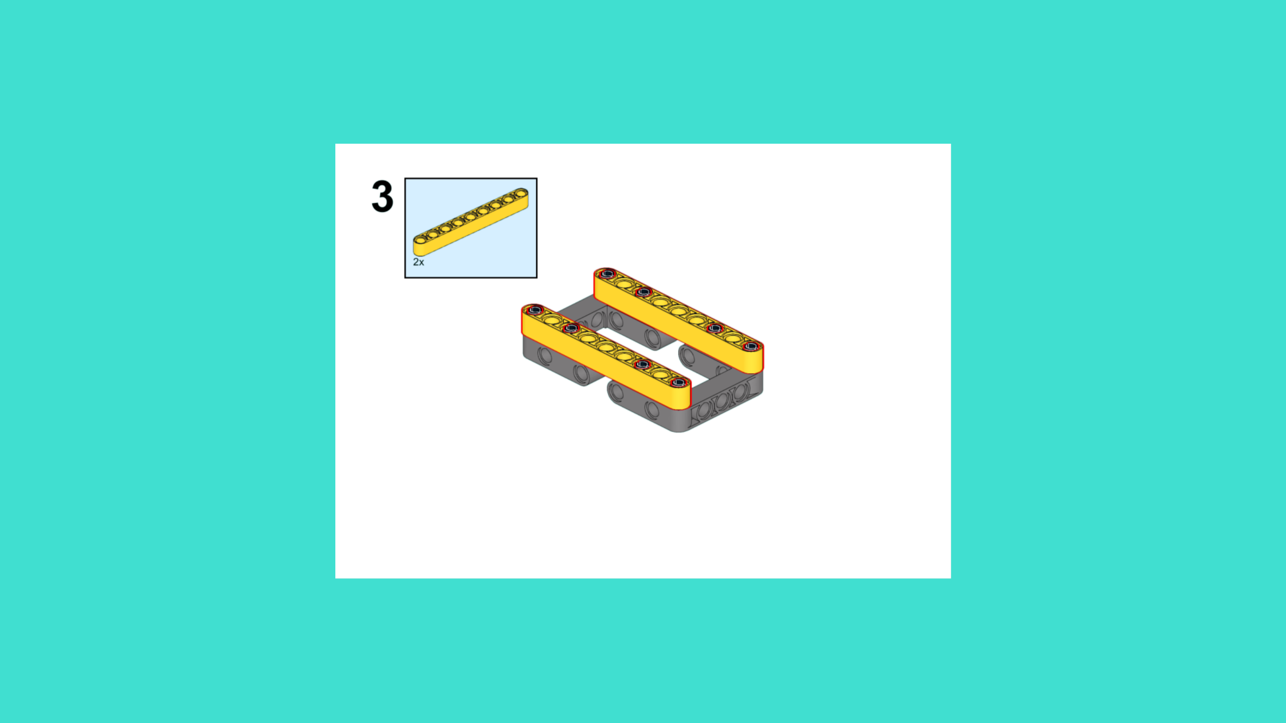
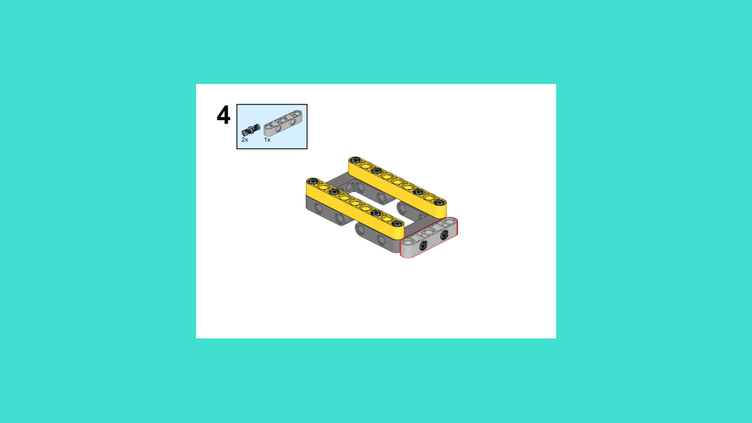
ASSEMBLY STEPS
STEP 49 – 51
PROGRESS: 77% COMPLETE (51 of 66 steps)
STEP 49
STEP 50
STEP 51
LUNAR LANDING ROVER · Techtelligence- Elecfreaks
17 / 22

Slide 20
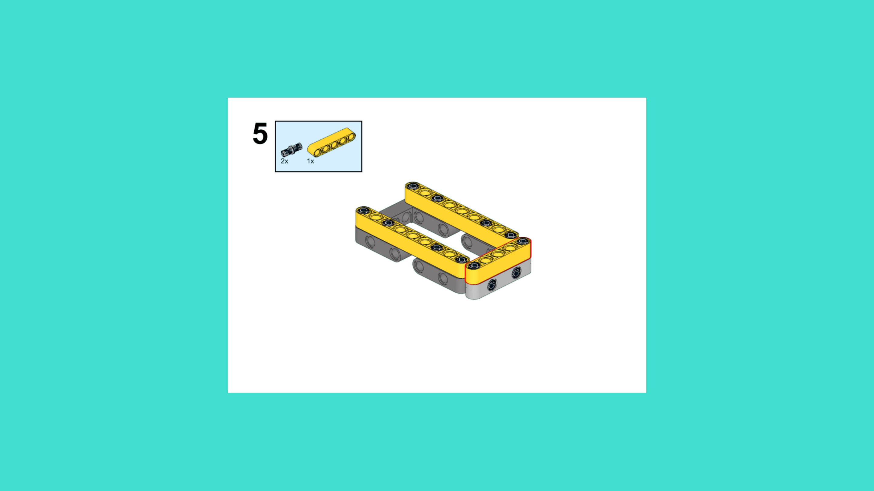


ASSEMBLY STEPS
STEP 52 – 54
PROGRESS: 82% COMPLETE (54 of 66 steps)
STEP 52
STEP 53
STEP 54
LUNAR LANDING ROVER · Techtelligence- Elecfreaks
18 / 22

Slide 21



ASSEMBLY STEPS
STEP 55 – 57
PROGRESS: 86% COMPLETE (57 of 66 steps)
STEP 55
STEP 56
STEP 57
LUNAR LANDING ROVER · Techtelligence- Elecfreaks
19 / 22

Slide 22



ASSEMBLY STEPS
STEP 58 – 60
PROGRESS: 91% COMPLETE (60 of 66 steps)
STEP 58
STEP 59
STEP 60
LUNAR LANDING ROVER · Techtelligence- Elecfreaks
20 / 22

Slide 23


ASSEMBLY STEPS
STEP 61 – 63
PROGRESS: 95% COMPLETE (63 of 66 steps)
STEP 61
STEP 62
STEP 63
LUNAR LANDING ROVER · Techtelligence- Elecfreaks
21 / 22

Slide 24
ASSEMBLY STEPS
STEP 64 – 66
PROGRESS: 100% COMPLETE (66 of 66 steps)
STEP 64
STEP 65
STEP 66
LUNAR LANDING ROVER · Techtelligence- Elecfreaks
22 / 22

Slide 25
ASSEMBLY
COMPLETE
66 STEPS · LUNAR LANDING ROVER · Techtelligence- Elecfreaks
66
22
100%
TOTAL STEPS
SLIDE SECTIONS
COMPLETE

