Slide 1
CASE 04
THE
LANDER
ASSEMBLY GUIDE · SPACE SCIENCE KIT · Techtelligence- Elecfreaks
30 STEPS
TOTAL

Slide 2
DESIGN BRIEF
OBJECTIVE
Build a precision lunar lander module with deployable landing legs and payload bay. This compact 30-step build introduces students to structural engineering and soft-landing mechanics used in real space missions.
DESIGN PRINCIPLES
01. Structural Integrity
Robust modular frame construction ensures stability throughout the entire assembly and operation.
02. Step-by-Step Build
Sequential instruction design guides students from individual components to a complete working model.
03. STEM Integration
Hands-on mechanics reinforce space science, engineering, and robotics concepts at every stage.
04. Scalable Design
Standardised connectors and components allow for reconfiguration and adaptation of the final model.
Techtelligence- Elecfreaks · THE LANDER

Slide 3
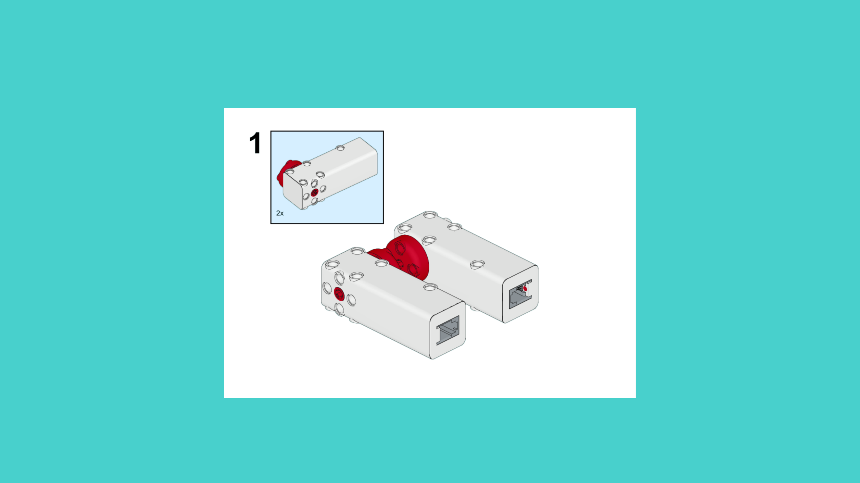
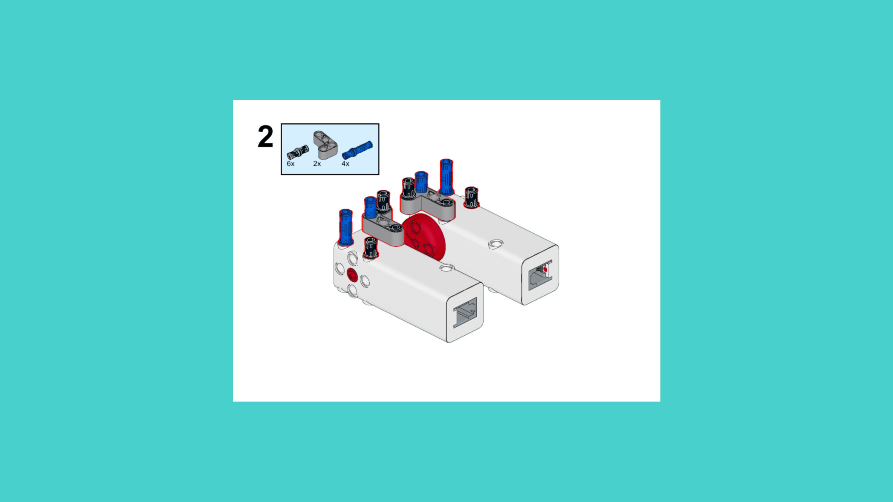
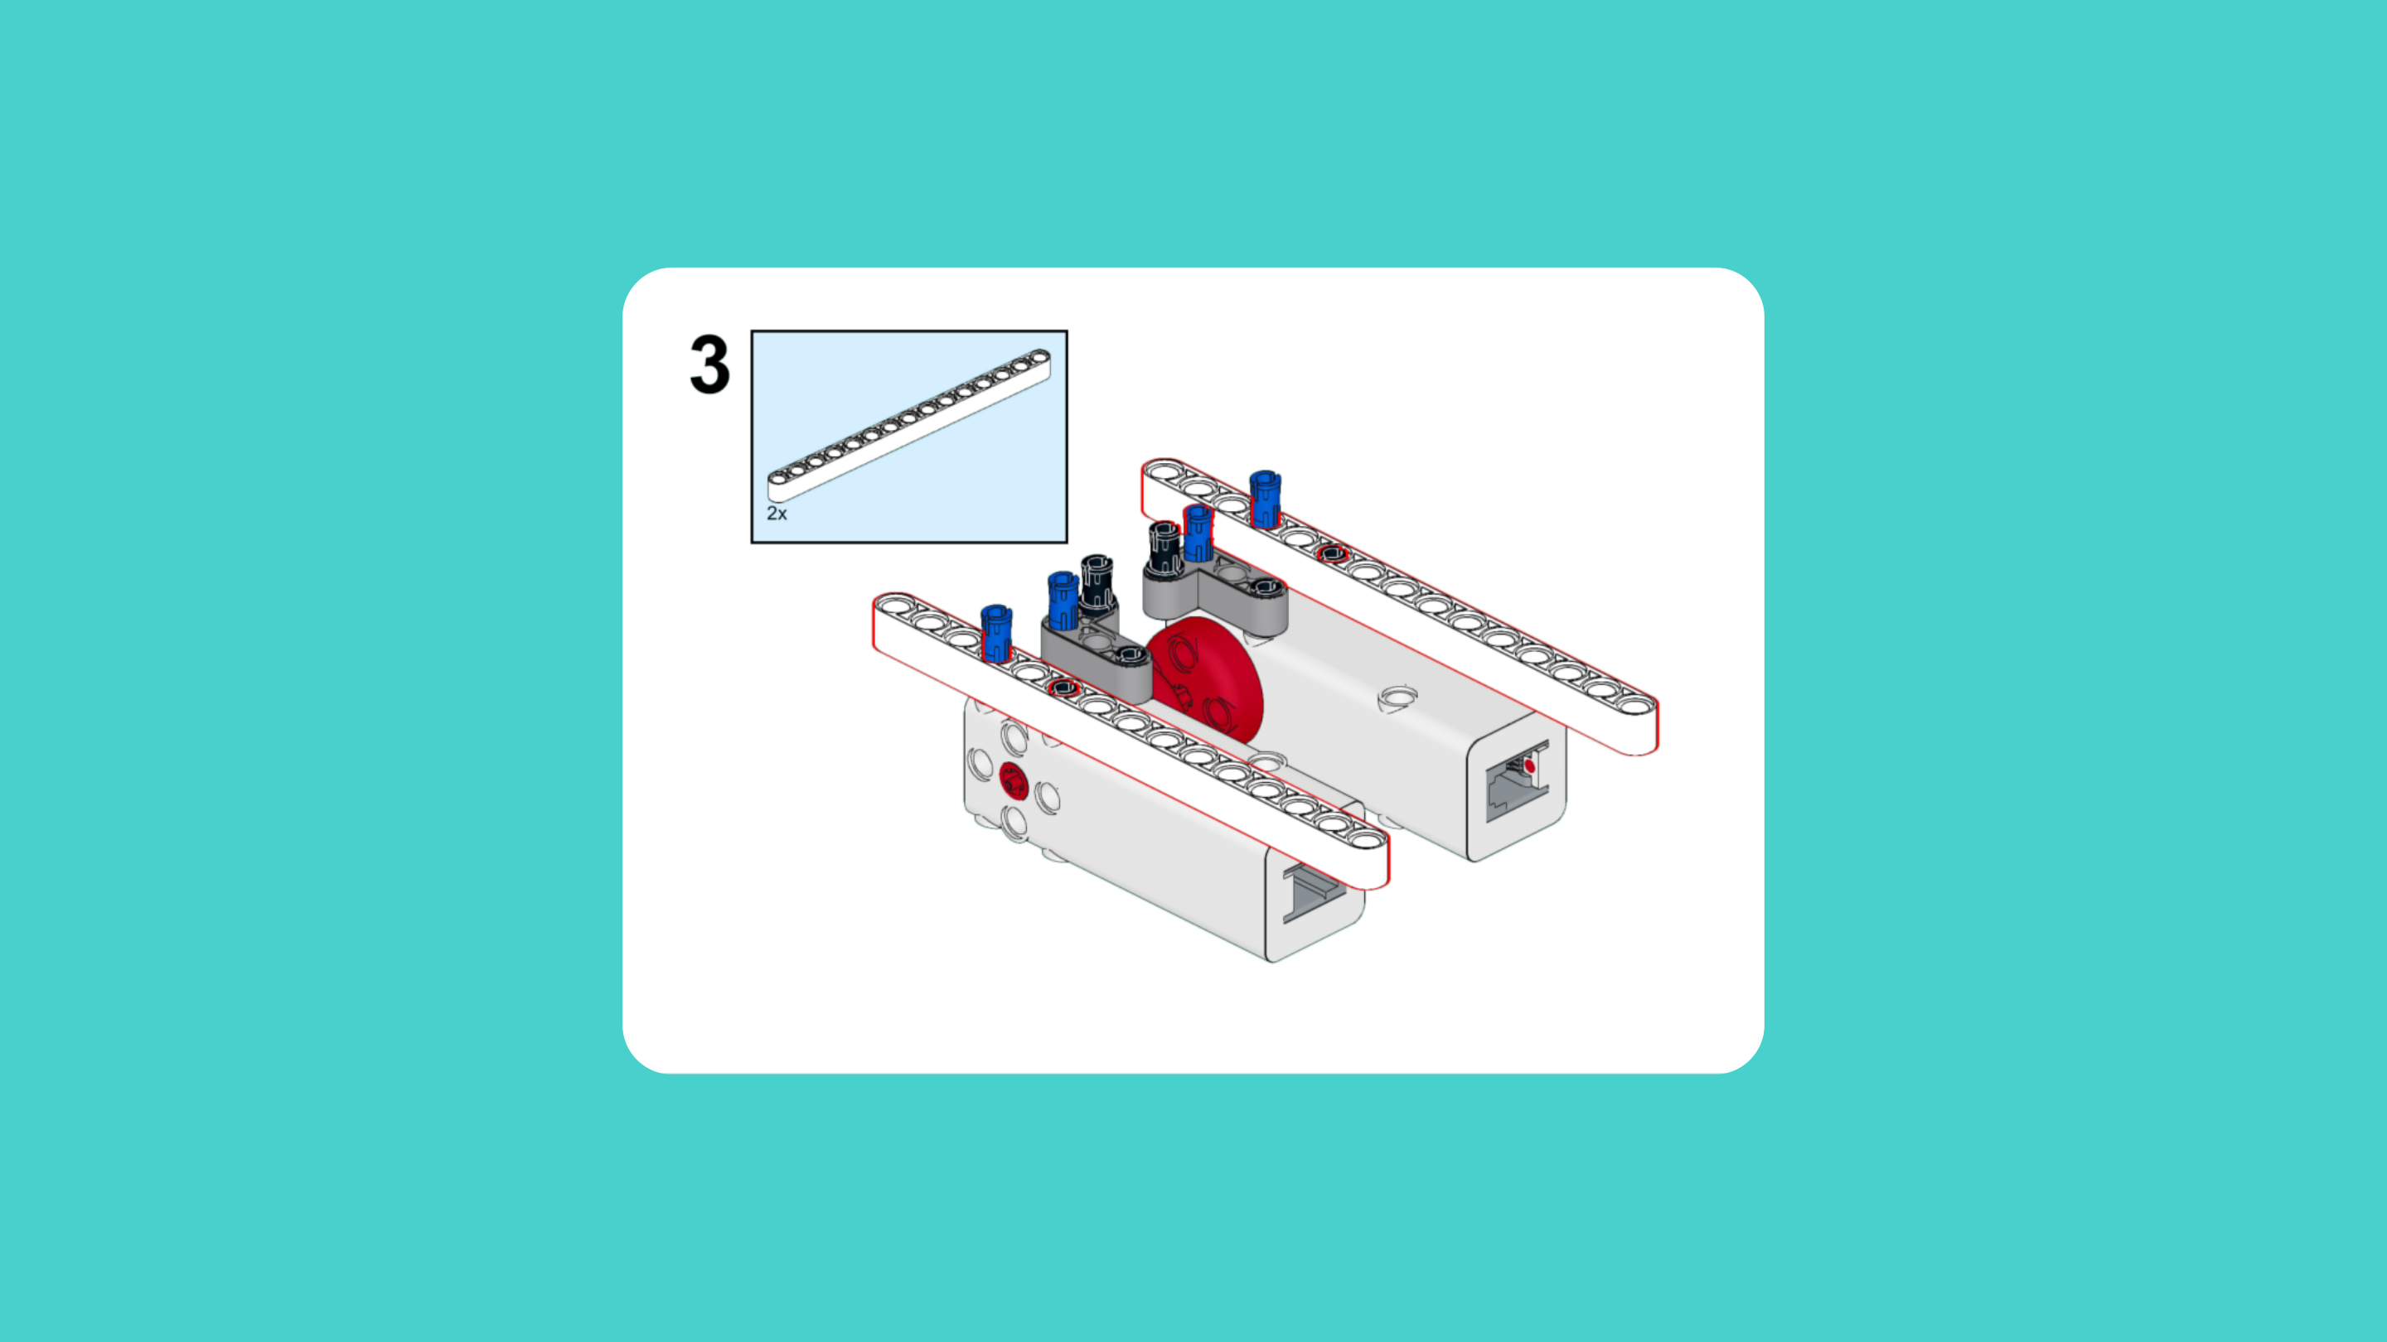
ASSEMBLY STEPS
STEP 1 – 3
PROGRESS: 10% COMPLETE (3 of 30 steps)
STEP 1
STEP 2
STEP 3
THE LANDER · Techtelligence- Elecfreaks
1 / 10

Slide 4
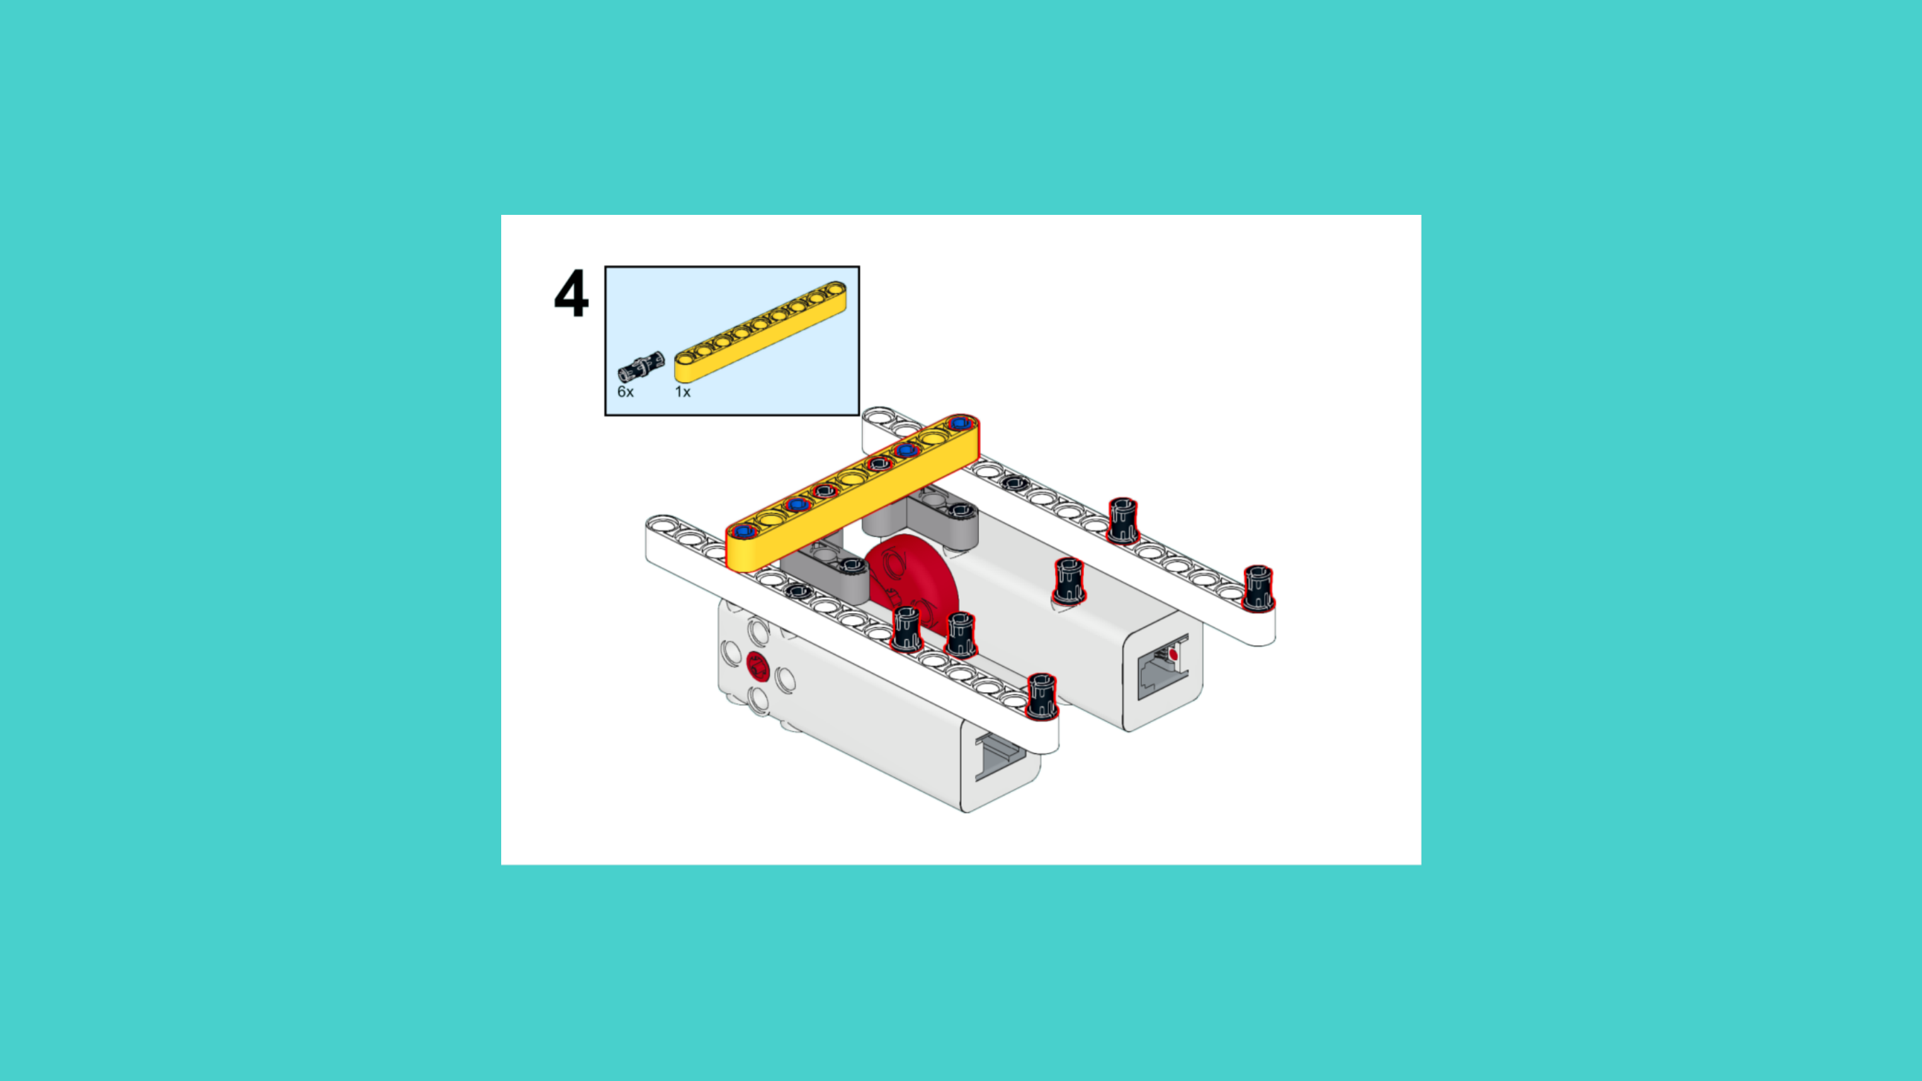
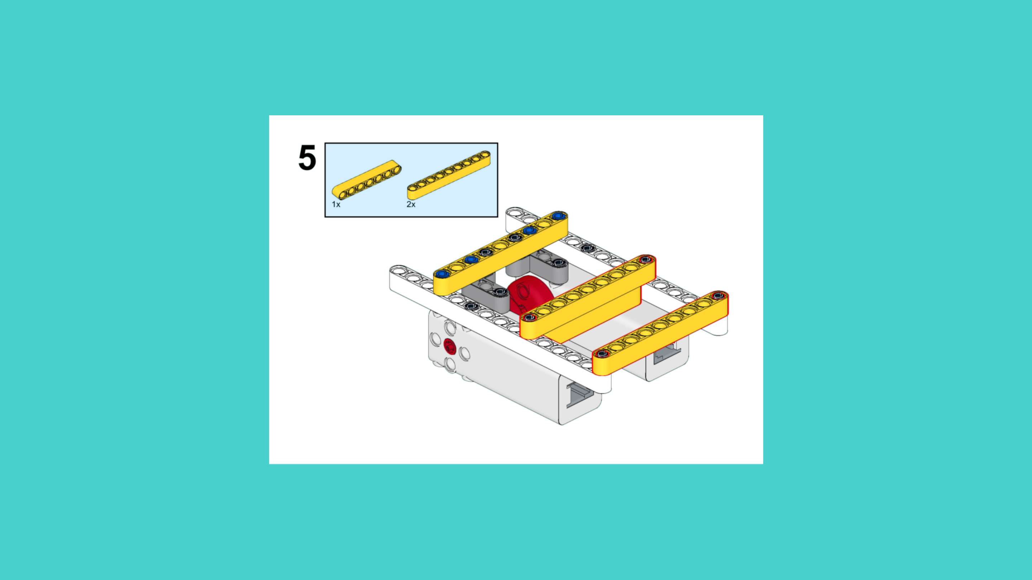
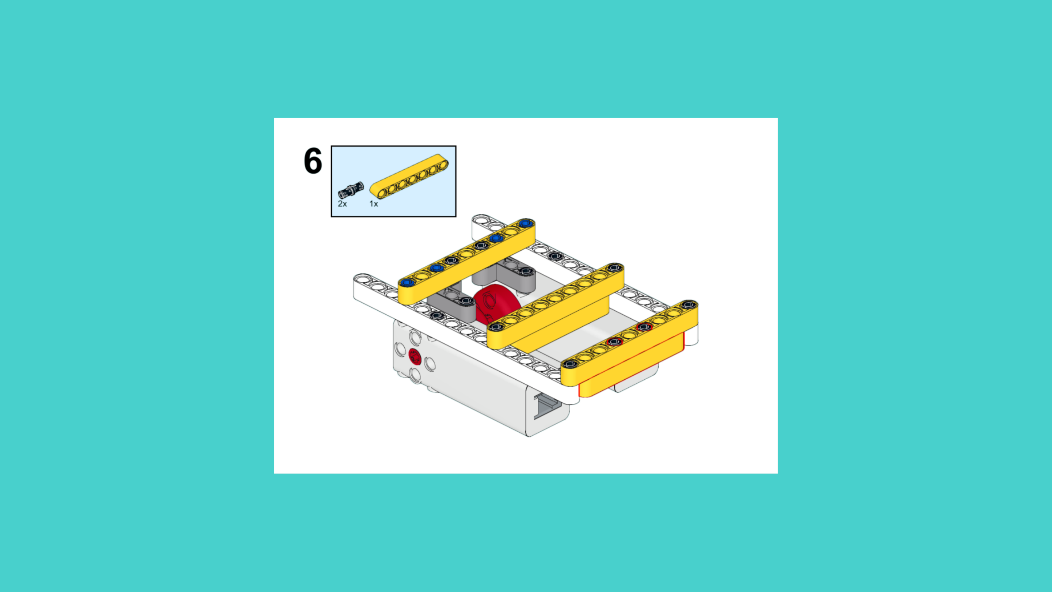
ASSEMBLY STEPS
STEP 4 – 6
PROGRESS: 20% COMPLETE (6 of 30 steps)
STEP 4
STEP 5
STEP 6
THE LANDER · Techtelligence- Elecfreaks
2 / 10

Slide 5
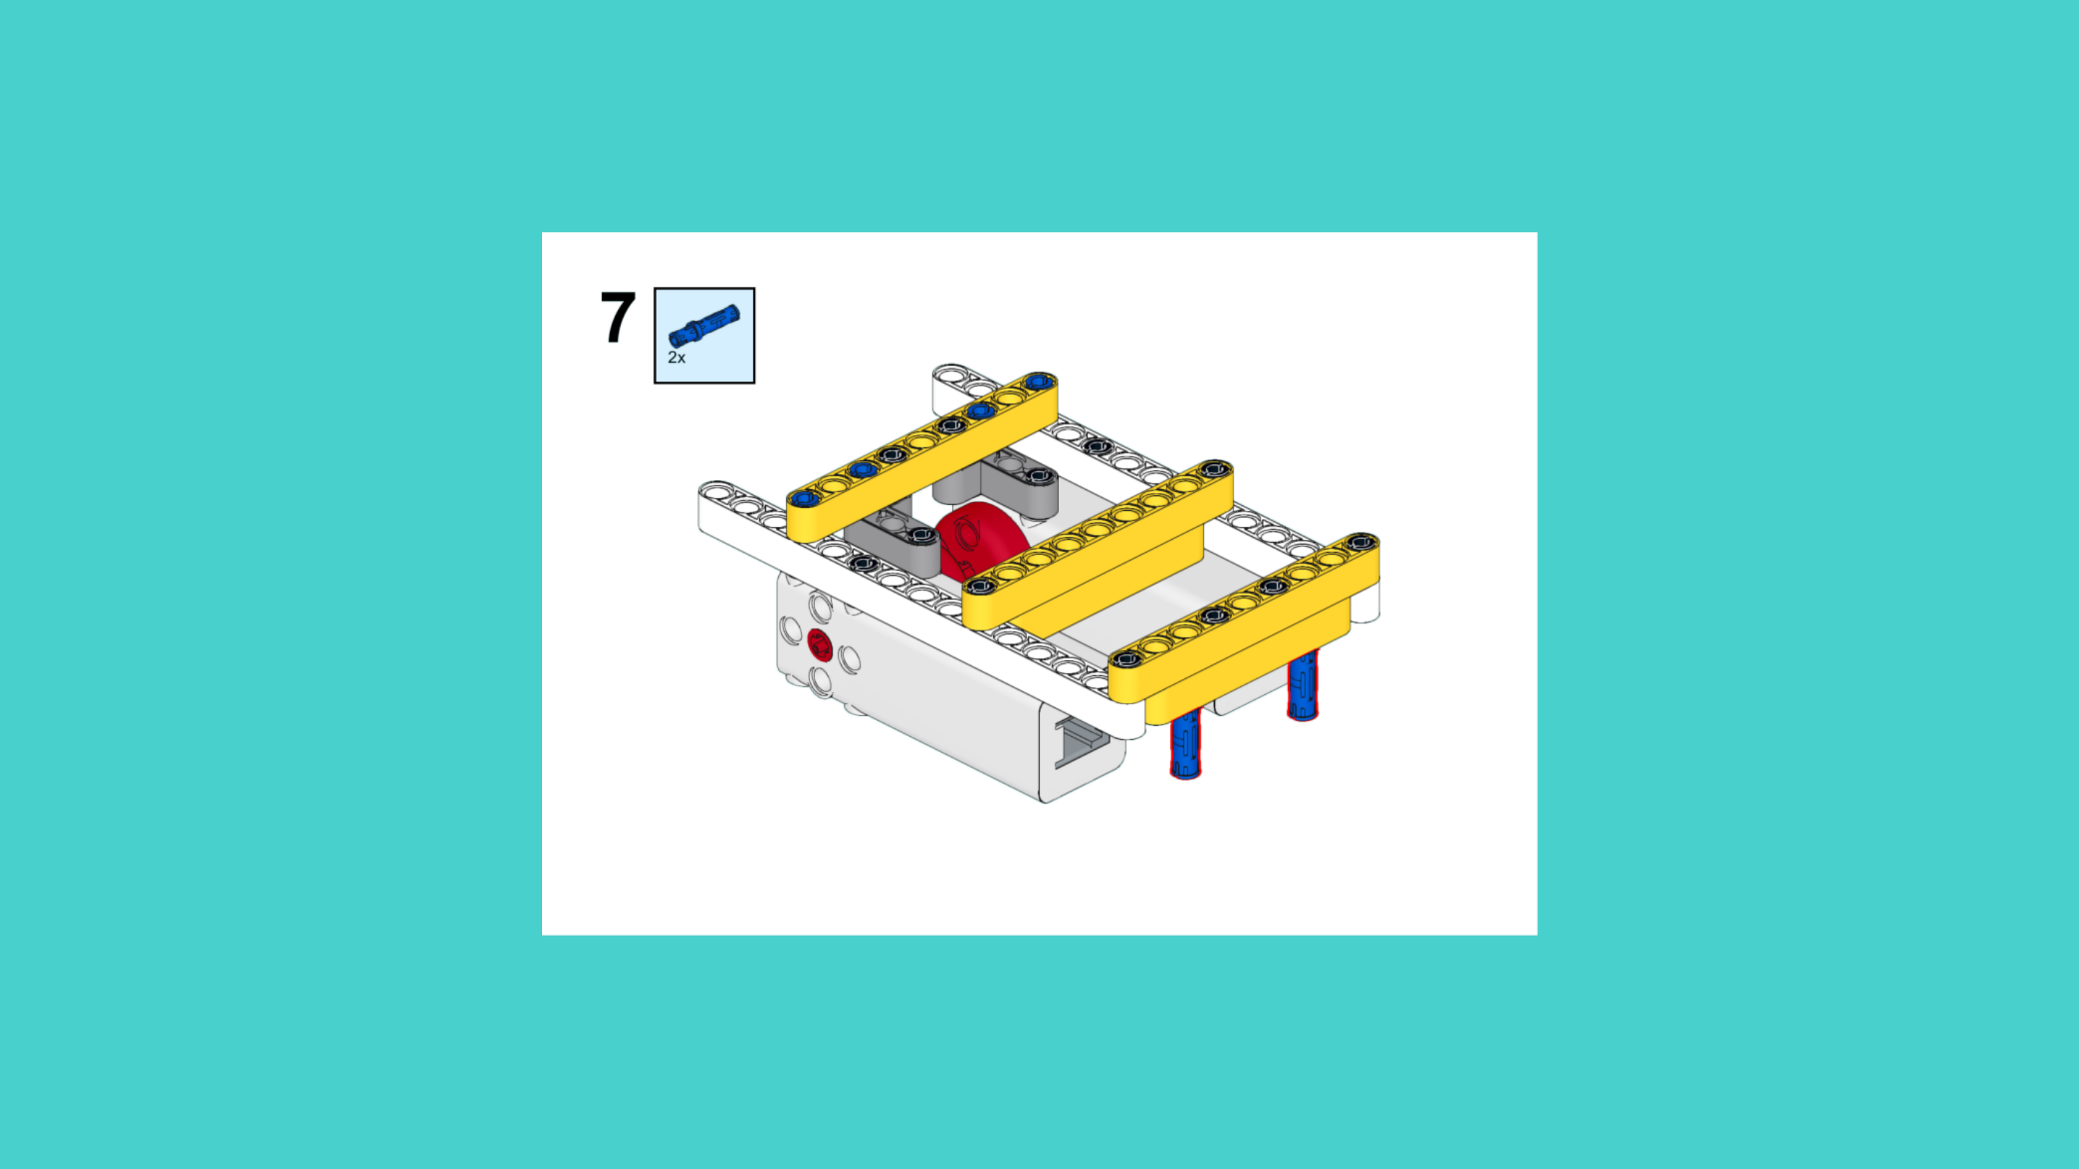
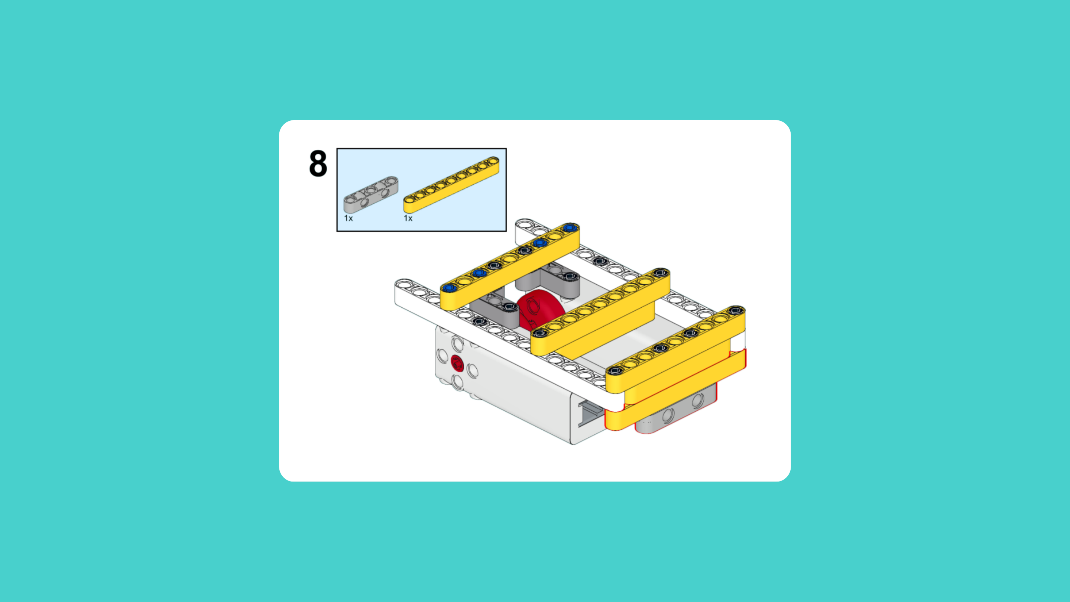
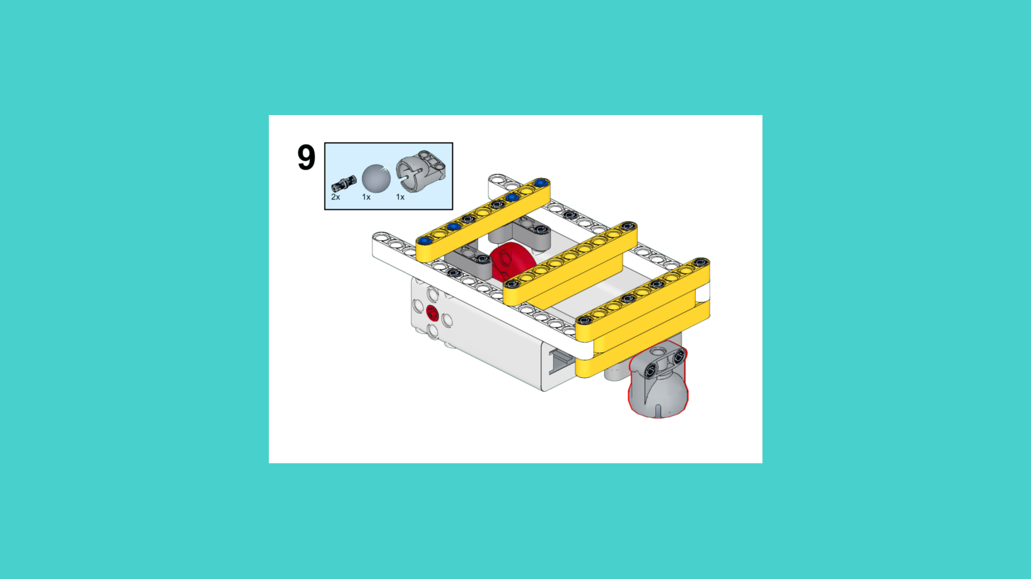
ASSEMBLY STEPS
STEP 7 – 9
PROGRESS: 30% COMPLETE (9 of 30 steps)
STEP 7
STEP 8
STEP 9
THE LANDER · Techtelligence- Elecfreaks
3 / 10

Slide 6
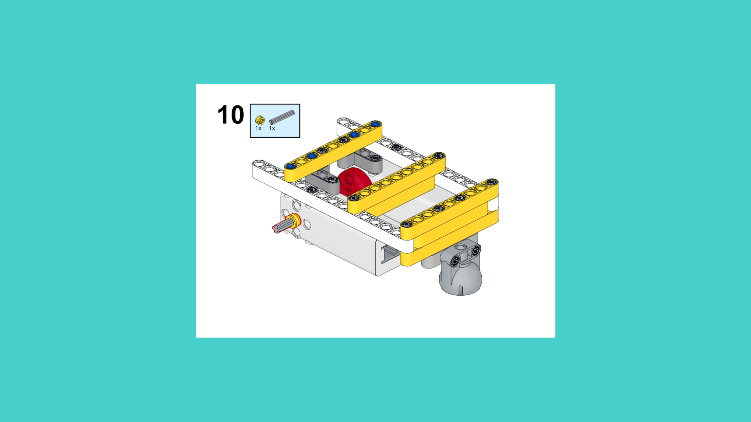
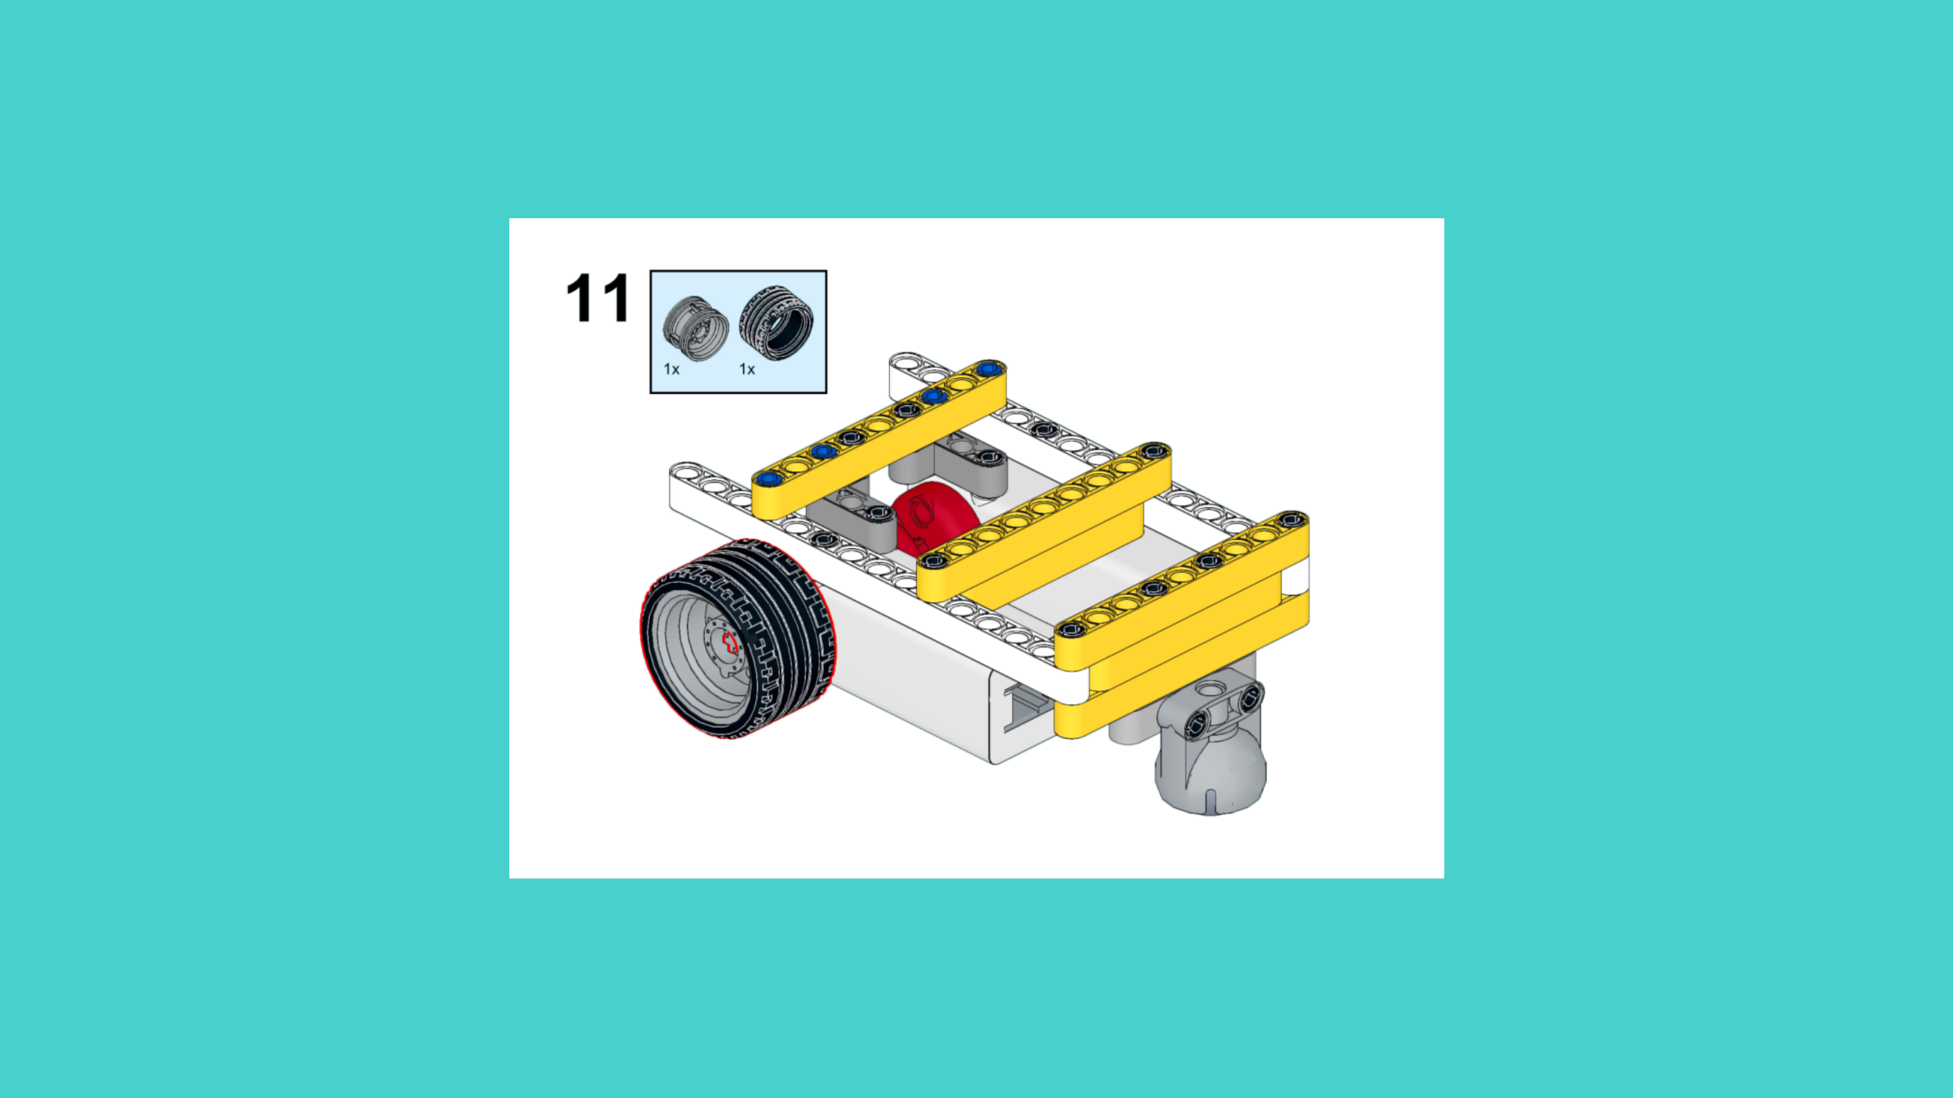
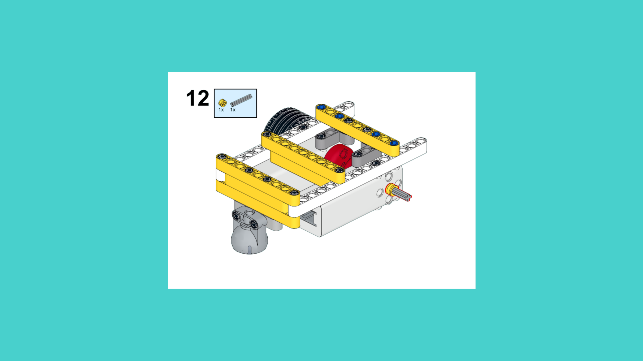
ASSEMBLY STEPS
STEP 10 – 12
PROGRESS: 40% COMPLETE (12 of 30 steps)
STEP 10
STEP 11
STEP 12
THE LANDER · Techtelligence- Elecfreaks
4 / 10

Slide 7
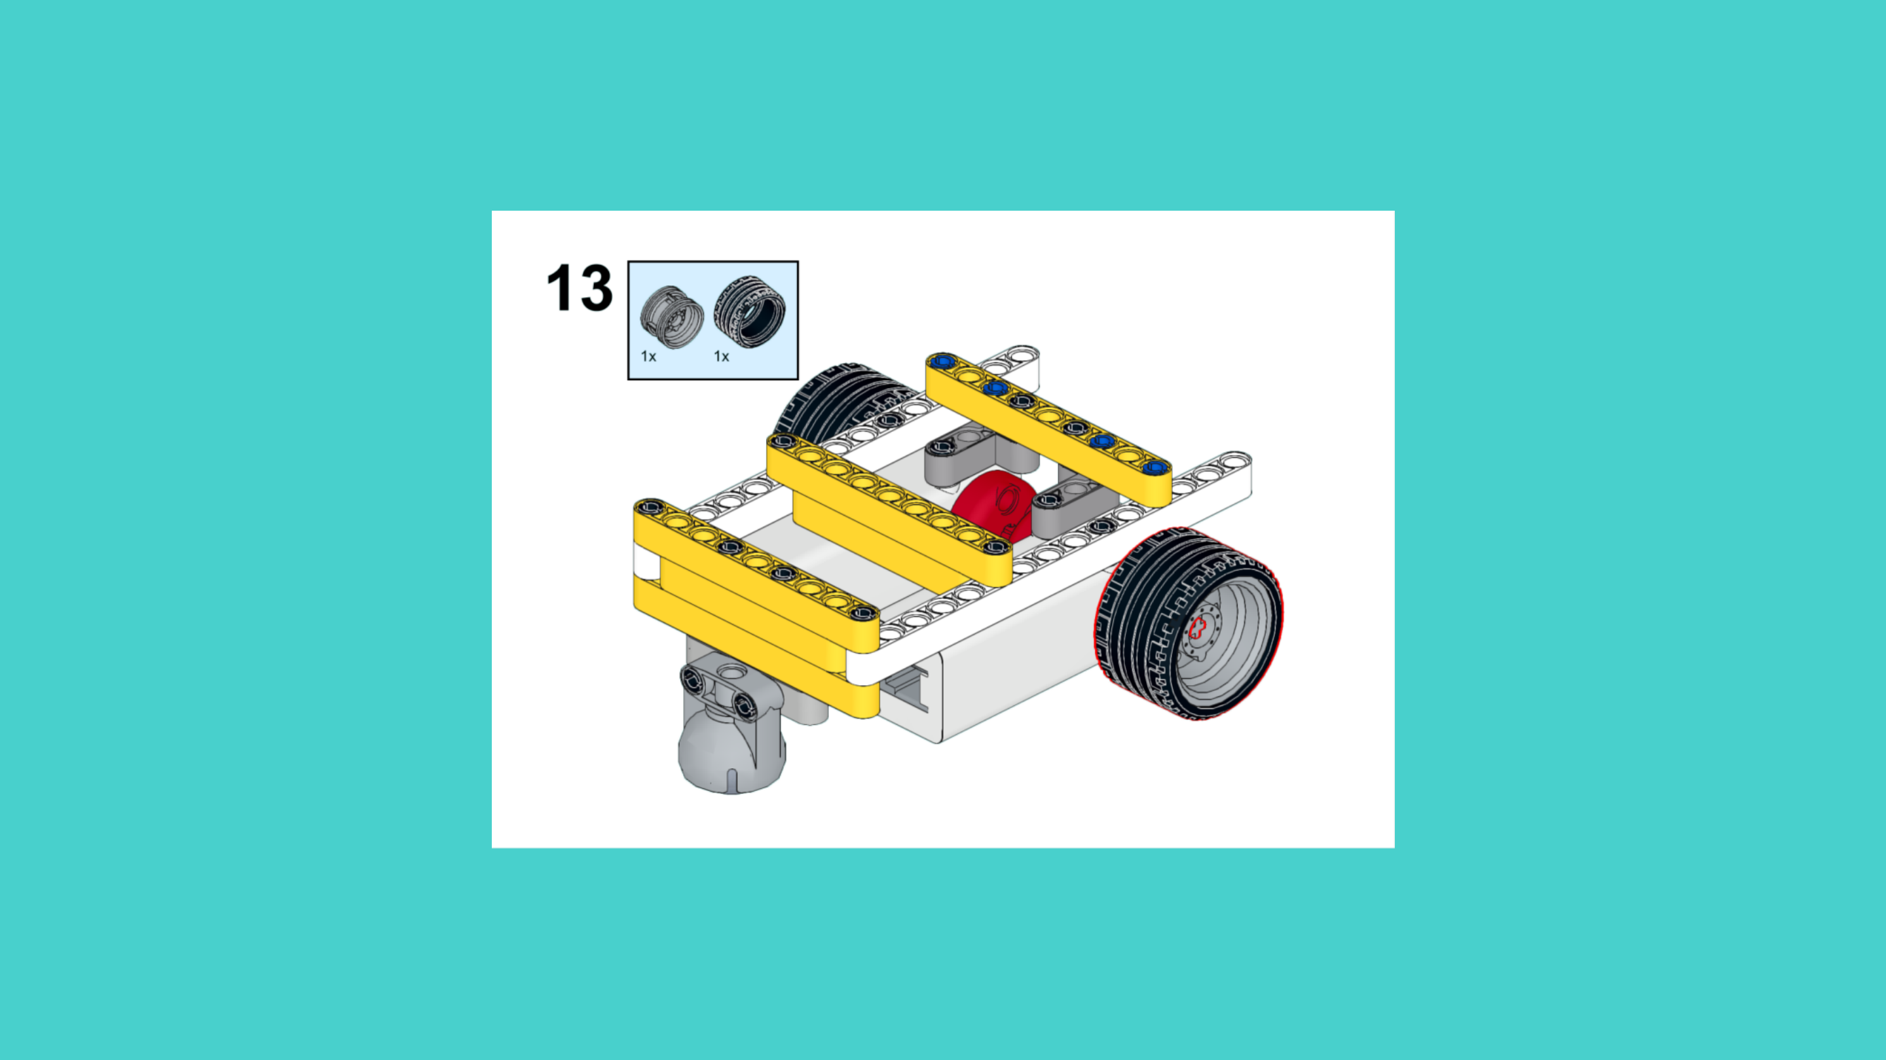
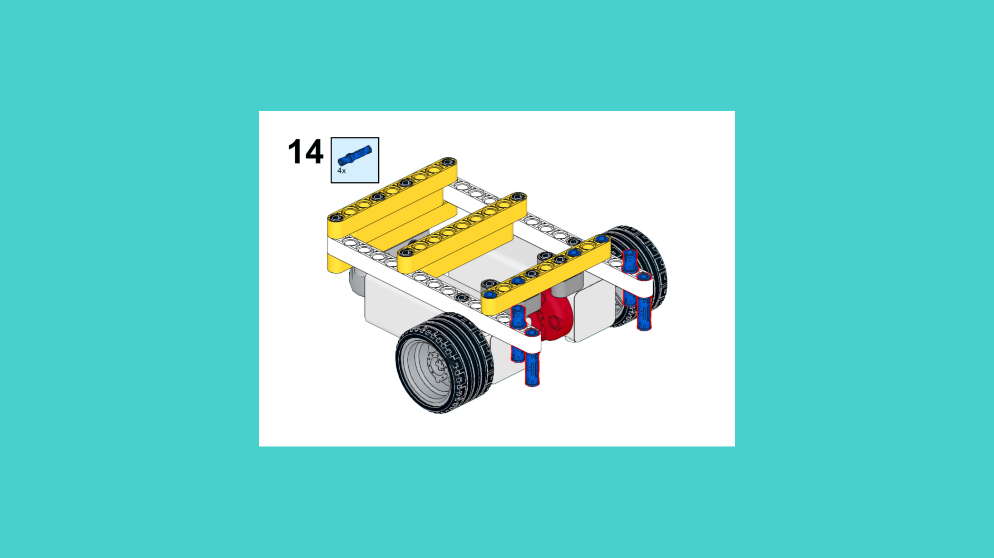
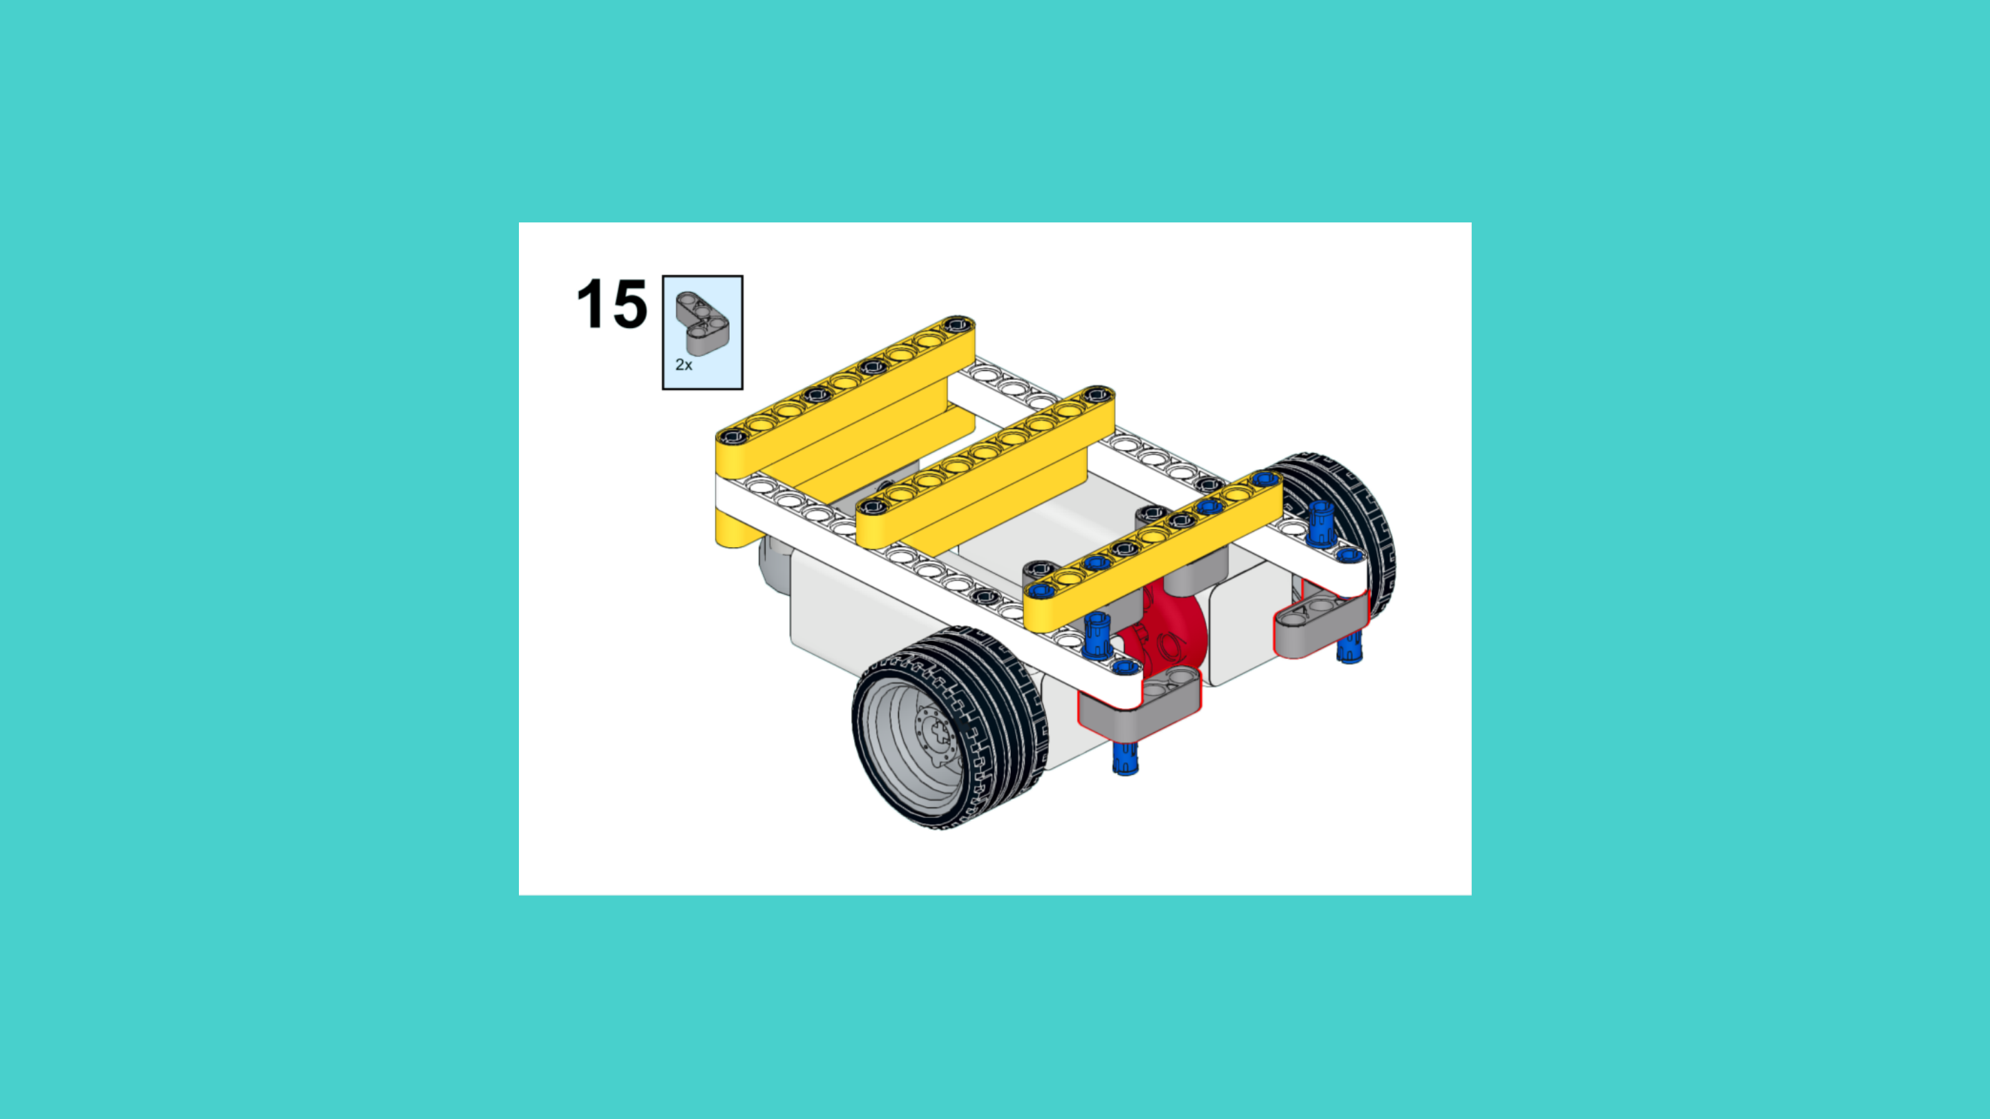
ASSEMBLY STEPS
STEP 13 – 15
PROGRESS: 50% COMPLETE (15 of 30 steps)
STEP 13
STEP 14
STEP 15
THE LANDER · Techtelligence- Elecfreaks
5 / 10

Slide 8
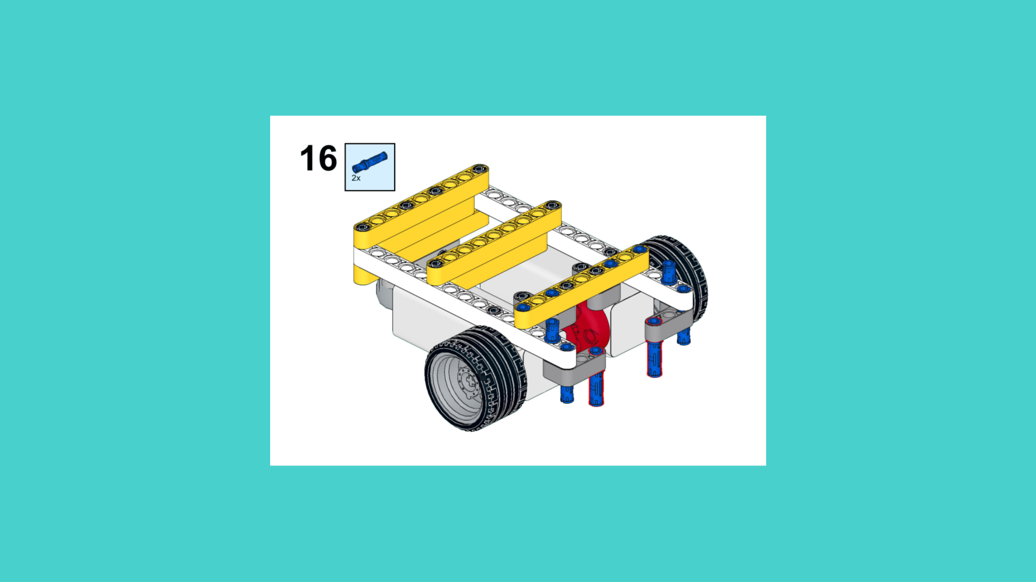
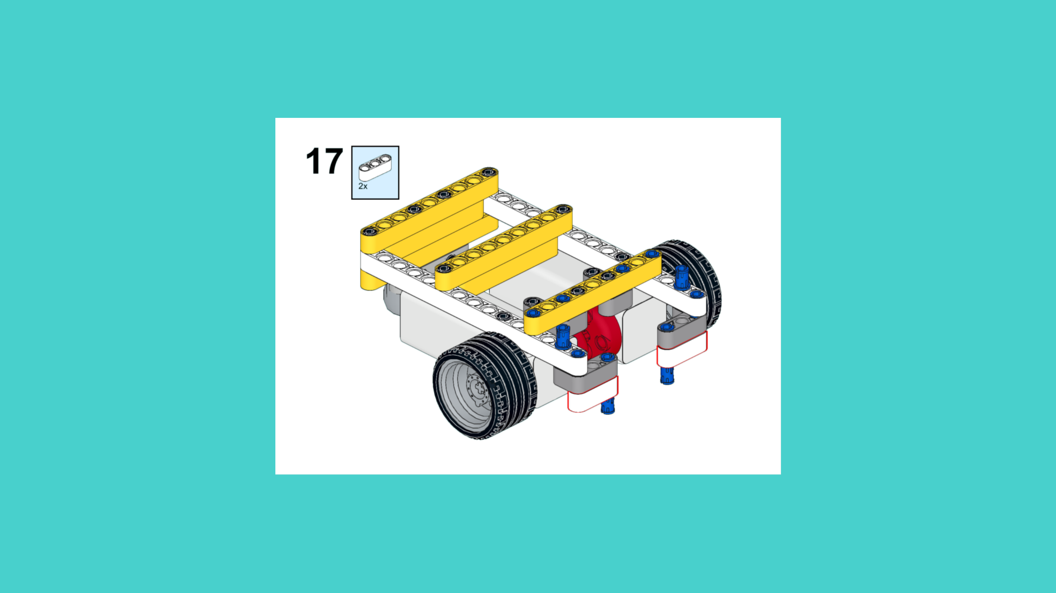
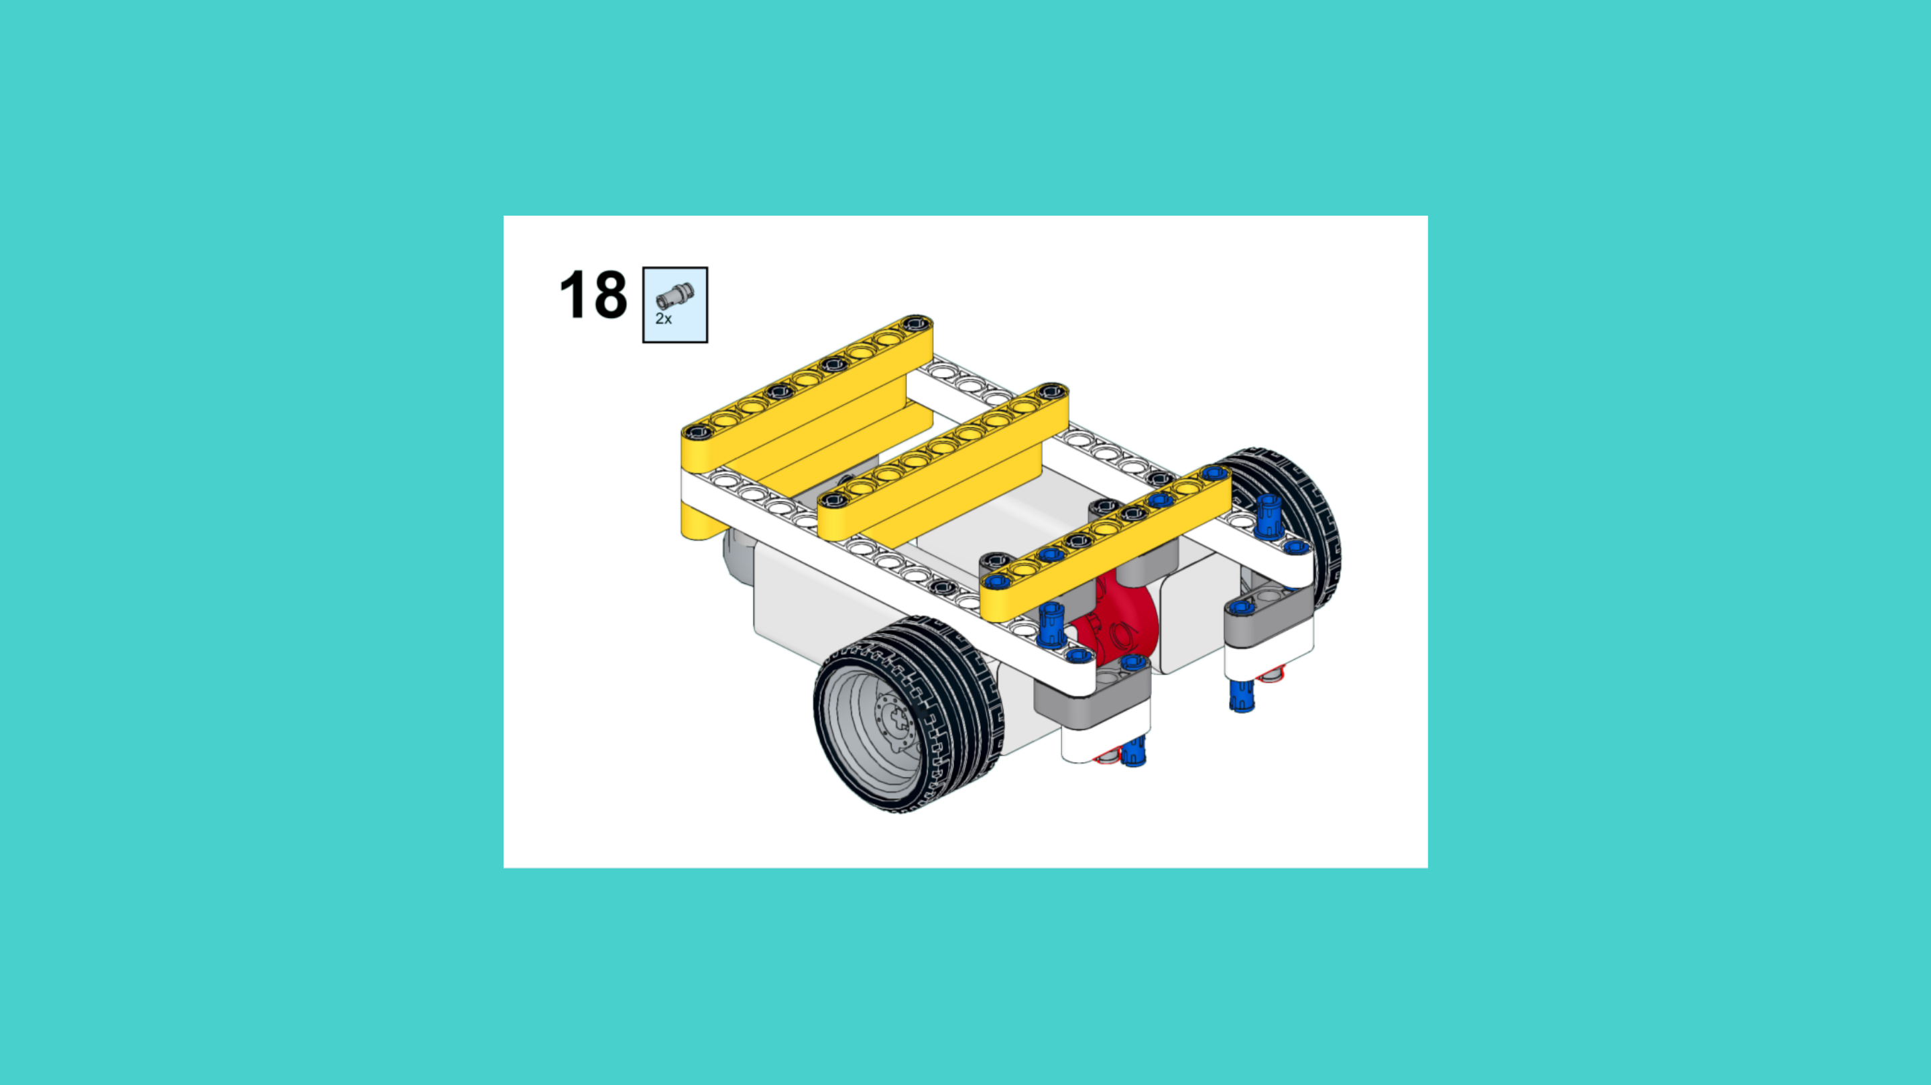
ASSEMBLY STEPS
STEP 16 – 18
PROGRESS: 60% COMPLETE (18 of 30 steps)
STEP 16
STEP 17
STEP 18
THE LANDER · Techtelligence- Elecfreaks
6 / 10

Slide 9
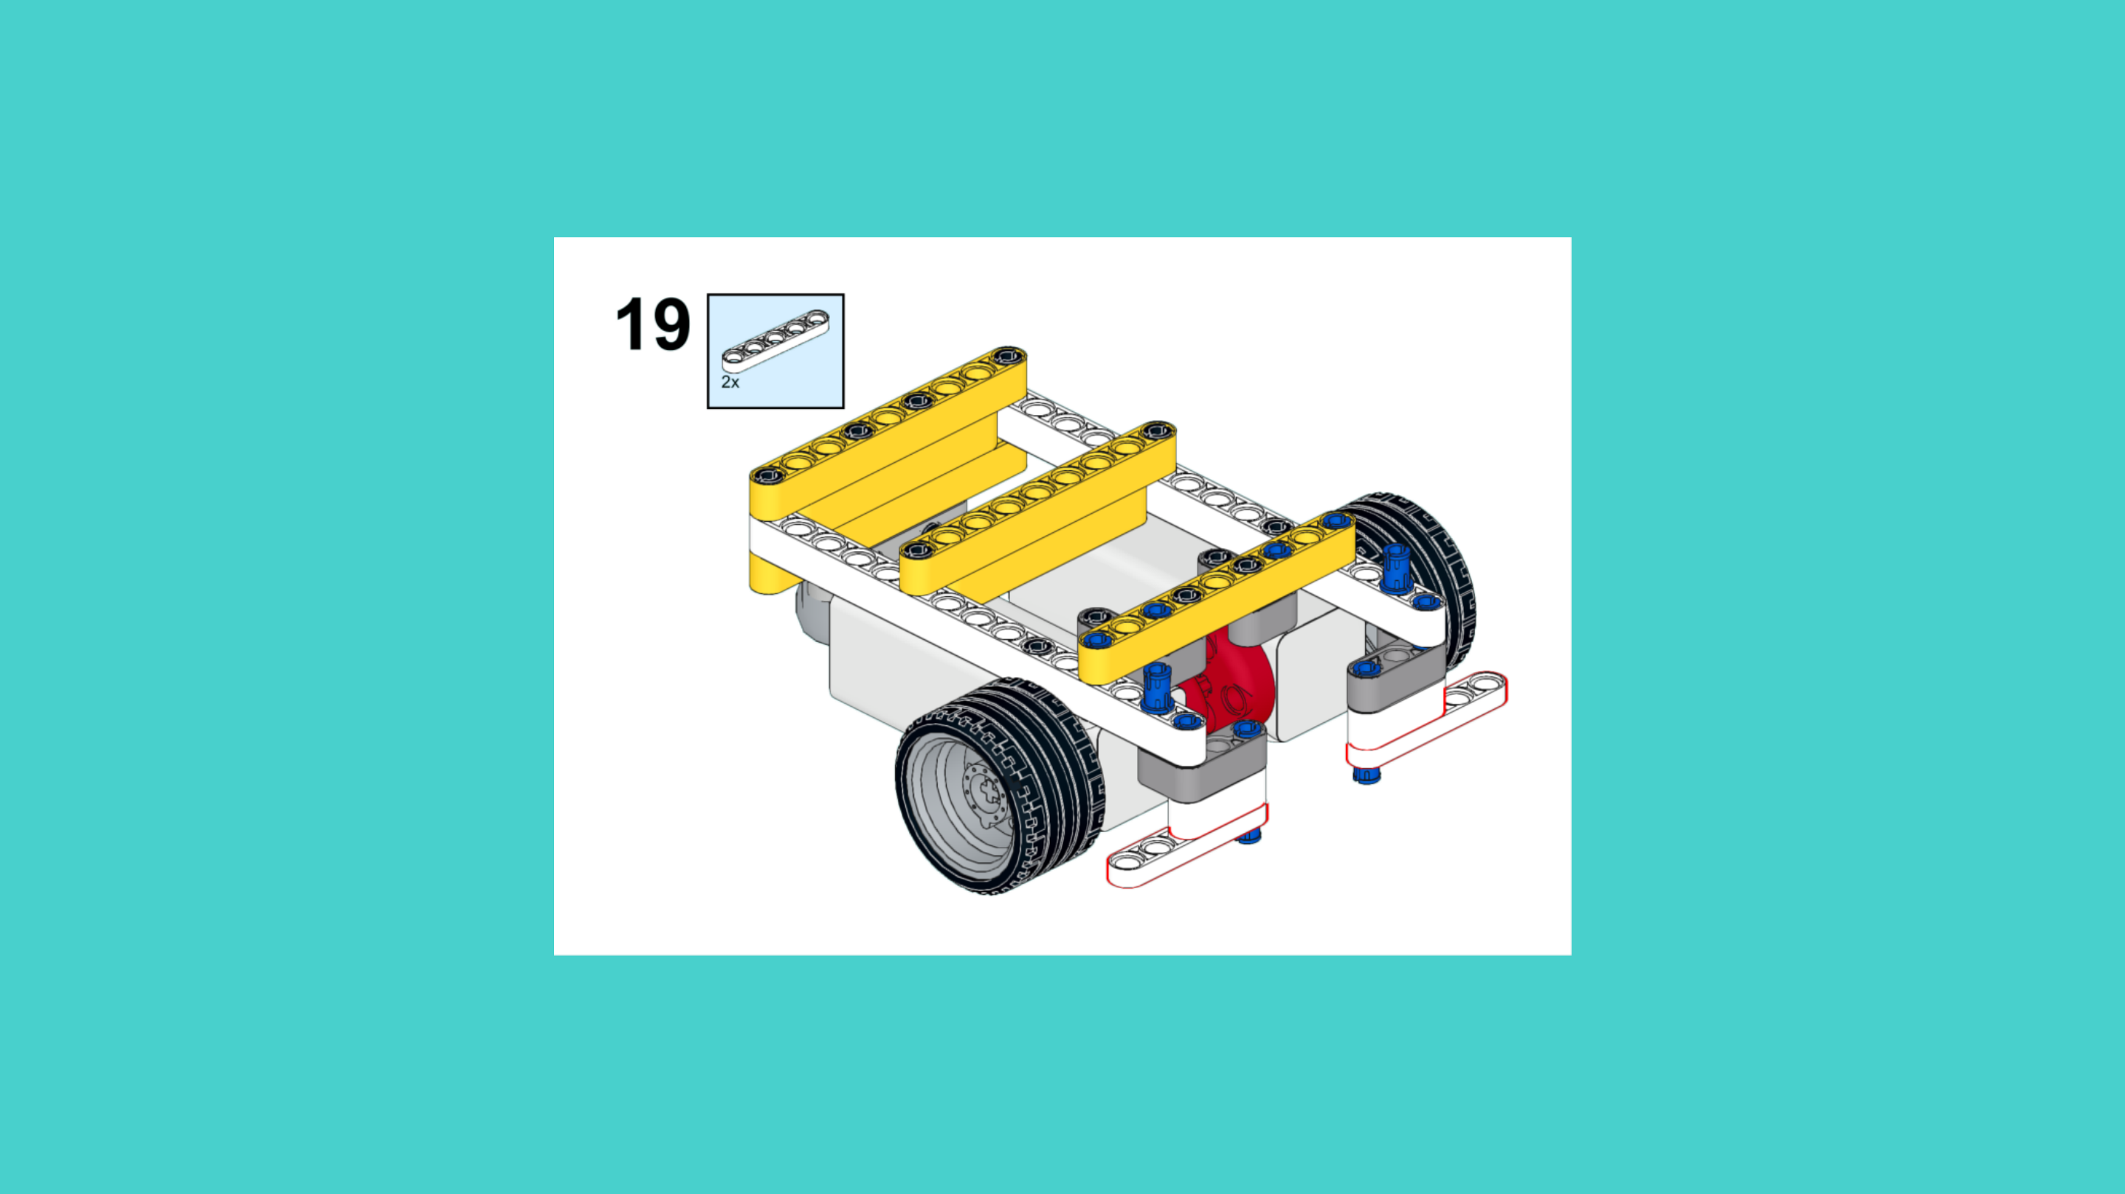
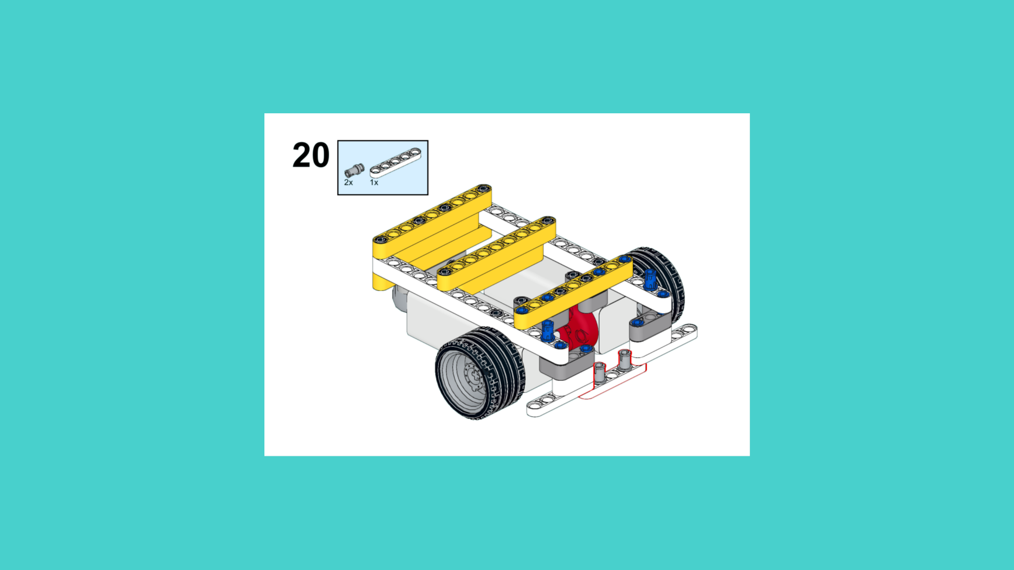
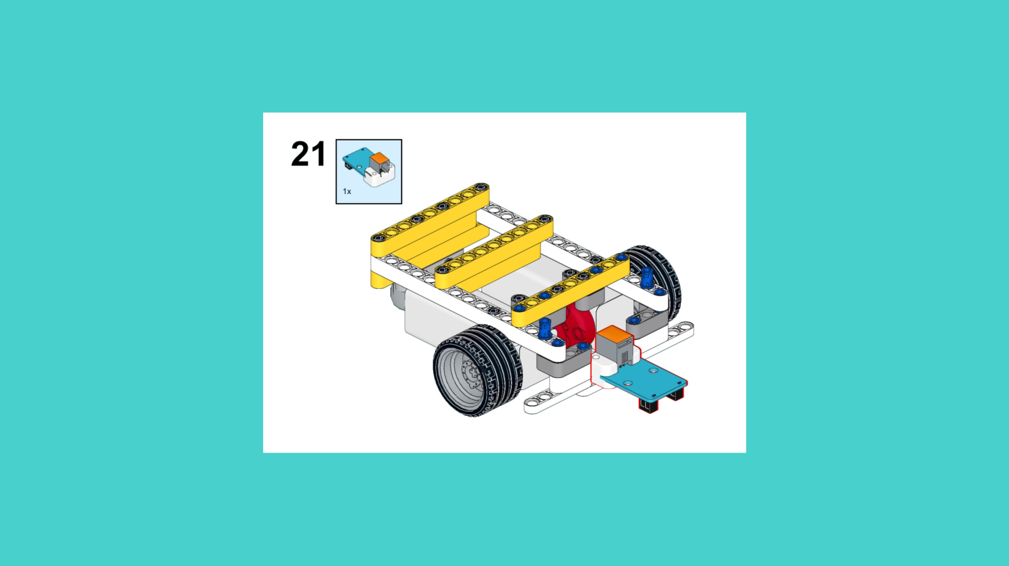
ASSEMBLY STEPS
STEP 19 – 21
PROGRESS: 70% COMPLETE (21 of 30 steps)
STEP 19
STEP 20
STEP 21
THE LANDER · Techtelligence- Elecfreaks
7 / 10

Slide 10
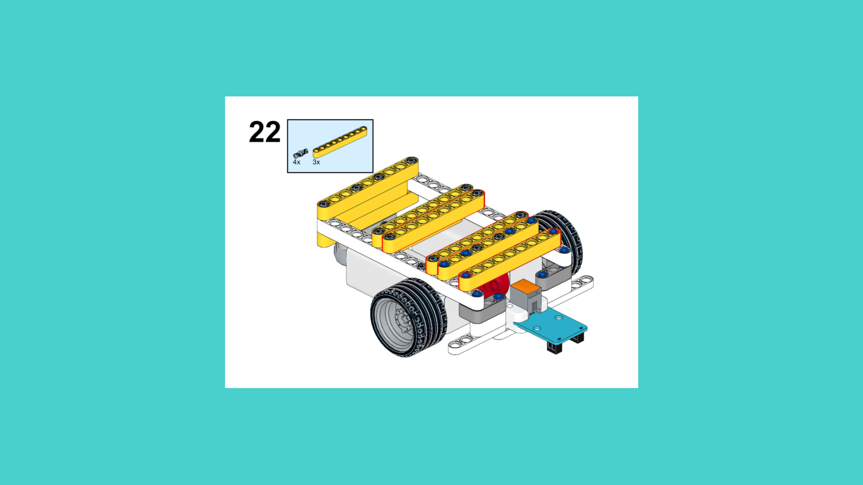
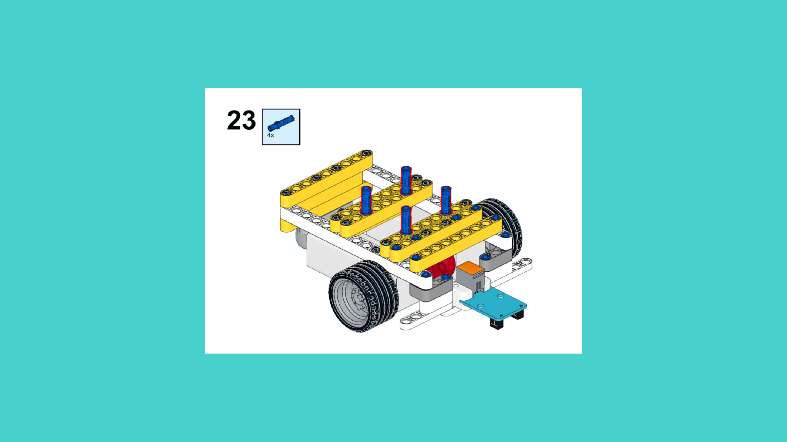
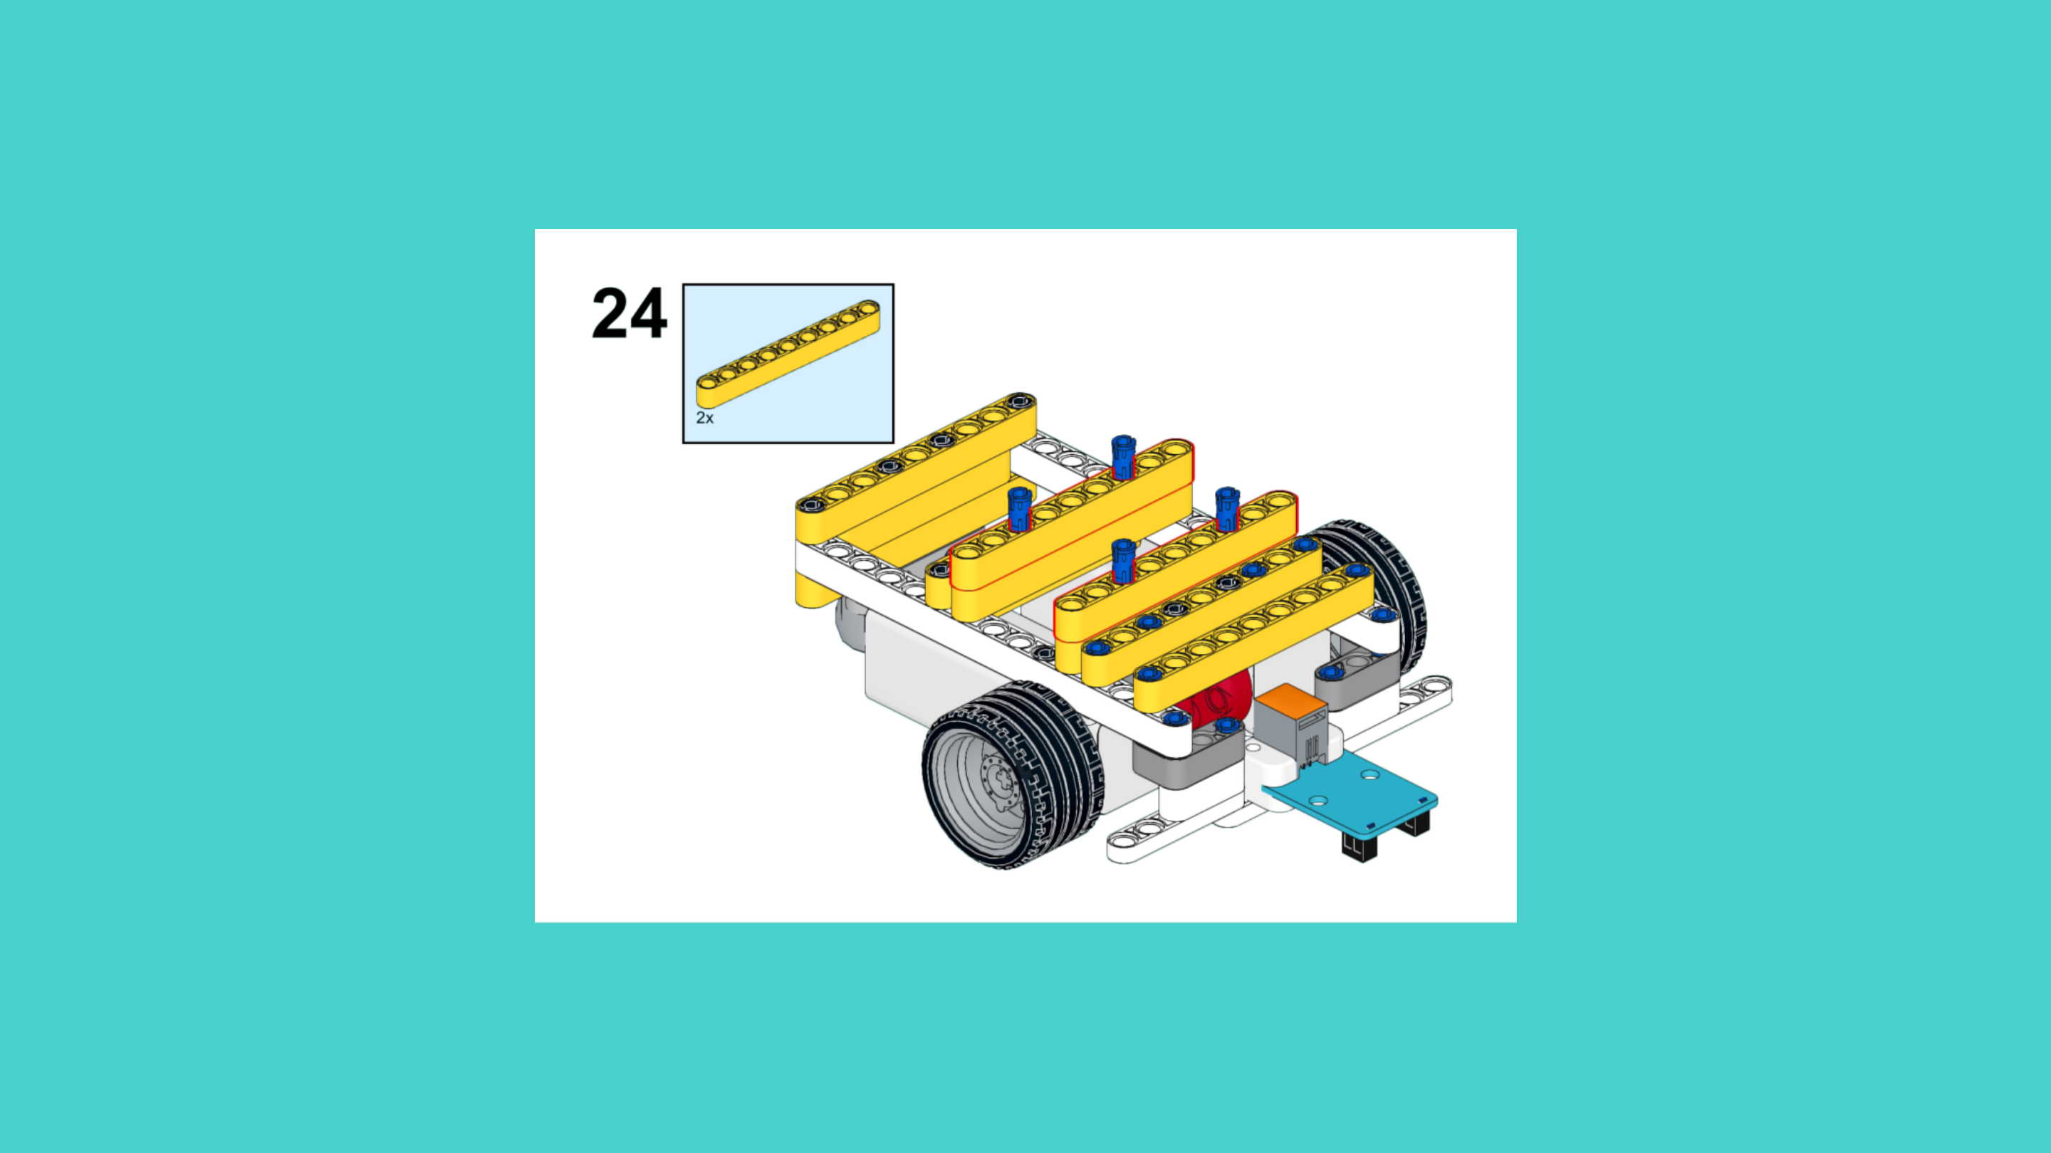
ASSEMBLY STEPS
STEP 22 – 24
PROGRESS: 80% COMPLETE (24 of 30 steps)
STEP 22
STEP 23
STEP 24
THE LANDER · Techtelligence- Elecfreaks
8 / 10

Slide 11
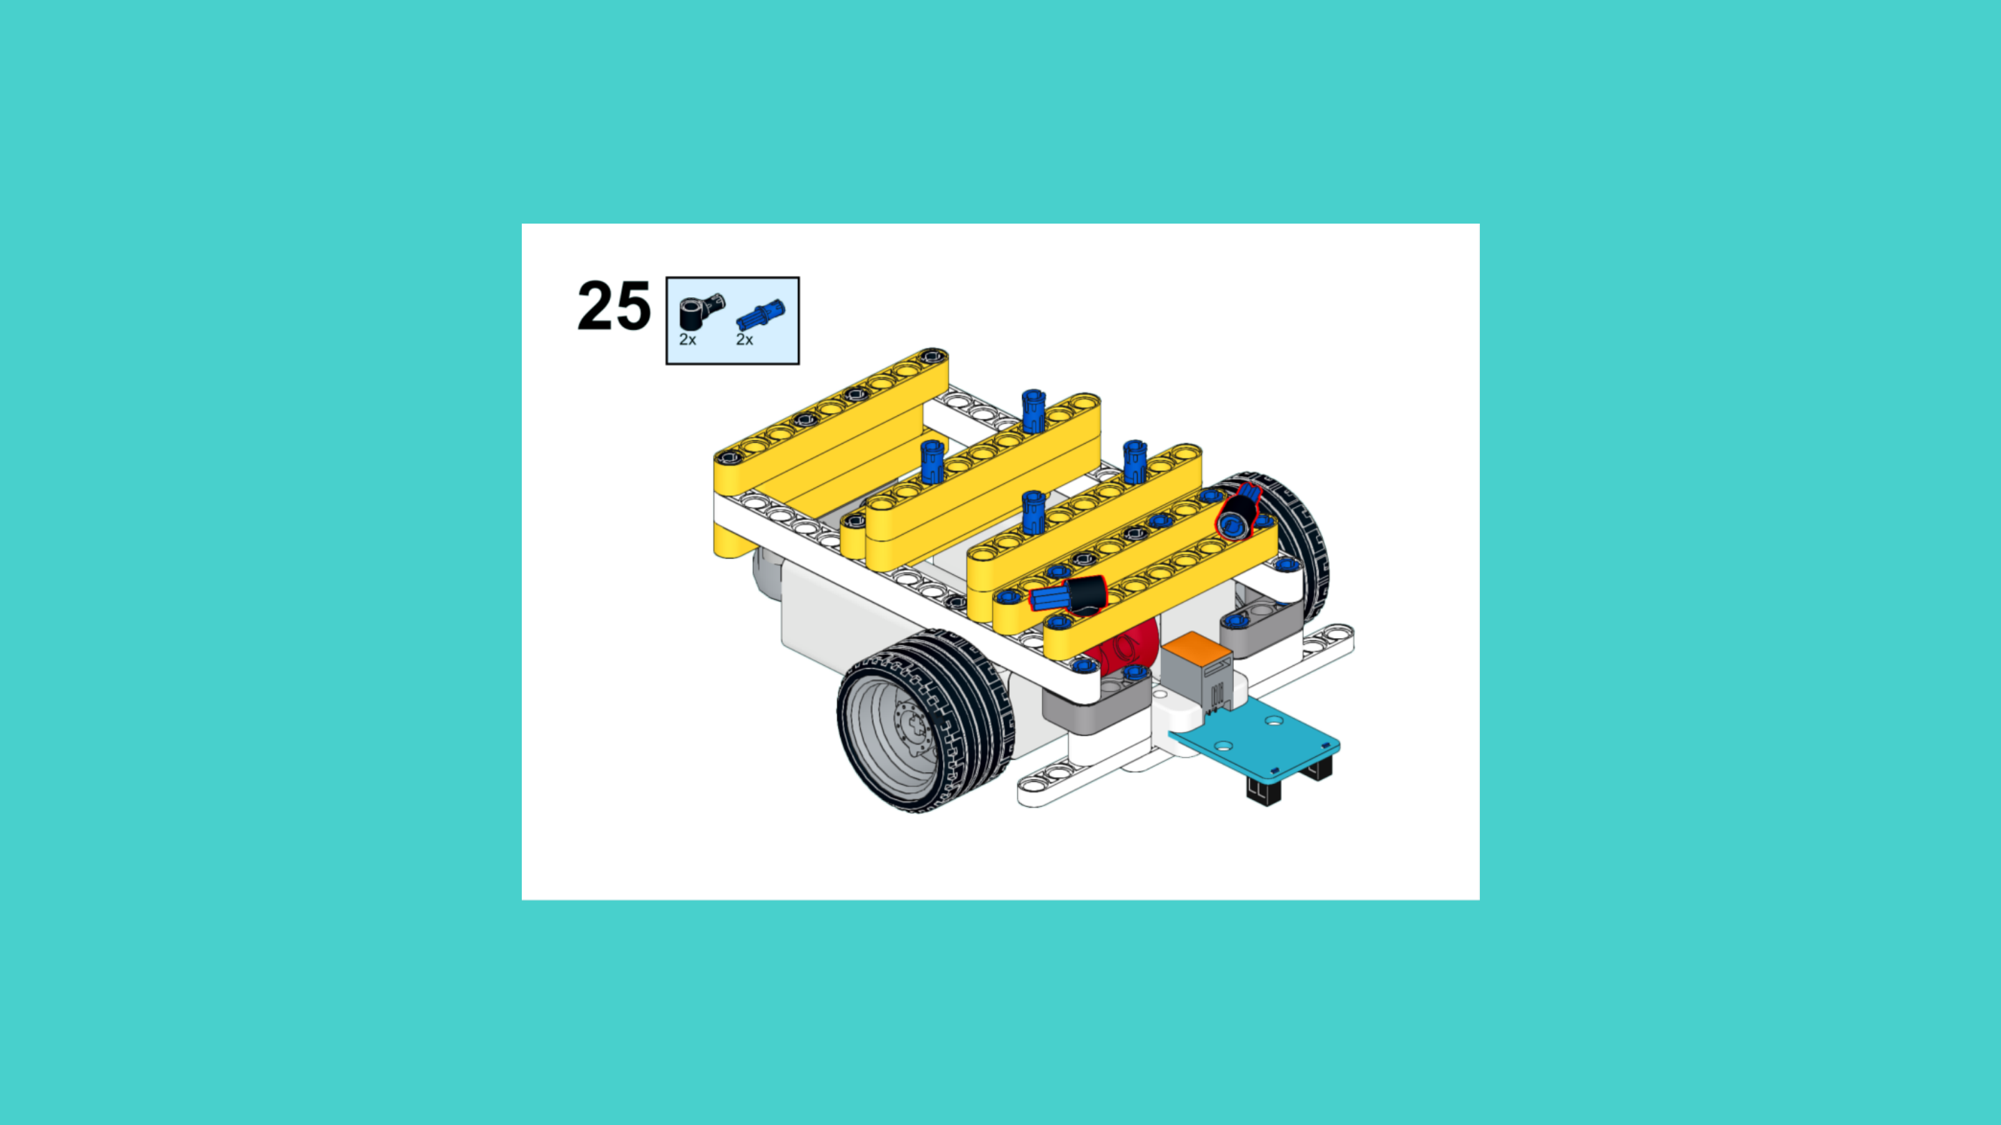
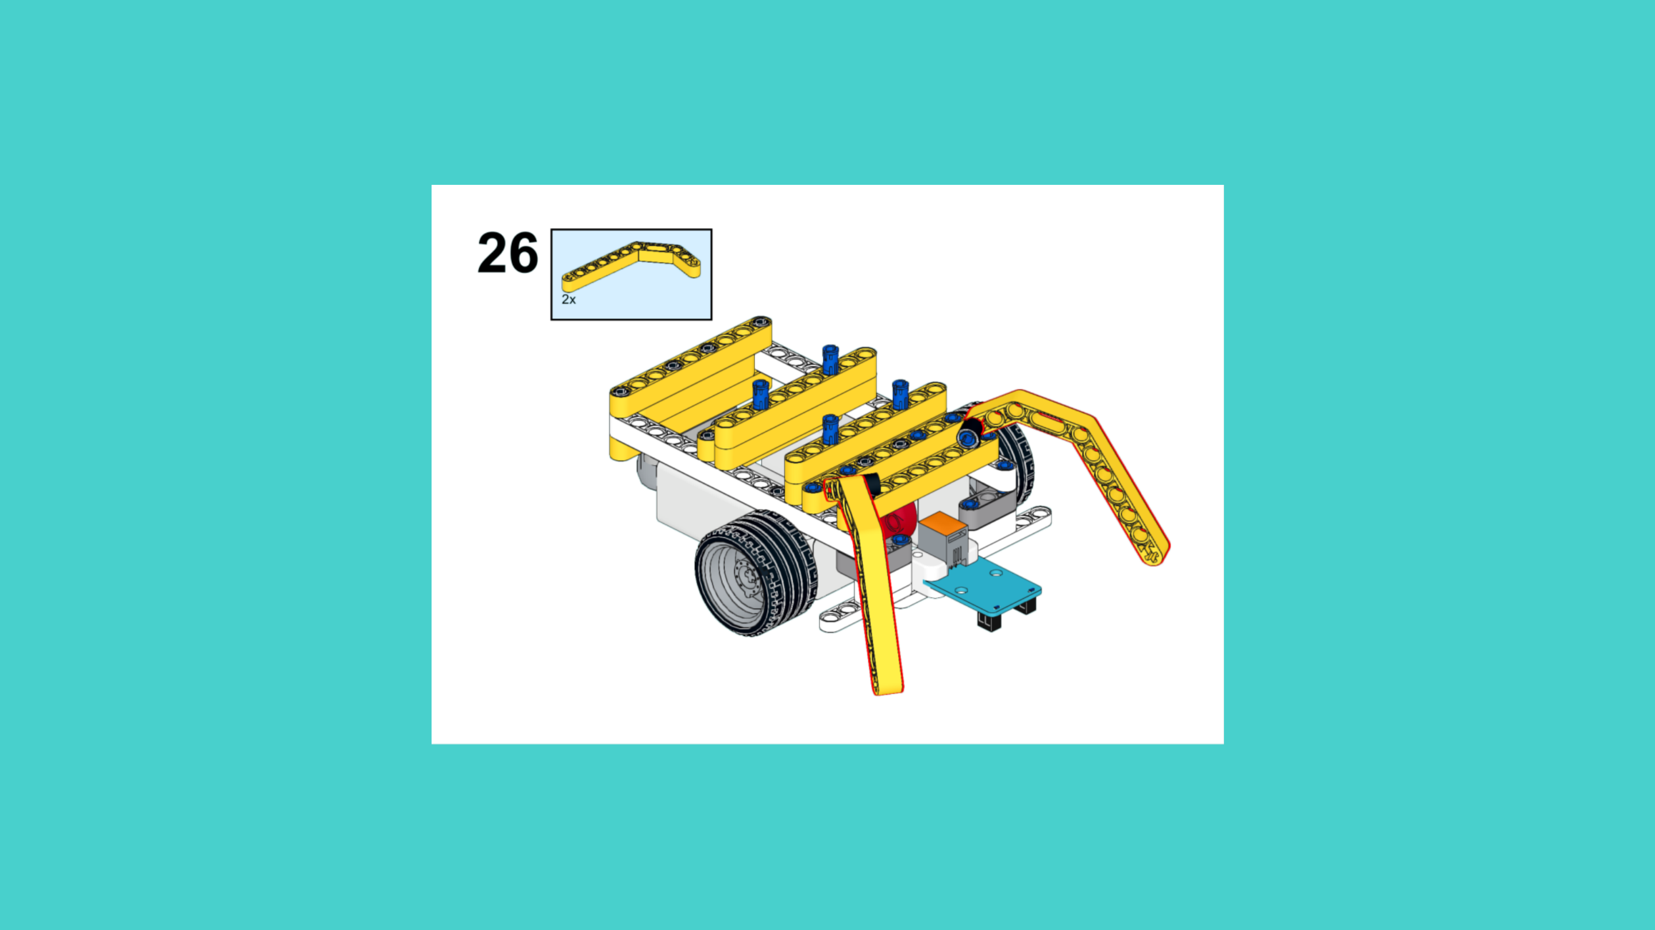
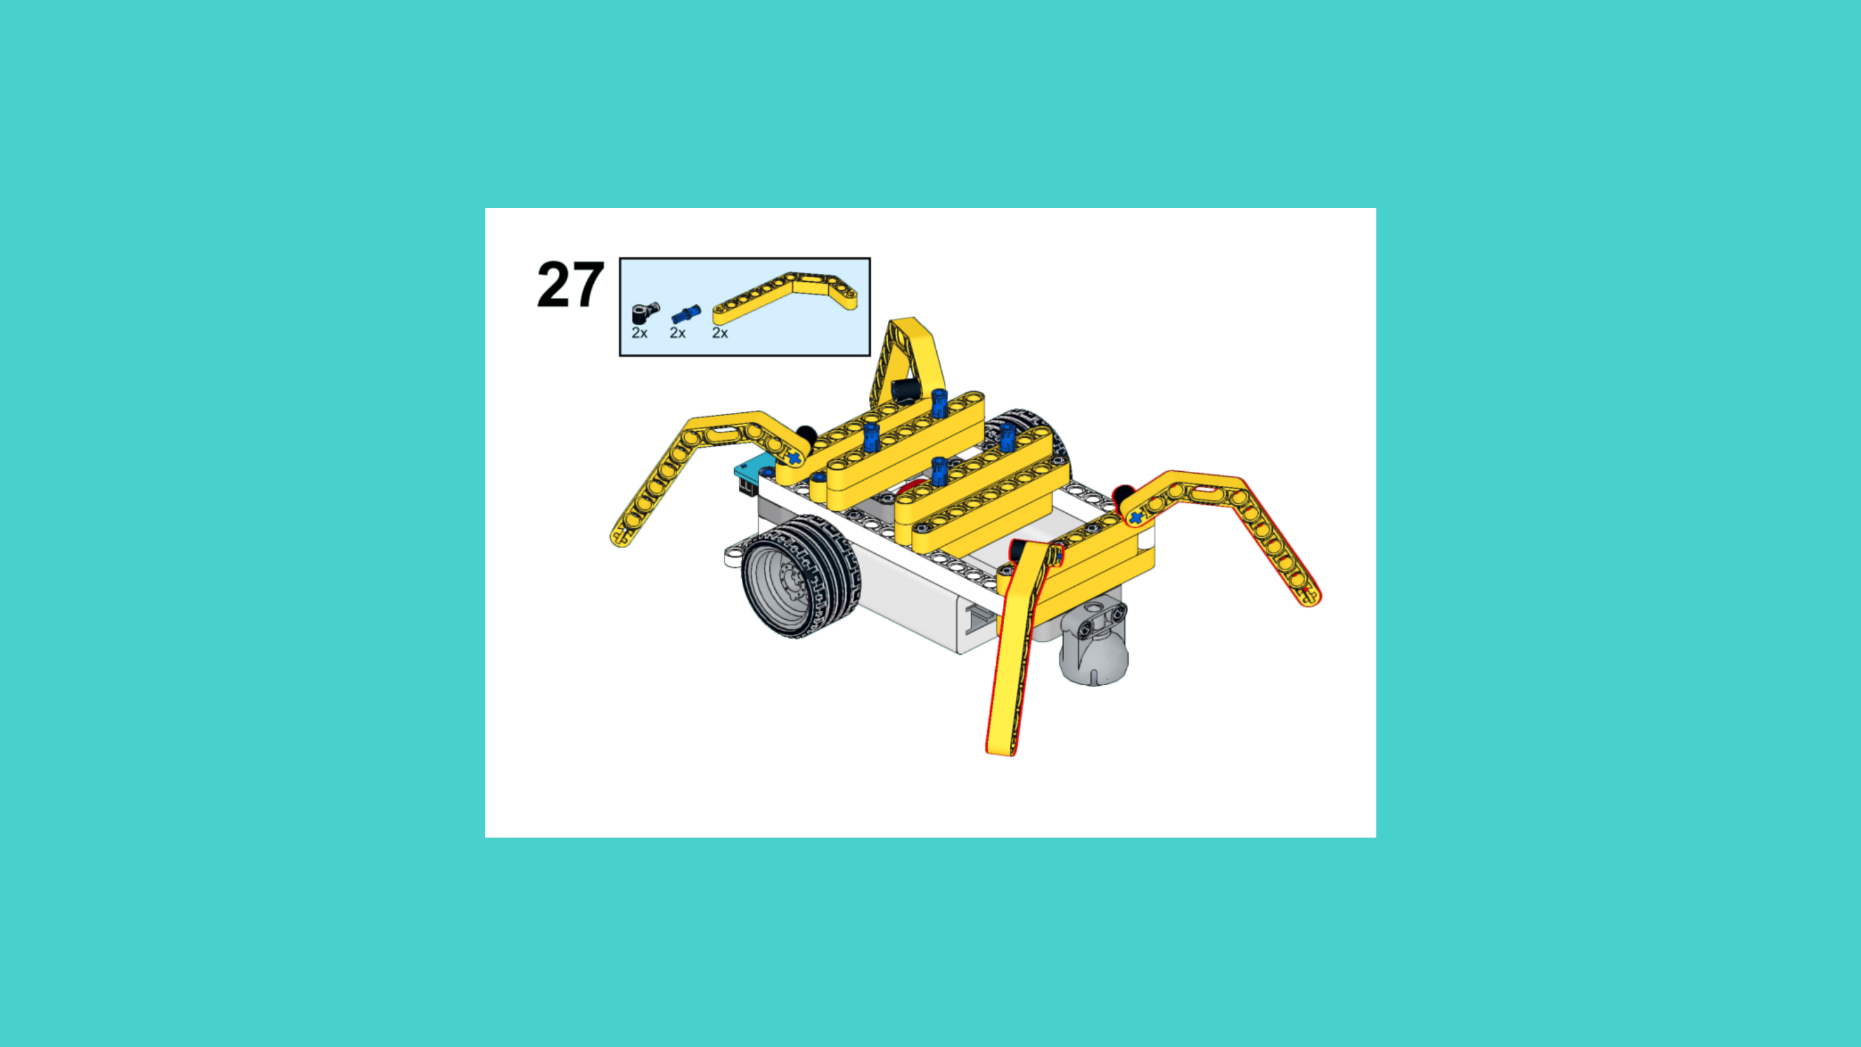
ASSEMBLY STEPS
STEP 25 – 27
PROGRESS: 90% COMPLETE (27 of 30 steps)
STEP 25
STEP 26
STEP 27
THE LANDER · Techtelligence- Elecfreaks
9 / 10

Slide 12
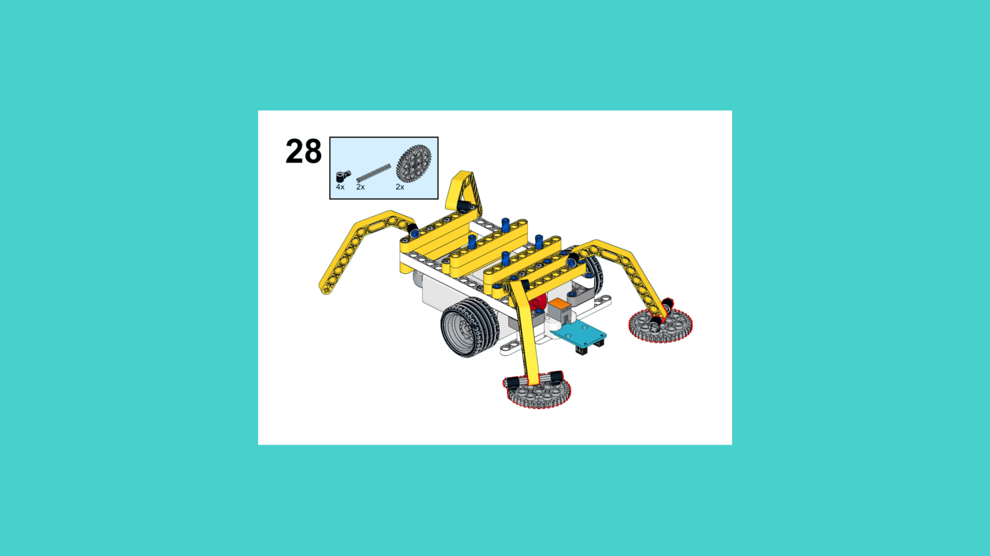
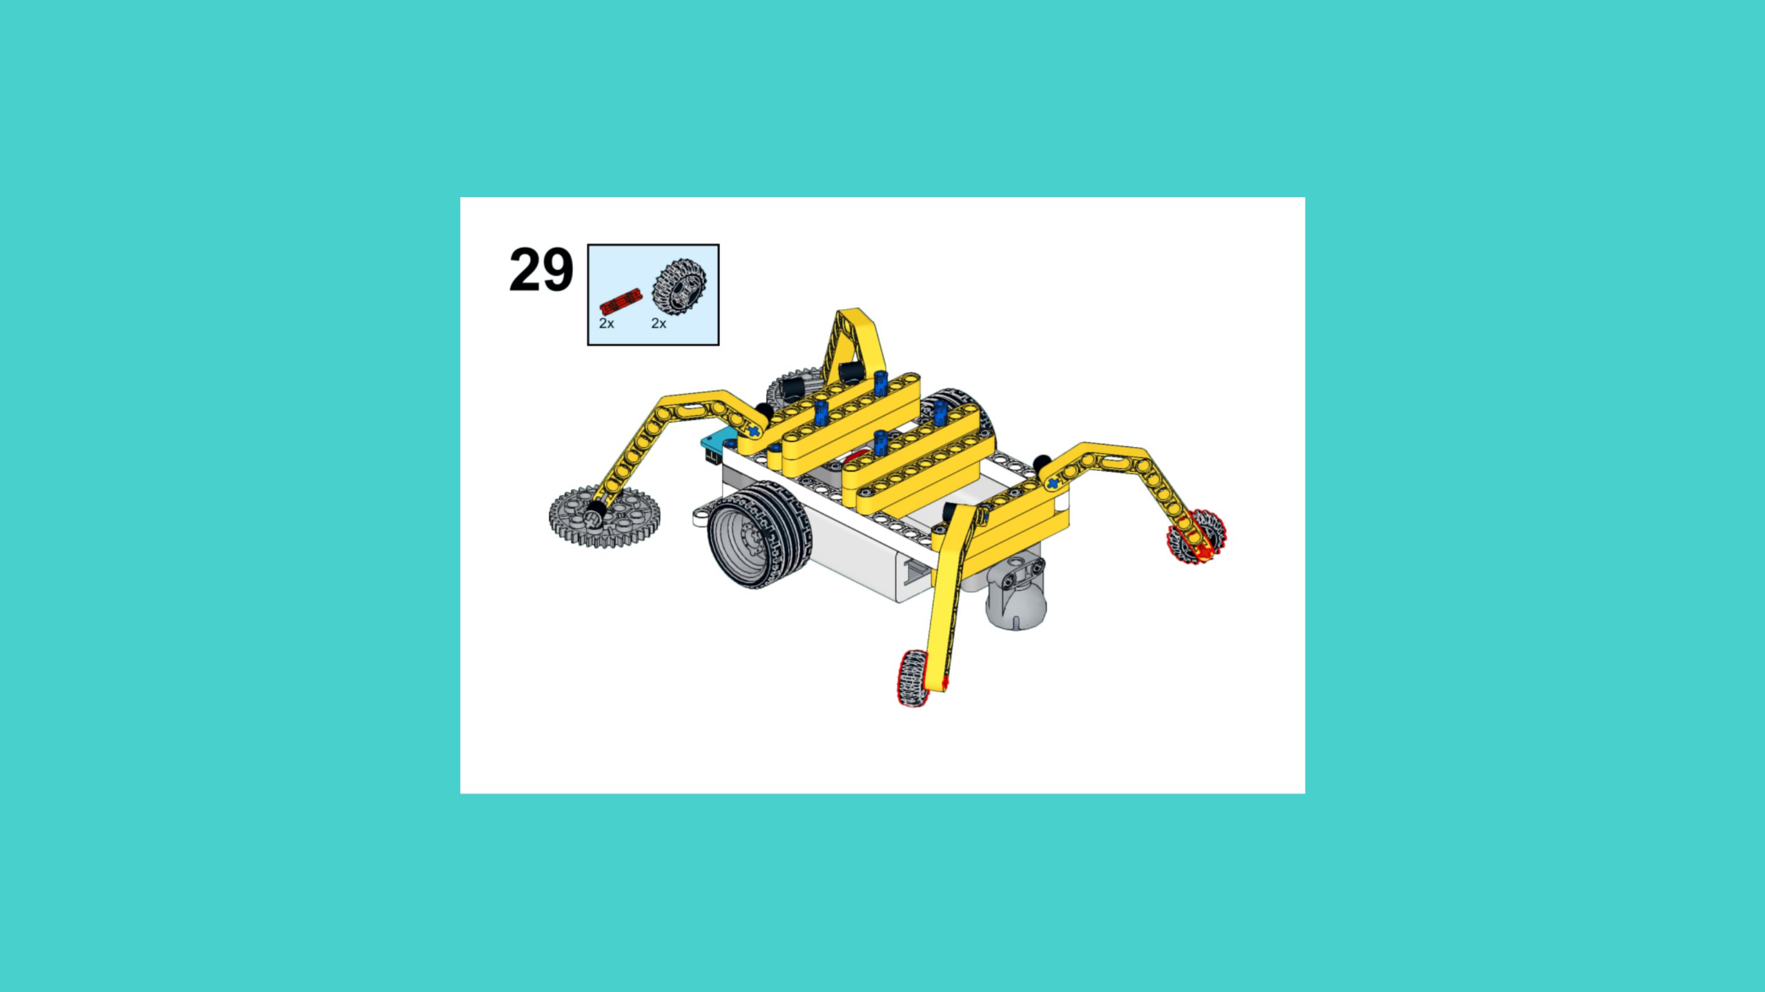
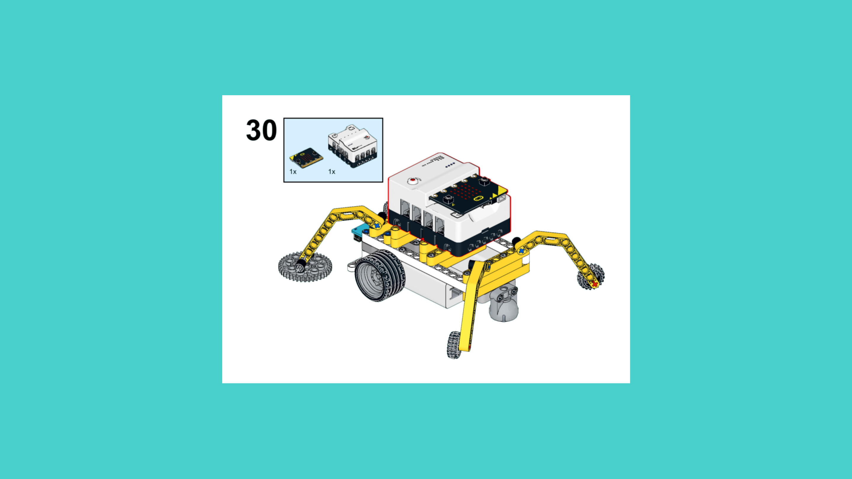
ASSEMBLY STEPS
STEP 28 – 30
PROGRESS: 100% COMPLETE (30 of 30 steps)
STEP 28
STEP 29
STEP 30
THE LANDER · Techtelligence- Elecfreaks
10 / 10

Slide 13
ASSEMBLY
COMPLETE
30 STEPS · THE LANDER · Techtelligence- Elecfreaks
30
10
100%
TOTAL STEPS
SLIDE SECTIONS
COMPLETE

