Slide 1
CASE 05
LUNAR
EXPLORATION
ASSEMBLY GUIDE · SPACE SCIENCE KIT · Techtelligence- Elecfreaks
187 STEPS
TOTAL

Slide 2
DESIGN BRIEF
OBJECTIVE
Assemble the most advanced model in the Space Science Kit series — the Lunar Exploration Vehicle. This comprehensive 187-step build features multi-wheel drive, sensors, a display panel, and a full articulated robotic arm.
DESIGN PRINCIPLES
01. Structural Integrity
Robust modular frame construction ensures stability throughout the entire assembly and operation.
02. Step-by-Step Build
Sequential instruction design guides students from individual components to a complete working model.
03. STEM Integration
Hands-on mechanics reinforce space science, engineering, and robotics concepts at every stage.
04. Scalable Design
Standardised connectors and components allow for reconfiguration and adaptation of the final model.
Techtelligence- Elecfreaks · LUNAR EXPLORATION

Slide 3
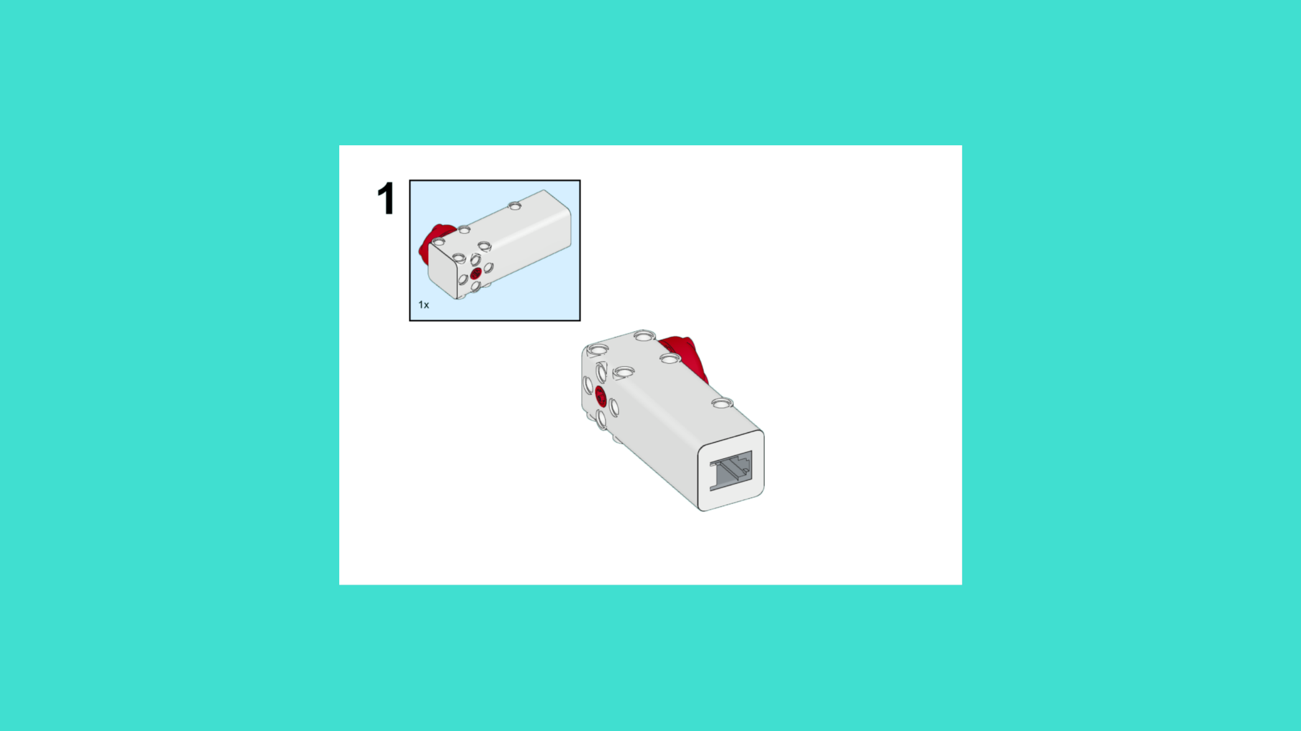
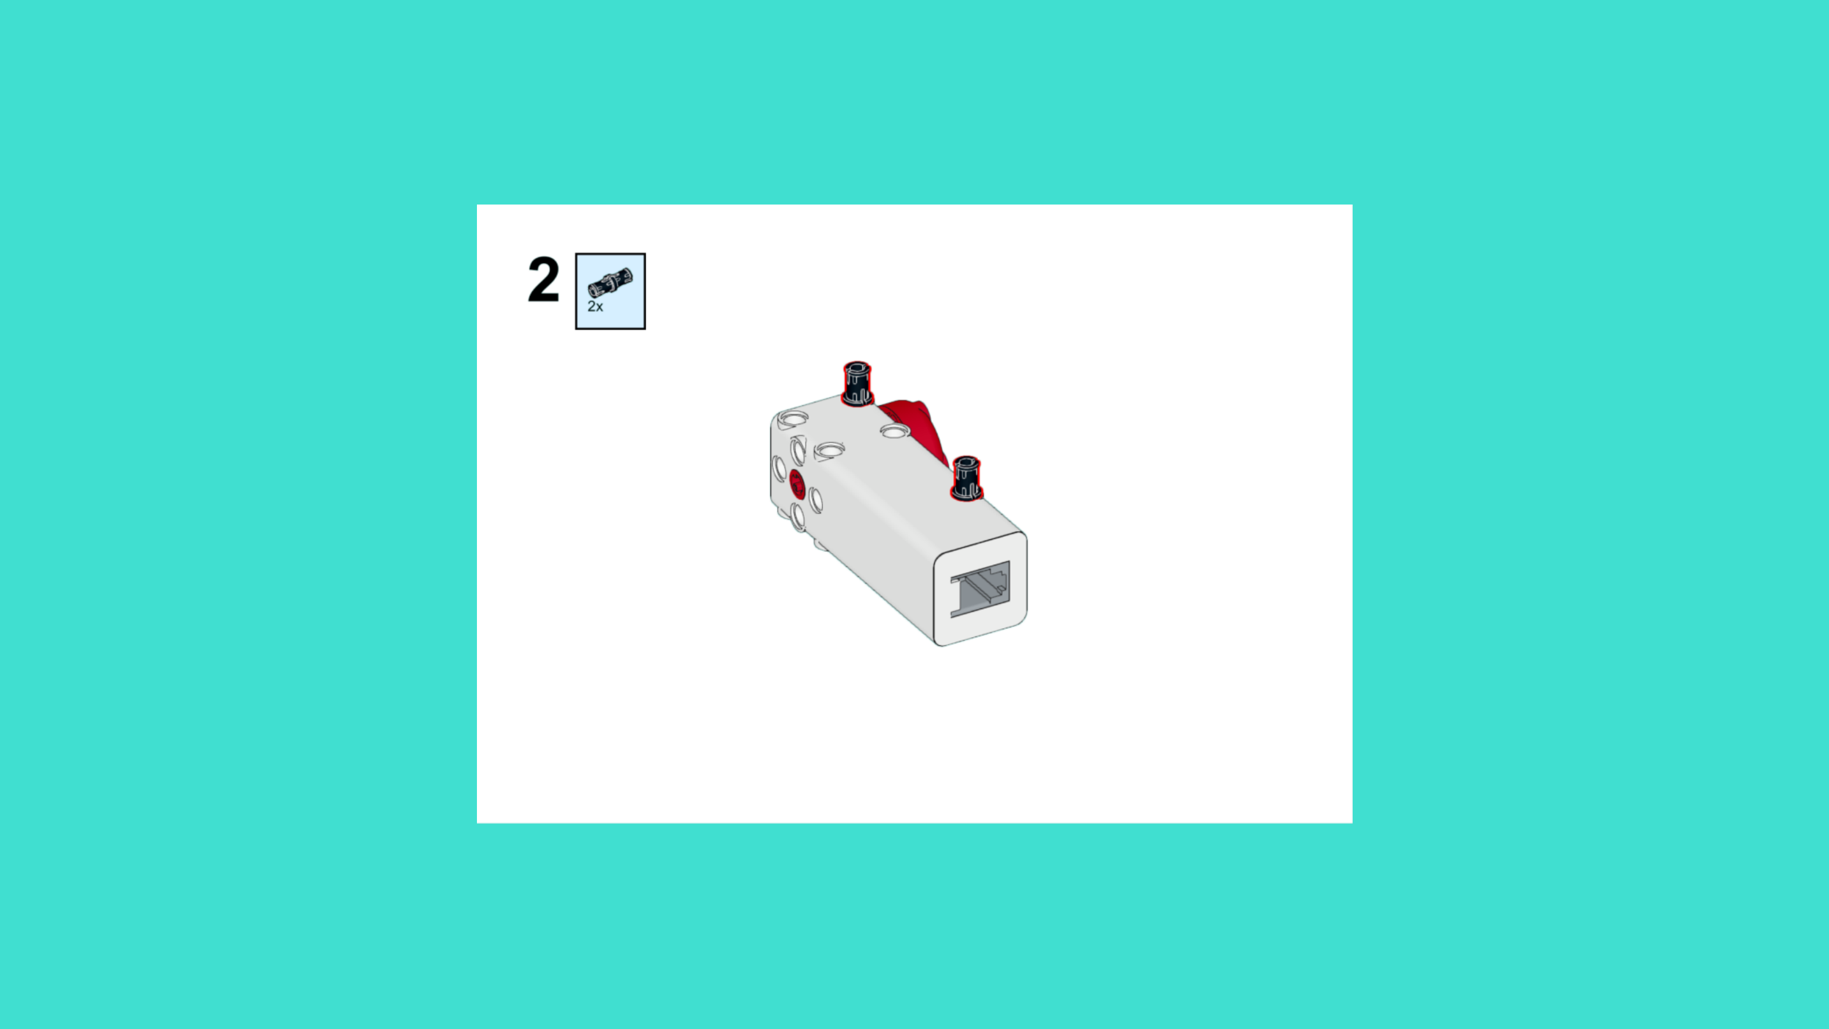
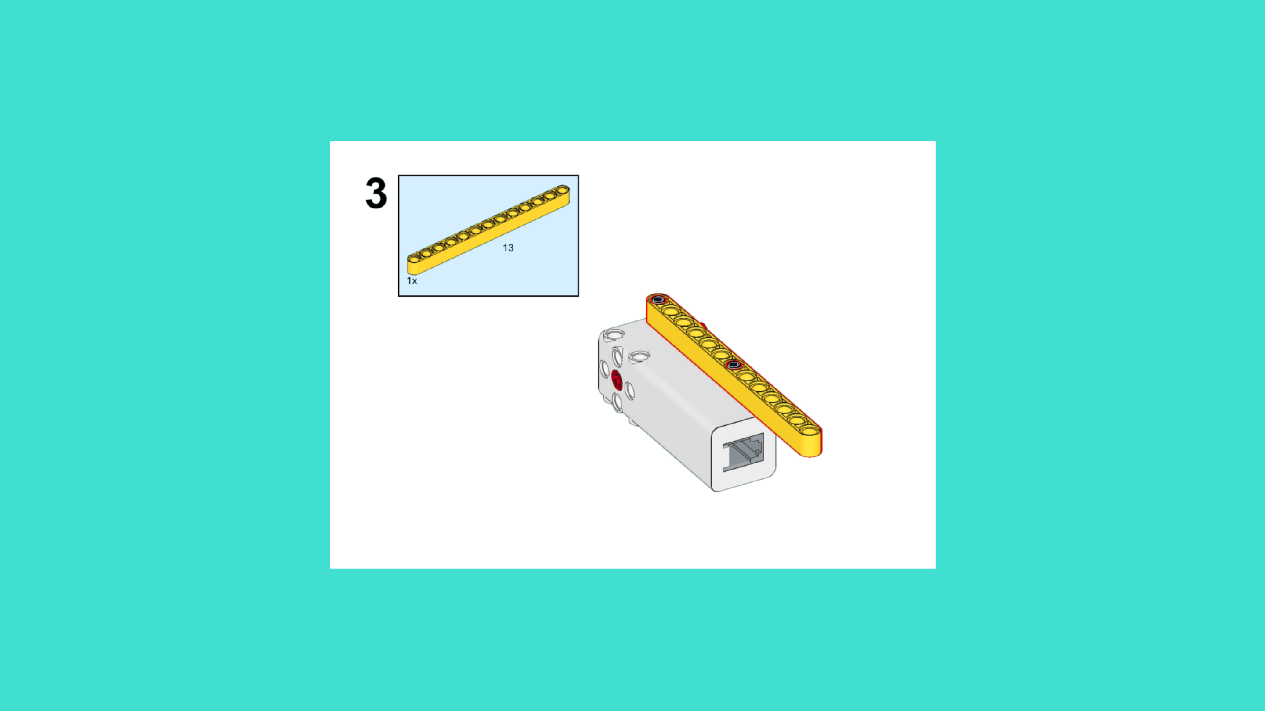
ASSEMBLY STEPS
STEP 1 – 3
PROGRESS: 2% COMPLETE (3 of 187 steps)
STEP 1
STEP 2
STEP 3
LUNAR EXPLORATION · Techtelligence- Elecfreaks
1 / 63

Slide 4
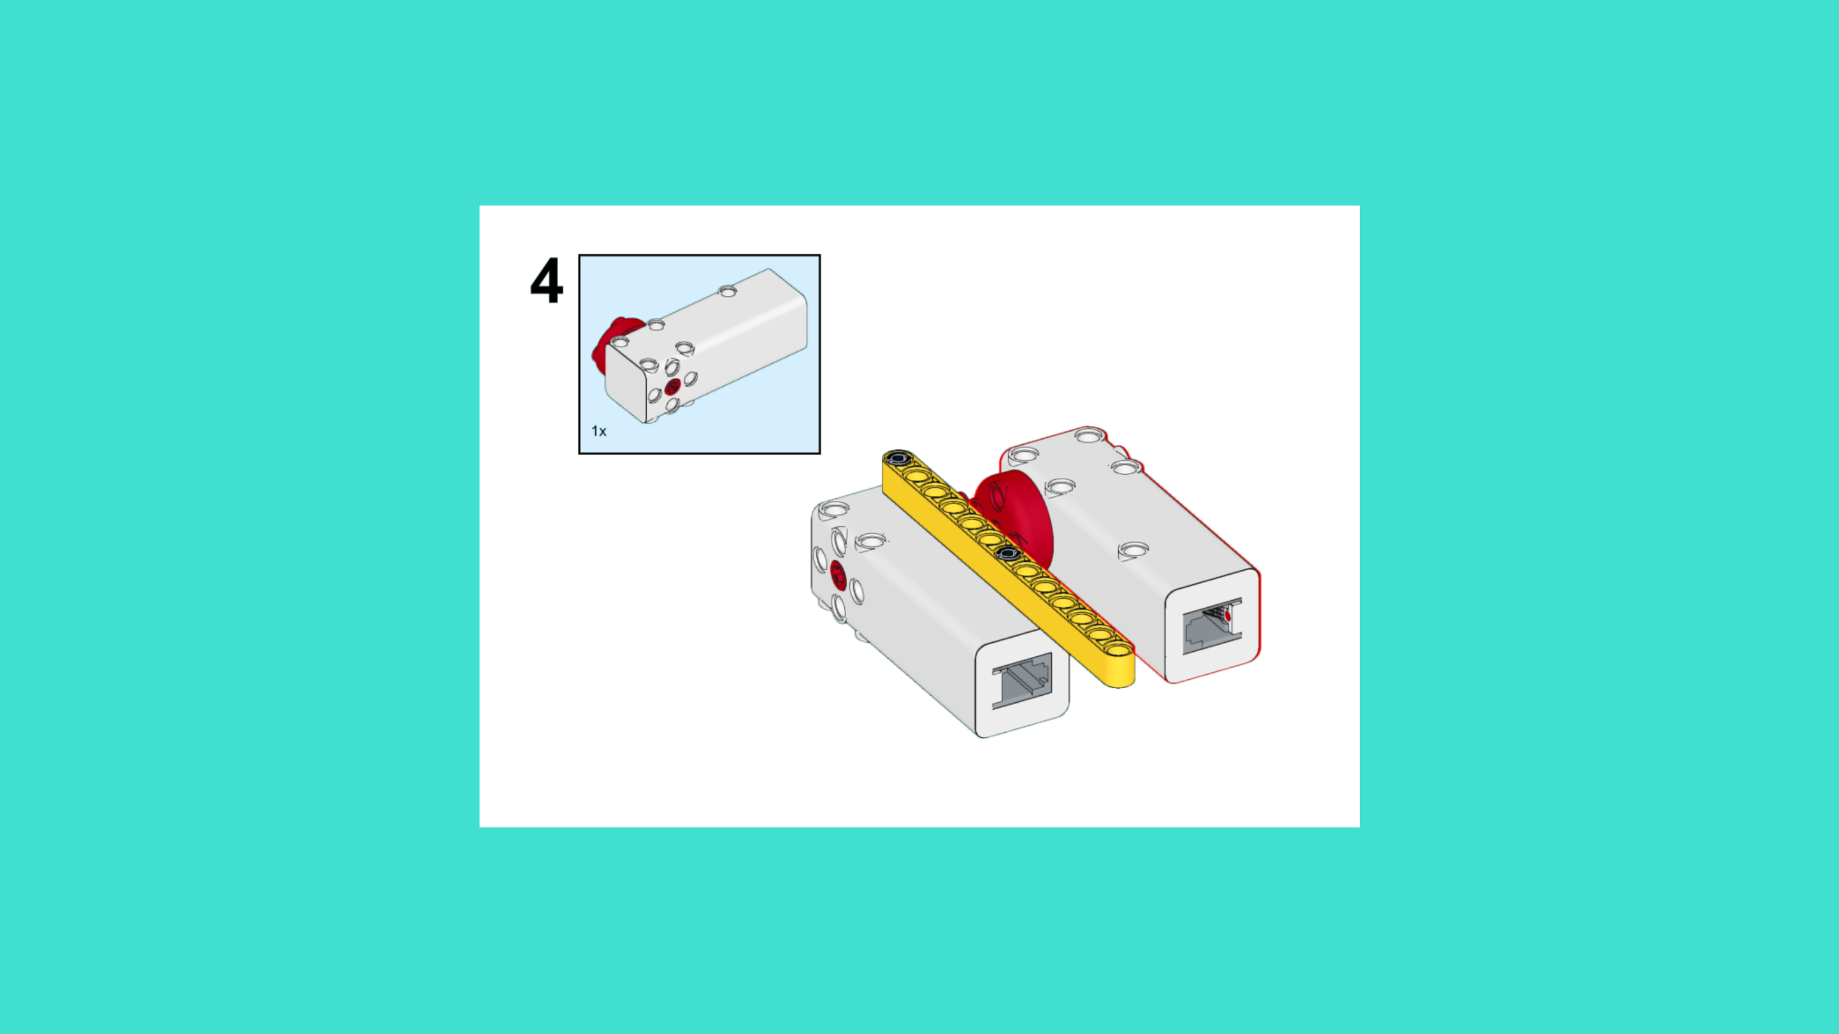
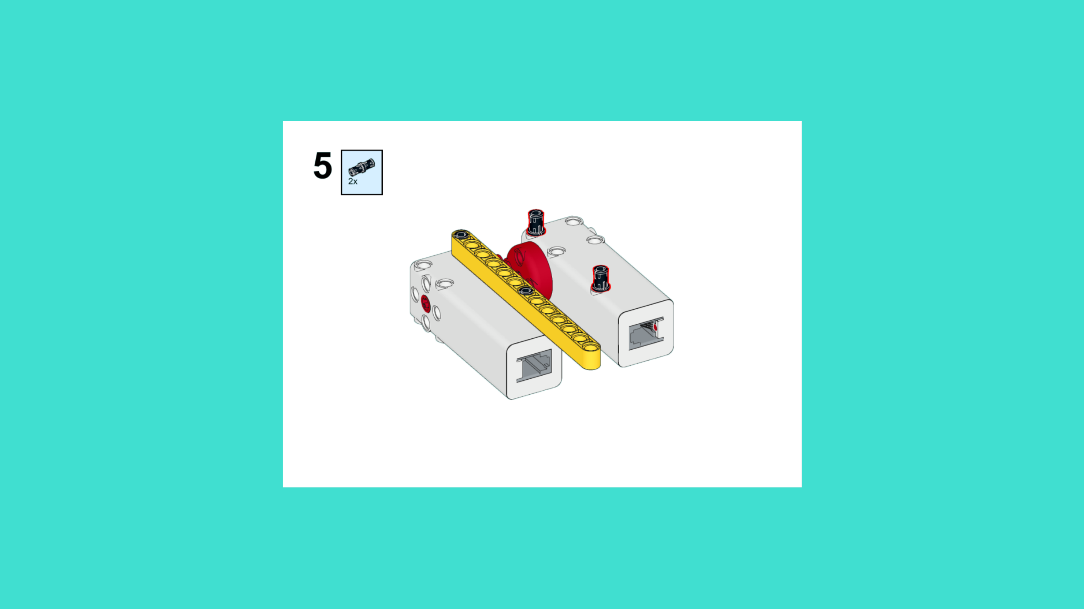
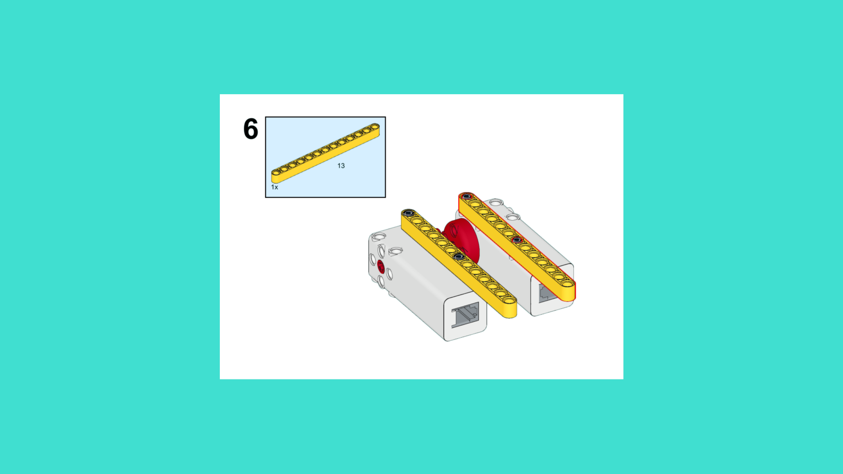
ASSEMBLY STEPS
STEP 4 – 6
PROGRESS: 3% COMPLETE (6 of 187 steps)
STEP 4
STEP 5
STEP 6
LUNAR EXPLORATION · Techtelligence- Elecfreaks
2 / 63

Slide 5
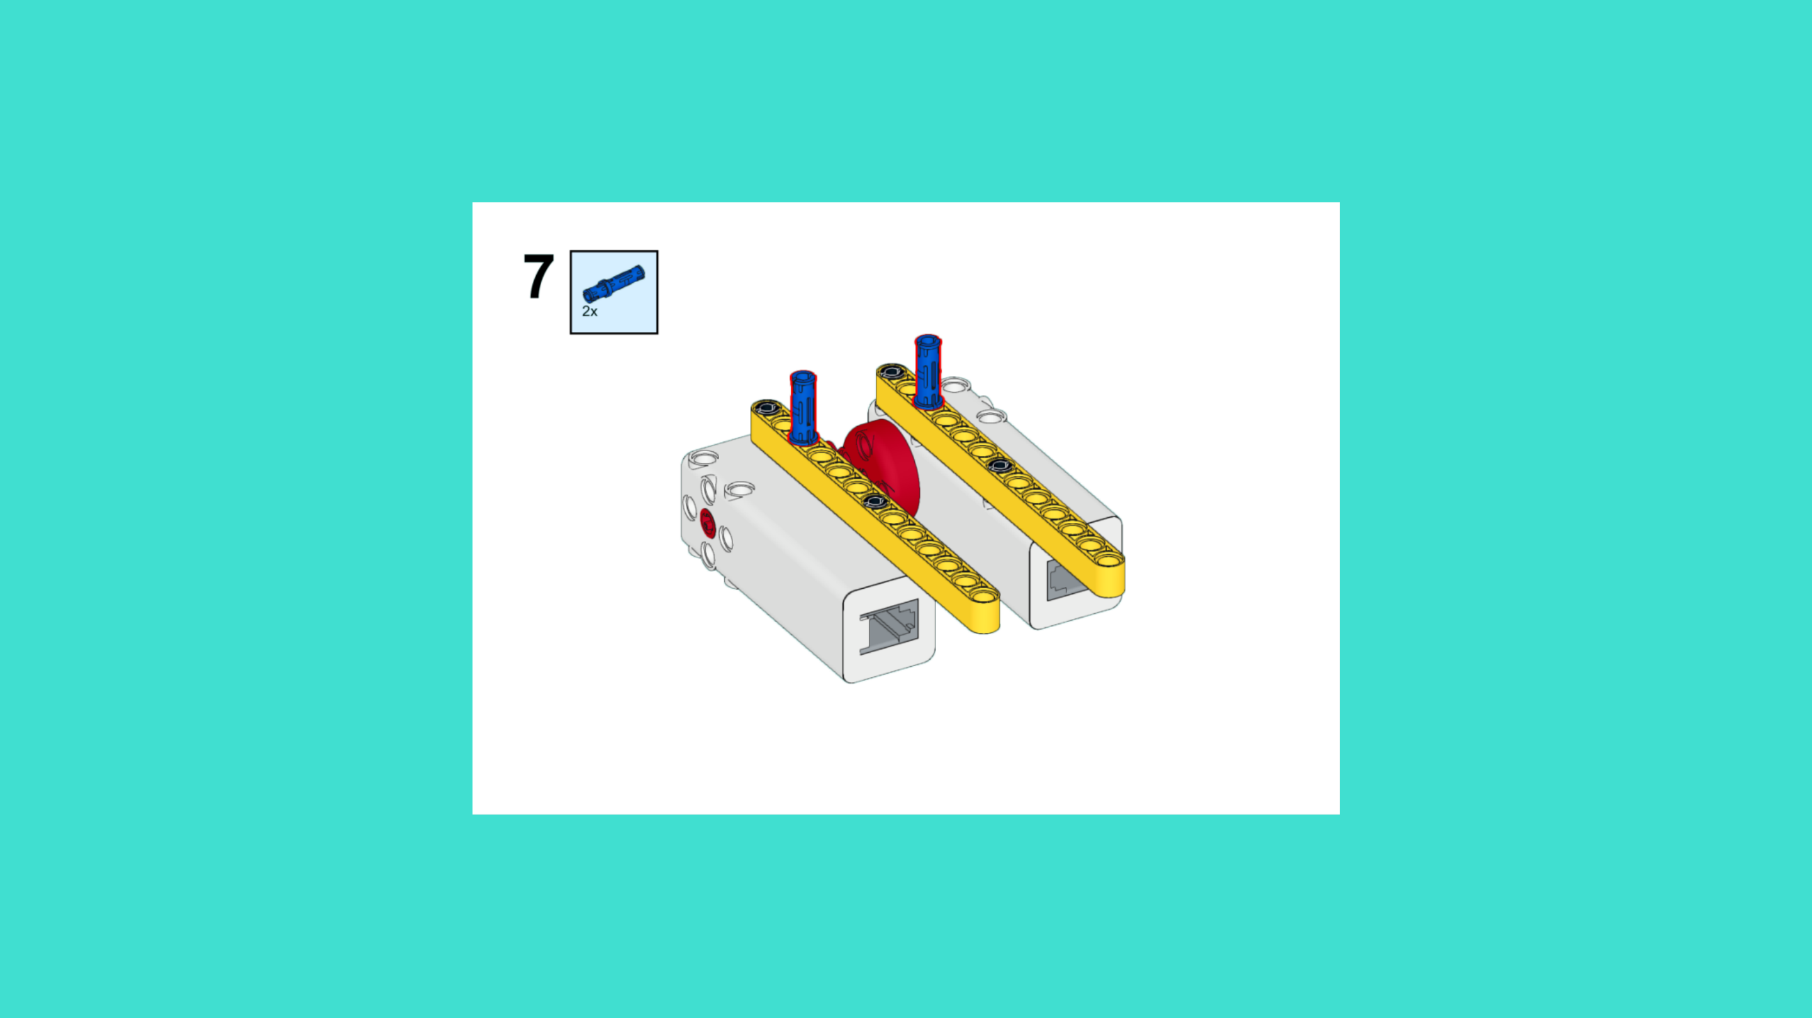
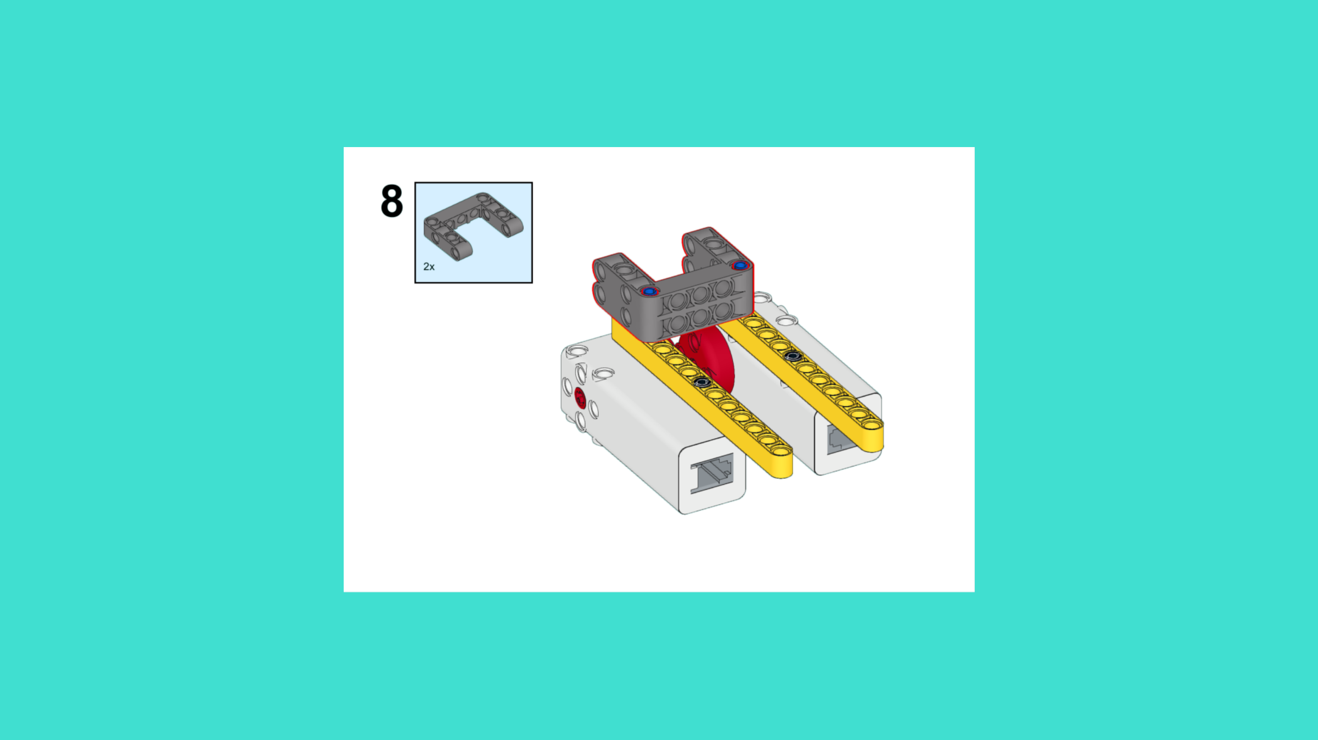
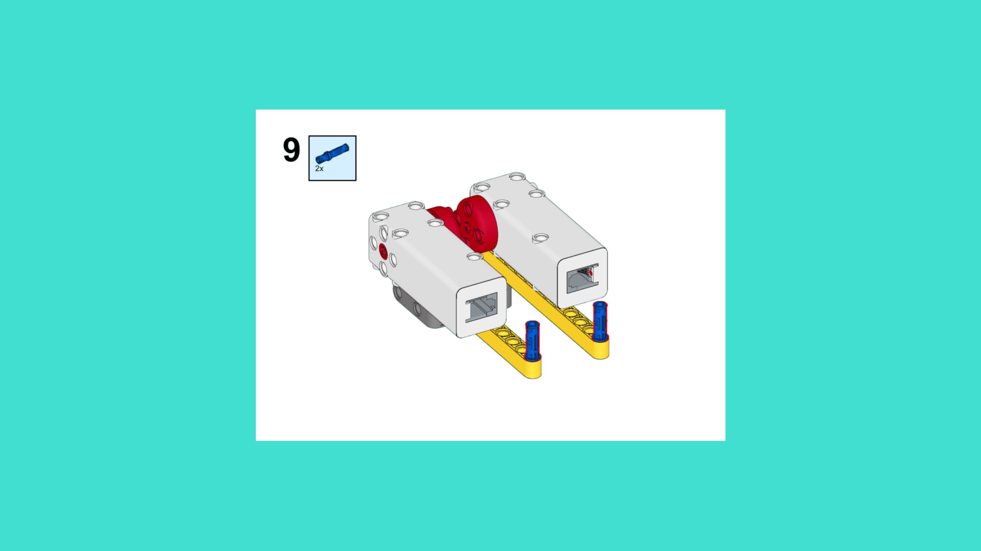
ASSEMBLY STEPS
STEP 7 – 9
PROGRESS: 5% COMPLETE (9 of 187 steps)
STEP 7
STEP 8
STEP 9
LUNAR EXPLORATION · Techtelligence- Elecfreaks
3 / 63

Slide 6
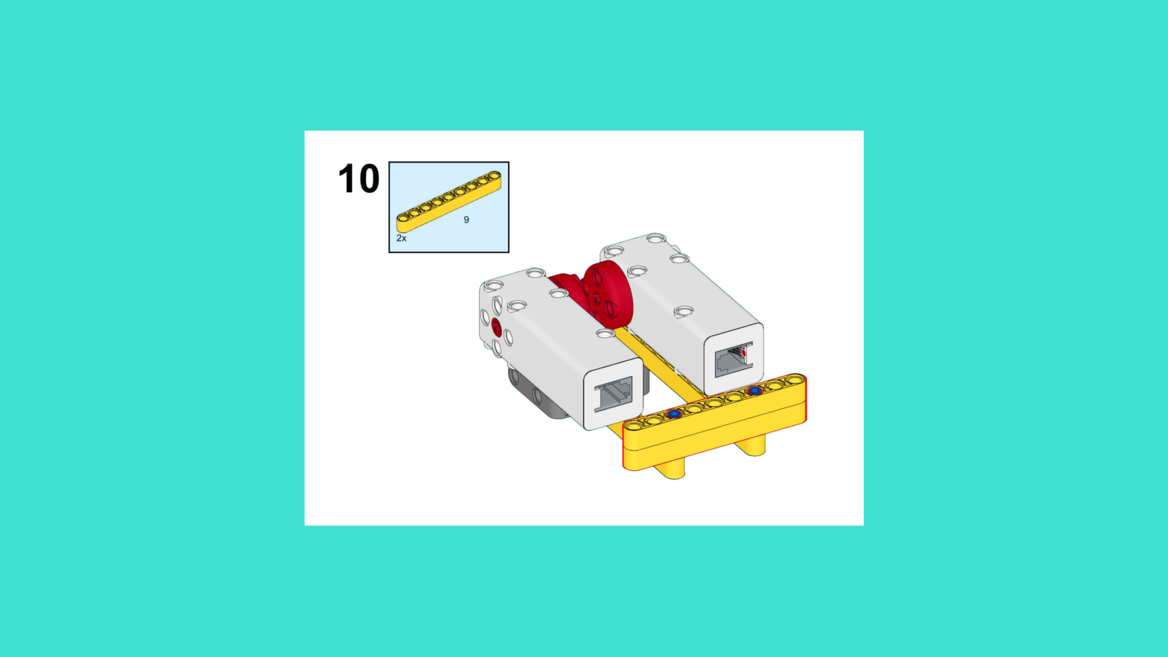
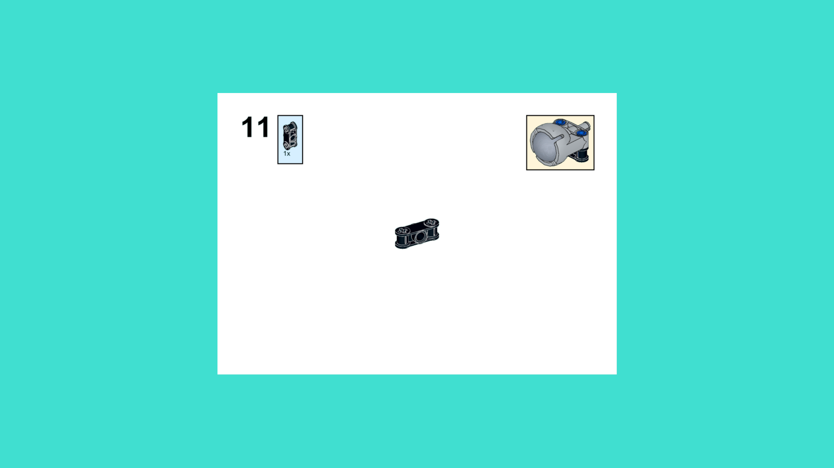

ASSEMBLY STEPS
STEP 10 – 12
PROGRESS: 6% COMPLETE (12 of 187 steps)
STEP 10
STEP 11
STEP 12
LUNAR EXPLORATION · Techtelligence- Elecfreaks
4 / 63

Slide 7
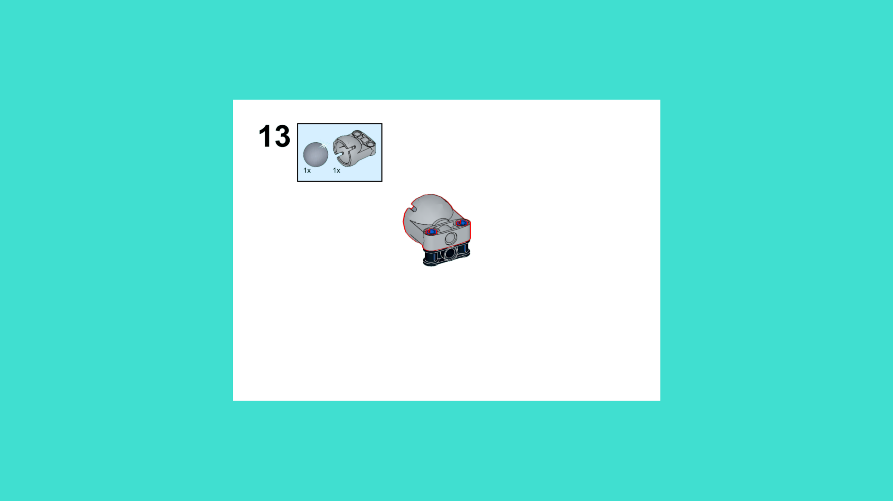
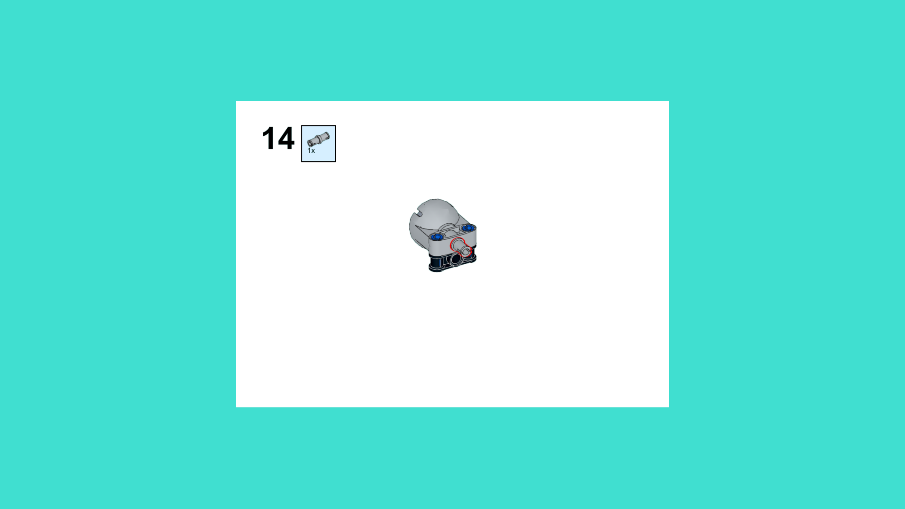
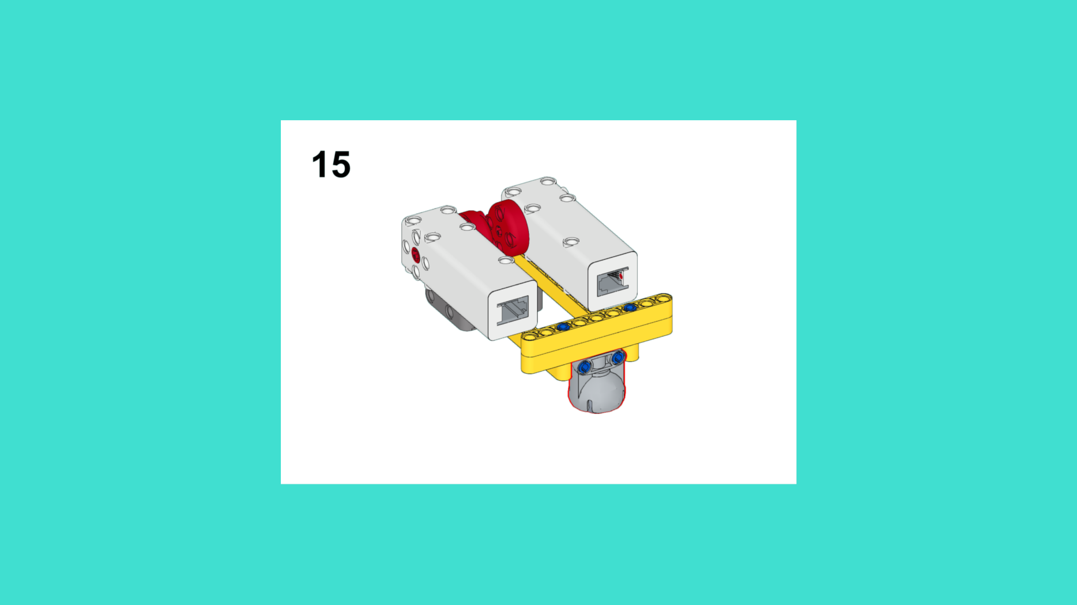
ASSEMBLY STEPS
STEP 13 – 15
PROGRESS: 8% COMPLETE (15 of 187 steps)
STEP 13
STEP 14
STEP 15
LUNAR EXPLORATION · Techtelligence- Elecfreaks
5 / 63

Slide 8
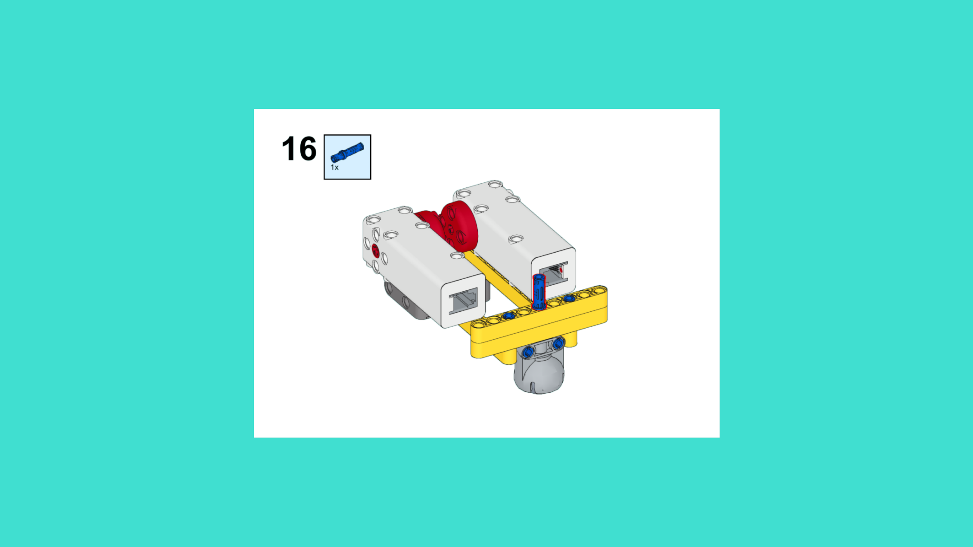
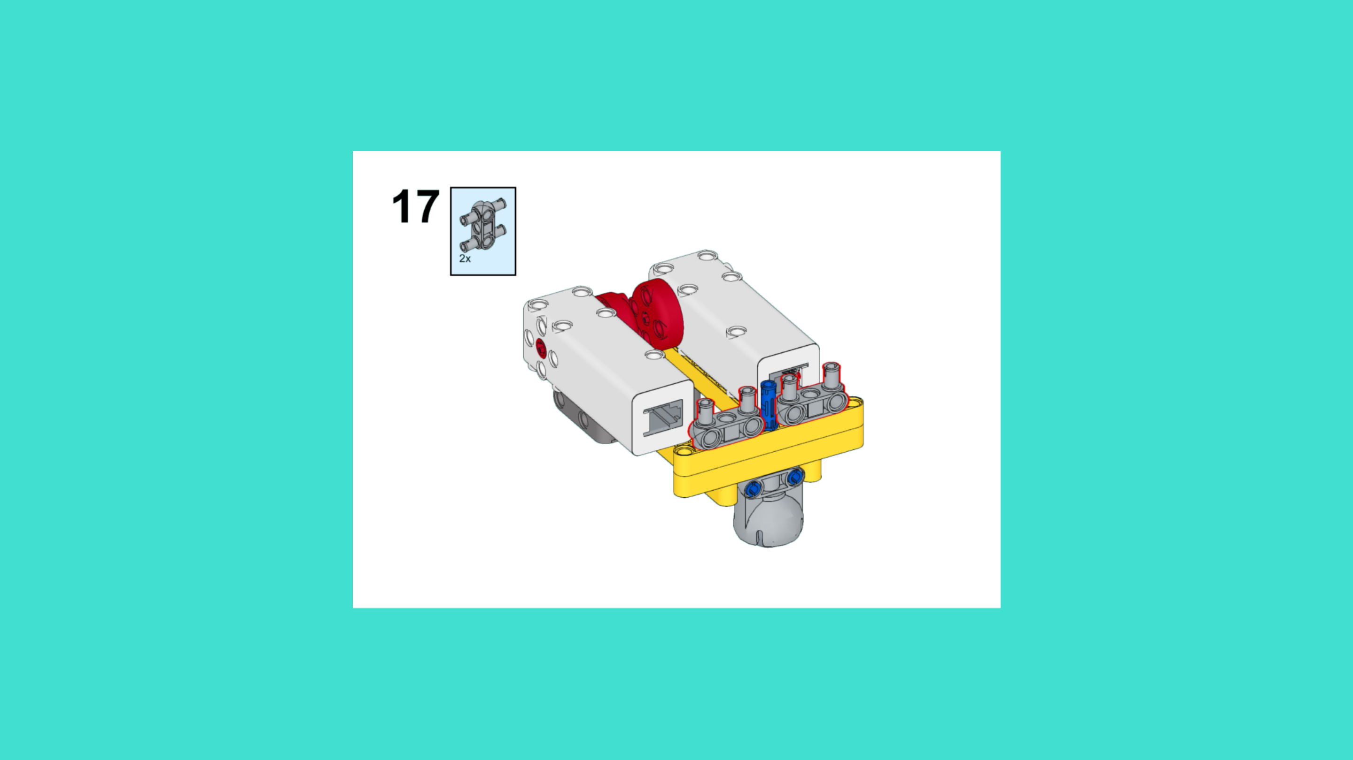
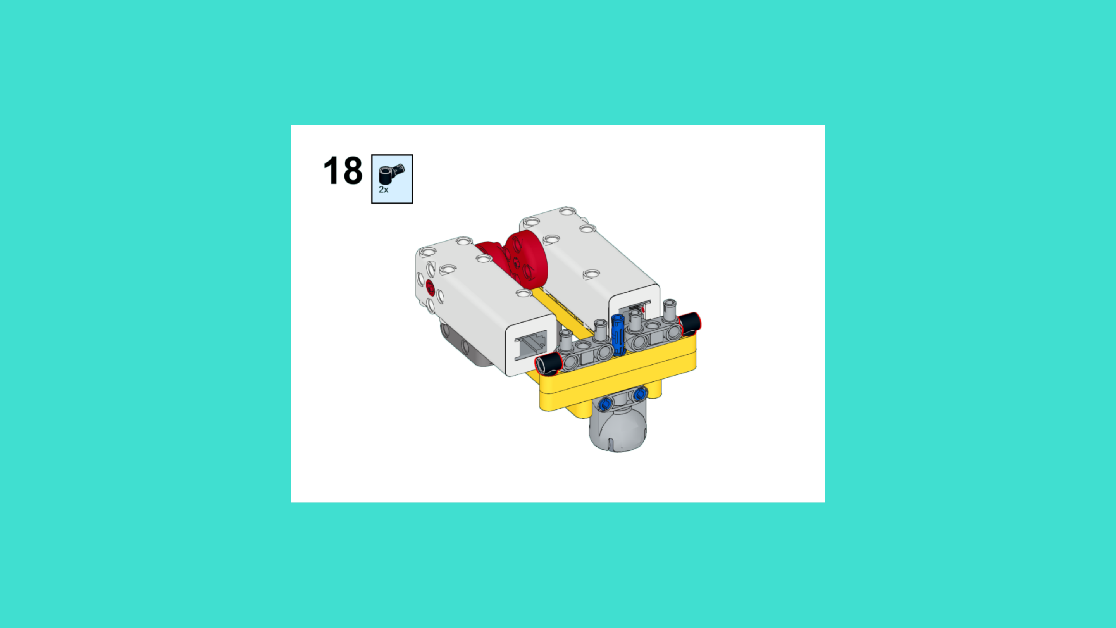
ASSEMBLY STEPS
STEP 16 – 18
PROGRESS: 10% COMPLETE (18 of 187 steps)
STEP 16
STEP 17
STEP 18
LUNAR EXPLORATION · Techtelligence- Elecfreaks
6 / 63

Slide 9
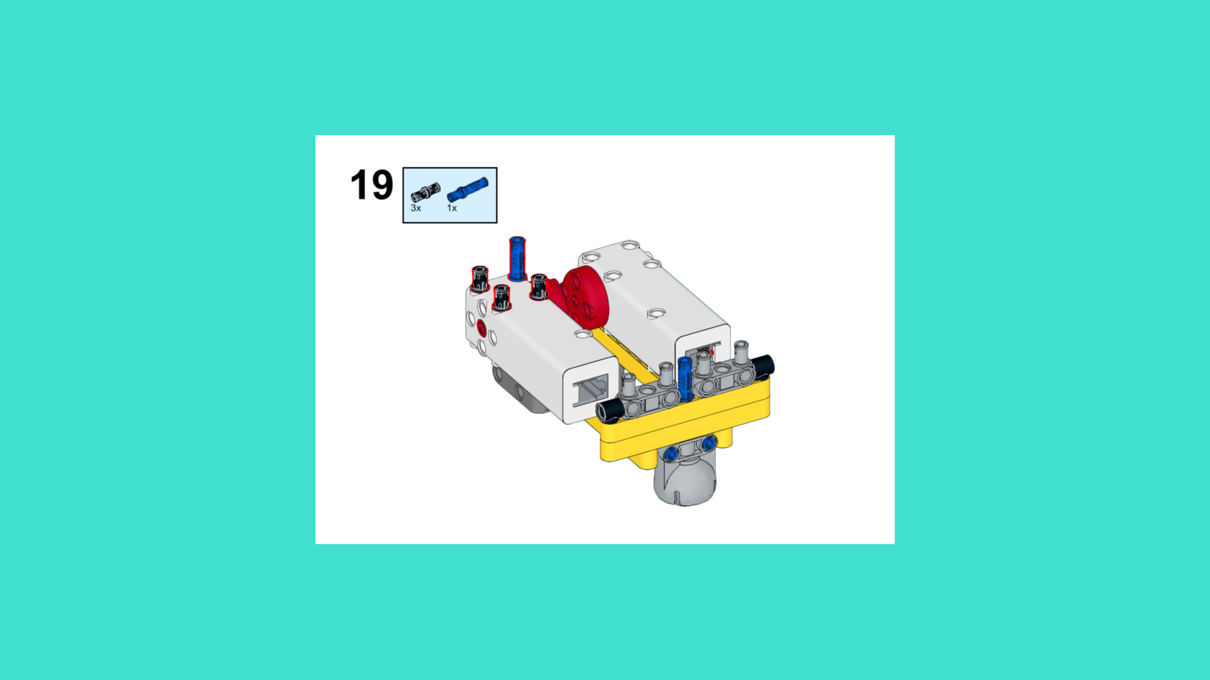
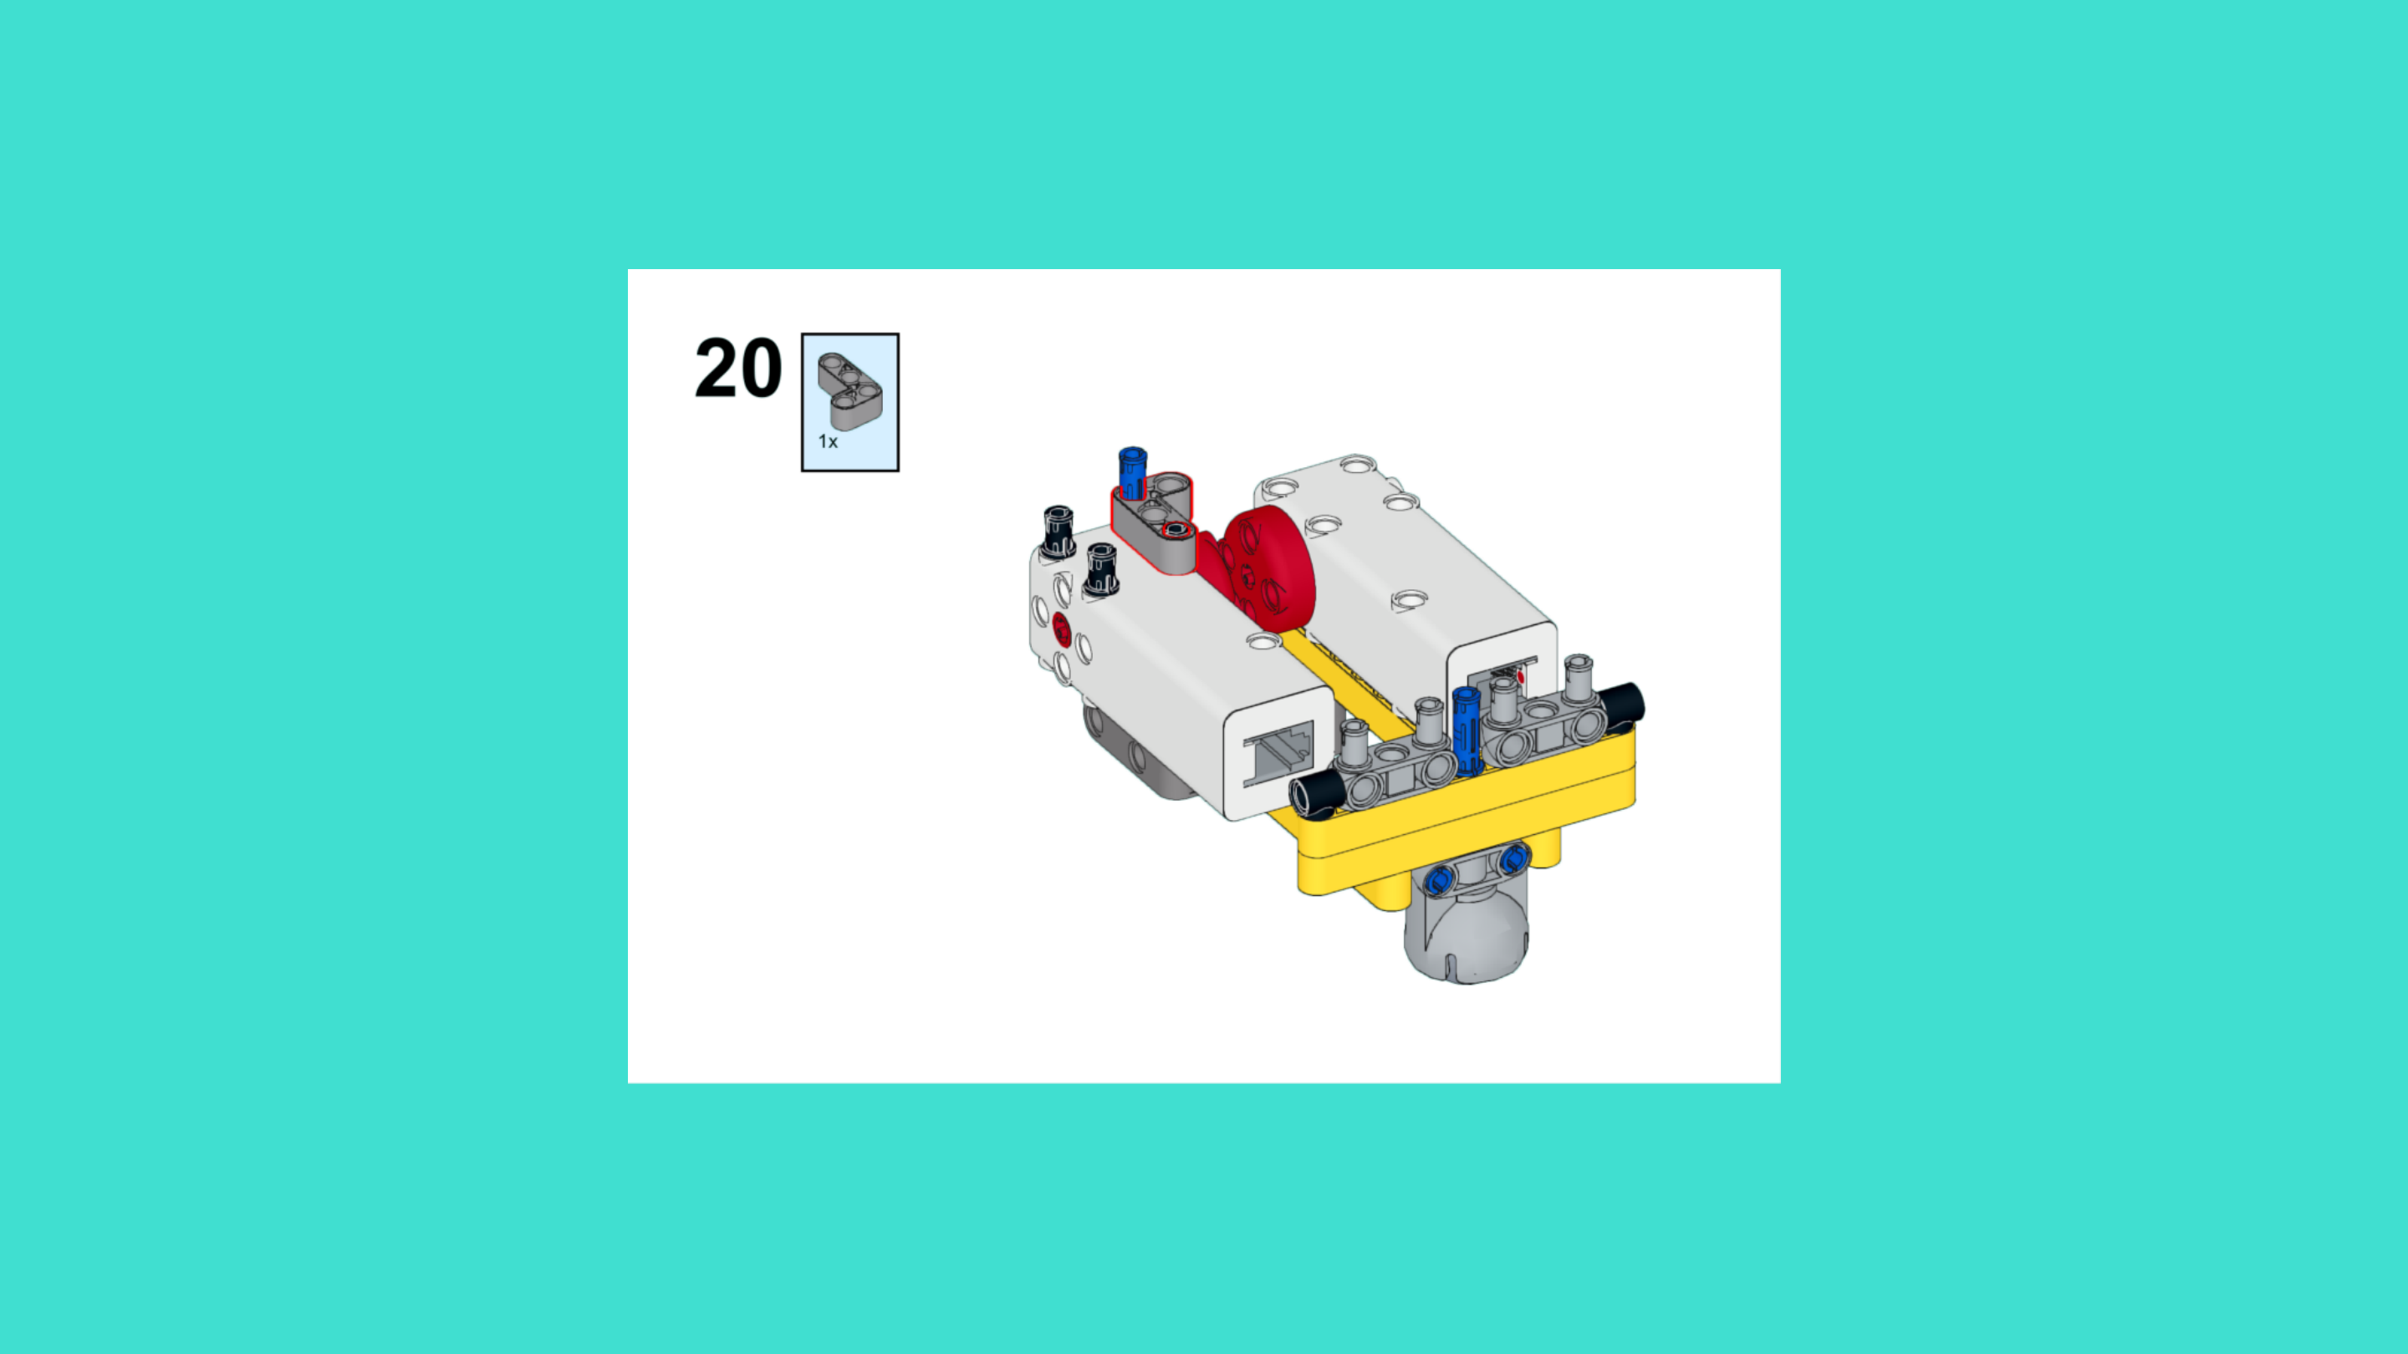
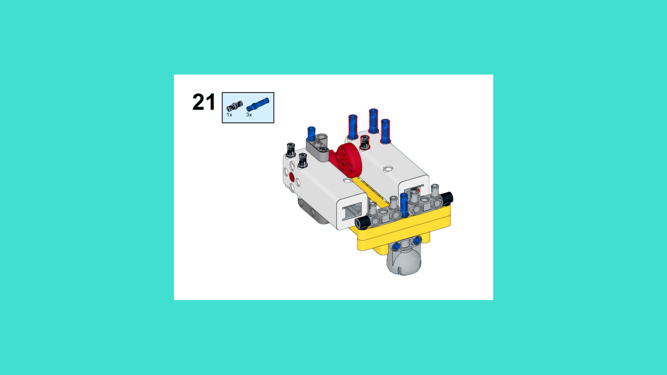
ASSEMBLY STEPS
STEP 19 – 21
PROGRESS: 11% COMPLETE (21 of 187 steps)
STEP 19
STEP 20
STEP 21
LUNAR EXPLORATION · Techtelligence- Elecfreaks
7 / 63

Slide 10
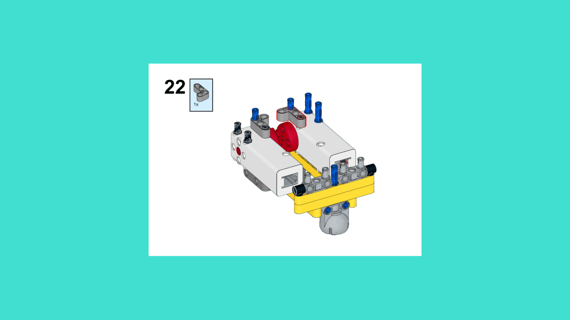
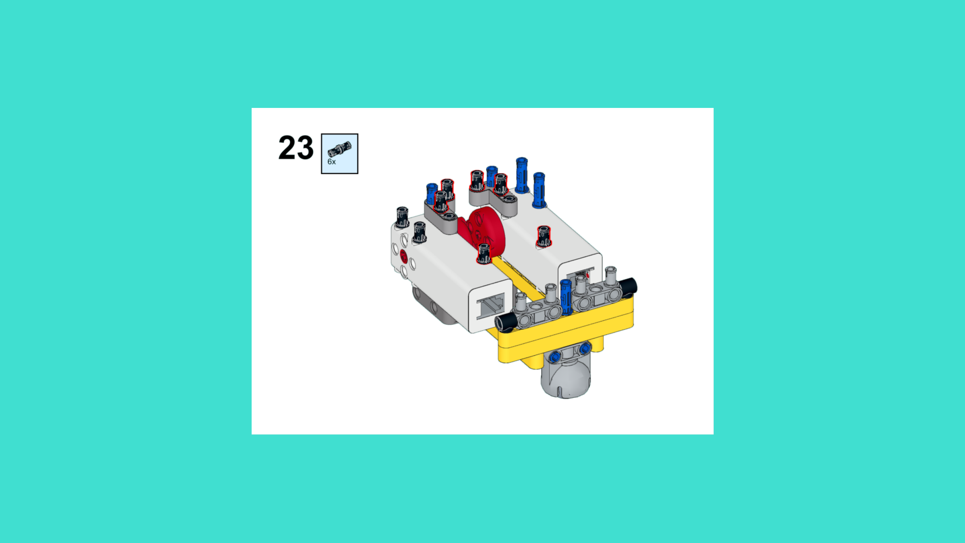
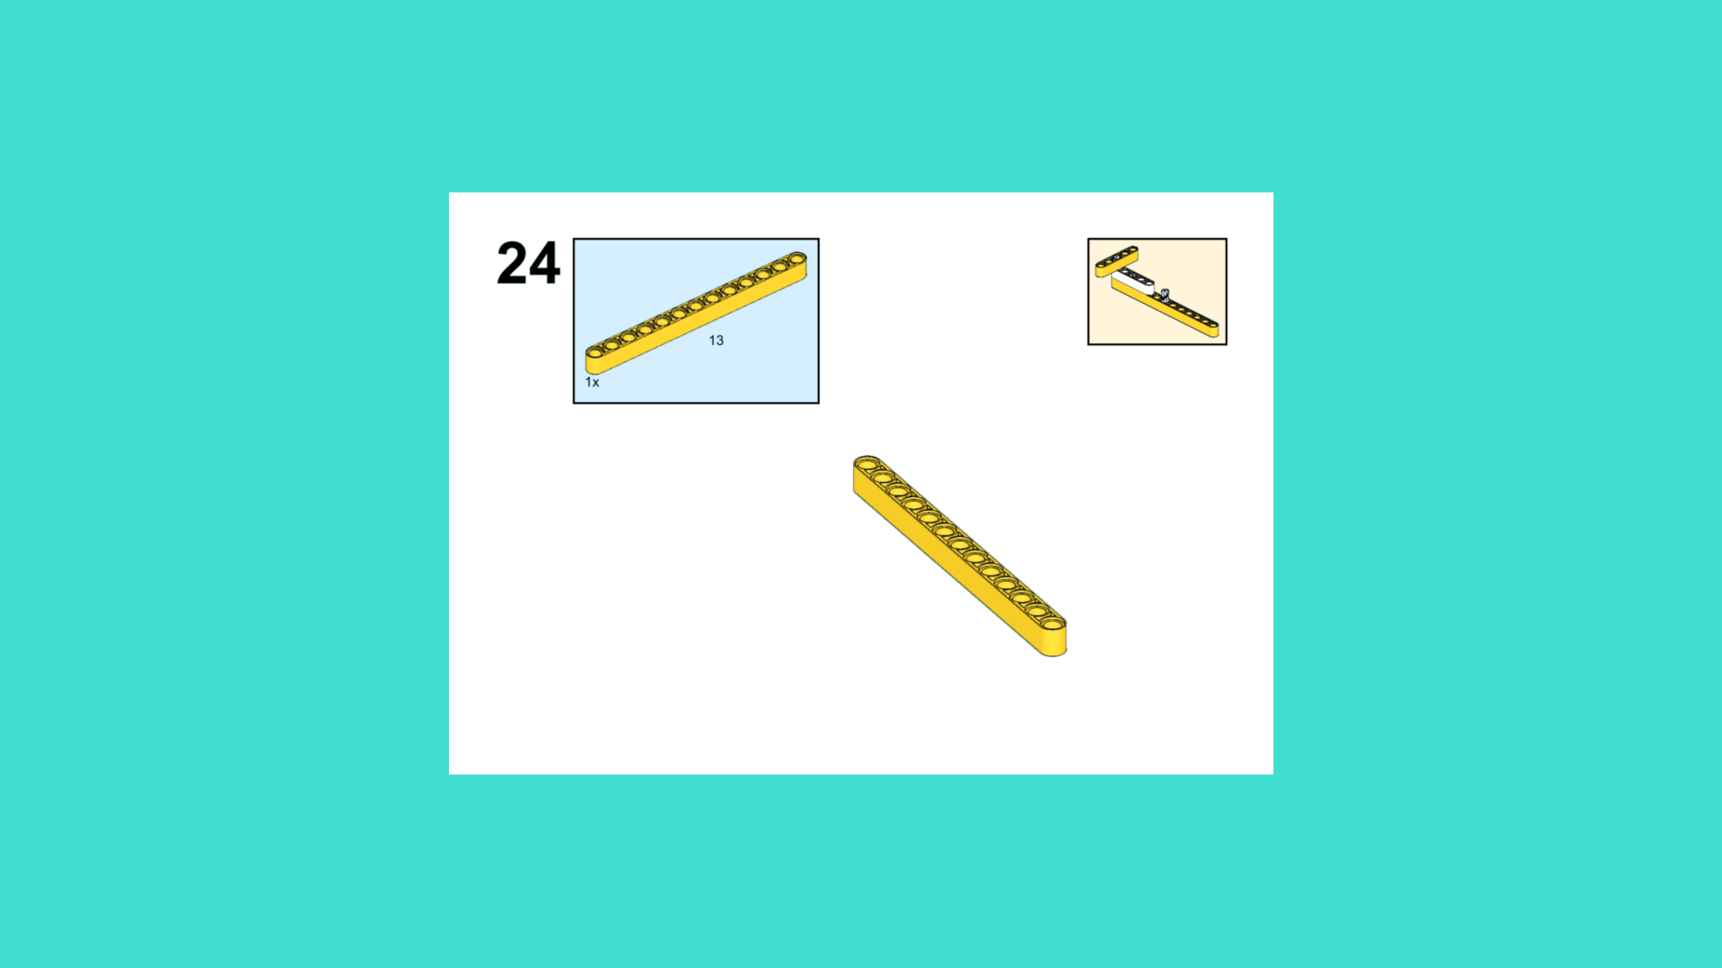
ASSEMBLY STEPS
STEP 22 – 24
PROGRESS: 13% COMPLETE (24 of 187 steps)
STEP 22
STEP 23
STEP 24
LUNAR EXPLORATION · Techtelligence- Elecfreaks
8 / 63

Slide 11
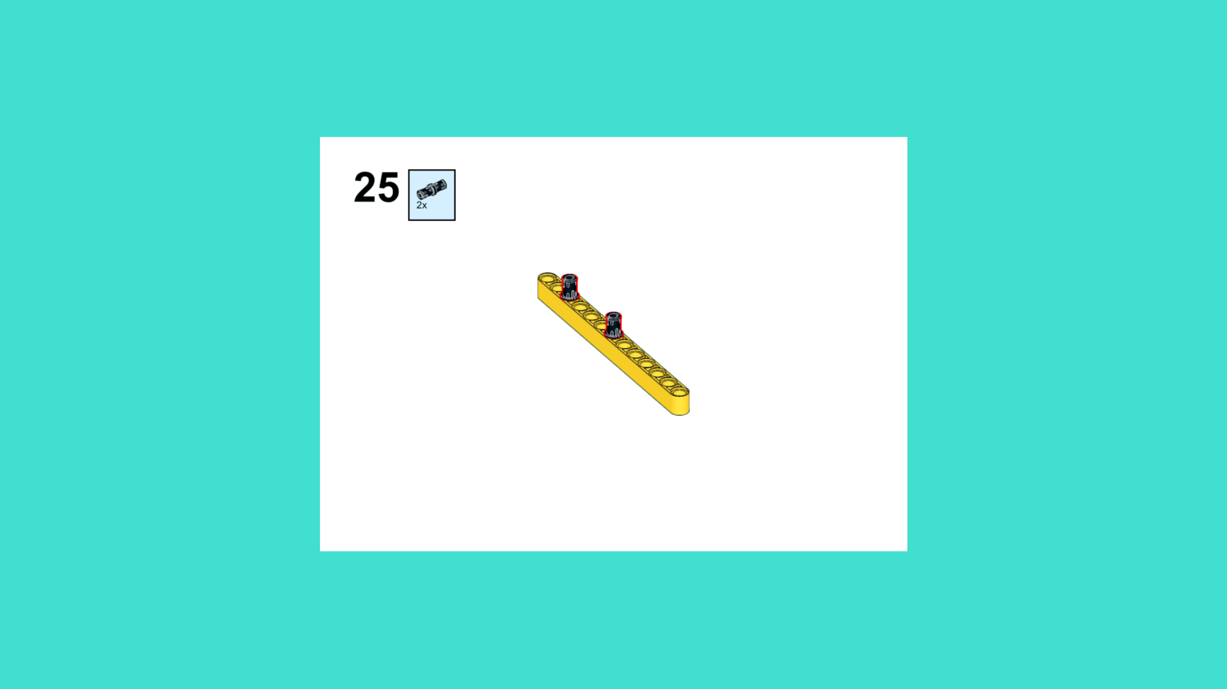
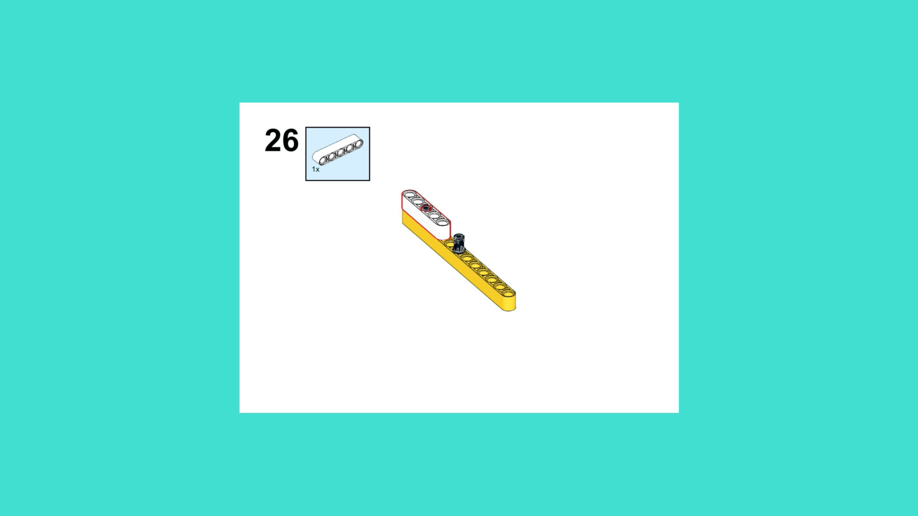
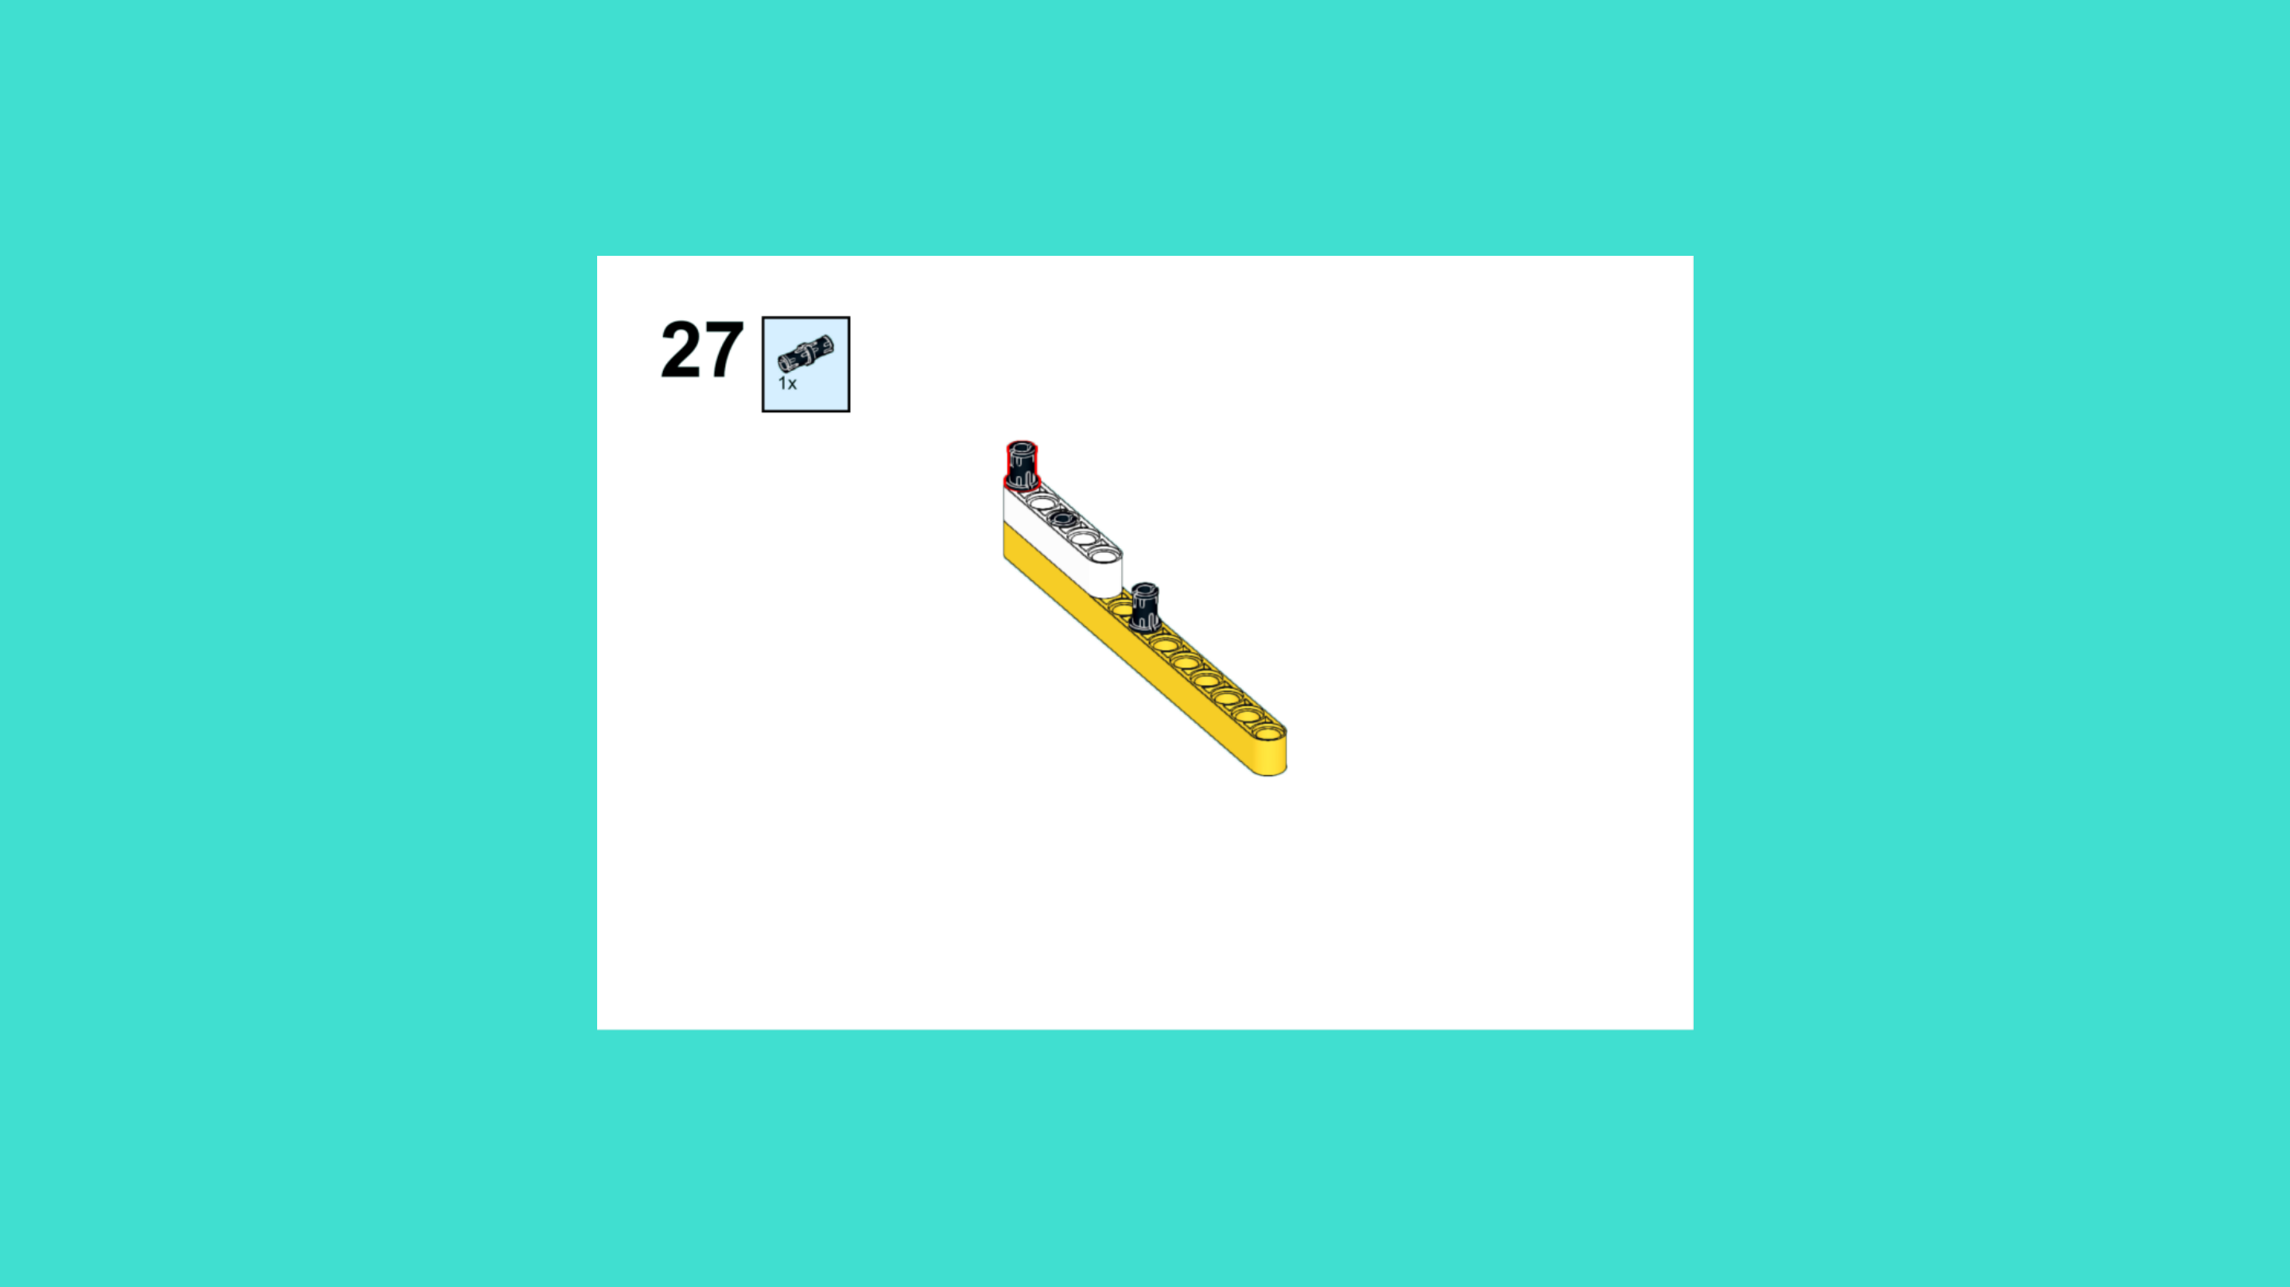
ASSEMBLY STEPS
STEP 25 – 27
PROGRESS: 14% COMPLETE (27 of 187 steps)
STEP 25
STEP 26
STEP 27
LUNAR EXPLORATION · Techtelligence- Elecfreaks
9 / 63

Slide 12
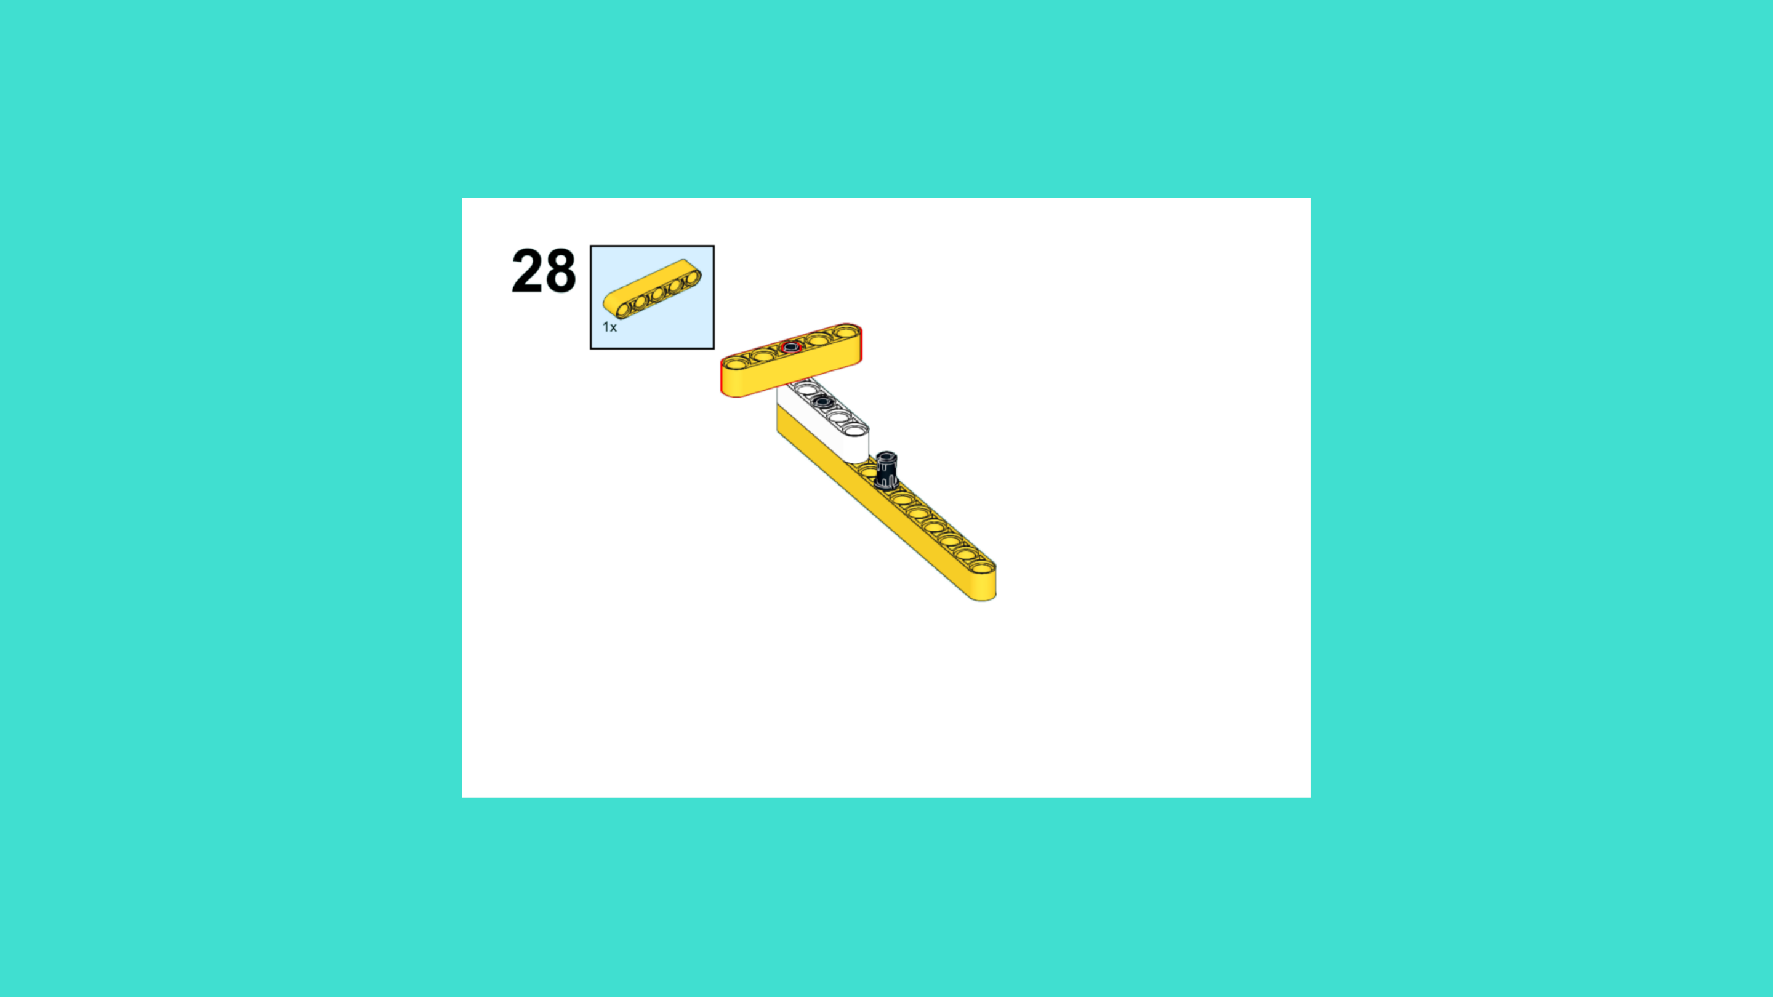
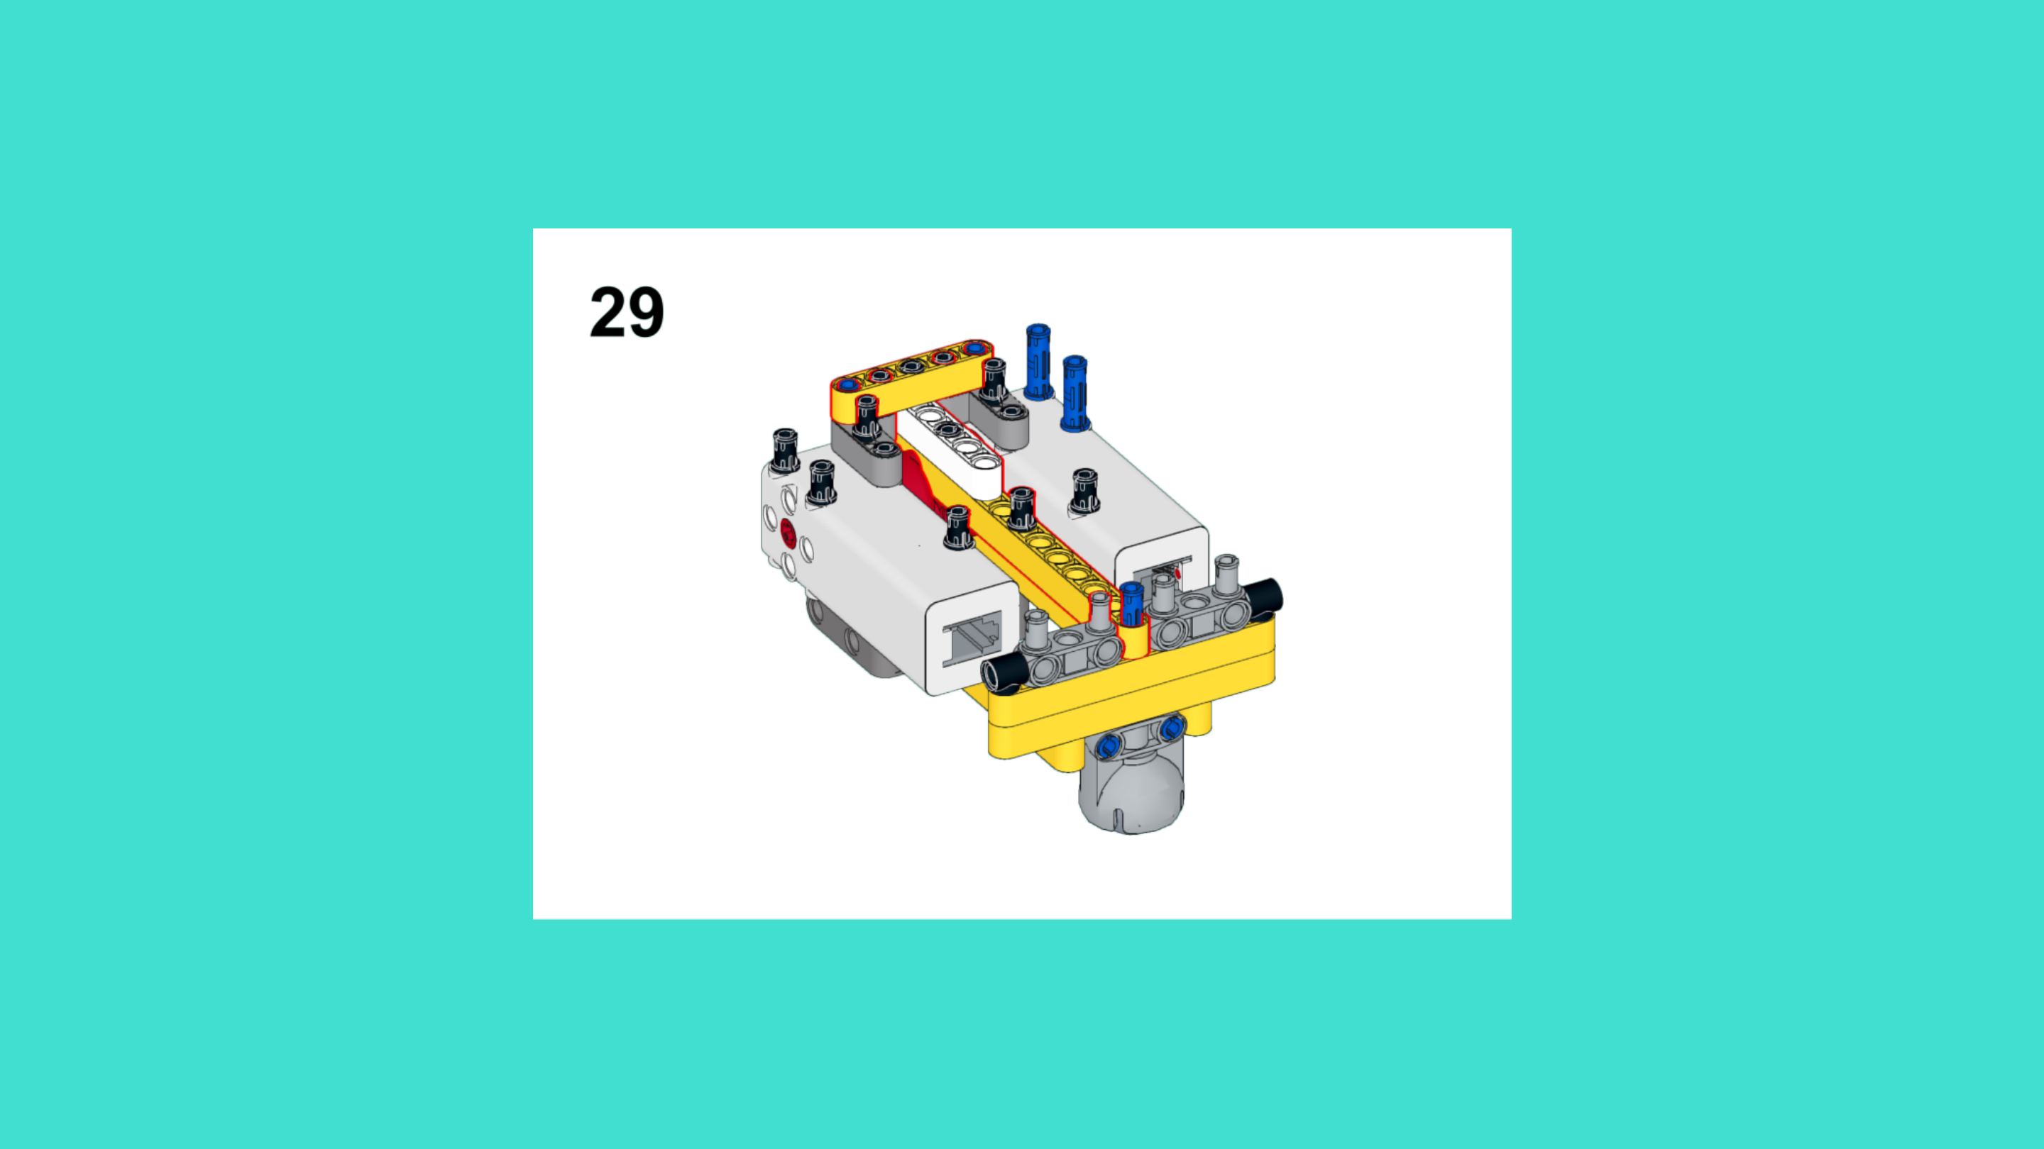
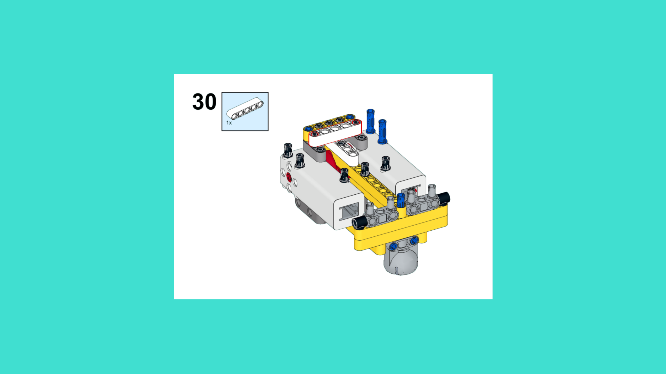
ASSEMBLY STEPS
STEP 28 – 30
PROGRESS: 16% COMPLETE (30 of 187 steps)
STEP 28
STEP 29
STEP 30
LUNAR EXPLORATION · Techtelligence- Elecfreaks
10 / 63

Slide 13
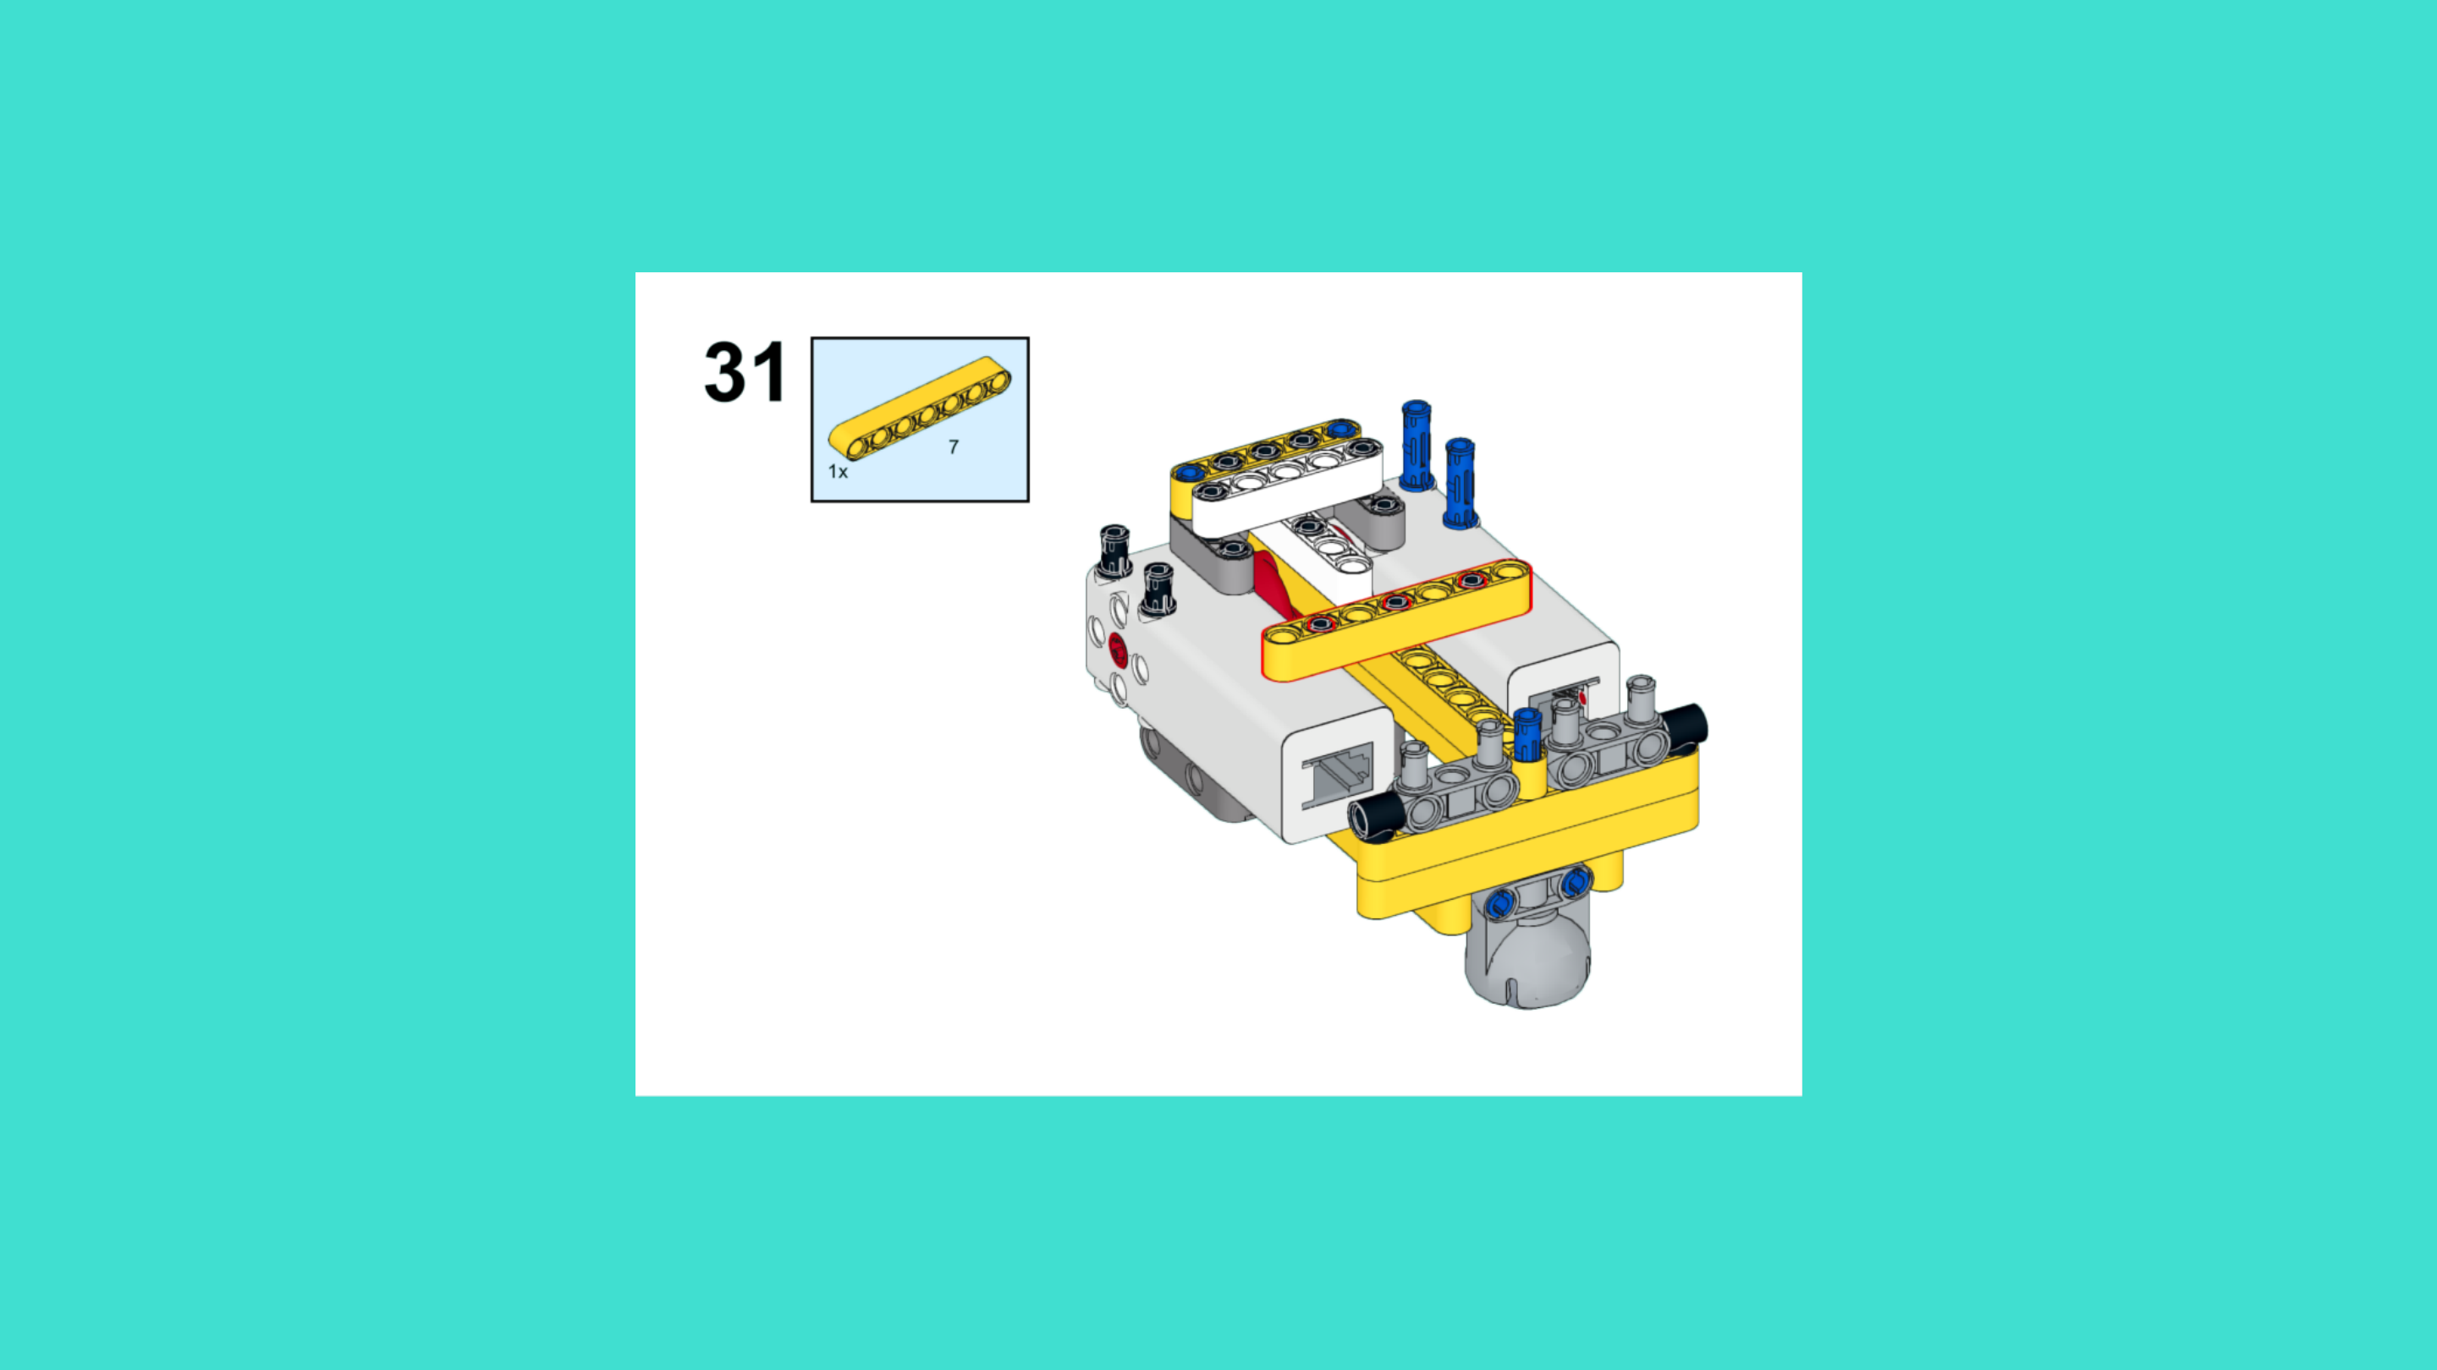
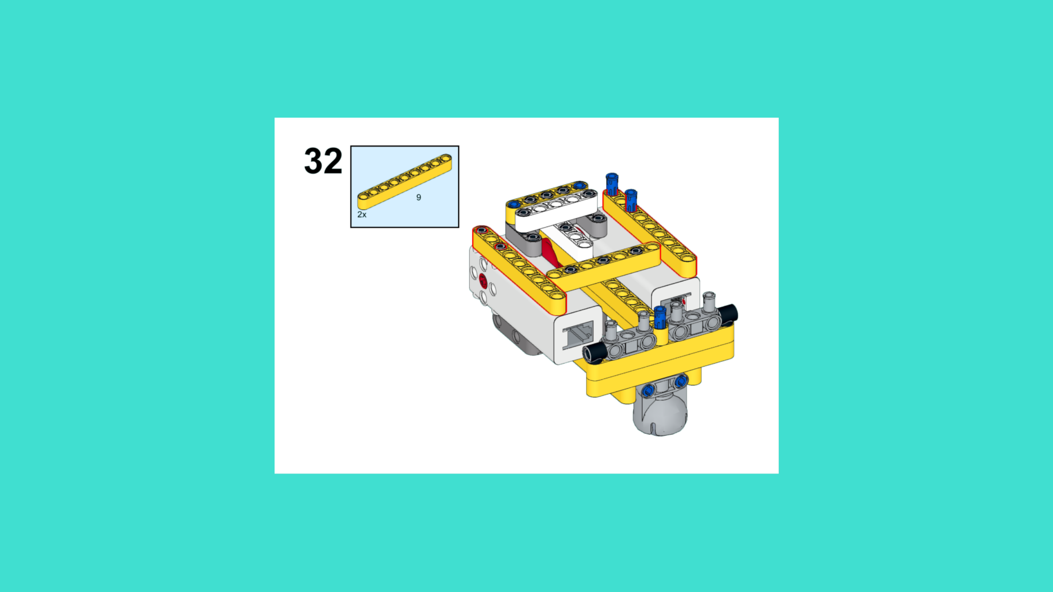
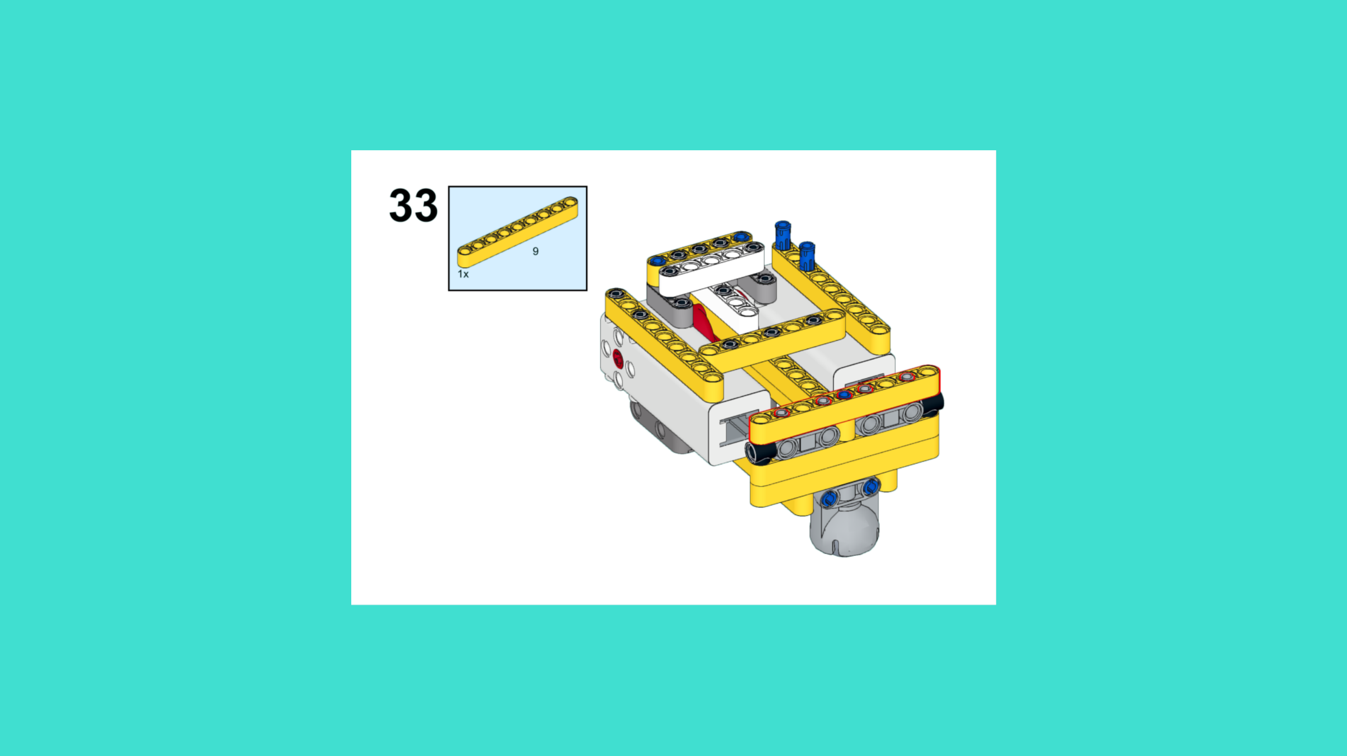
ASSEMBLY STEPS
STEP 31 – 33
PROGRESS: 18% COMPLETE (33 of 187 steps)
STEP 31
STEP 32
STEP 33
LUNAR EXPLORATION · Techtelligence- Elecfreaks
11 / 63

Slide 14
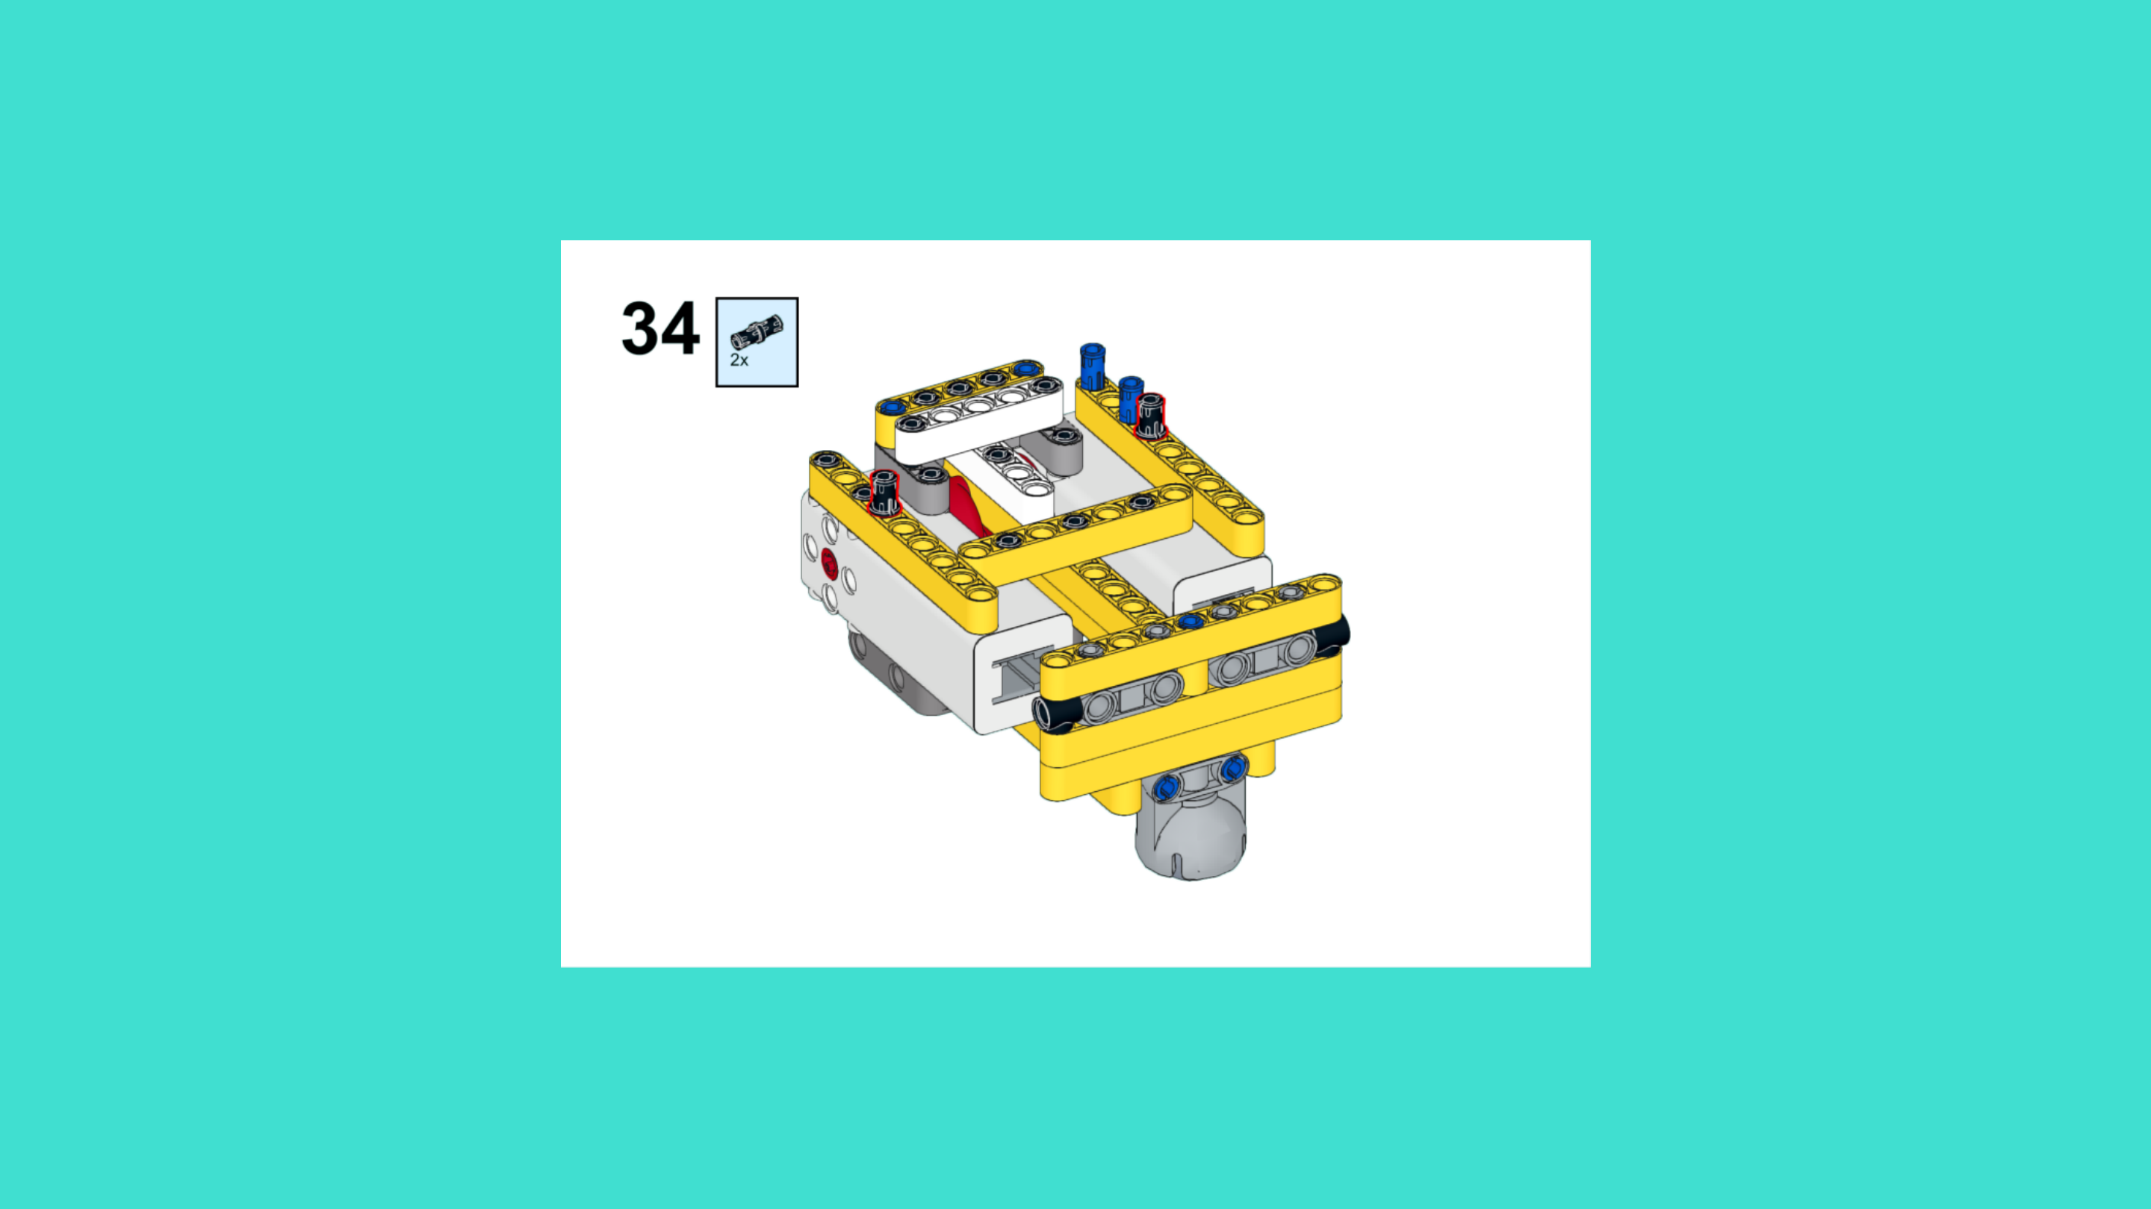
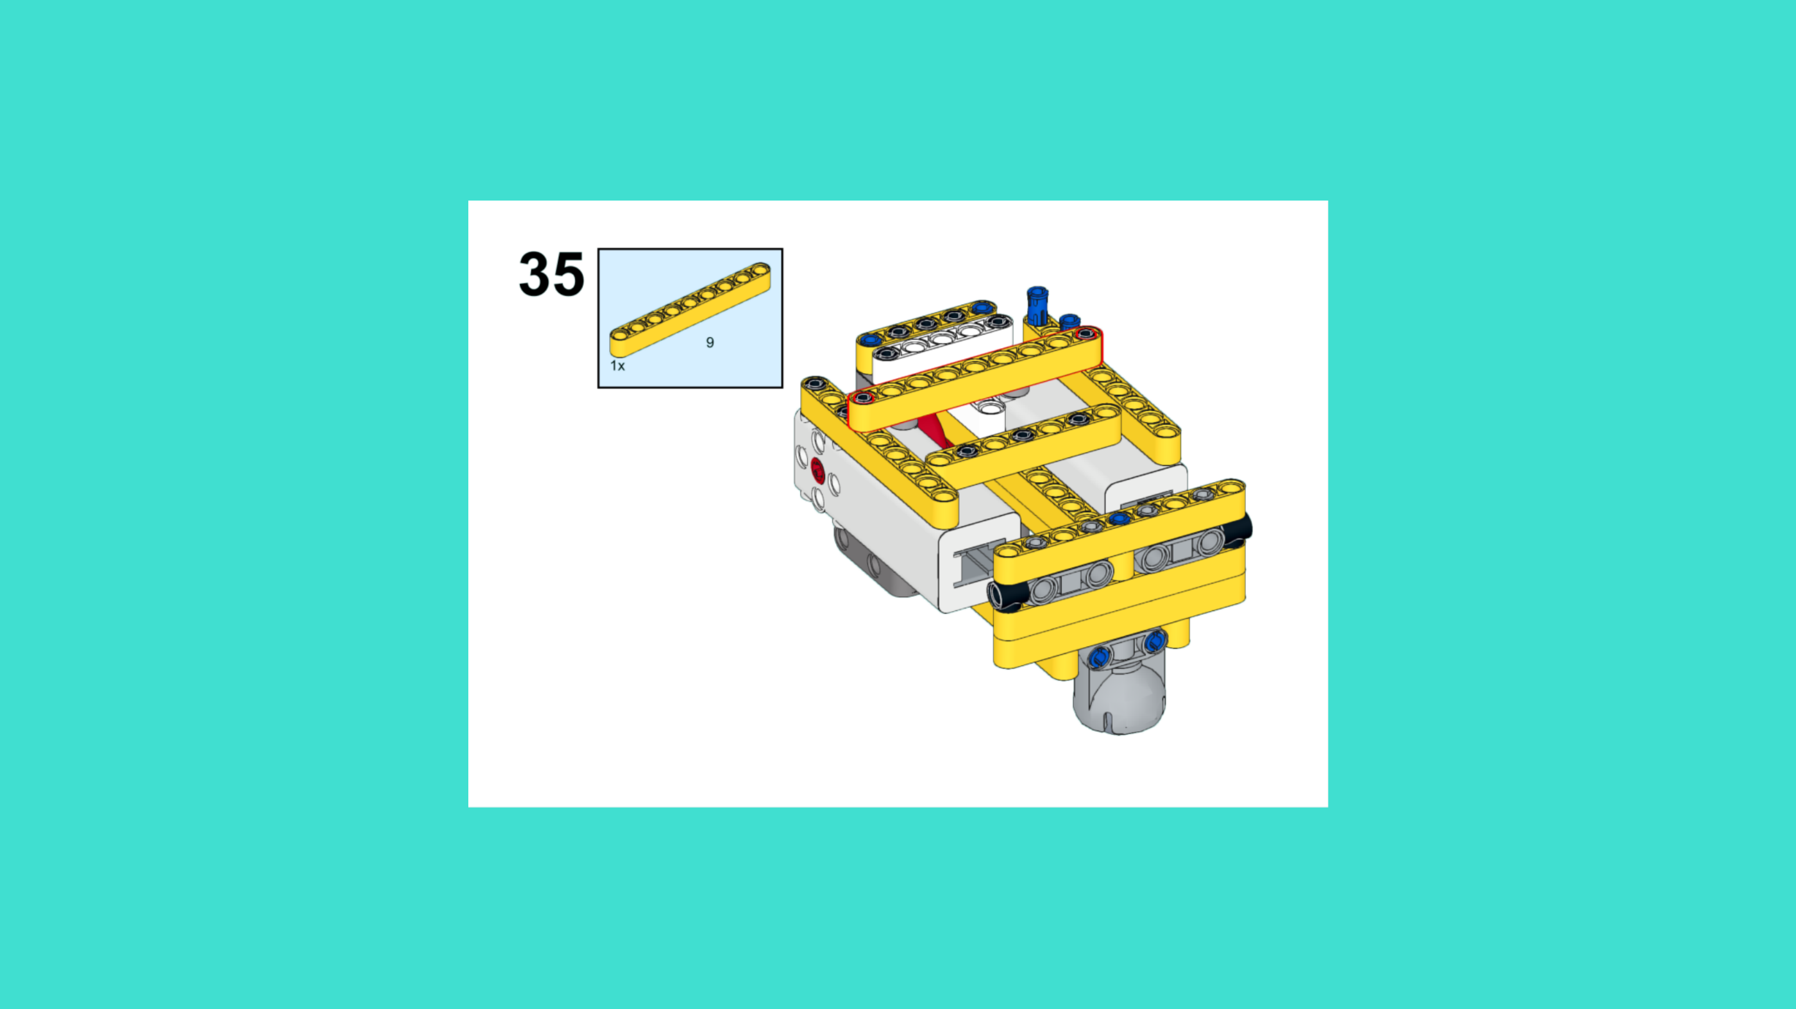
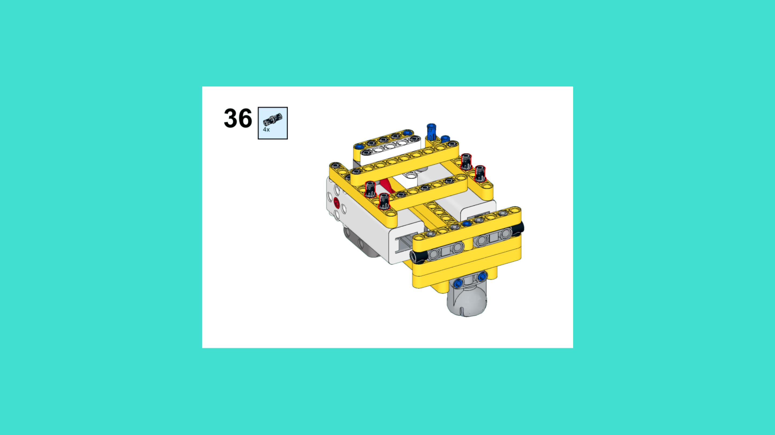
ASSEMBLY STEPS
STEP 34 – 36
PROGRESS: 19% COMPLETE (36 of 187 steps)
STEP 34
STEP 35
STEP 36
LUNAR EXPLORATION · Techtelligence- Elecfreaks
12 / 63

Slide 15
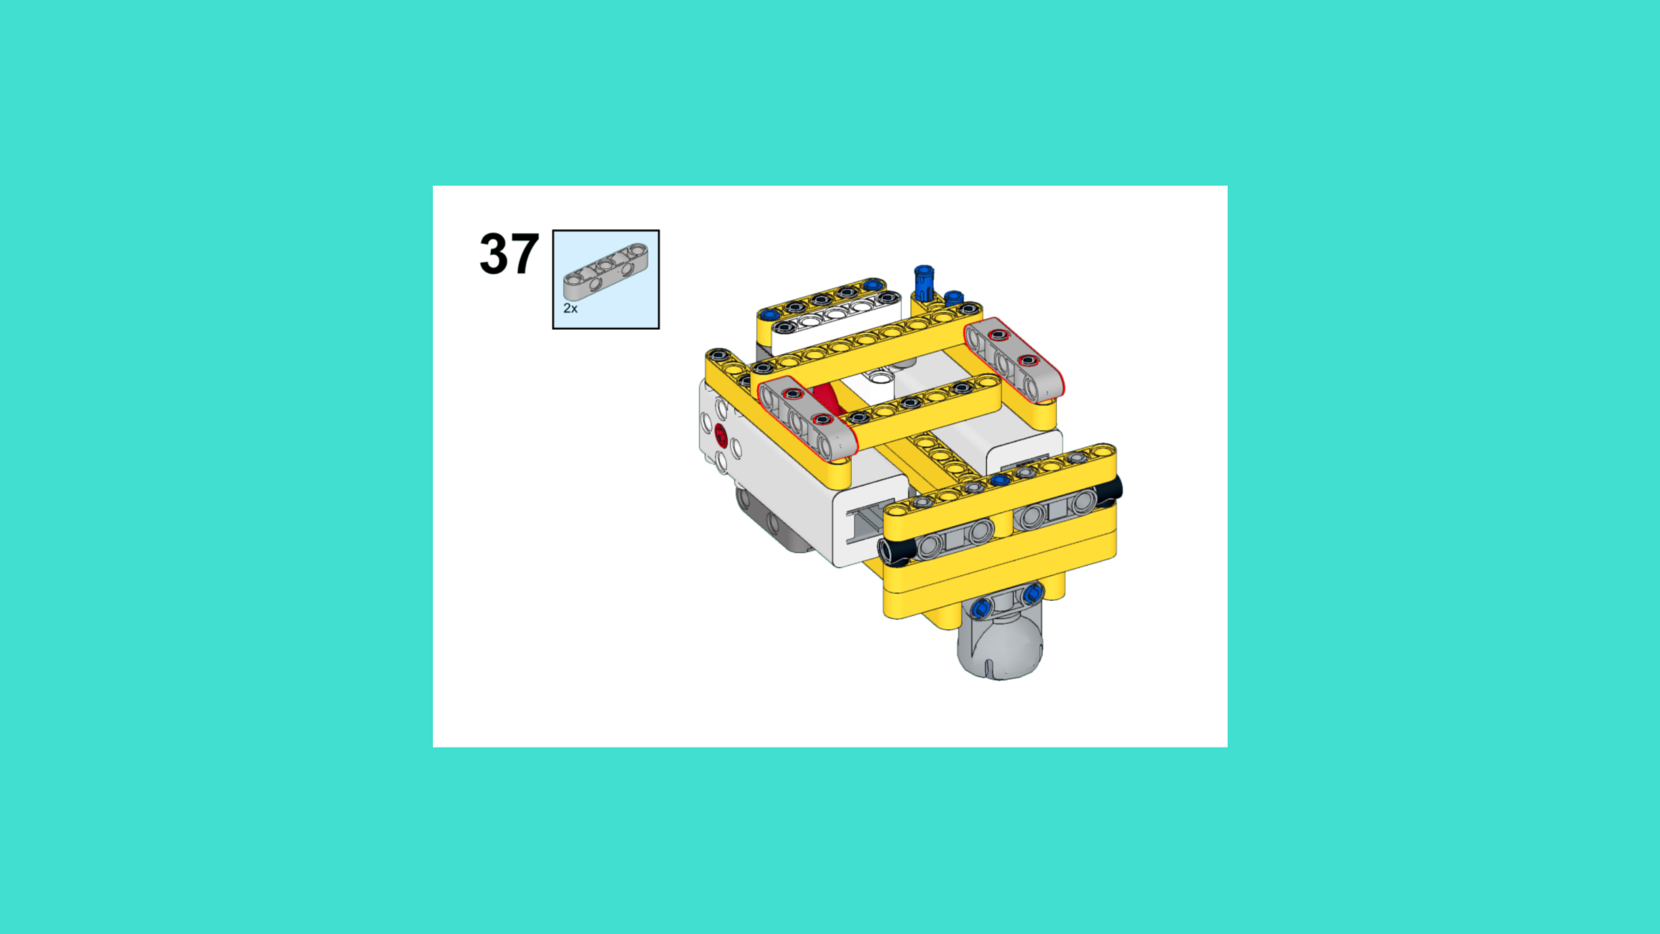
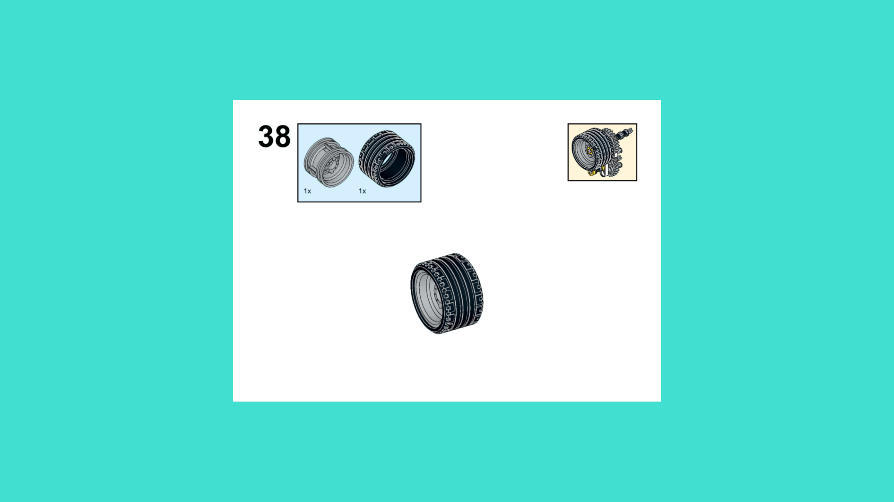
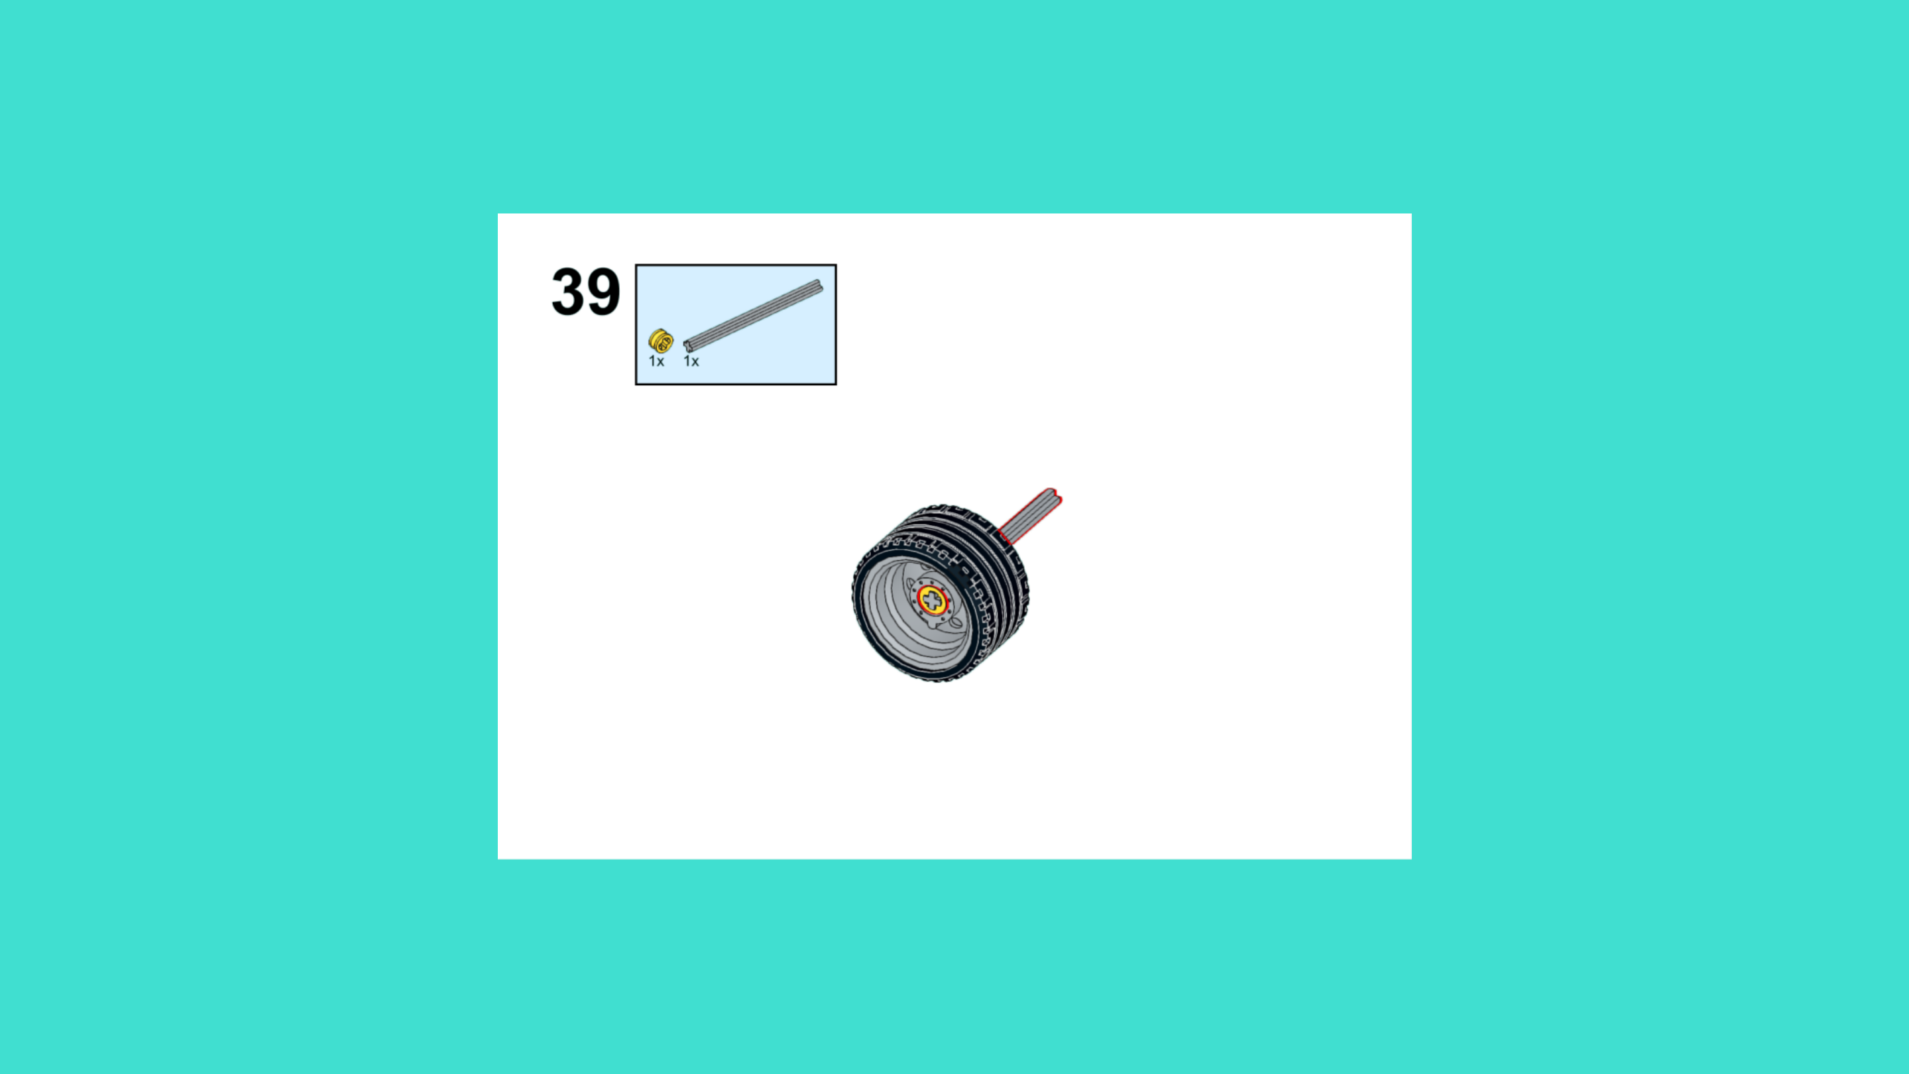
ASSEMBLY STEPS
STEP 37 – 39
PROGRESS: 21% COMPLETE (39 of 187 steps)
STEP 37
STEP 38
STEP 39
LUNAR EXPLORATION · Techtelligence- Elecfreaks
13 / 63

Slide 16
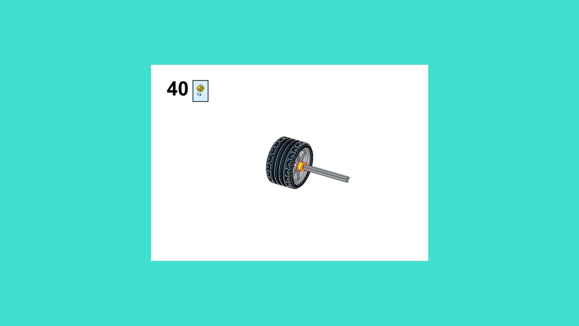
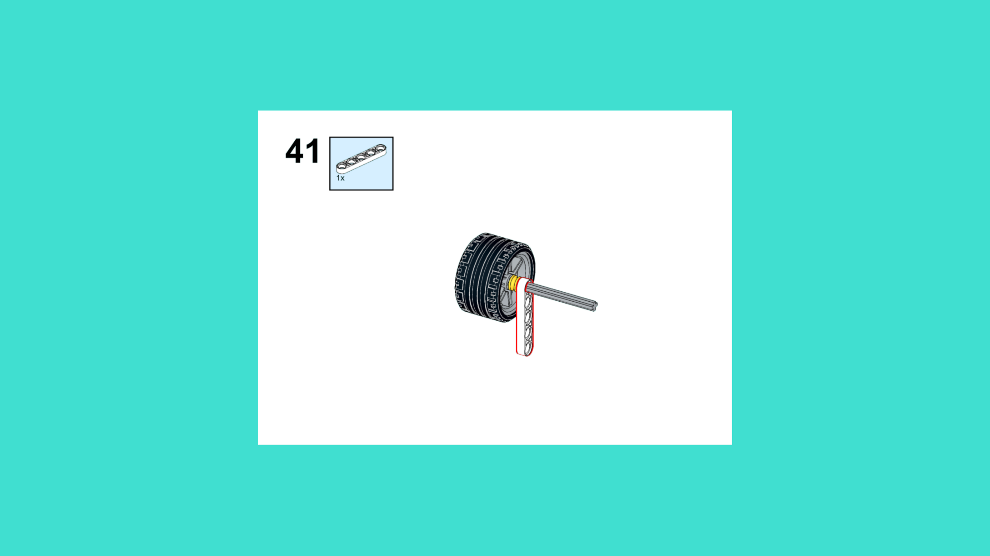
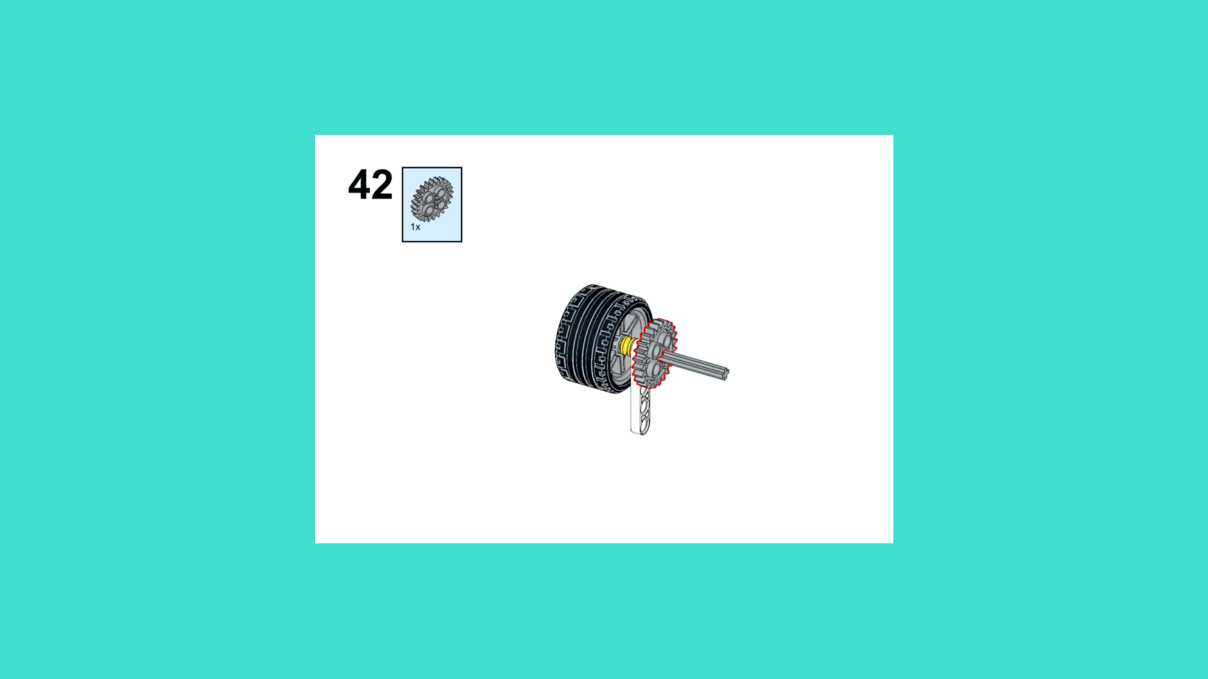
ASSEMBLY STEPS
STEP 40 – 42
PROGRESS: 22% COMPLETE (42 of 187 steps)
STEP 40
STEP 41
STEP 42
LUNAR EXPLORATION · Techtelligence- Elecfreaks
14 / 63

Slide 17
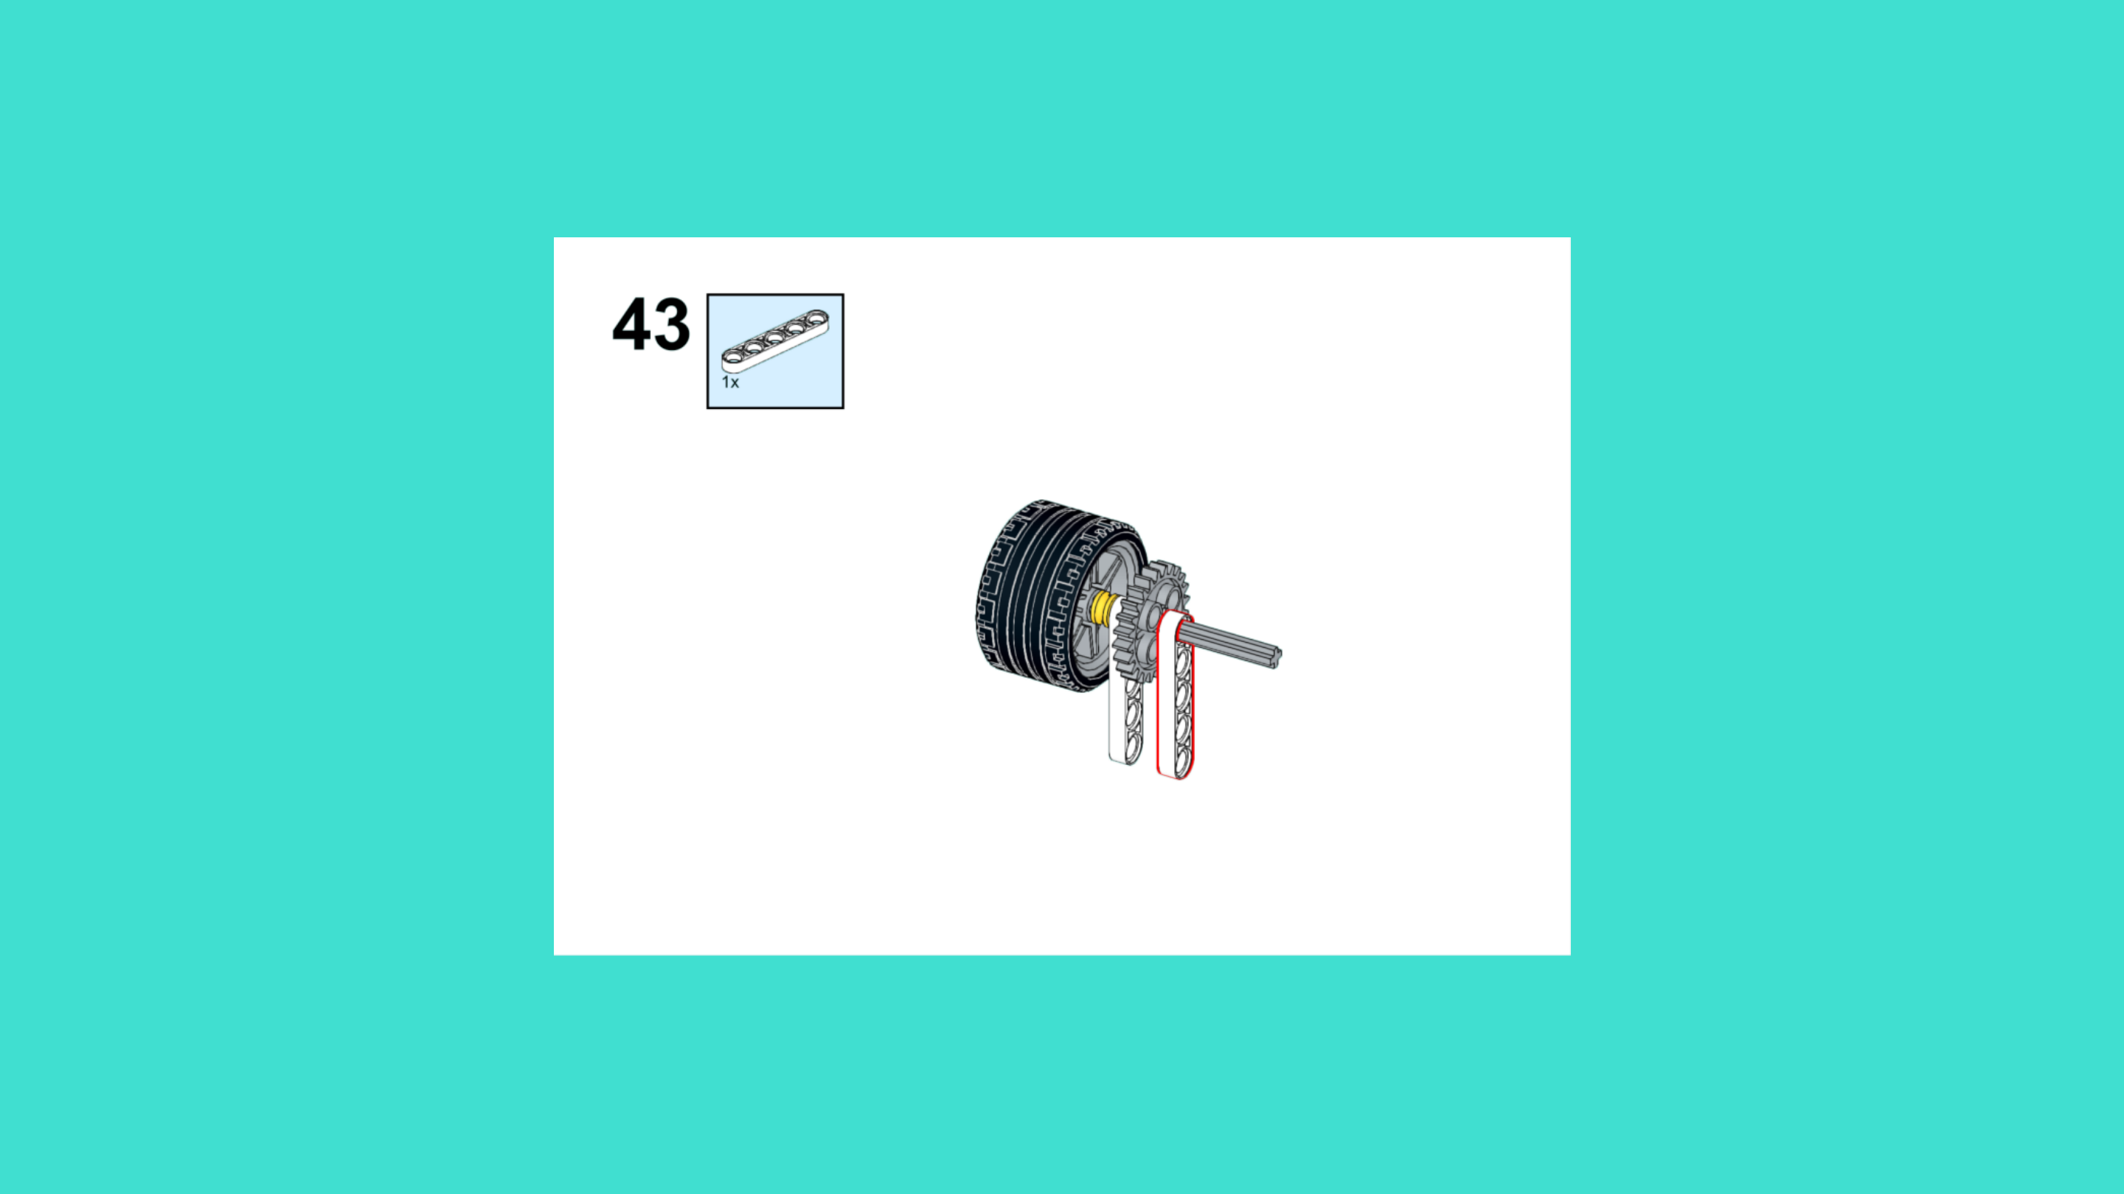
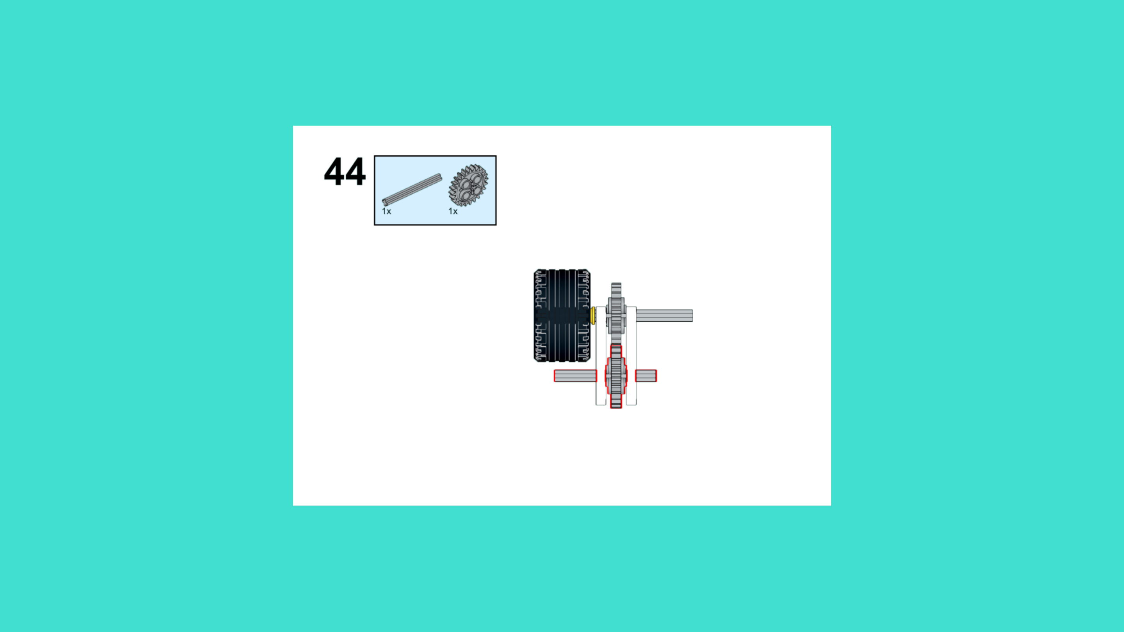
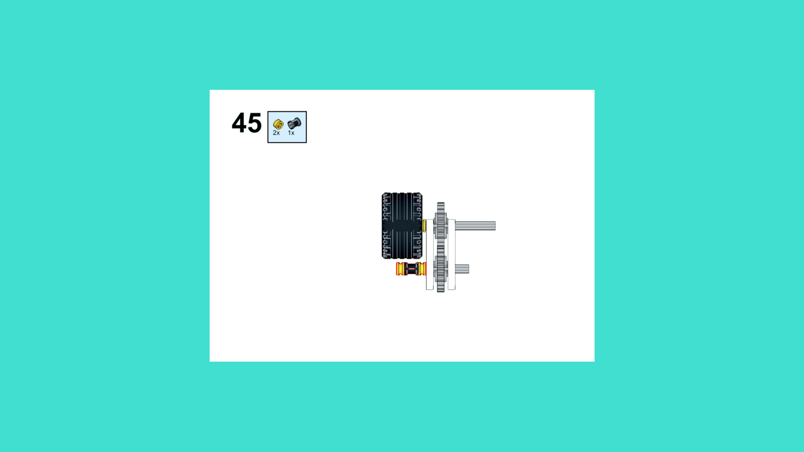
ASSEMBLY STEPS
STEP 43 – 45
PROGRESS: 24% COMPLETE (45 of 187 steps)
STEP 43
STEP 44
STEP 45
LUNAR EXPLORATION · Techtelligence- Elecfreaks
15 / 63

Slide 18
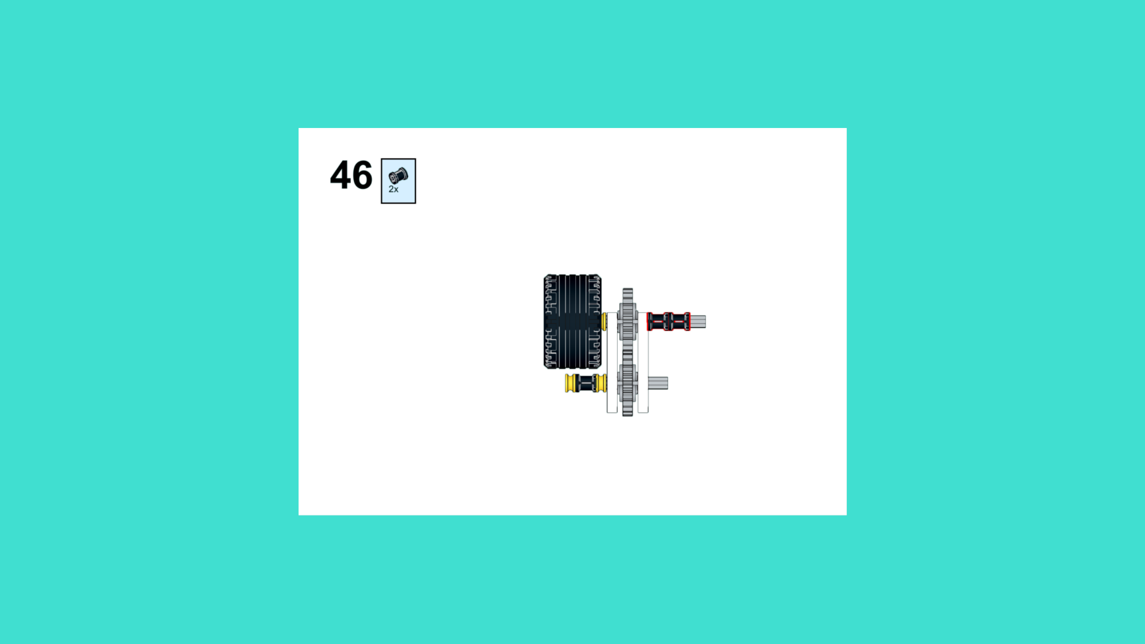
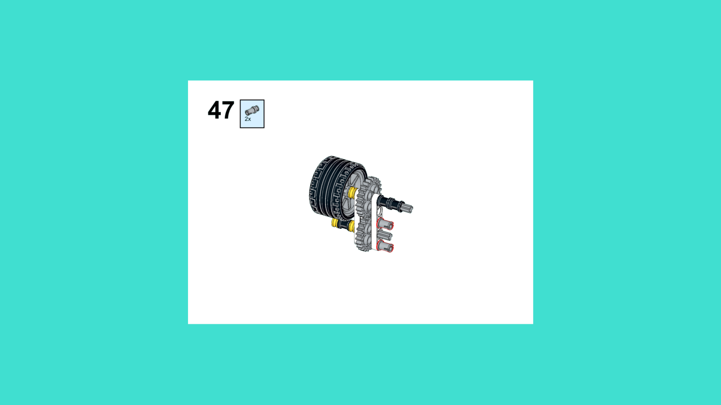
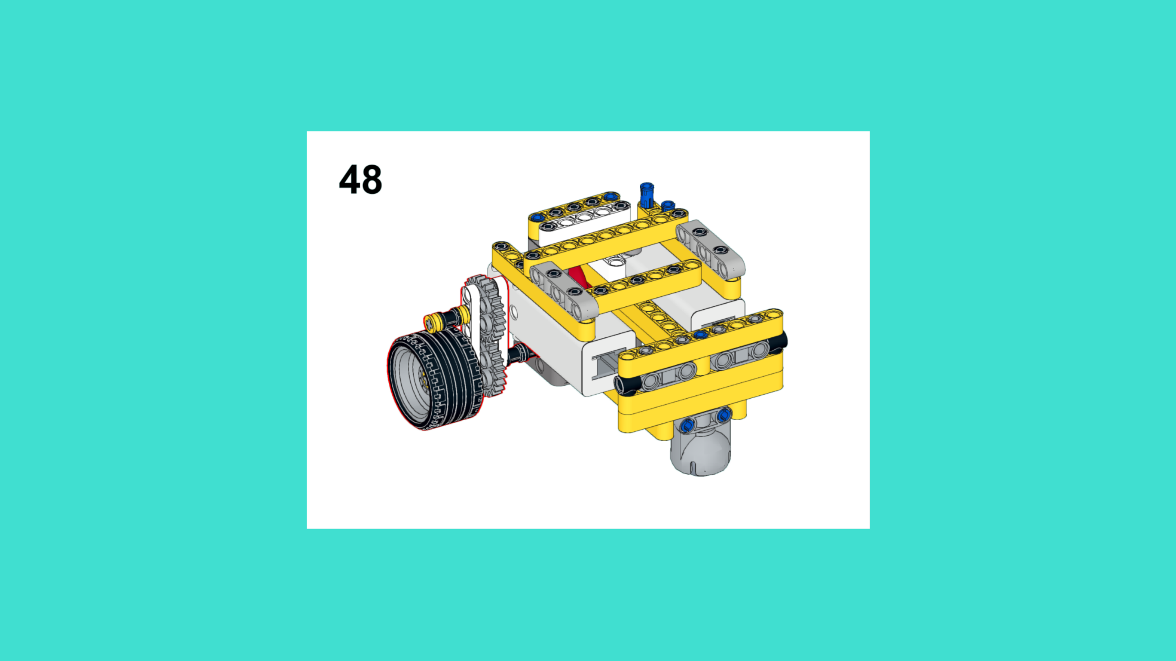
ASSEMBLY STEPS
STEP 46 – 48
PROGRESS: 26% COMPLETE (48 of 187 steps)
STEP 46
STEP 47
STEP 48
LUNAR EXPLORATION · Techtelligence- Elecfreaks
16 / 63

Slide 19
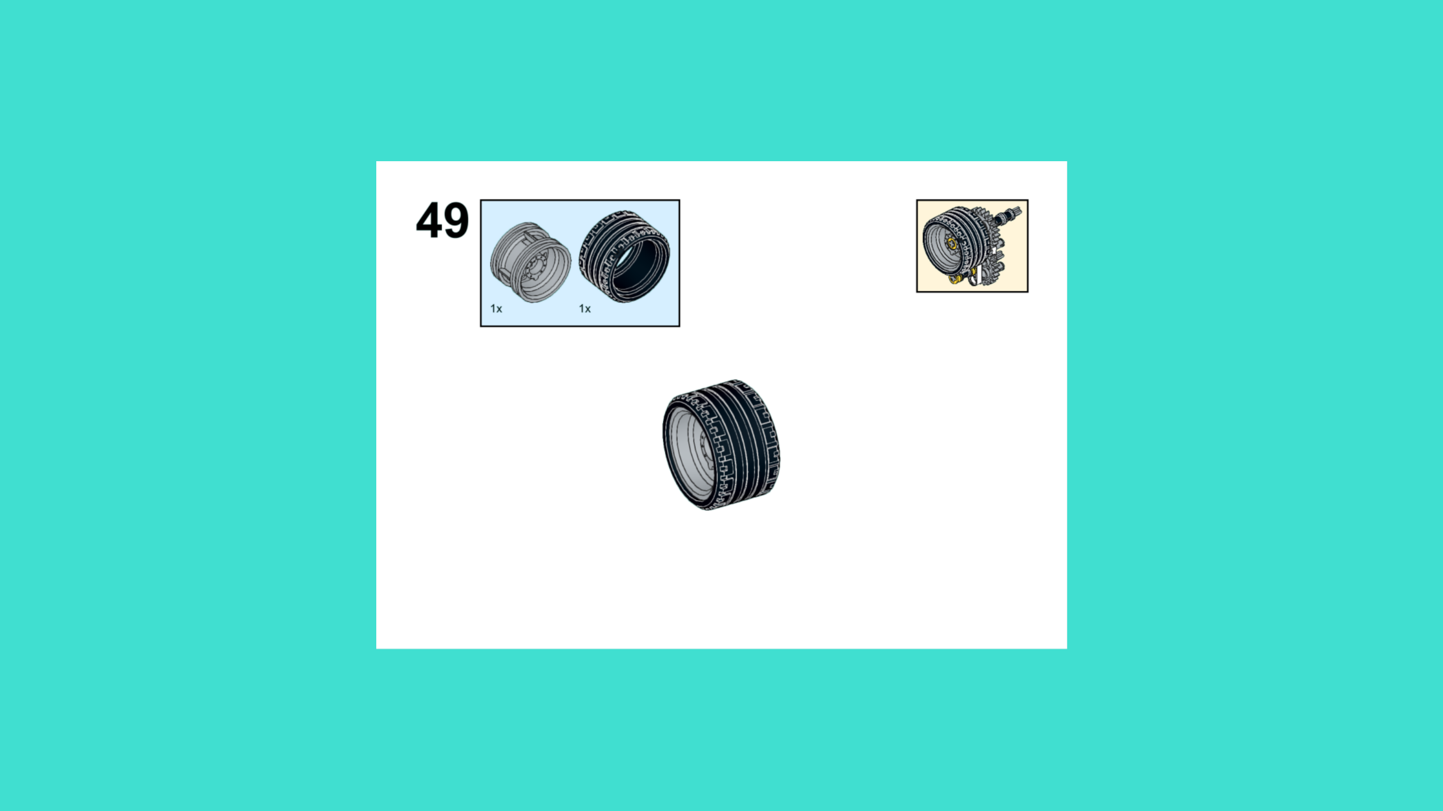
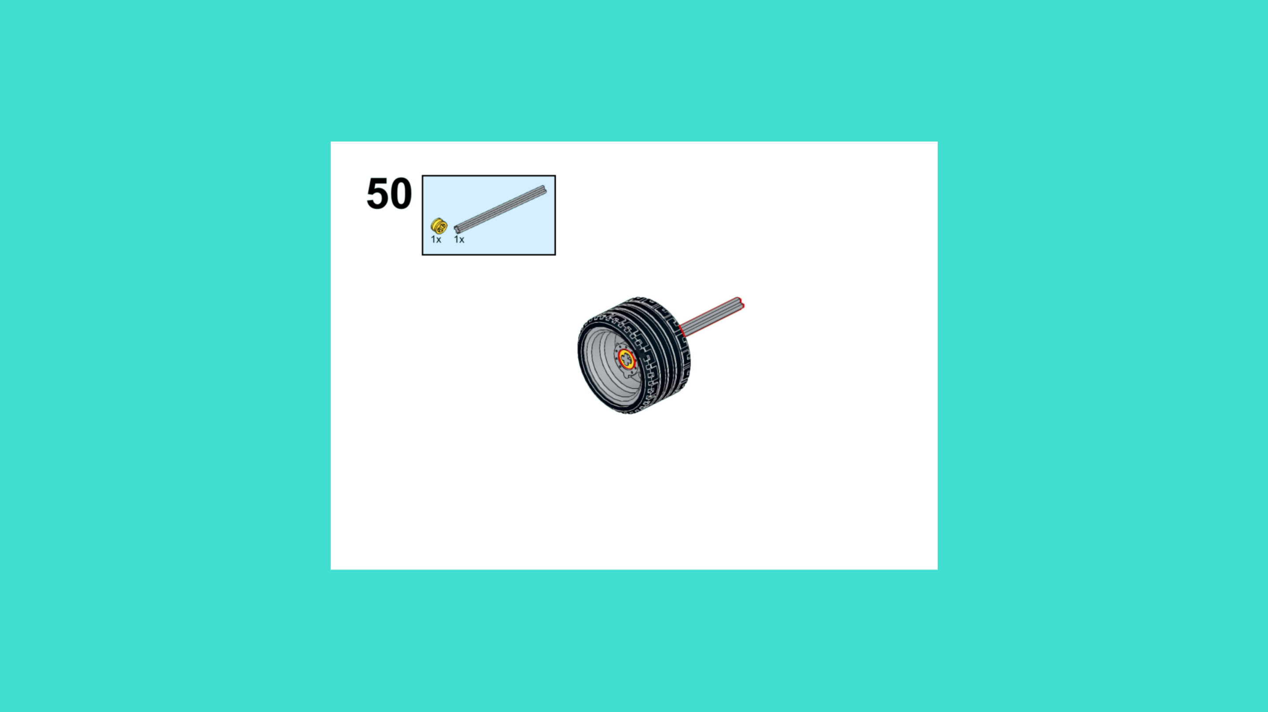
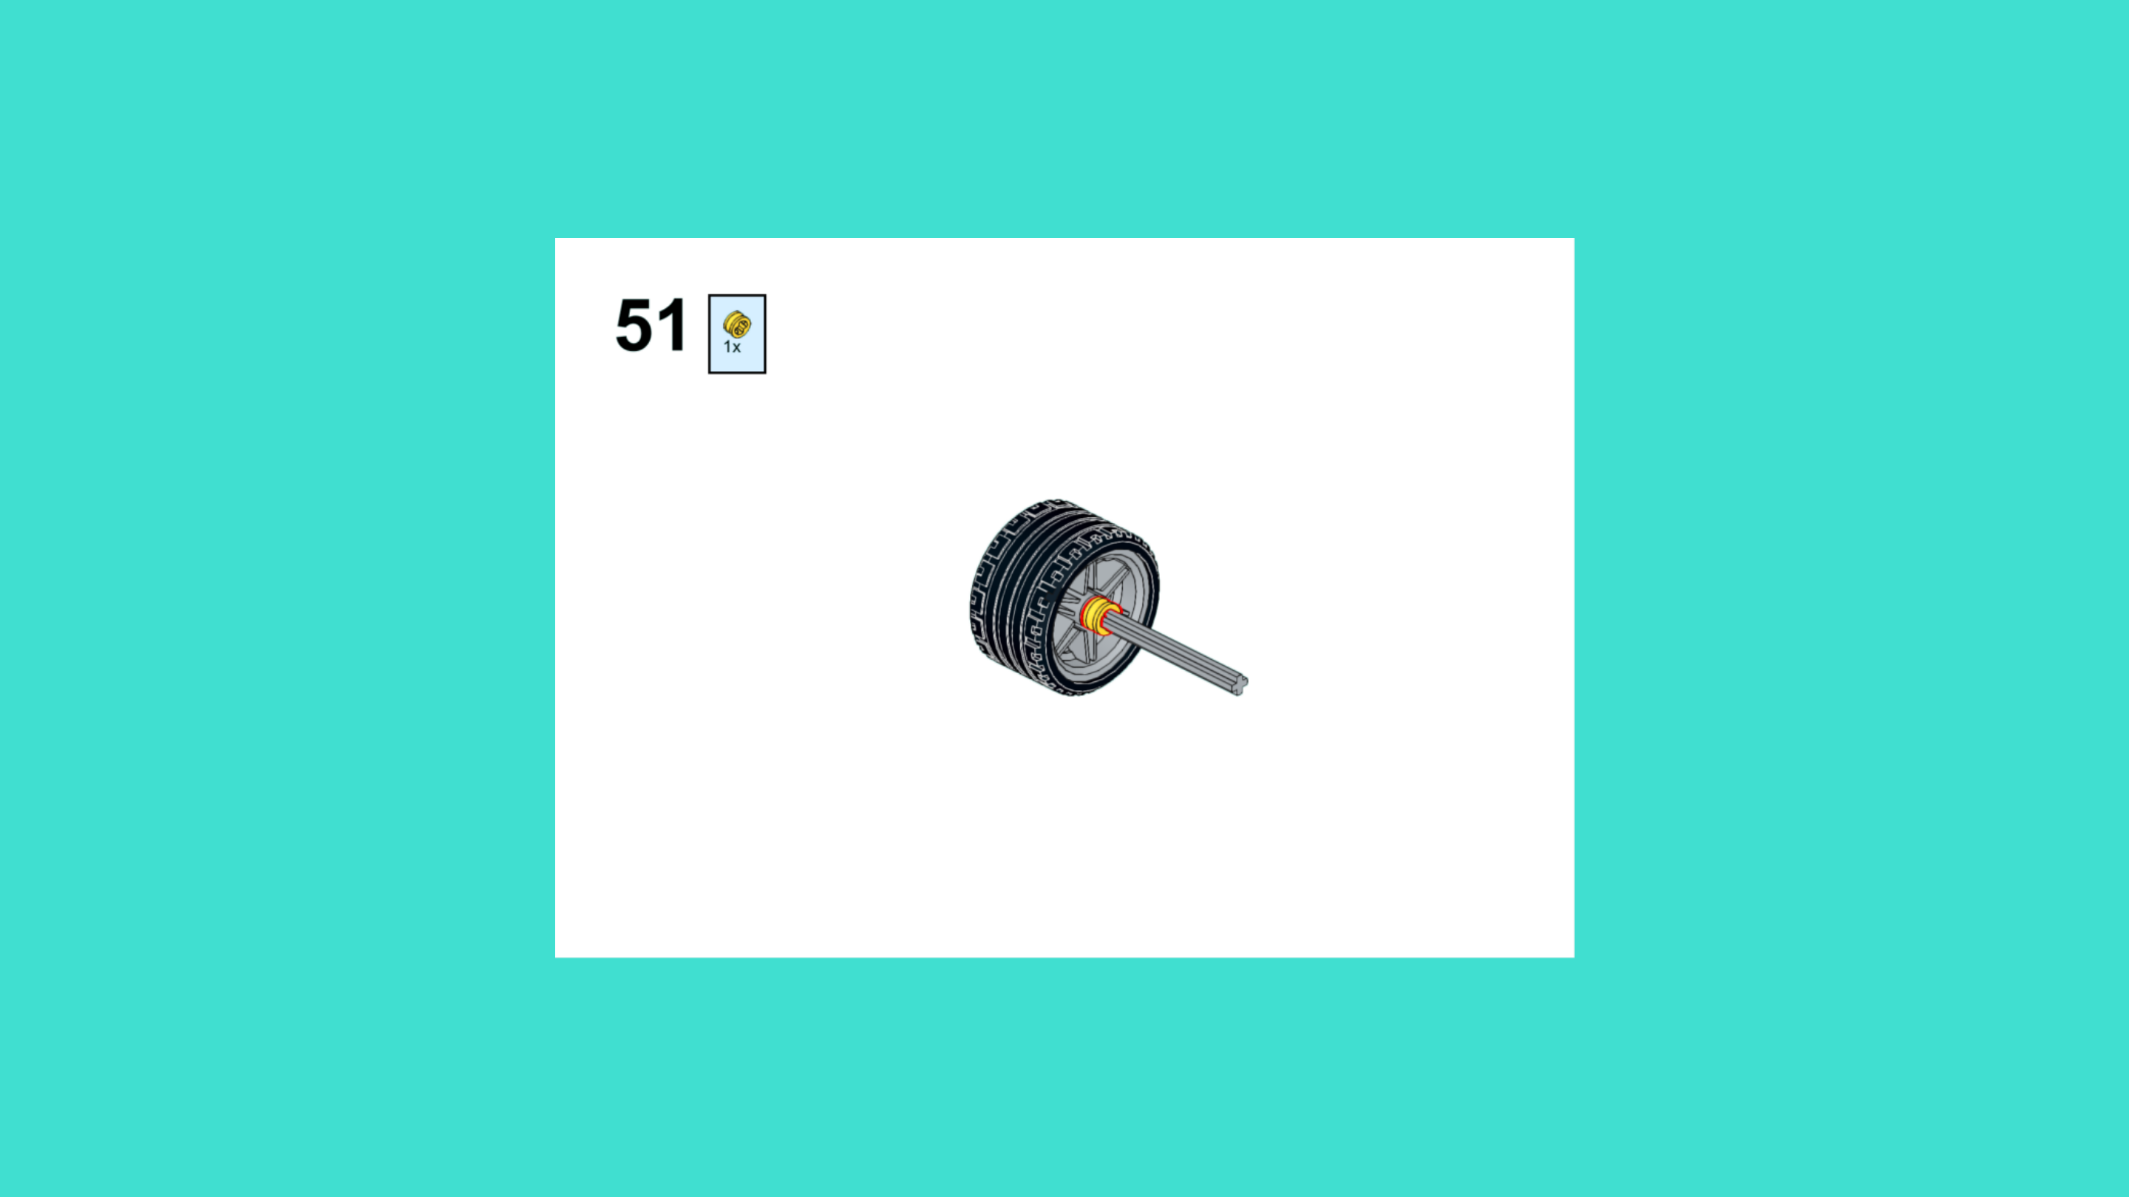
ASSEMBLY STEPS
STEP 49 – 51
PROGRESS: 27% COMPLETE (51 of 187 steps)
STEP 49
STEP 50
STEP 51
LUNAR EXPLORATION · Techtelligence- Elecfreaks
17 / 63

Slide 20



ASSEMBLY STEPS
STEP 52 – 54
PROGRESS: 29% COMPLETE (54 of 187 steps)
STEP 52
STEP 53
STEP 54
LUNAR EXPLORATION · Techtelligence- Elecfreaks
18 / 63

Slide 21



ASSEMBLY STEPS
STEP 55 – 57
PROGRESS: 30% COMPLETE (57 of 187 steps)
STEP 55
STEP 56
STEP 57
LUNAR EXPLORATION · Techtelligence- Elecfreaks
19 / 63

Slide 22



ASSEMBLY STEPS
STEP 58 – 60
PROGRESS: 32% COMPLETE (60 of 187 steps)
STEP 58
STEP 59
STEP 60
LUNAR EXPLORATION · Techtelligence- Elecfreaks
20 / 63

Slide 23



ASSEMBLY STEPS
STEP 61 – 63
PROGRESS: 34% COMPLETE (63 of 187 steps)
STEP 61
STEP 62
STEP 63
LUNAR EXPLORATION · Techtelligence- Elecfreaks
21 / 63

Slide 24



ASSEMBLY STEPS
STEP 64 – 66
PROGRESS: 35% COMPLETE (66 of 187 steps)
STEP 64
STEP 65
STEP 66
LUNAR EXPLORATION · Techtelligence- Elecfreaks
22 / 63

Slide 25



ASSEMBLY STEPS
STEP 67 – 69
PROGRESS: 37% COMPLETE (69 of 187 steps)
STEP 67
STEP 68
STEP 69
LUNAR EXPLORATION · Techtelligence- Elecfreaks
23 / 63

Slide 26



ASSEMBLY STEPS
STEP 70 – 72
PROGRESS: 39% COMPLETE (72 of 187 steps)
STEP 70
STEP 71
STEP 72
LUNAR EXPLORATION · Techtelligence- Elecfreaks
24 / 63

Slide 27



ASSEMBLY STEPS
STEP 73 – 75
PROGRESS: 40% COMPLETE (75 of 187 steps)
STEP 73
STEP 74
STEP 75
LUNAR EXPLORATION · Techtelligence- Elecfreaks
25 / 63

Slide 28



ASSEMBLY STEPS
STEP 76 – 78
PROGRESS: 42% COMPLETE (78 of 187 steps)
STEP 76
STEP 77
STEP 78
LUNAR EXPLORATION · Techtelligence- Elecfreaks
26 / 63

Slide 29



ASSEMBLY STEPS
STEP 79 – 81
PROGRESS: 43% COMPLETE (81 of 187 steps)
STEP 79
STEP 80
STEP 81
LUNAR EXPLORATION · Techtelligence- Elecfreaks
27 / 63

Slide 30



ASSEMBLY STEPS
STEP 82 – 84
PROGRESS: 45% COMPLETE (84 of 187 steps)
STEP 82
STEP 83
STEP 84
LUNAR EXPLORATION · Techtelligence- Elecfreaks
28 / 63

Slide 31



ASSEMBLY STEPS
STEP 85 – 87
PROGRESS: 47% COMPLETE (87 of 187 steps)
STEP 85
STEP 86
STEP 87
LUNAR EXPLORATION · Techtelligence- Elecfreaks
29 / 63

Slide 32



ASSEMBLY STEPS
STEP 88 – 90
PROGRESS: 48% COMPLETE (90 of 187 steps)
STEP 88
STEP 89
STEP 90
LUNAR EXPLORATION · Techtelligence- Elecfreaks
30 / 63

Slide 33



ASSEMBLY STEPS
STEP 91 – 93
PROGRESS: 50% COMPLETE (93 of 187 steps)
STEP 91
STEP 92
STEP 93
LUNAR EXPLORATION · Techtelligence- Elecfreaks
31 / 63

Slide 34



ASSEMBLY STEPS
STEP 94 – 96
PROGRESS: 51% COMPLETE (96 of 187 steps)
STEP 94
STEP 95
STEP 96
LUNAR EXPLORATION · Techtelligence- Elecfreaks
32 / 63

Slide 35



ASSEMBLY STEPS
STEP 97 – 99
PROGRESS: 53% COMPLETE (99 of 187 steps)
STEP 97
STEP 98
STEP 99
LUNAR EXPLORATION · Techtelligence- Elecfreaks
33 / 63

Slide 36



ASSEMBLY STEPS
STEP 100 – 102
PROGRESS: 55% COMPLETE (102 of 187 steps)
STEP 100
STEP 101
STEP 102
LUNAR EXPLORATION · Techtelligence- Elecfreaks
34 / 63

Slide 37



ASSEMBLY STEPS
STEP 103 – 105
PROGRESS: 56% COMPLETE (105 of 187 steps)
STEP 103
STEP 104
STEP 105
LUNAR EXPLORATION · Techtelligence- Elecfreaks
35 / 63

Slide 38



ASSEMBLY STEPS
STEP 106 – 108
PROGRESS: 58% COMPLETE (108 of 187 steps)
STEP 106
STEP 107
STEP 108
LUNAR EXPLORATION · Techtelligence- Elecfreaks
36 / 63

Slide 39



ASSEMBLY STEPS
STEP 109 – 111
PROGRESS: 59% COMPLETE (111 of 187 steps)
STEP 109
STEP 110
STEP 111
LUNAR EXPLORATION · Techtelligence- Elecfreaks
37 / 63

Slide 40



ASSEMBLY STEPS
STEP 112 – 114
PROGRESS: 61% COMPLETE (114 of 187 steps)
STEP 112
STEP 113
STEP 114
LUNAR EXPLORATION · Techtelligence- Elecfreaks
38 / 63

Slide 41



ASSEMBLY STEPS
STEP 115 – 117
PROGRESS: 63% COMPLETE (117 of 187 steps)
STEP 115
STEP 116
STEP 117
LUNAR EXPLORATION · Techtelligence- Elecfreaks
39 / 63

Slide 42



ASSEMBLY STEPS
STEP 118 – 120
PROGRESS: 64% COMPLETE (120 of 187 steps)
STEP 118
STEP 119
STEP 120
LUNAR EXPLORATION · Techtelligence- Elecfreaks
40 / 63

Slide 43



ASSEMBLY STEPS
STEP 121 – 123
PROGRESS: 66% COMPLETE (123 of 187 steps)
STEP 121
STEP 122
STEP 123
LUNAR EXPLORATION · Techtelligence- Elecfreaks
41 / 63

Slide 44



ASSEMBLY STEPS
STEP 124 – 126
PROGRESS: 67% COMPLETE (126 of 187 steps)
STEP 124
STEP 125
STEP 126
LUNAR EXPLORATION · Techtelligence- Elecfreaks
42 / 63

Slide 45



ASSEMBLY STEPS
STEP 127 – 129
PROGRESS: 69% COMPLETE (129 of 187 steps)
STEP 127
STEP 128
STEP 129
LUNAR EXPLORATION · Techtelligence- Elecfreaks
43 / 63

Slide 46



ASSEMBLY STEPS
STEP 130 – 132
PROGRESS: 71% COMPLETE (132 of 187 steps)
STEP 130
STEP 131
STEP 132
LUNAR EXPLORATION · Techtelligence- Elecfreaks
44 / 63

Slide 47



ASSEMBLY STEPS
STEP 133 – 135
PROGRESS: 72% COMPLETE (135 of 187 steps)
STEP 133
STEP 134
STEP 135
LUNAR EXPLORATION · Techtelligence- Elecfreaks
45 / 63

Slide 48



ASSEMBLY STEPS
STEP 136 – 138
PROGRESS: 74% COMPLETE (138 of 187 steps)
STEP 136
STEP 137
STEP 138
LUNAR EXPLORATION · Techtelligence- Elecfreaks
46 / 63

Slide 49



ASSEMBLY STEPS
STEP 139 – 141
PROGRESS: 75% COMPLETE (141 of 187 steps)
STEP 139
STEP 140
STEP 141
LUNAR EXPLORATION · Techtelligence- Elecfreaks
47 / 63

Slide 50



ASSEMBLY STEPS
STEP 142 – 144
PROGRESS: 77% COMPLETE (144 of 187 steps)
STEP 142
STEP 143
STEP 144
LUNAR EXPLORATION · Techtelligence- Elecfreaks
48 / 63

Slide 51



ASSEMBLY STEPS
STEP 145 – 147
PROGRESS: 79% COMPLETE (147 of 187 steps)
STEP 145
STEP 146
STEP 147
LUNAR EXPLORATION · Techtelligence- Elecfreaks
49 / 63

Slide 52



ASSEMBLY STEPS
STEP 148 – 150
PROGRESS: 80% COMPLETE (150 of 187 steps)
STEP 148
STEP 149
STEP 150
LUNAR EXPLORATION · Techtelligence- Elecfreaks
50 / 63

Slide 53



ASSEMBLY STEPS
STEP 151 – 153
PROGRESS: 82% COMPLETE (153 of 187 steps)
STEP 151
STEP 152
STEP 153
LUNAR EXPLORATION · Techtelligence- Elecfreaks
51 / 63

Slide 54



ASSEMBLY STEPS
STEP 154 – 156
PROGRESS: 83% COMPLETE (156 of 187 steps)
STEP 154
STEP 155
STEP 156
LUNAR EXPLORATION · Techtelligence- Elecfreaks
52 / 63

Slide 55



ASSEMBLY STEPS
STEP 157 – 159
PROGRESS: 85% COMPLETE (159 of 187 steps)
STEP 157
STEP 158
STEP 159
LUNAR EXPLORATION · Techtelligence- Elecfreaks
53 / 63

Slide 56



ASSEMBLY STEPS
STEP 160 – 162
PROGRESS: 87% COMPLETE (162 of 187 steps)
STEP 160
STEP 161
STEP 162
LUNAR EXPLORATION · Techtelligence- Elecfreaks
54 / 63

Slide 57



ASSEMBLY STEPS
STEP 163 – 165
PROGRESS: 88% COMPLETE (165 of 187 steps)
STEP 163
STEP 164
STEP 165
LUNAR EXPLORATION · Techtelligence- Elecfreaks
55 / 63

Slide 58



ASSEMBLY STEPS
STEP 166 – 168
PROGRESS: 90% COMPLETE (168 of 187 steps)
STEP 166
STEP 167
STEP 168
LUNAR EXPLORATION · Techtelligence- Elecfreaks
56 / 63

Slide 59



ASSEMBLY STEPS
STEP 169 – 171
PROGRESS: 91% COMPLETE (171 of 187 steps)
STEP 169
STEP 170
STEP 171
LUNAR EXPLORATION · Techtelligence- Elecfreaks
57 / 63

Slide 60



ASSEMBLY STEPS
STEP 172 – 174
PROGRESS: 93% COMPLETE (174 of 187 steps)
STEP 172
STEP 173
STEP 174
LUNAR EXPLORATION · Techtelligence- Elecfreaks
58 / 63

Slide 61



ASSEMBLY STEPS
STEP 175 – 177
PROGRESS: 95% COMPLETE (177 of 187 steps)
STEP 175
STEP 176
STEP 177
LUNAR EXPLORATION · Techtelligence- Elecfreaks
59 / 63

Slide 62



ASSEMBLY STEPS
STEP 178 – 180
PROGRESS: 96% COMPLETE (180 of 187 steps)
STEP 178
STEP 179
STEP 180
LUNAR EXPLORATION · Techtelligence- Elecfreaks
60 / 63

Slide 63



ASSEMBLY STEPS
STEP 181 – 183
PROGRESS: 98% COMPLETE (183 of 187 steps)
STEP 181
STEP 182
STEP 183
LUNAR EXPLORATION · Techtelligence- Elecfreaks
61 / 63

Slide 64



ASSEMBLY STEPS
STEP 184 – 186
PROGRESS: 99% COMPLETE (186 of 187 steps)
STEP 184
STEP 185
STEP 186
LUNAR EXPLORATION · Techtelligence- Elecfreaks
62 / 63

Slide 65

ASSEMBLY STEPS
STEP 187
PROGRESS: 100% COMPLETE (187 of 187 steps)
STEP 187
LUNAR EXPLORATION · Techtelligence- Elecfreaks
63 / 63

Slide 66
ASSEMBLY
COMPLETE
187 STEPS · LUNAR EXPLORATION · Techtelligence- Elecfreaks
187
63
100%
TOTAL STEPS
SLIDE SECTIONS
COMPLETE

