Slide 1
CASE 06
THE
RETURNER
ASSEMBLY GUIDE · SPACE SCIENCE KIT · Techtelligence- Elecfreaks
34 STEPS
TOTAL

Slide 2
DESIGN BRIEF
OBJECTIVE
Construct the Returner — a sample-return capsule vehicle designed to collect and transport lunar specimens. This 34-step build covers capsule mechanics, claw assembly, and re-entry vehicle design principles.
DESIGN PRINCIPLES
01. Structural Integrity
Robust modular frame construction ensures stability throughout the entire assembly and operation.
02. Step-by-Step Build
Sequential instruction design guides students from individual components to a complete working model.
03. STEM Integration
Hands-on mechanics reinforce space science, engineering, and robotics concepts at every stage.
04. Scalable Design
Standardised connectors and components allow for reconfiguration and adaptation of the final model.
Techtelligence- Elecfreaks · THE RETURNER

Slide 3
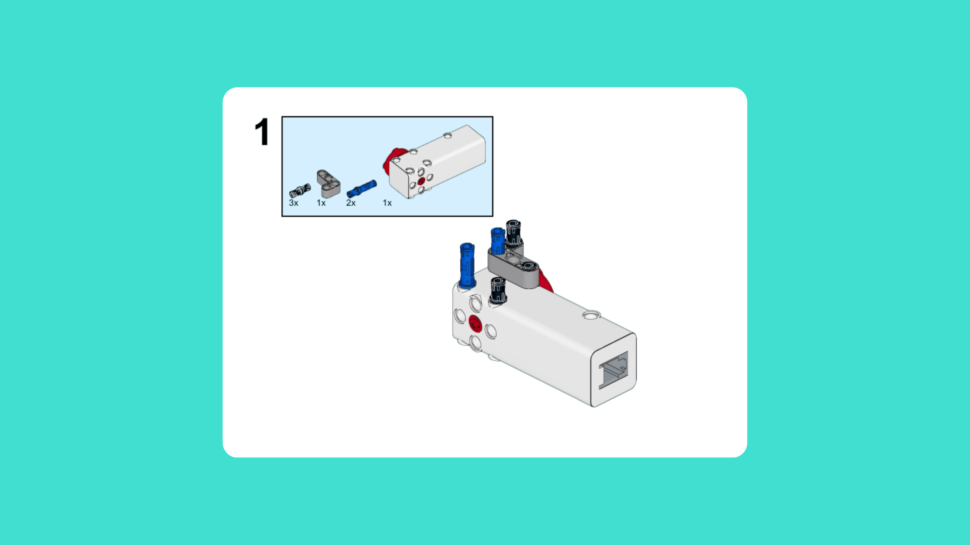
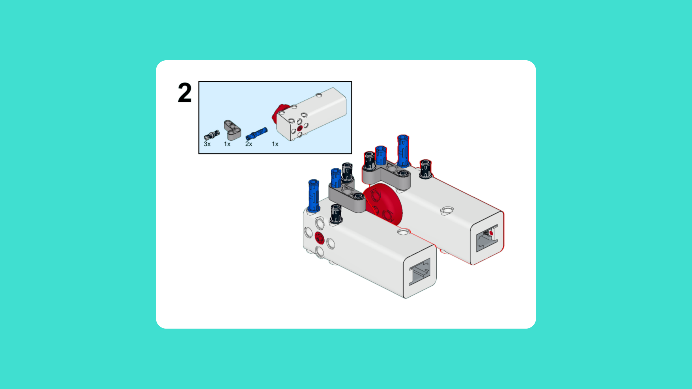
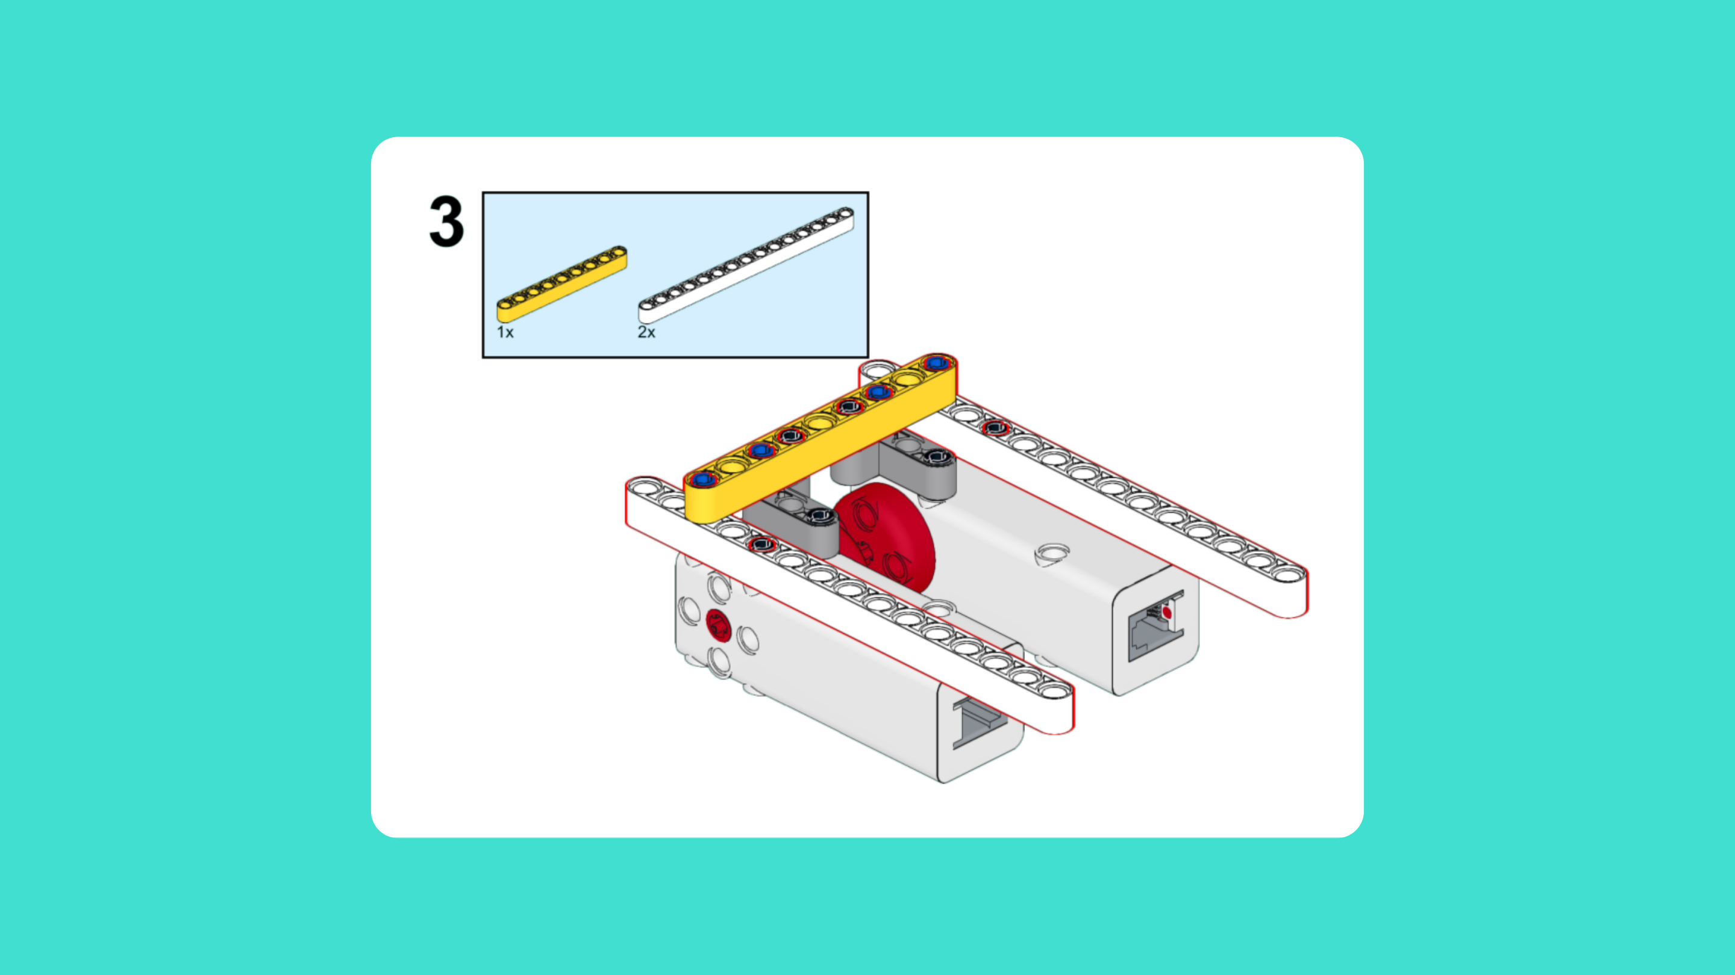
ASSEMBLY STEPS
STEP 1 – 3
PROGRESS: 9% COMPLETE (3 of 34 steps)
STEP 1
STEP 2
STEP 3
THE RETURNER · Techtelligence- Elecfreaks
1 / 12

Slide 4
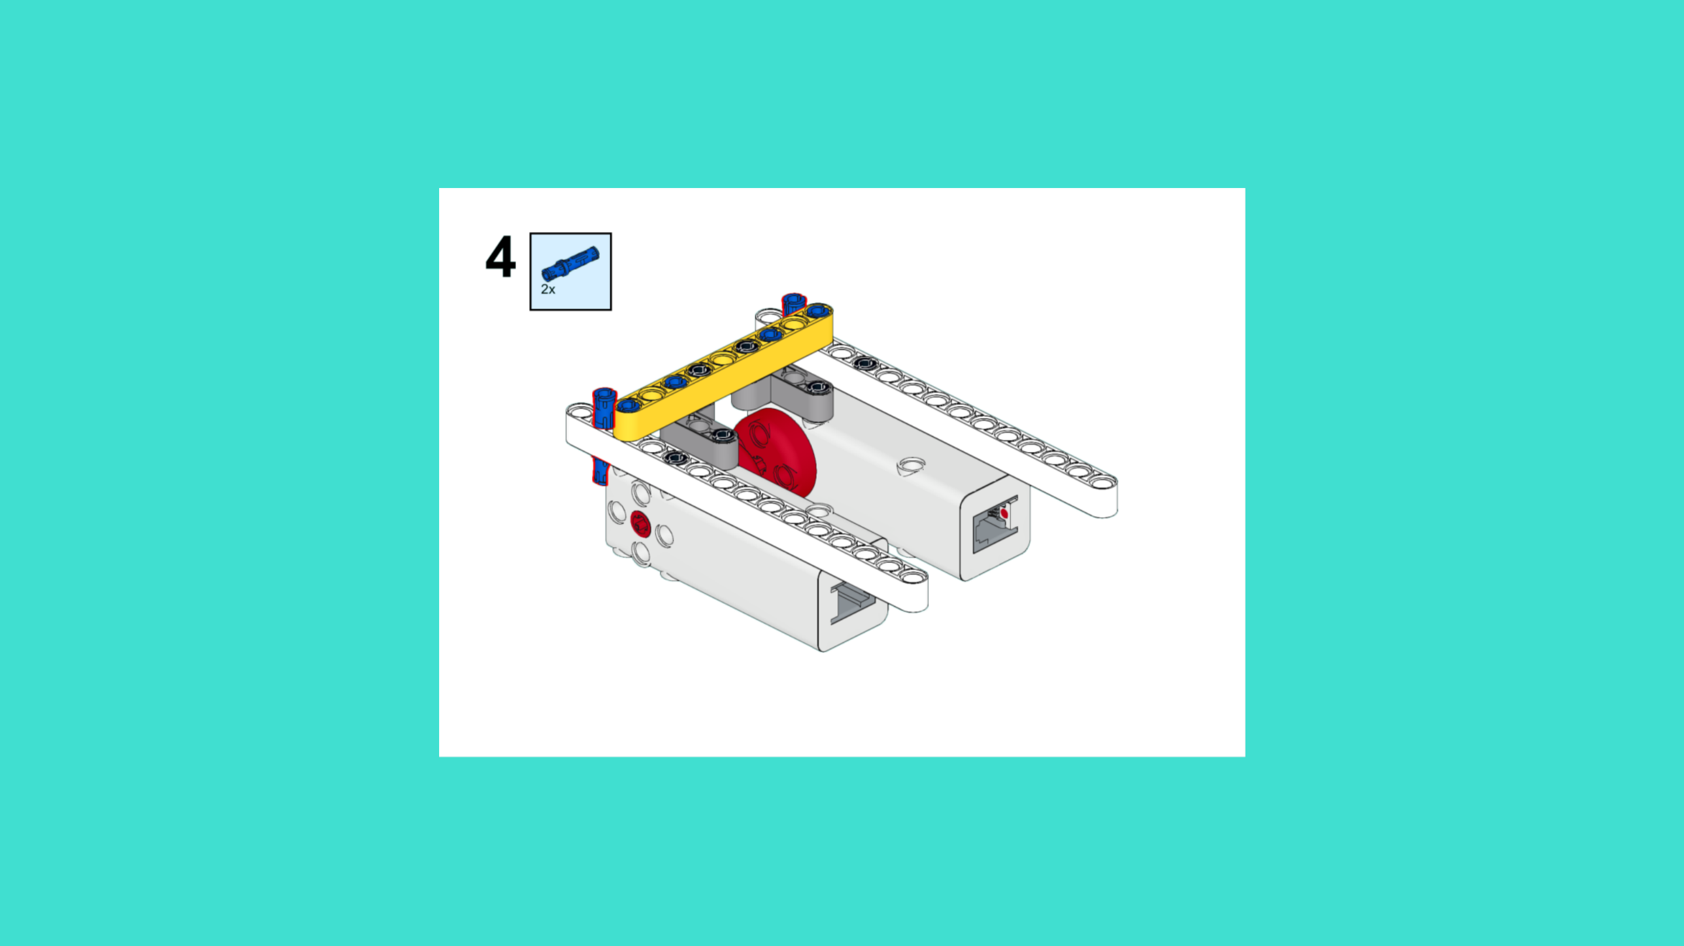
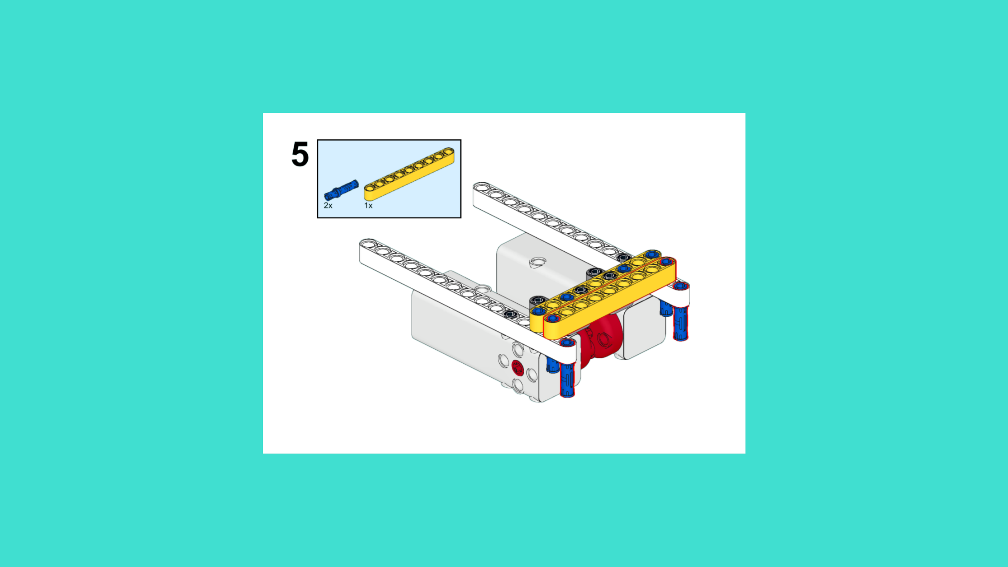
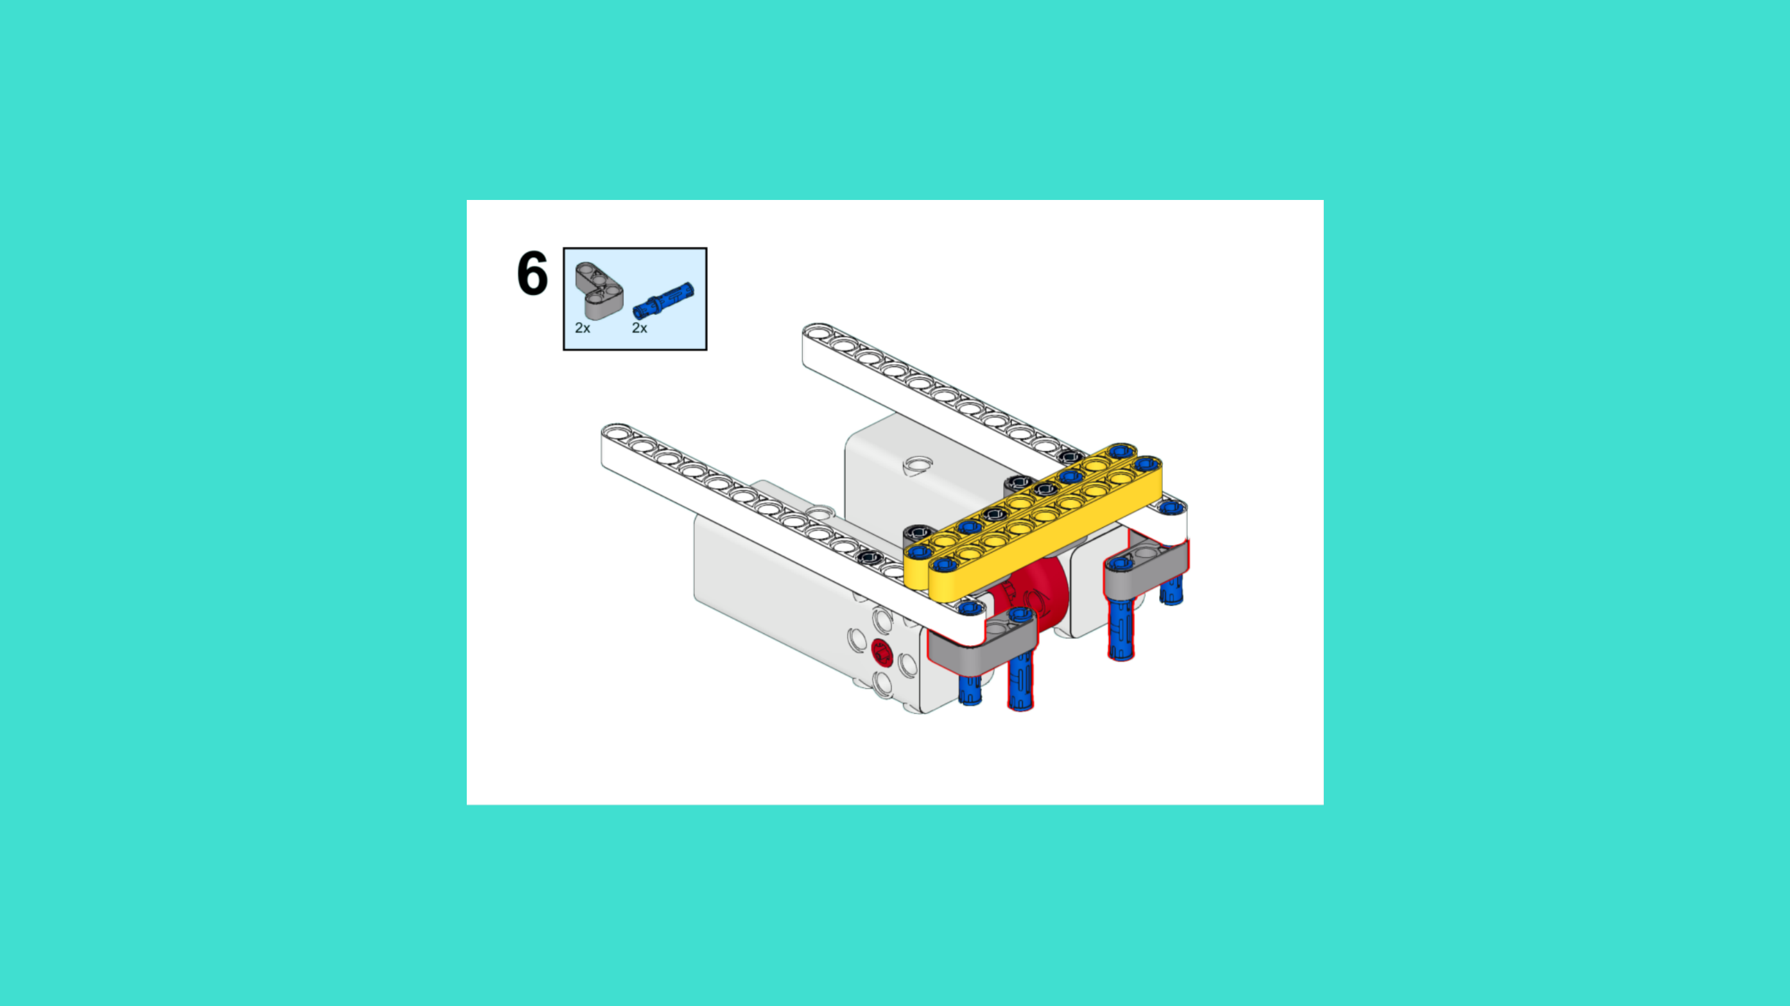
ASSEMBLY STEPS
STEP 4 – 6
PROGRESS: 18% COMPLETE (6 of 34 steps)
STEP 4
STEP 5
STEP 6
THE RETURNER · Techtelligence- Elecfreaks
2 / 12

Slide 5
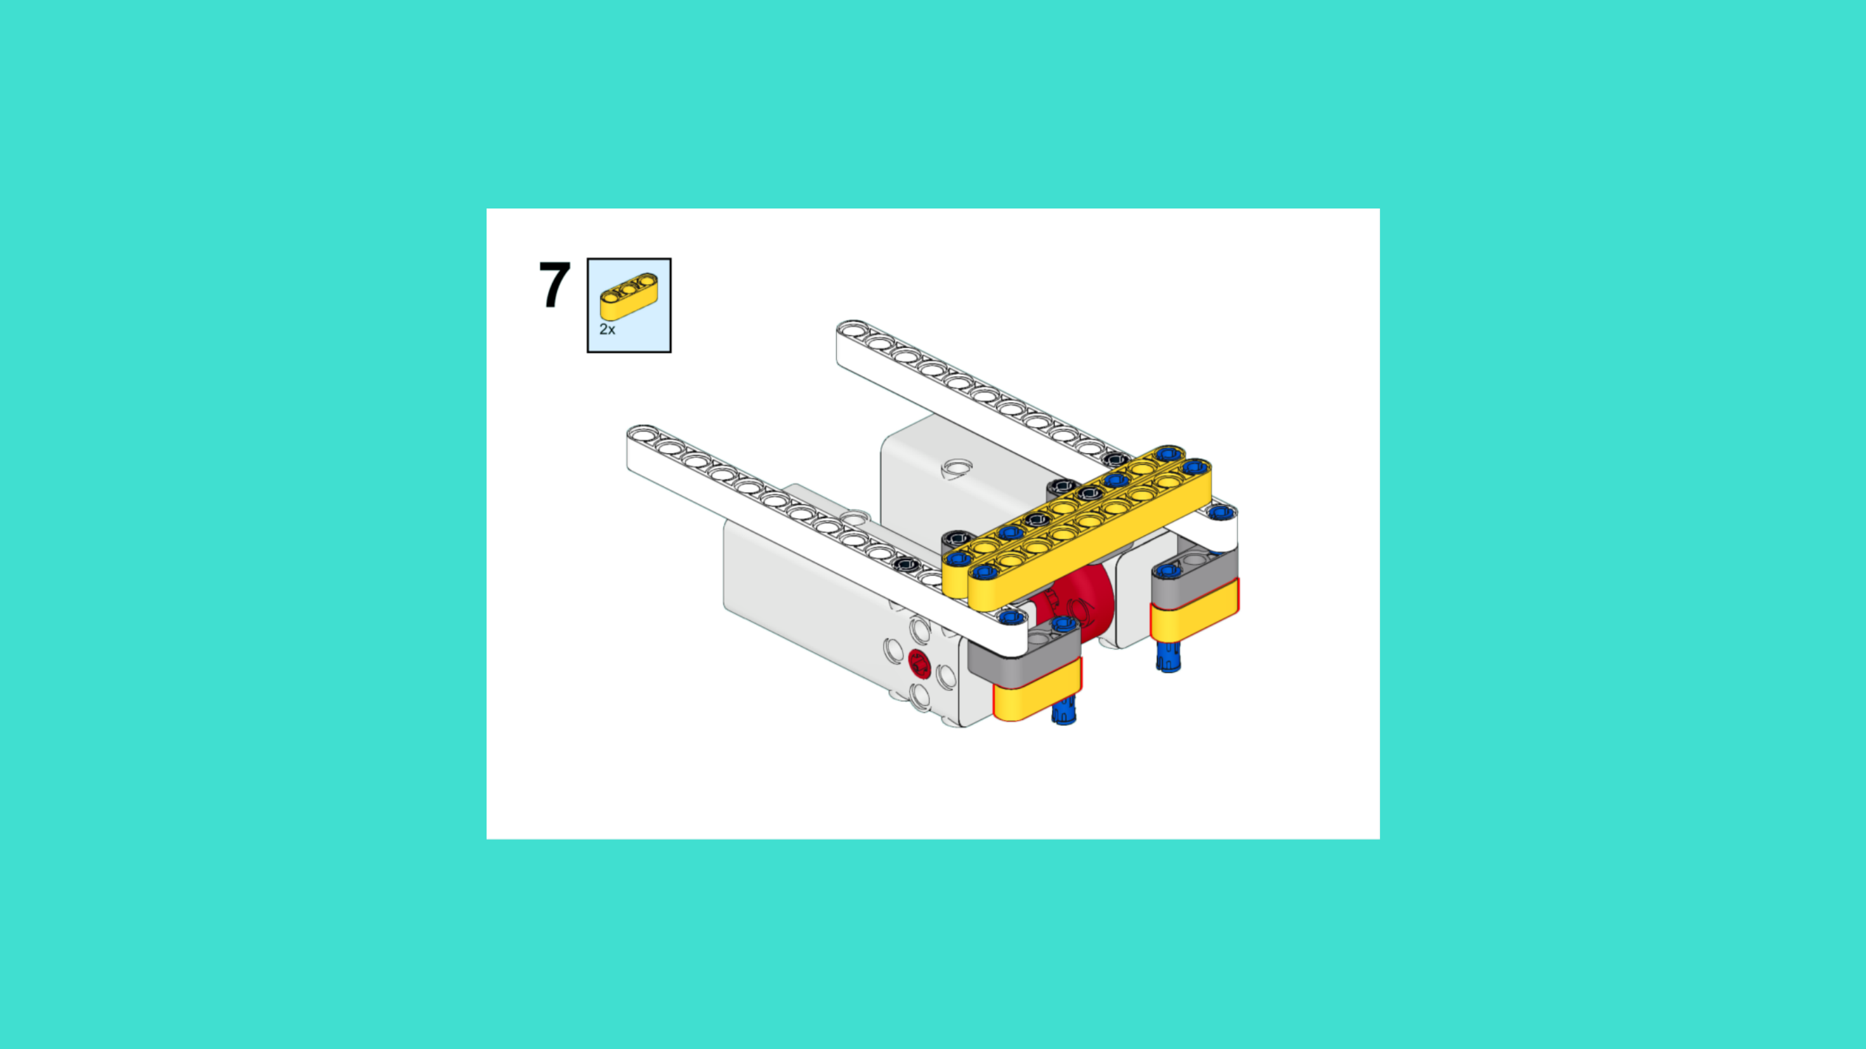
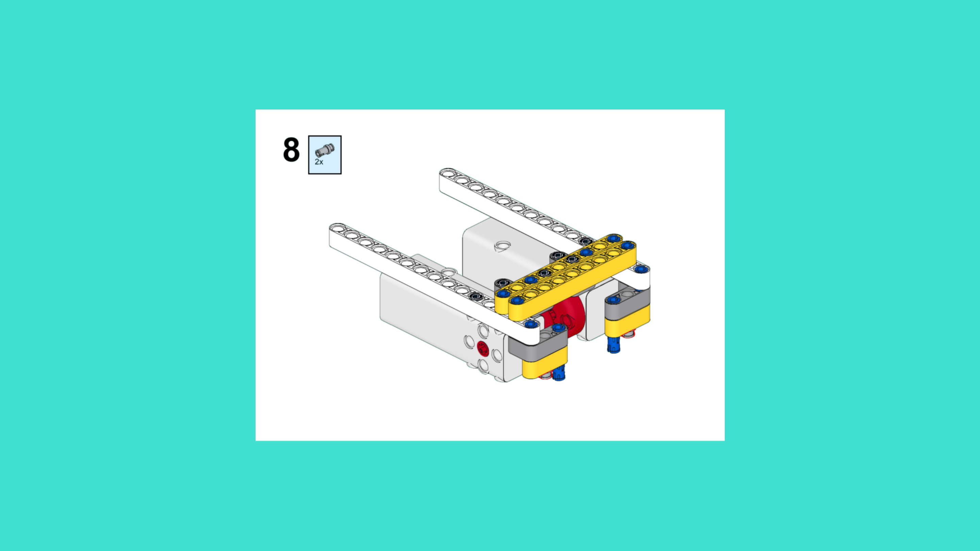
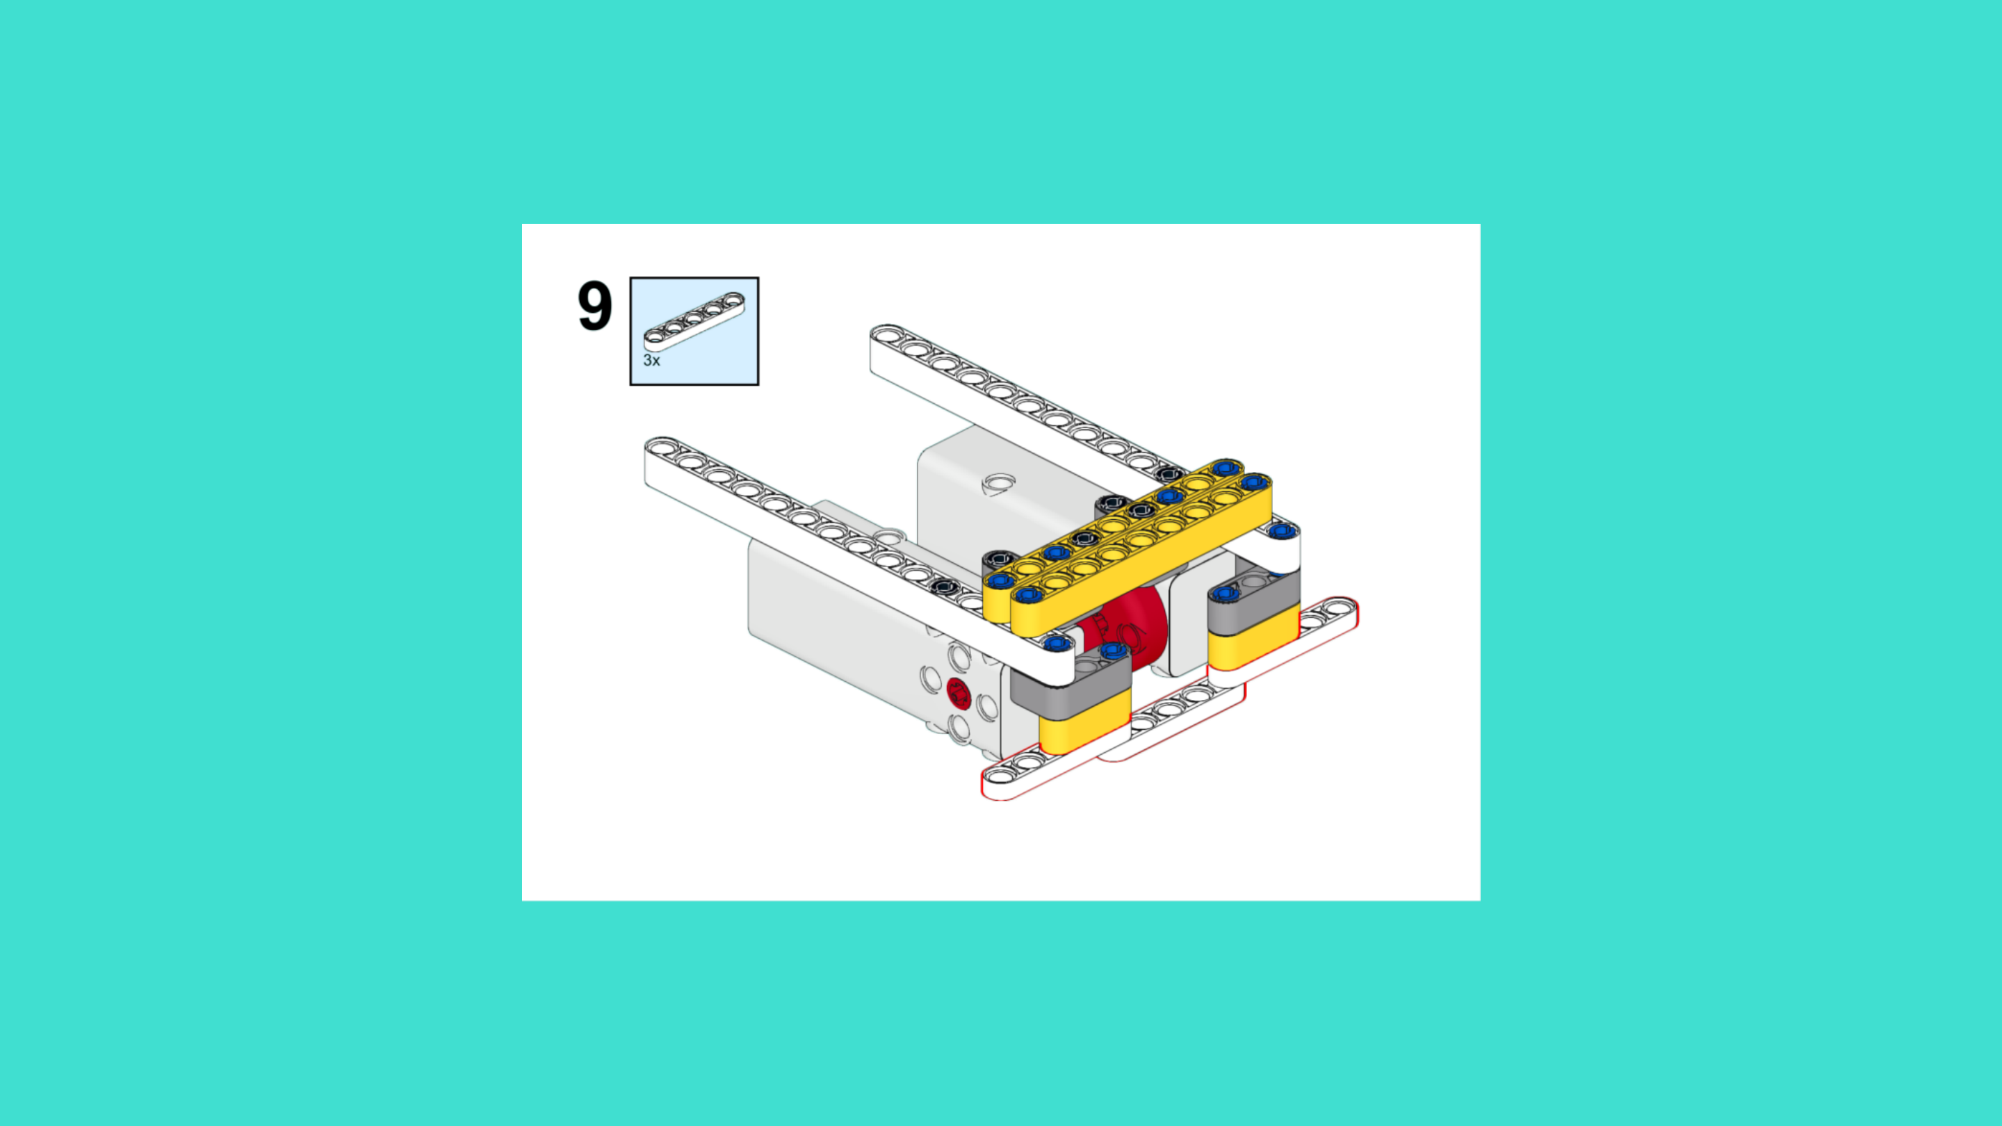
ASSEMBLY STEPS
STEP 7 – 9
PROGRESS: 26% COMPLETE (9 of 34 steps)
STEP 7
STEP 8
STEP 9
THE RETURNER · Techtelligence- Elecfreaks
3 / 12

Slide 6
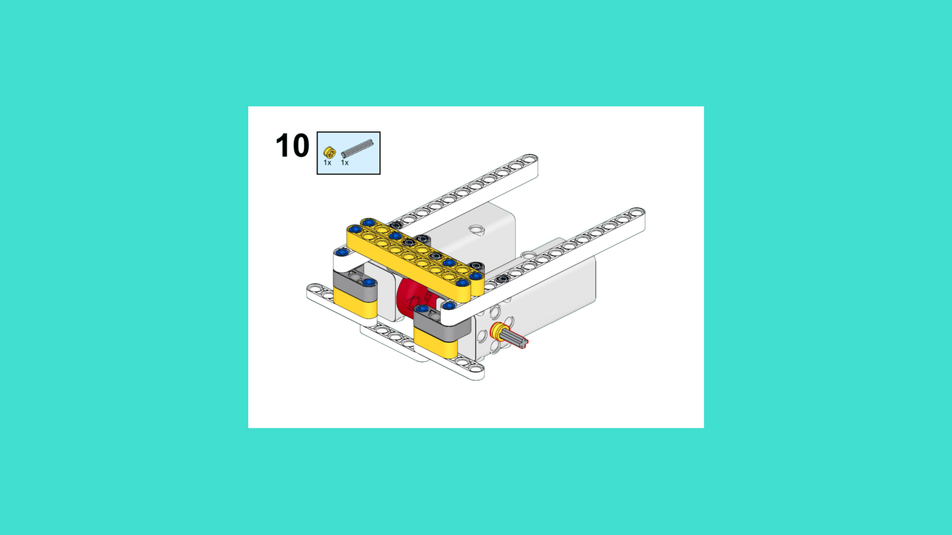
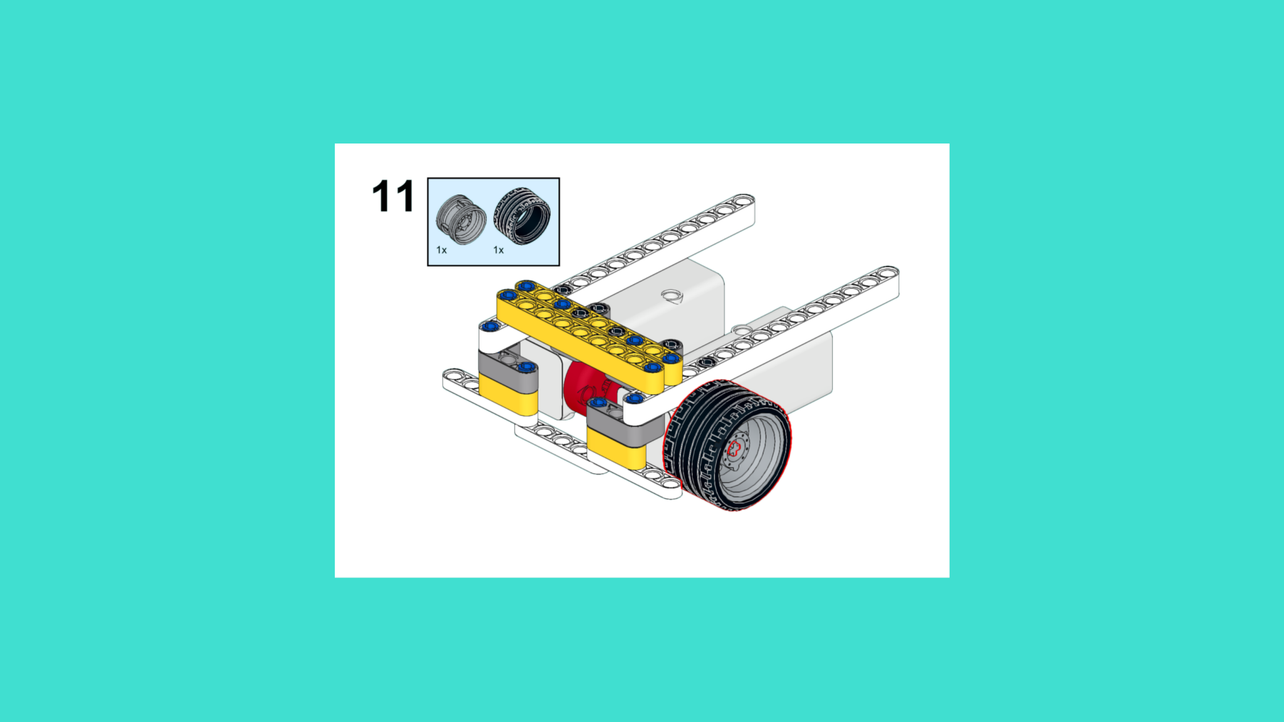
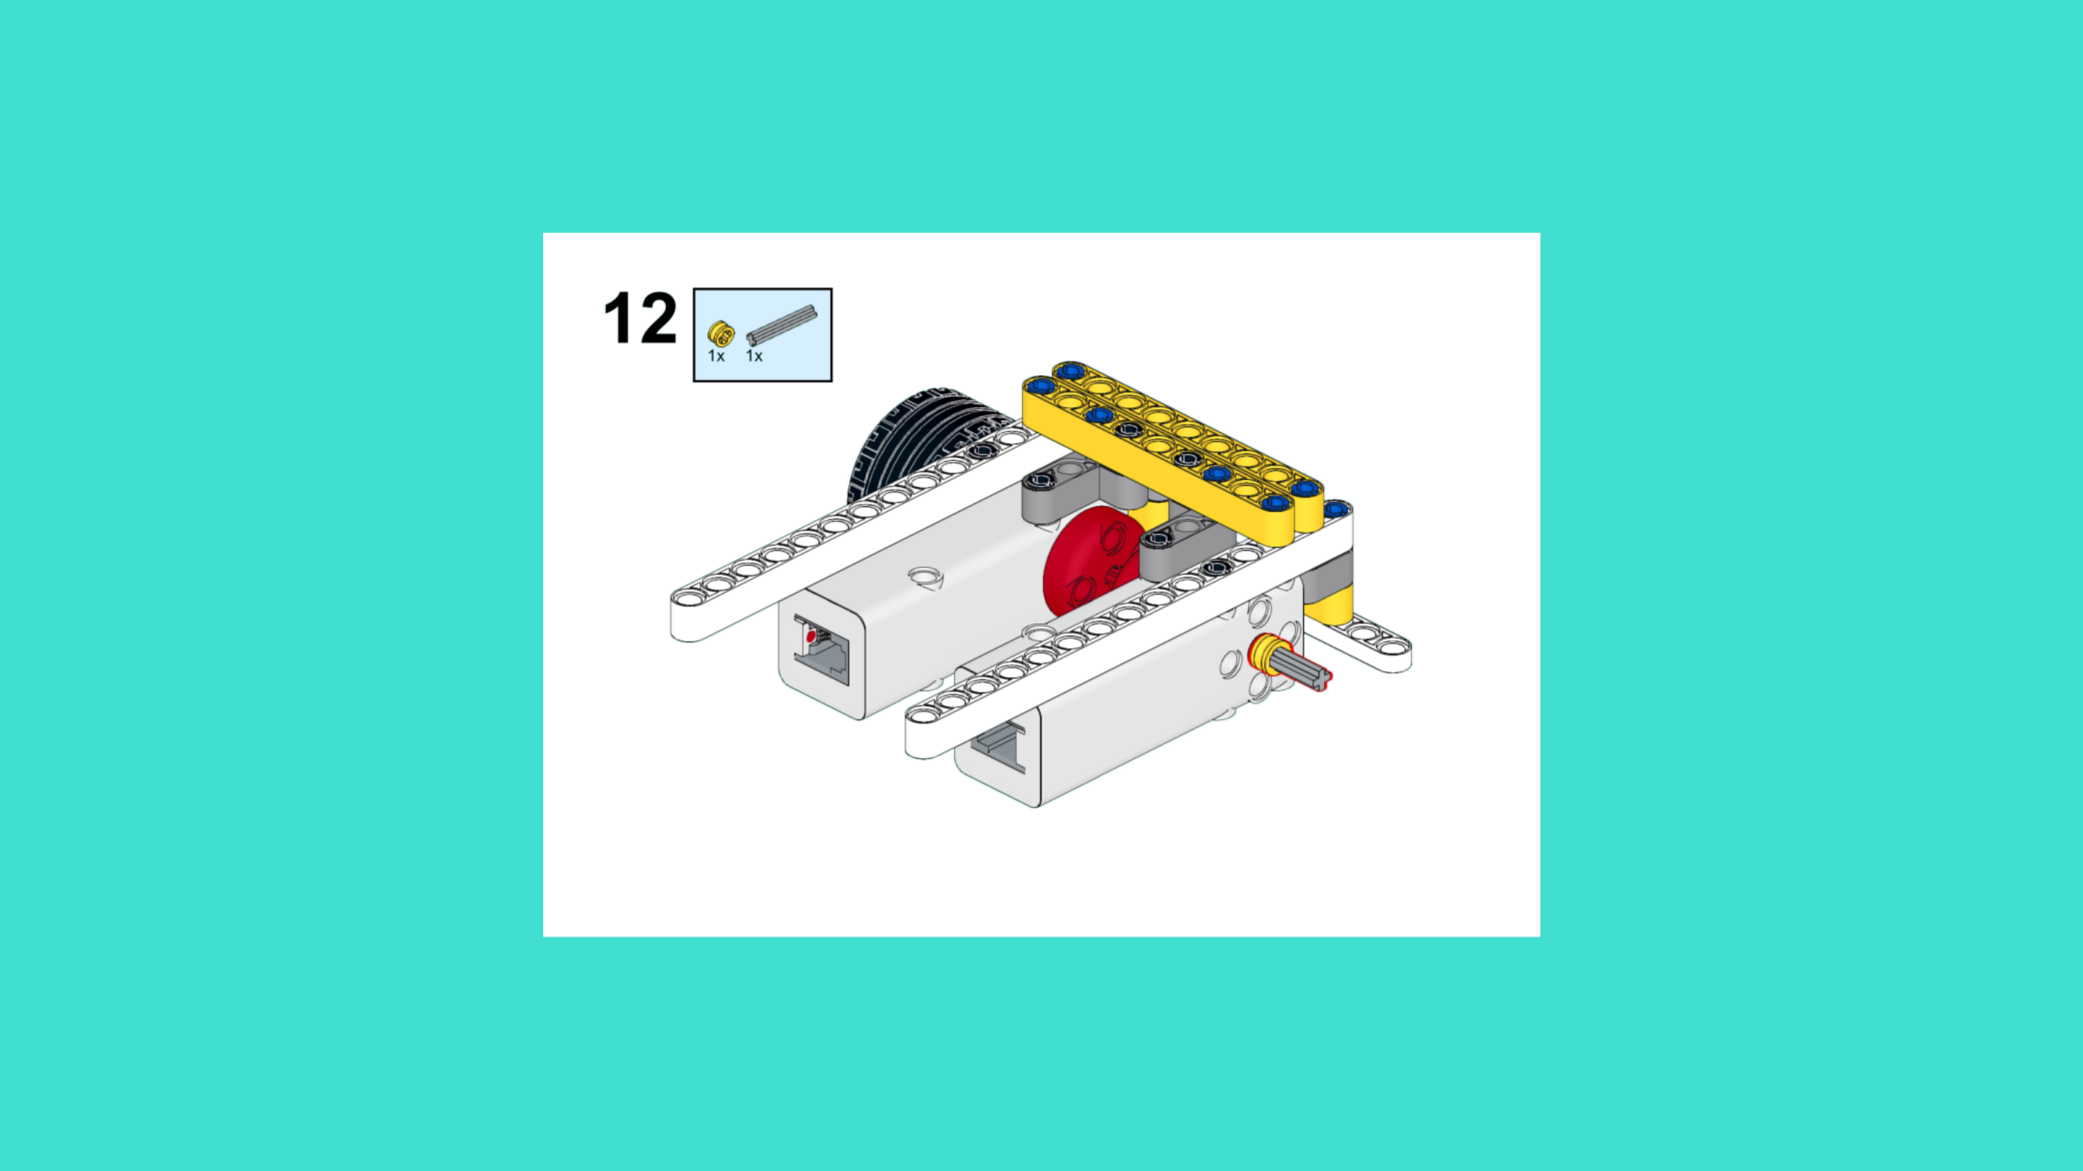
ASSEMBLY STEPS
STEP 10 – 12
PROGRESS: 35% COMPLETE (12 of 34 steps)
STEP 10
STEP 11
STEP 12
THE RETURNER · Techtelligence- Elecfreaks
4 / 12

Slide 7
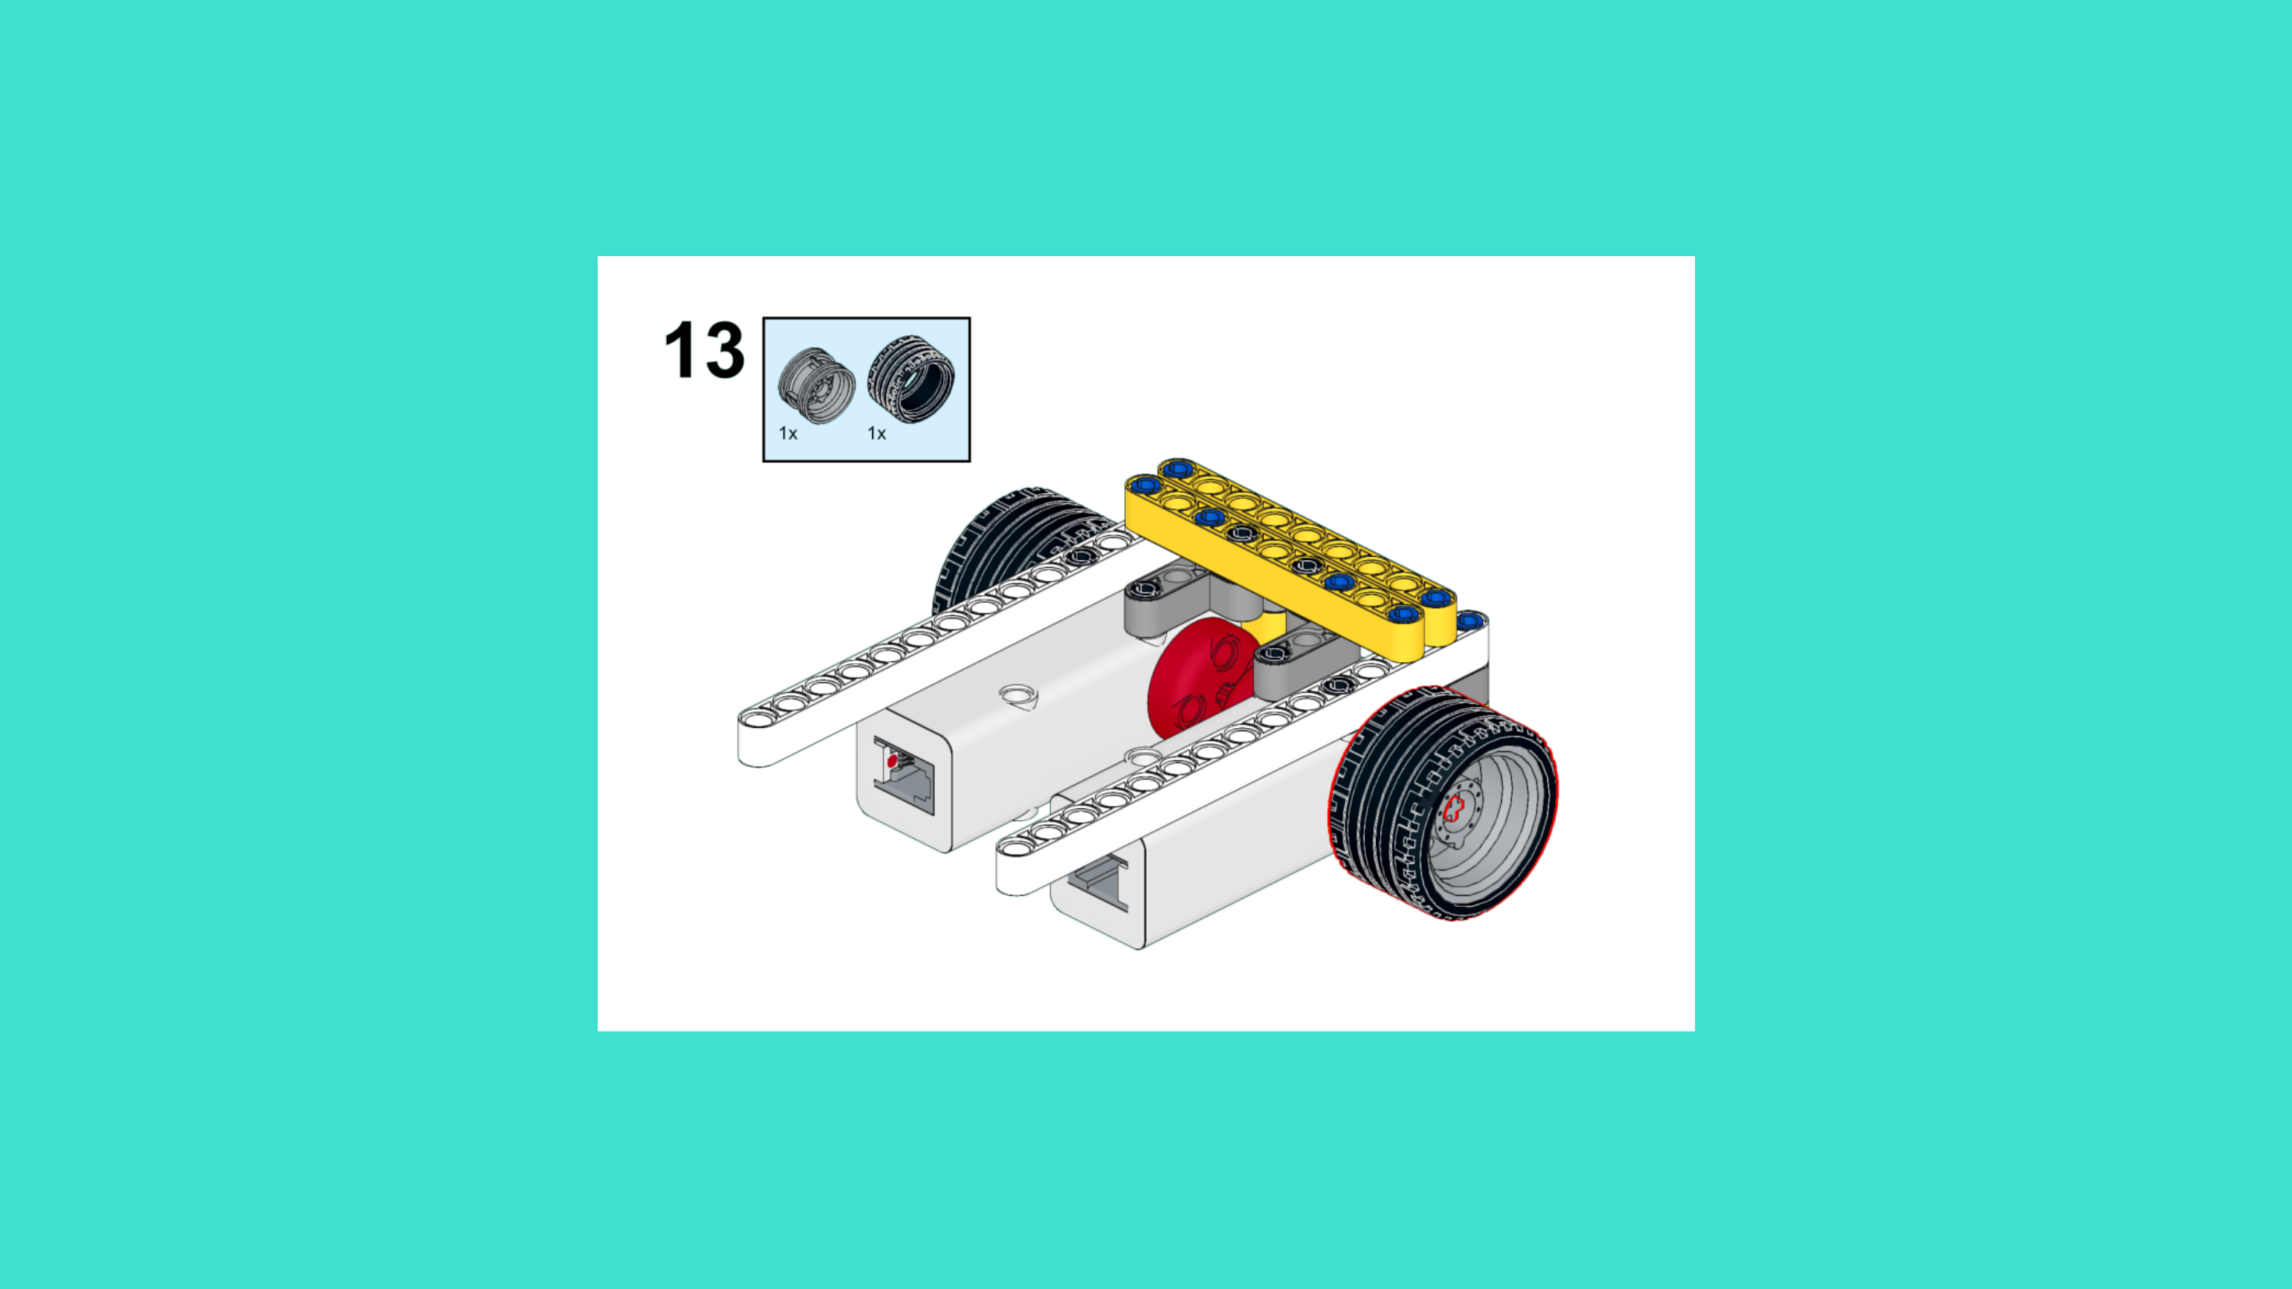
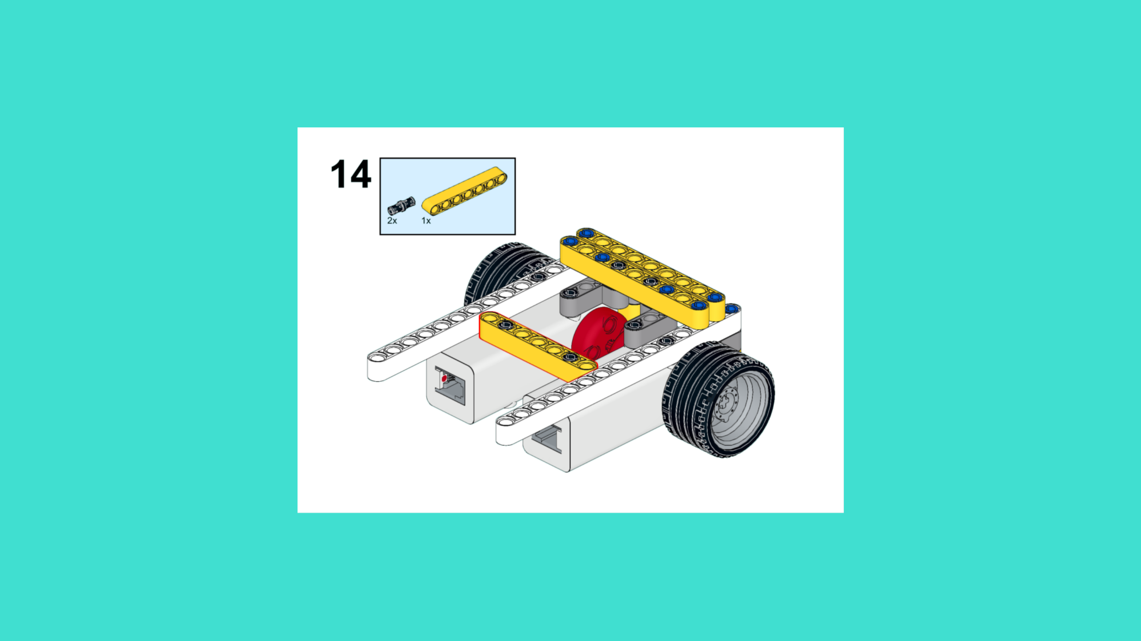
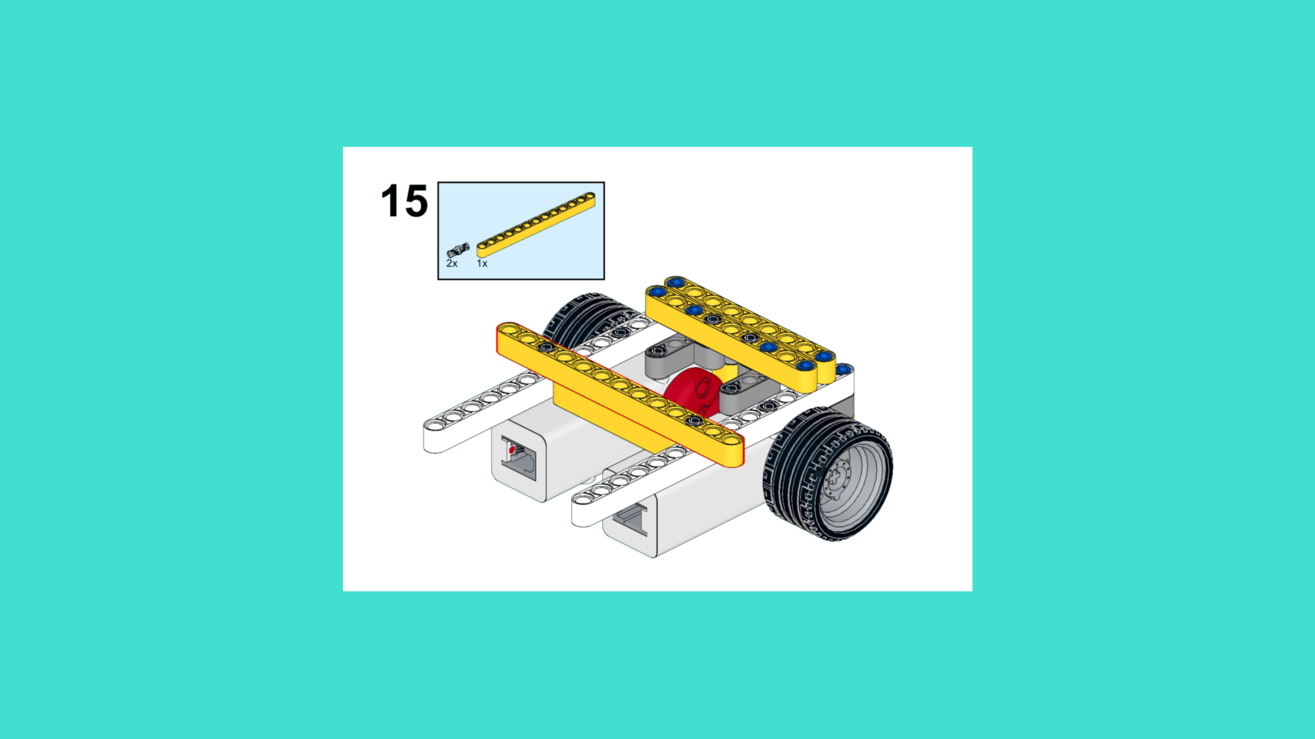
ASSEMBLY STEPS
STEP 13 – 15
PROGRESS: 44% COMPLETE (15 of 34 steps)
STEP 13
STEP 14
STEP 15
THE RETURNER · Techtelligence- Elecfreaks
5 / 12

Slide 8
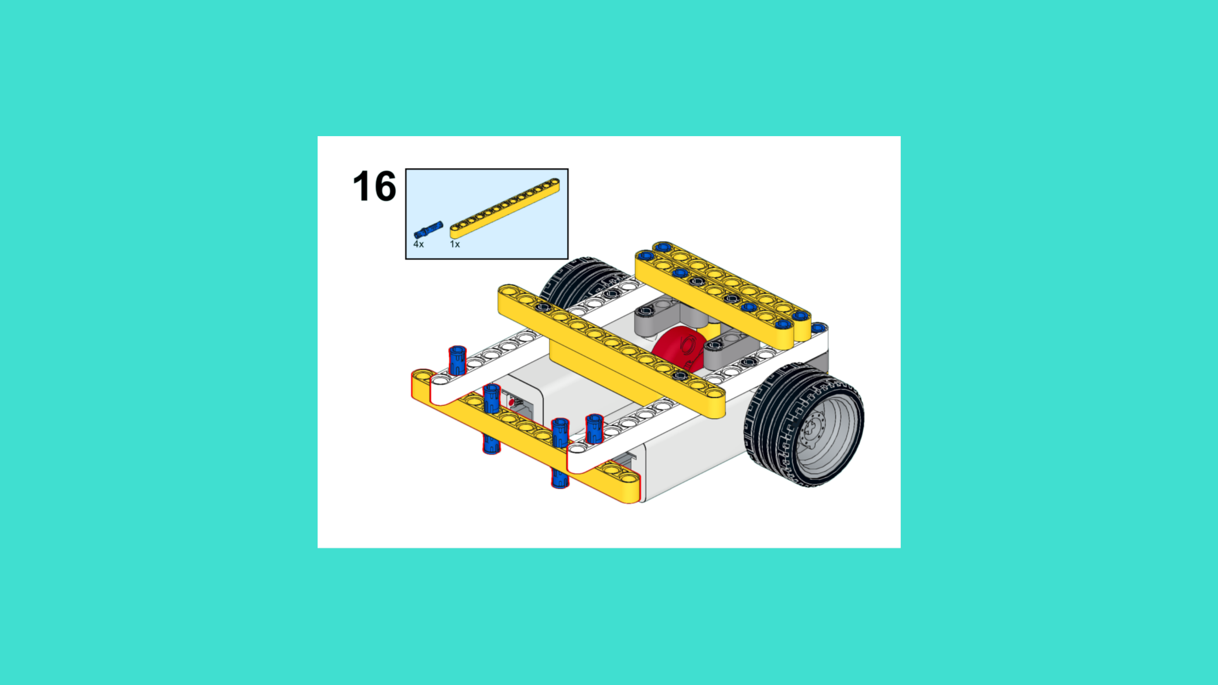
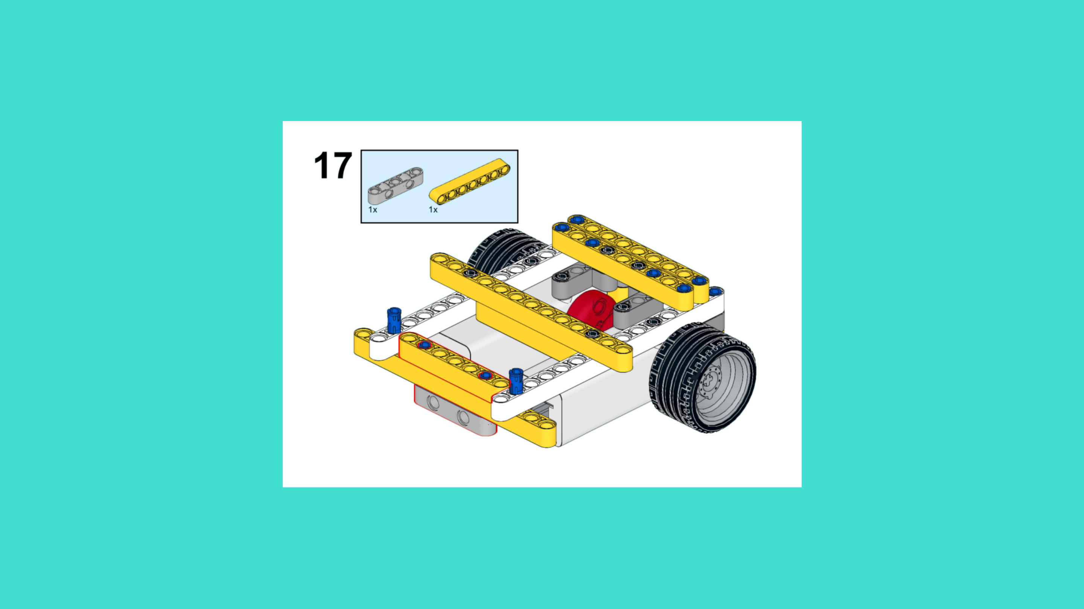
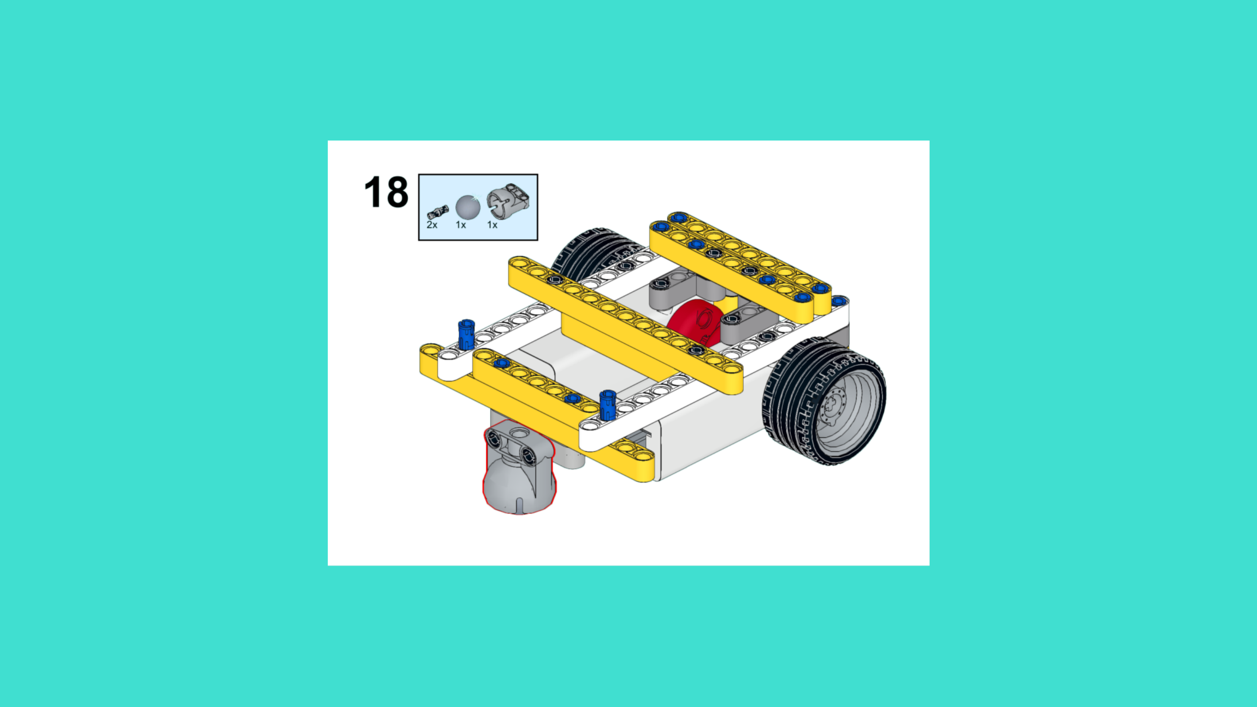
ASSEMBLY STEPS
STEP 16 – 18
PROGRESS: 53% COMPLETE (18 of 34 steps)
STEP 16
STEP 17
STEP 18
THE RETURNER · Techtelligence- Elecfreaks
6 / 12

Slide 9
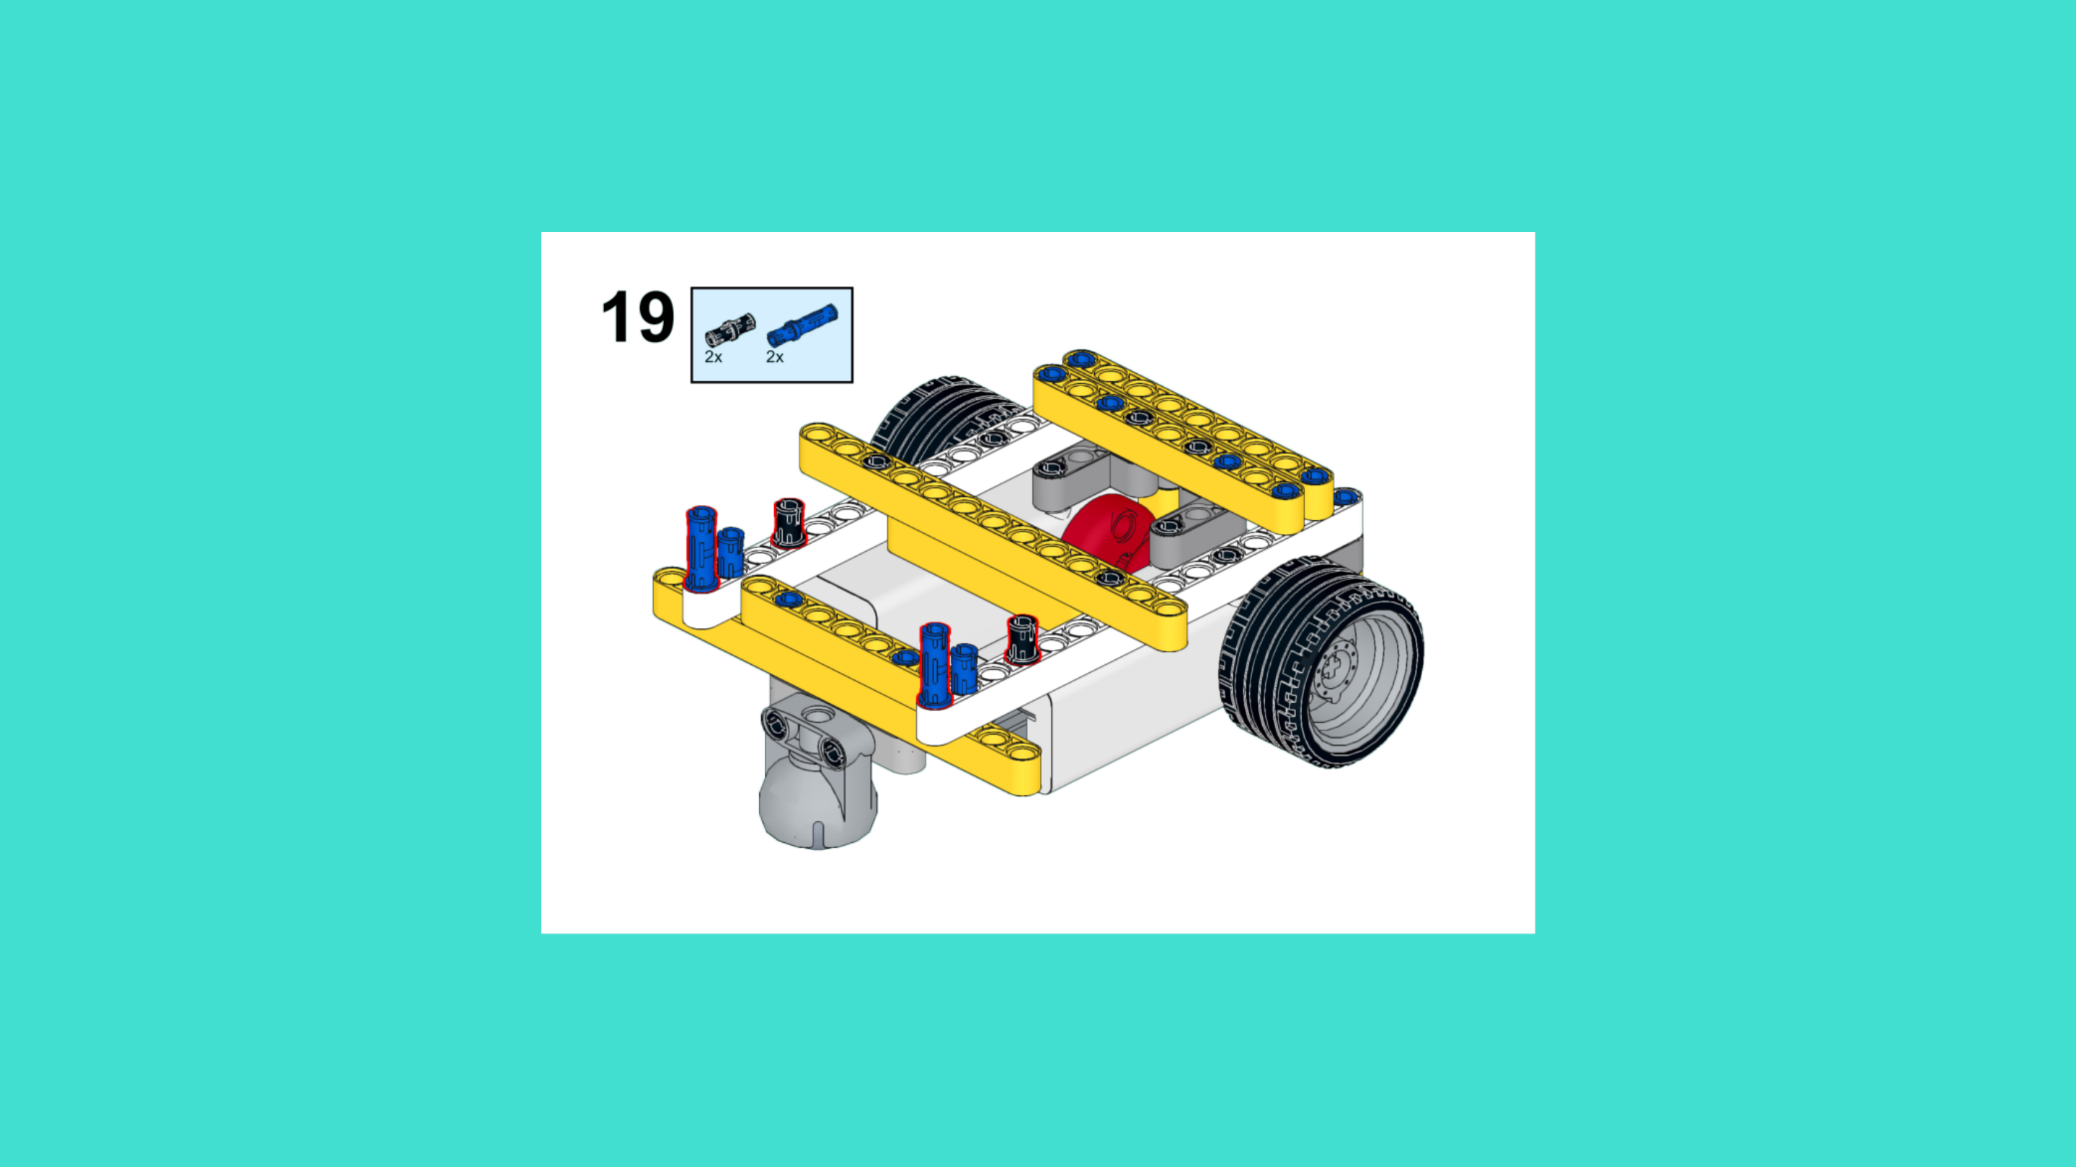
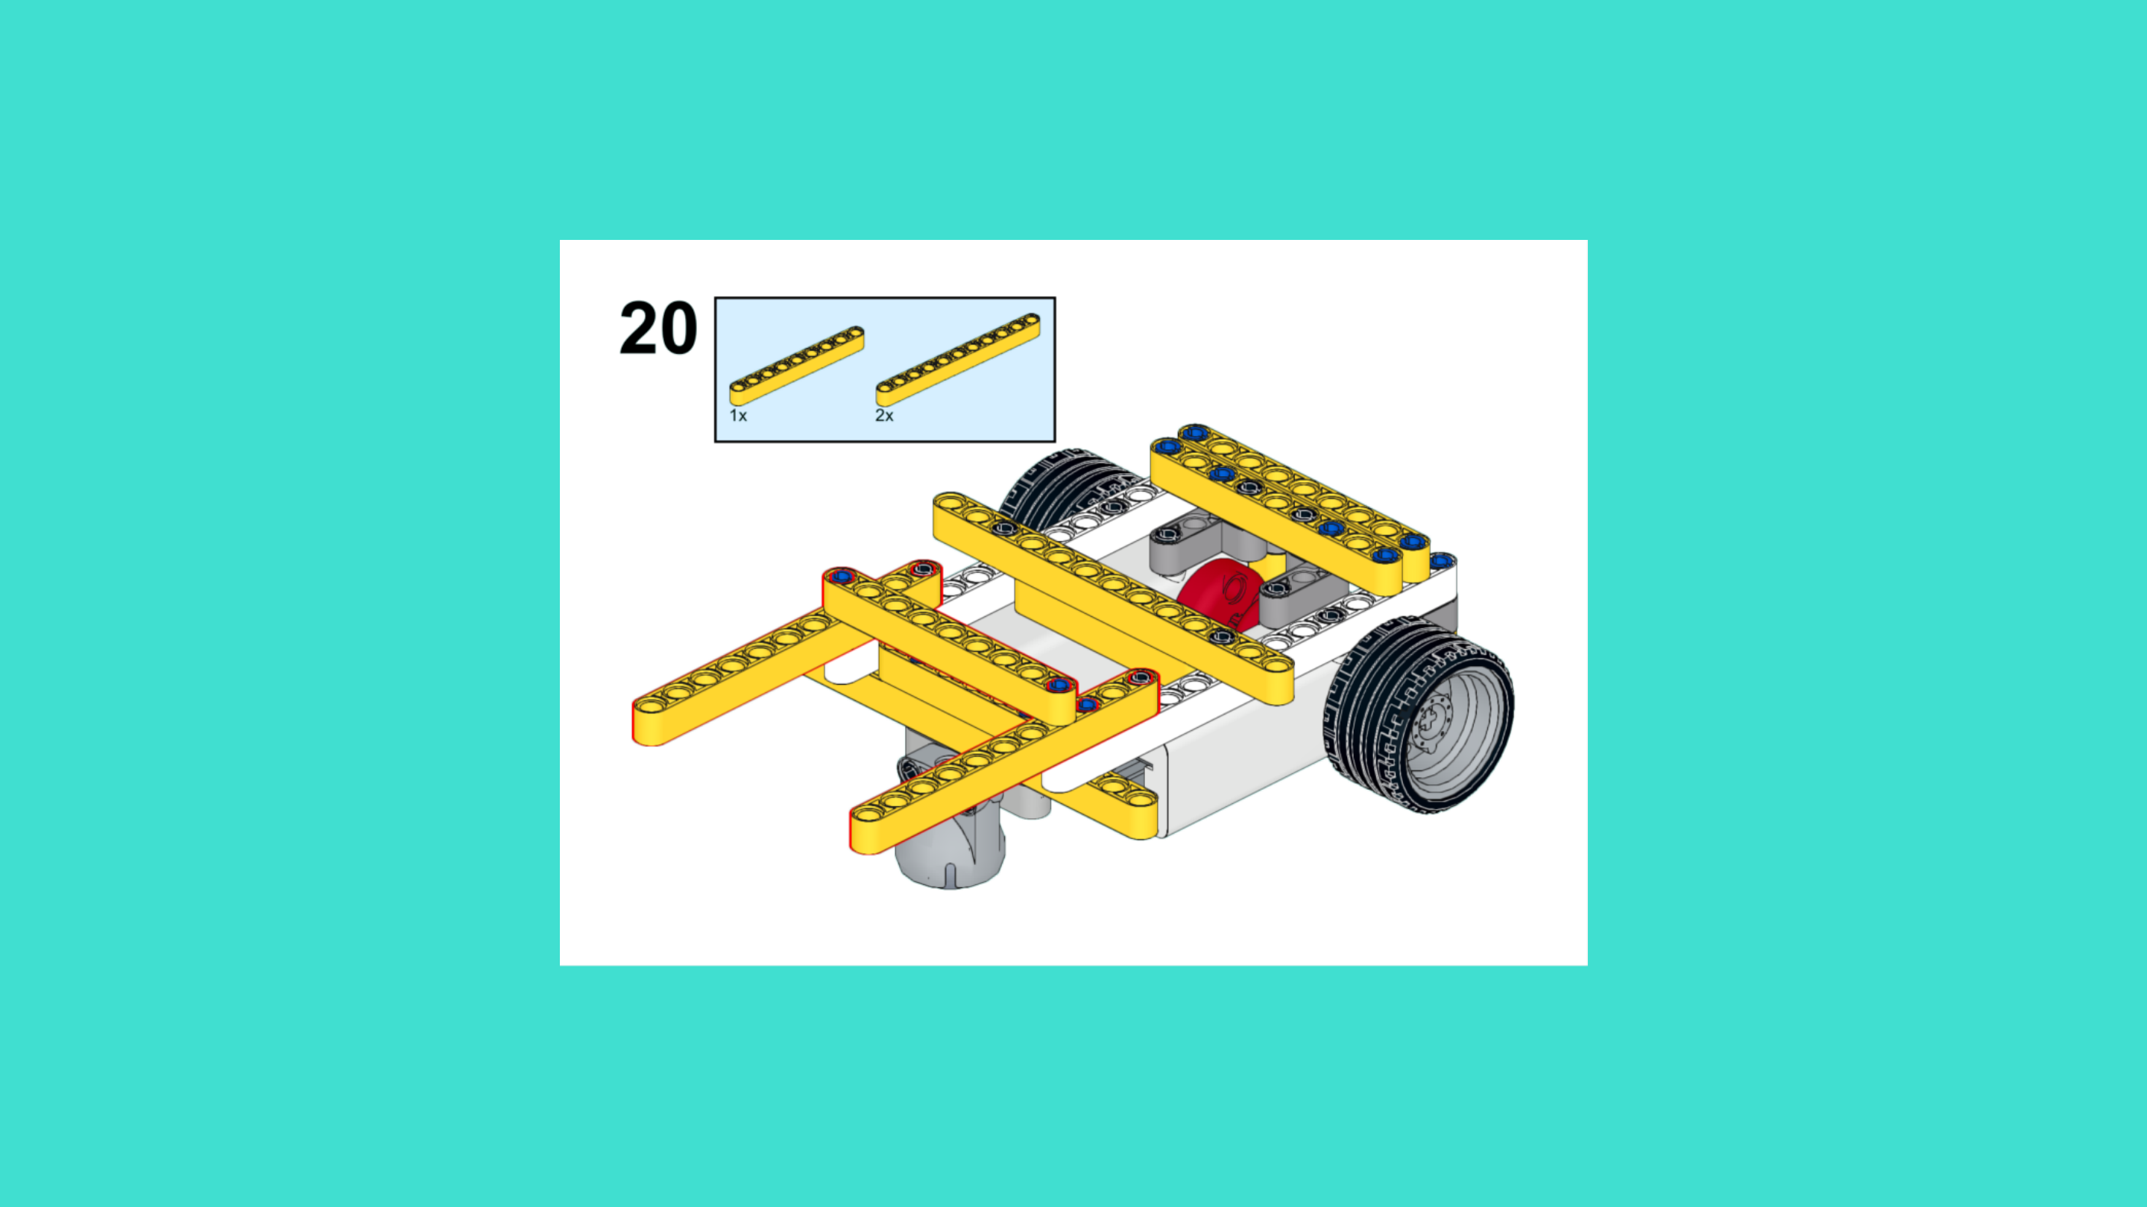
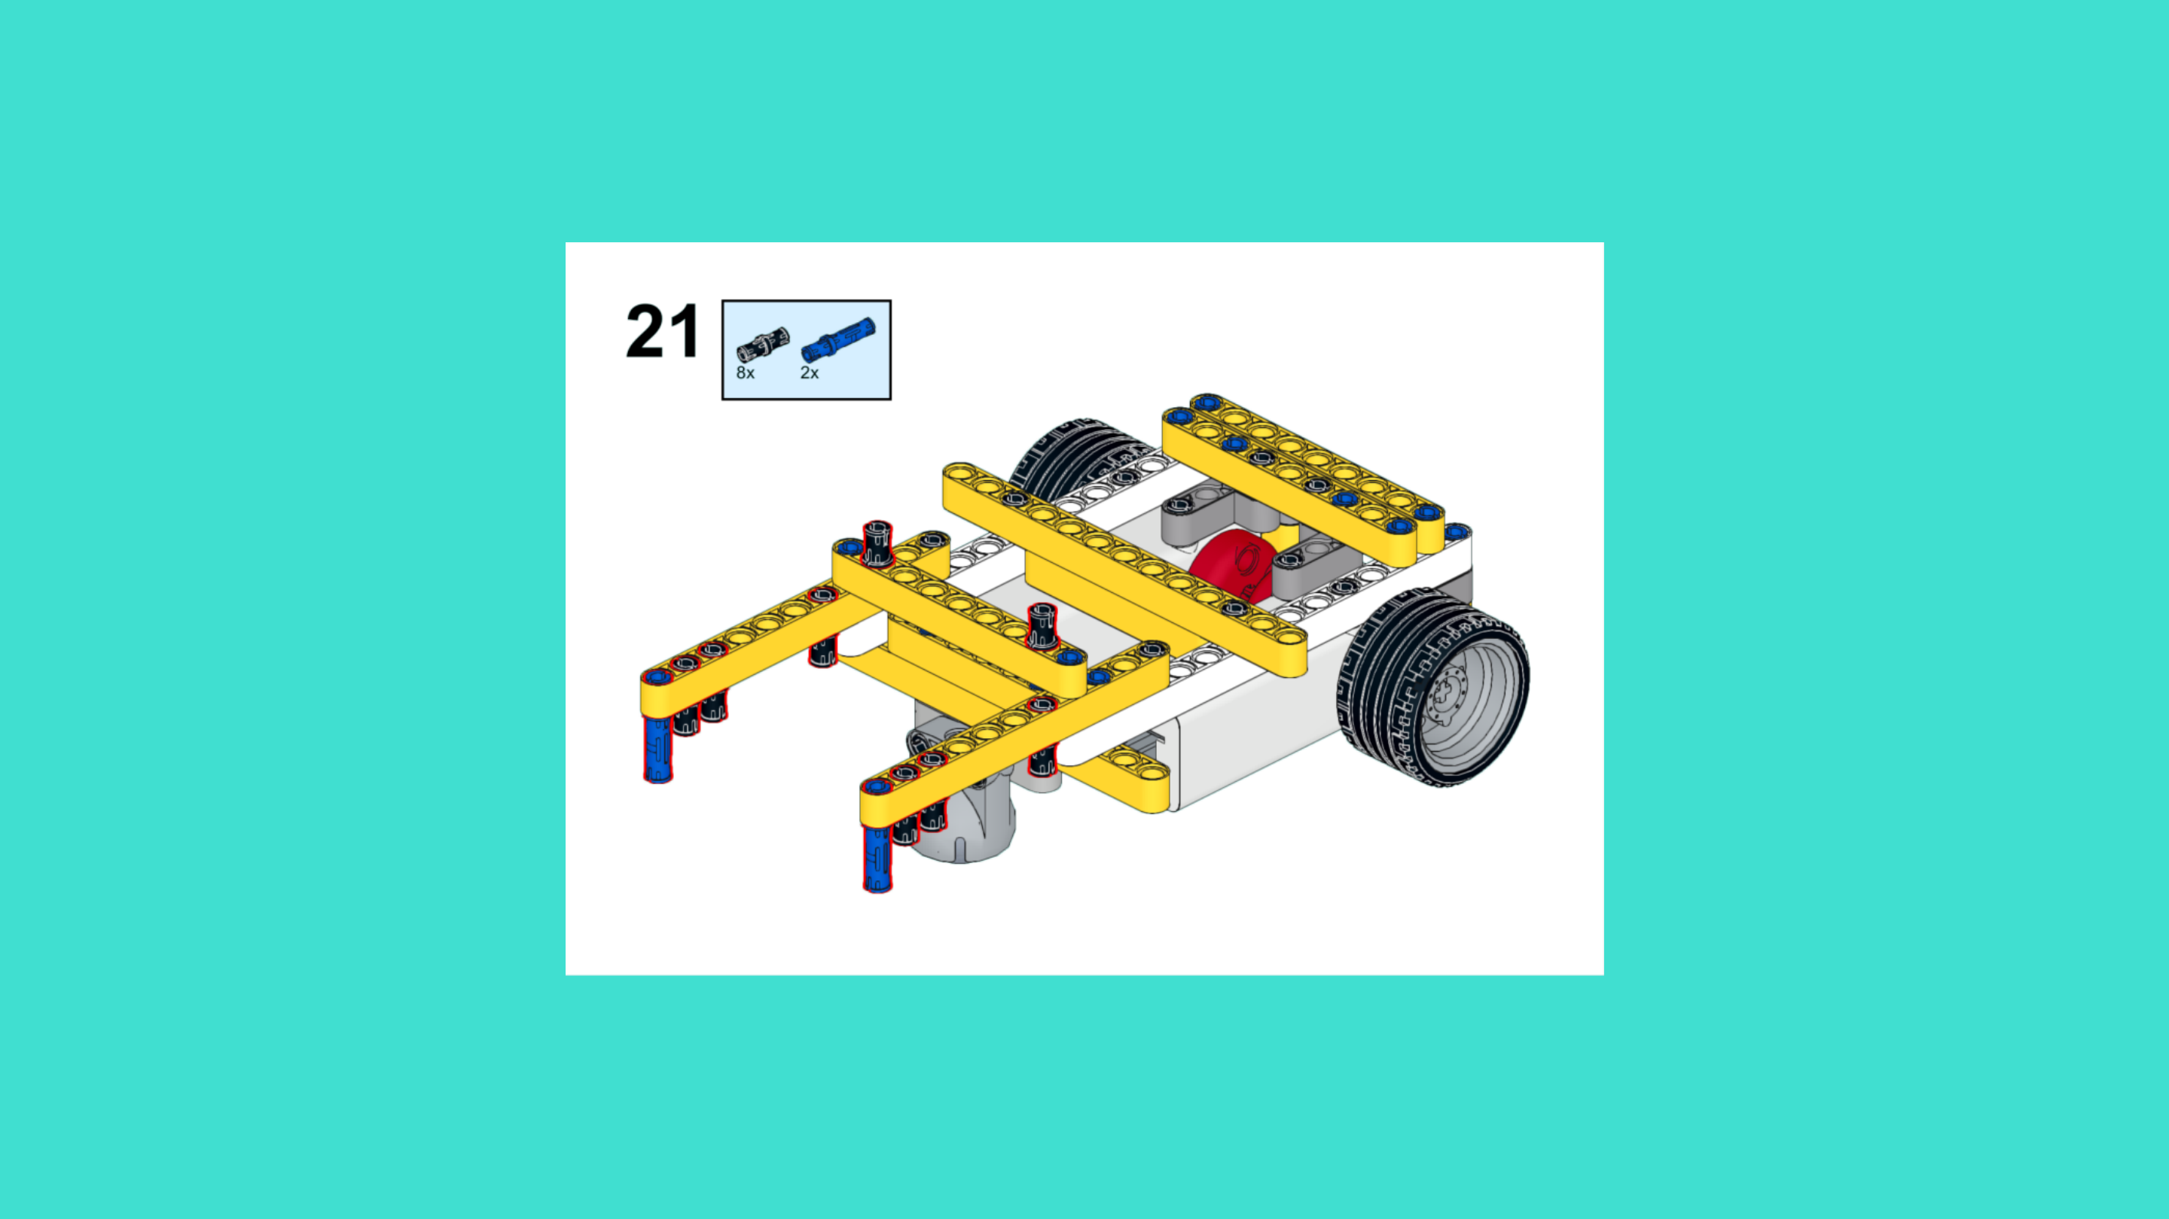
ASSEMBLY STEPS
STEP 19 – 21
PROGRESS: 62% COMPLETE (21 of 34 steps)
STEP 19
STEP 20
STEP 21
THE RETURNER · Techtelligence- Elecfreaks
7 / 12

Slide 10
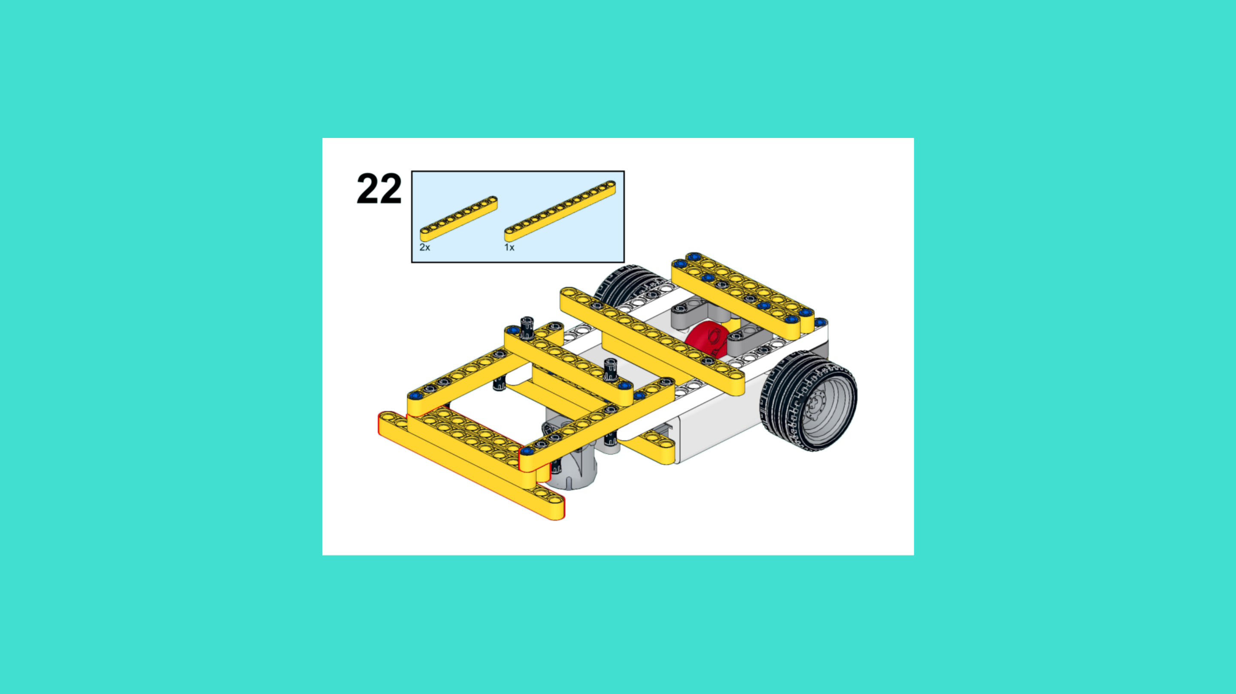
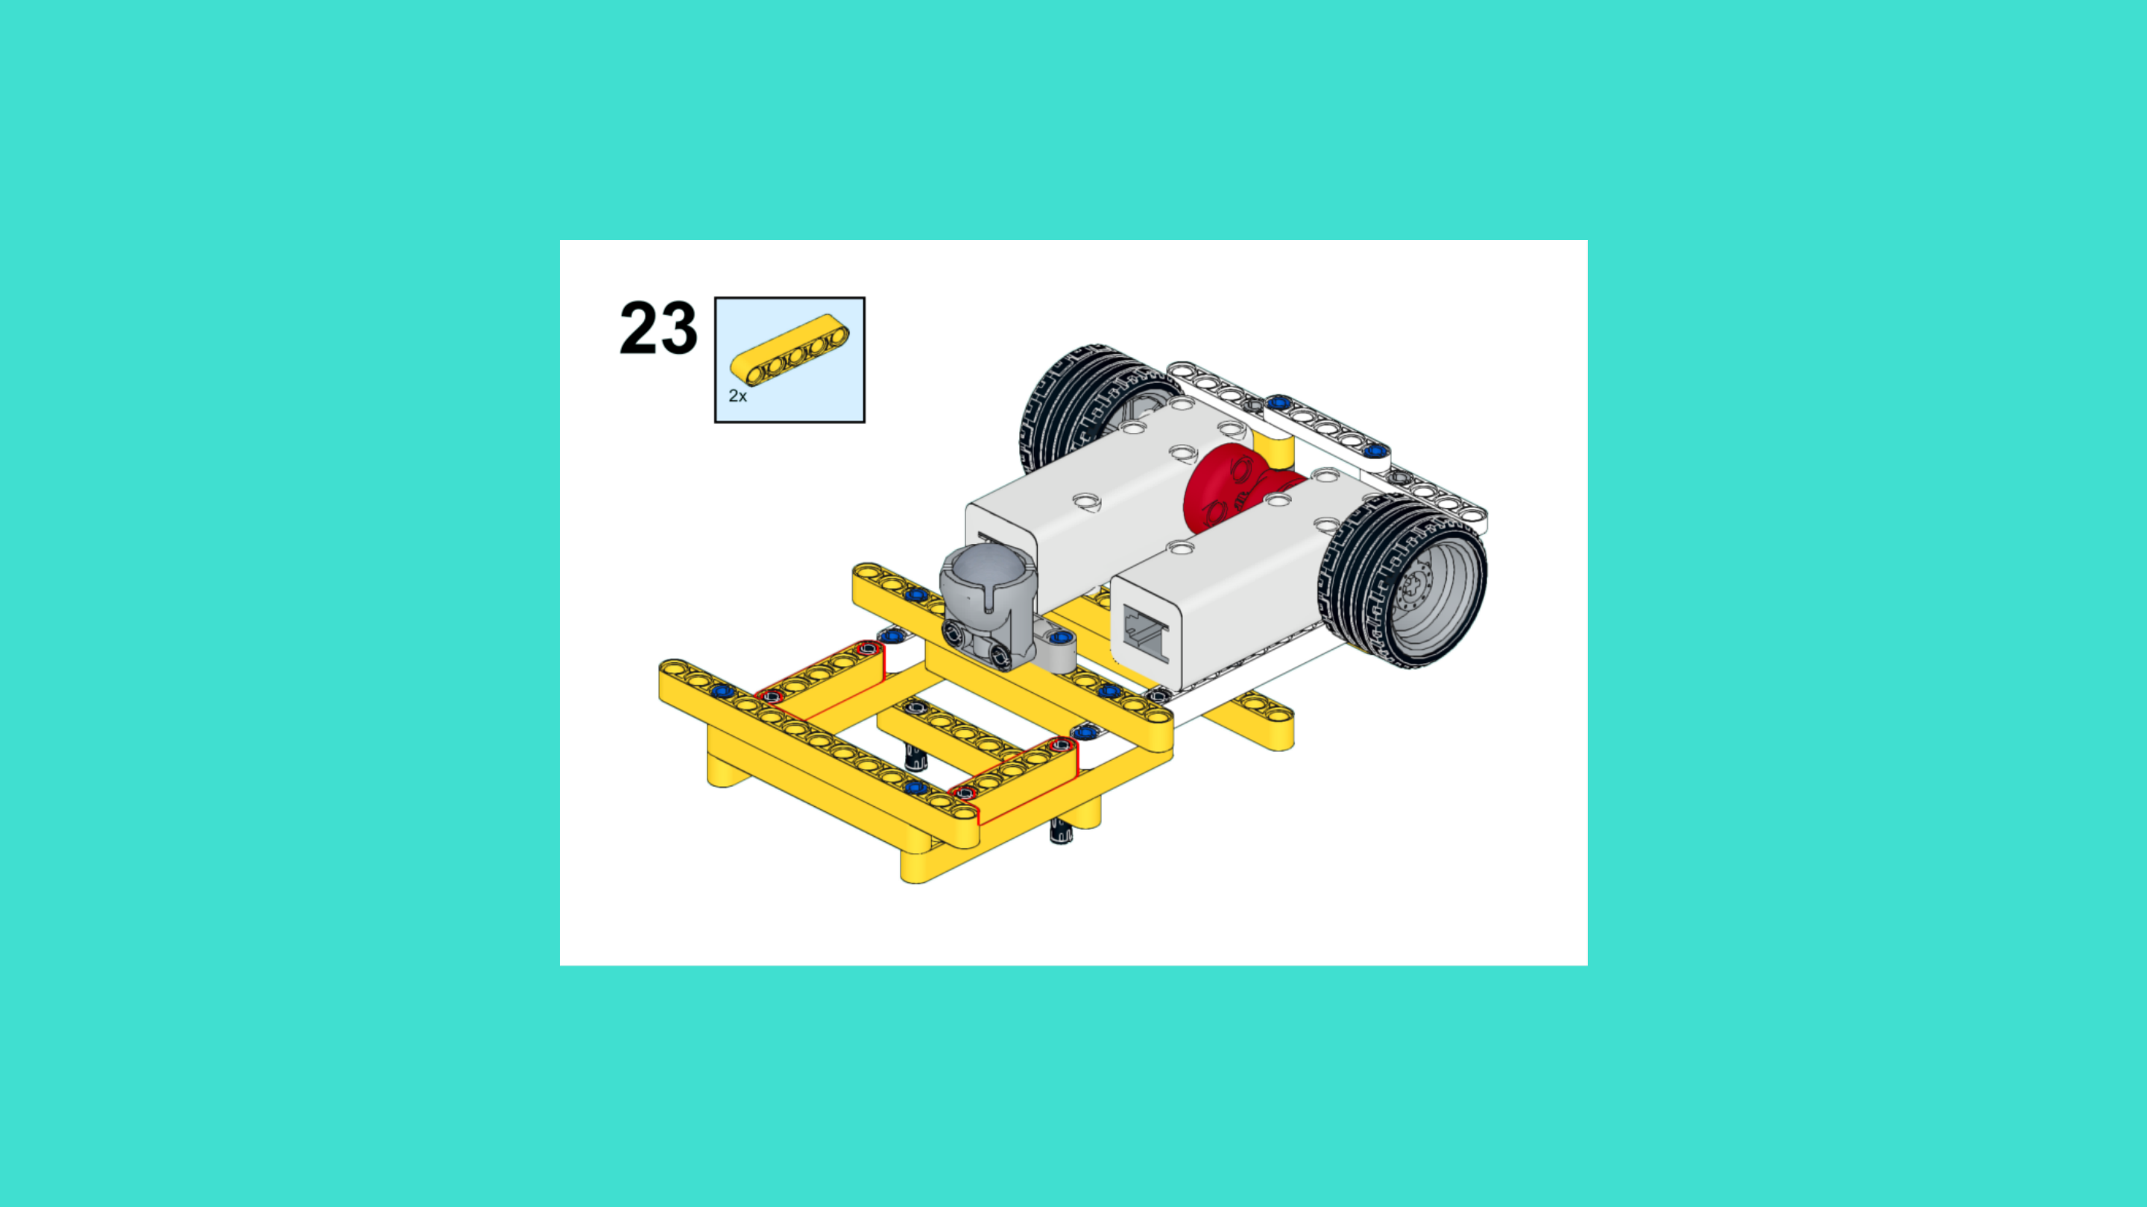
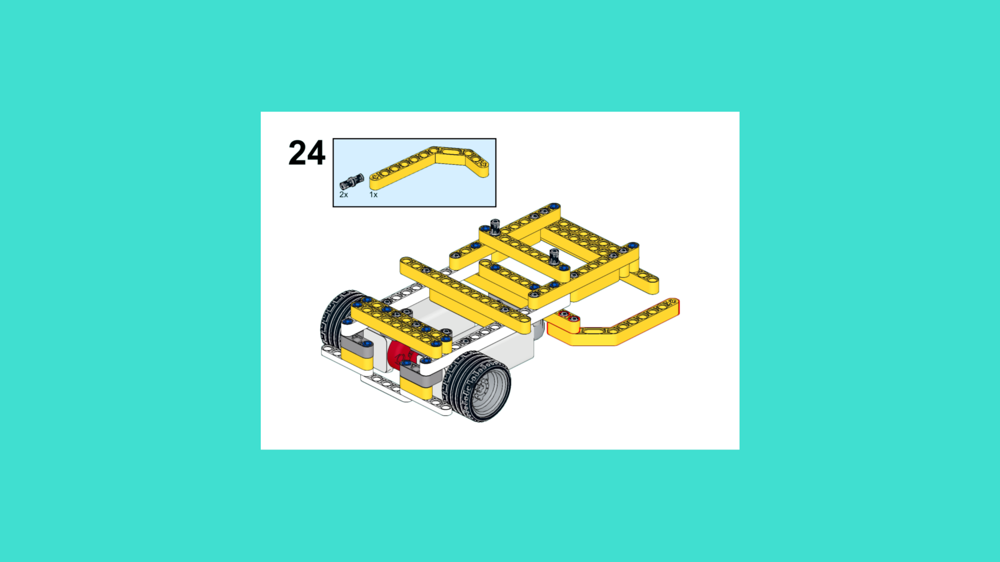
ASSEMBLY STEPS
STEP 22 – 24
PROGRESS: 71% COMPLETE (24 of 34 steps)
STEP 22
STEP 23
STEP 24
THE RETURNER · Techtelligence- Elecfreaks
8 / 12

Slide 11
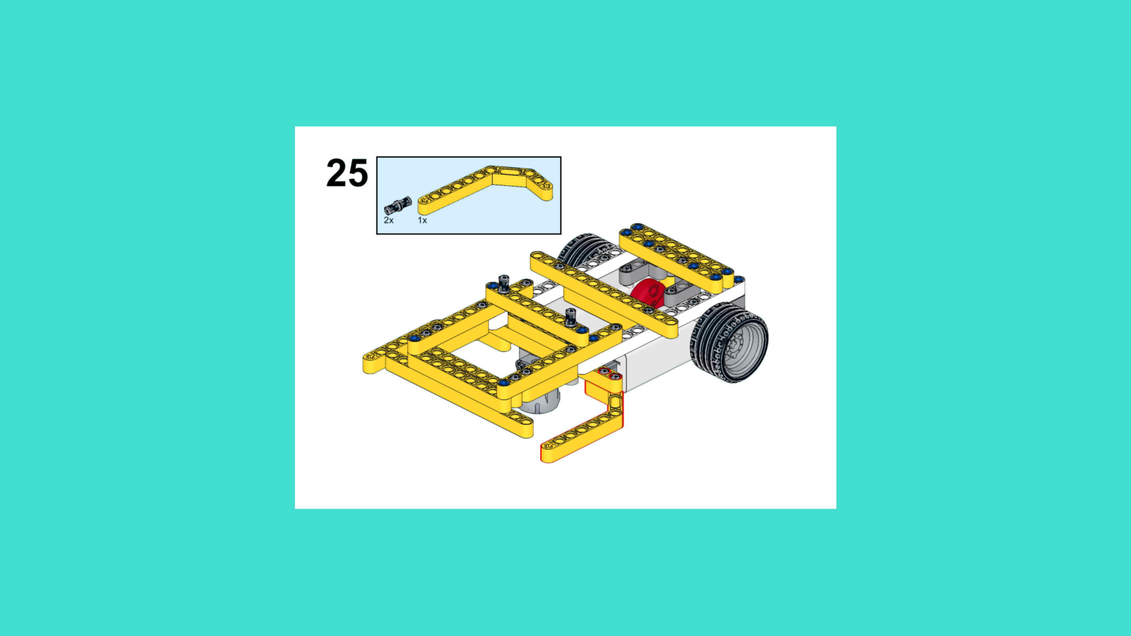
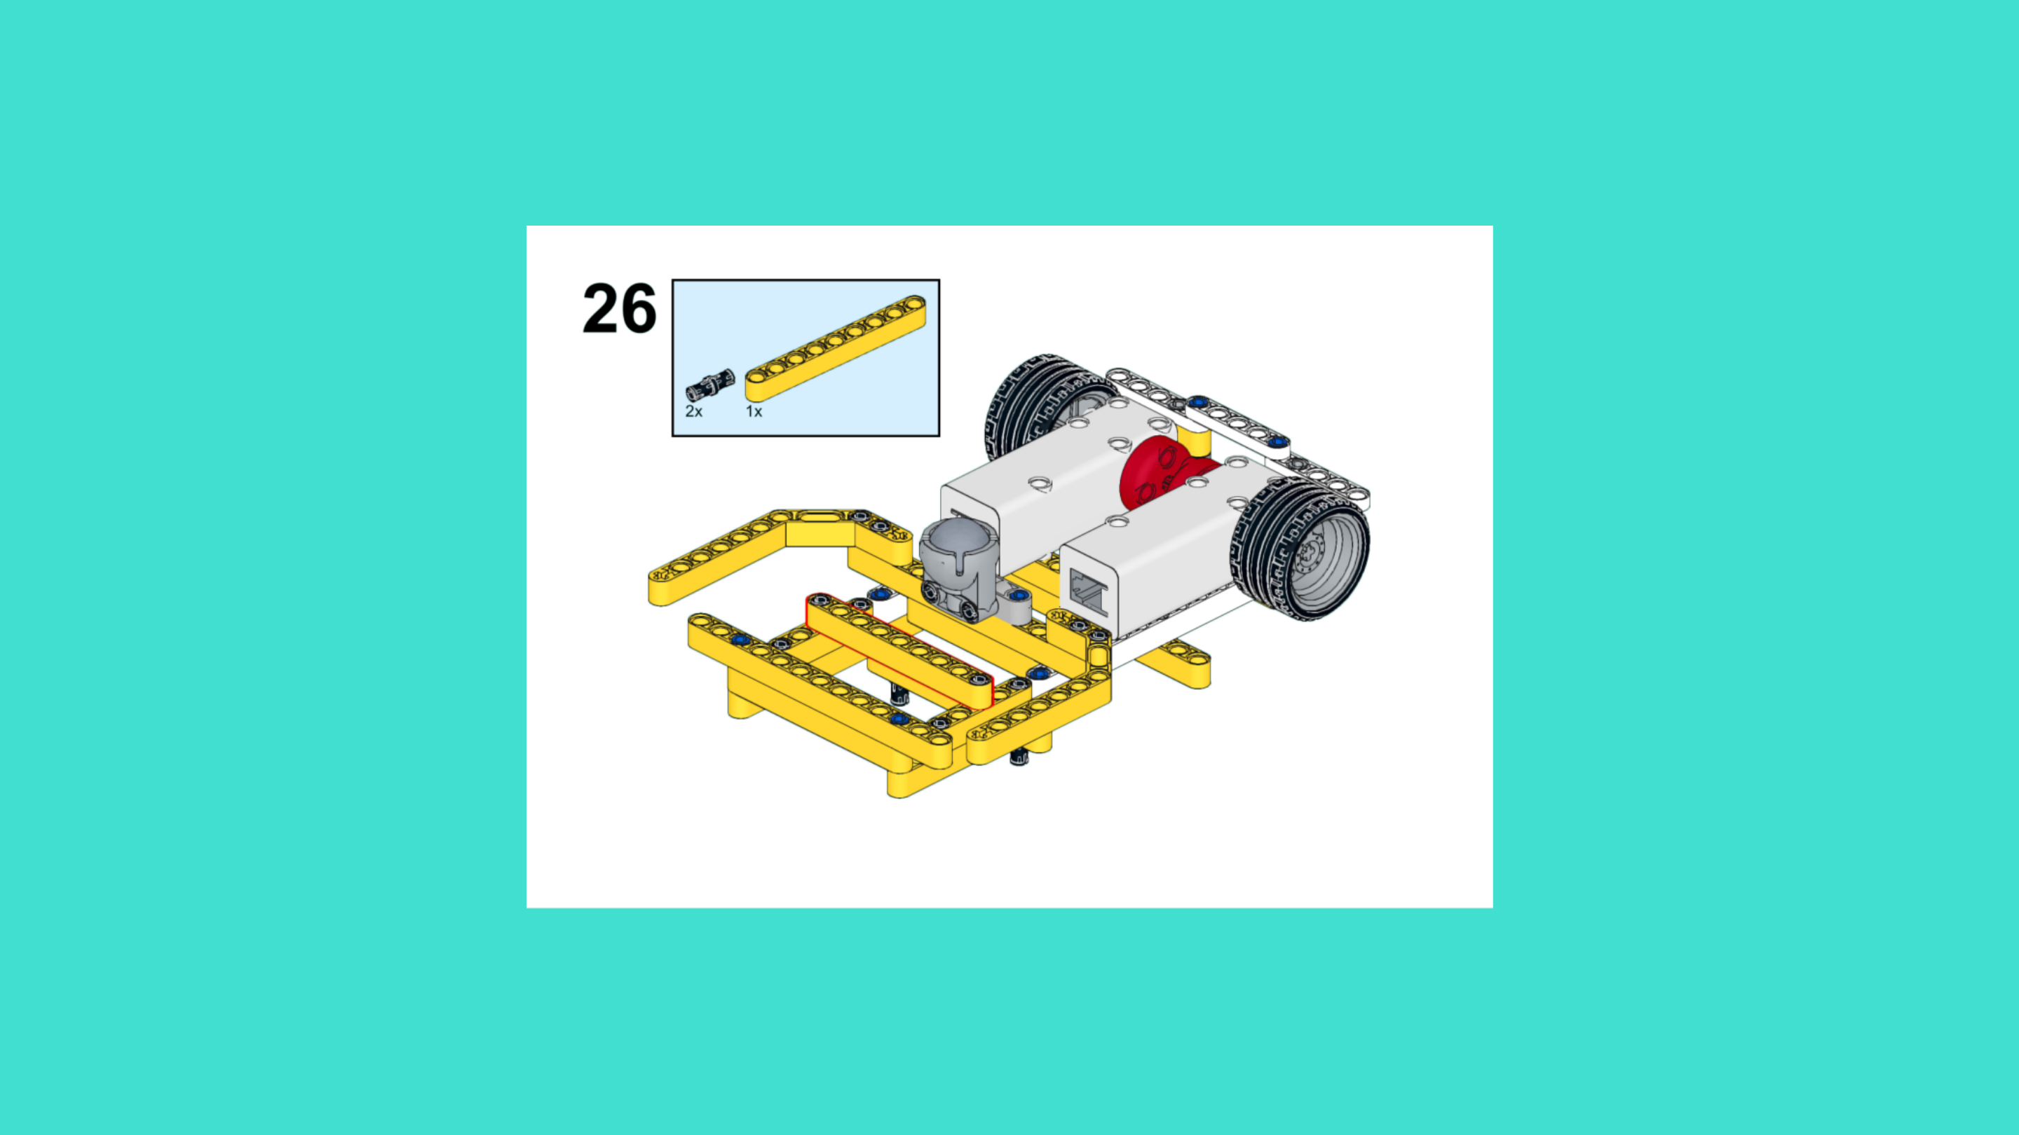
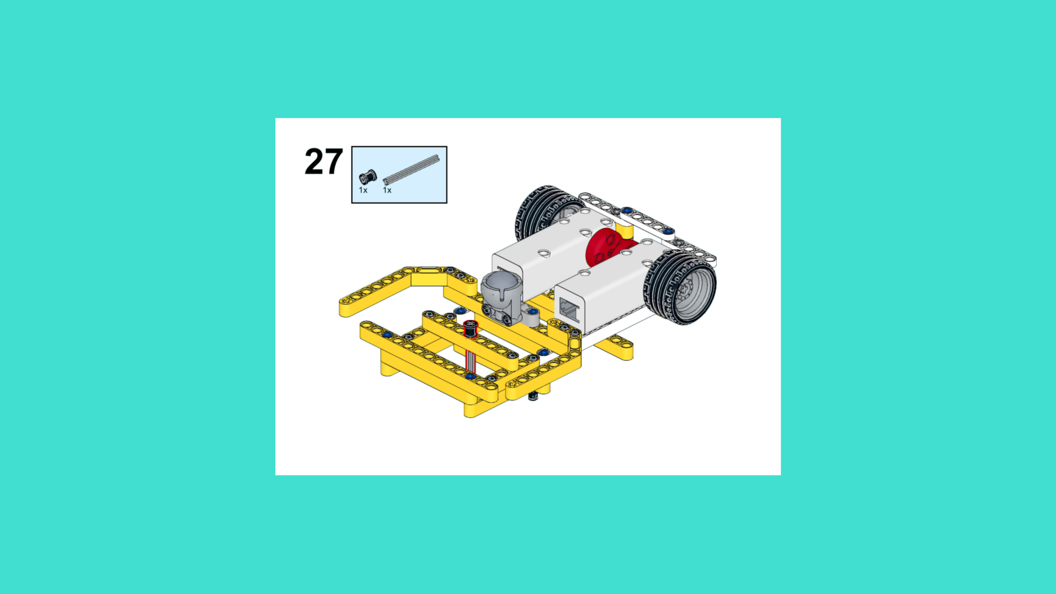
ASSEMBLY STEPS
STEP 25 – 27
PROGRESS: 79% COMPLETE (27 of 34 steps)
STEP 25
STEP 26
STEP 27
THE RETURNER · Techtelligence- Elecfreaks
9 / 12

Slide 12
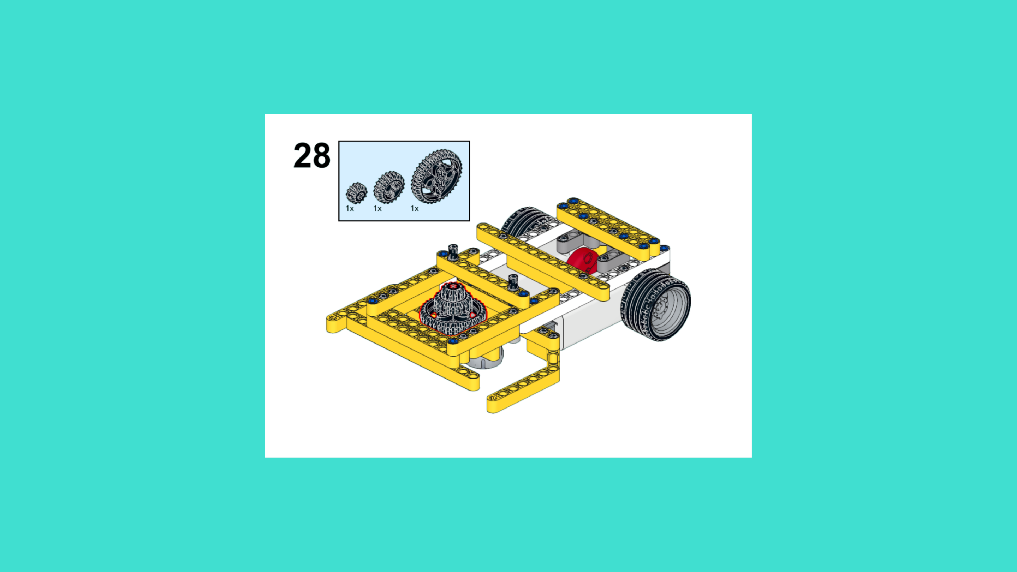
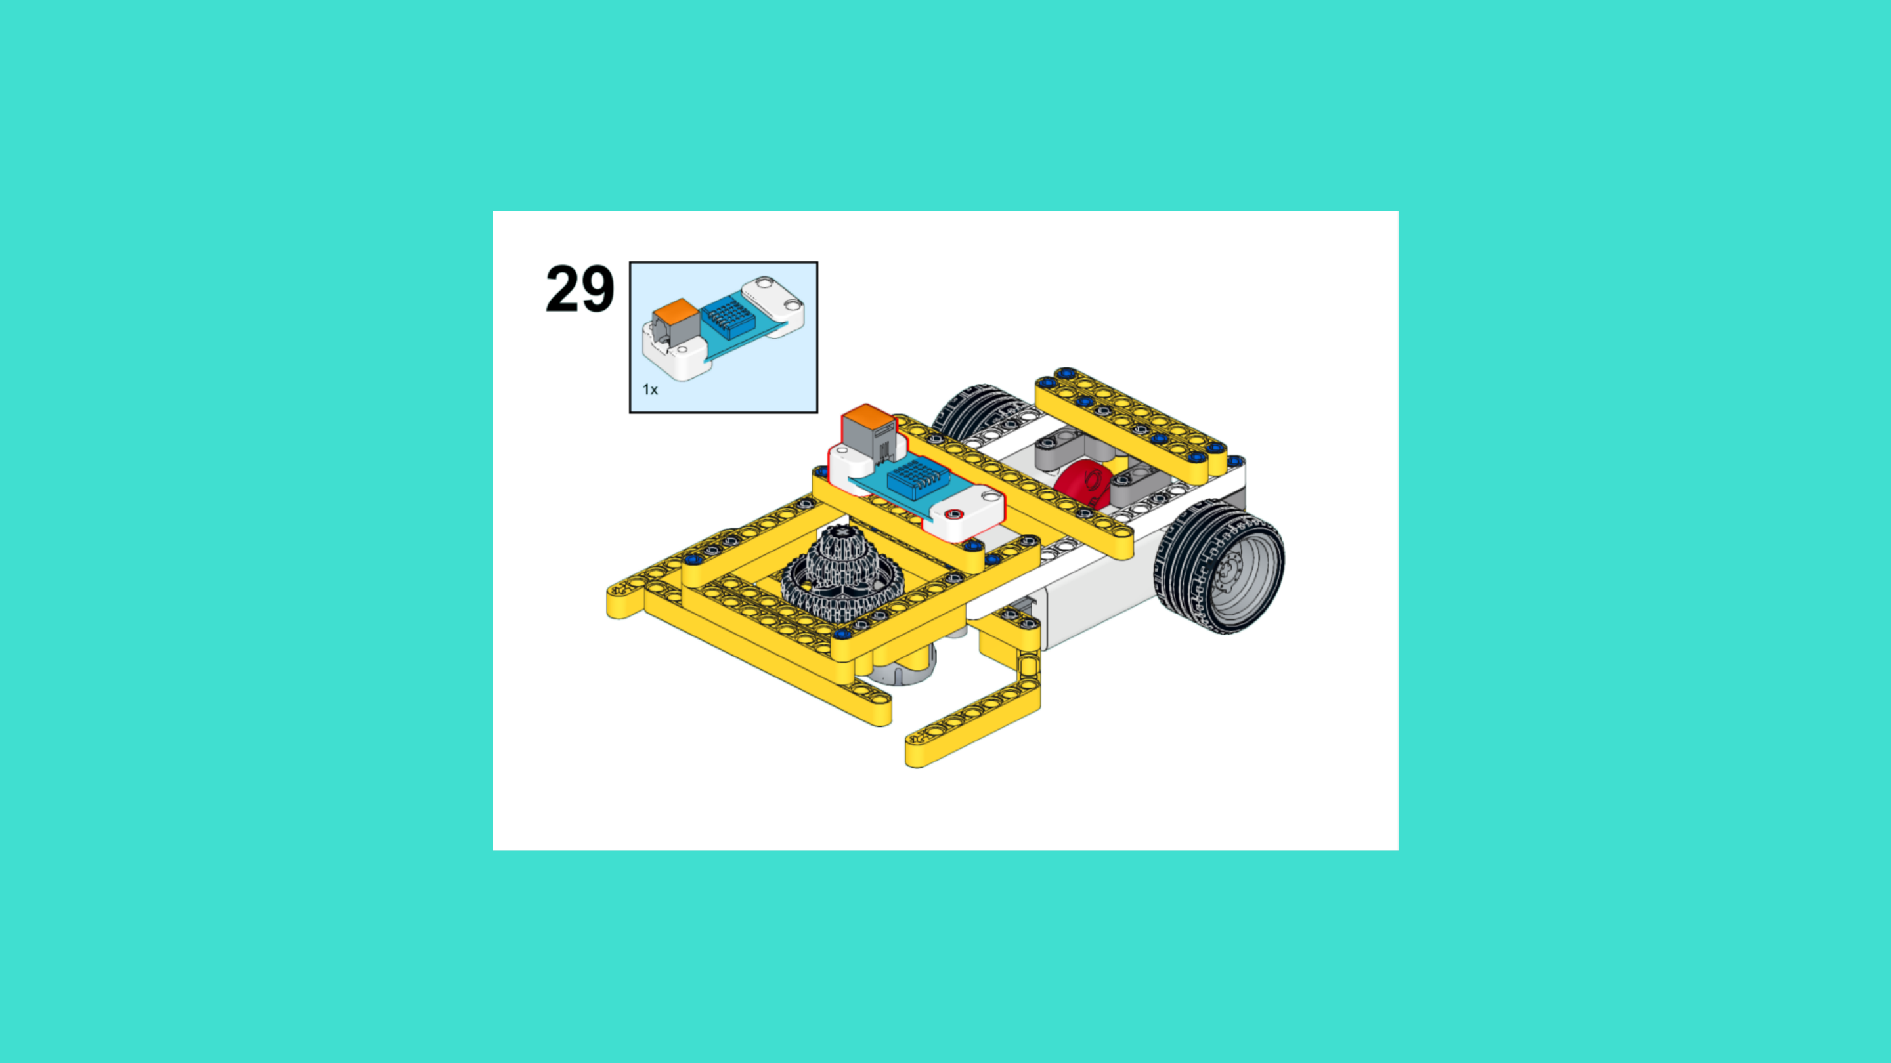
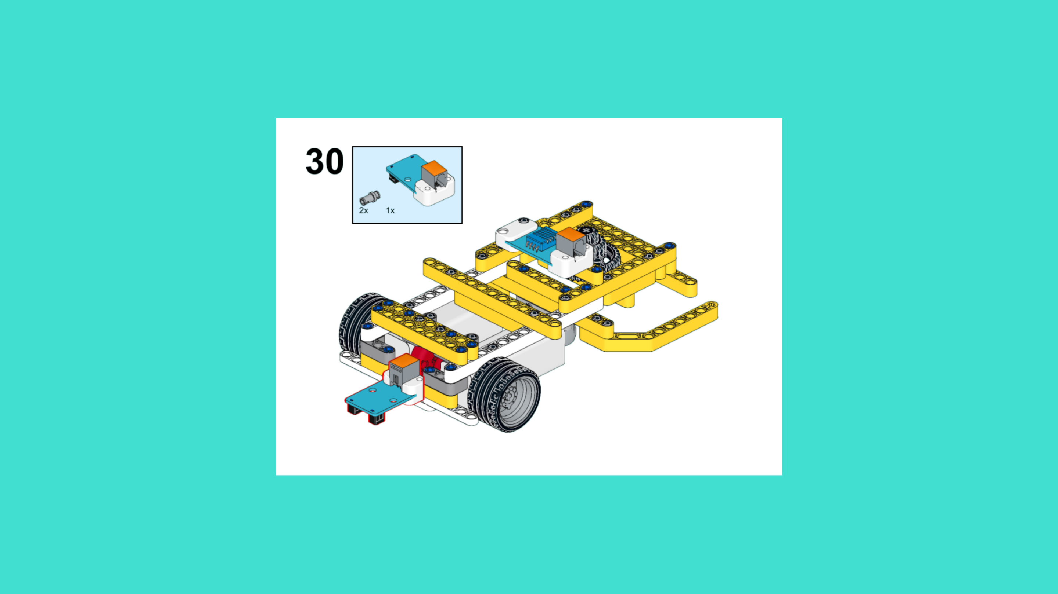
ASSEMBLY STEPS
STEP 28 – 30
PROGRESS: 88% COMPLETE (30 of 34 steps)
STEP 28
STEP 29
STEP 30
THE RETURNER · Techtelligence- Elecfreaks
10 / 12

Slide 13
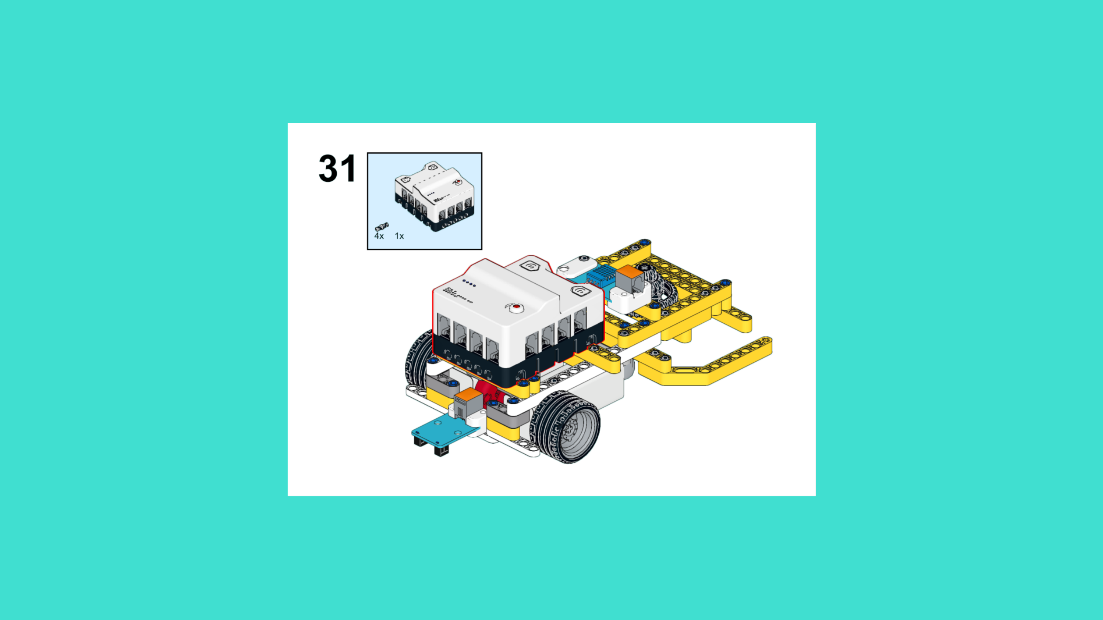
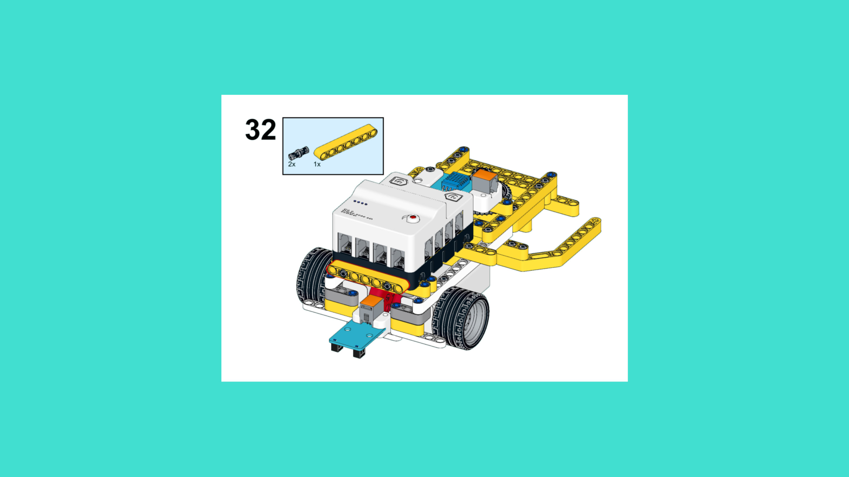
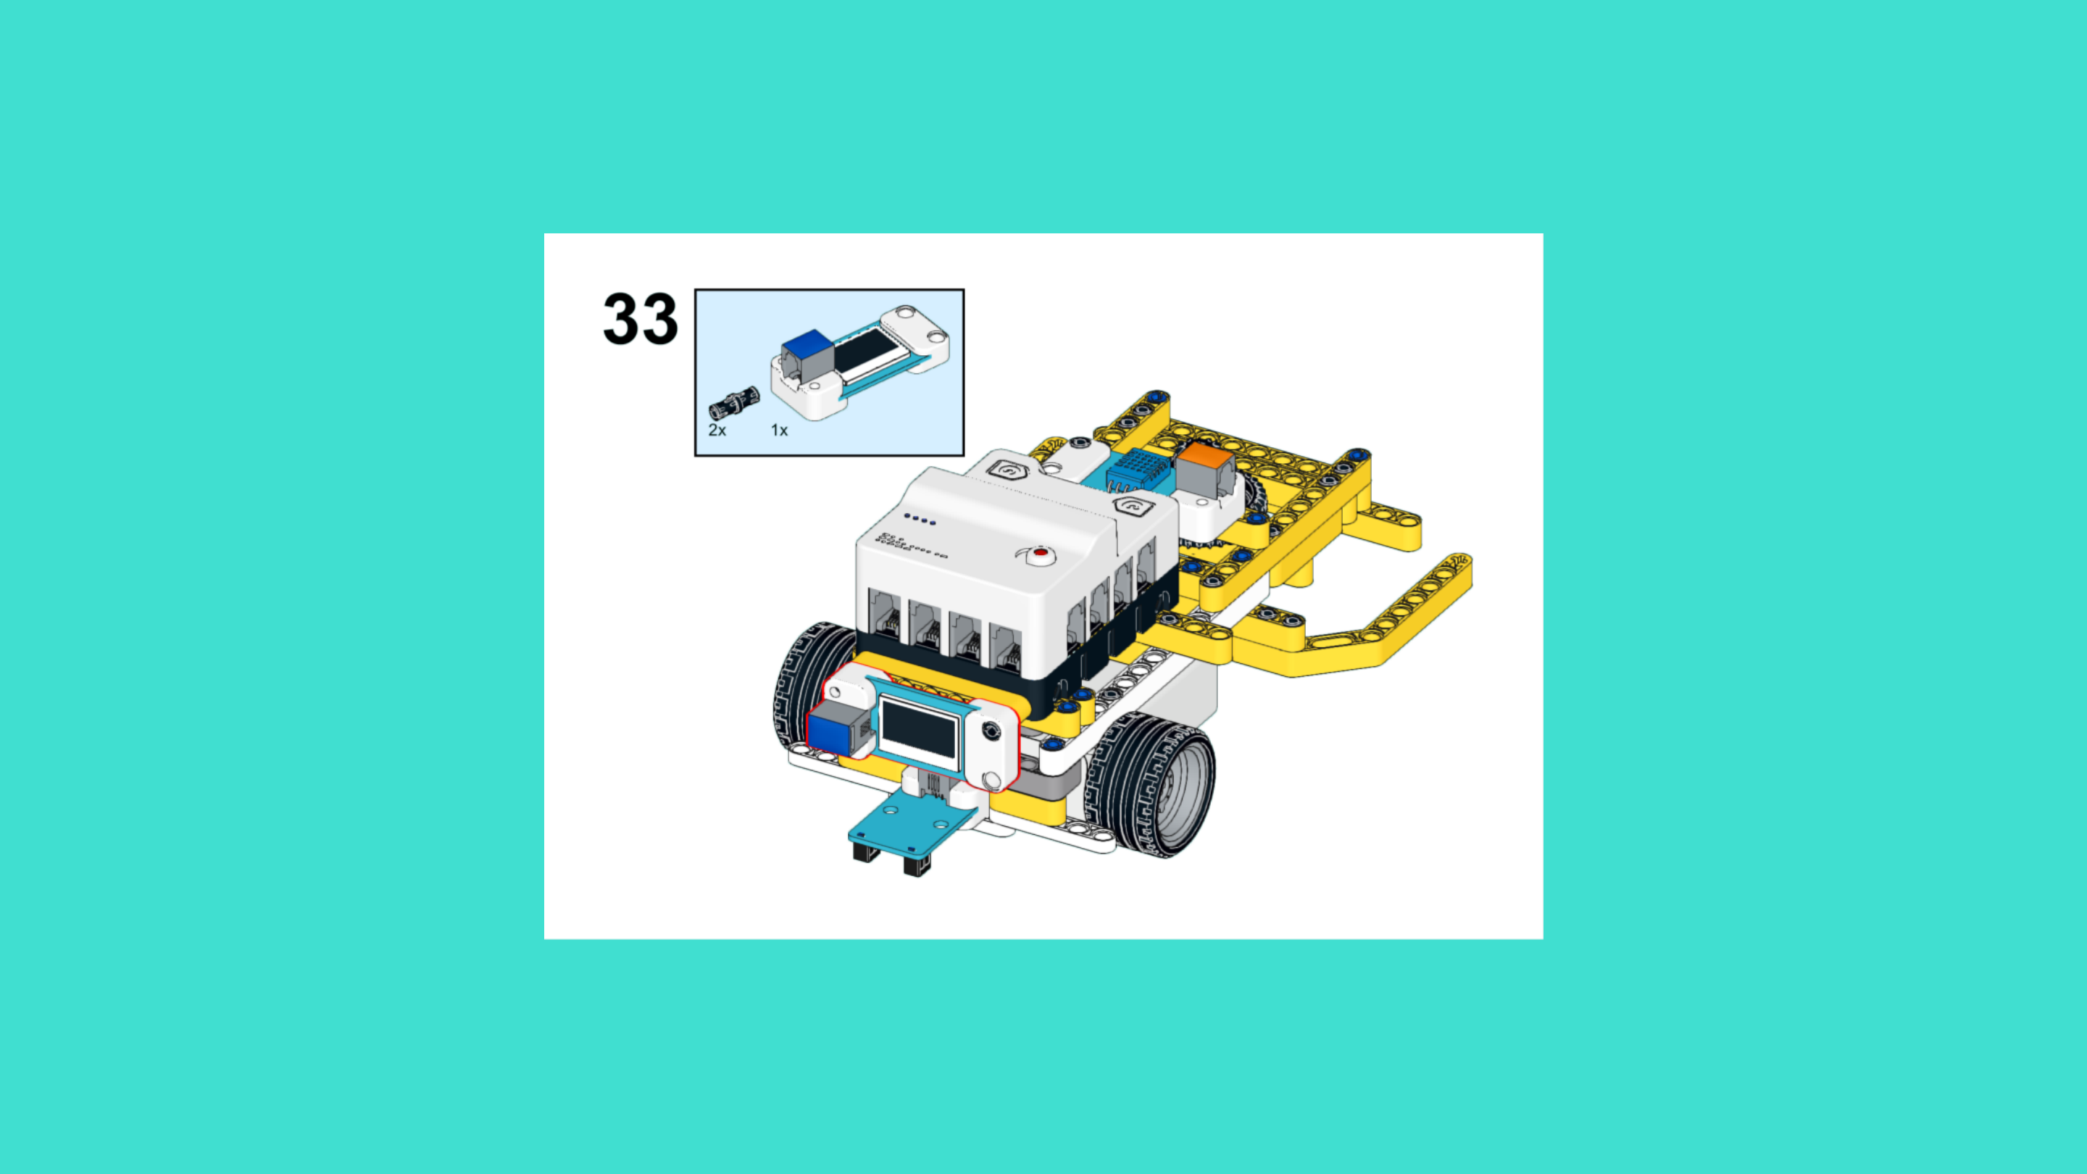
ASSEMBLY STEPS
STEP 31 – 33
PROGRESS: 97% COMPLETE (33 of 34 steps)
STEP 31
STEP 32
STEP 33
THE RETURNER · Techtelligence- Elecfreaks
11 / 12

Slide 14
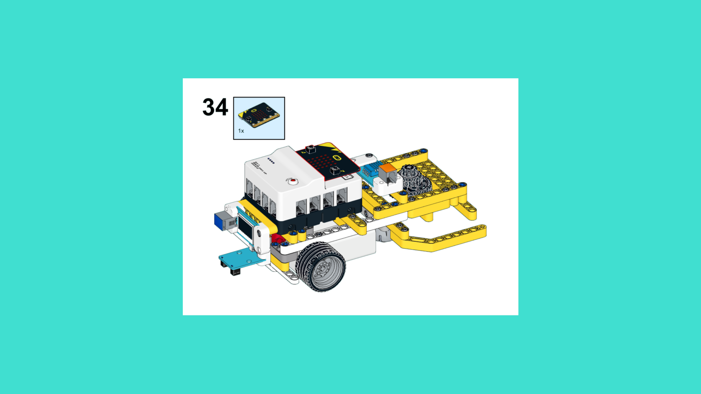
ASSEMBLY STEPS
STEP 34
PROGRESS: 100% COMPLETE (34 of 34 steps)
STEP 34
THE RETURNER · Techtelligence- Elecfreaks
12 / 12

Slide 15
ASSEMBLY
COMPLETE
34 STEPS · THE RETURNER · Techtelligence- Elecfreaks
34
12
100%
TOTAL STEPS
SLIDE SECTIONS
COMPLETE

