Slide 1
CASE 07
SPACE
STATION
ASSEMBLY GUIDE · SPACE SCIENCE KIT · Techtelligence- Elecfreaks
72 STEPS
TOTAL

Slide 2
DESIGN BRIEF
OBJECTIVE
Construct an elaborate Space Station model featuring modular docking bays, rotating solar panels, and a central command hub. This 72-step build explores orbital mechanics, structural engineering, and the systems that keep a real space station operational.
DESIGN PRINCIPLES
01. Structural Integrity
Robust modular frame construction ensures stability throughout assembly and operation.
02. Step-by-Step Build
Sequential instructions guide students from individual components to a complete working model.
03. STEM Integration
Hands-on mechanics reinforce space science, engineering, and robotics at every stage.
04. Scalable Design
Standardised connectors allow reconfiguration and adaptation of the final model.
Techtelligence- Elecfreaks · SPACE STATION

Slide 3
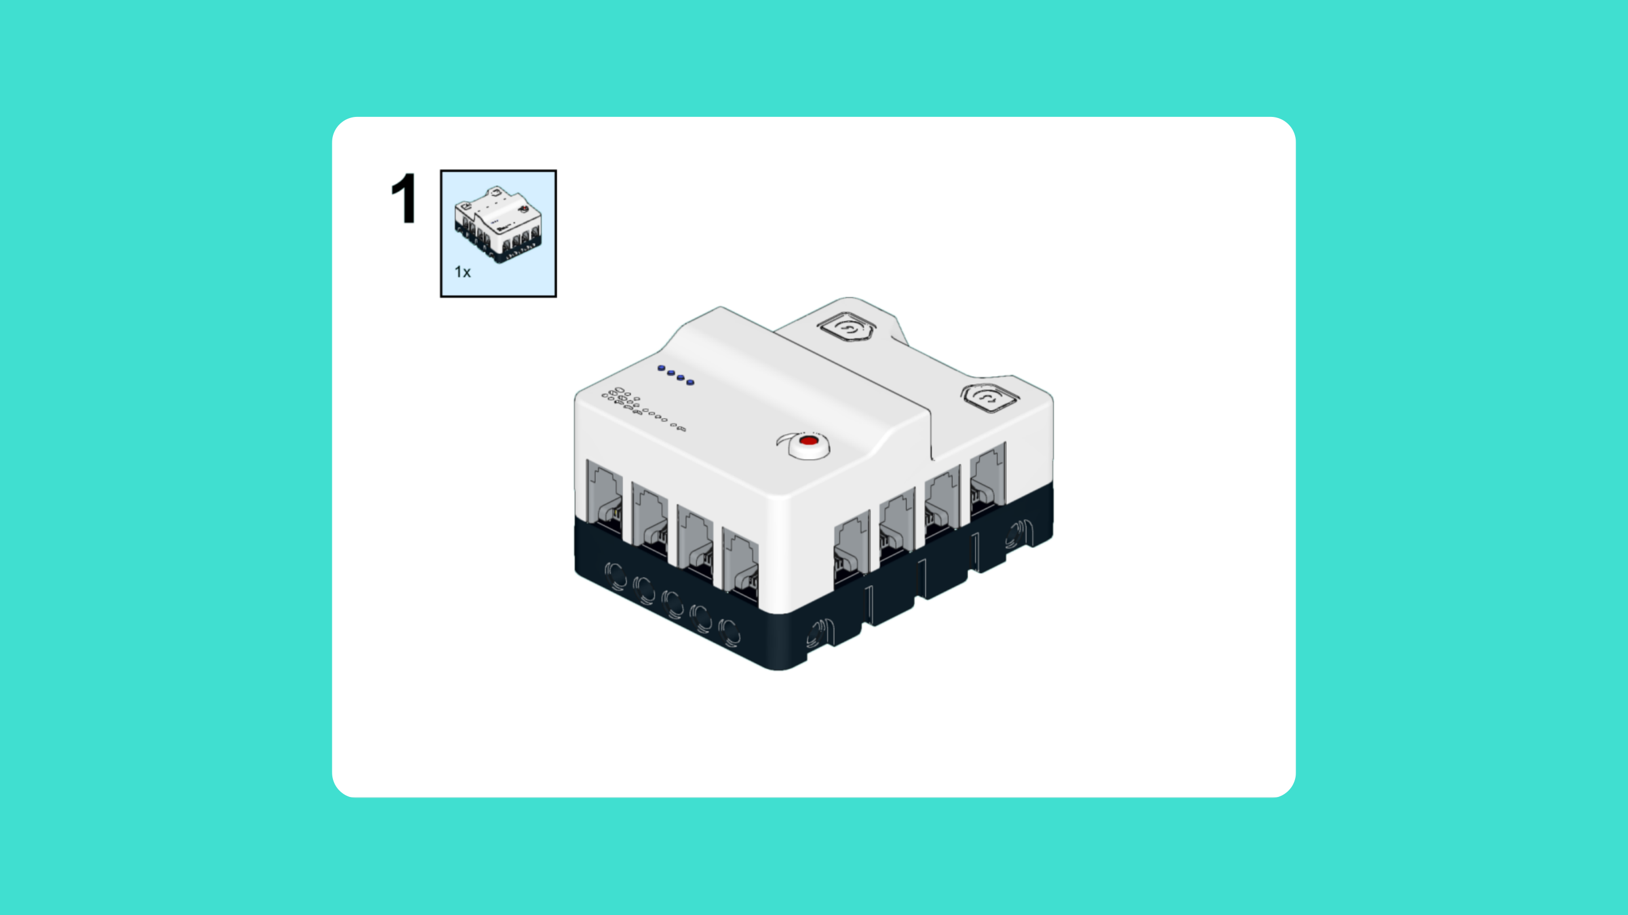
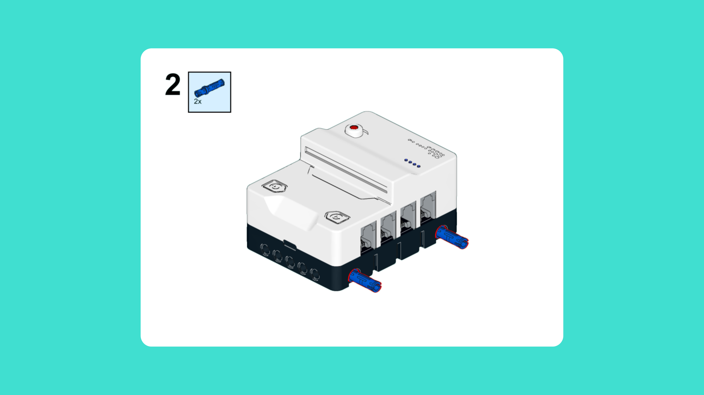
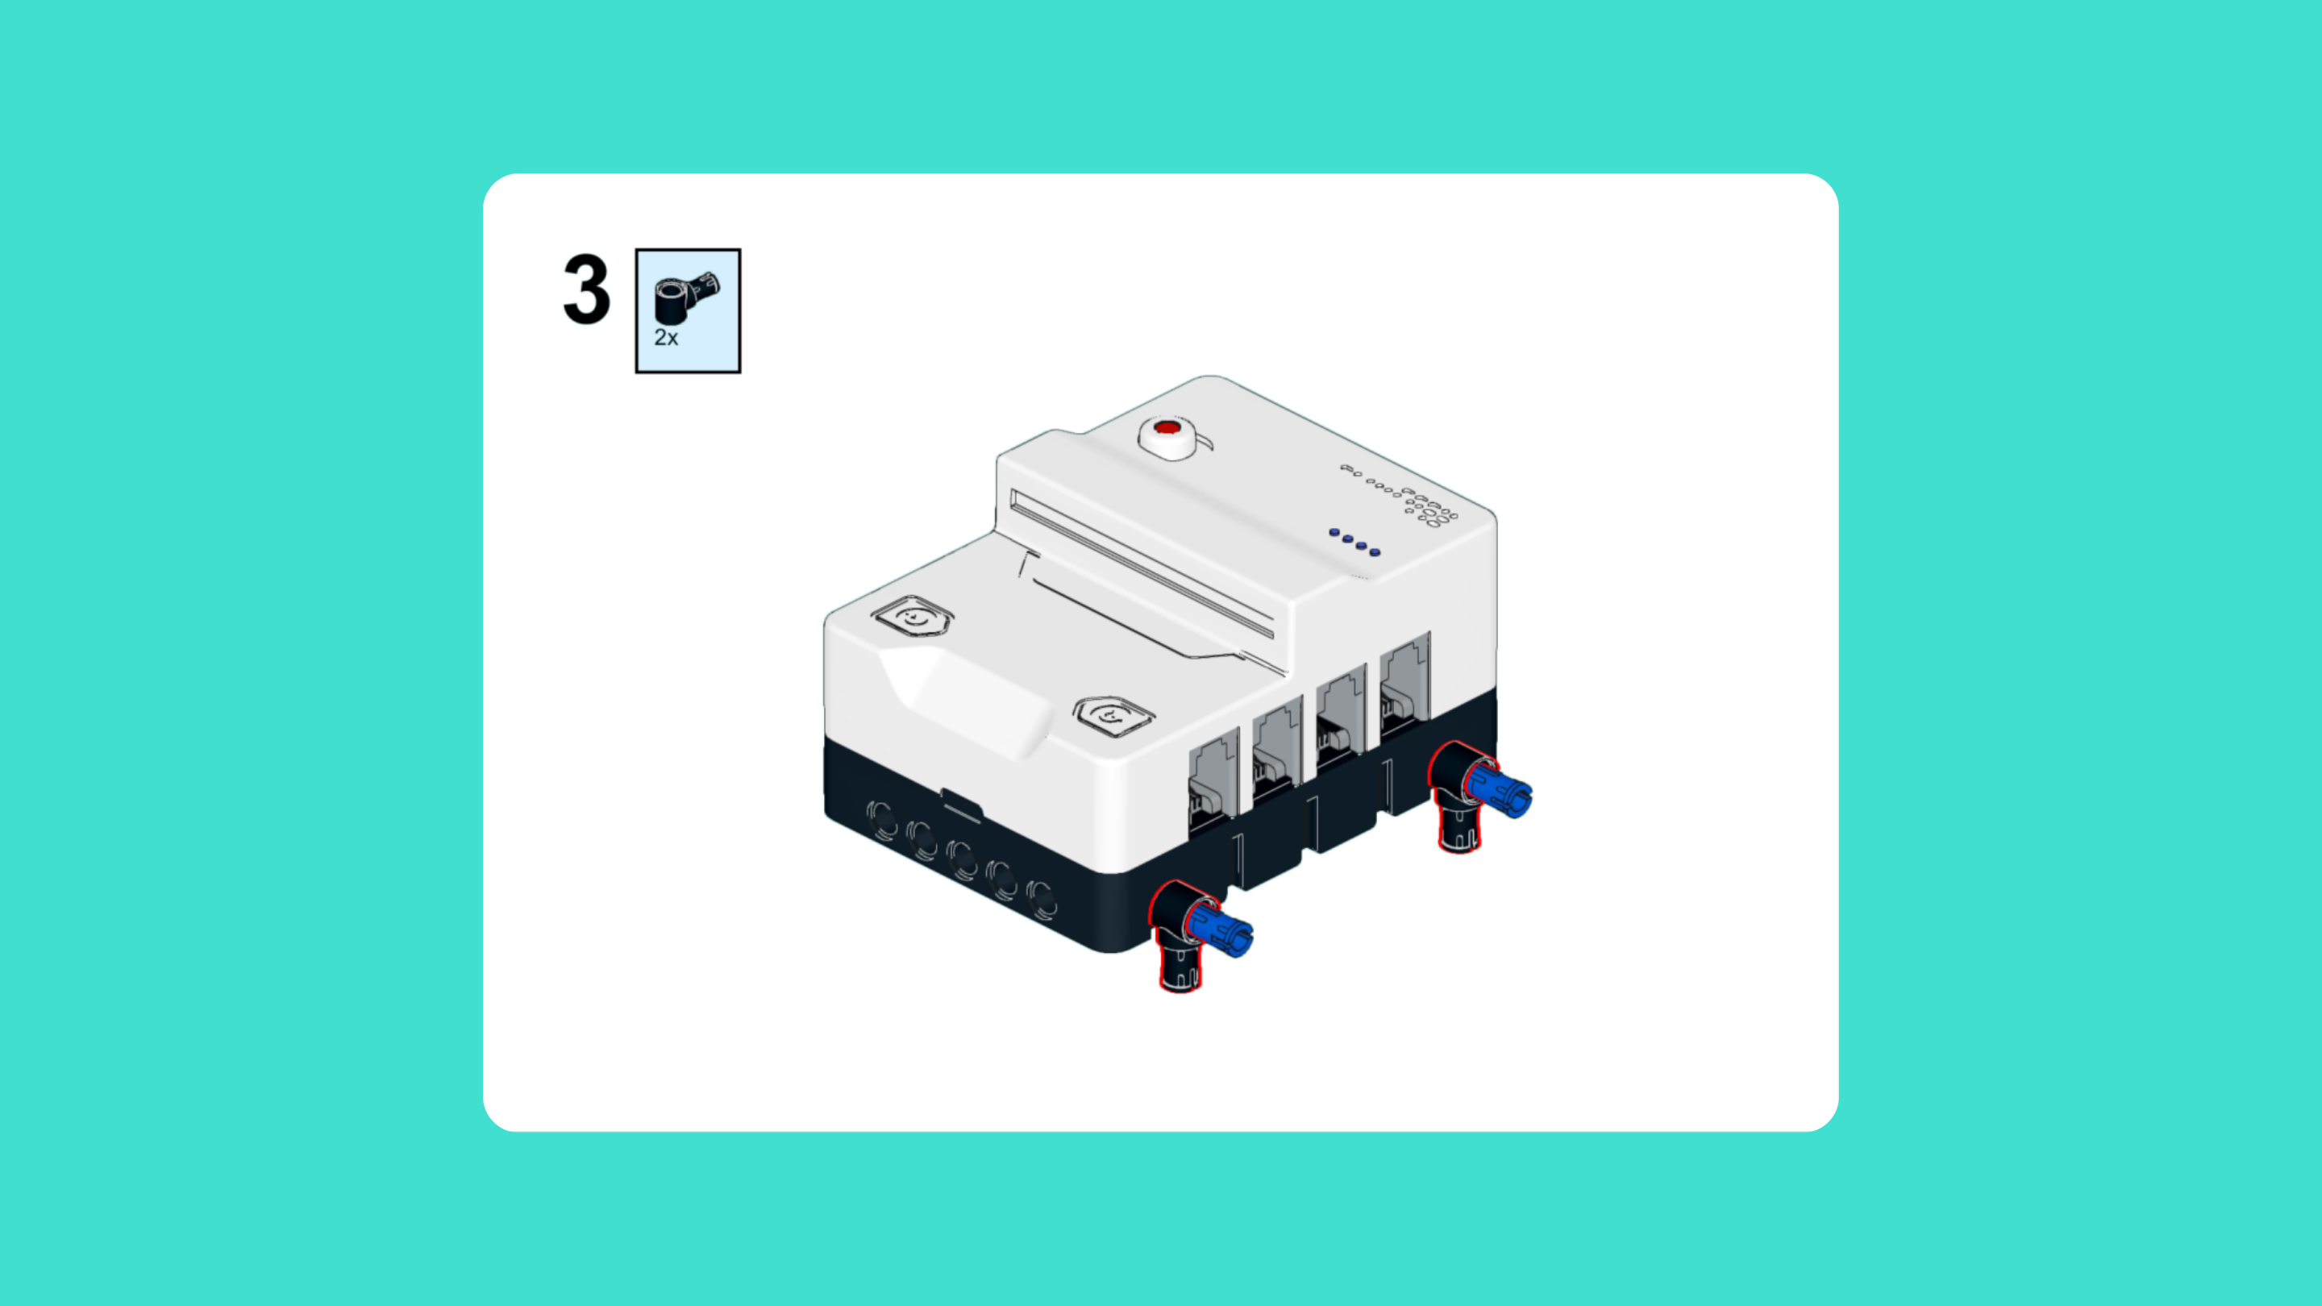
ASSEMBLY STEPS
STEP 1 – 3
PROGRESS: 4% COMPLETE (3 of 72 steps)
STEP 1
STEP 2
STEP 3
SPACE STATION · Techtelligence- Elecfreaks
1 / 24

Slide 4
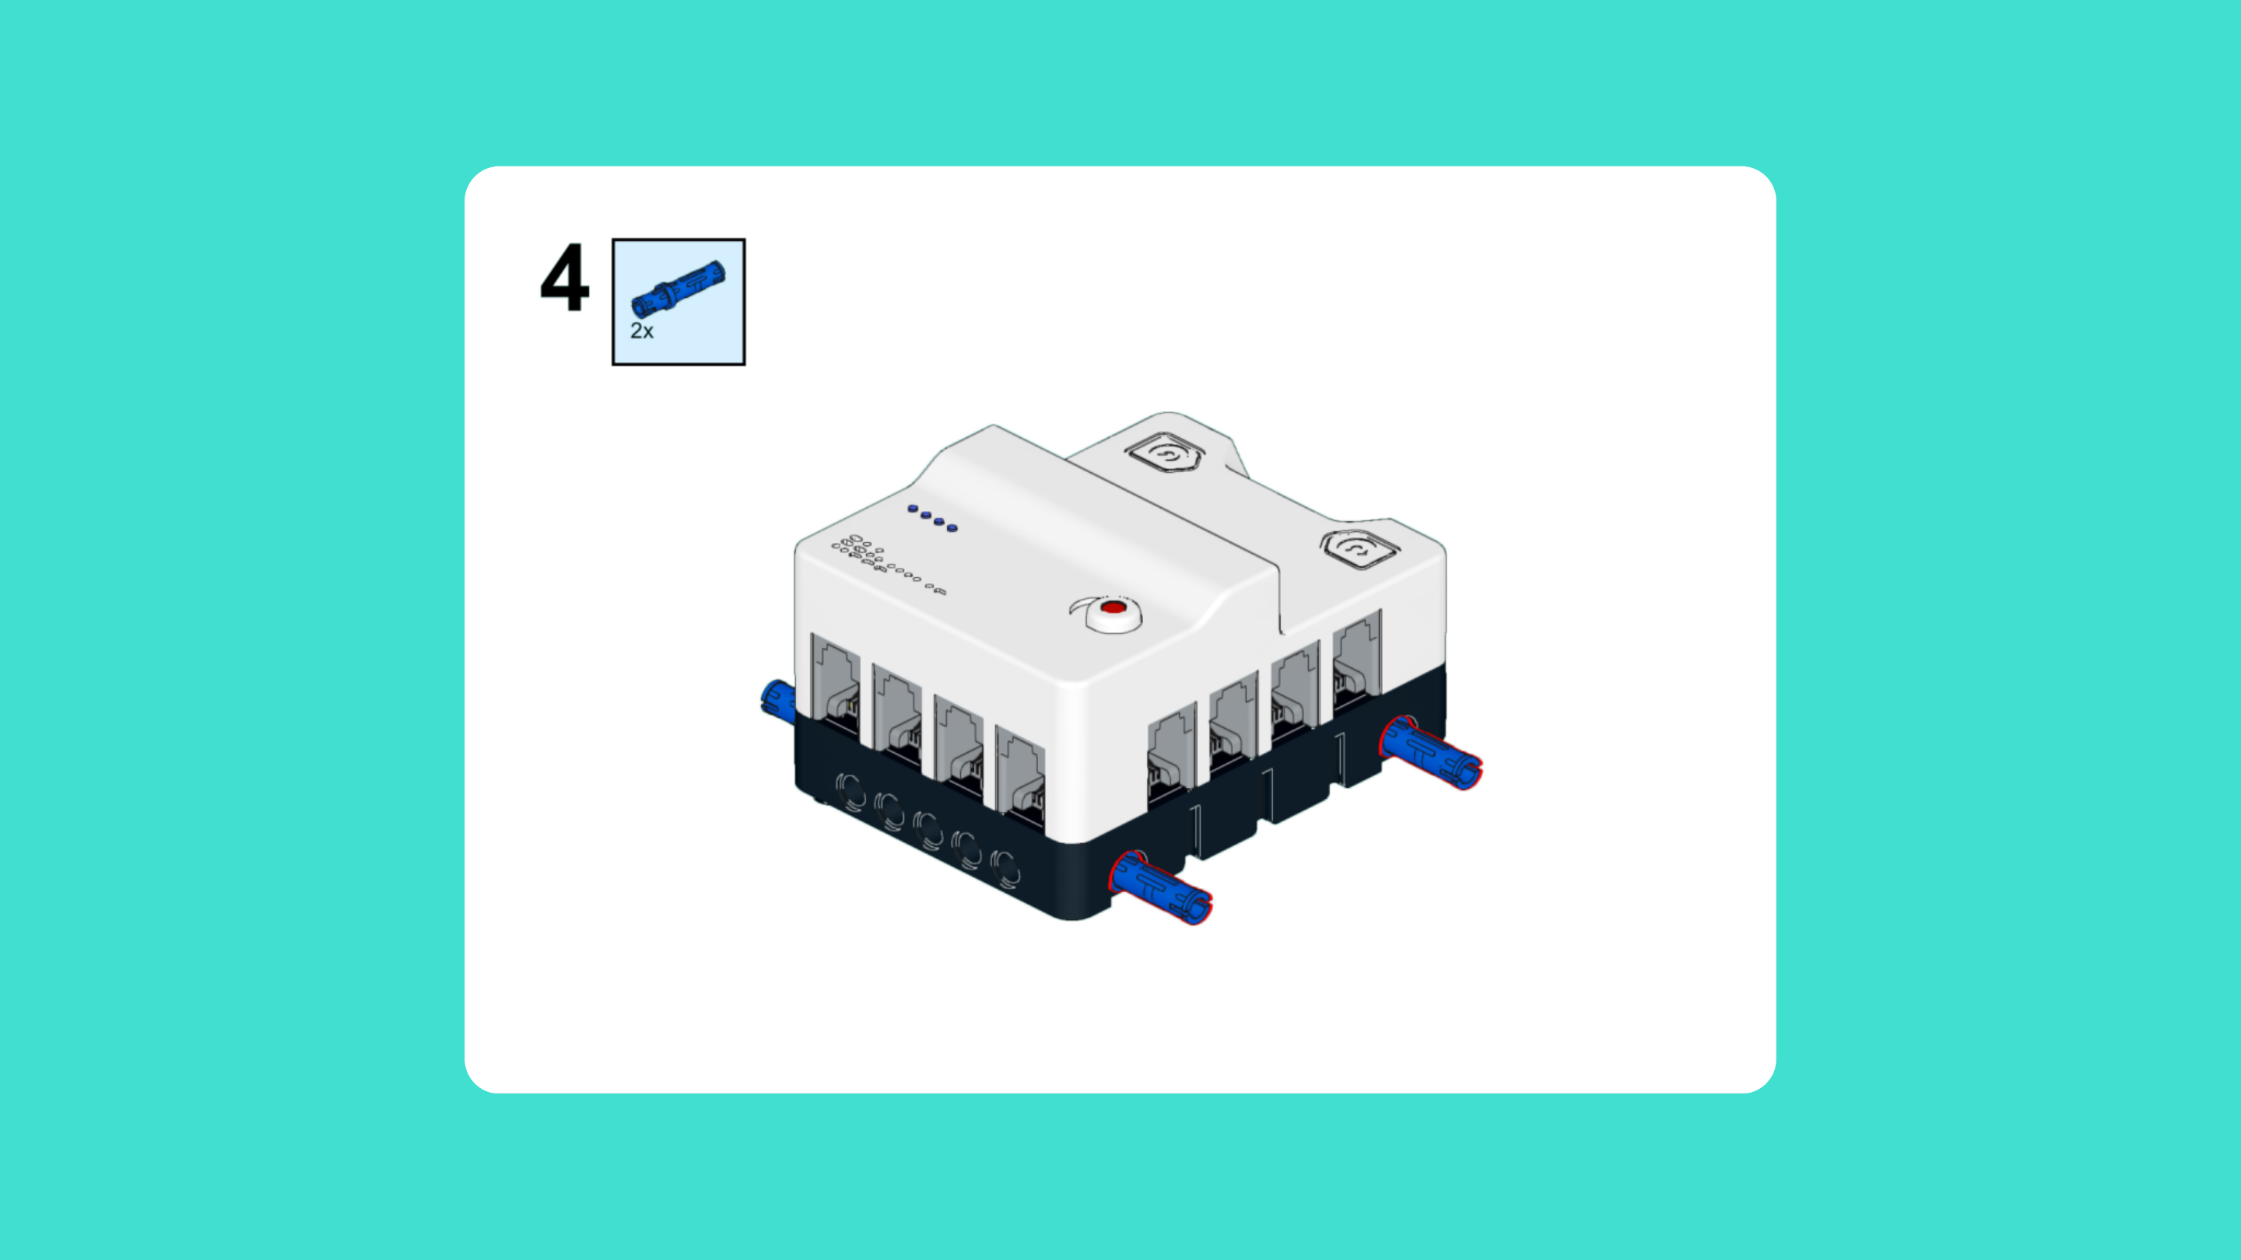
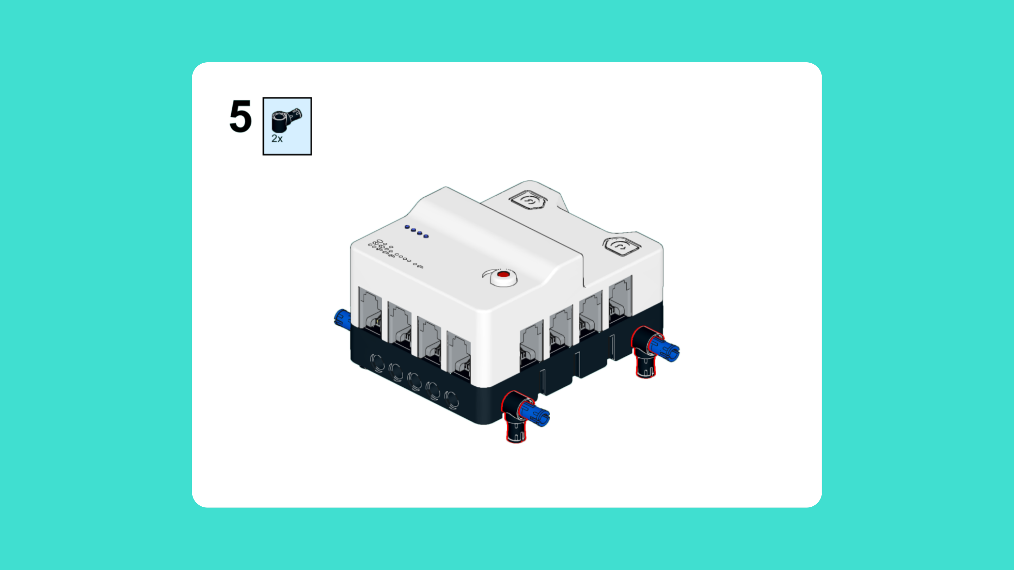
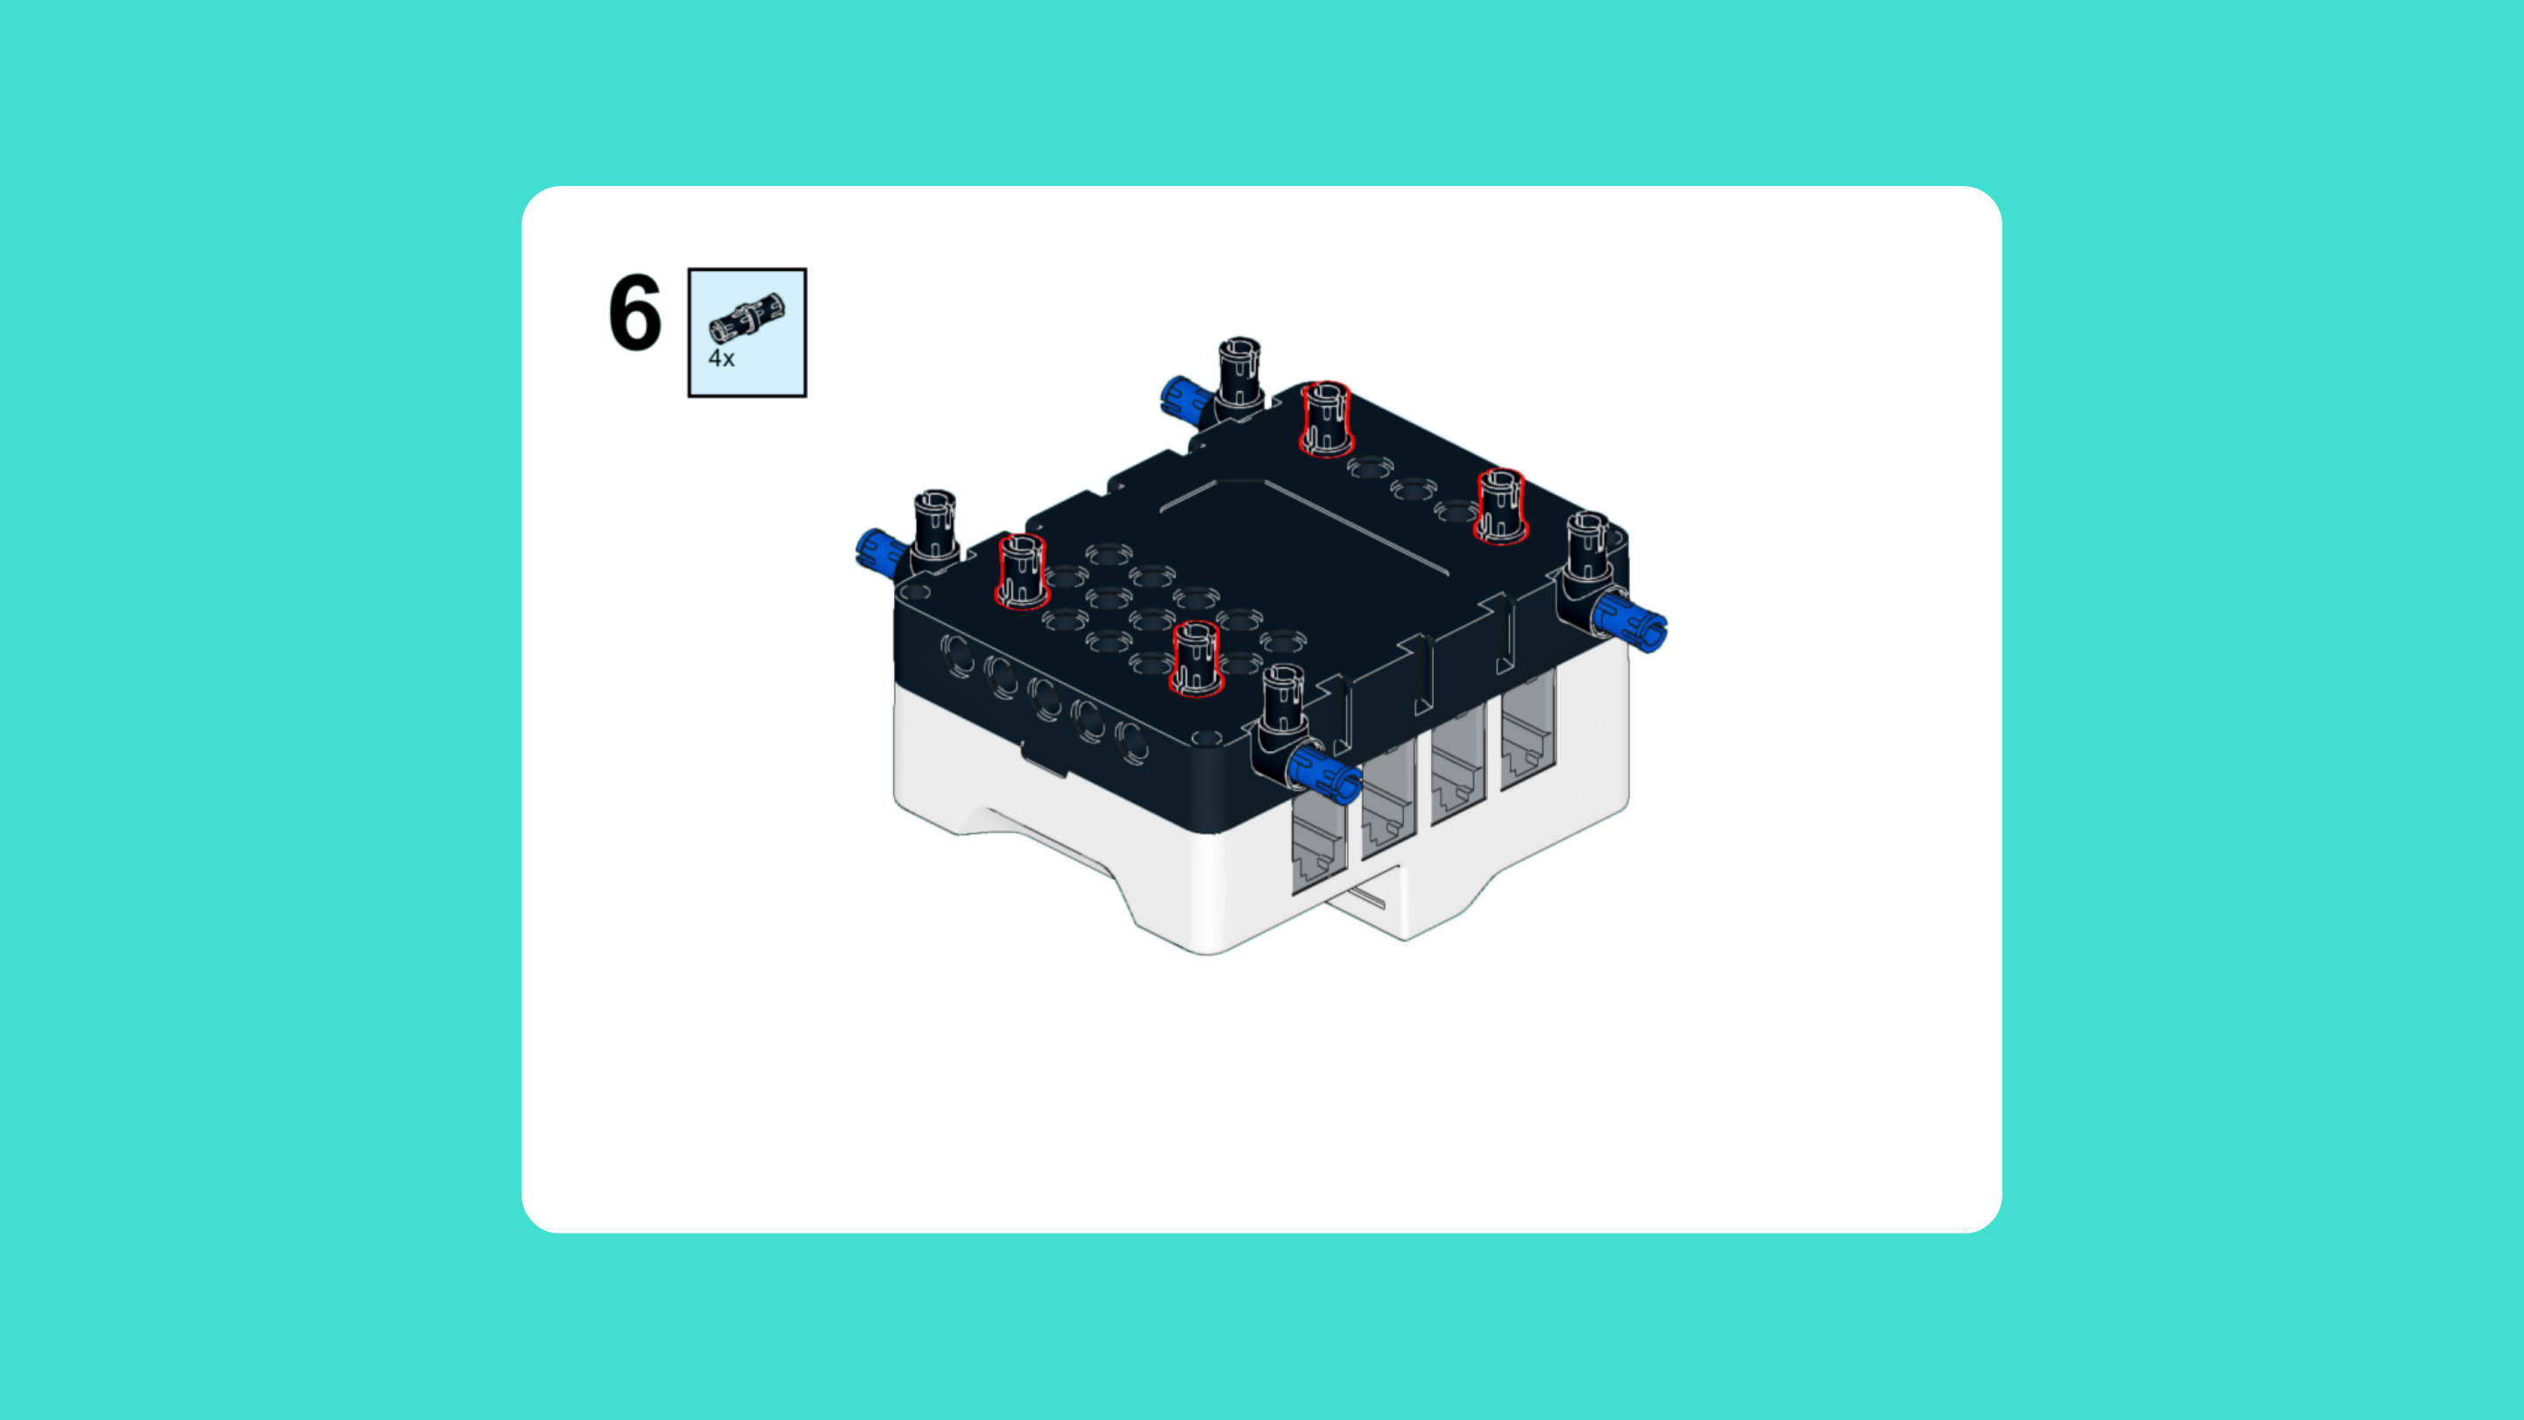
ASSEMBLY STEPS
STEP 4 – 6
PROGRESS: 8% COMPLETE (6 of 72 steps)
STEP 4
STEP 5
STEP 6
SPACE STATION · Techtelligence- Elecfreaks
2 / 24

Slide 5
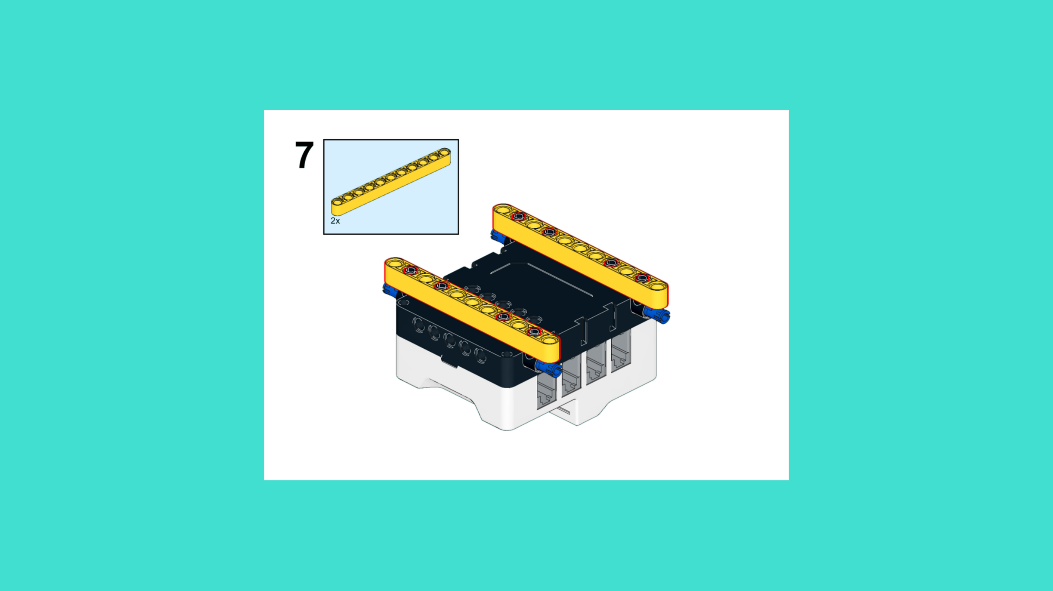
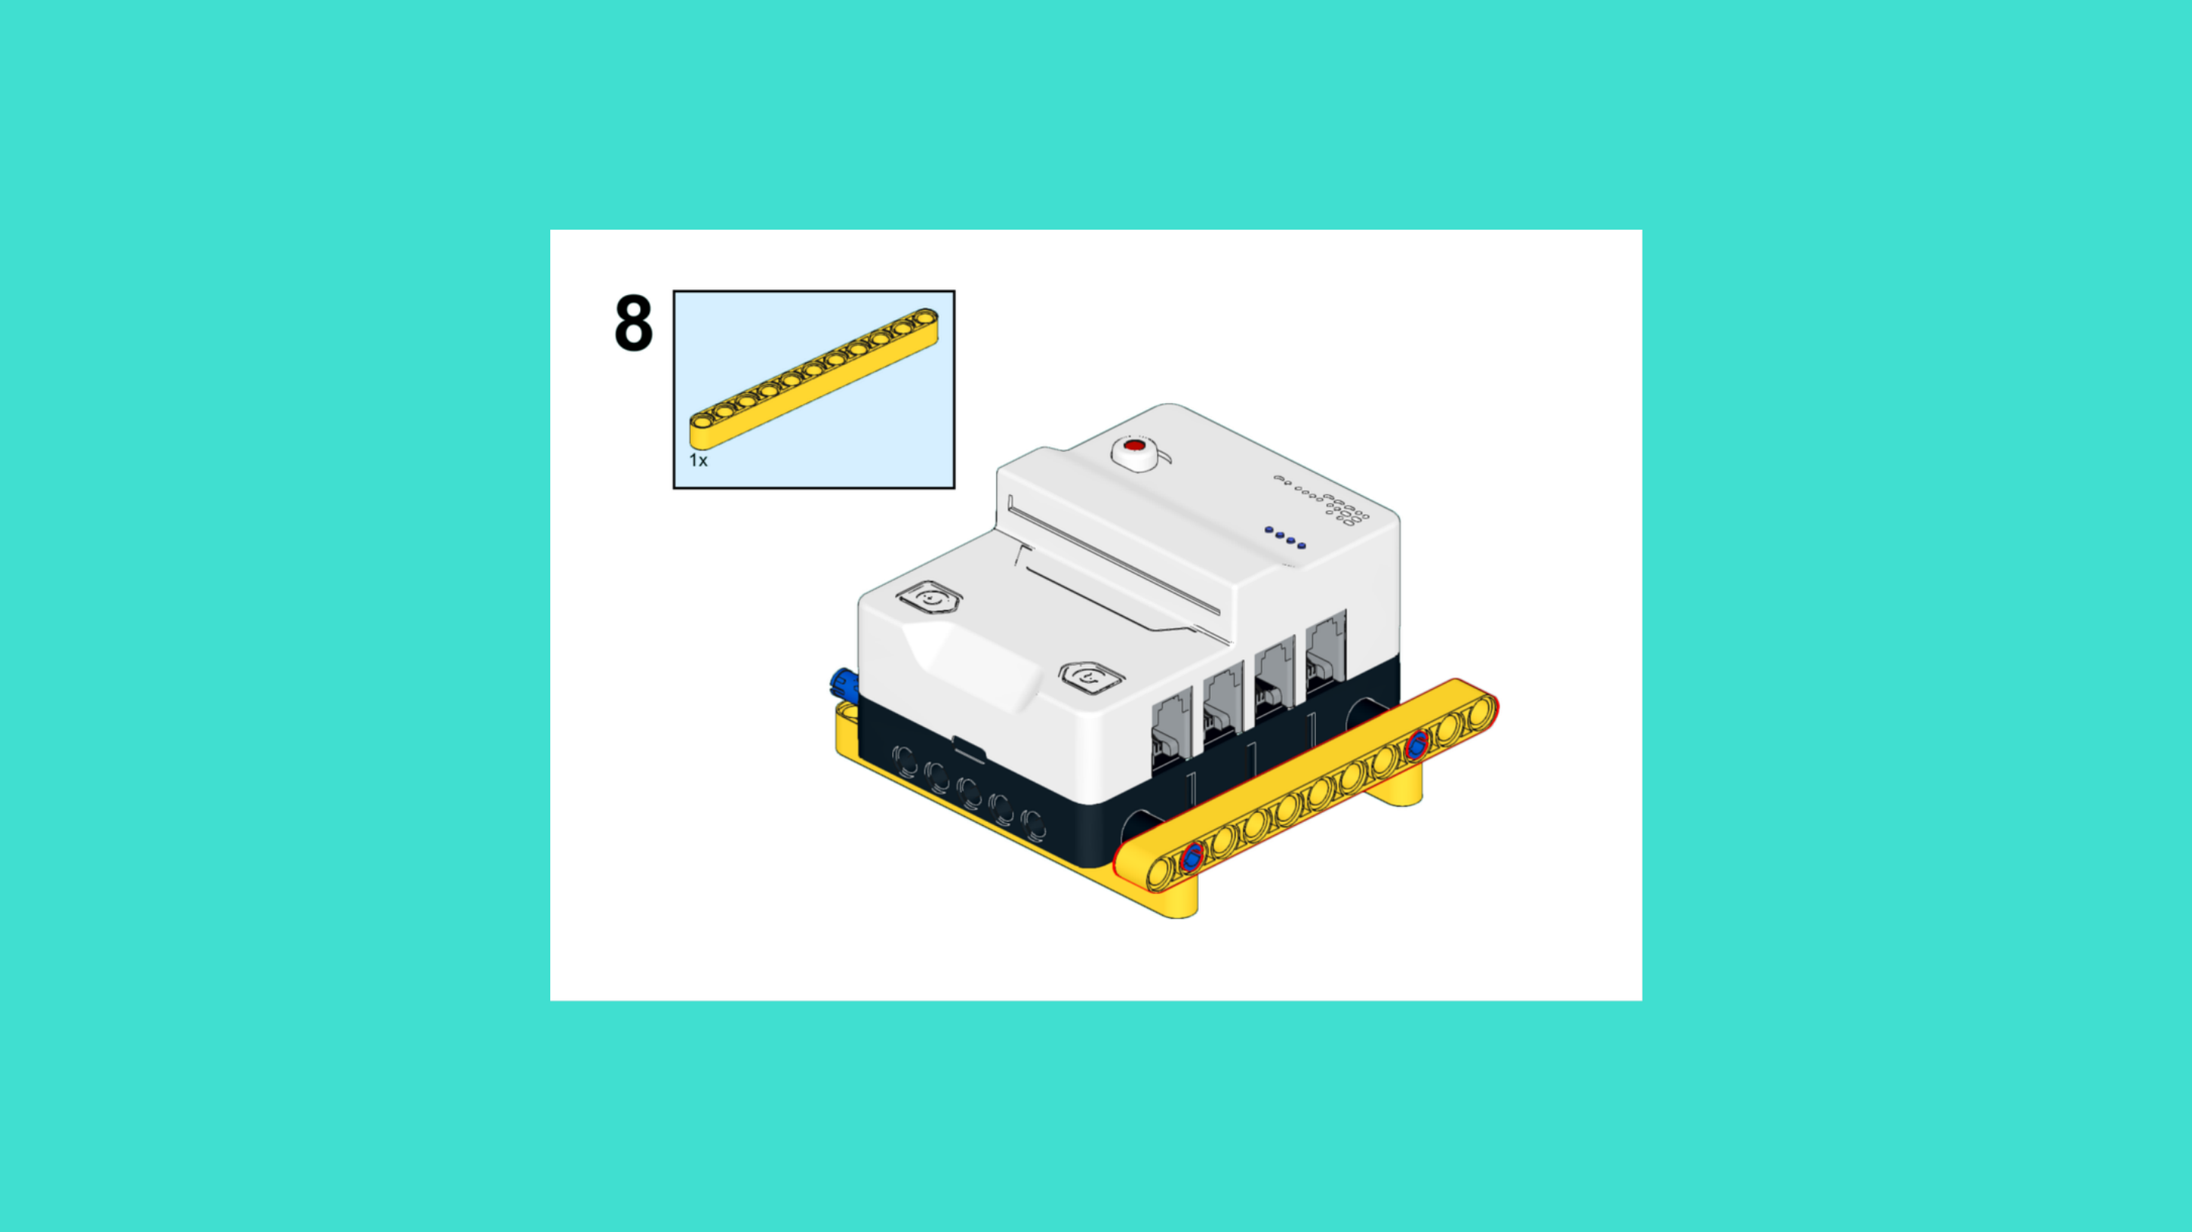
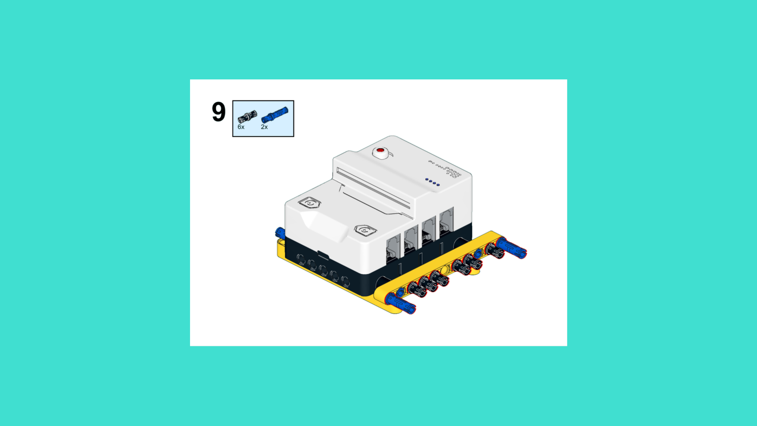
ASSEMBLY STEPS
STEP 7 – 9
PROGRESS: 13% COMPLETE (9 of 72 steps)
STEP 7
STEP 8
STEP 9
SPACE STATION · Techtelligence- Elecfreaks
3 / 24

Slide 6
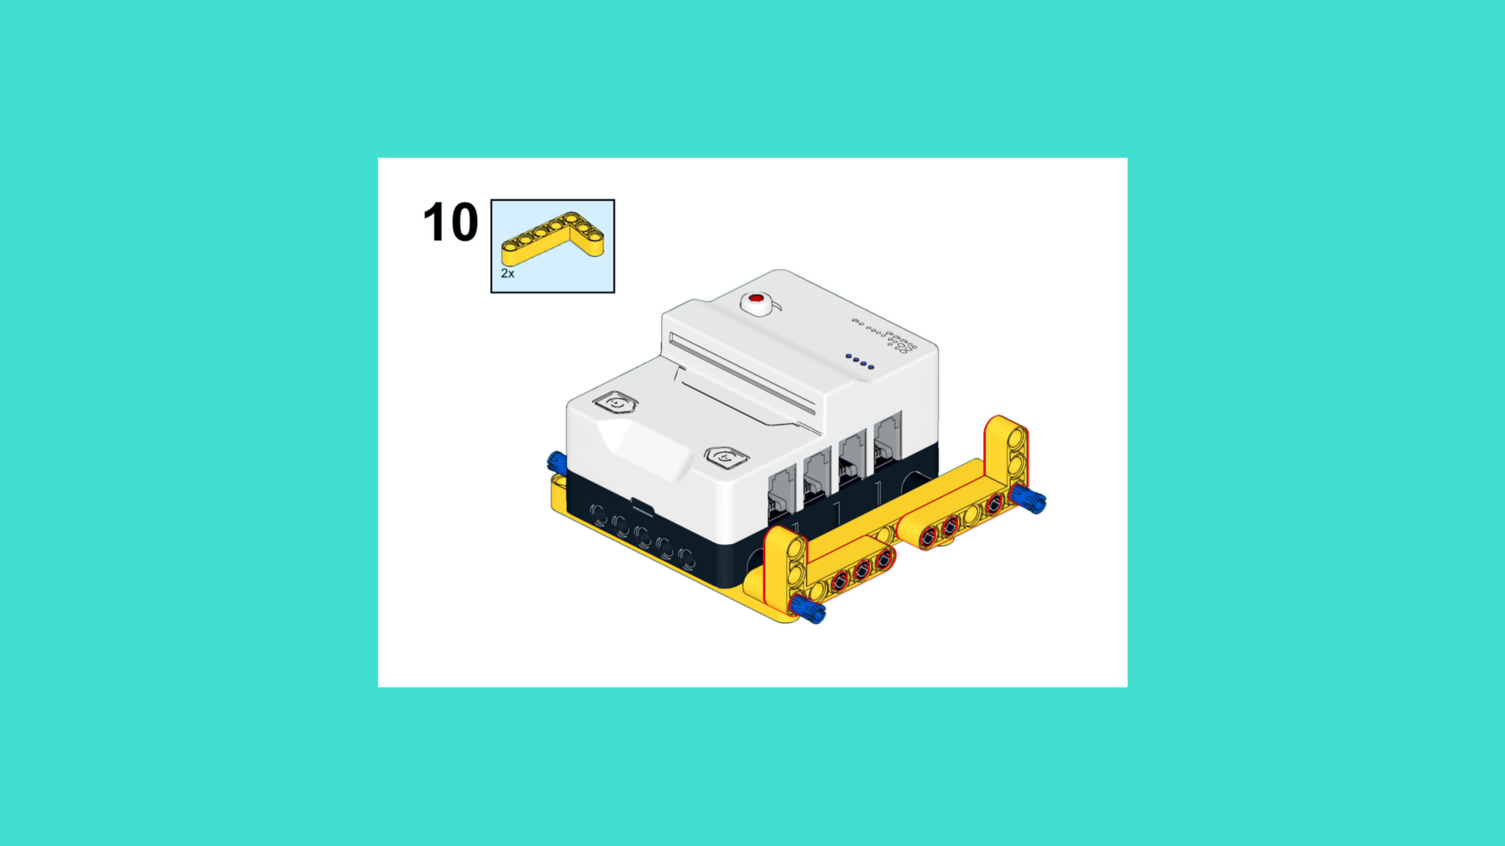
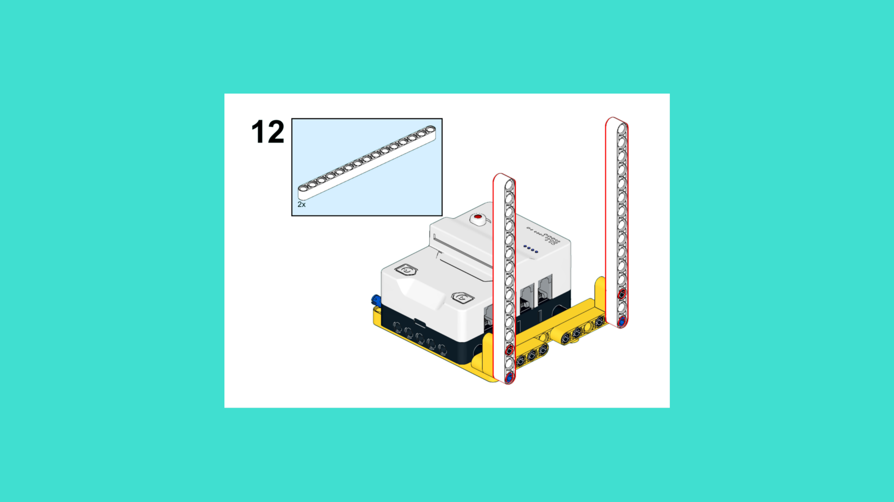
ASSEMBLY STEPS
STEP 10 – 12
PROGRESS: 17% COMPLETE (12 of 72 steps)
STEP 10
STEP 11
STEP 12
SPACE STATION · Techtelligence- Elecfreaks
4 / 24

Slide 7
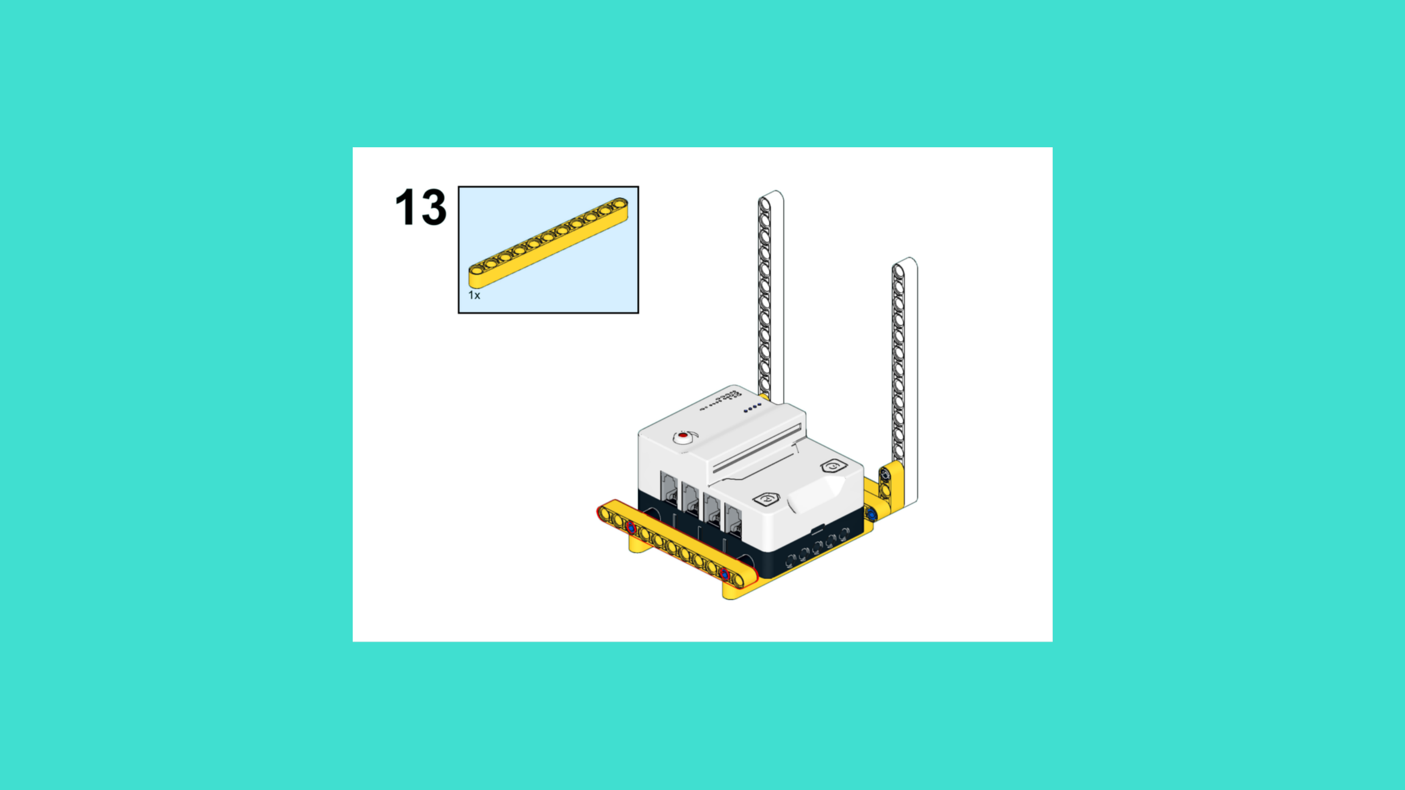
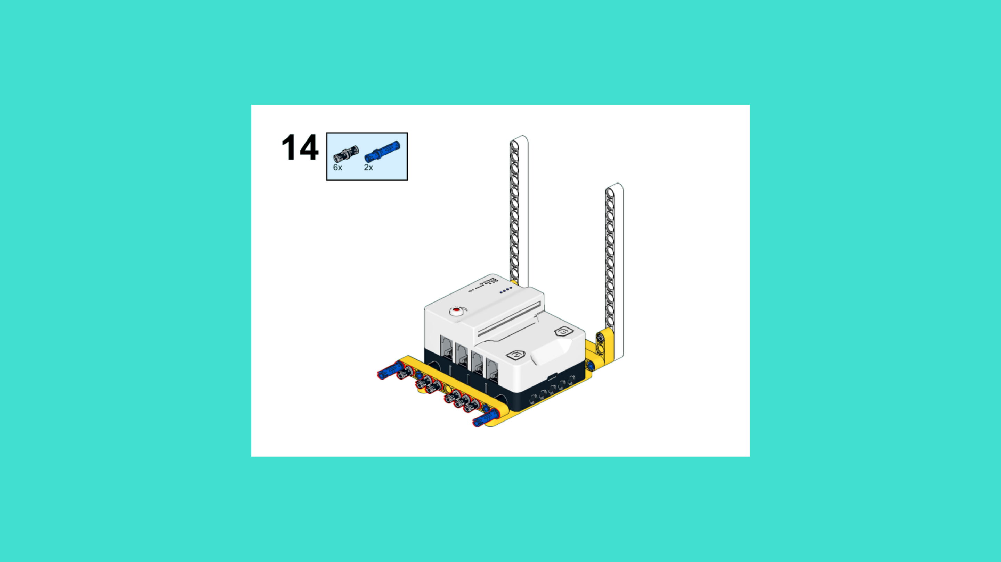
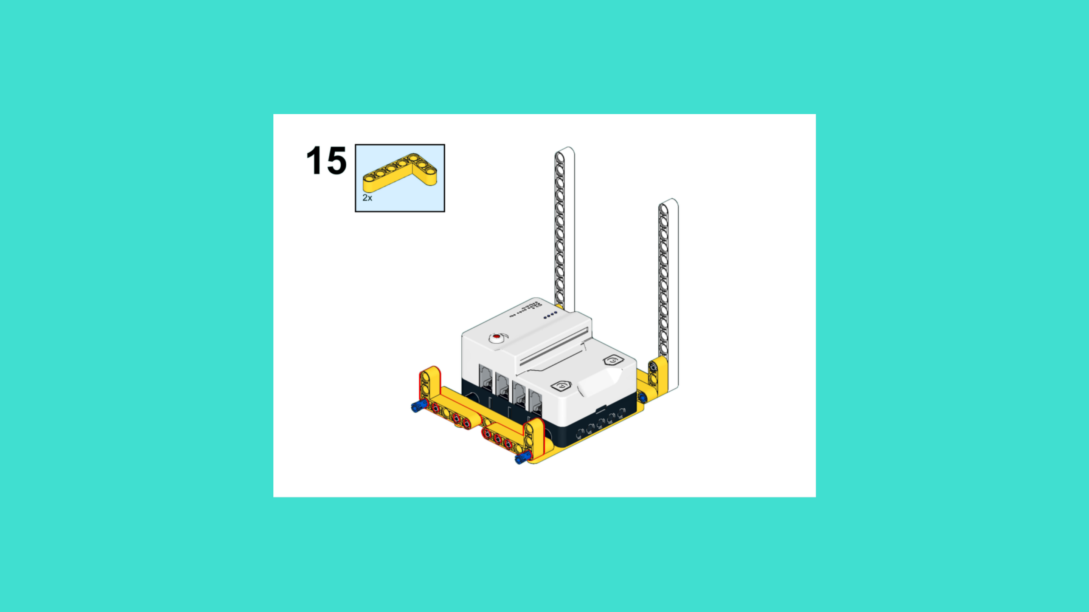
ASSEMBLY STEPS
STEP 13 – 15
PROGRESS: 21% COMPLETE (15 of 72 steps)
STEP 13
STEP 14
STEP 15
SPACE STATION · Techtelligence- Elecfreaks
5 / 24

Slide 8
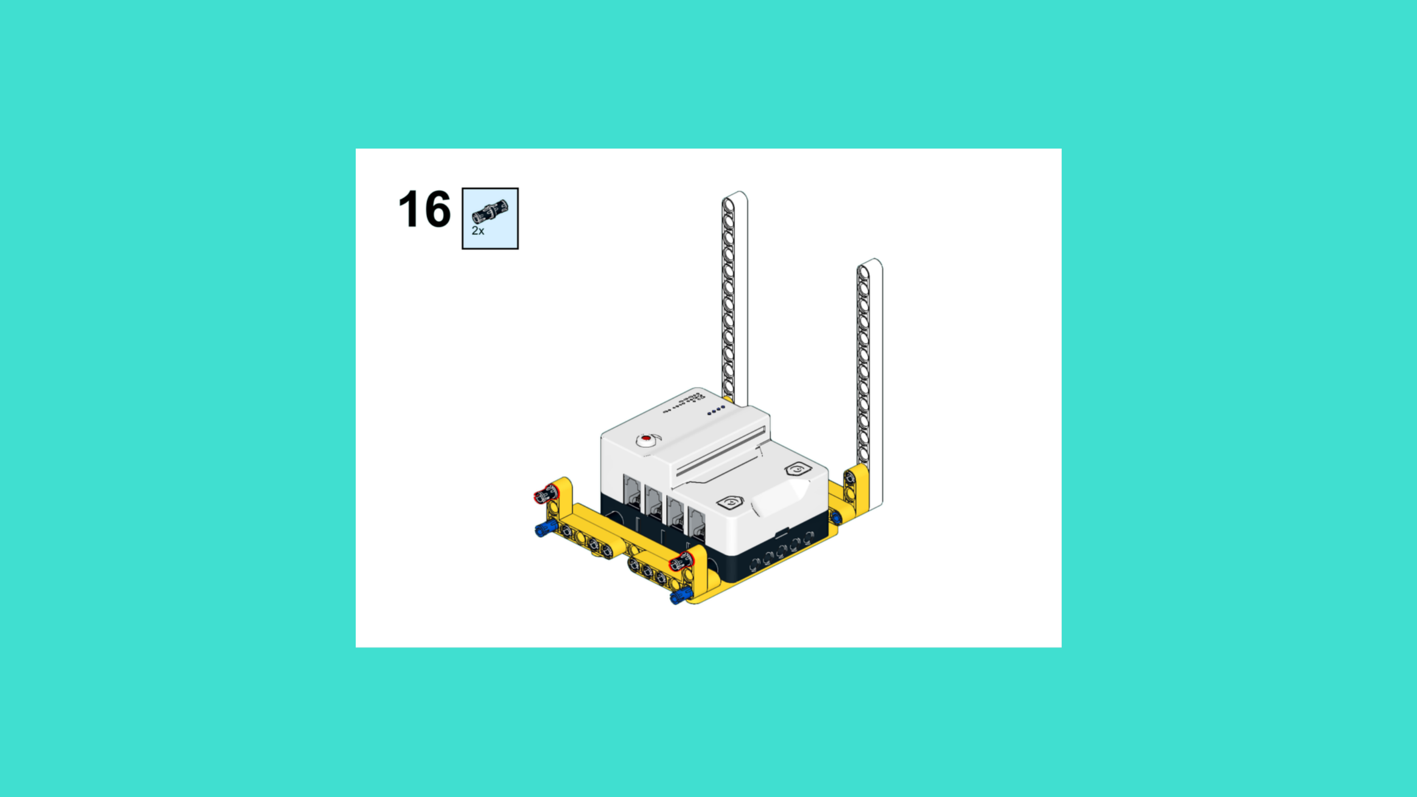
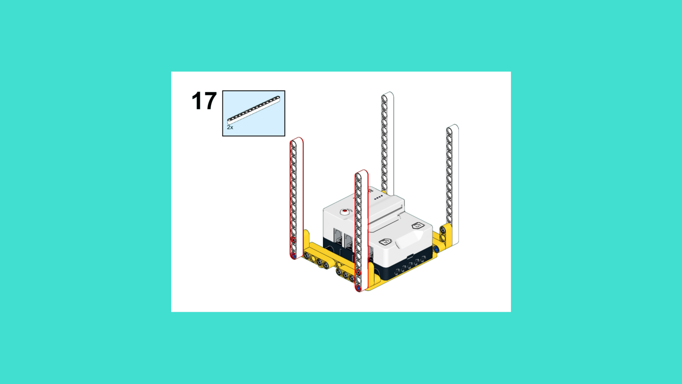
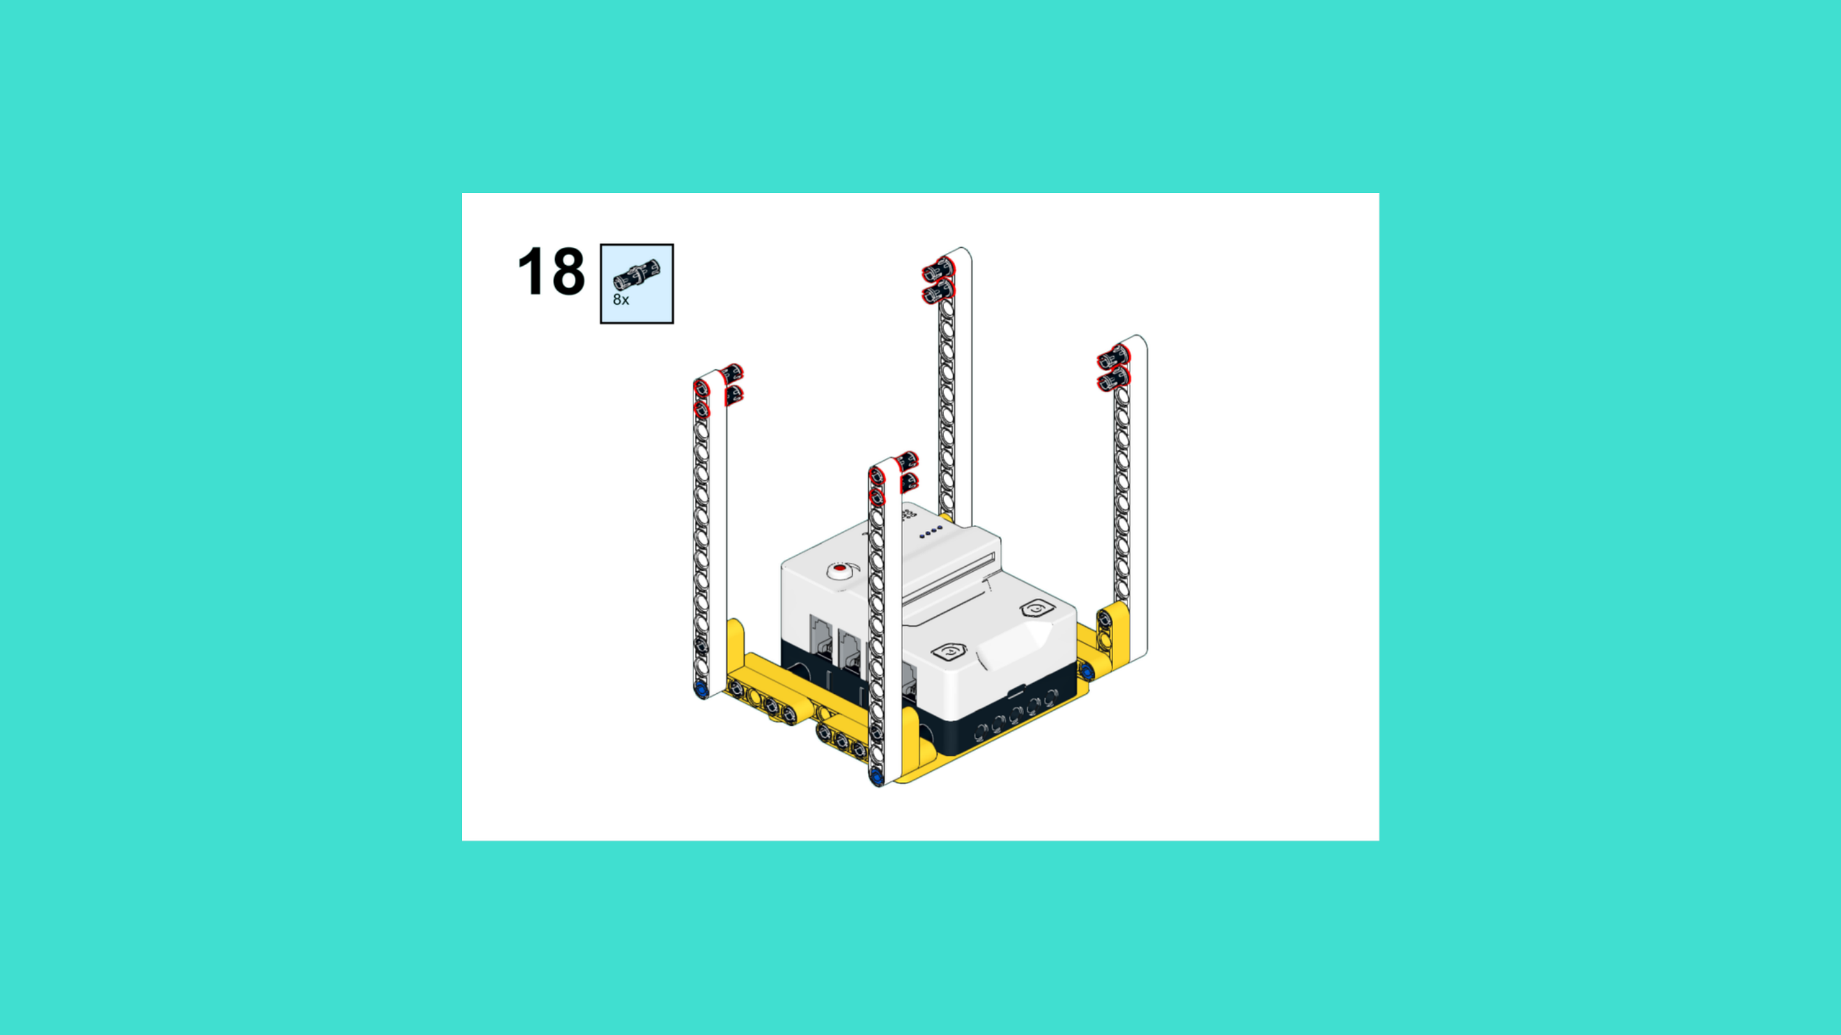
ASSEMBLY STEPS
STEP 16 – 18
PROGRESS: 25% COMPLETE (18 of 72 steps)
STEP 16
STEP 17
STEP 18
SPACE STATION · Techtelligence- Elecfreaks
6 / 24

Slide 9
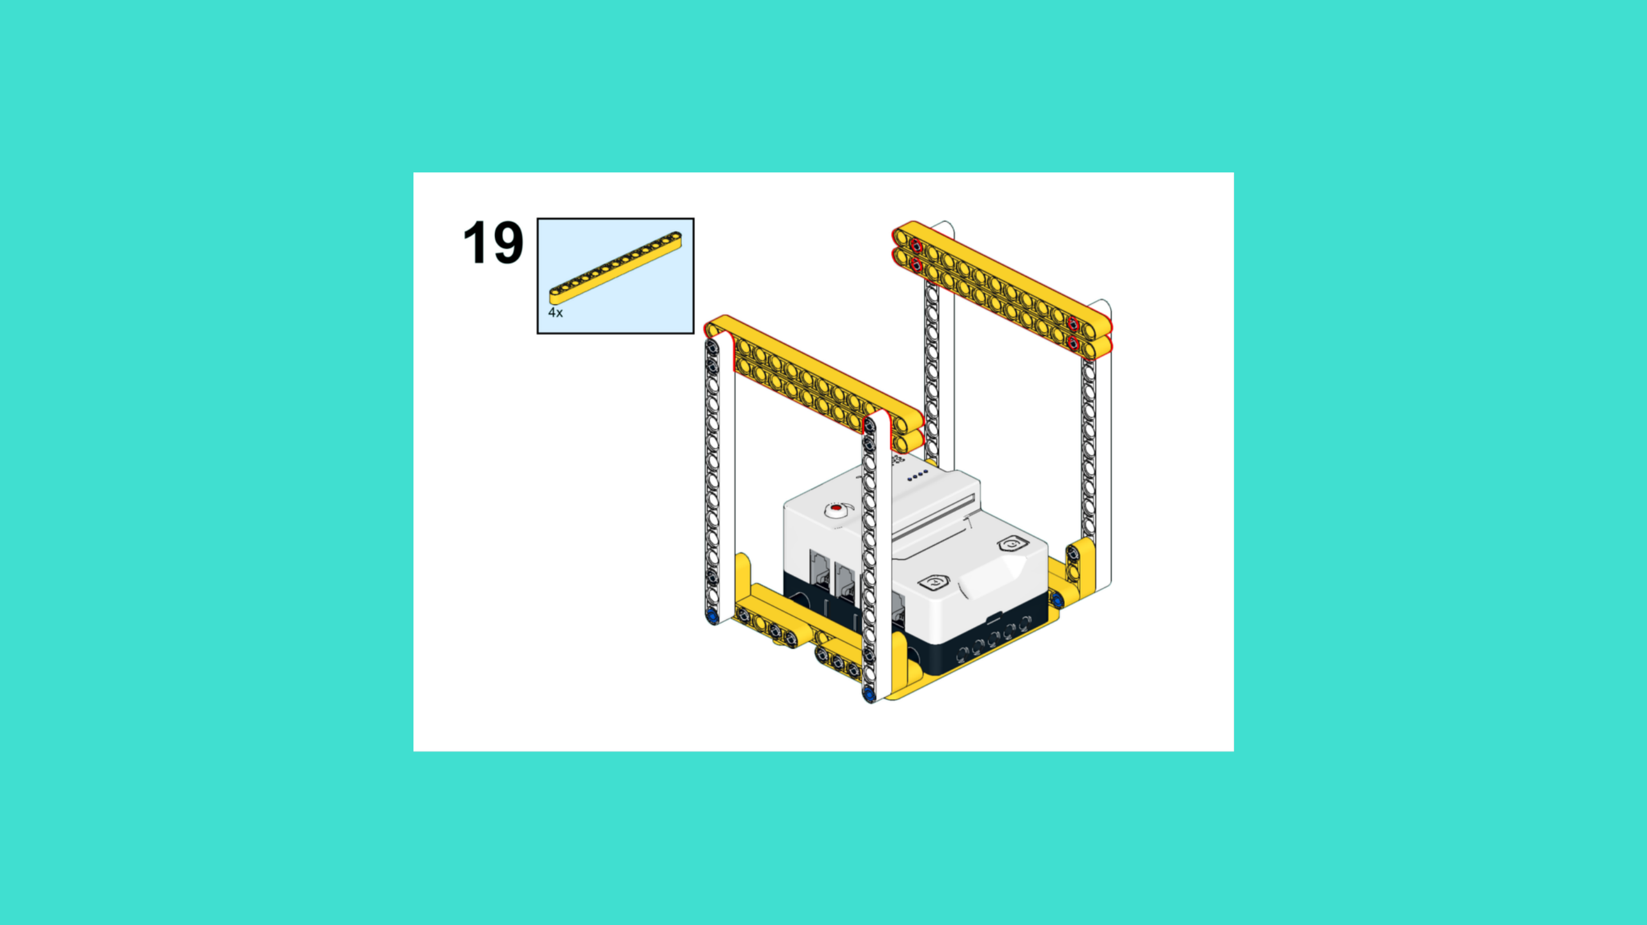
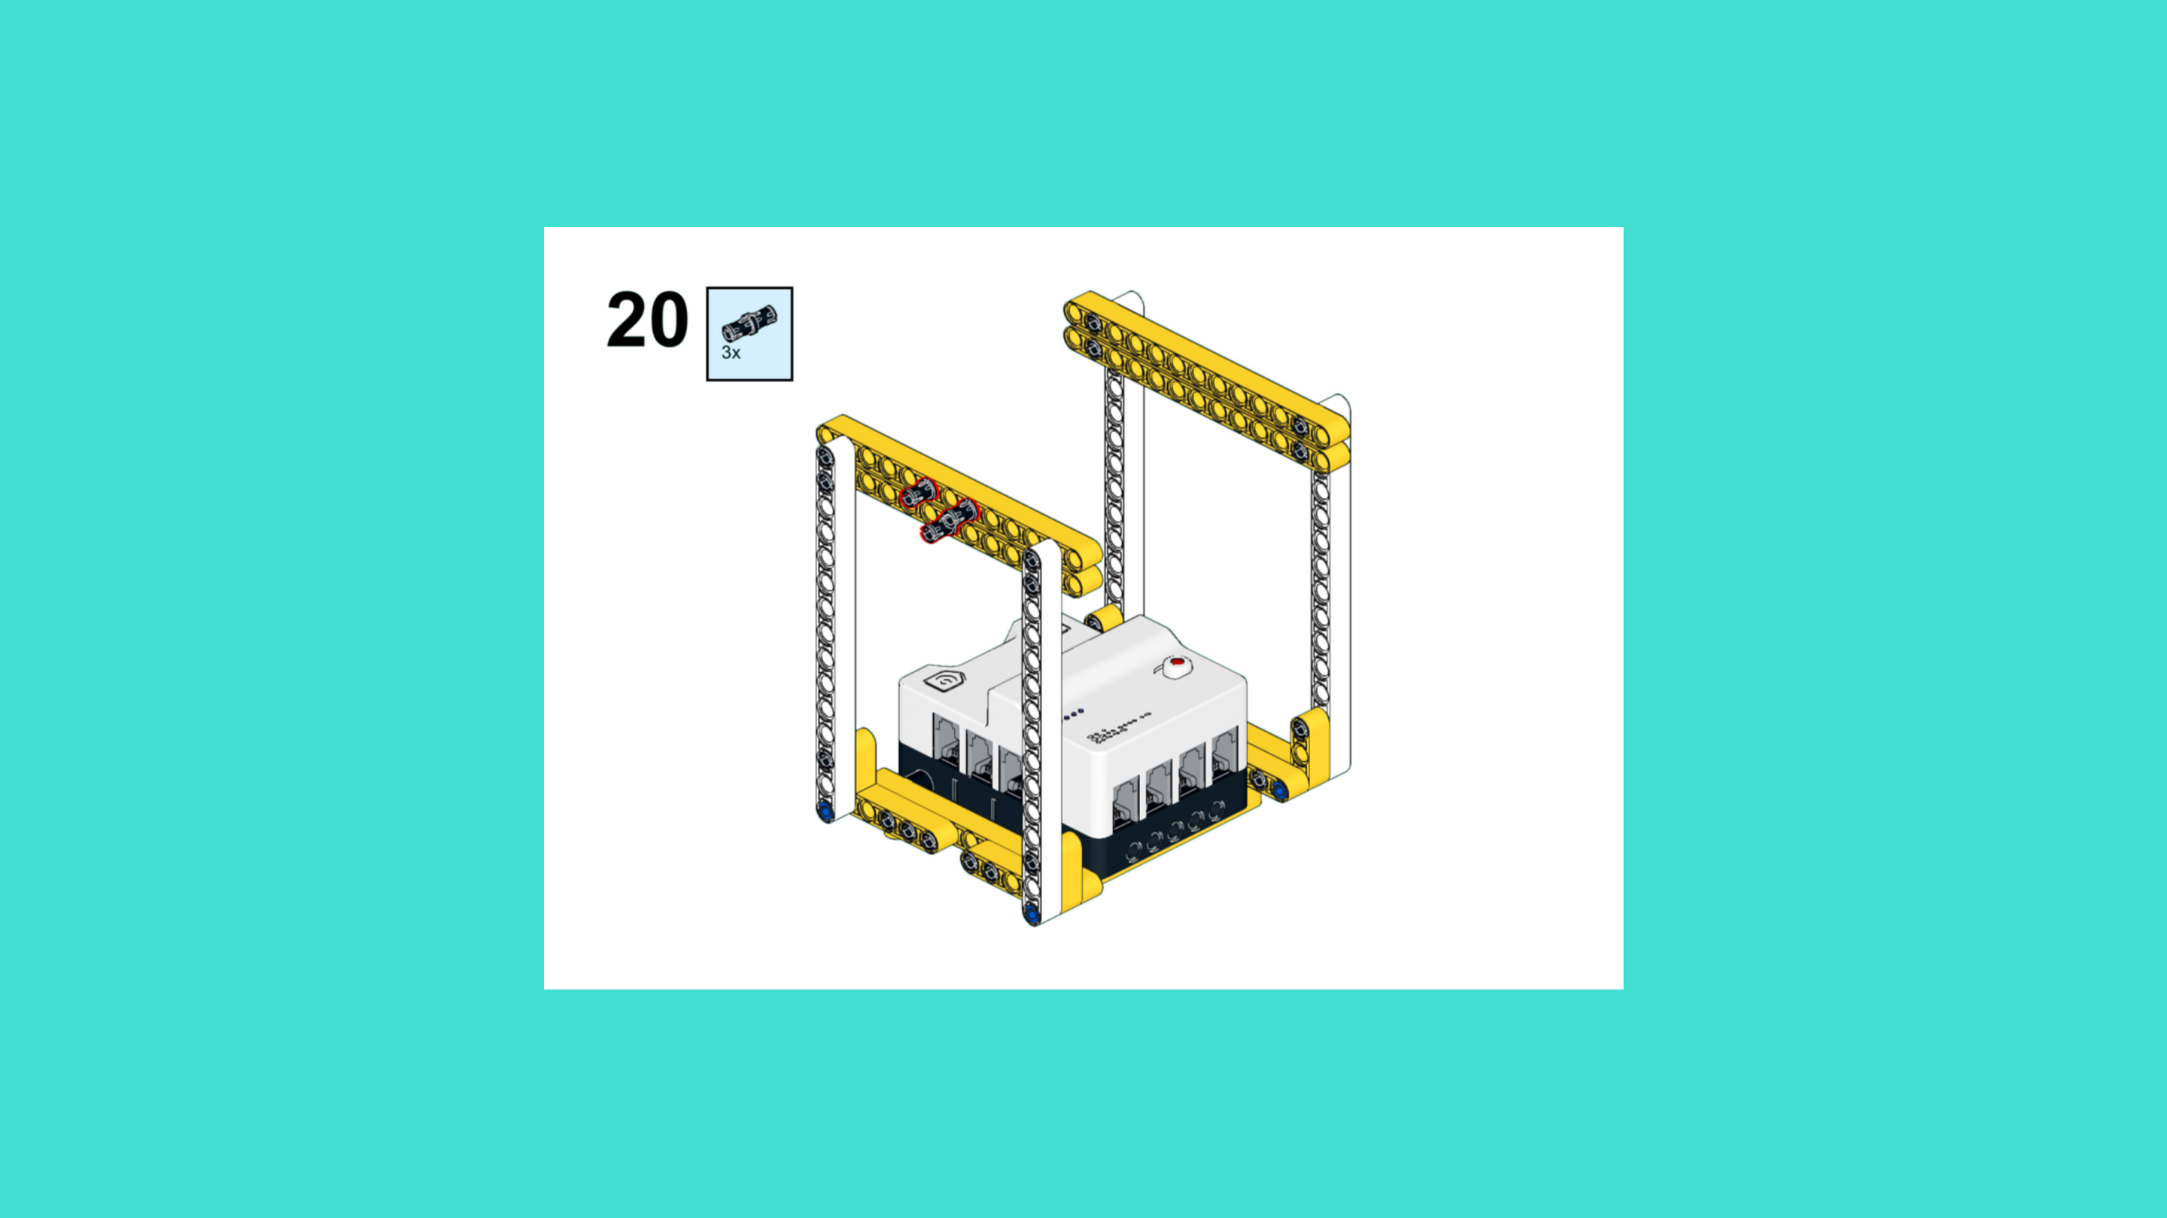
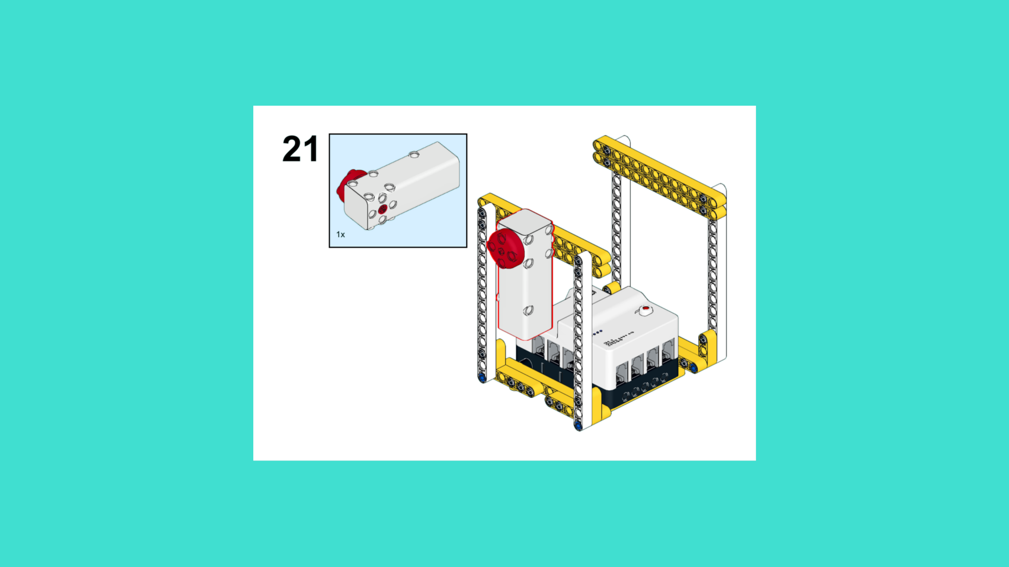
ASSEMBLY STEPS
STEP 19 – 21
PROGRESS: 29% COMPLETE (21 of 72 steps)
STEP 19
STEP 20
STEP 21
SPACE STATION · Techtelligence- Elecfreaks
7 / 24

Slide 10
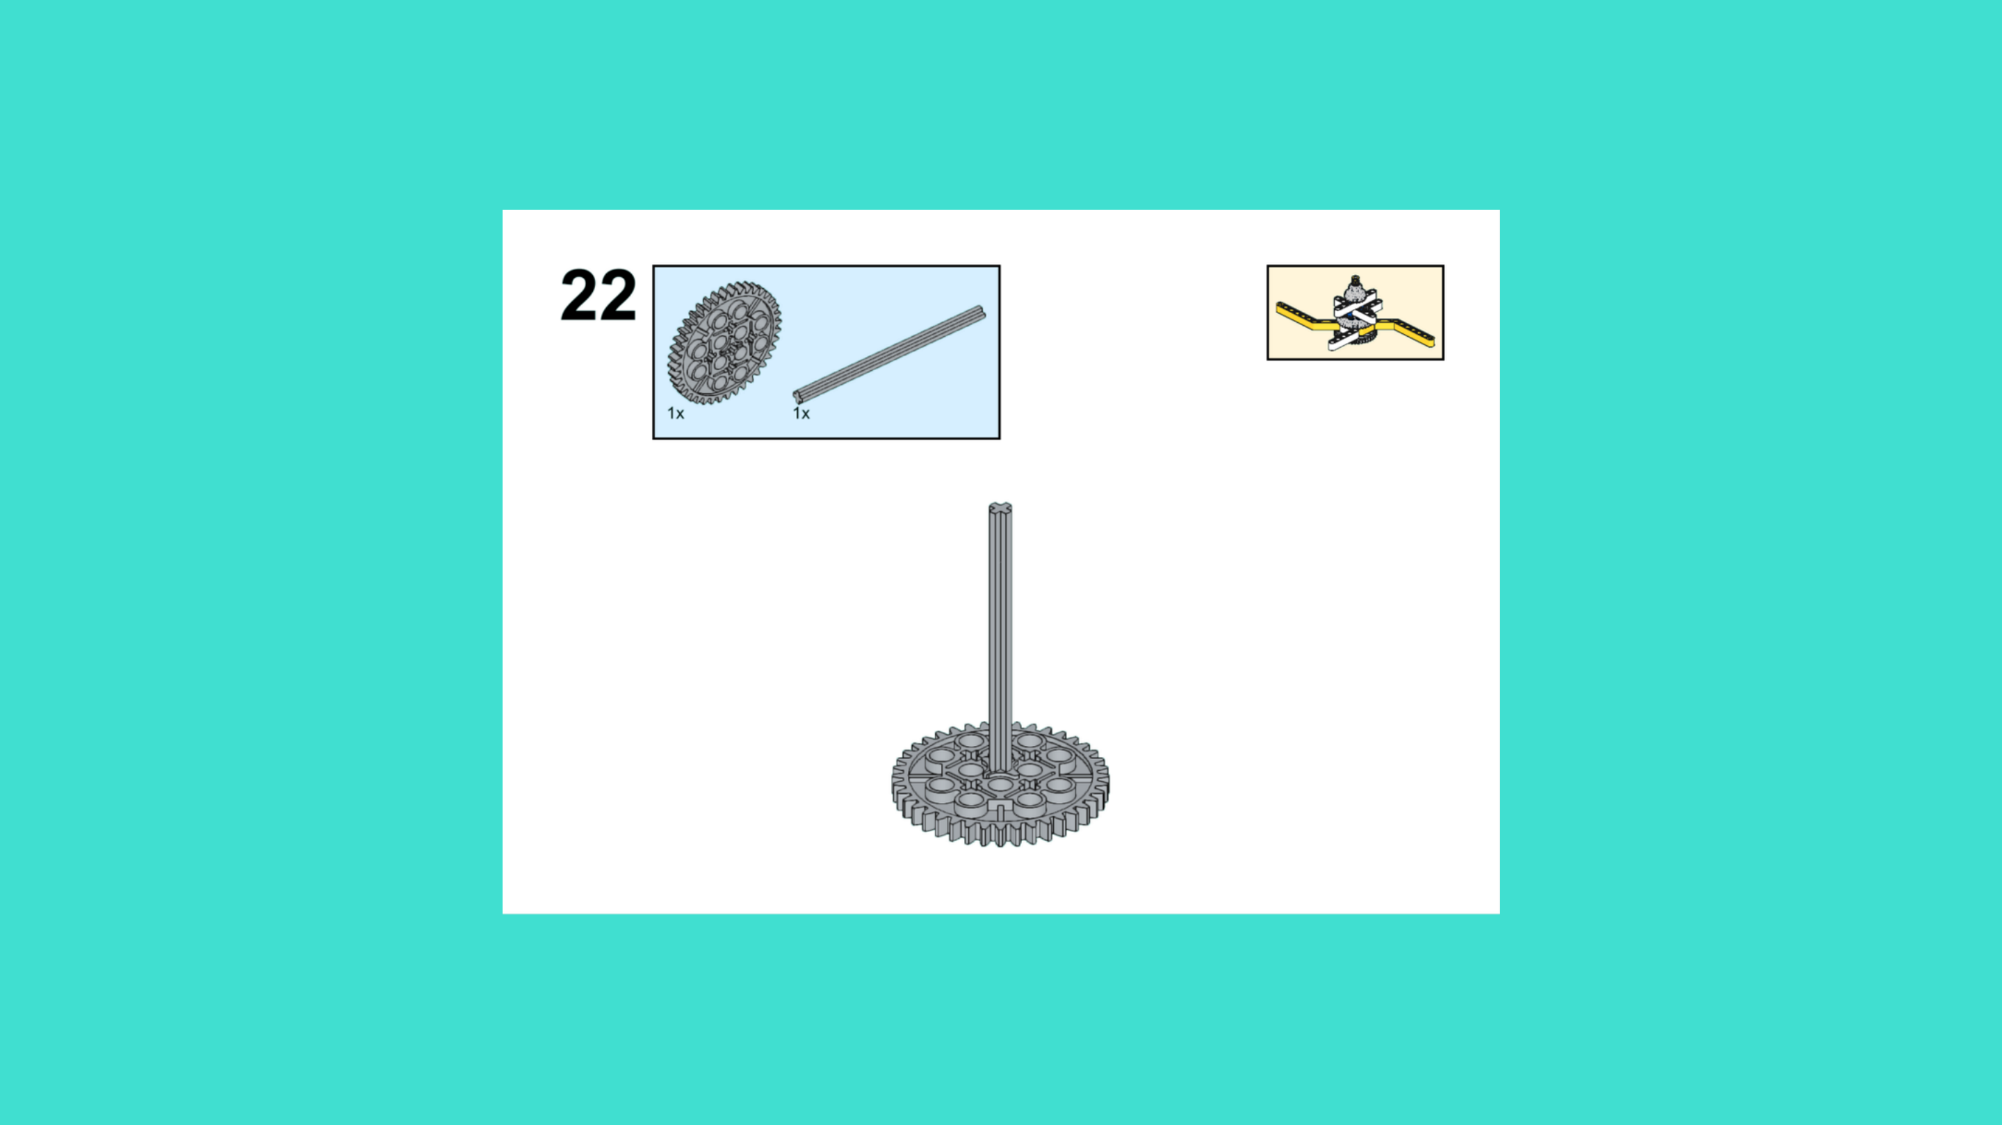
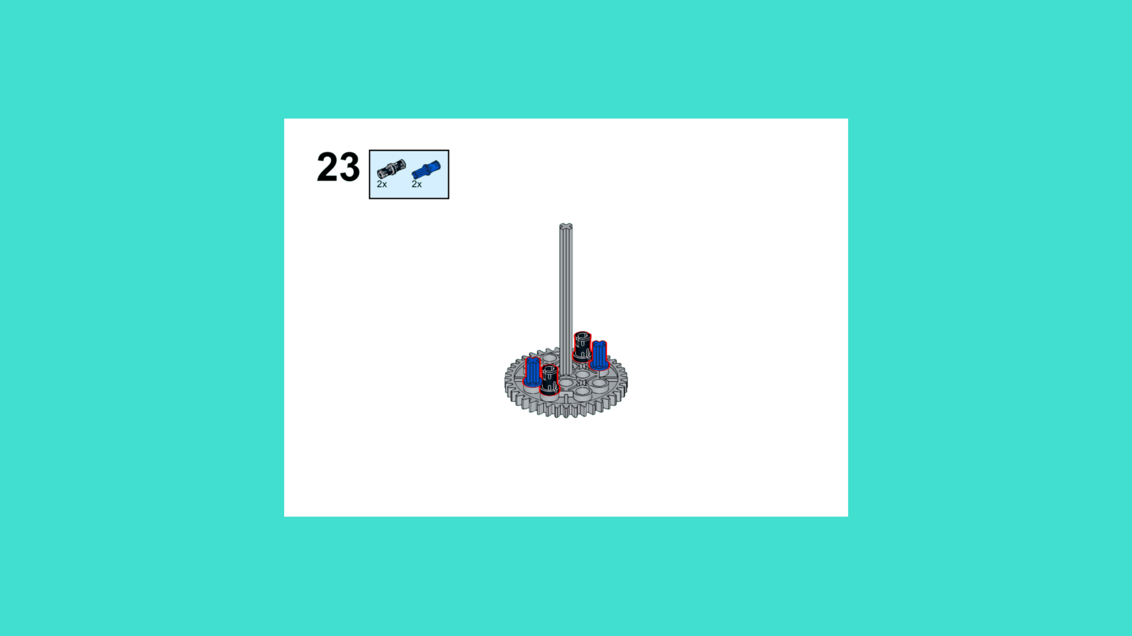
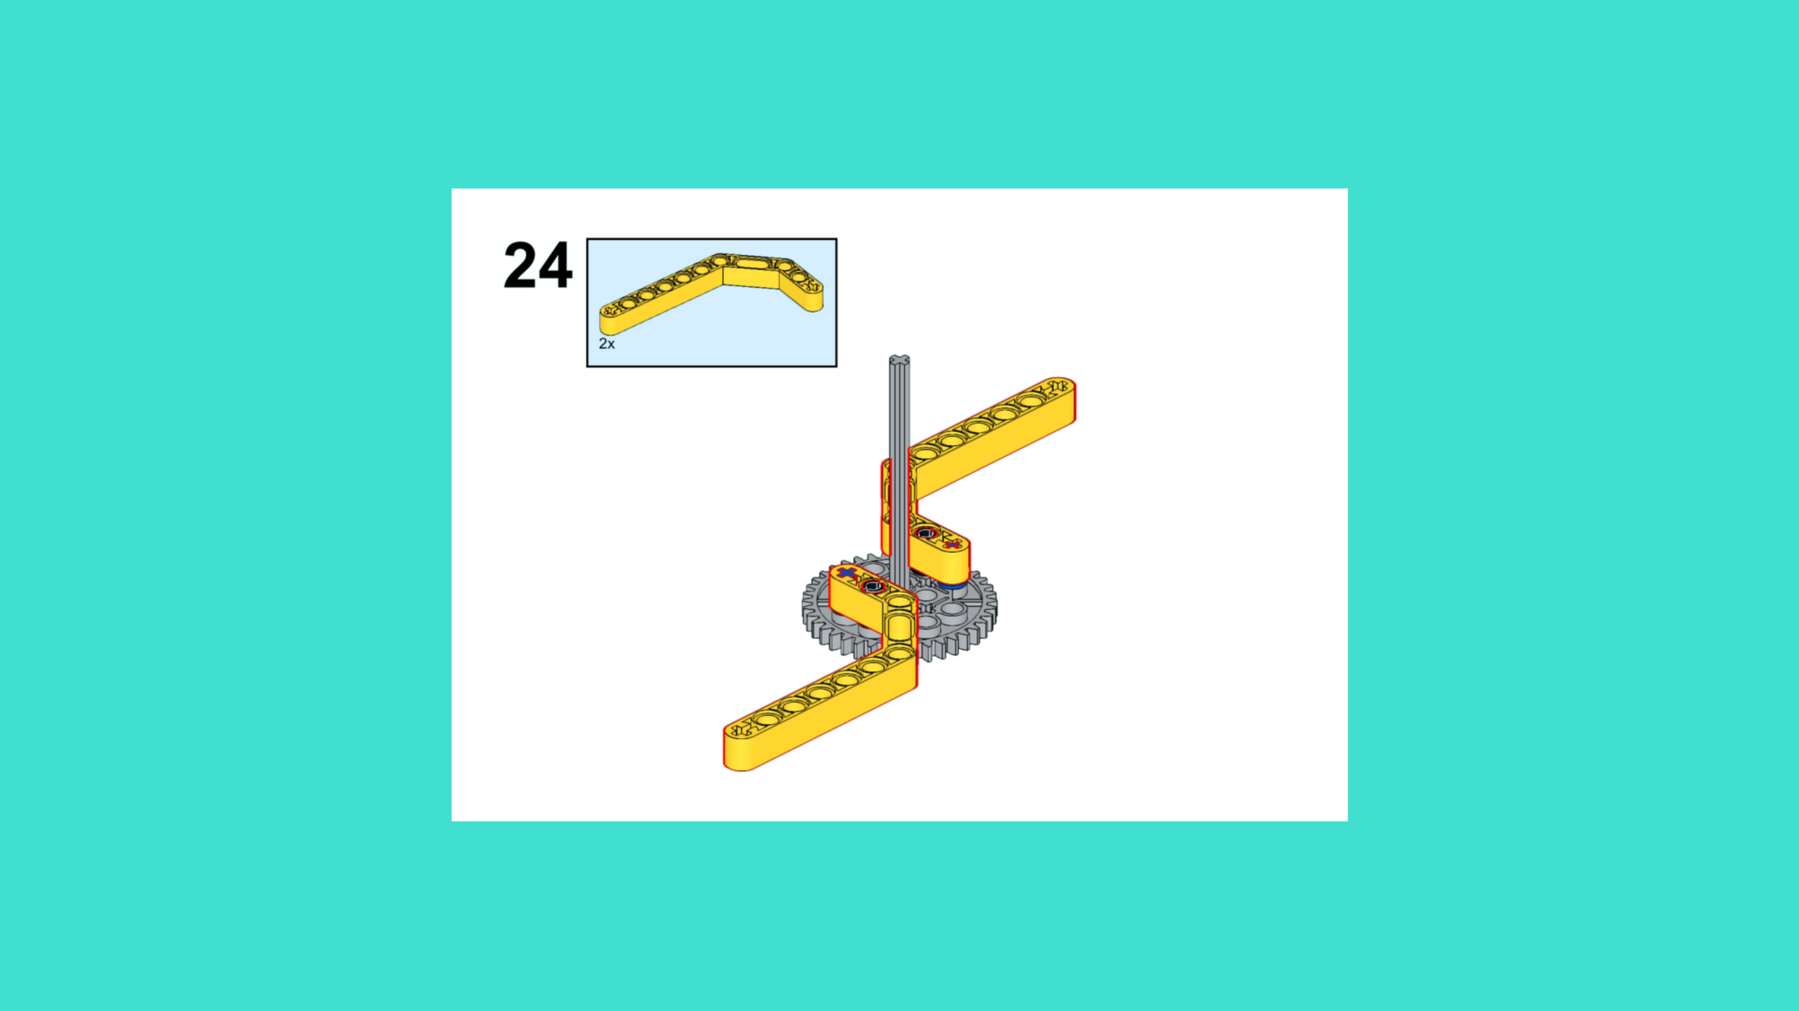
ASSEMBLY STEPS
STEP 22 – 24
PROGRESS: 33% COMPLETE (24 of 72 steps)
STEP 22
STEP 23
STEP 24
SPACE STATION · Techtelligence- Elecfreaks
8 / 24

Slide 11
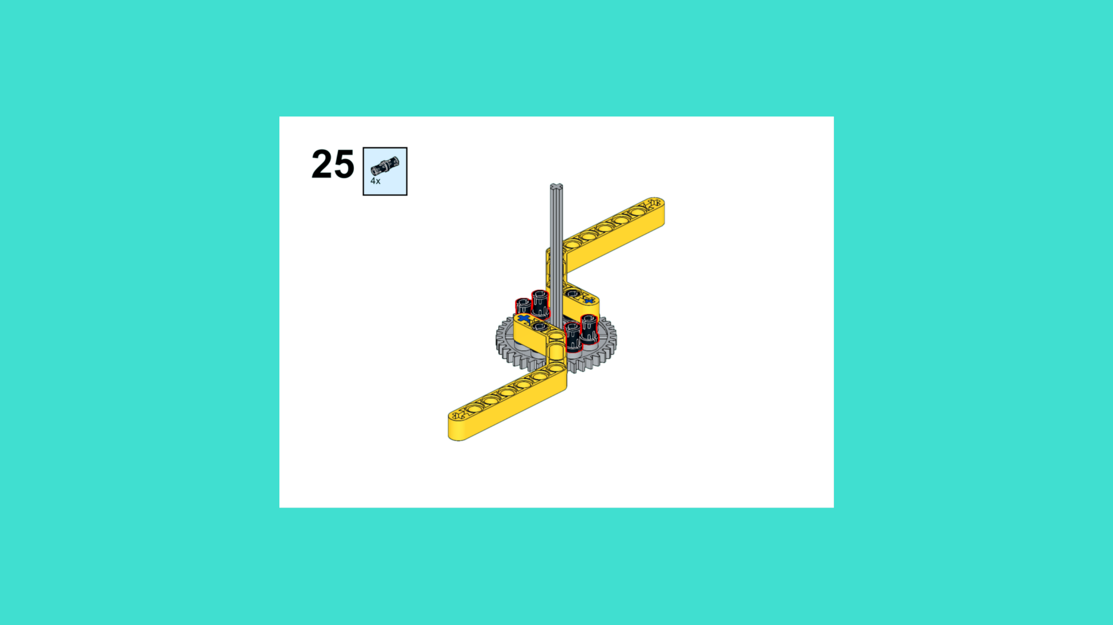
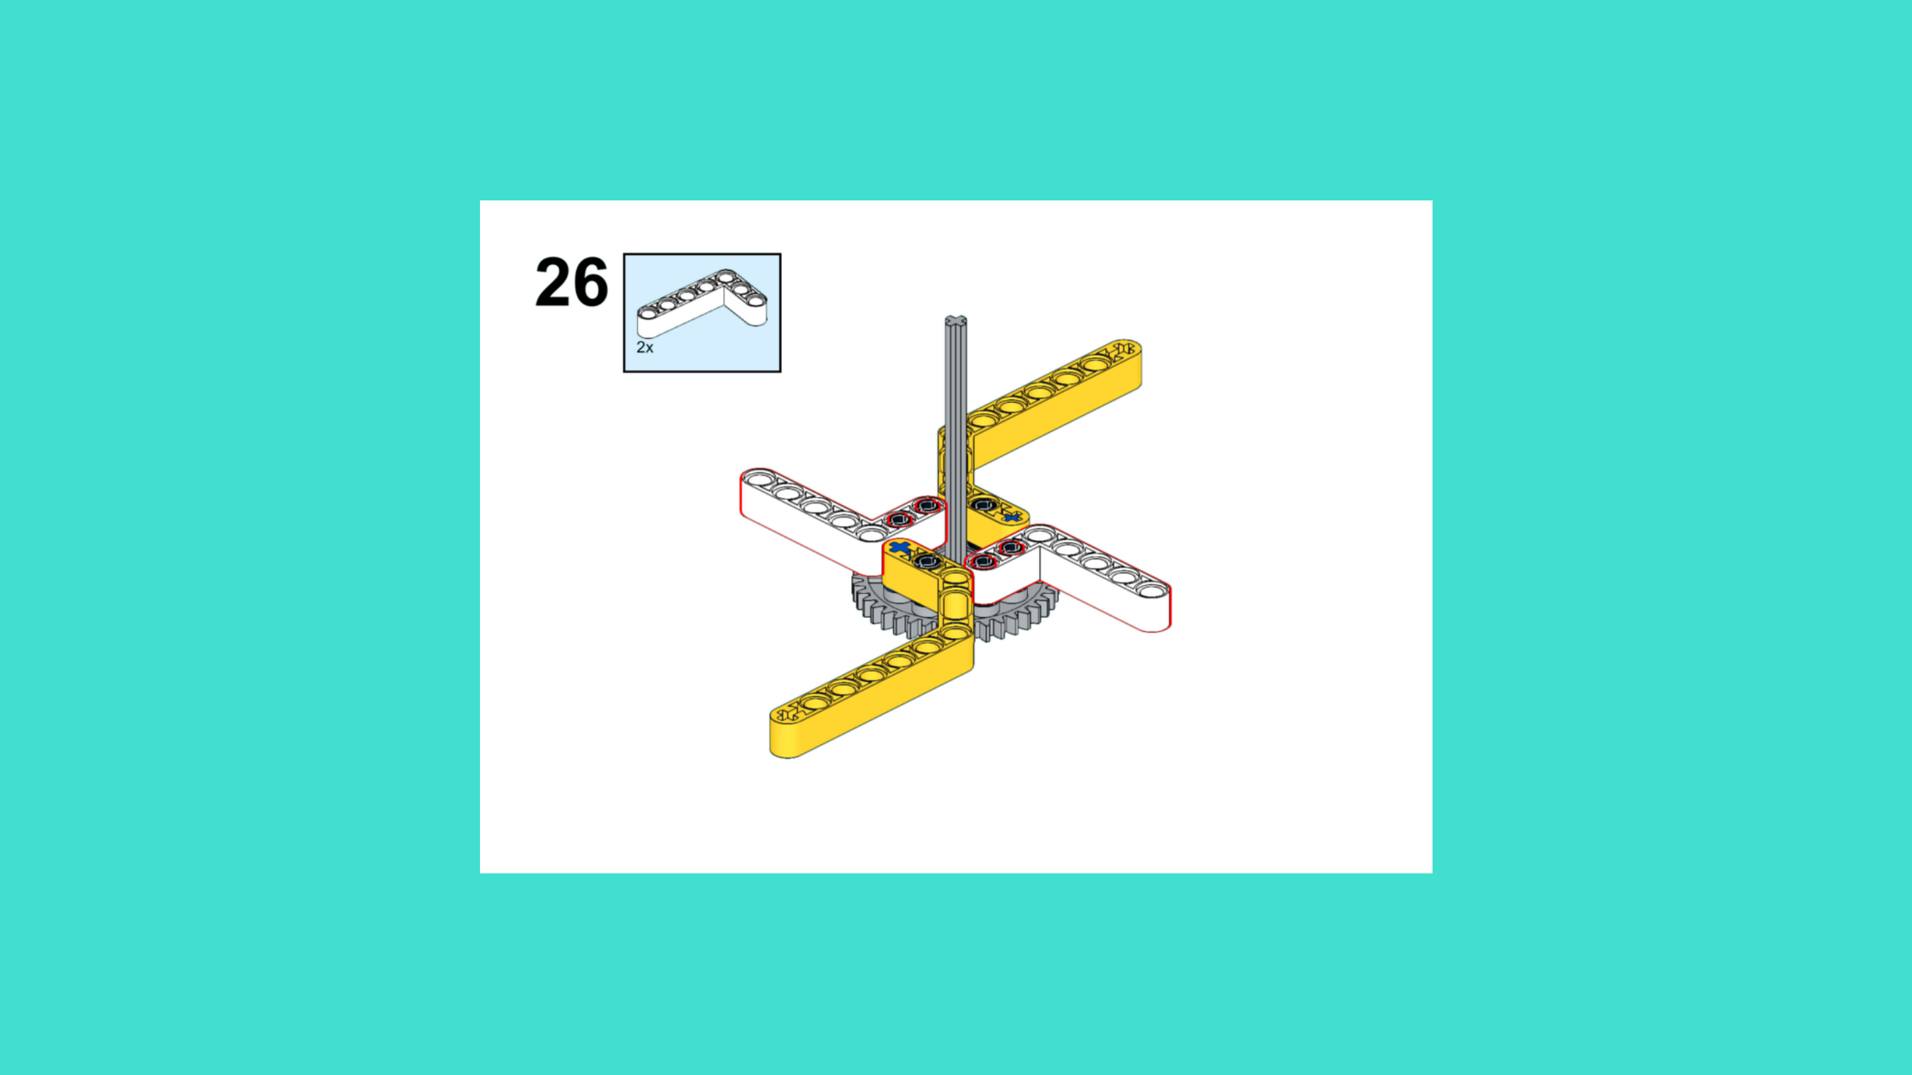
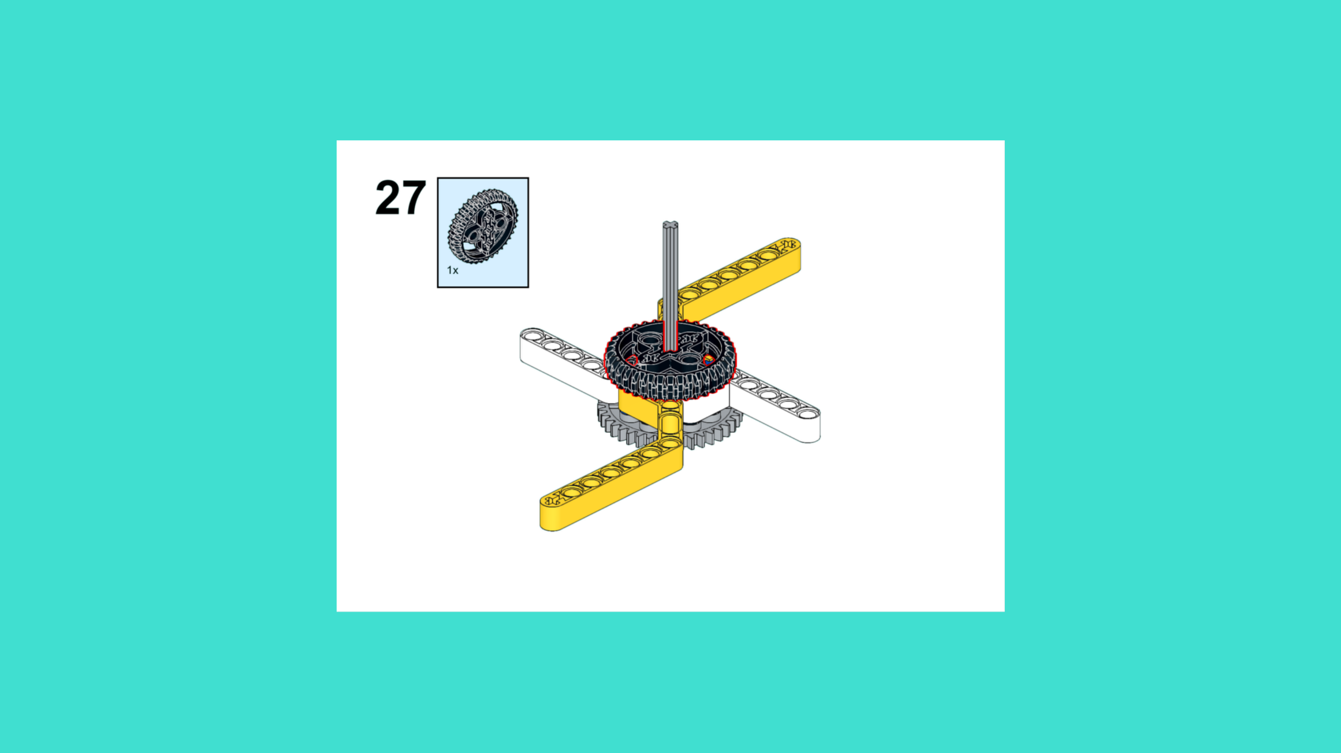
ASSEMBLY STEPS
STEP 25 – 27
PROGRESS: 38% COMPLETE (27 of 72 steps)
STEP 25
STEP 26
STEP 27
SPACE STATION · Techtelligence- Elecfreaks
9 / 24

Slide 12
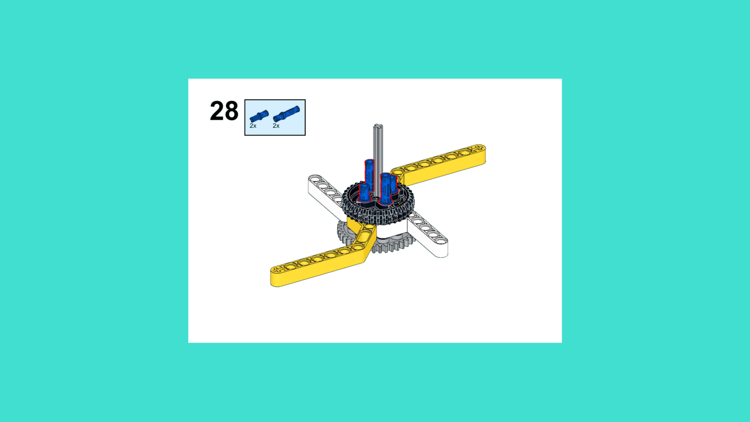
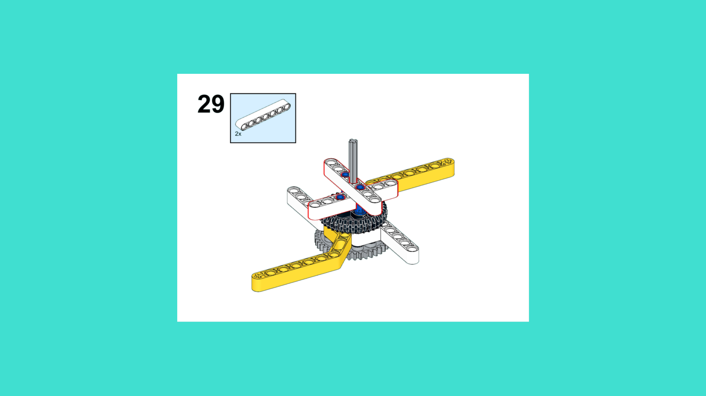
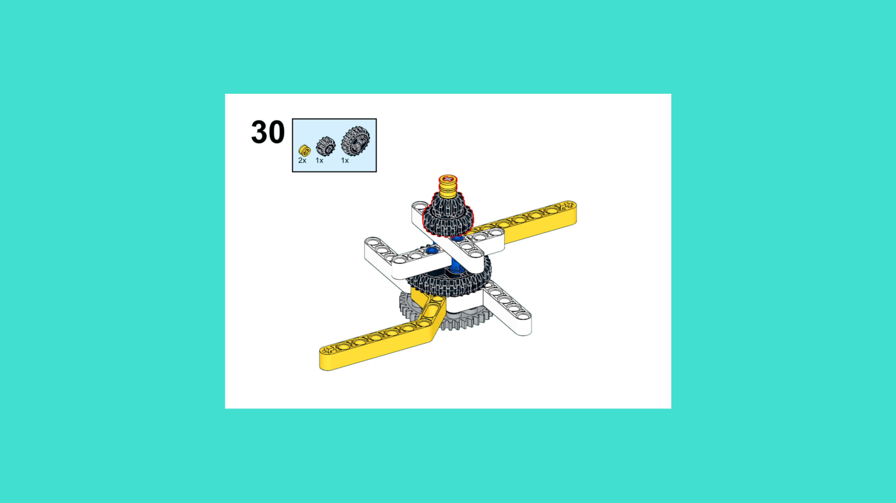
ASSEMBLY STEPS
STEP 28 – 30
PROGRESS: 42% COMPLETE (30 of 72 steps)
STEP 28
STEP 29
STEP 30
SPACE STATION · Techtelligence- Elecfreaks
10 / 24

Slide 13
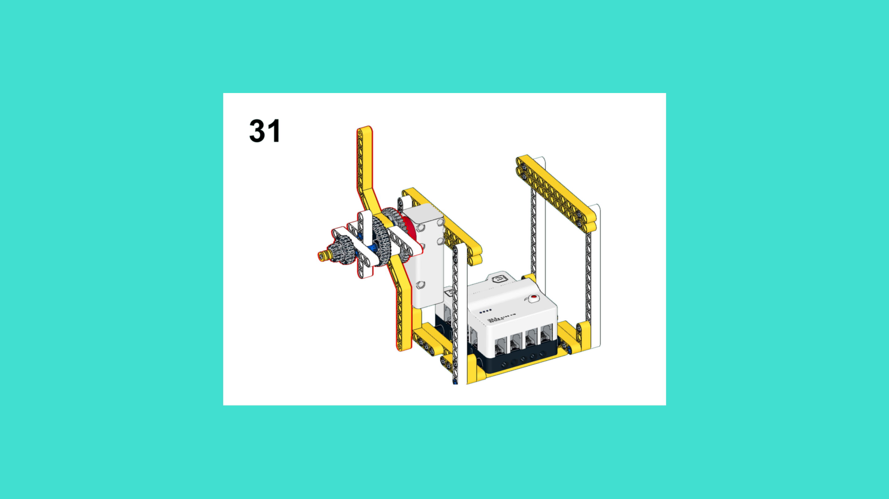
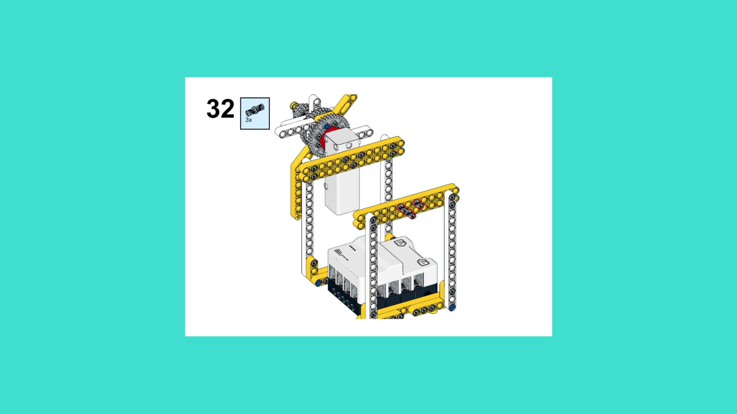
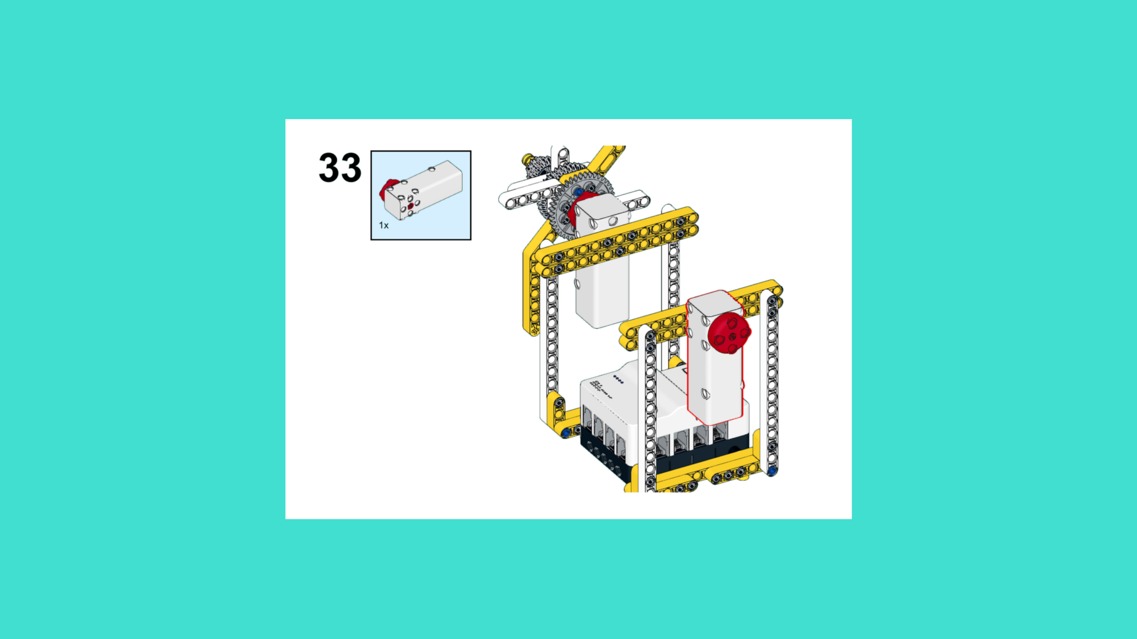
ASSEMBLY STEPS
STEP 31 – 33
PROGRESS: 46% COMPLETE (33 of 72 steps)
STEP 31
STEP 32
STEP 33
SPACE STATION · Techtelligence- Elecfreaks
11 / 24

Slide 14

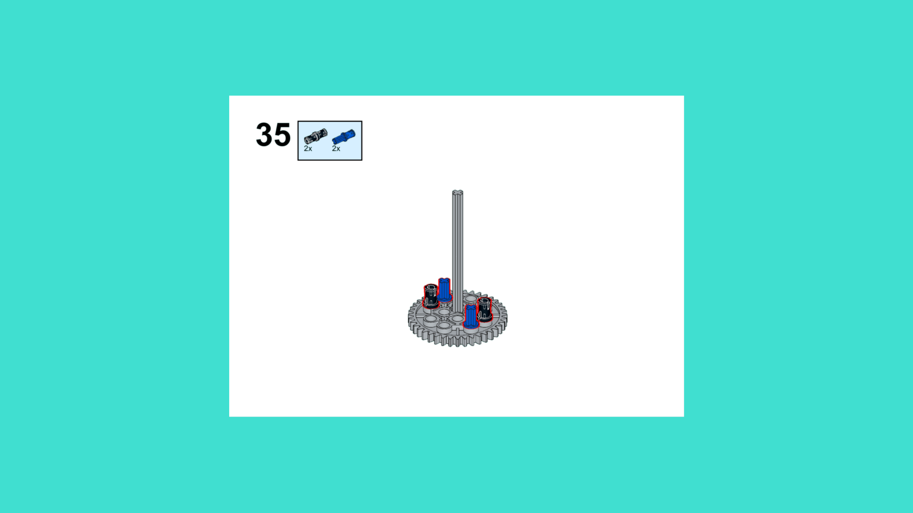
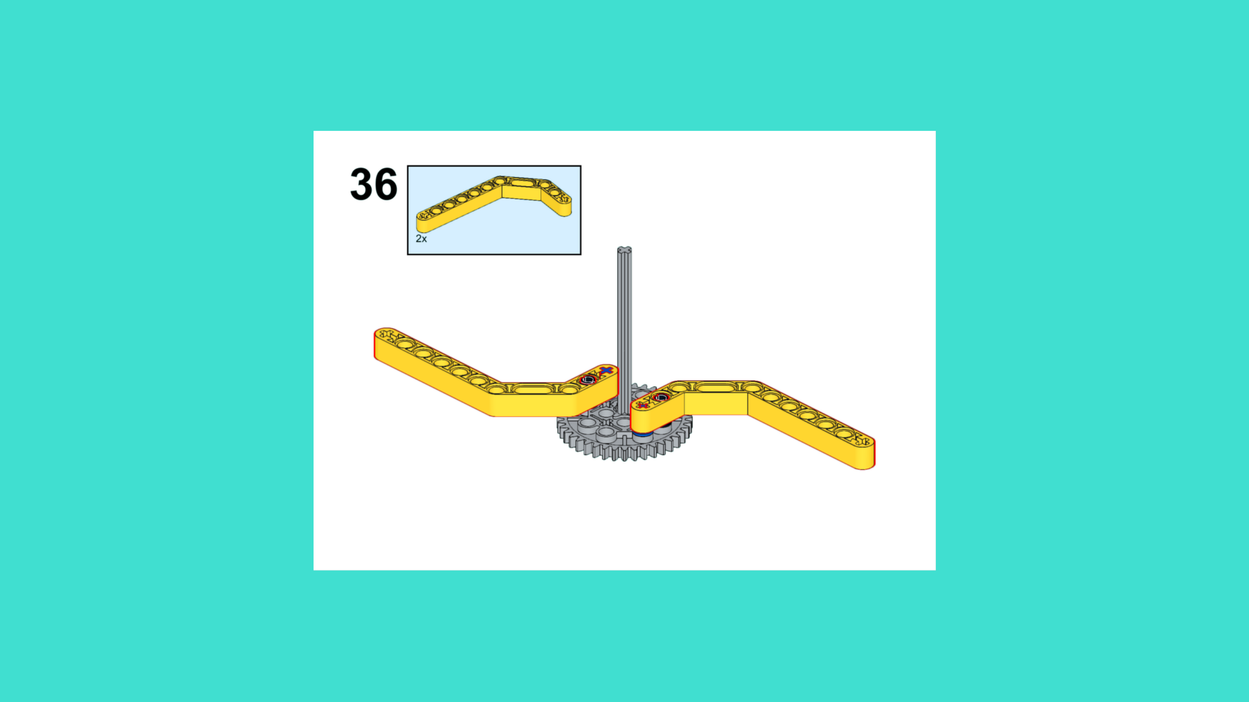
ASSEMBLY STEPS
STEP 34 – 36
PROGRESS: 50% COMPLETE (36 of 72 steps)
STEP 34
STEP 35
STEP 36
SPACE STATION · Techtelligence- Elecfreaks
12 / 24

Slide 15
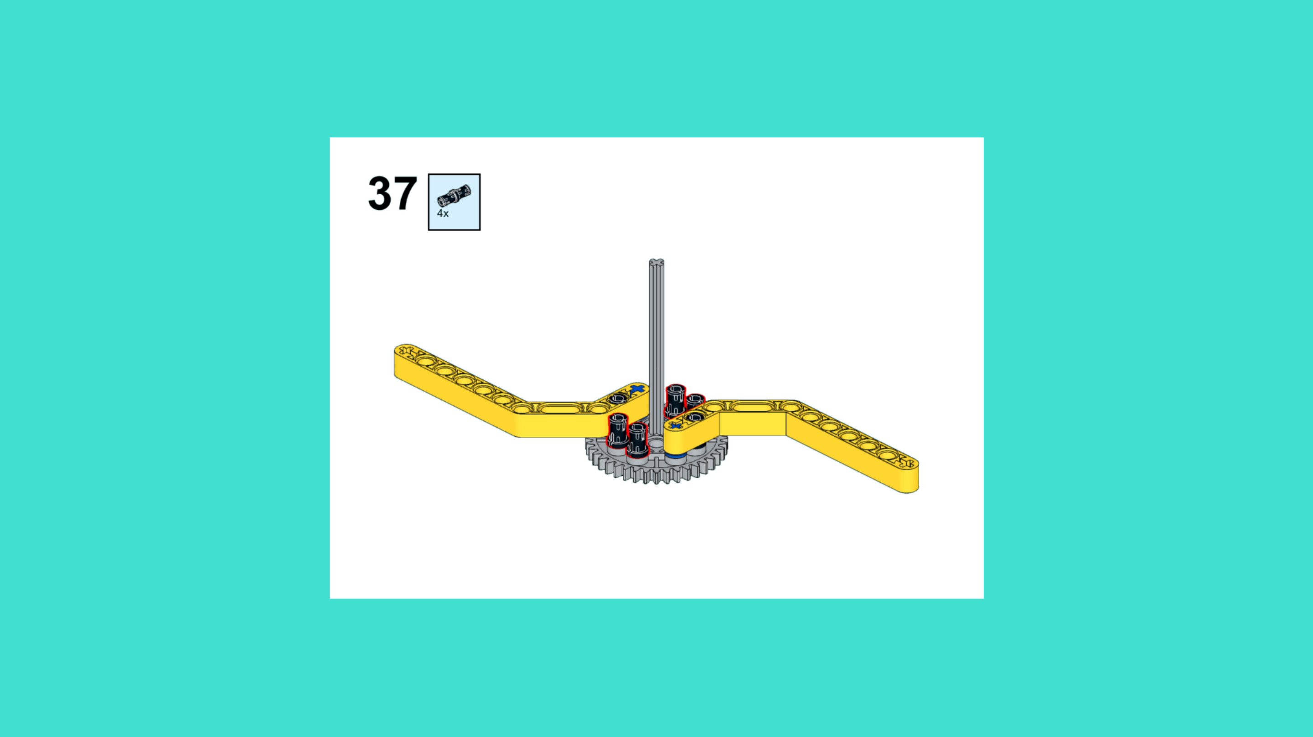
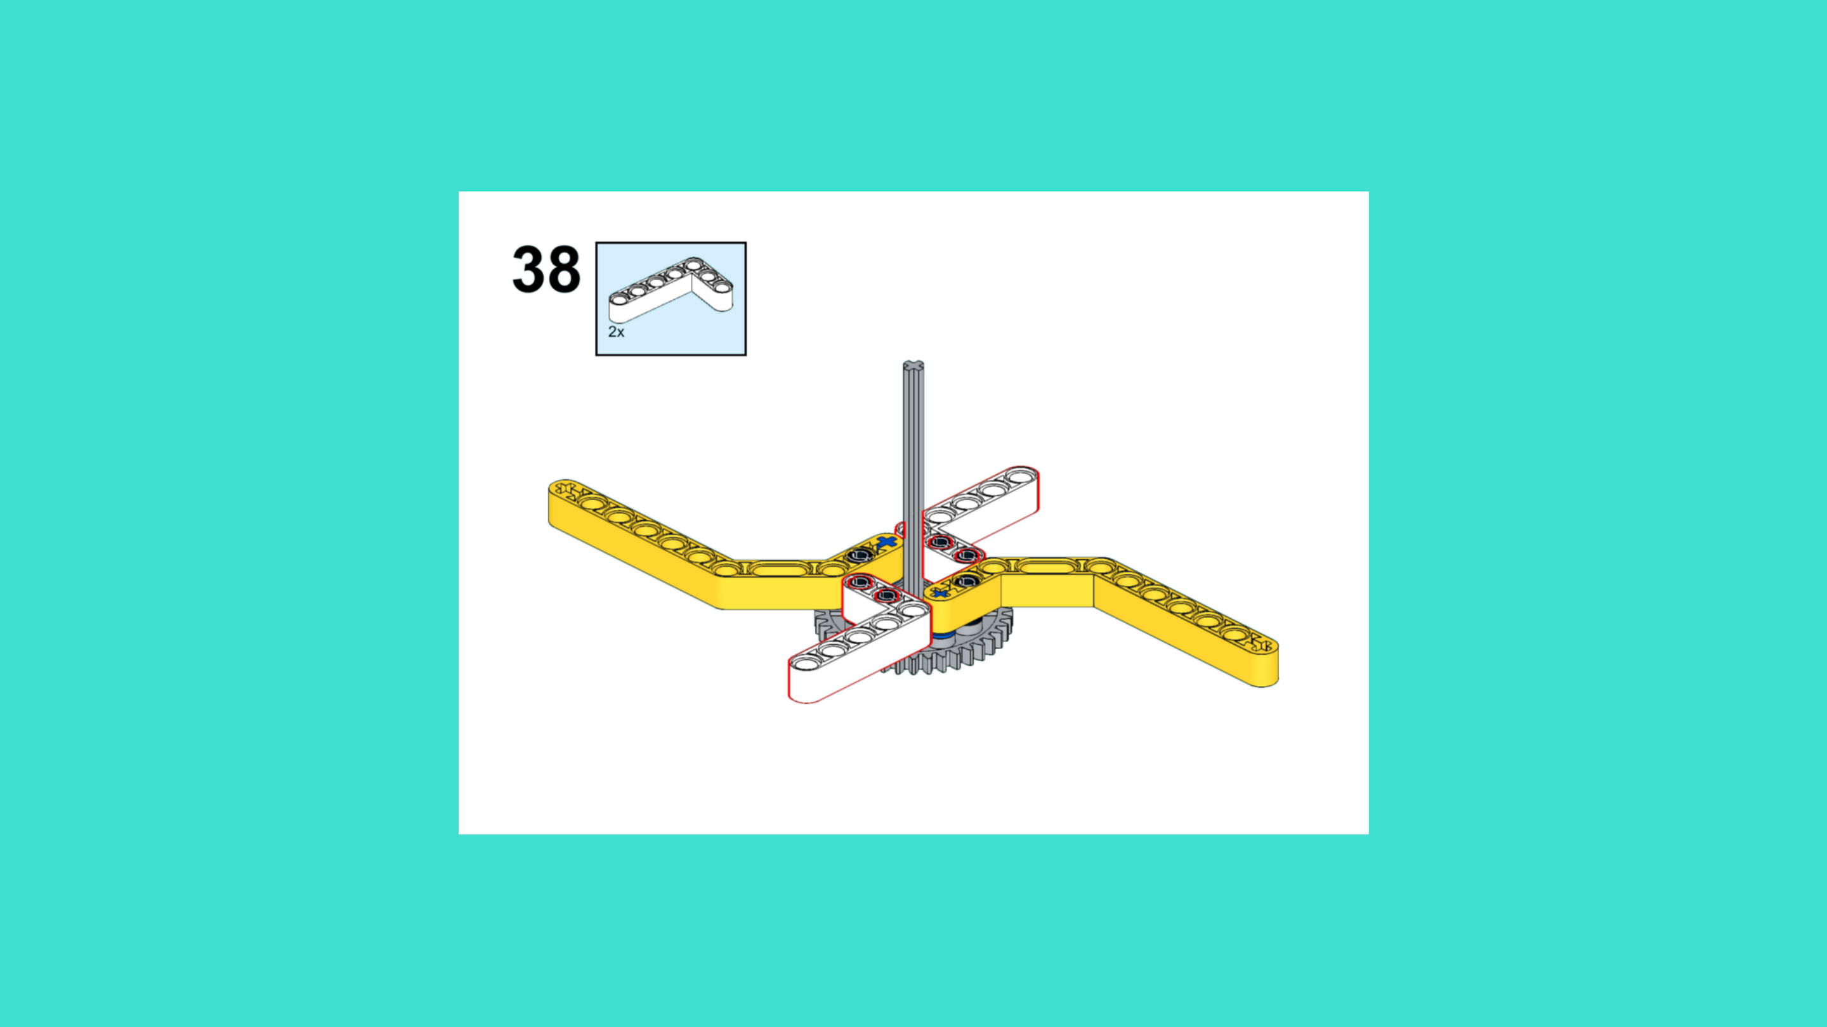
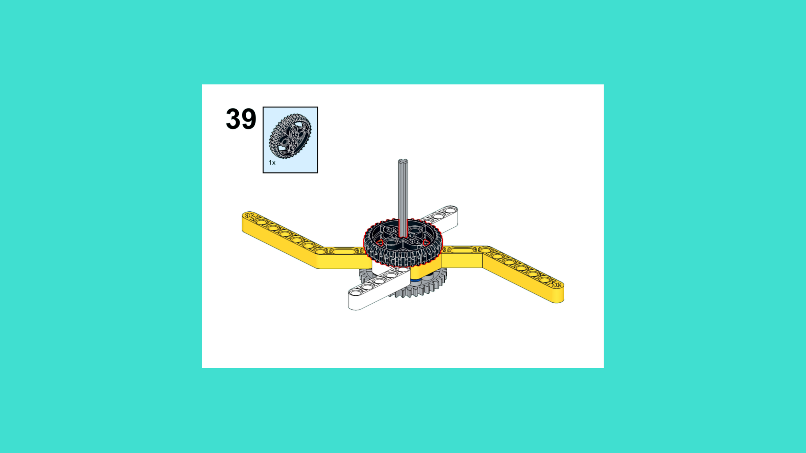
ASSEMBLY STEPS
STEP 37 – 39
PROGRESS: 54% COMPLETE (39 of 72 steps)
STEP 37
STEP 38
STEP 39
SPACE STATION · Techtelligence- Elecfreaks
13 / 24

Slide 16
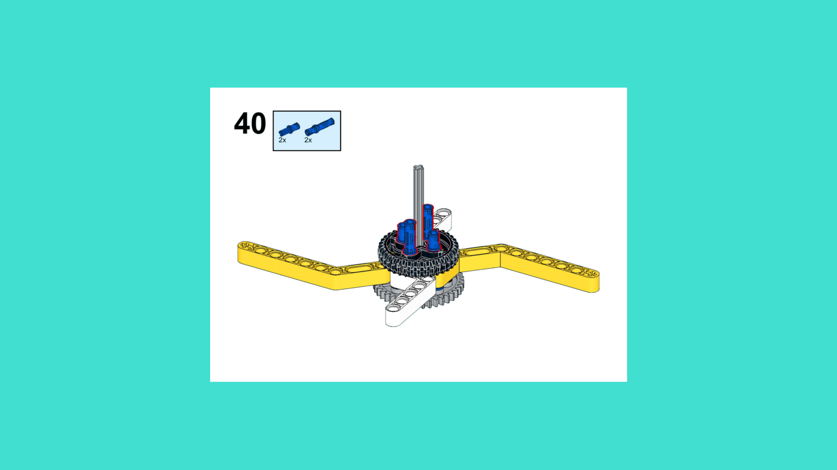
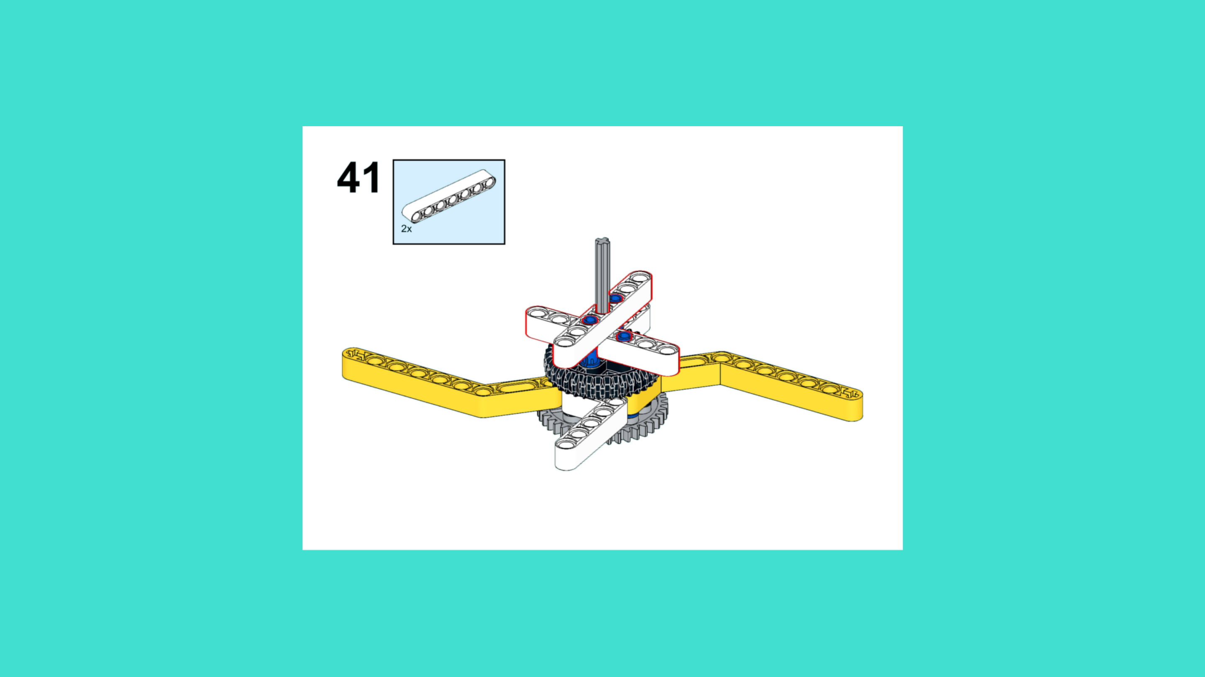
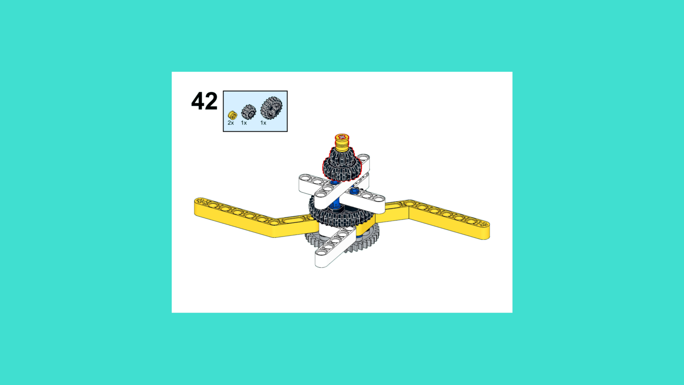
ASSEMBLY STEPS
STEP 40 – 42
PROGRESS: 58% COMPLETE (42 of 72 steps)
STEP 40
STEP 41
STEP 42
SPACE STATION · Techtelligence- Elecfreaks
14 / 24

Slide 17
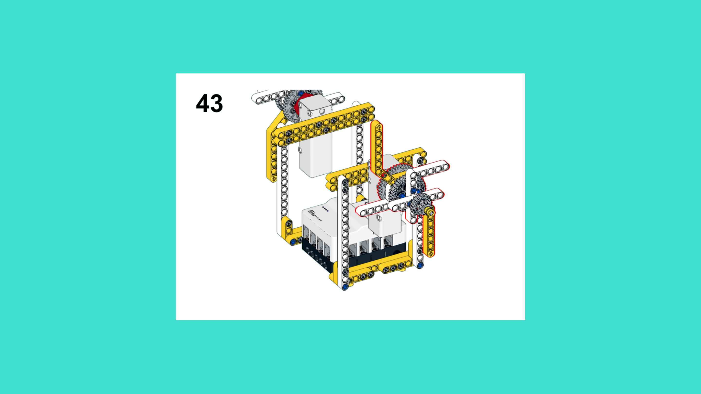
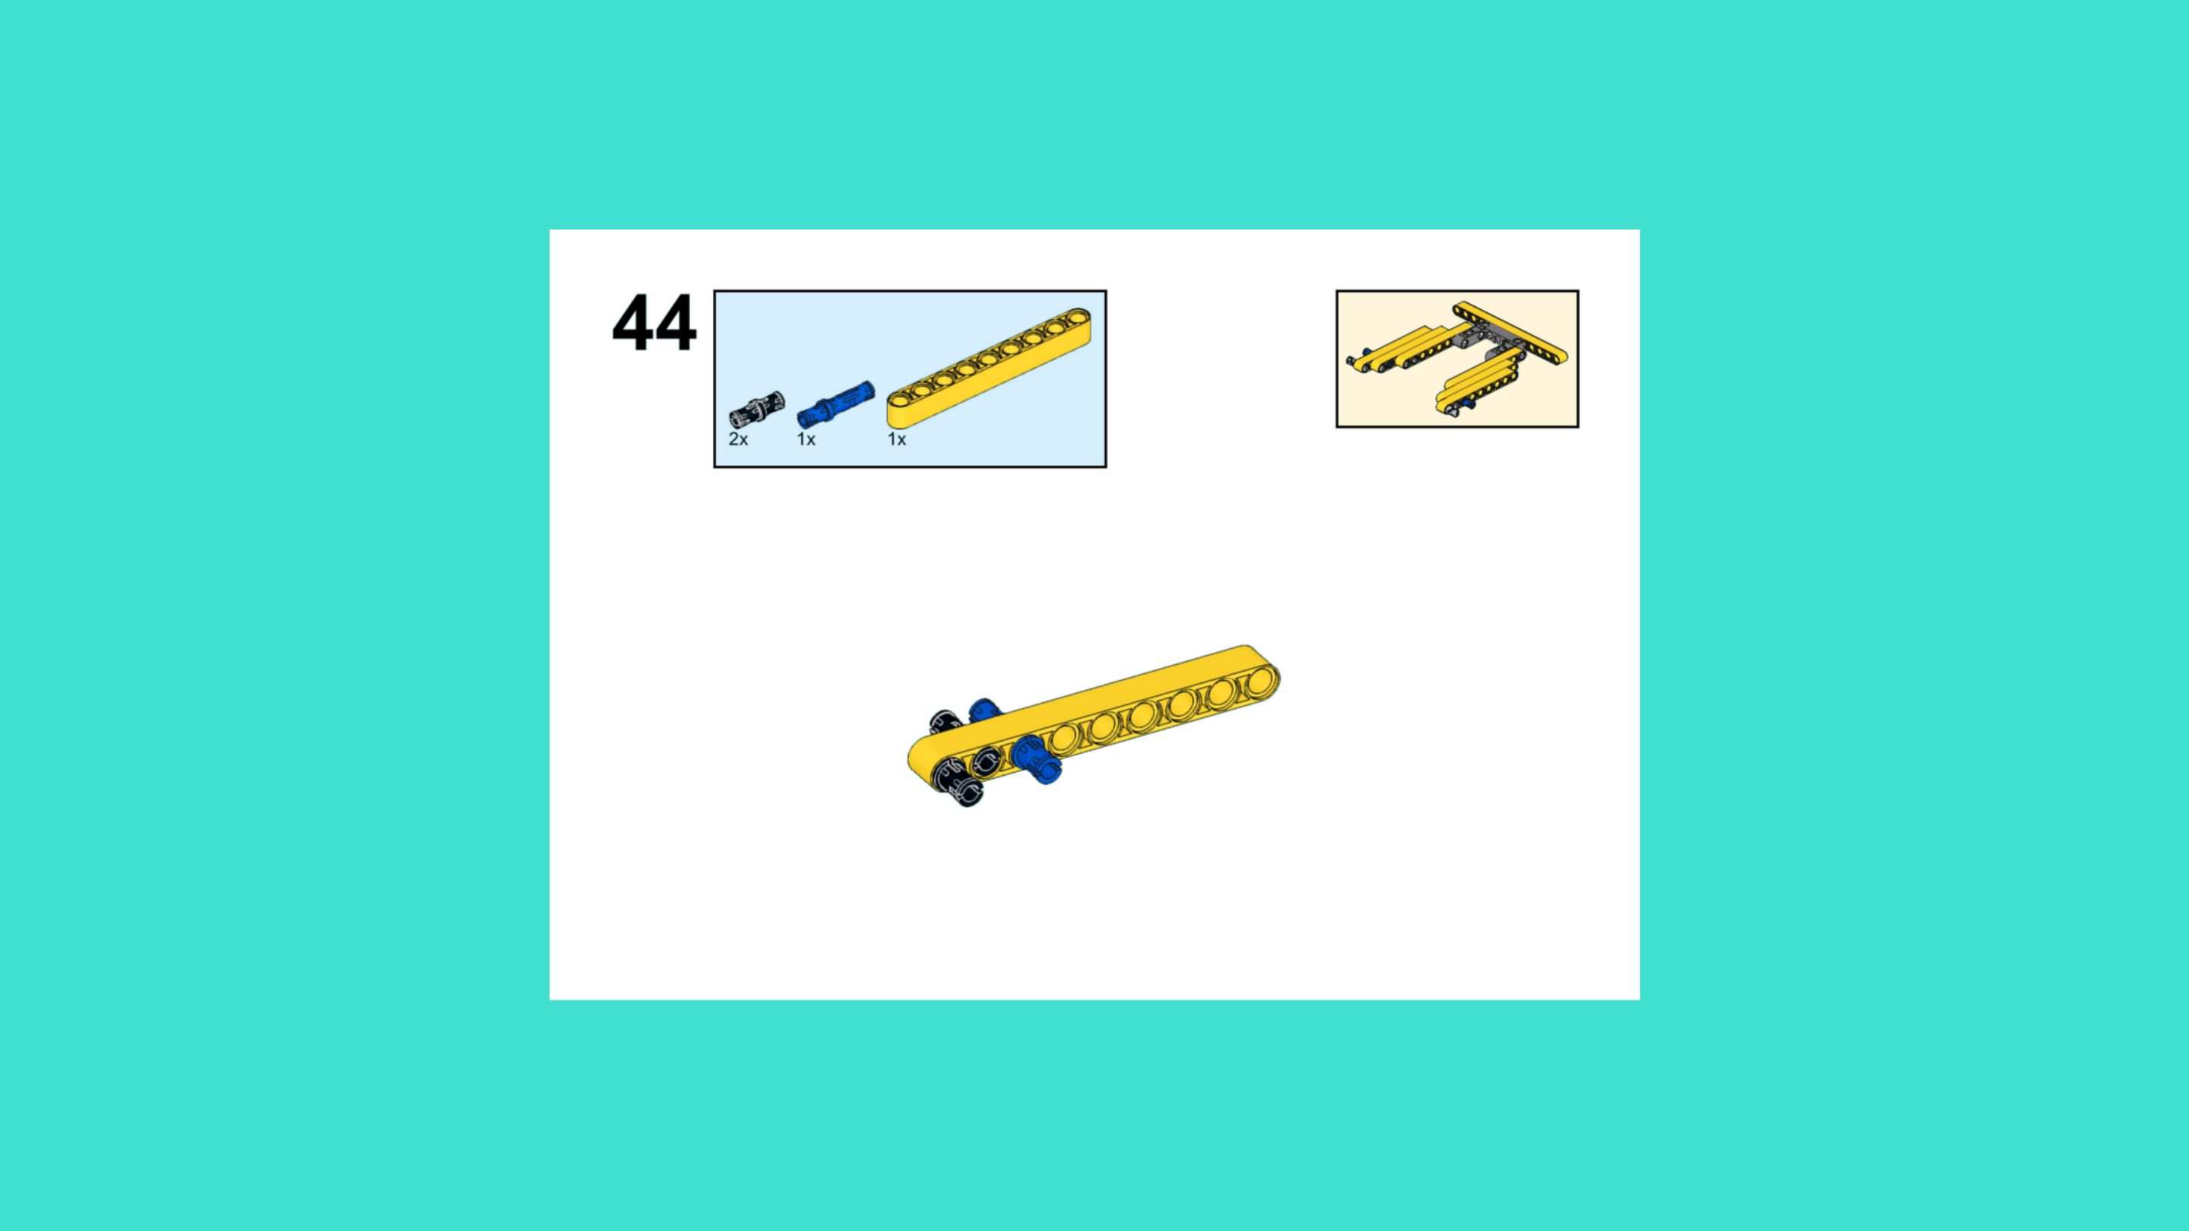
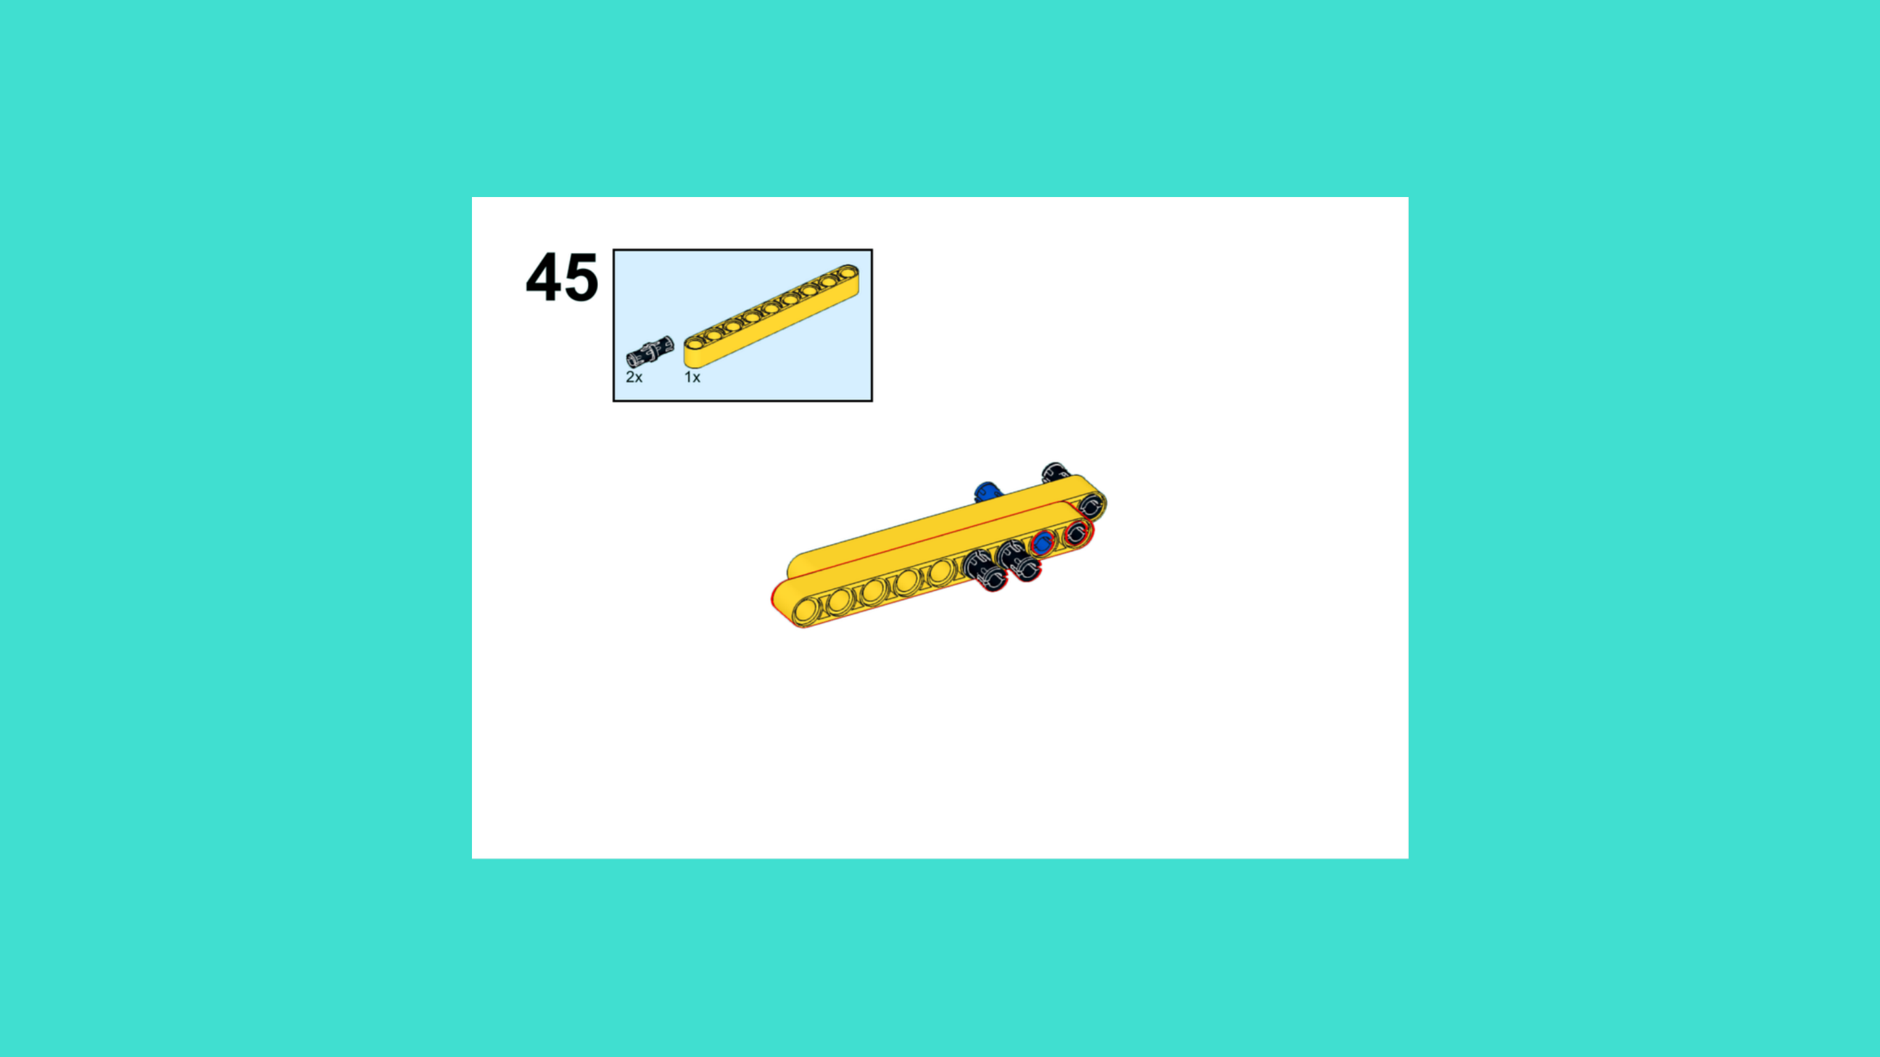
ASSEMBLY STEPS
STEP 43 – 45
PROGRESS: 63% COMPLETE (45 of 72 steps)
STEP 43
STEP 44
STEP 45
SPACE STATION · Techtelligence- Elecfreaks
15 / 24

Slide 18
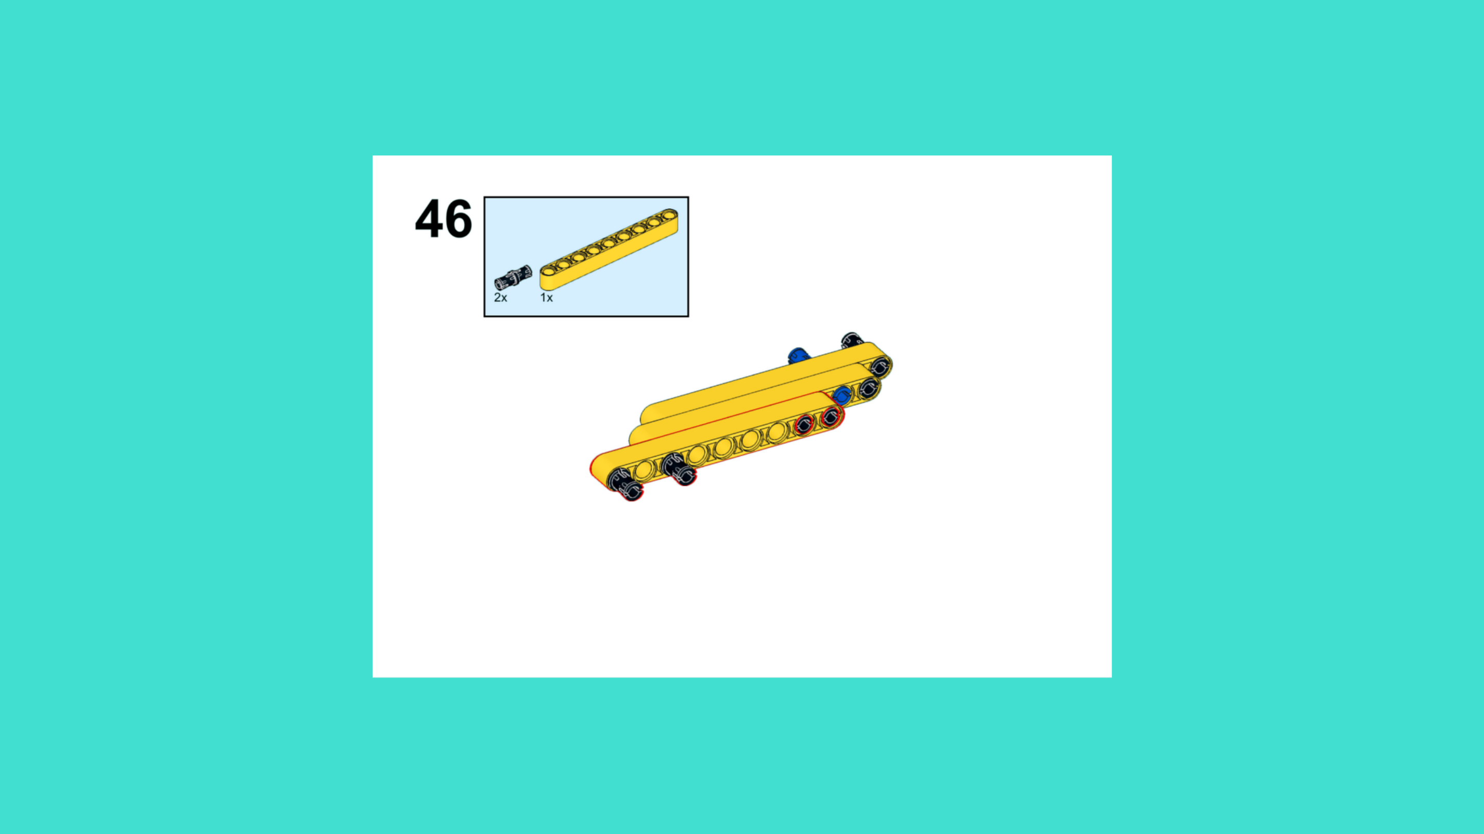
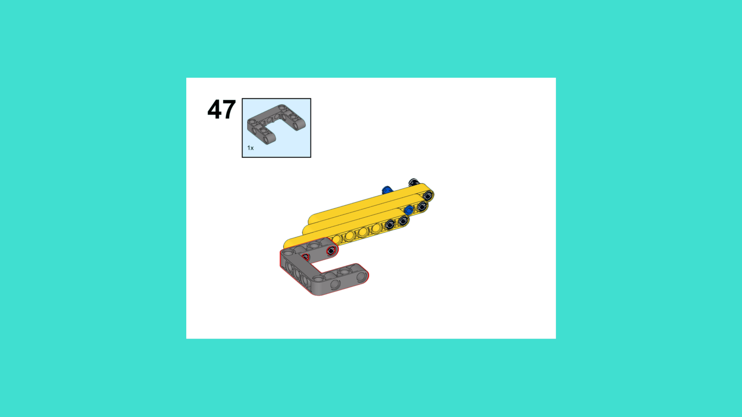
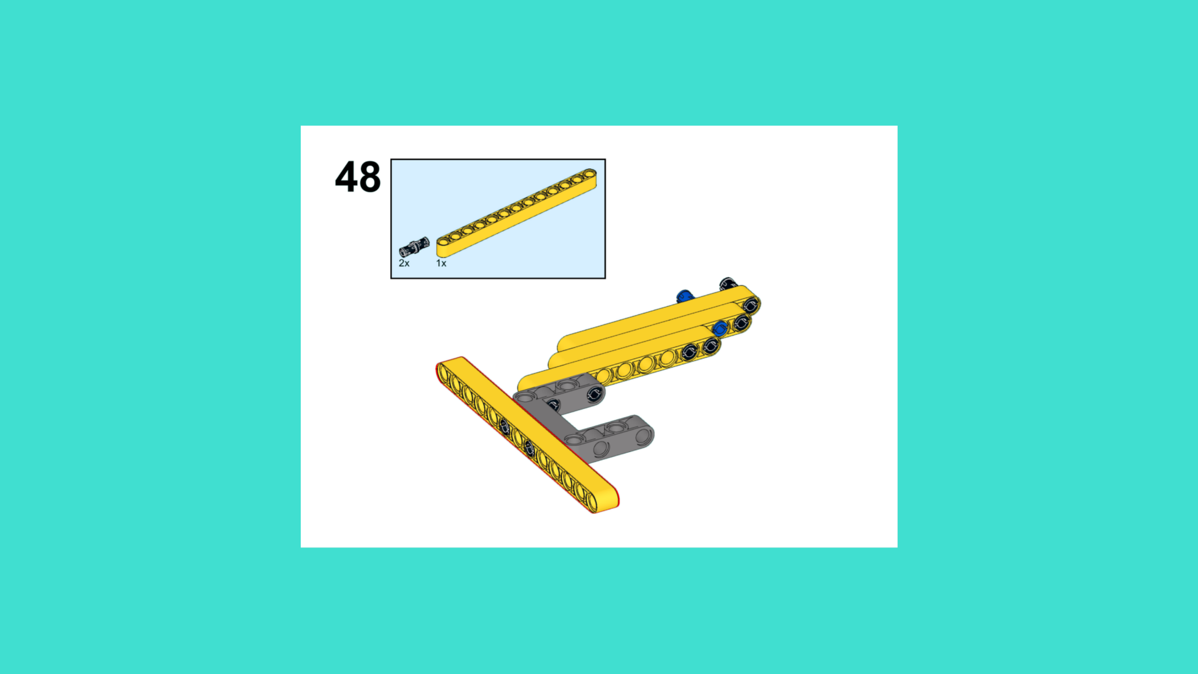
ASSEMBLY STEPS
STEP 46 – 48
PROGRESS: 67% COMPLETE (48 of 72 steps)
STEP 46
STEP 47
STEP 48
SPACE STATION · Techtelligence- Elecfreaks
16 / 24

Slide 19
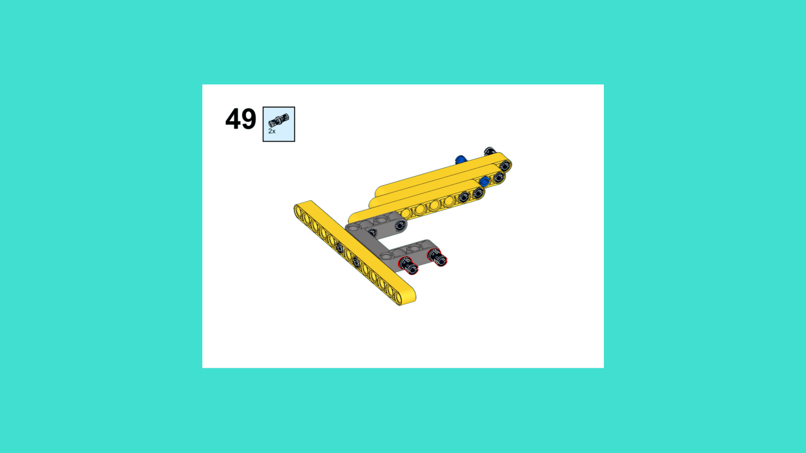
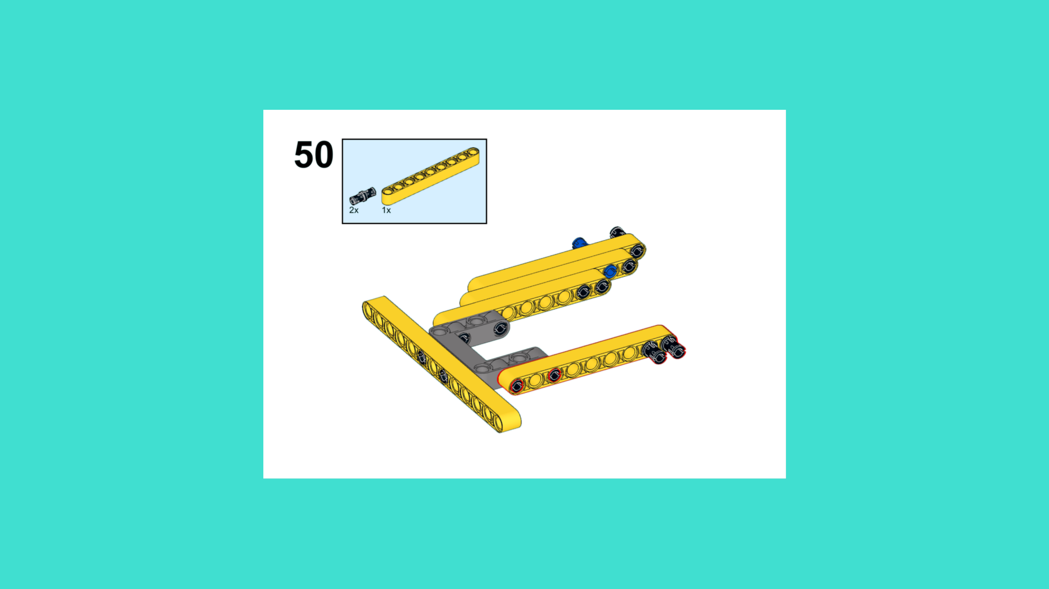
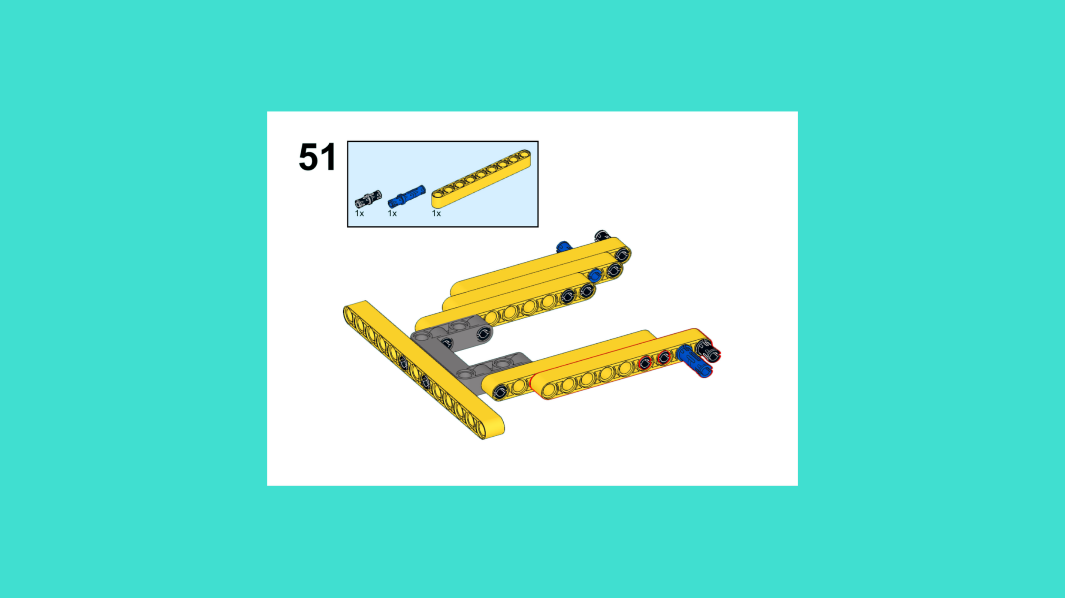
ASSEMBLY STEPS
STEP 49 – 51
PROGRESS: 71% COMPLETE (51 of 72 steps)
STEP 49
STEP 50
STEP 51
SPACE STATION · Techtelligence- Elecfreaks
17 / 24

Slide 20
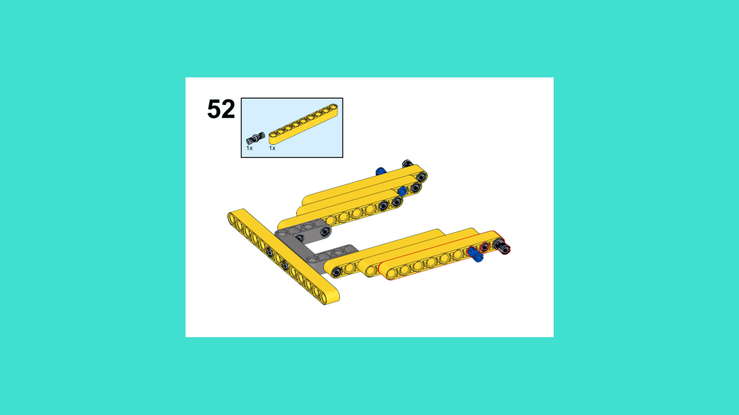


ASSEMBLY STEPS
STEP 52 – 54
PROGRESS: 75% COMPLETE (54 of 72 steps)
STEP 52
STEP 53
STEP 54
SPACE STATION · Techtelligence- Elecfreaks
18 / 24

Slide 21



ASSEMBLY STEPS
STEP 55 – 57
PROGRESS: 79% COMPLETE (57 of 72 steps)
STEP 55
STEP 56
STEP 57
SPACE STATION · Techtelligence- Elecfreaks
19 / 24

Slide 22



ASSEMBLY STEPS
STEP 58 – 60
PROGRESS: 83% COMPLETE (60 of 72 steps)
STEP 58
STEP 59
STEP 60
SPACE STATION · Techtelligence- Elecfreaks
20 / 24

Slide 23



ASSEMBLY STEPS
STEP 61 – 63
PROGRESS: 88% COMPLETE (63 of 72 steps)
STEP 61
STEP 62
STEP 63
SPACE STATION · Techtelligence- Elecfreaks
21 / 24

Slide 24



ASSEMBLY STEPS
STEP 64 – 66
PROGRESS: 92% COMPLETE (66 of 72 steps)
STEP 64
STEP 65
STEP 66
SPACE STATION · Techtelligence- Elecfreaks
22 / 24

Slide 25



ASSEMBLY STEPS
STEP 67 – 69
PROGRESS: 96% COMPLETE (69 of 72 steps)
STEP 67
STEP 68
STEP 69
SPACE STATION · Techtelligence- Elecfreaks
23 / 24

Slide 26



ASSEMBLY STEPS
STEP 70 – 72
PROGRESS: 100% COMPLETE (72 of 72 steps)
STEP 70
STEP 71
STEP 72
SPACE STATION · Techtelligence- Elecfreaks
24 / 24

Slide 27
ASSEMBLY
COMPLETE
72 STEPS · SPACE STATION · Techtelligence- Elecfreaks
72
24
100%
TOTAL STEPS
SLIDE SECTIONS
COMPLETE

